Slide 1
IRI Climate Briefing: Mar. 16, 2023 Sub-seasonal Update
Bohar Singh

Slide 2
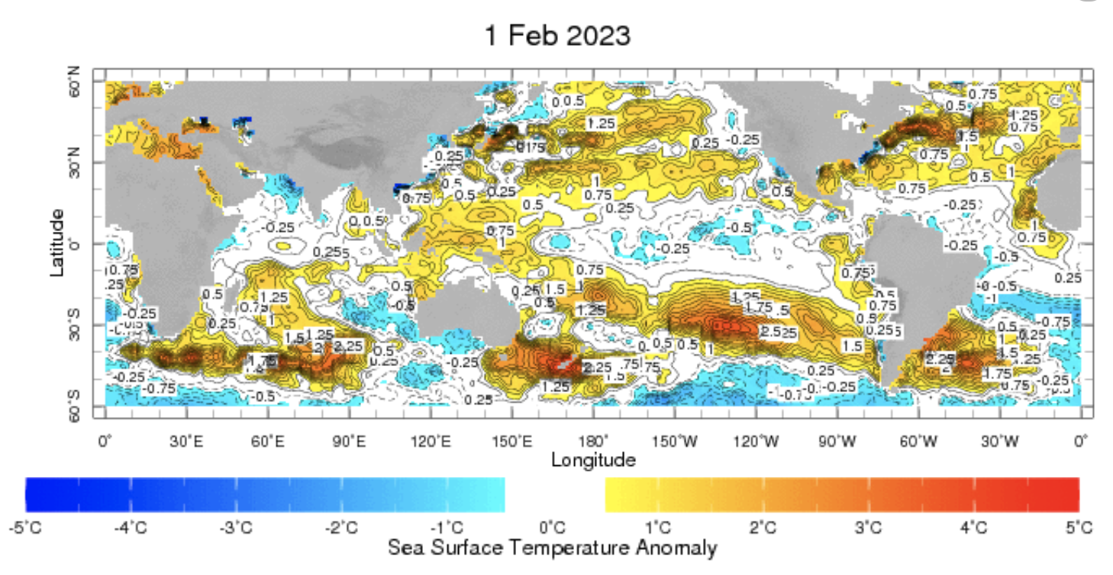
Sub-seasonal climate drivers: State of Climate
Cold anomalies in eastern and central Pacific are weaker as compared to previous month

Slide 3
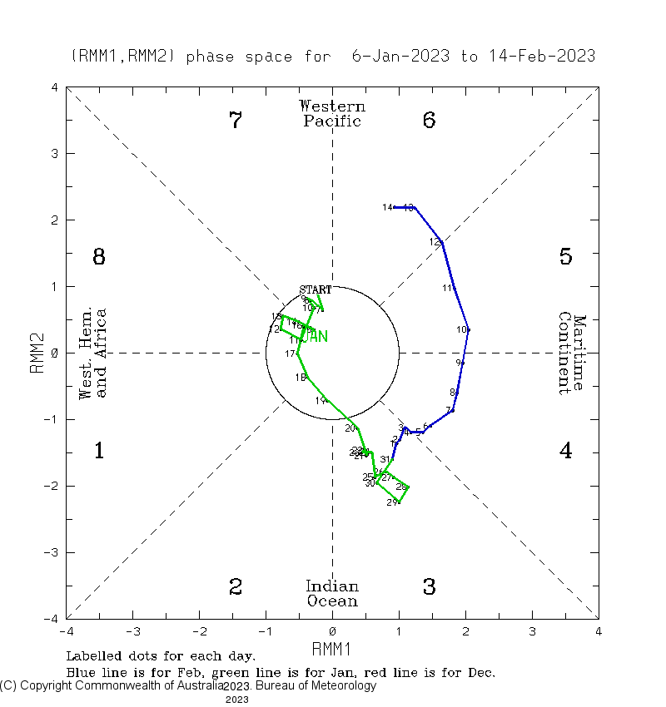
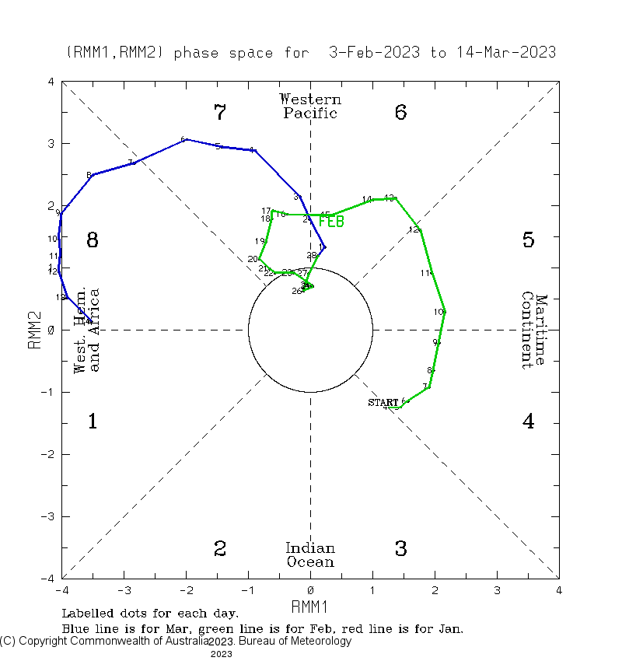
Current and Past evolution of the MJO Wheeler-Hendon Indices
Currently MJO is in active state since 20th January

Slide 4
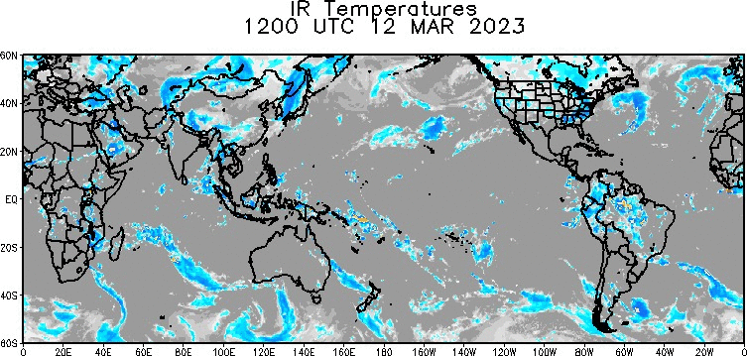
State of the climate: Cloudiness and circulation
Source : CPC

Slide 5
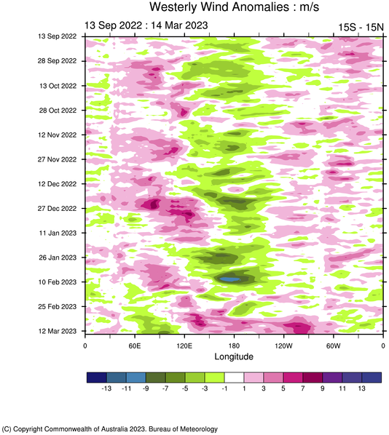
State of the climate: Cloudiness and circulation
Since the start of 2023, westerly wind start crossing 120$°$E
Episode of westerly wind burst (WWB) in progress
Current WWB making conditions favorable for El-Niño onset.

Slide 6
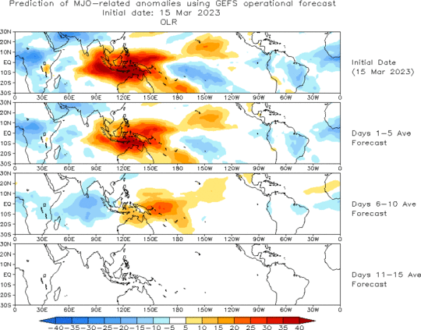
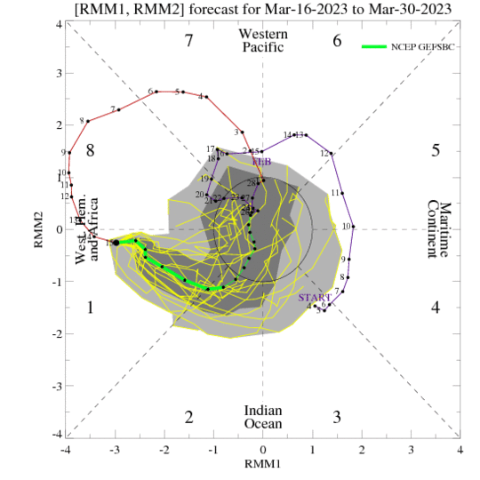
Forecast of MJO: Wheeler-Hendon Indices
MJO 15-day Forecast from NCEP GEFS model
Another MJO is likely to be initiated in Indian Ocean before current event is dying into phase 8

Slide 7
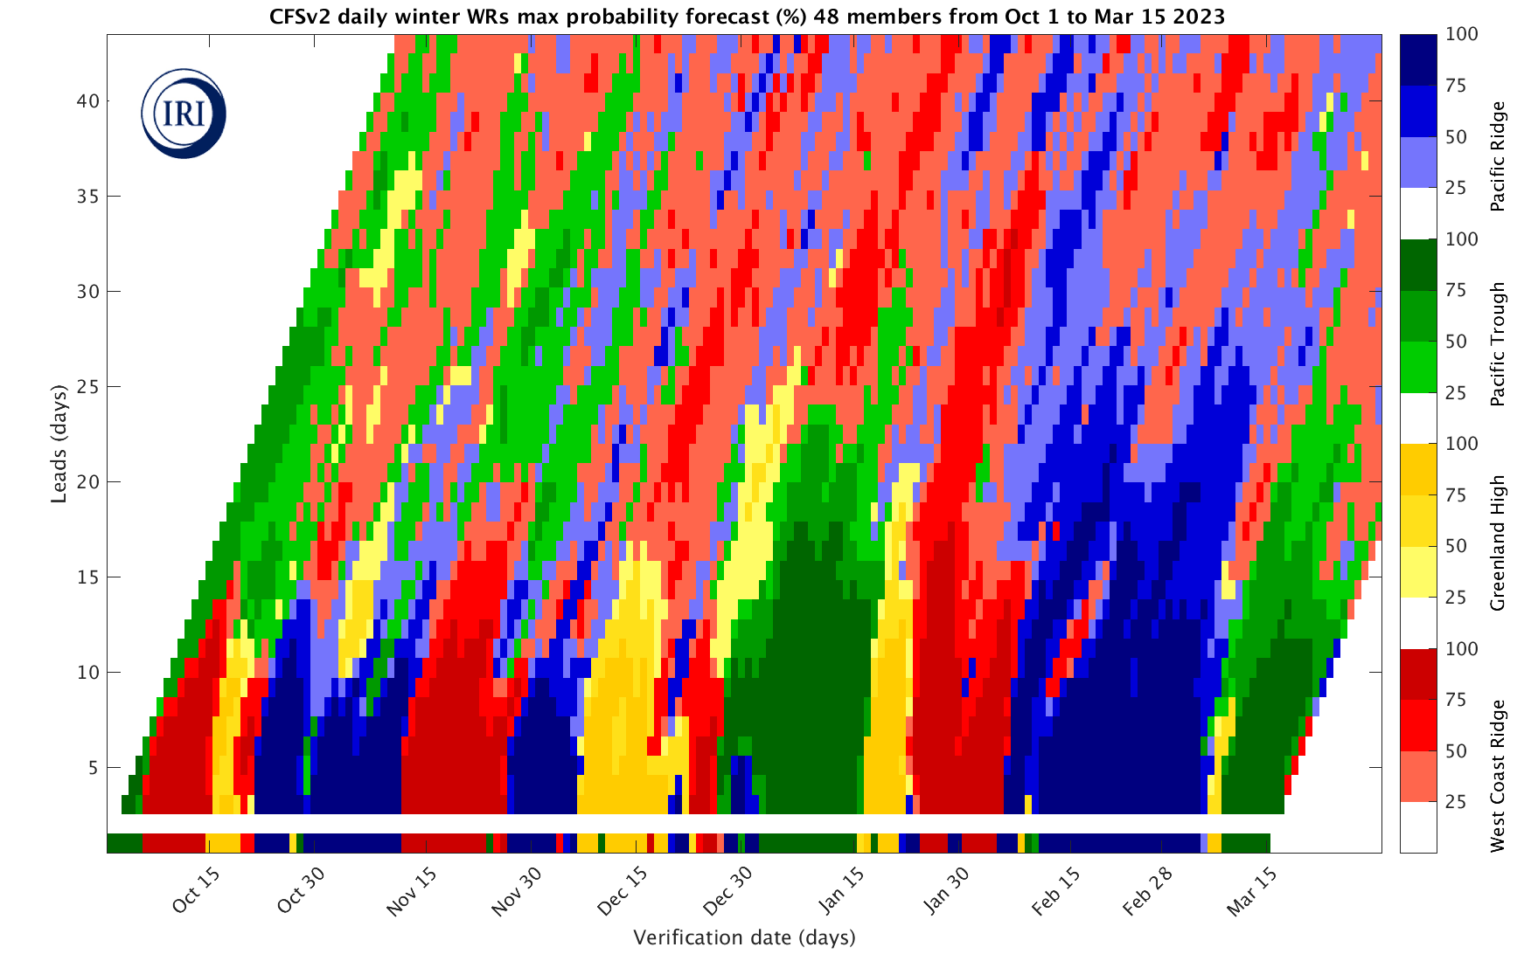
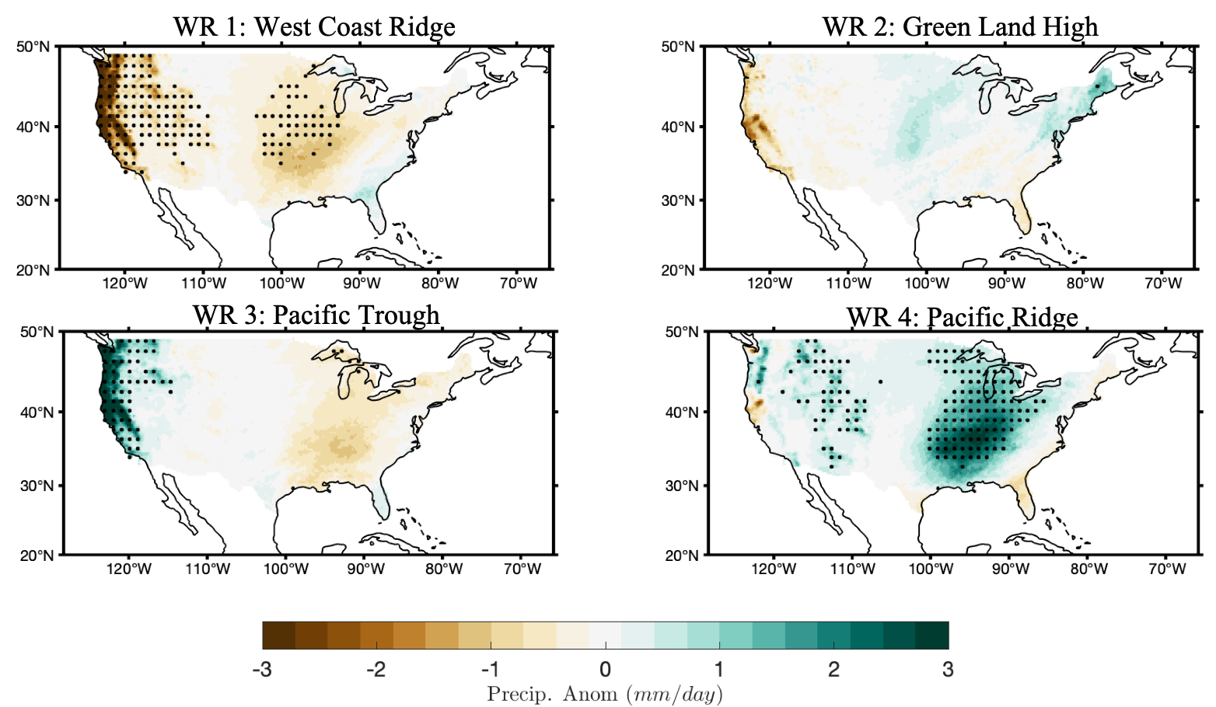
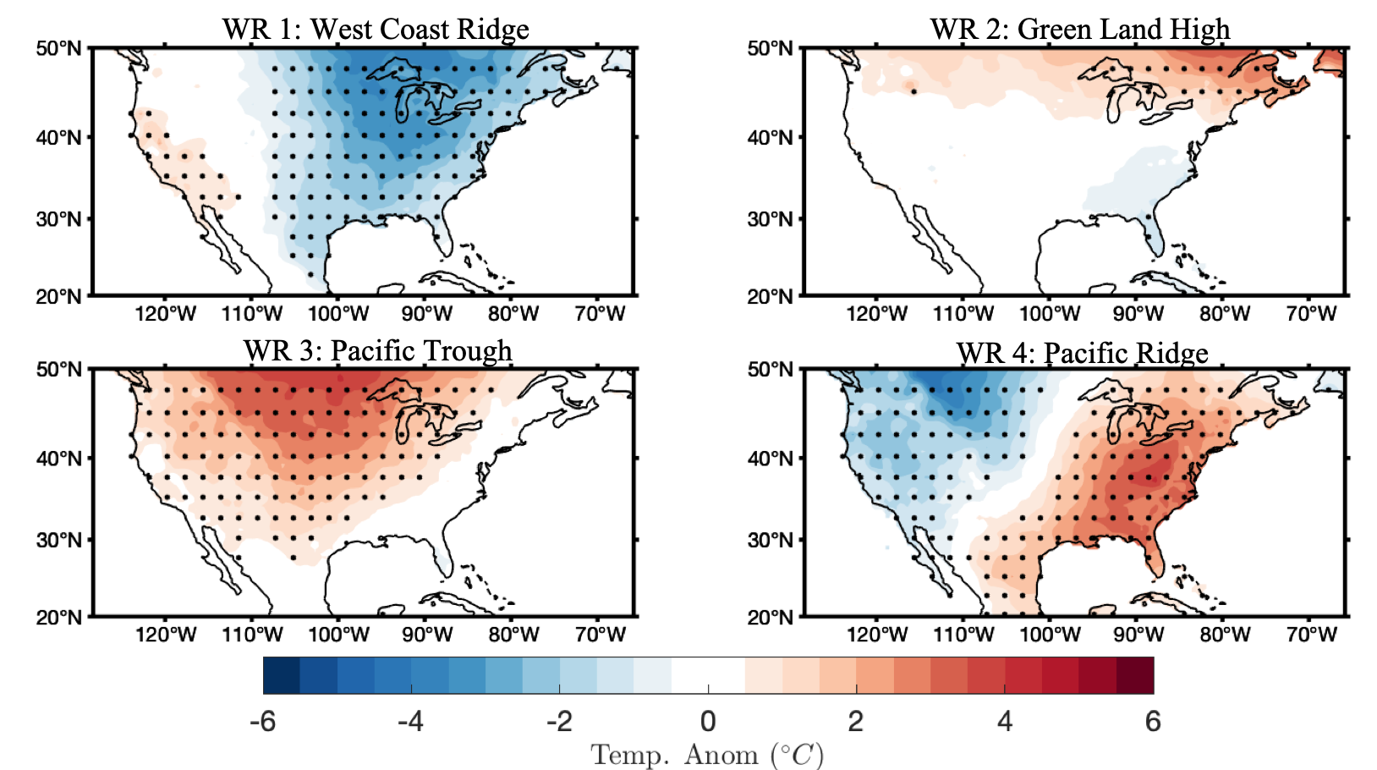
IRI Weather Regime forecast
Expected Weather conditions

Slide 8
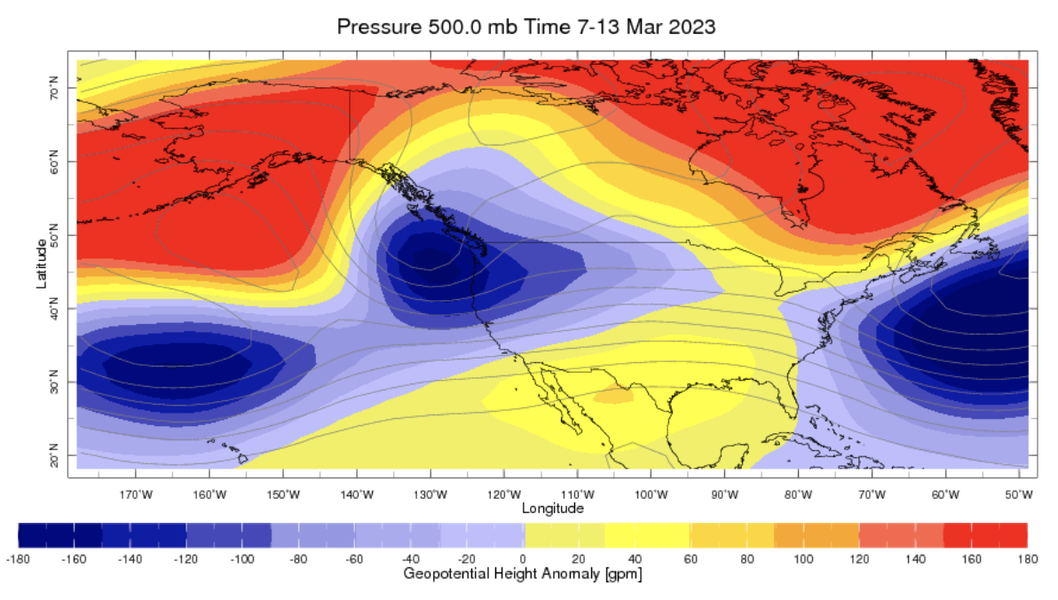
State of the climate: Geopotential height

Slide 9
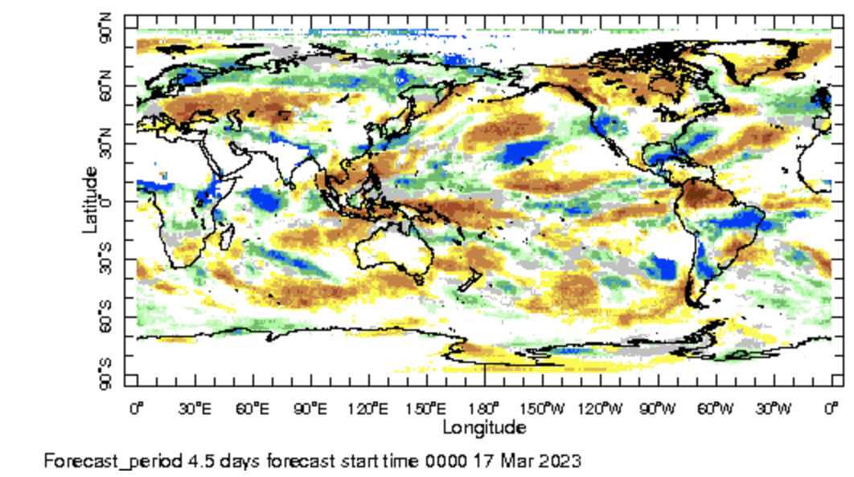
IRI Sub-seasonal Forecast: Precipitation (week 1)
Week:1 : ( 18th -24th Mar.)
Forecast issue date: Mar. 17th

Slide 10
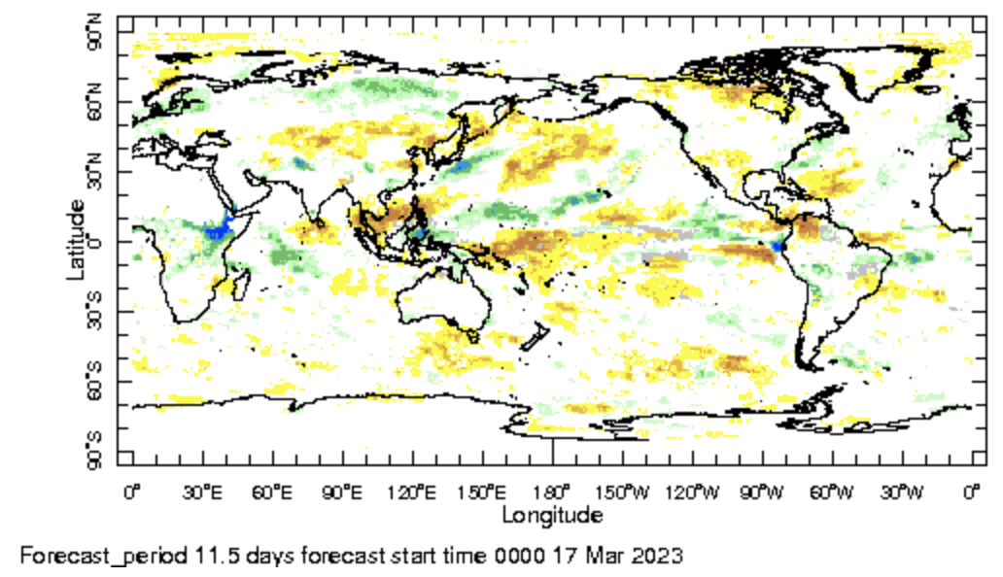
IRI Sub-seasonal Forecast: Precipitation (week 2 )
Week:2 : ( 25th Mar.-31 Mar.)
Forecast issue date: Mar. 17th

Slide 11
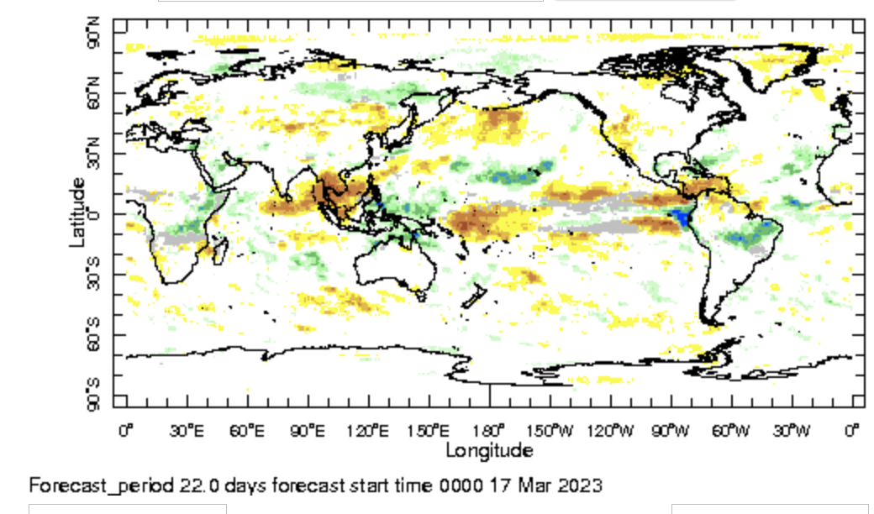
IRI Sub-seasonal Forecast: Precipitation (week 3+4 )
Week:2 : ( 1st Apr.-14th Mar.)
Forecast issue date: Feb. 17th

Slide 12
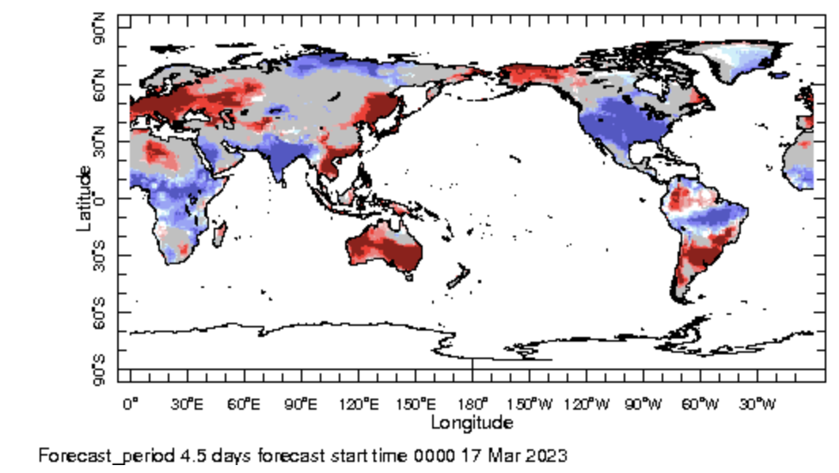
IRI Sub-seasonal Forecast : Near-Surface Temperature (week 1)
Week:1 : ( 18th -24th Mar.)
Forecast issue date: Mar. 17th

Slide 13
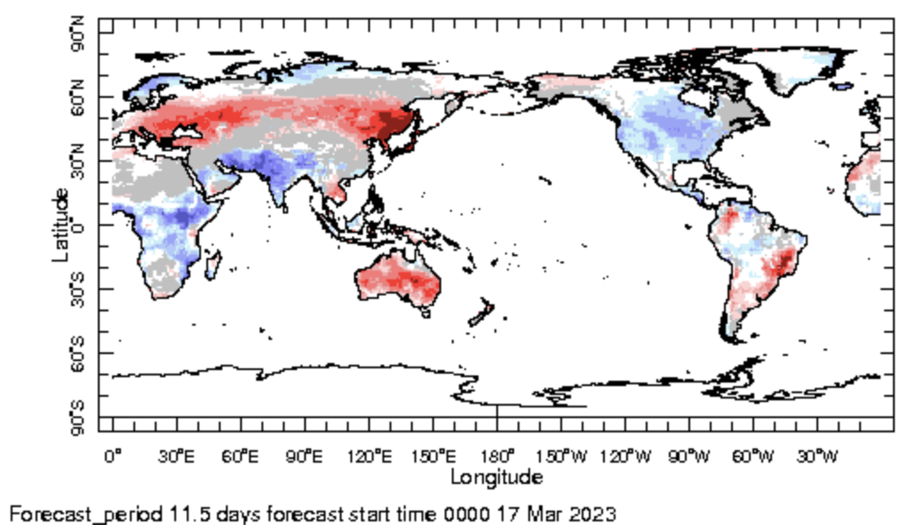
IRI Sub-seasonal Forecast : Near-Surface Temperature (week 2)
Week:2 : ( 25th Mar.-31st Mar.)
Forecast issue date: Mar. 17th

Slide 14
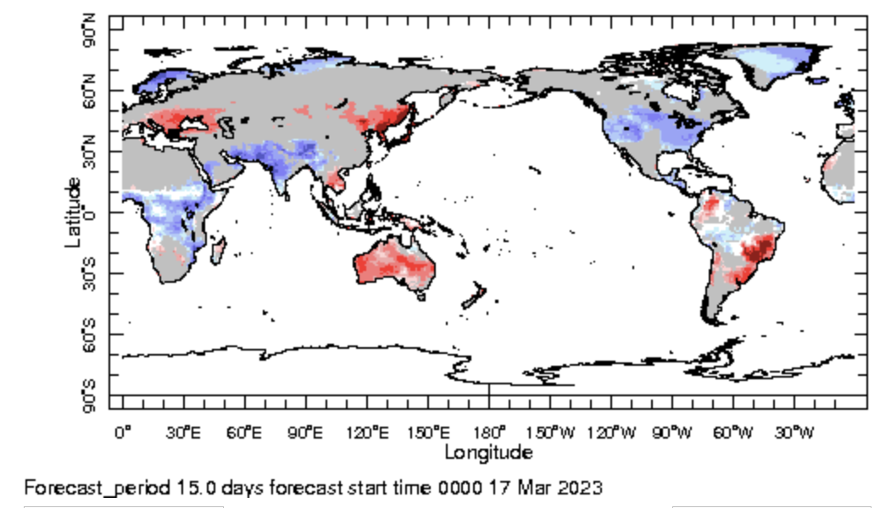
IRI Sub-seasonal Forecast : Near-Surface Temperature (week 3+4)
Week:2 : ( 1st Apr.-14th Mar.)
Forecast issue date: Feb. 17th

Slide 15
Summary
El Nino : Not a matter of if, but how strong?
MJO related convection and circulation are active likely to be active and move into indian Ocean by the next week
Above normal rainfall is expected western and Southern United state during week 1
Above normal rainfall is expected over central Africa for next two weeks.
Below normal temperature is likely in eastern United States is expected during next one month

Slide 16
Thank You!

