Slide 1
IRI Climate Briefing: Jan. 19, 2023 Sub-seasonal Update
Bohar Singh

Slide 2
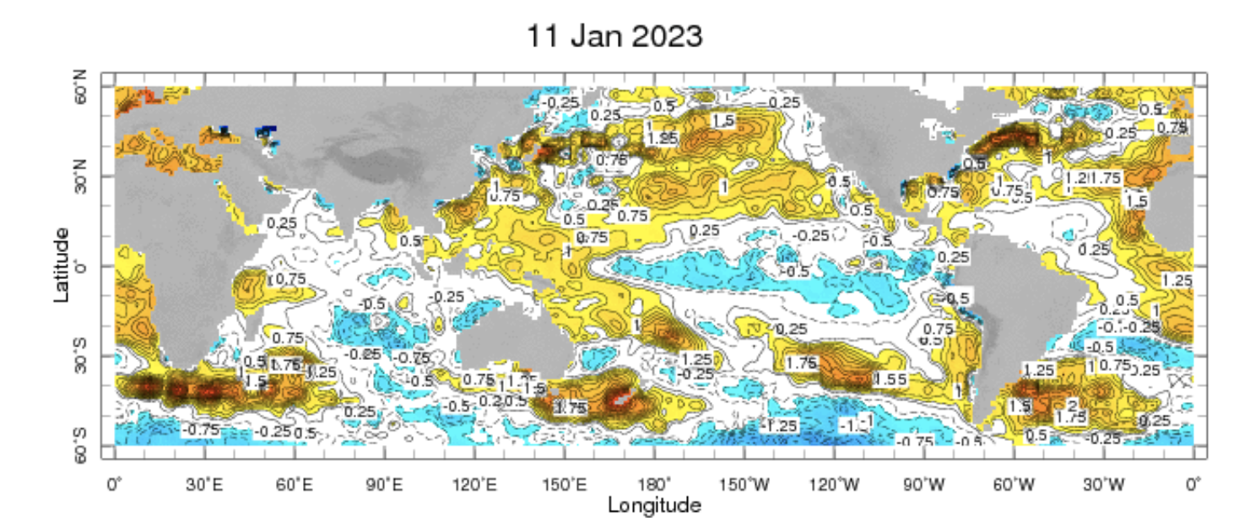
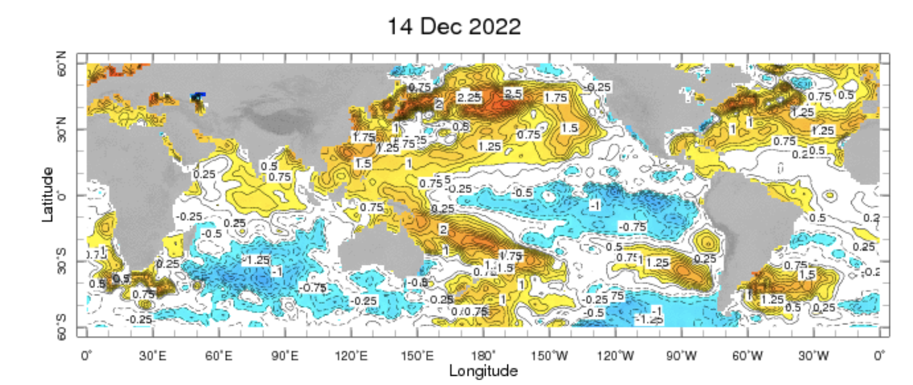
Sub-seasonal climate drivers: State of Climate
Cold anomalies in eastern and central Pacific are weaker as compared to previous month
Warm anomalies around Maritime continent expanded eastward in the west Pacific Ocean

Slide 3
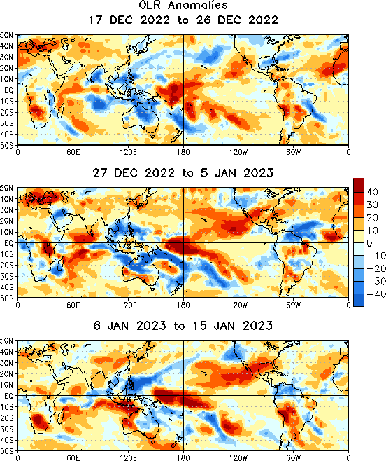
State of the climate: Cloudiness and circulation
MJO related OLR anomalies propagated over
Maritime continent
MJO-precipitation teleconnections influenced
atmospheric river related precipitation over
California
Currently OLR anomalies in western pacific are
become week
Source : CPC

Slide 4
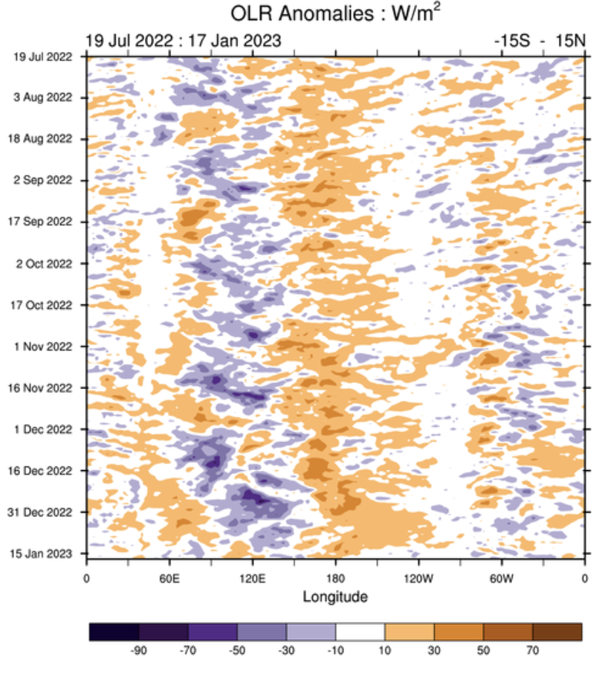
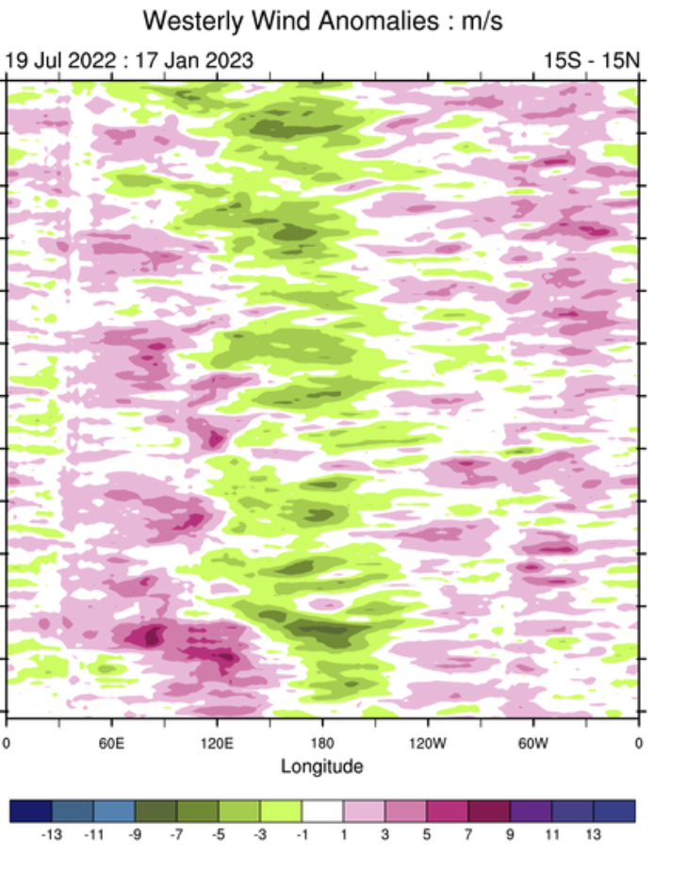
State of the climate: Cloudiness and circulation
Source : CPC

Slide 5
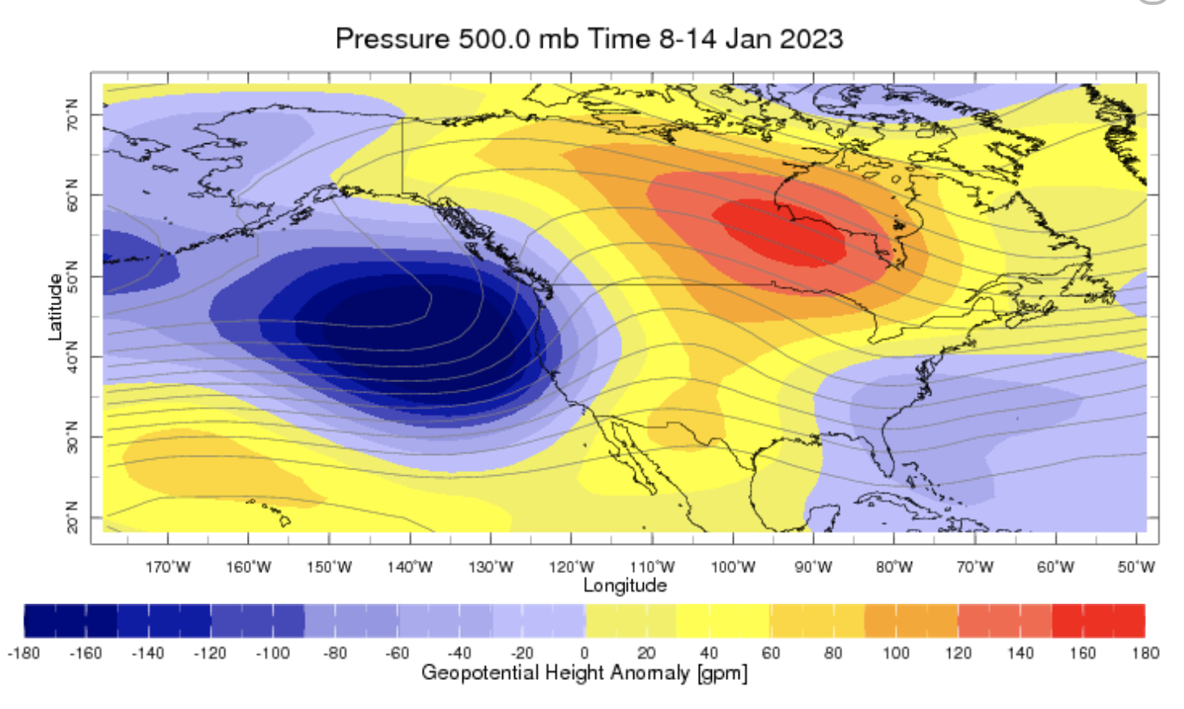
State of the climate: Geopotential height

Slide 6
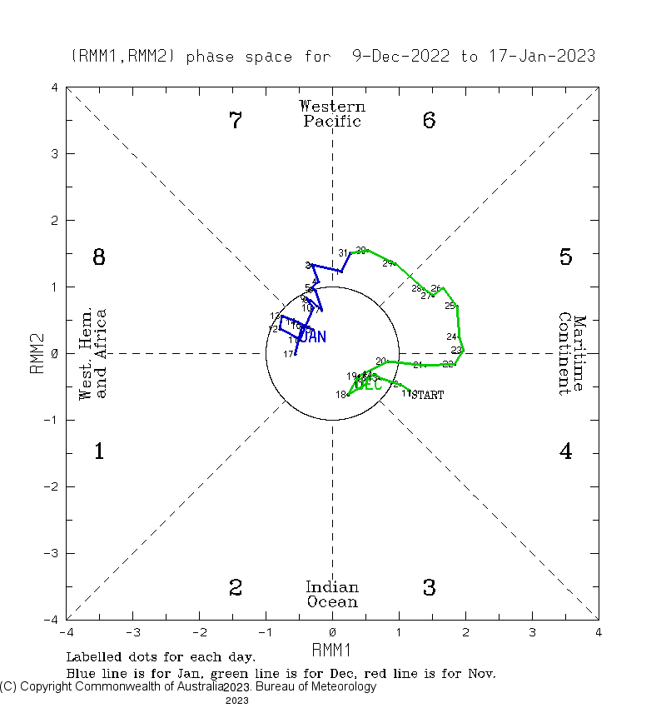
Current and Past evolution of the MJO Wheeler-Hendon Indices
Currently MJO is in inactive state

Slide 7
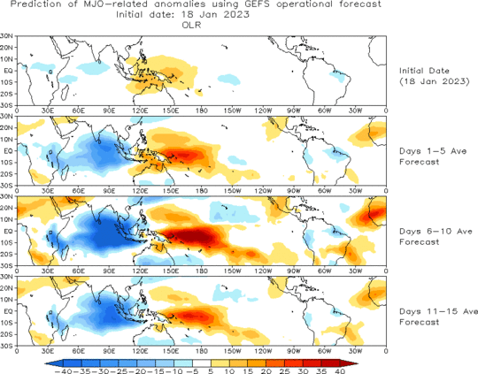
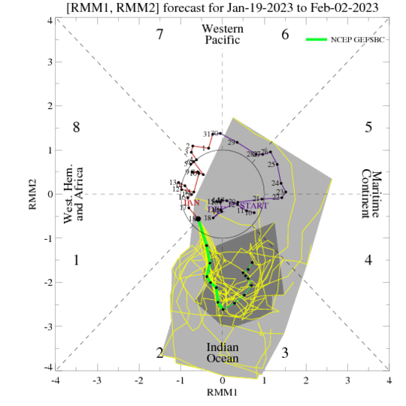
Forecast of MJO: Wheeler-Hendon Indices
MJO 15-day Forecast from NCEP GEFS model
MJO is likely to be active in the Indian Ocean

Slide 8
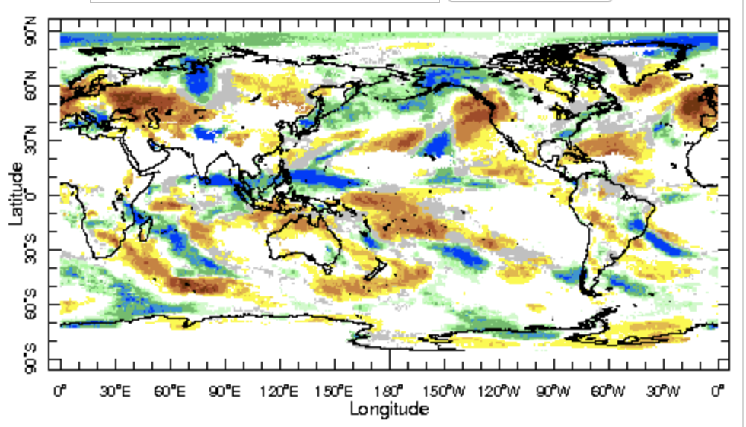
IRI Sub-seasonal Forecast: Precipitation (week 1)
Week:1 : ( 20st -26th Jan.)
Forecast issue date: Jan. 20th

Slide 9
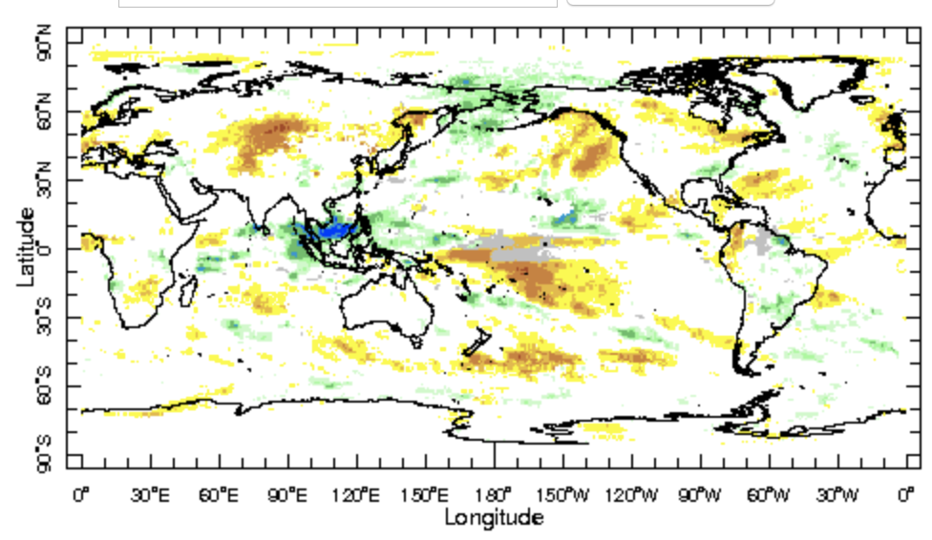
IRI Sub-seasonal Forecast: Precipitation (week 2 )
Week:2 : ( 27th Jan.-2nd Feb.)
Forecast issue date: Jan. 20th

Slide 10
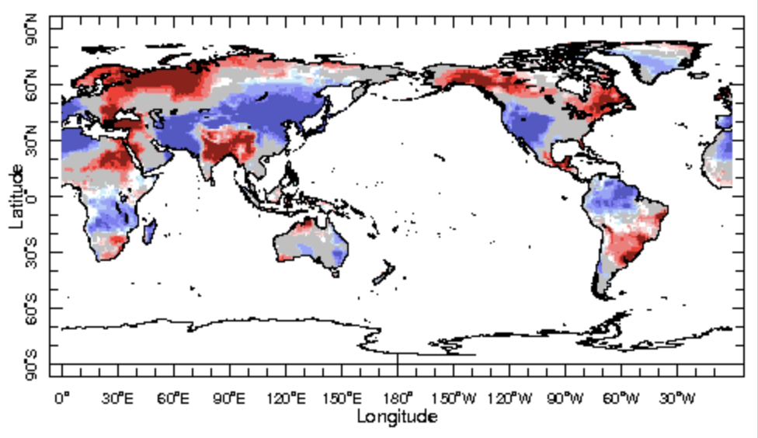
IRI Sub-seasonal Forecast : Near-Surface Temperature (week 1)
Week:1 : ( 20st -26th Jan.)
Forecast issue date: Jan. 20th

Slide 11
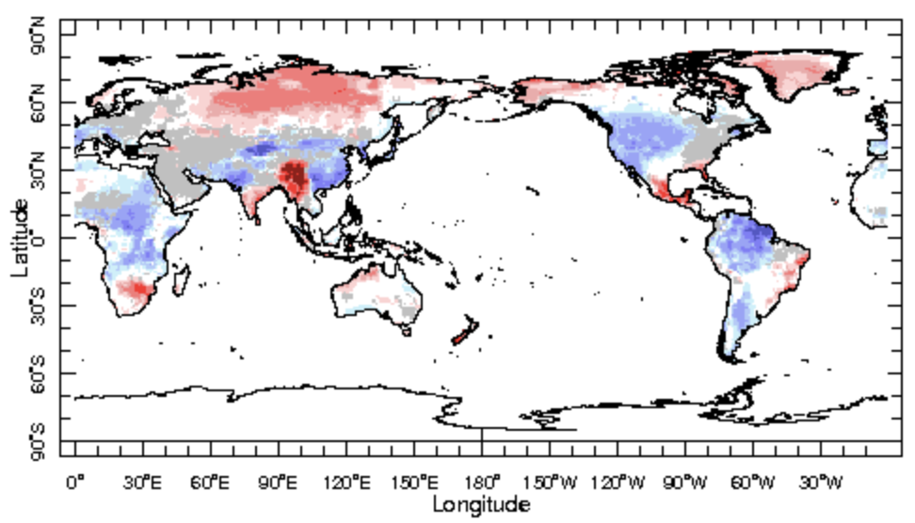
IRI Sub-seasonal Forecast : Near-Surface Temperature (week 2)
Week:2 : ( 27th Jan.-2nd Feb.)
Forecast issue date: Jan. 20th

Slide 12
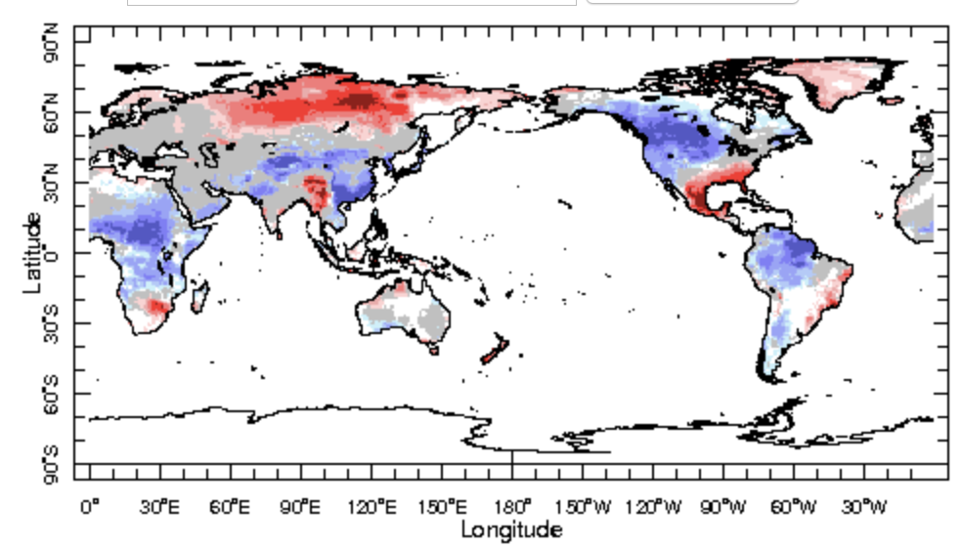
IRI Sub-seasonal Forecast : Near-Surface Temperature (week 2)
Week:2 : ( 3rd Feb.-16th Feb.)
Forecast issue date: Jan. 20th

Slide 13
Summary
However SST anomalies in eastern Pacific Ocean become weaker but La Niña is still active
MJO related convection and circulation are about to be active in the Indian Ocean most likely remain active for one week.
Maritime continent are likely to get above normal rainfall during week 1 and 2
Below normal temperature is expected over Africa between 27 Jan and 16th Feb.
Belo normal temperature is likely in United States is expected during next one month

Slide 14
Thank You!

