Slide 1
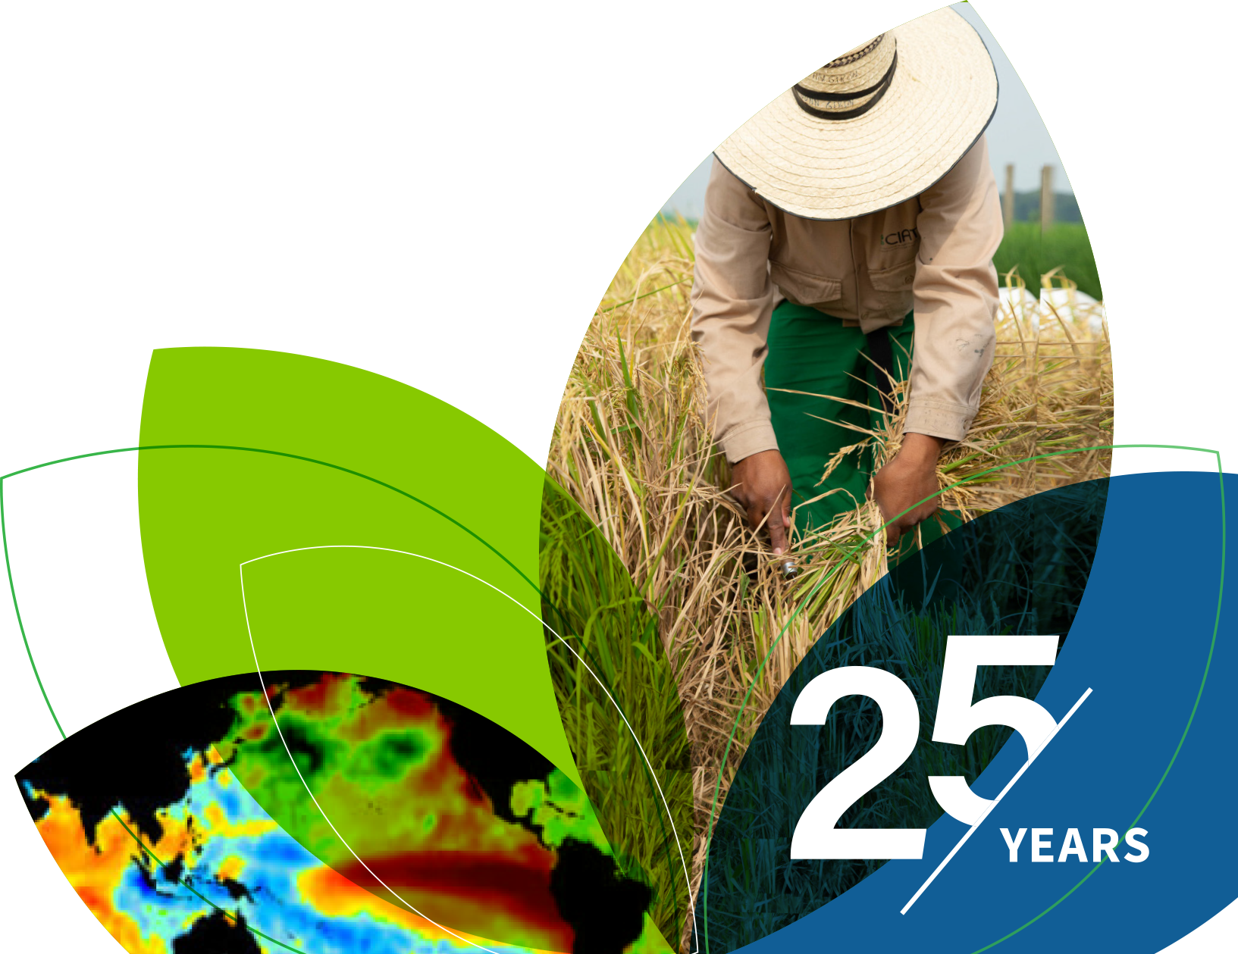
IRI Climate Briefing: Feb. 16, 2023 Sub-seasonal Update
Bohar Singh

Slide 2
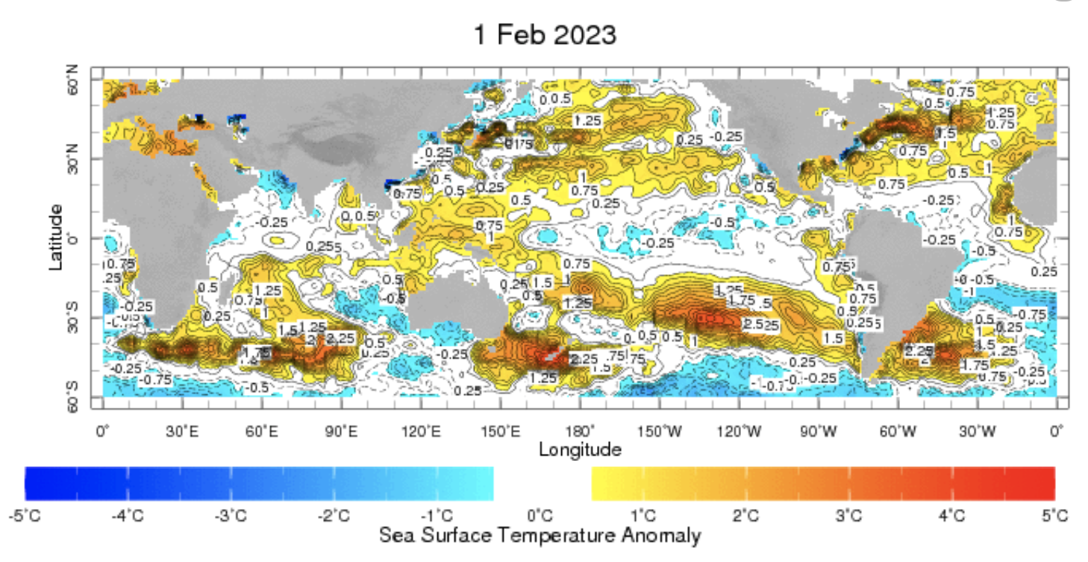
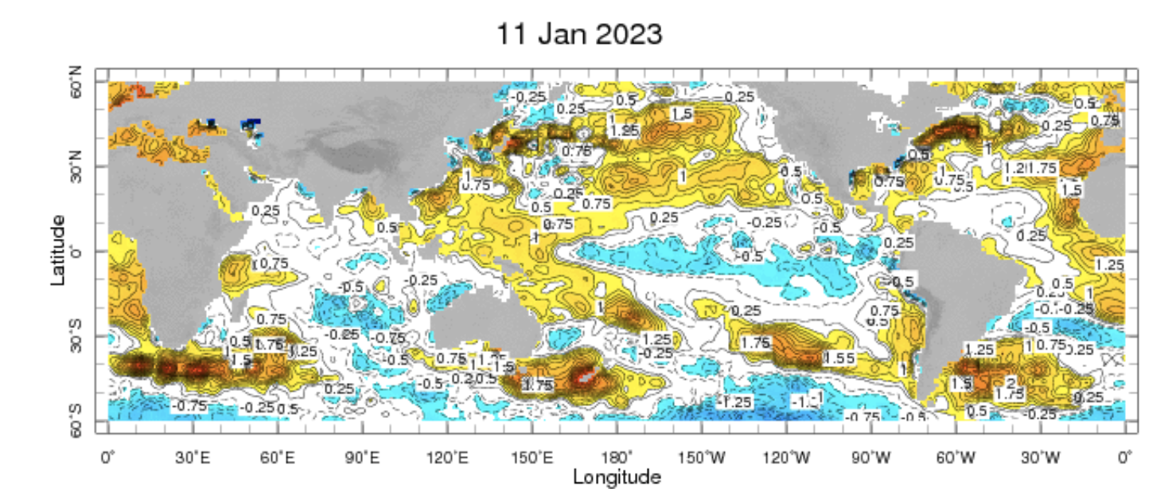
Sub-seasonal climate drivers: State of Climate
Cold anomalies in eastern and central Pacific are weaker as compared to previous month

Slide 3
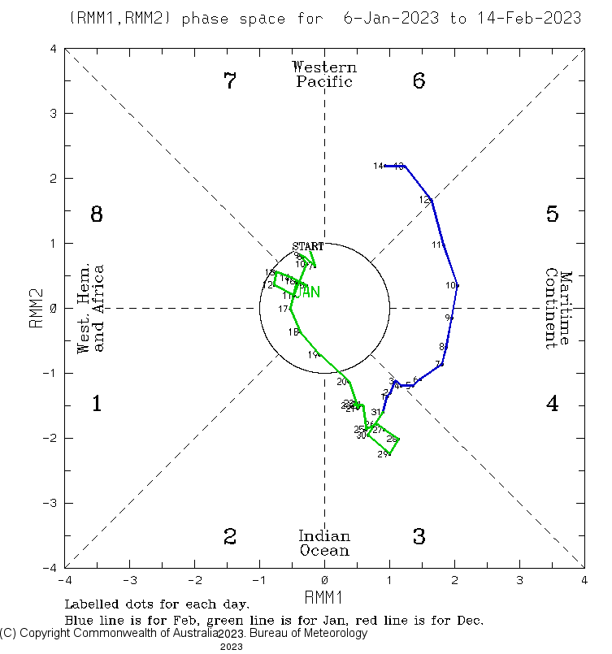
Current and Past evolution of the MJO Wheeler-Hendon Indices
Currently MJO is in active state

Slide 4
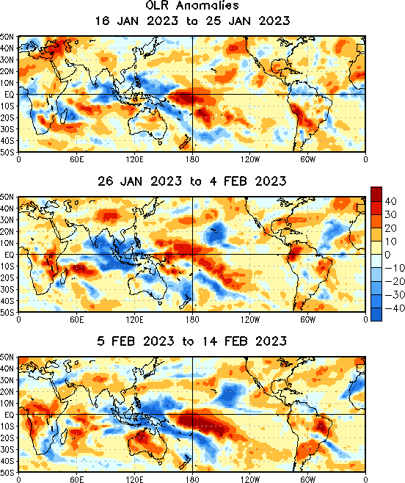
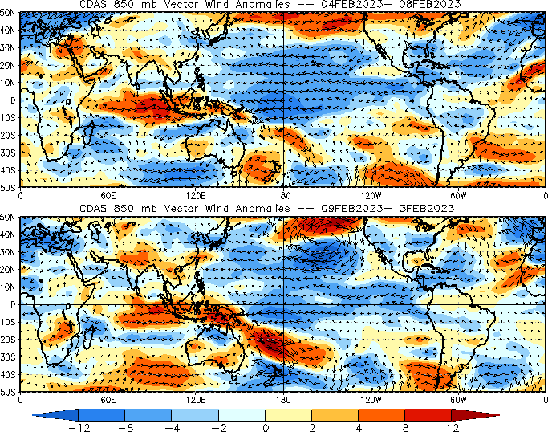
State of the climate: Cloudiness and circulation
Source : CPC
MJO related OLR anomalies propagated over Maritime continent

Slide 5
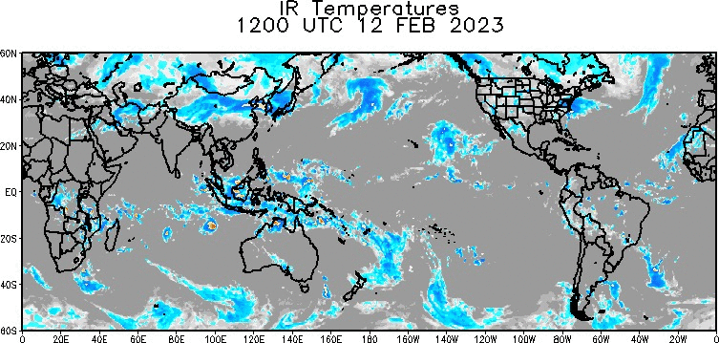
State of the climate: Cloudiness and circulation
Source : CPC

Slide 6
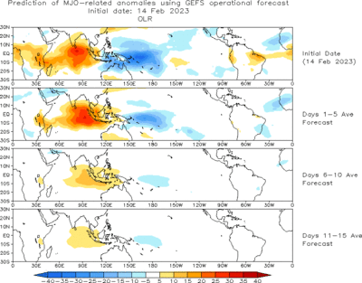
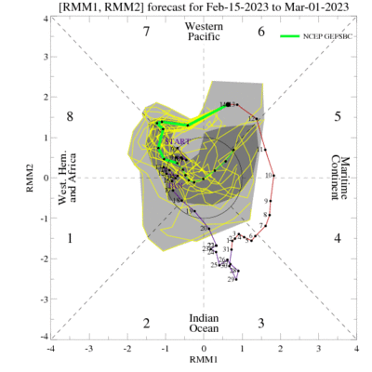
Forecast of MJO: Wheeler-Hendon Indices
MJO 15-day Forecast from NCEP GEFS model
MJO is likely to be progress into phase 8 before dying

Slide 7
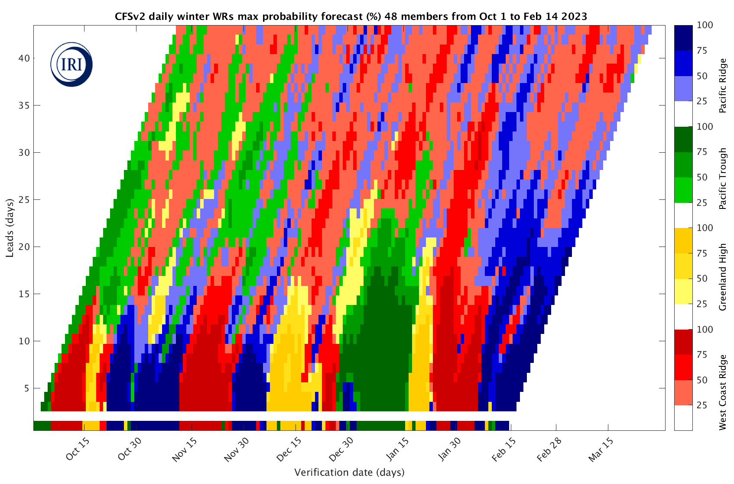
IRI Weather Regime forecast
Expected Weather conditions

Slide 8
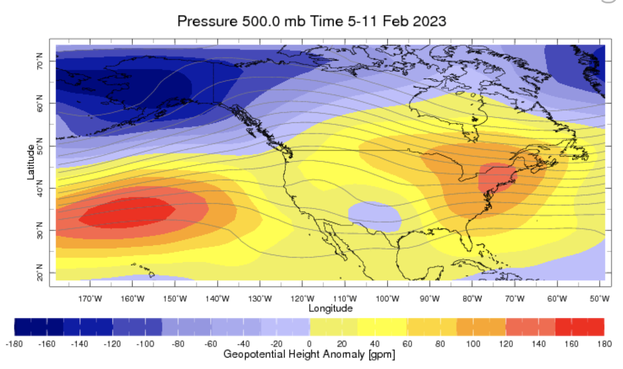
State of the climate: Geopotential height

Slide 9
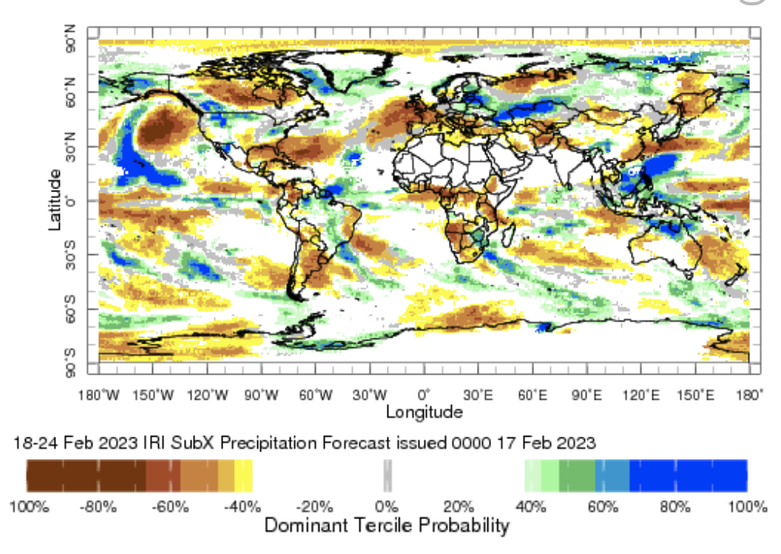
IRI Sub-seasonal Forecast: Precipitation (week 1)
Week:1 : ( 18th -24th Feb.)
Forecast issue date: Feb. 17th

Slide 10
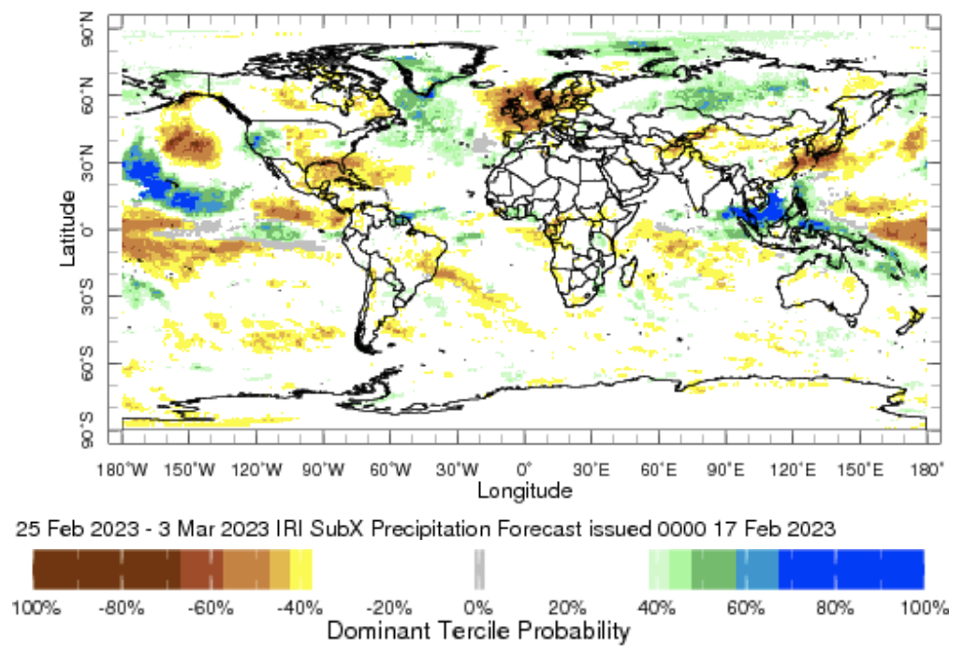
IRI Sub-seasonal Forecast: Precipitation (week 2 )
Week:2 : ( 25th Feb.-3rd Mar.)
Forecast issue date: Feb. 17th

Slide 11
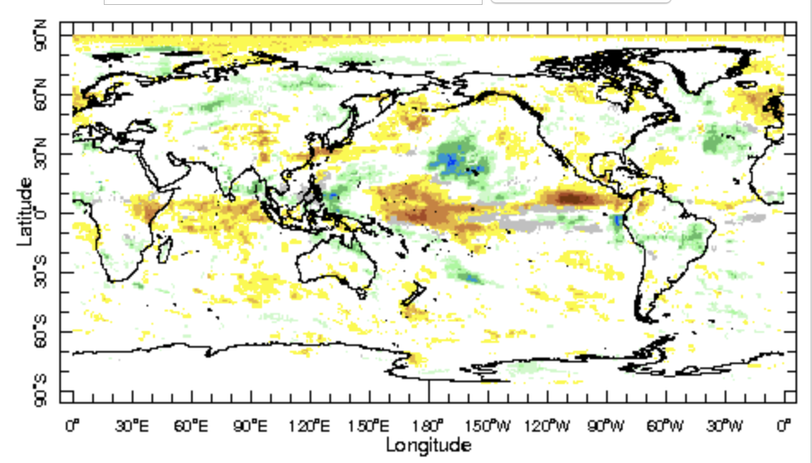
IRI Sub-seasonal Forecast: Precipitation (week 3+4 )
Week:2 : ( 4th Mar.-17th Mar.)
Forecast issue date: Feb. 17th

Slide 12
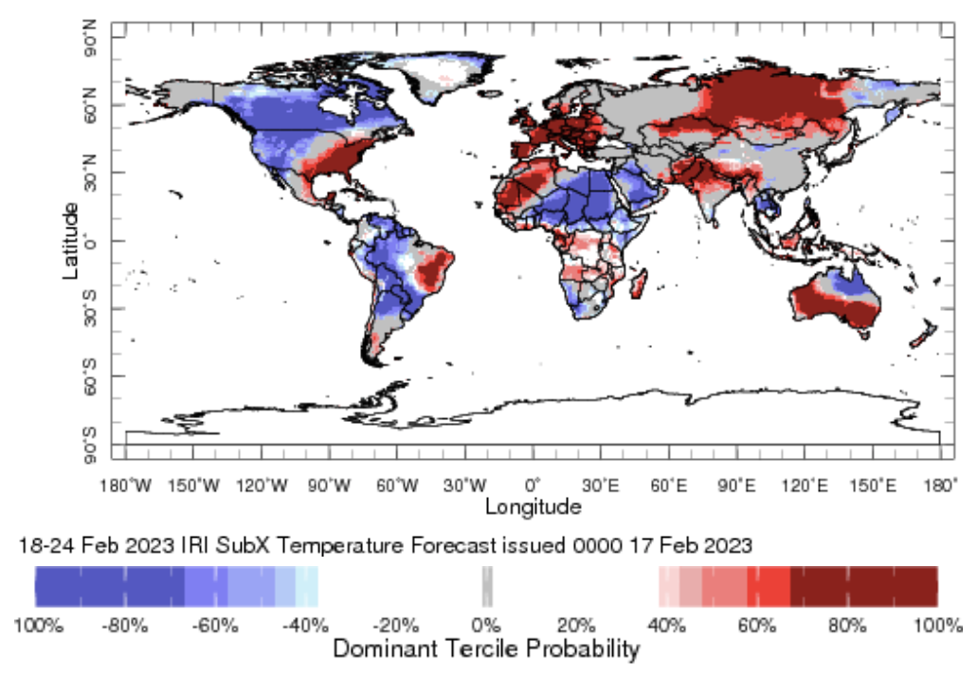
IRI Sub-seasonal Forecast : Near-Surface Temperature (week 1)
Week:1 : ( 18th -24th Feb.)
Forecast issue date: Feb. 17th

Slide 13
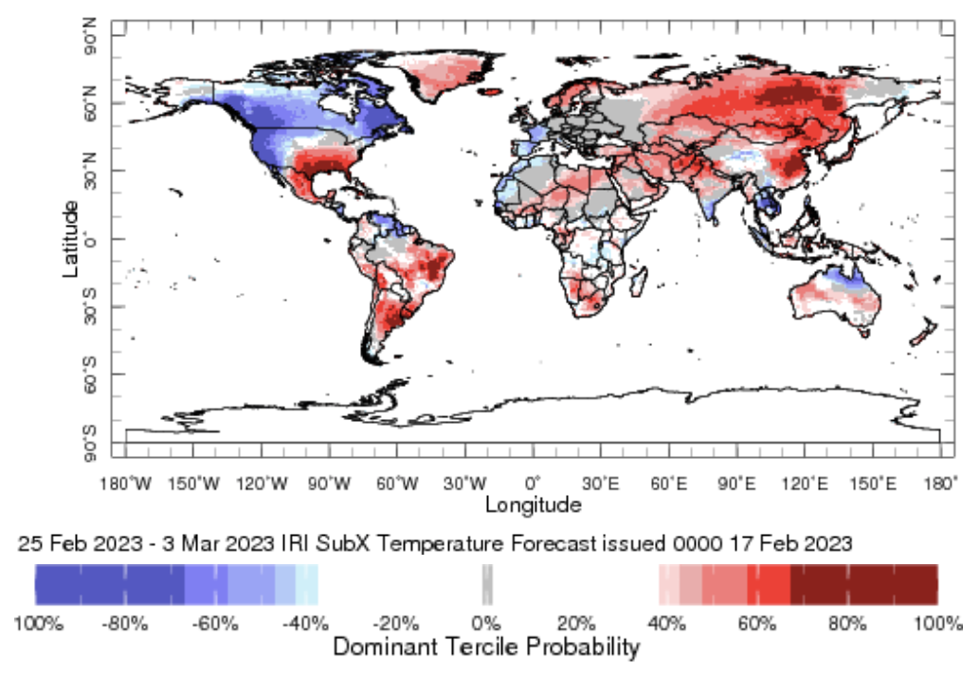
IRI Sub-seasonal Forecast : Near-Surface Temperature (week 2)
Week:2 : ( 25th Feb.-3rd Mar.)
Forecast issue date: Feb. 17th

Slide 14
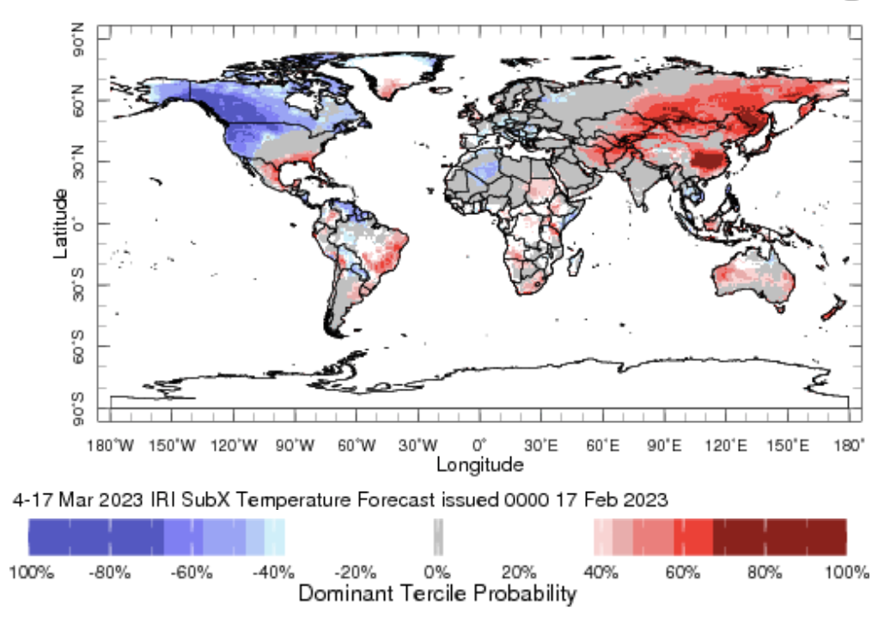
IRI Sub-seasonal Forecast : Near-Surface Temperature (week 2)
Week:2 : ( 4th Mar.-17th Mar.)
Forecast issue date: Feb. 17th

Slide 15
Summary
However SST anomalies in eastern Pacific Ocean become weaker but La Niña is still active
MJO related convection and circulation are active over the Maritime Continent likely to be active and move into west pacific Ocean
Above normal rainfall is expected northwest United state and Canada during week 1 and 2
Below normal temperature is expected over western United state for next two weeks.
Above normal temperature is likely in eastern United States is expected during next one month

Slide 16
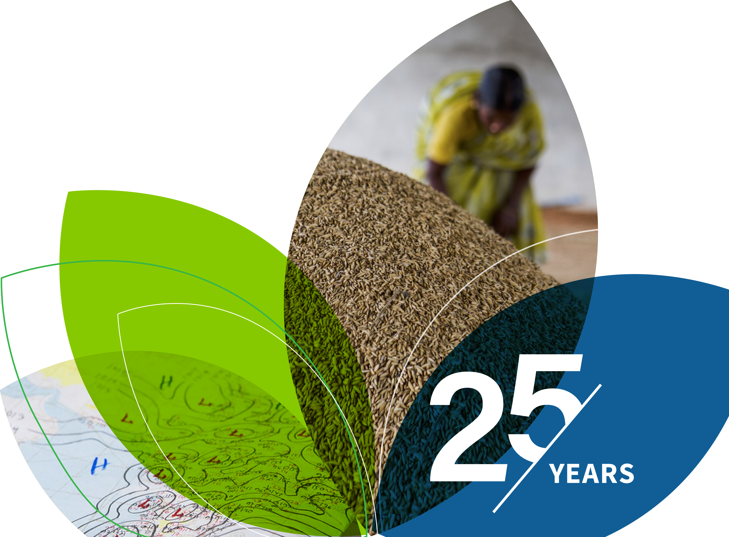
Thank You!

