Slide 1
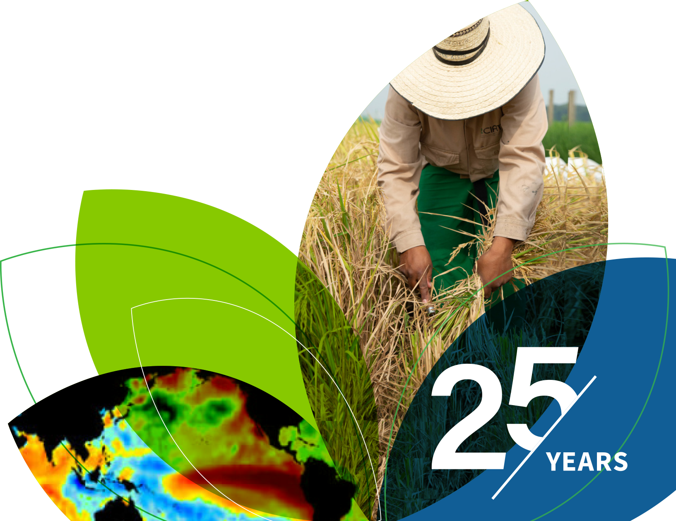
IRI Climate Briefing: Dec. 15, 2022 Sub-seasonal Update
Bohar Singh

Slide 2
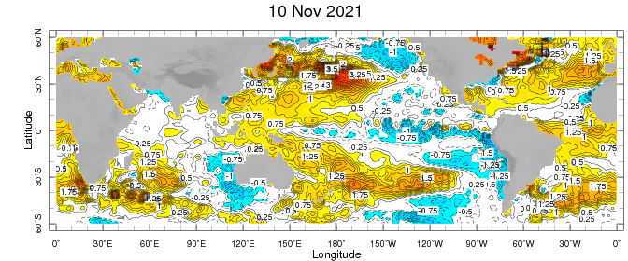
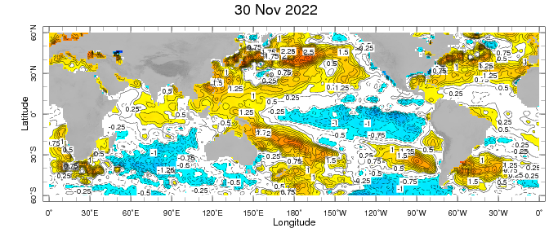
Sub-seasonal climate drivers: State of Climate
Cold anomalies in eastern and central Pacific become stronger as compared to previous month
Warm anomalies around Maritime continent expanded eastward in the west Pacific Ocean
Warm SST anomalies in the sub-tropical Pacific Ocean weakened and expanded eastward
Indian Ocean south of the equator become cooler as compared to previous month

Slide 3
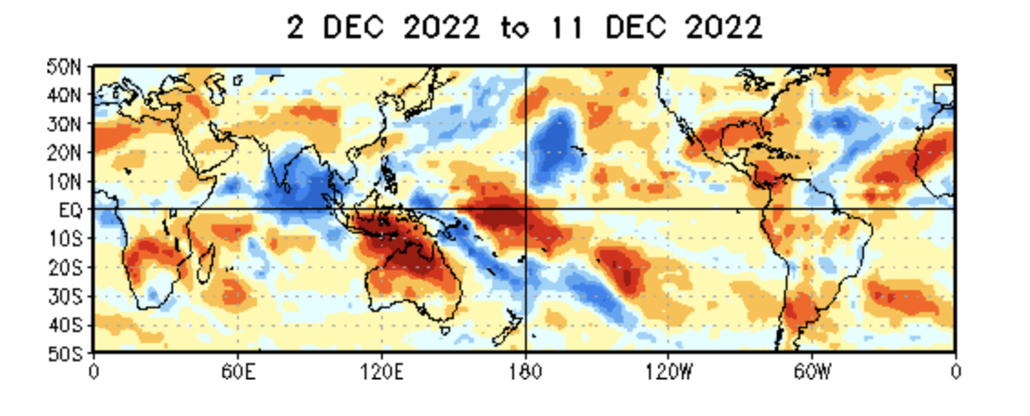
State of the climate: Cloudiness and circulation
Source : CPC
Convective clouds are observed over Indian ocean
Clear sky is observed in over South of the equator over maritime continent and Northern Australia
Clear sky over date line at the equator

Slide 4
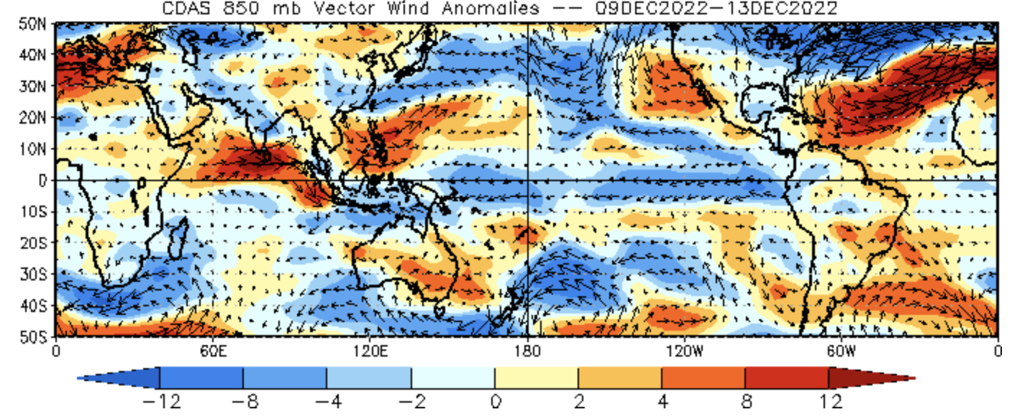
State of the climate: Cloudiness and circulation
Source : CPC

Slide 5
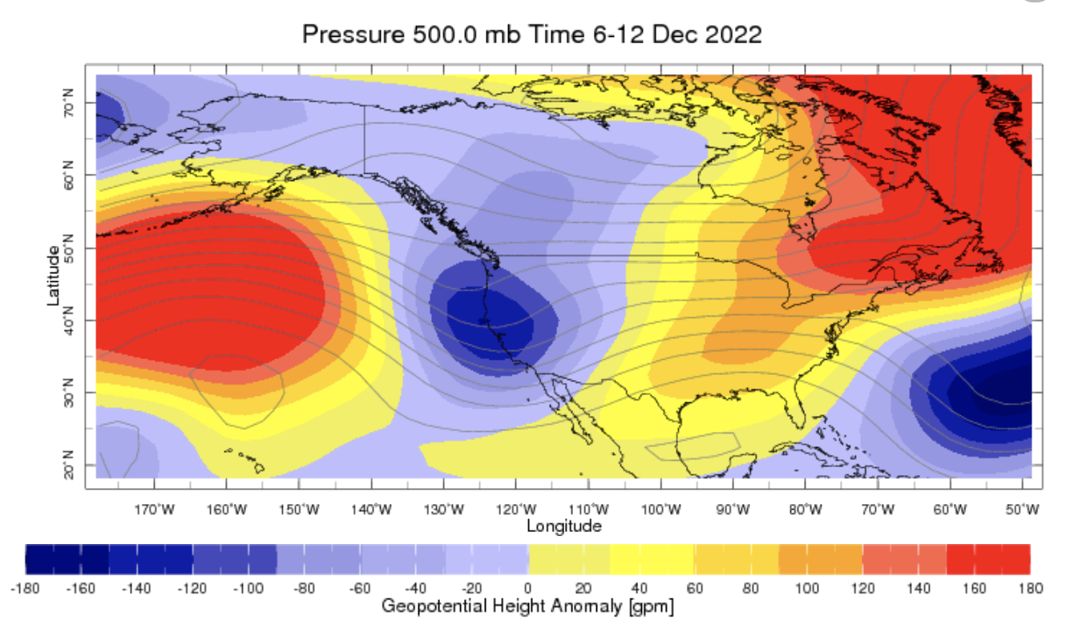
State of the climate: Geopotential height

Slide 6
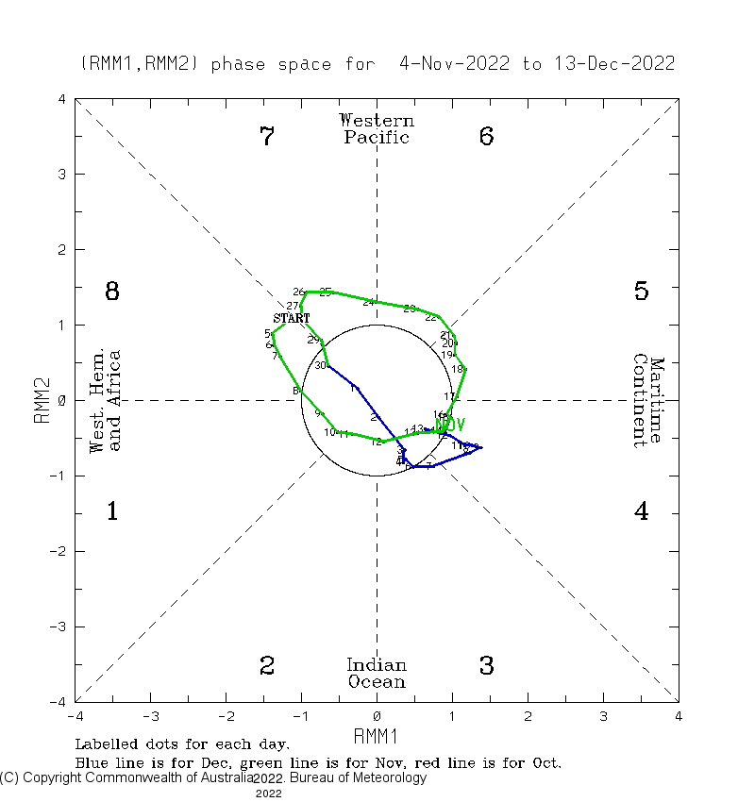
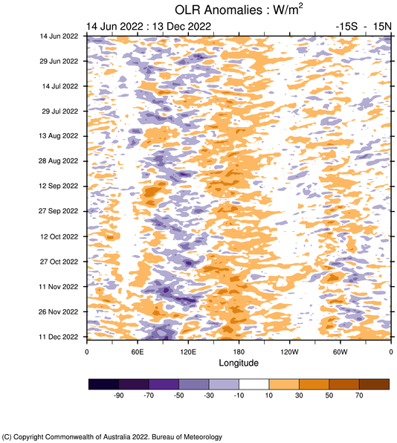
Current and Past evolution of the MJO Wheeler-Hendon Indices
Currently MJO is in in-active state in the Indian Ocean

Slide 7
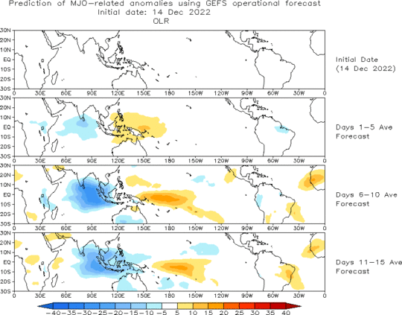
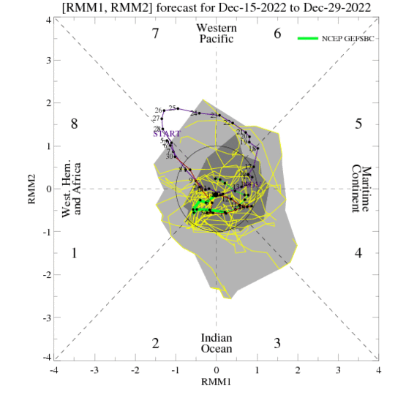
Forecast of MJO: Wheeler-Hendon Indices
MJO 15-day Forecast from NCEP GEFS model
MJO is likely to be active and expected to be remain active and propagate eastward over next two weeks

Slide 8
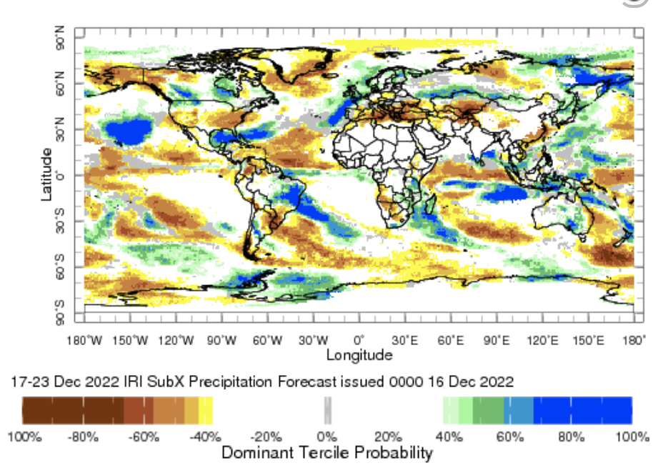
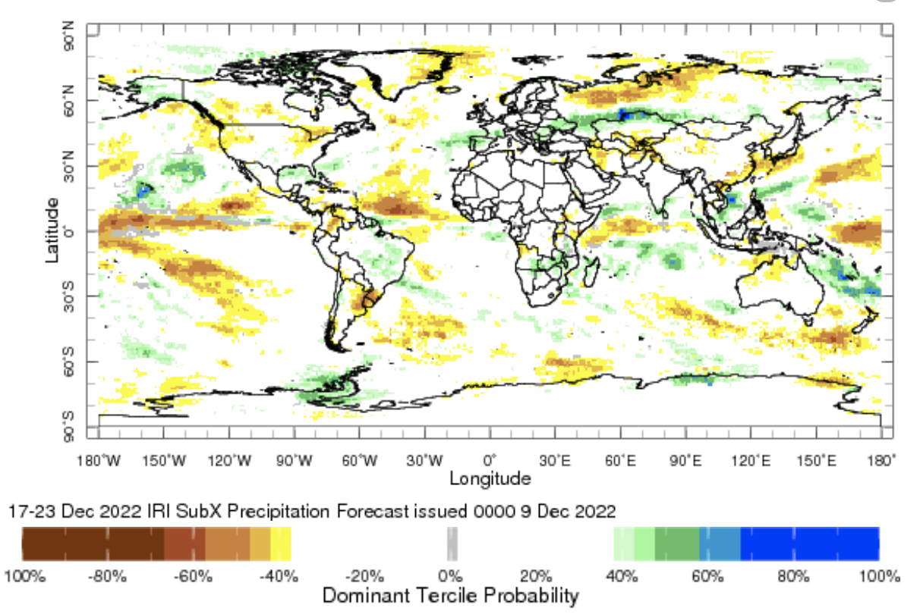
IRI Sub-seasonal Forecast: Precipitation (week 1)

Slide 9
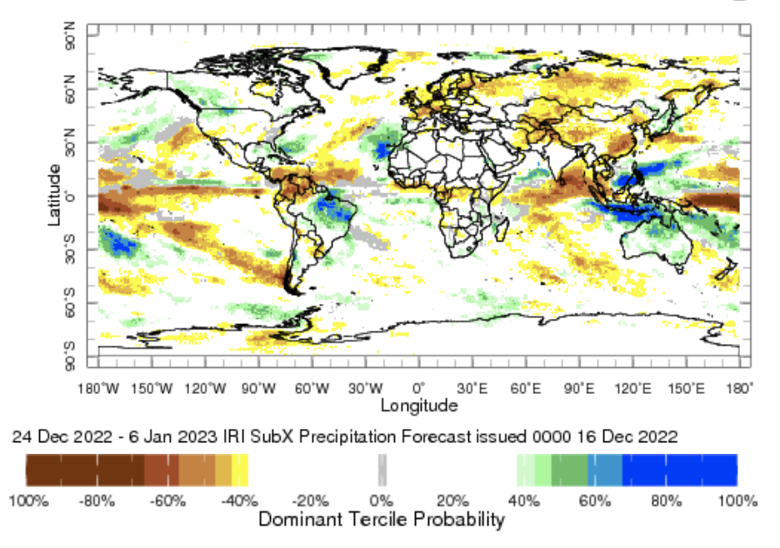
IRI Sub-seasonal Forecast: Precipitation (week 2 and 3)
Week:2 and 3: ( 24 Dec.-6th Jan.)
Forecast issue date: Dec. 16th

Slide 10
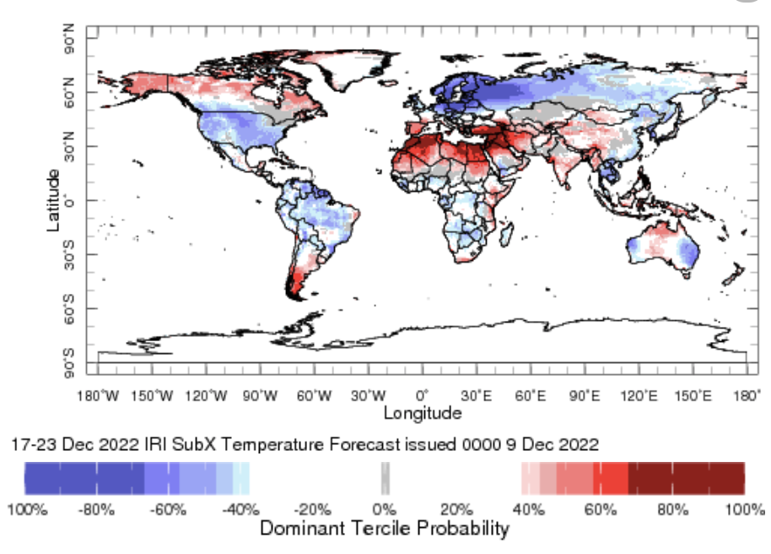
IRI Sub-seasonal Forecast : Near-Surface Temperature (week 1)
Week:2: ( 17-23 Dec.)
Forecast issue date: Dec. 9th

Slide 11
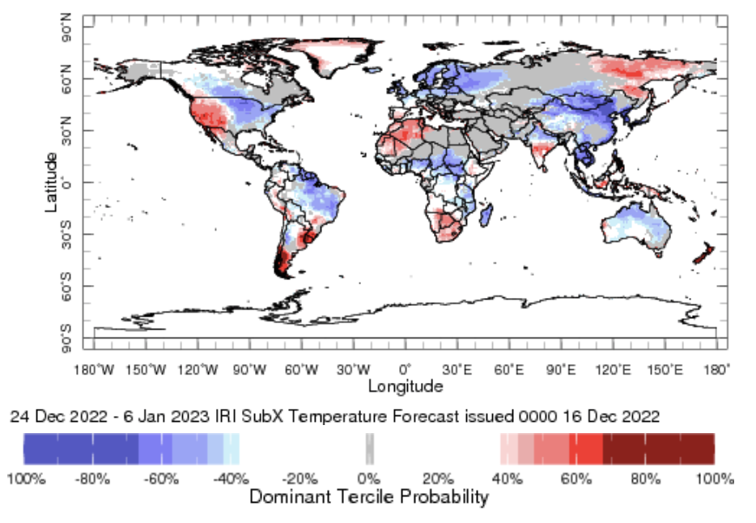
IRI Sub-seasonal Forecast : Near-Surface Temperature (week 2-3)
Week:2-3: ( 24 Dec.- 6 Jan.).
Forecast issue date: Dec. 16th

Slide 12
Summary
La Niña is active
MJO related convection and circulation are currently about to be active in the Indian Ocean most likely remain active for next two week.
Maritime continent are likely to get above normal rainfall during week 1 and 2-3
SACZ of South America are likely to get above normal rainfall at week 1
Continental United States is likely to see below normal temperature in week
Above normal temperature in western United States is expected during weeks of (24th Dec-6th Jan)
Belo normal temperature in eatern United States is expected during weeks of (24th Dec-6th Jan)

Slide 13
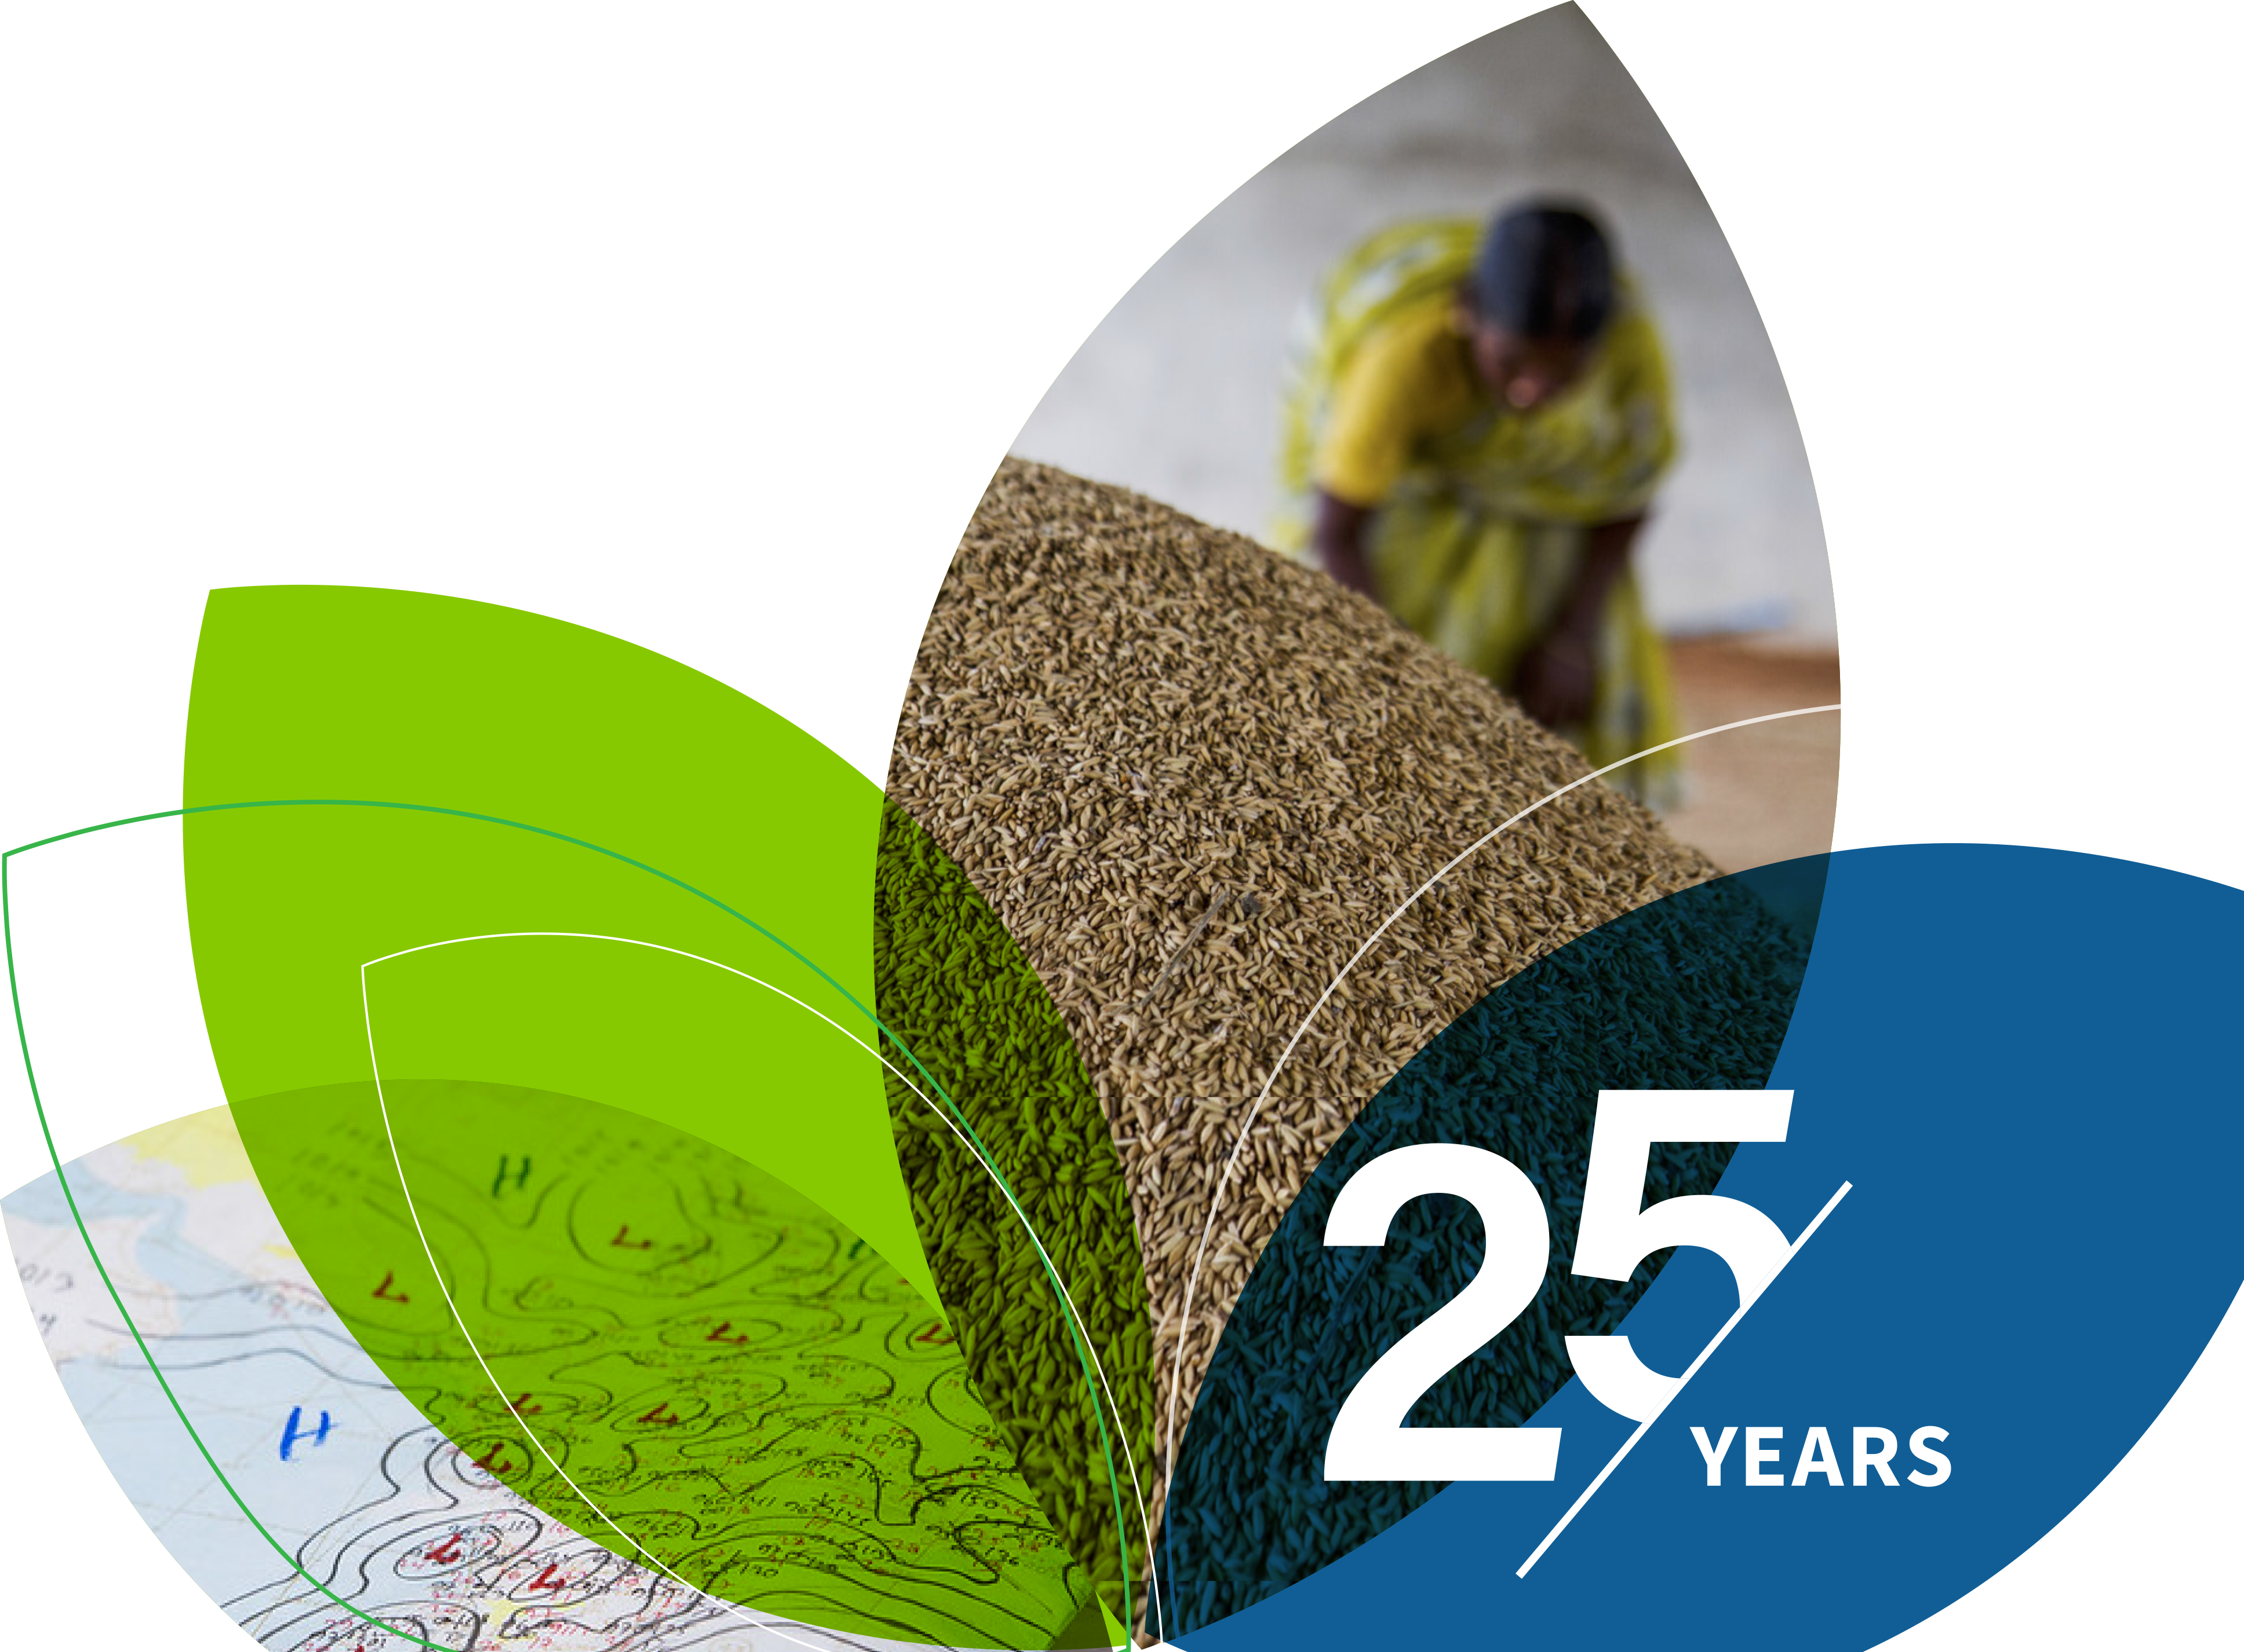
Thank You!

