Slide 1
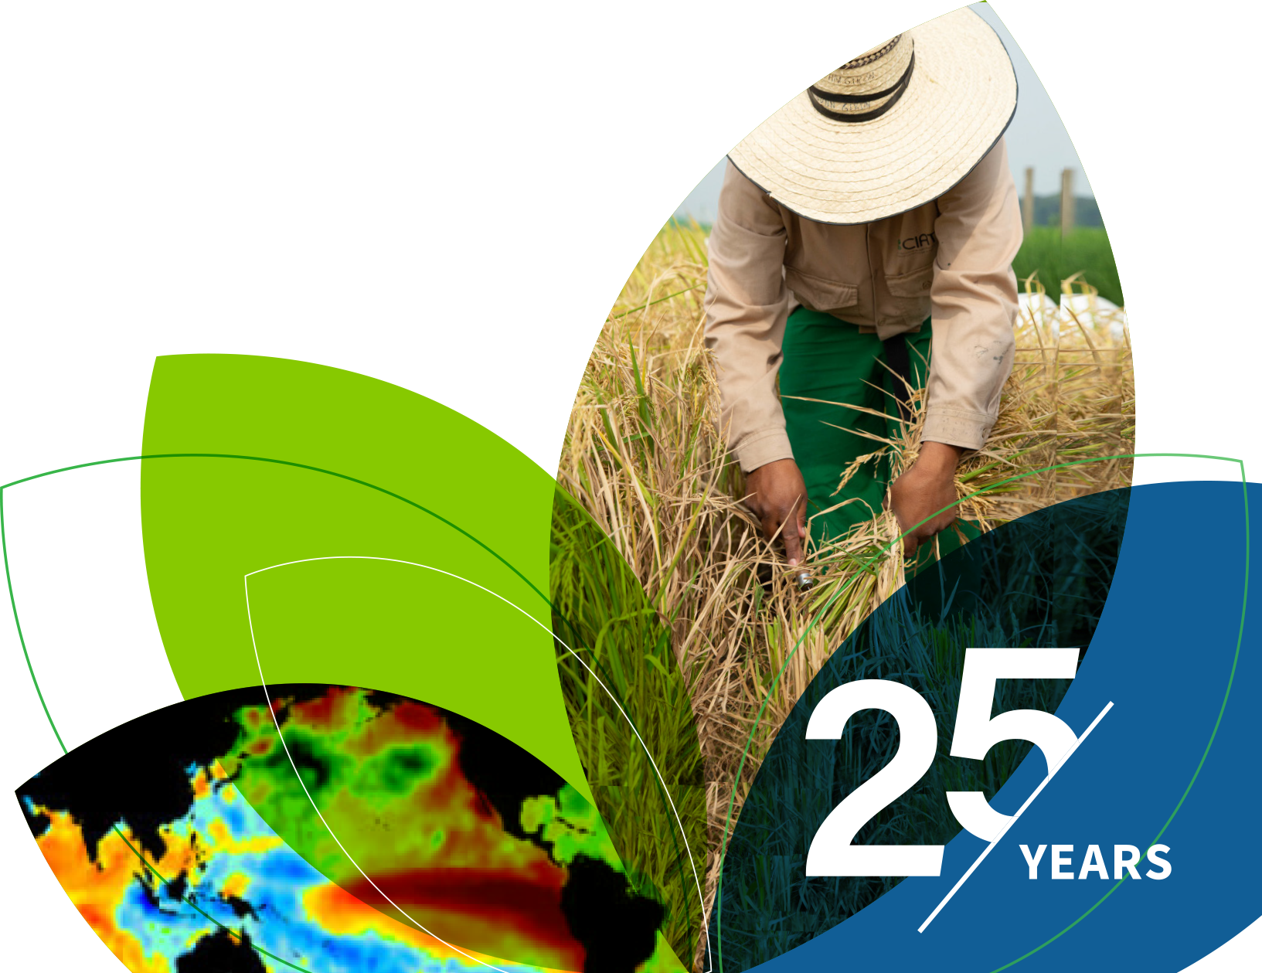
IRI Climate Briefing: Apr. 20, 2023 Sub-seasonal Update
Bohar Singh

Slide 2
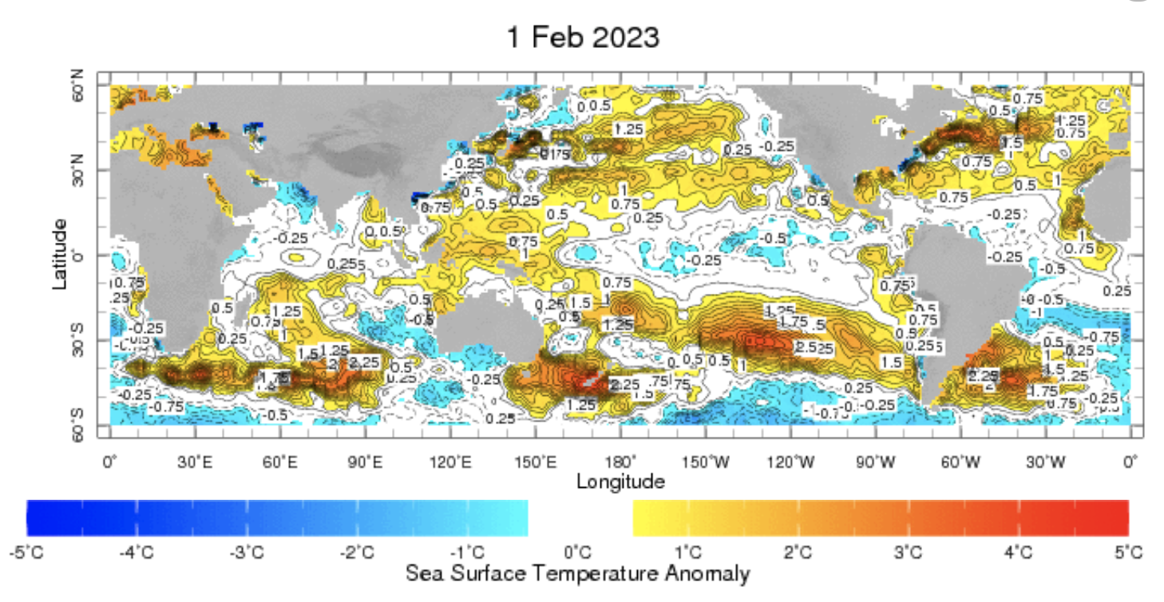
Sub-seasonal climate drivers: State of Climate
Cold anomalies in eastern and central Pacific are weaker as compared to previous month

Slide 3
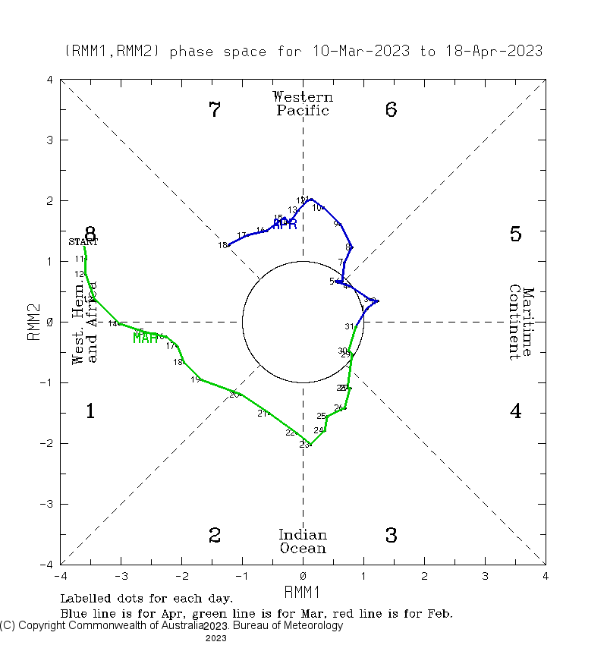
Current and Past evolution of the MJO Wheeler-Hendon Indices
Currently MJO is in active state since 6th April in west Pacific Ocean

Slide 4
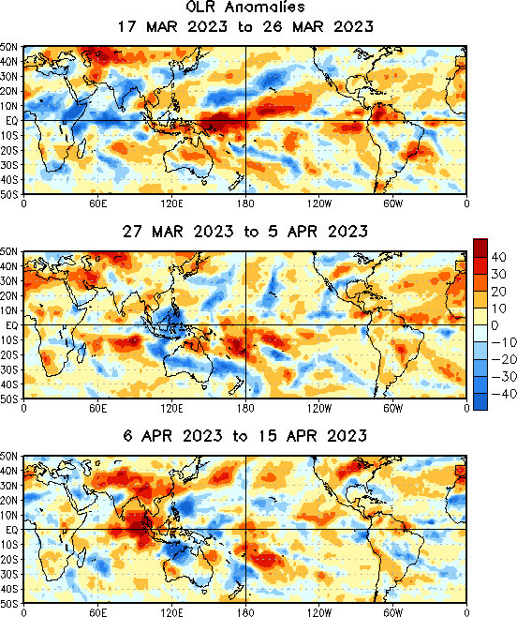
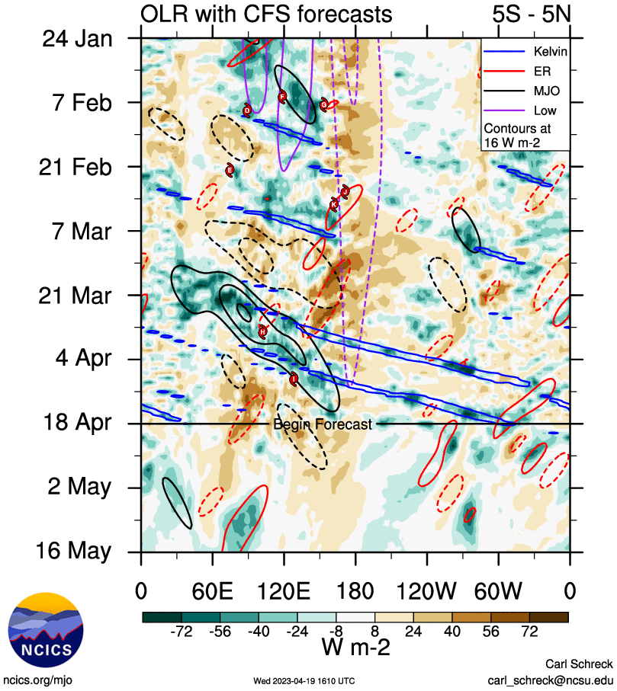
State of the climate: Cloudiness and wave propagation
Source : CPC
MJO is moved through the Indian Ocean and Maritime Continent since March
However, convective phase is disrupted by Kelvin
waves moving across the Pacific, and a persistent
clear sky near the Date Line.

Slide 5
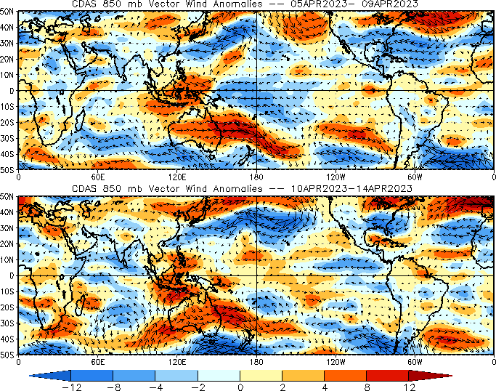
State of the climate : Circulation
Trade wind regime over the Pacific is disrupted due to current MJO activity

Slide 6
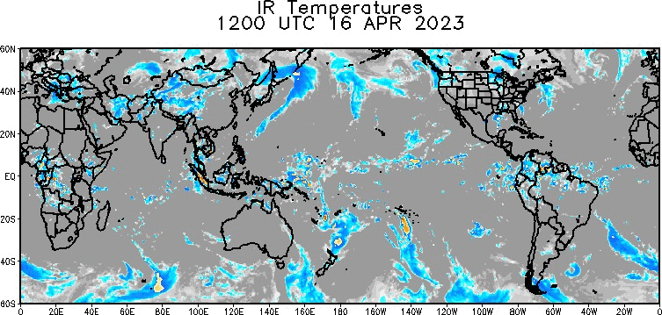
State of the climate :Global IR
MJO scale convection currently ending in western Pacific ocean in phase 8
MJO impact resulted in to enhanced convective activity Observed over the western US

Slide 7
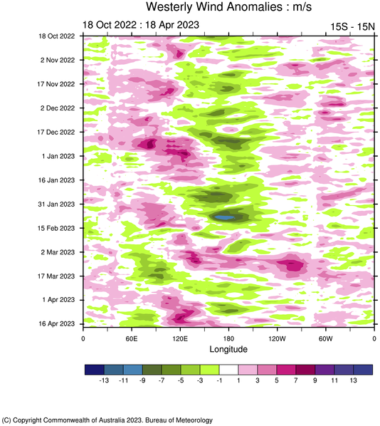
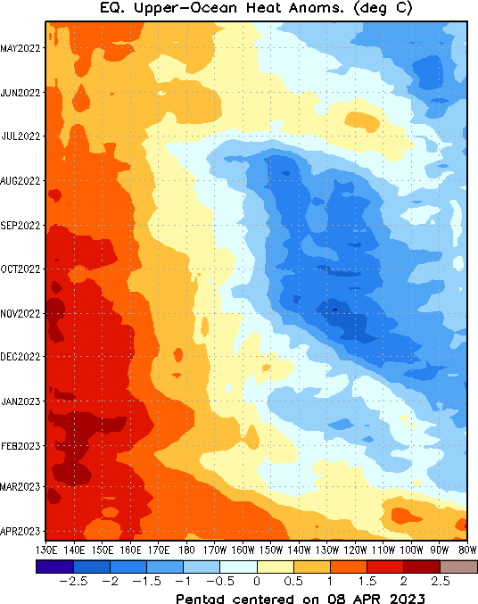
State of the climate: Cloudiness and circulation
Due to episode of MJO related westerly wind burst (WWB) forced series of oceanic Kelvin wave
That leads to the expansion of warm pool eastward
During March 2023, westerly wind have seen over entire central Pacific Ocean
WWB’s are making conditions favorable for El-Niño onset.

Slide 8
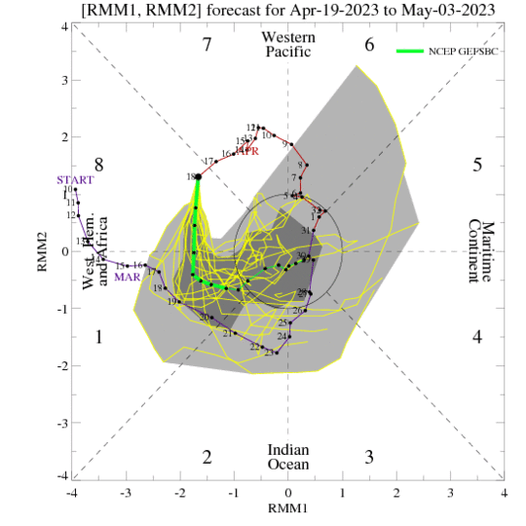
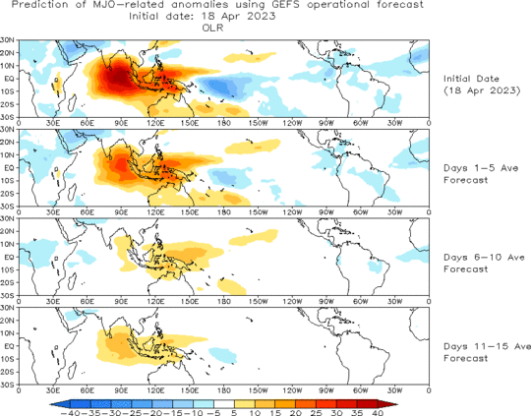
Forecast of MJO: Wheeler-Hendon Indices
MJO 15-day Forecast from NCEP GEFS model
Another MJO is likely to be initiated in Indian Ocean and current event is dying into phase 8

Slide 9
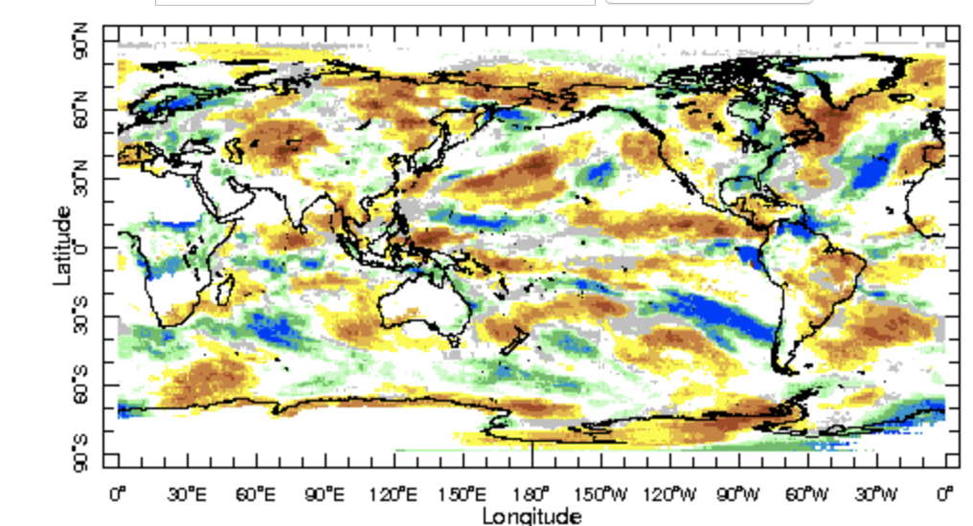
IRI Sub-seasonal Forecast: Precipitation (week 1)
Week:1 : ( 22nd -28th Apr.)
Forecast issue date: Apr. 21st
Above normal rainfall is likely over south-east and eastern United States, Central Africa

Slide 10
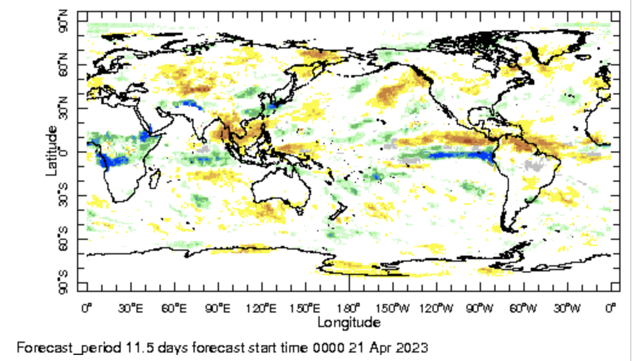
IRI Sub-seasonal Forecast: Precipitation (week 2 )
Week:2 : ( 29th Apr.-5th May.)
Forecast issue date: Apr. 21st
Above normal rainfall is likely over eastern tropical Pacific Ocean and central African region

Slide 11
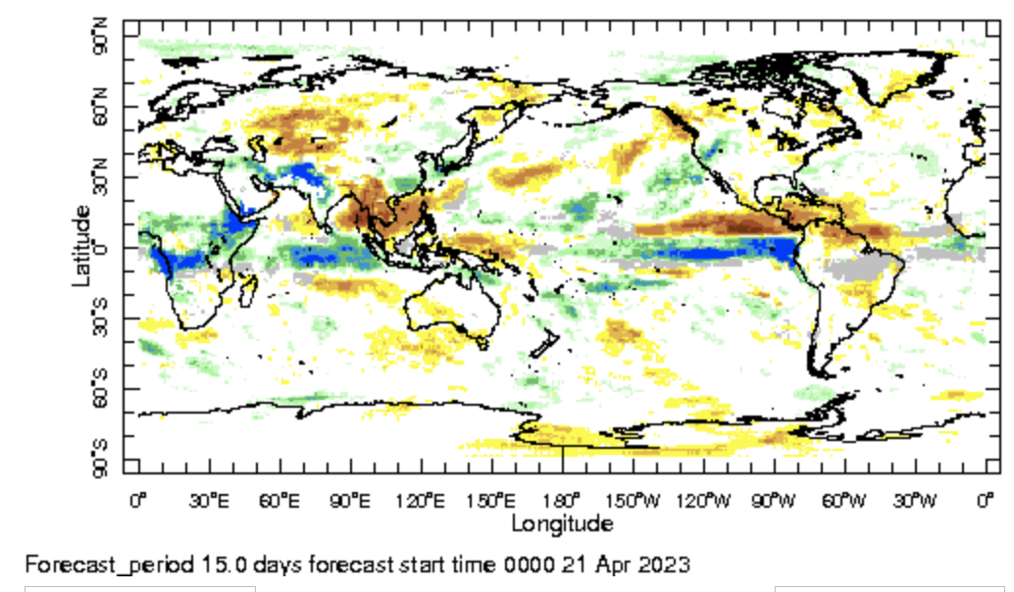
IRI Sub-seasonal Forecast: Precipitation (week 3+4 )
Week:3-4 : ( 6th May.-19th Mar.)
Forecast issue date: Apr. 21st
Above normal rainfall is likely over eastern tropical Pacific, central African region, northwest India and Pakistan

Slide 12
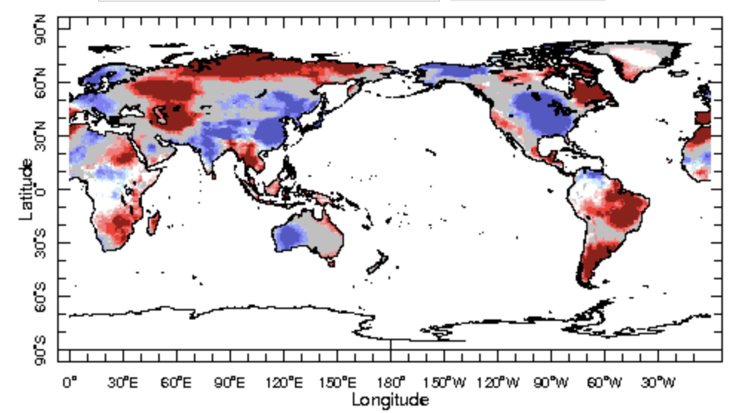
IRI Sub-seasonal Forecast : Near-Surface Temperature (week 1)
Week:1 : ( 22nd -28th Apr.)
Forecast issue date: Apr. 21st

Slide 13
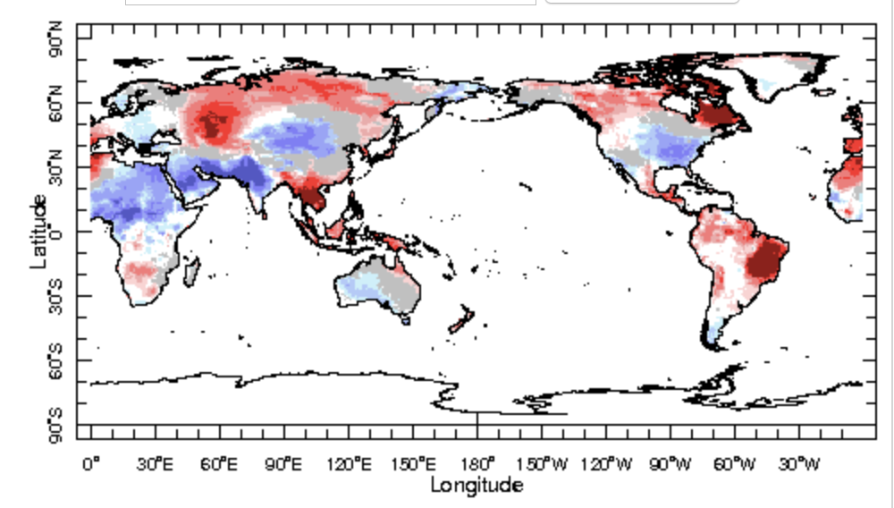
IRI Sub-seasonal Forecast : Near-Surface Temperature (week 2)
Week:2 : ( 29th Apr.-5th May.)
Forecast issue date: Apr. 21st

Slide 14
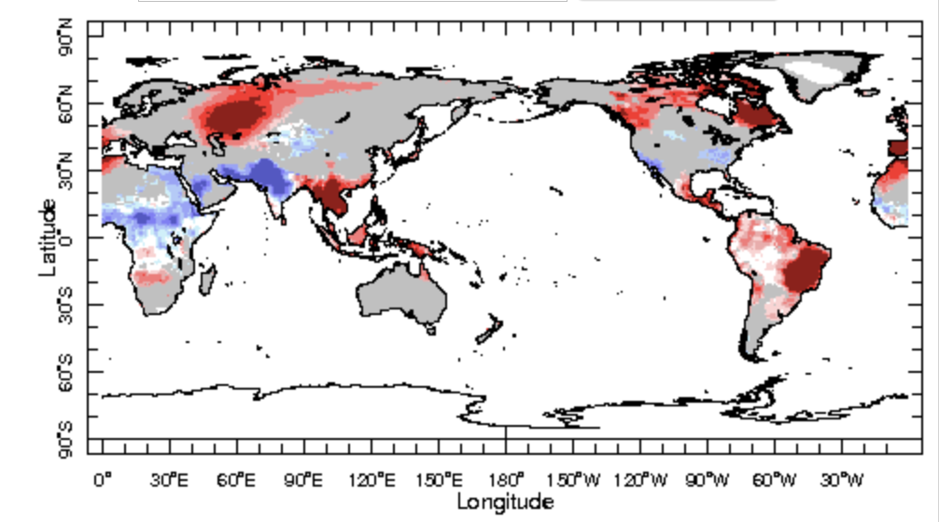
IRI Sub-seasonal Forecast : Near-Surface Temperature (week 3+4)
Week:3-4 : ( 6th May.-19th Mar.)
Forecast issue date: Apr. 21st

Slide 15
Summary
El Niño : Not a matter of if, but how strong?
Current active MJO related convection is ending in western pacific
Another episode of MJO likely to be active in the Indian Ocean by the next week
MJO impacts, through its teleconnection are expect during coming weeks

Slide 16
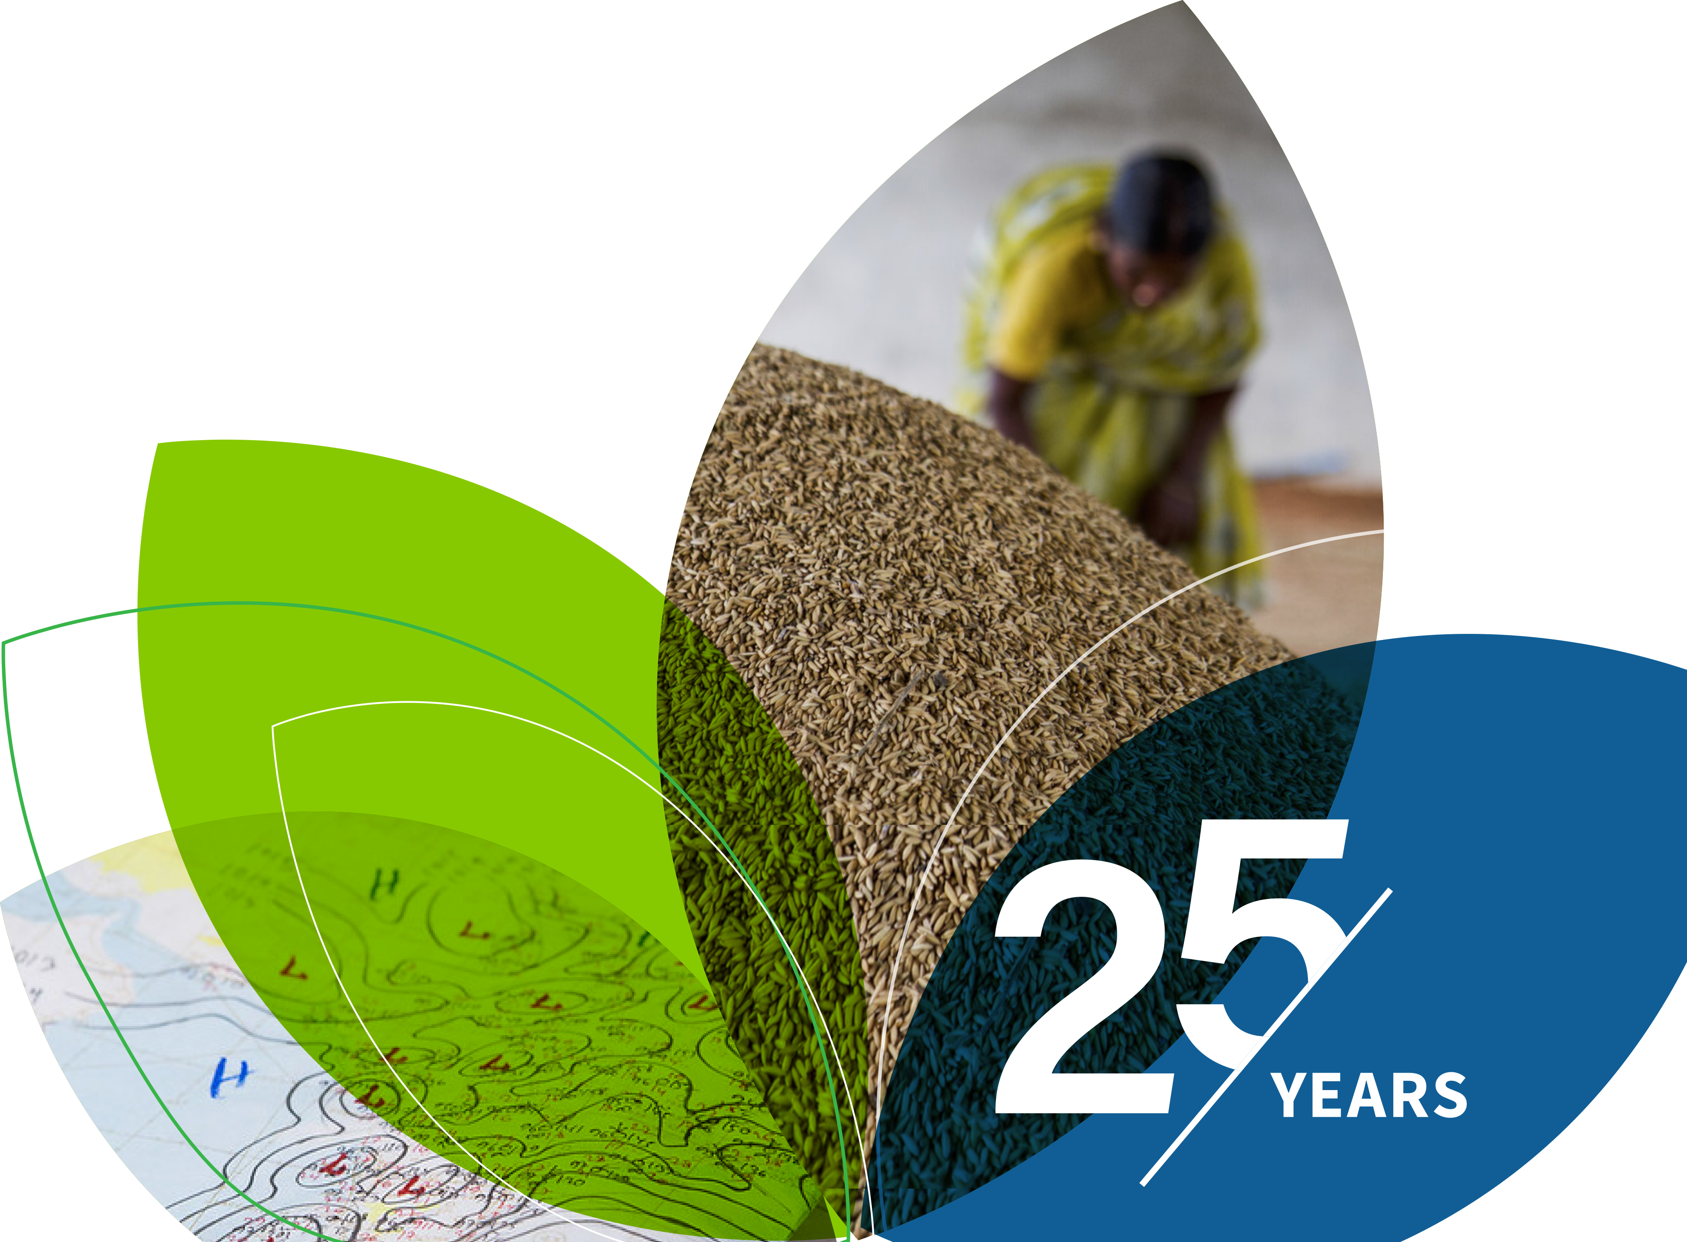
Thank You!

Slide 17
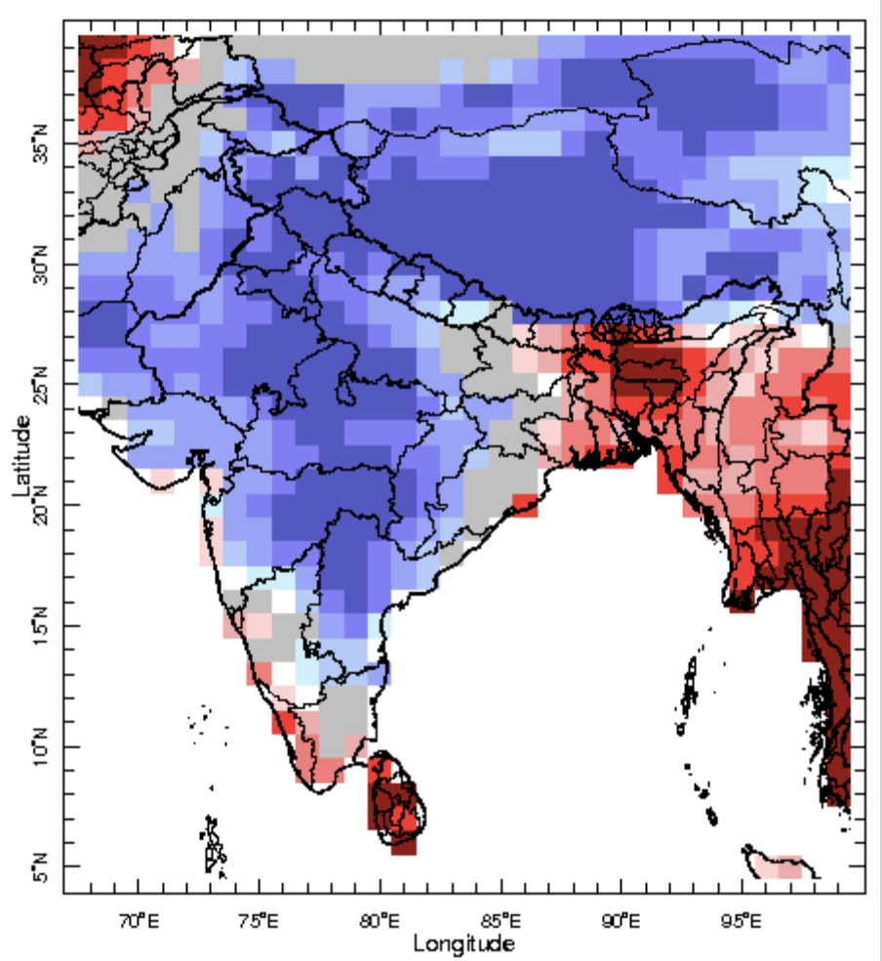
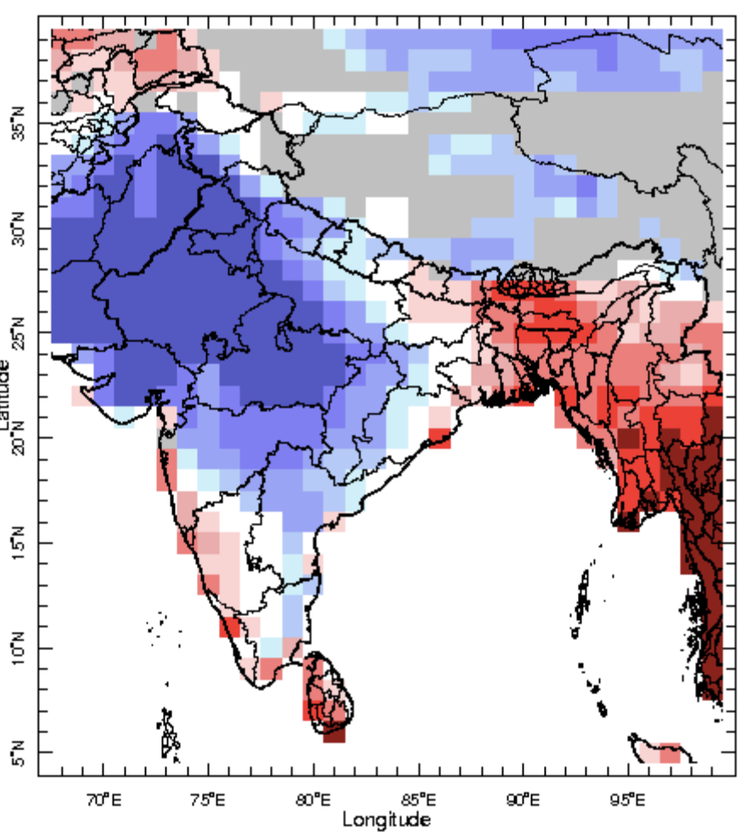
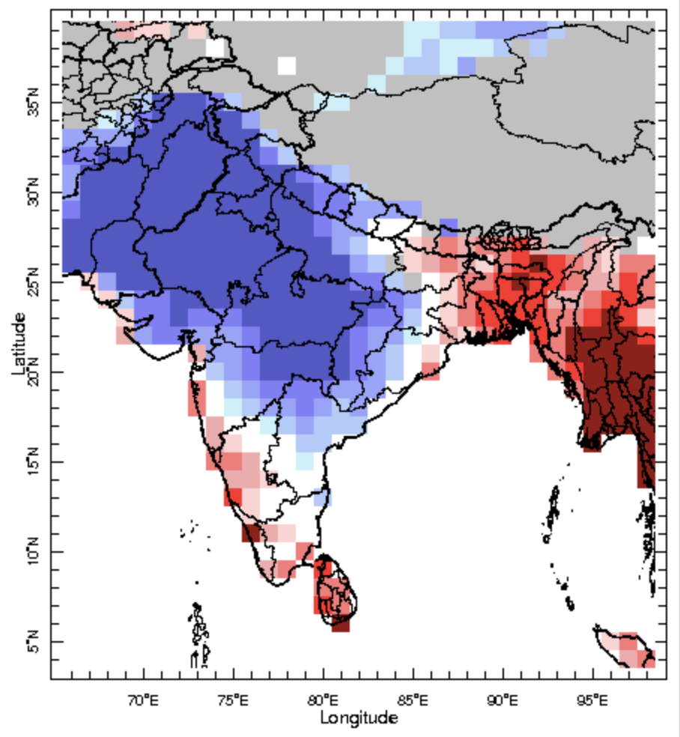
IRI-Sub-seasonal probabilistic temperature forecast (issue date: Apr. 21st)
Week:1 : ( 22nd -28th Apr.)
Week:2 : ( 29th Apr.-5th May.)
Week:3-4 : ( 6th May.-19th Mar.)

Slide 18
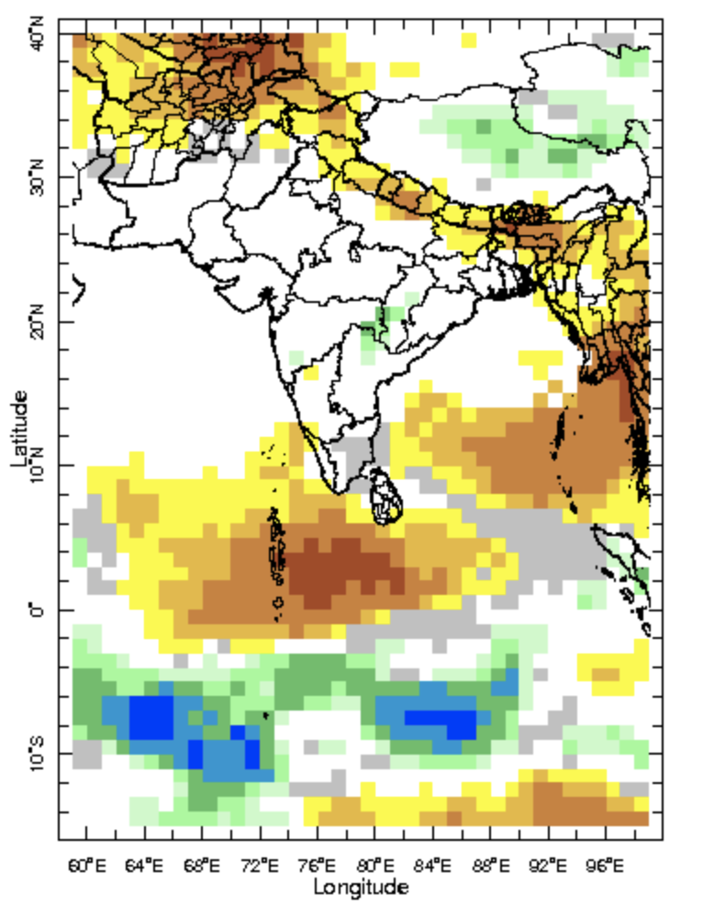
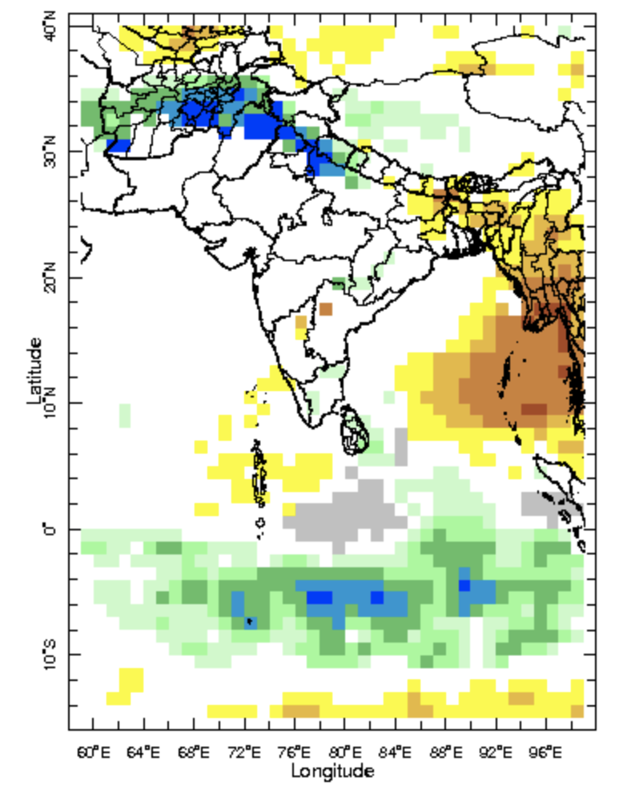
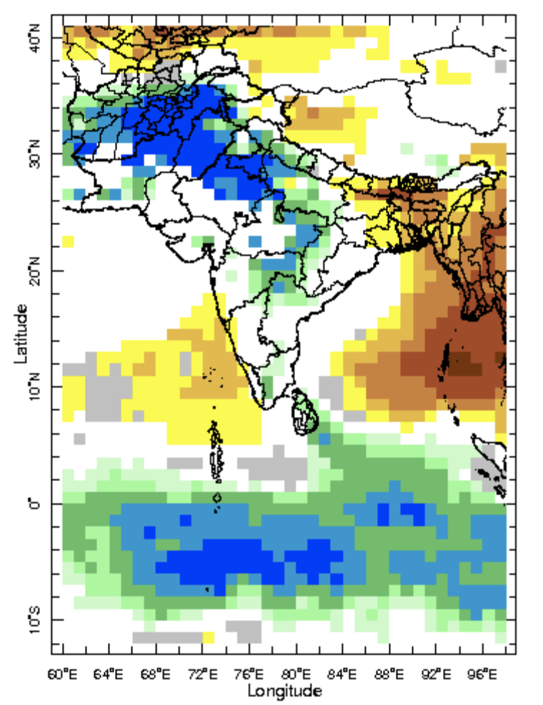
IRI-Sub-seasonal probabilistic rainfall forecast (issue date: Apr. 21st)
Week:1 : ( 22nd -28th Apr.)
Week:2 : ( 29th Apr.-5th May.)
Week:3-4 : ( 6th May.-19th Mar.)

