Slide 1
IRI Climate Briefing: Jun. 15, 2023 Sub-seasonal Update
Bohar Singh

Slide 2
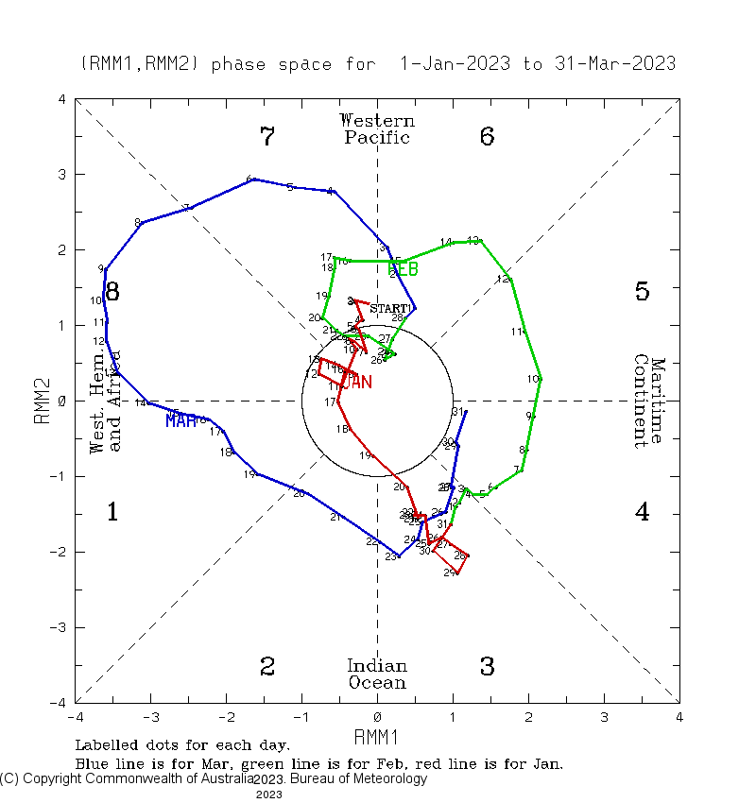
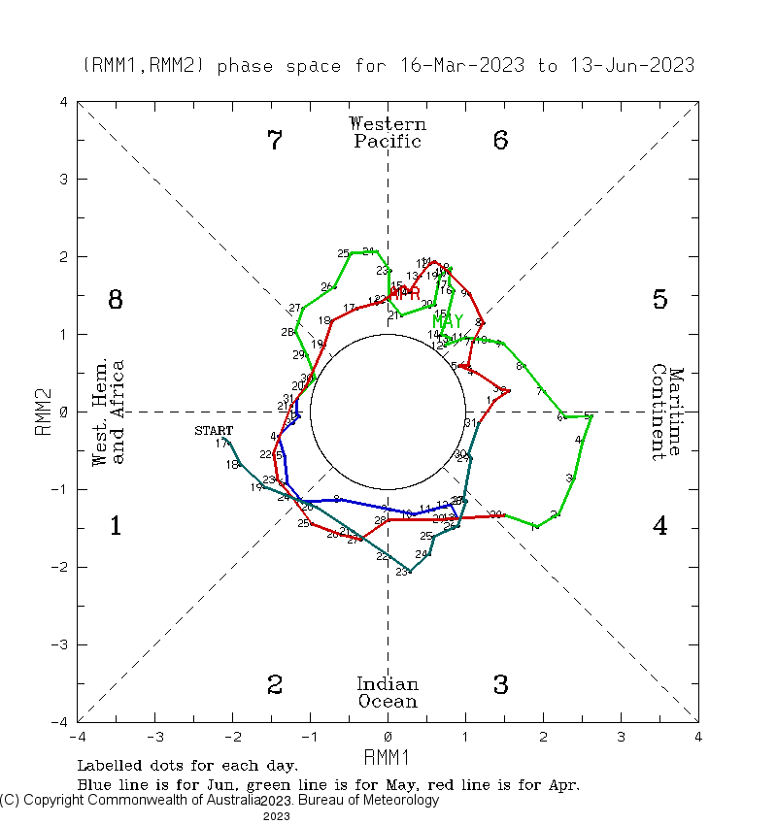
Current and Past evolution of the MJO Wheeler-Hendon Indices
Event 1: 20th Jan. -14th Mar.
Event 2: 15th Mar. -21st Apr.
Event 3: 22nd Apr. -31th May.
Event 4: 1st Jun. - continue.
MJO is in active state since late January and, currently it is in the phase 3 in the Indian Ocean
These multiple MJO events and subsequent Oceanic Kelvin waves enforcing El Niño to become stronger

Slide 3
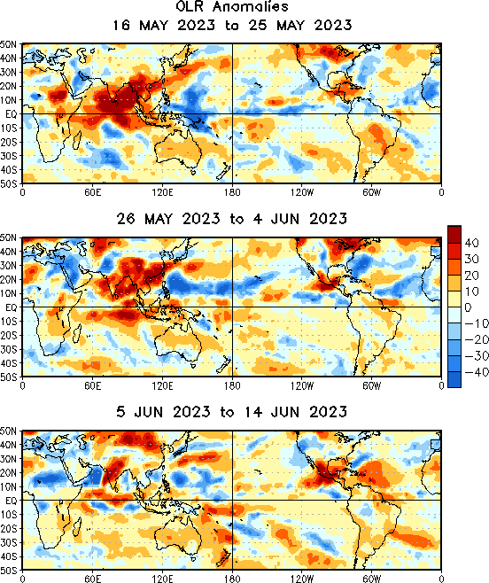
State of the climate: Cloudiness
Large blob of clear sky over South Asia.
Initiation of cyclone “Biparjoy” the in Arabian Sea

Slide 4
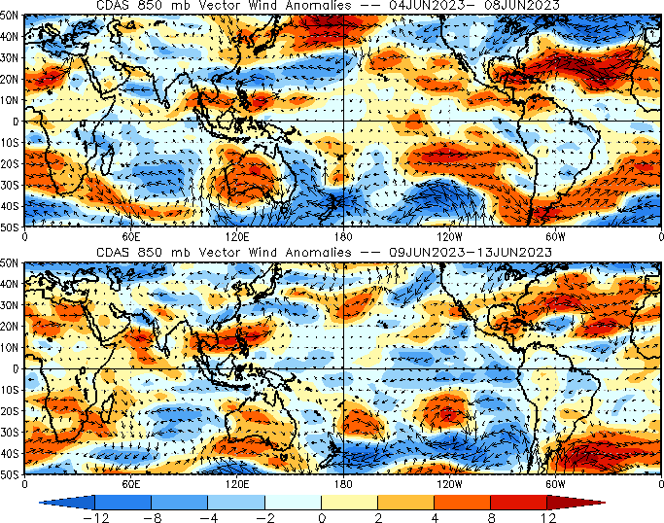
State of the climate : Circulation
Easterly winds over the central Pacific strengthen after current MJO activity moved into the Indian Ocean

Slide 5
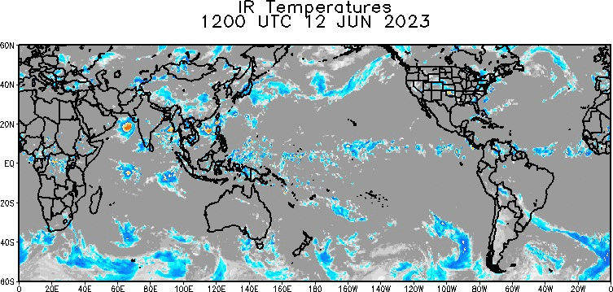
State of the climate :Global IR (12-15 June)
MJO scale cloudiness is rejuvenated recently in the western Pacific after destructive interference with high frequency waves

Slide 6
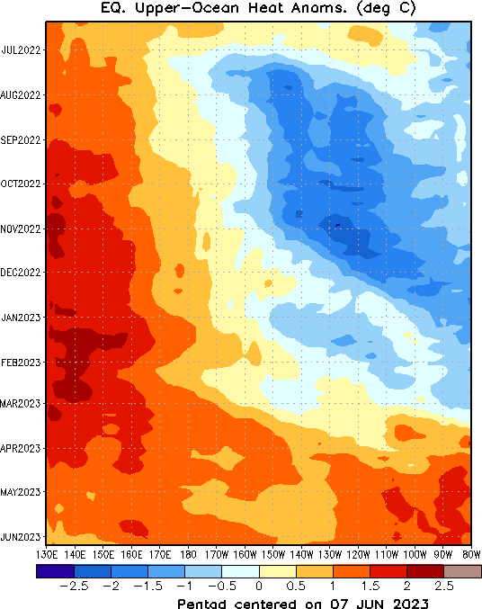
State of the climate : Upper Ocean heat Content
Above-normal oceanic subsurface temperatures are present across the entire equatorial Pacific
All Niño indices increasing continuously

Slide 7
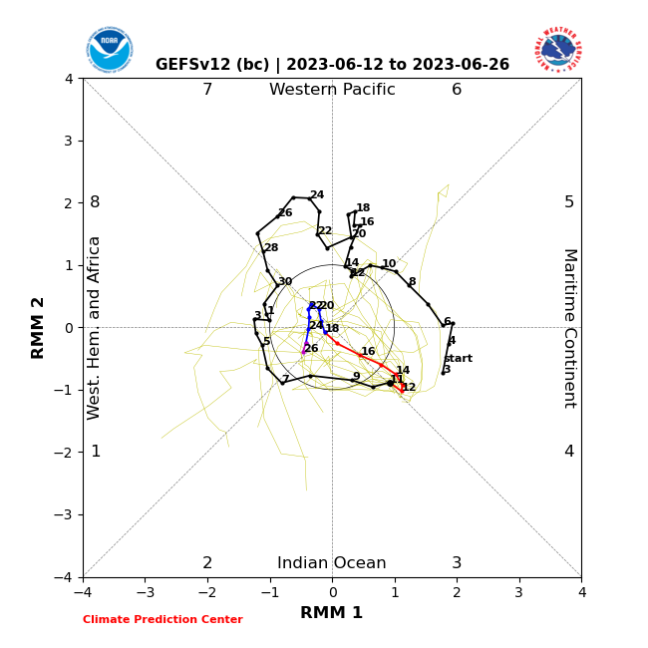
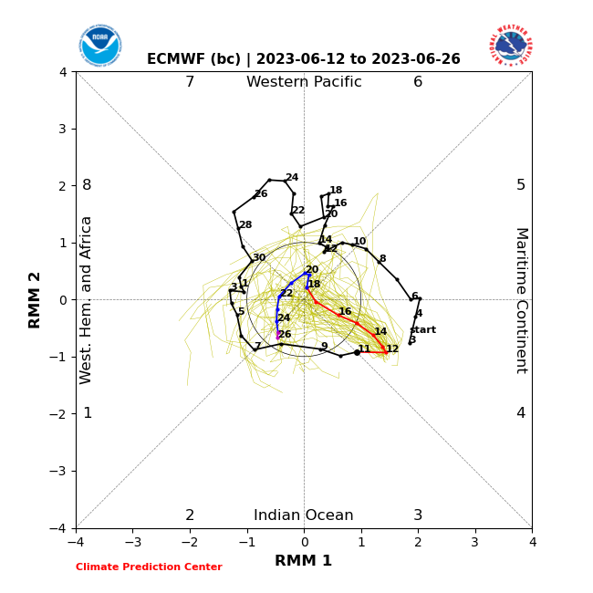
Forecast of MJO: Wheeler-Hendon Indices
MJO 15-day Forecast from NCEP GEFSv12 and ECMWF models
ECMWF Forecast
GEFSv12 Forecast

Slide 8
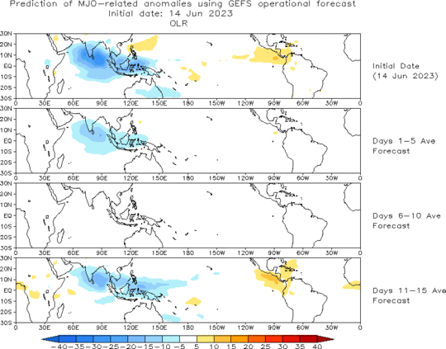
OLR anomalies 15-day Forecast from NCEP GEFS model
The forecast indicates weakening MJO(MISO) and re-emergence between day 11-15 of the forecast

Slide 9
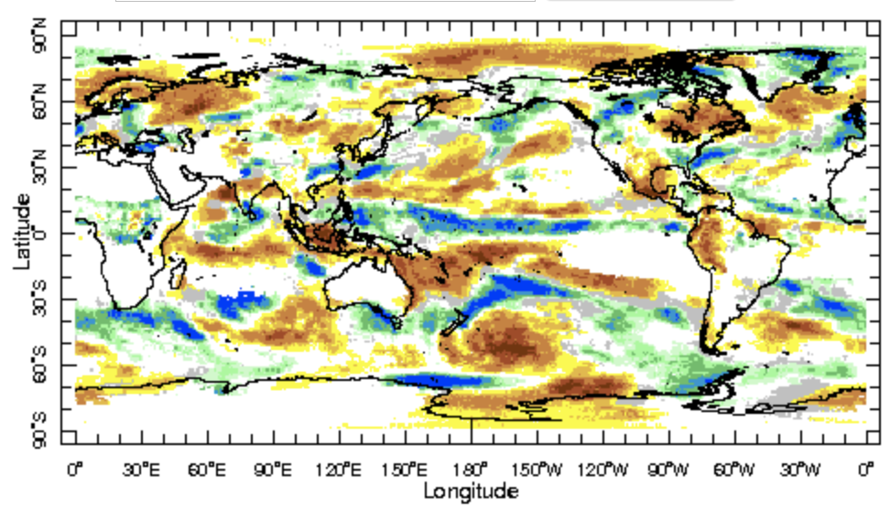
IRI Sub-seasonal Forecast: Precipitation (week 1)
Week:1 : ( 17th -23th May.)
Forecast issue date: May. 16th
Above normal rainfall is likely over north west pacific and equatorial Pacific Ocean
Dry conditions are likely over central India, Bangladesh and Myanmar
Above normal rainfall is likely over central African region

Slide 10
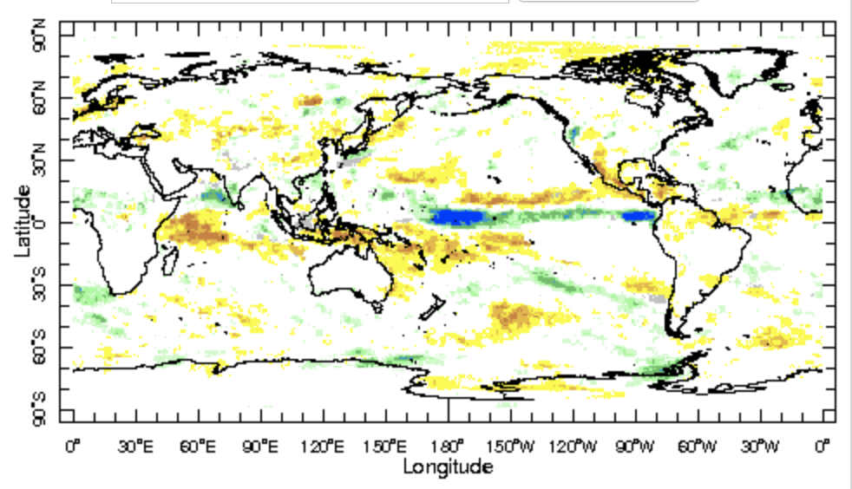
IRI Sub-seasonal Forecast: Precipitation (week 2 )
Week:2 : ( 24th May.-30 Jun.)
Forecast issue date: May. 16th
Below normal rainfall is likely over central America and maritime Continent
Above normal conditions are also likely over Southern Peninsula of India

Slide 11
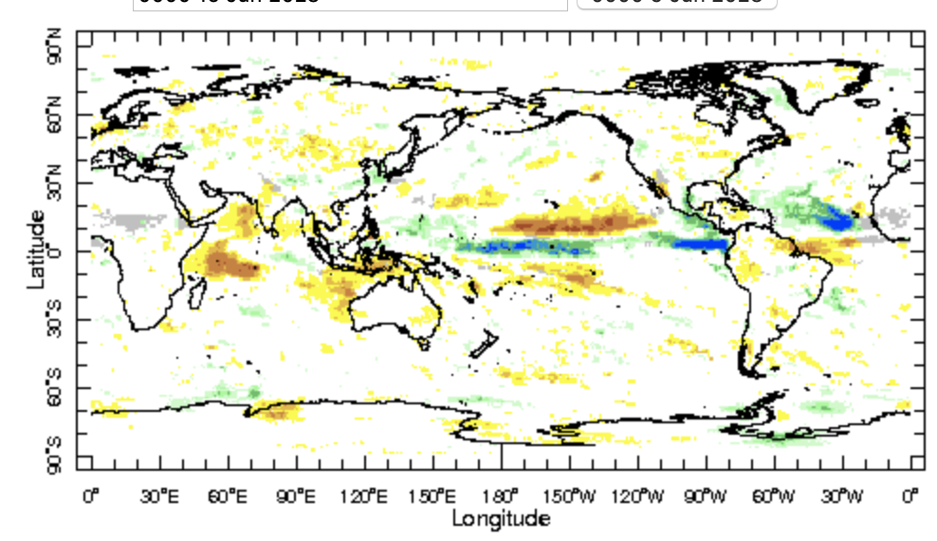
IRI Sub-seasonal Forecast: Precipitation (week 3+4 )
Week:3-4 : ( 1st July-14th July.)
Forecast issue date: May. 16th
The equatorial Pacific and and north of equator of Atlantic is likely get above normal rainfall.
Maritime continent is likely to get below normal rainfall
Below normal rainfall is likely over central and southern India suggest weak monsoon after delayed monsoon .

Slide 12
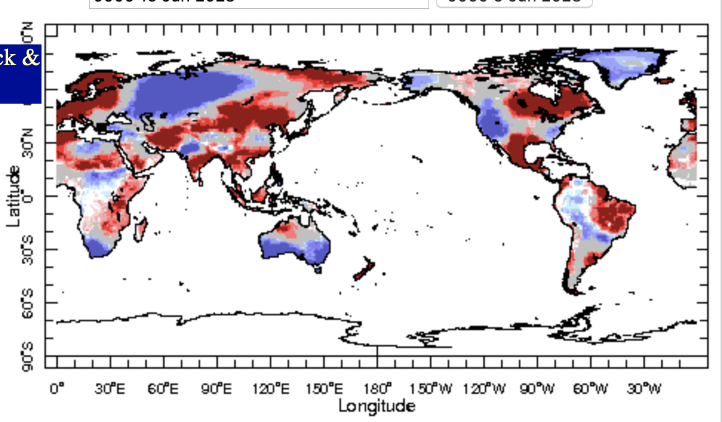
IRI Sub-seasonal Forecast : Near-Surface Temperature (week 1)
Week:1 : ( 17th -23th May.)
Forecast issue date: May. 16th
Above normal temperature is likely over greater horn and Sahel regions of Africa,
Northwest North America and southern Australia likely to experience below normal temperatures

Slide 13
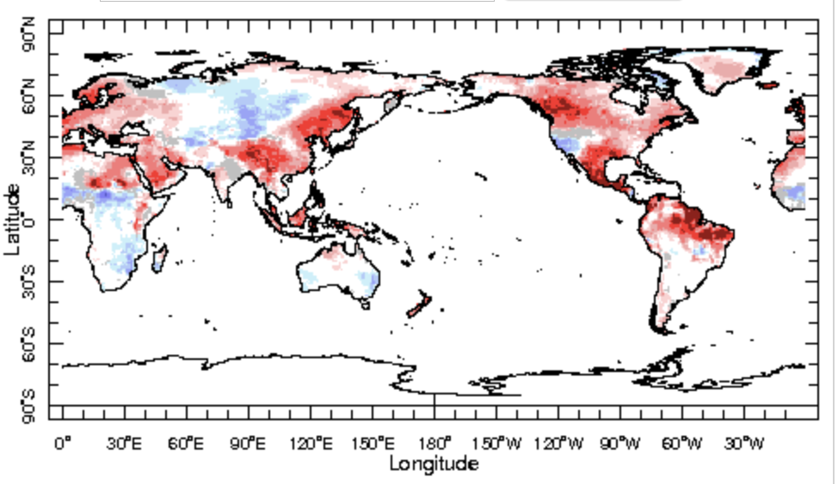
IRI Sub-seasonal Forecast : Near-Surface Temperature (week 2)
Week:2 : ( 24th May.-30 June.)
Forecast issue date: May. 16th
Warm conditions likely over north-east Africa and Arabian peninsula regions
Warm conditions also likely over south east Asia
In Americas, North, central and southeast of south America will likely to remain warm except western United States

Slide 14
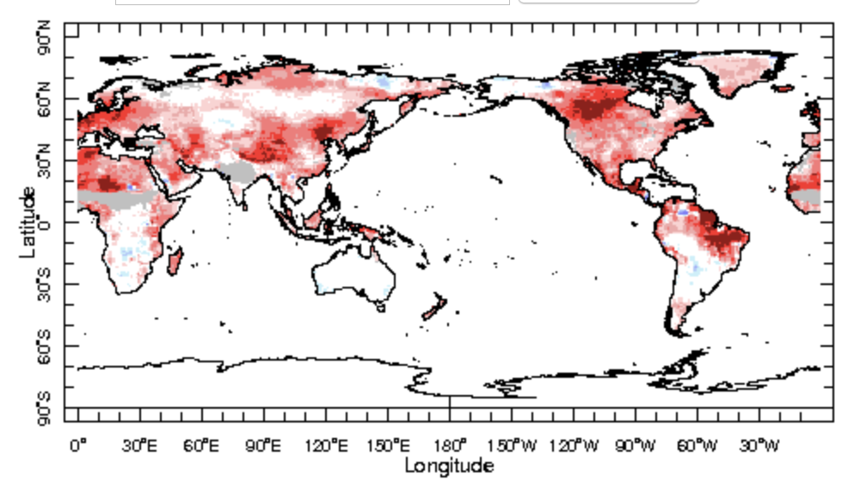
IRI Sub-seasonal Forecast : Near-Surface Temperature (week 3+4)
Week:3-4 : ( 1st July-14th July.)
Forecast issue date: May. 16th
Warm conditions are likely all around the globe except Indian monsoon region and central Africa

Slide 15
Summary
El Niño : getting stronger by episodic forcing from MJO
Currently MJO is in active state, is not likely to be weaken in the Indian Ocean
Indian monsoon is expected to progress northward after delayed monsoon onset due to cyclone “BiparJoy”
Southeast United State, India, western states of Canada and central African regions are likely to be wet in first week of forecast
During week 2, Central Africa, peninsular India and northwest United states are likely to be wet and dry conditions are expected over Maritime continent and central Americas
During weeks 3-4. Maritime continent and central-southern India are likely to get below normal rainfall suggest weak monsoon after delayed monsoon in July .

Slide 16
Thank You!

Slide 17
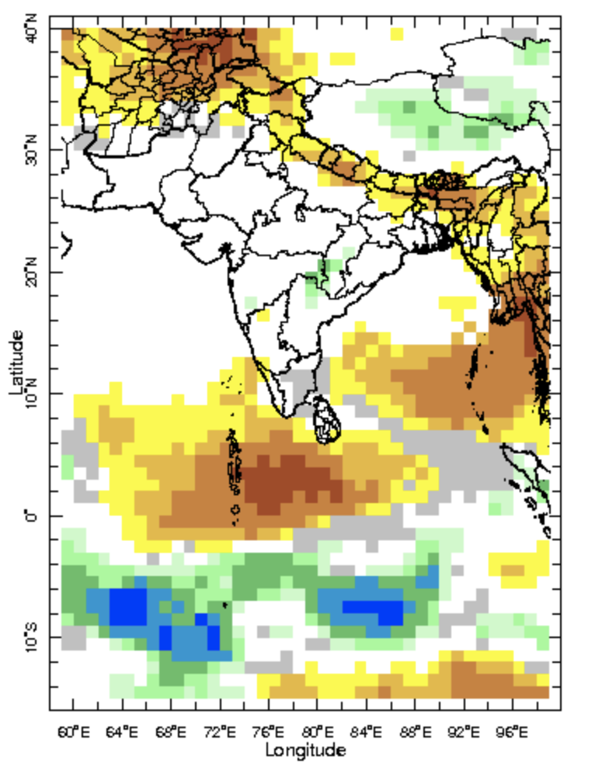
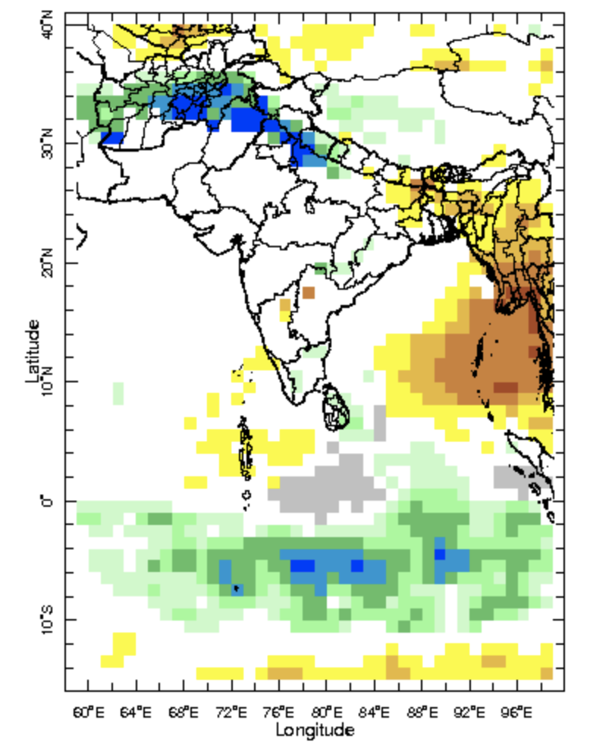
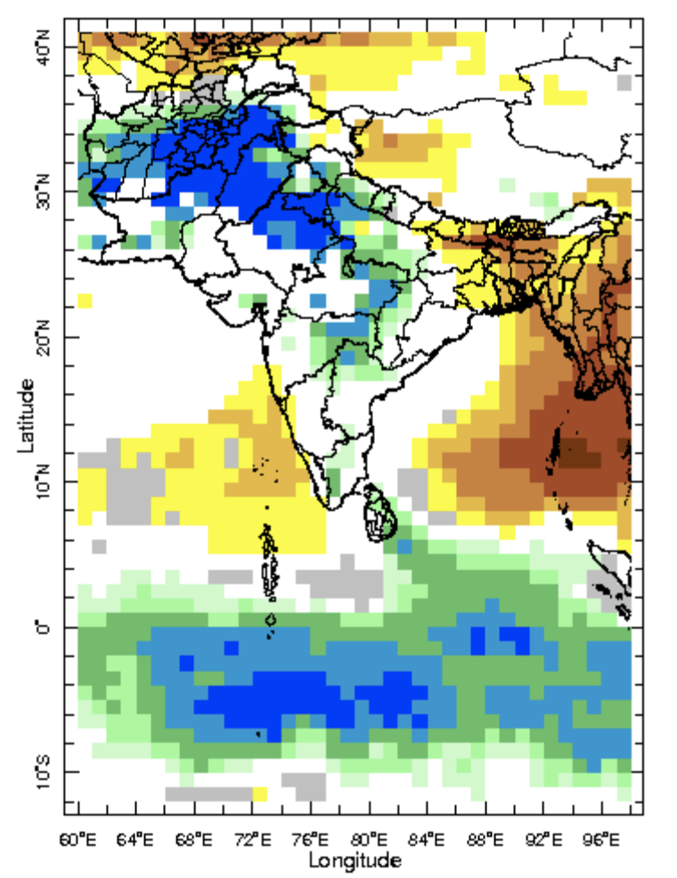
IRI-Sub-seasonal probabilistic rainfall forecast (issue date: Apr. 21st)
Week:1 : ( 22nd -28th Apr.)
Week:2 : ( 29th Apr.-5th May.)
Week:3-4 : ( 6th May.-19th May.)

