Slide 1
IRI Climate Briefing: Jul. 20th, 2023 Sub-seasonal Update
Bohar Singh

Slide 2
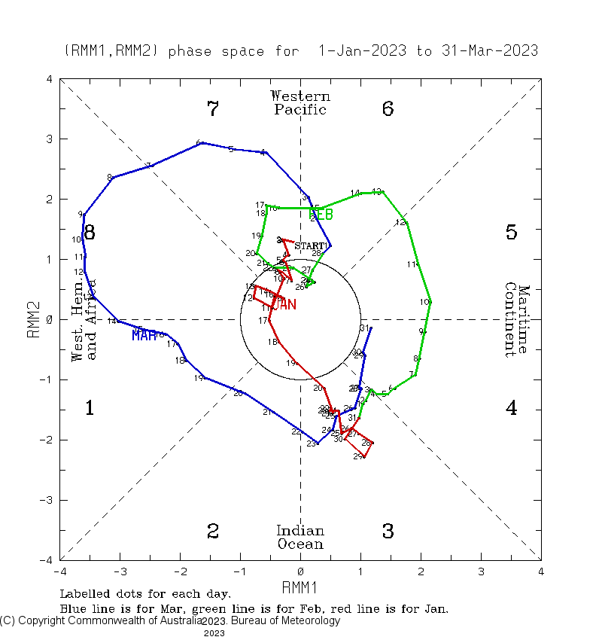
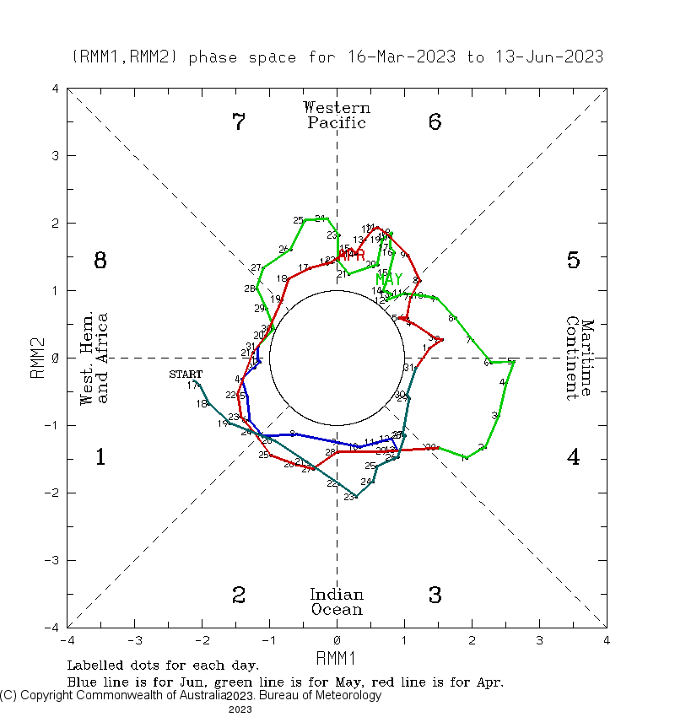
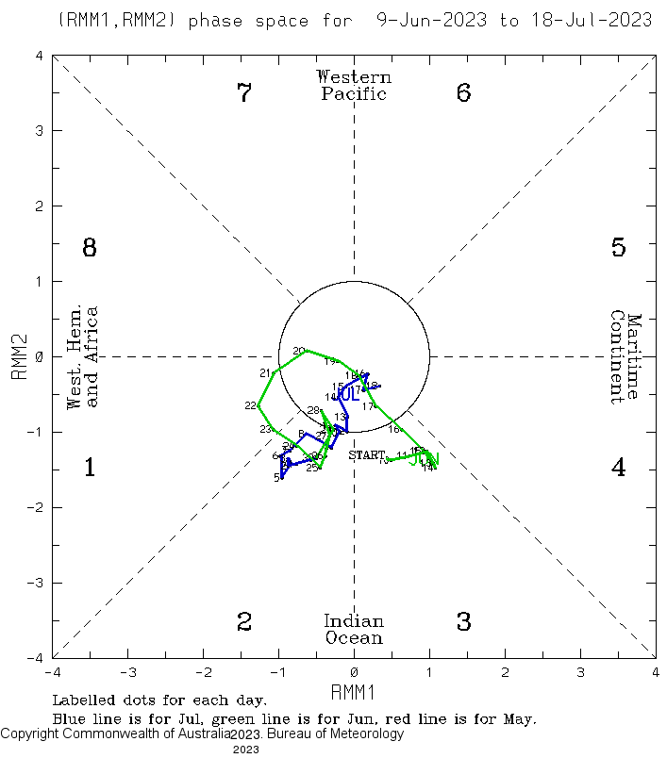
Current and Past evolution of the MJO Wheeler-Hendon Indices
Event 1: 20th Jan. -14th Mar.
These multiple MJO events and subsequent Oceanic Kelvin waves enforcing El Niño to become stronger
Due to northward propagation during summer months, eastward propagation are less frequent
Event 2: 15th Mar. -21st Apr.
Event 3: 22nd Apr. -31th May.
Event 4: 1st Jun. - continue.

Slide 3
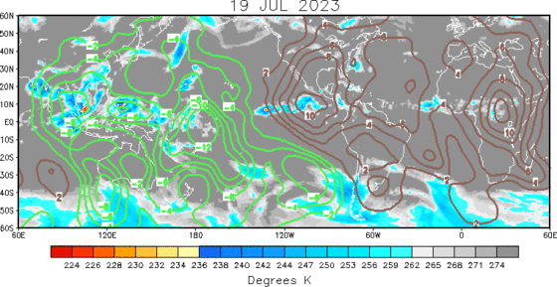
State of the climate: Velocity potential (200hPa)
Velocity potential at 200 hPa shows wave-1 pattern favorable for the enhanced convection over the Maritime Continent

Slide 4
State of the climate: OLR anomalies
Enhanced convection continues along and to the west of the Date Line, while suppressed convection over the Indian Ocean and equatorial Africa.

Slide 5
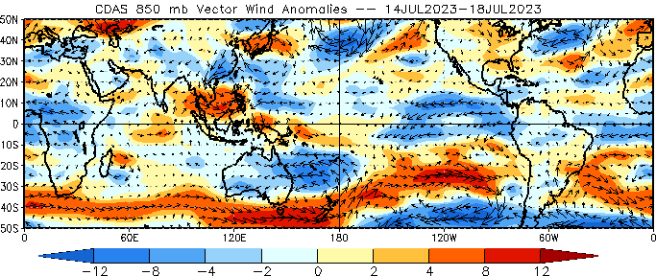
State of the climate: Wind anomalies (850hPa)
Trade winds over the tropical Pacific remained enhanced, although they have significantly weakened near the Date Line due to the presence of weak westerly anomalies.

Slide 6
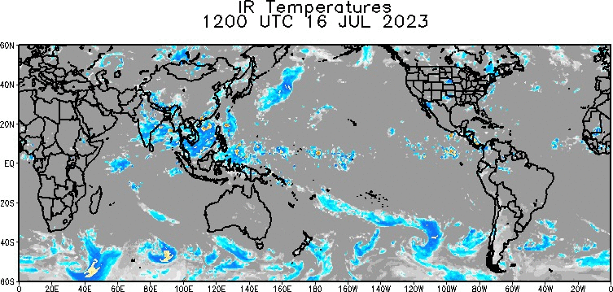
State of the climate :Global IR (16-19 July)
Recent cloudiness is observed over the southeast Asia and western Pacific

Slide 7
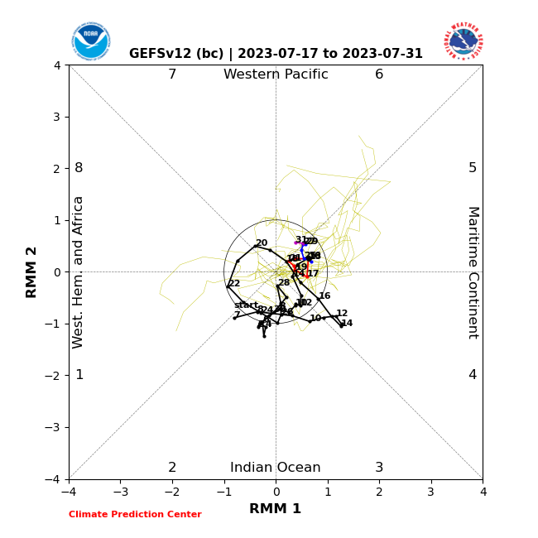
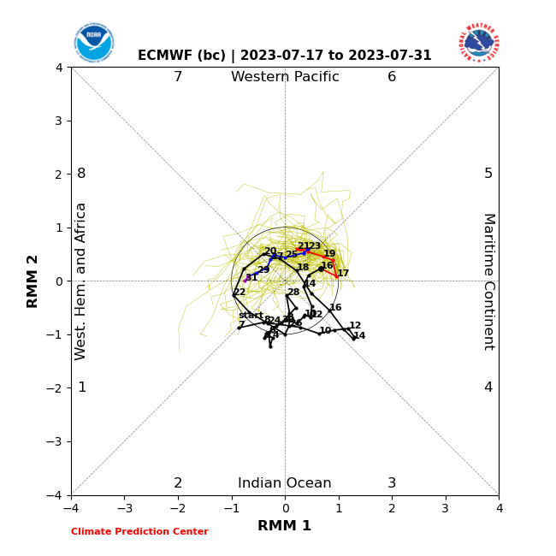
Forecast of MJO: Wheeler-Hendon Indices
MJO 15-day Forecast from NCEP GEFSv12 and ECMWF models
GEFSv12 Forecast
ECMWF Forecast
GEFS and ECMWF both show MJO propagation with an increase signal strength in the week-3 and beyond
Some ensemble members indicating a strong MJO event in early August in western Pacific

Slide 8
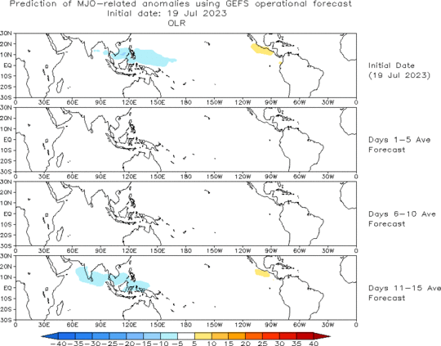
OLR anomalies 15-day Forecast from NCEP GEFS model
The forecast indicates northward propagation initiation between day 11-15 of the forecast

Slide 9
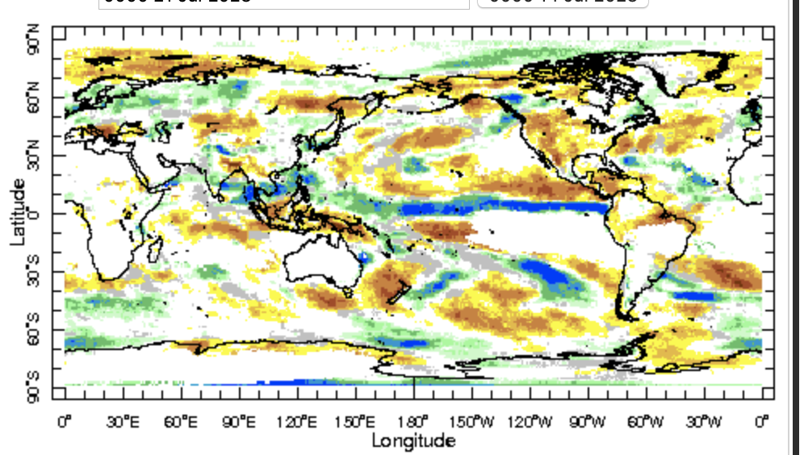
IRI Sub-seasonal Forecast: Precipitation (week 1)
Week:1 : ( 22nd -28th Jul.)
Forecast issue date: Jul. 21st
Wet conditions are likely over southeast Asia, peninsular India, western and eastern Canada
Dry conditions are likely over the United States, central America and eastern south America

Slide 10
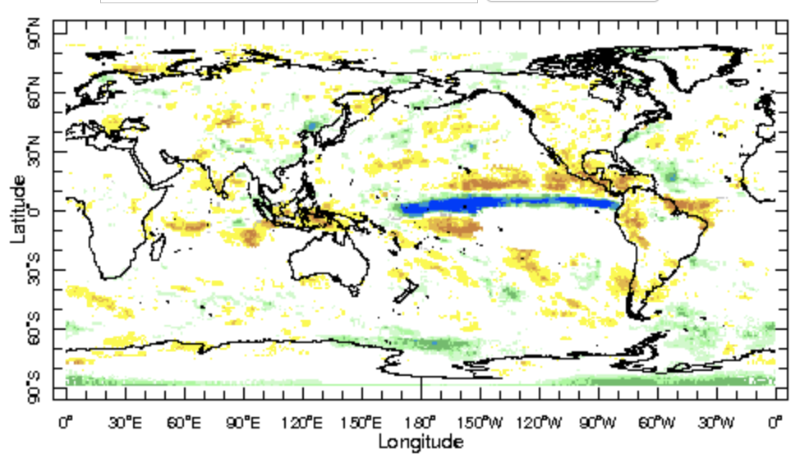
IRI Sub-seasonal Forecast: Precipitation (week 2 )
Week:2 : ( 29th Jul -4 Aug.)
Forecast issue date: Jul. 21st
Below normal rainfall is likely over central America, north America and maritime Continent
Above normal conditions are likely over equatorial Pacific Ocean

Slide 11
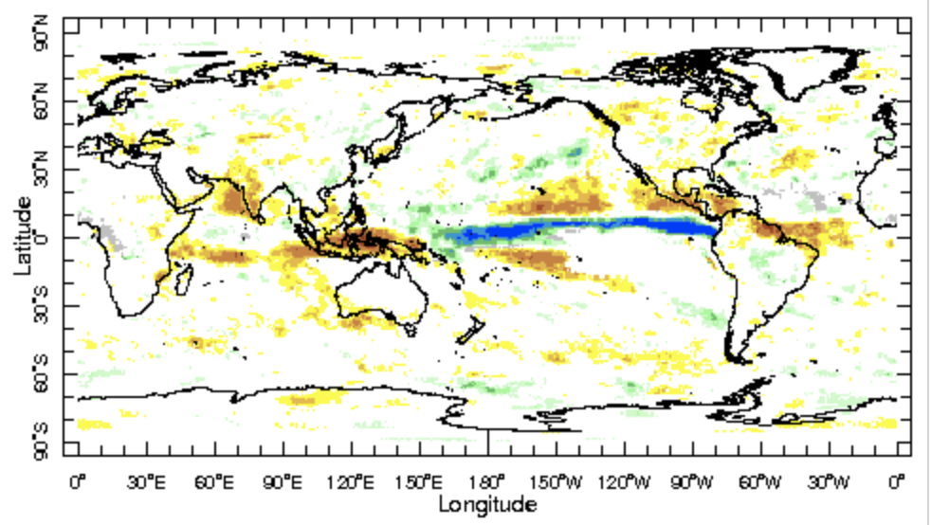
IRI Sub-seasonal Forecast: Precipitation (week 3+4 )
Week:3-4 : ( 5th -18th Aug.)
Forecast issue date: Jul. 21st
The equatorial Pacific is likely get above normal rainfall.
Maritime continent, India and central America are likely to get below normal rainfall

Slide 12
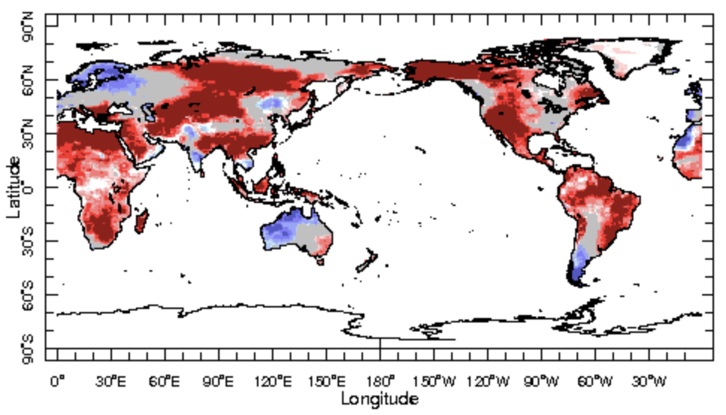
IRI Sub-seasonal Forecast : Near-Surface Temperature (week 1)
Week:1 : ( 22nd -28th Jul.)
Forecast issue date: Jul. 21st
Above normal temperature is likely over Africa, North and South America and Asia
Below normal temperature is likely over western Australia and the southern tip of south America

Slide 13
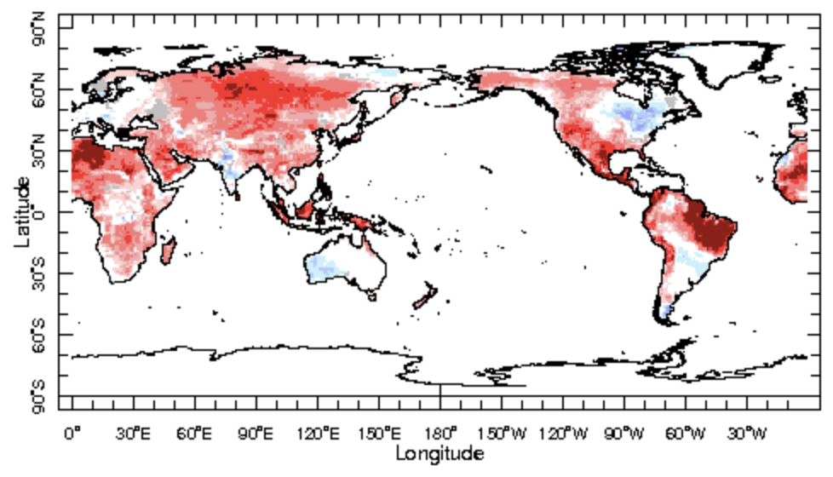
IRI Sub-seasonal Forecast : Near-Surface Temperature (week 2)
Week:2 : ( 29th Jul -4 Aug.)
Forecast issue date: Jul. 21st
Warm conditions are likely over Asia, Africa, Brazil western and southwest United States

Slide 14
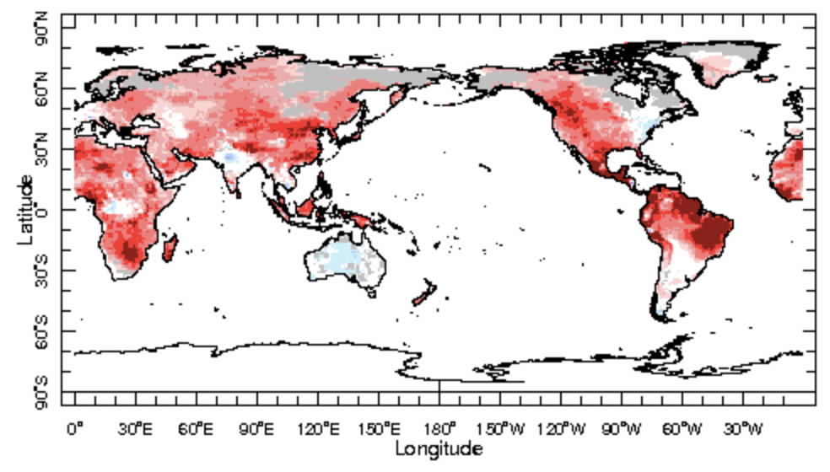
IRI Sub-seasonal Forecast : Near-Surface Temperature (week 3+4)
Week:3-4 : ( 5th -18th Aug.)
Forecast issue date: Jul. 21st
Warm conditions are likely all around the globe except Indian monsoon region, eastern United States and Australia

Slide 15
Summary
Currently MJO is inactive , likely to be active in the west pacific Ocean
Indian monsoon may expected a northward propagation during early August
Rainfall likely to remain below normal over United States during next 4 weeks
Over the land, temperature around the globe likely to be warm expect few places

Slide 16
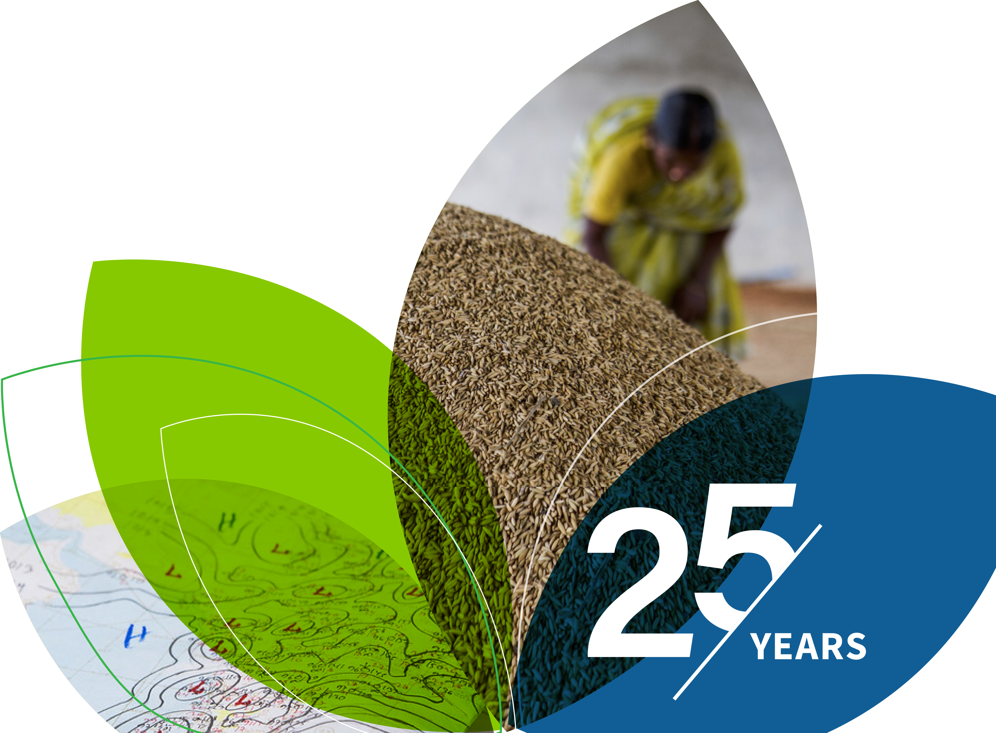
Thank You!

Slide 17
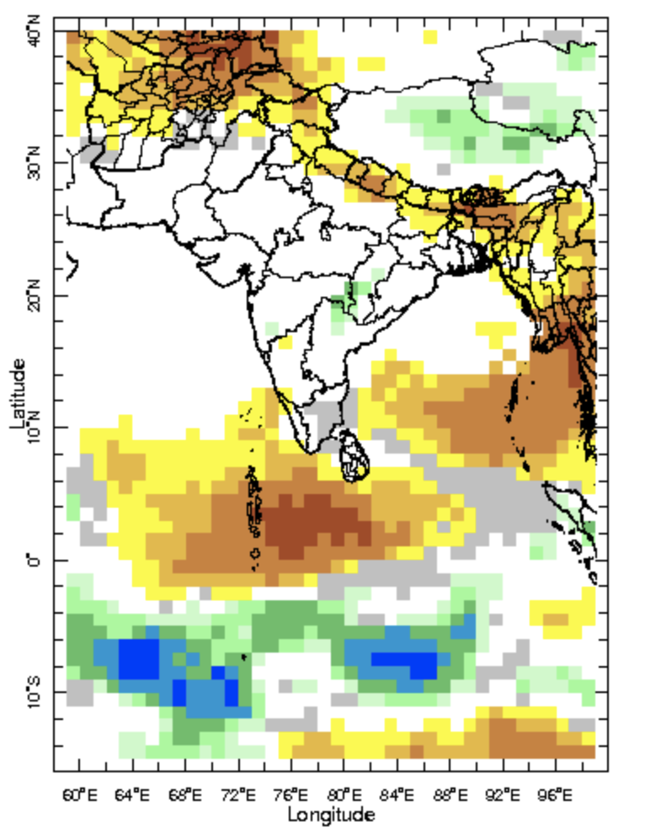
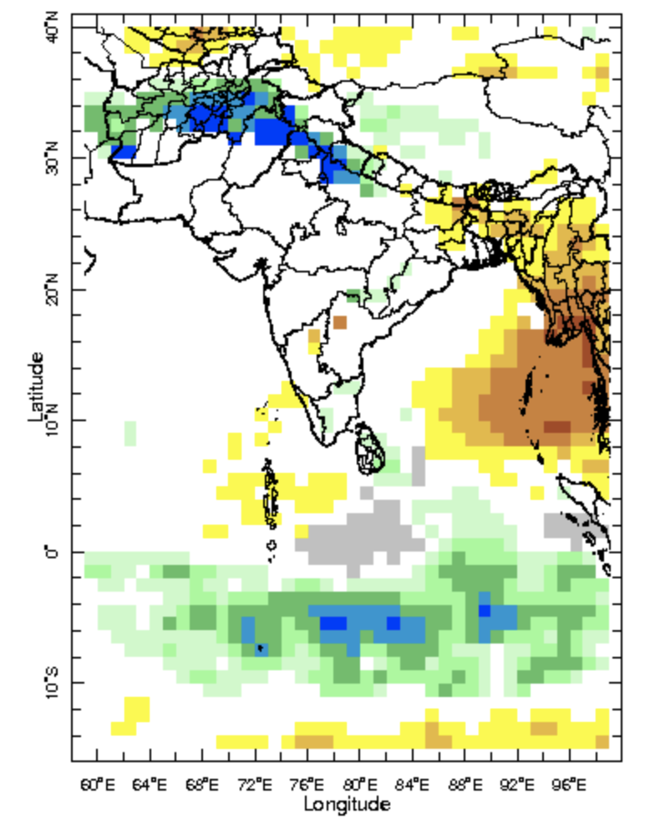
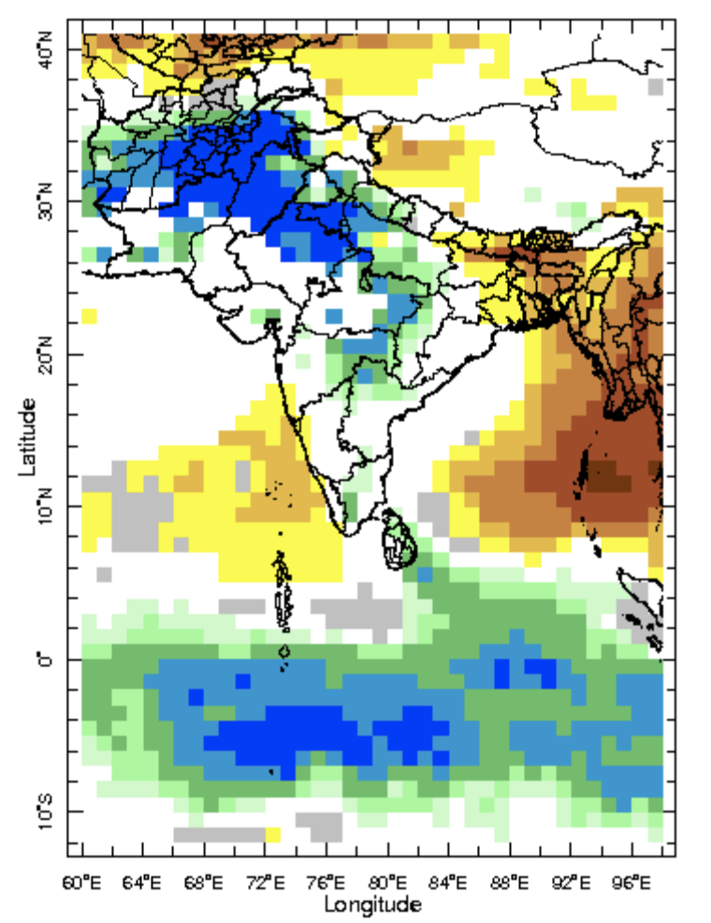
IRI-Sub-seasonal probabilistic rainfall forecast (issue date: Apr. 21st)
Week:1 : ( 22nd -28th Apr.)
Week:2 : ( 29th Apr.-5th May.)
Week:3-4 : ( 6th May.-19th May.)

