Slide 1
IRI Climate Briefing: Nov. 18, 2021
Sub-seasonal Update
Bohar Singh
bohar@iri.Columbia.edu

Slide 2
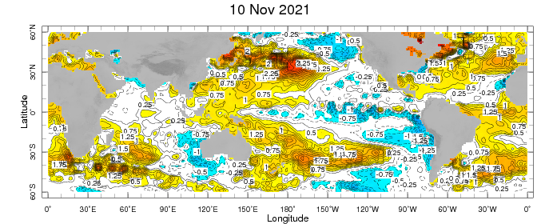
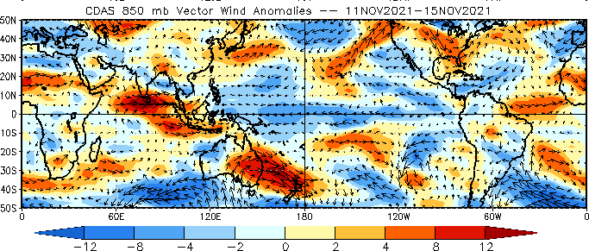
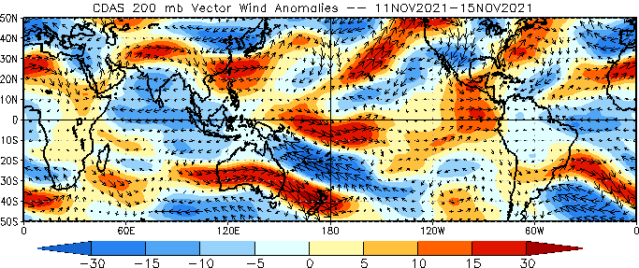
Sub-seasonal climate drivers
Weekly Observed SST anomalies (7-13 November)
SST is warm in the west Pacific Ocean, and Central Pacific cold anomalies crossed the dateline
Upper-level easterlies are strong in the Indian Ocean; at a lower level, the wind is westerlies over the Indian Ocean
The convective envelope is observed over Maritime Continent

Slide 3
Current and Past evolution of the MJO
OLR anomalies, Upper and lower level circulation and SST suggest active MJO over Maritime continent

Slide 4
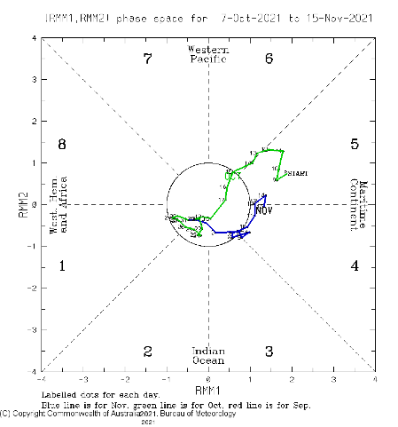
Current and Past evolution of the MJO
Wheeler-Hendon Indices
MJO has been strengthened over the past week
Currently, MJO is active over the Maritime continent
The magnitude of the RMM signal suggests a moderate MJO signal

Slide 5
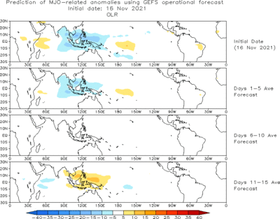
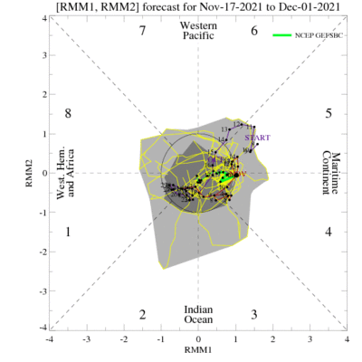
MJO 15-day Forecast from NCEP GEFS model
The ensemble spread of the RMM forecast is very high; most of the ensemble member forecasts are within the unit circle
For the next two weeks, the MJO signal is likely to die without any further eastward propagation

Slide 6
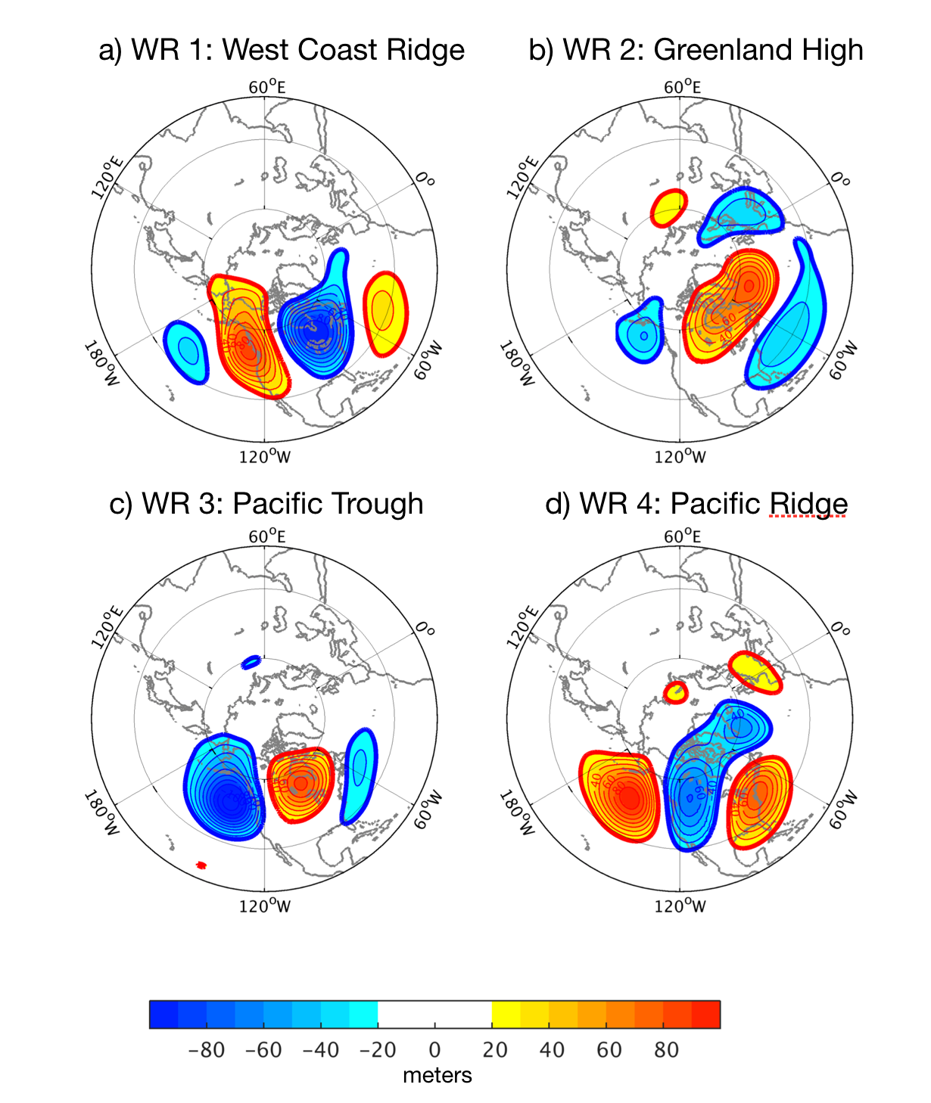
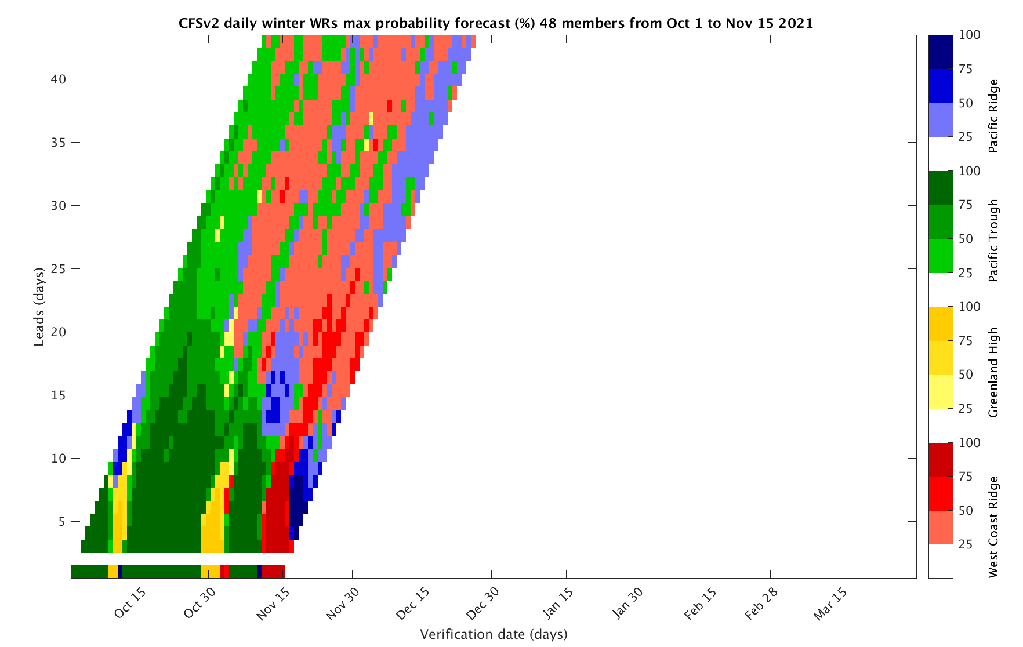
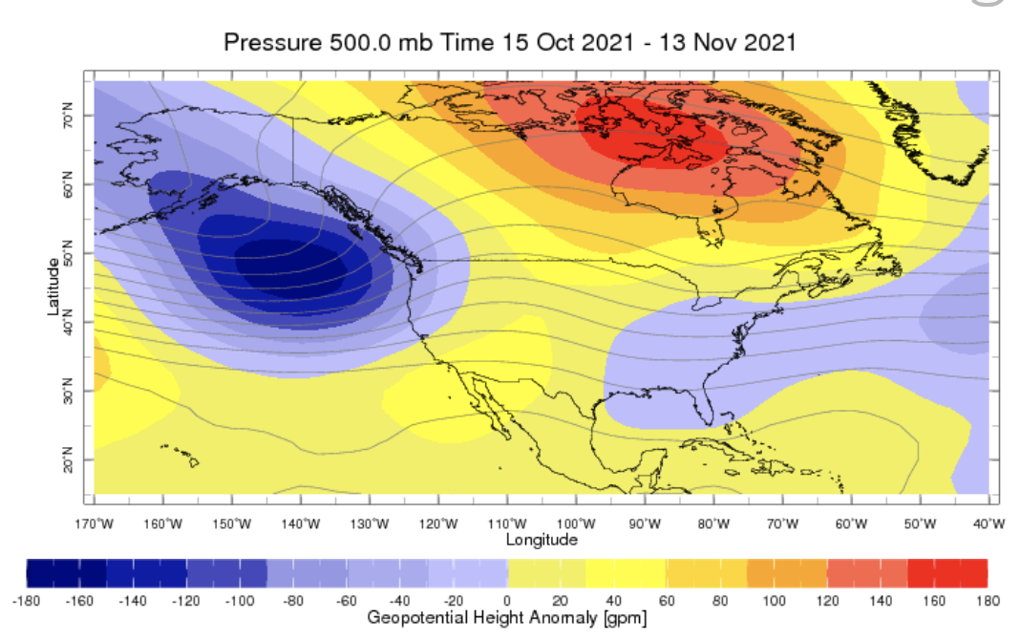
Sub-seasonal Forecast: Weather Regimes
Pacific trough Weather regime is observed
Pacific trough WR is likely be there over next week
Location of WR is conducive for the rainfall and colder weather over Washington state and western Canada
https://wiki.iri.columbia.edu/index.php?n=Climate.S2S-WRs

Slide 7
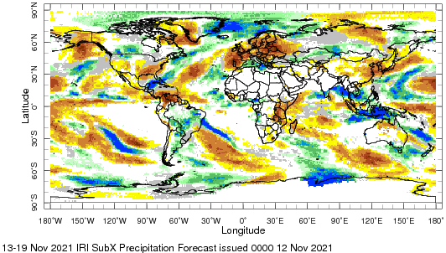
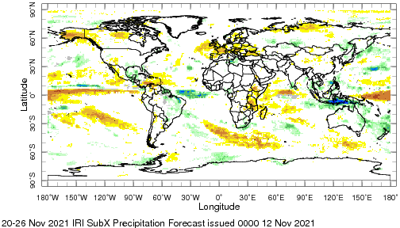

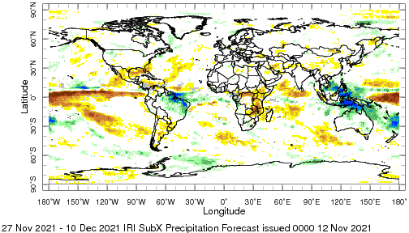
IRI Sub-seasonal Forecast: Precipitation
Week:1: (13-19 Nov).
Forecast issue date Nov 12th
Week:2 (20-26 Nov.)
Week:3+4 (27Nov.-10Dec)
MJO related, above-normal precipitation is likely over
Maritime continent
Precipitation is likely to be above normal over parts of Washington
State and western Canada
For the next two weeks, the weather over Europe is expected to be dry
Amazon likely be continued to receive above-average rainfall
during next month

Slide 8
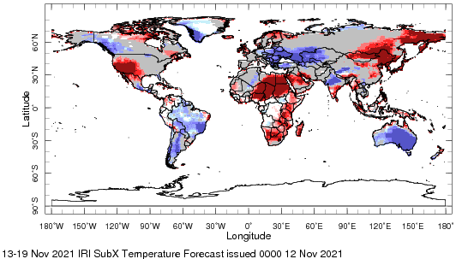
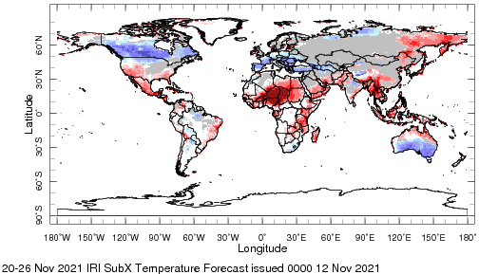

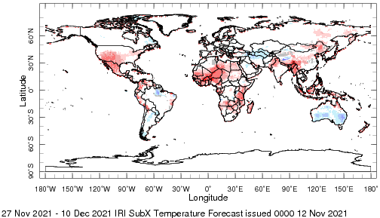
IRI Sub-seasonal Forecast : Near-Surface Temperature
Week:1: (13-19 Nov).
Forecast starting date Nov 12th
Week:2 (20-26 Nov.)
Week:3+4 (27Nov.-10Dec)
Above average temperature is likely over central and east Africa
Below normal temperature is likely over western Canada
Europe is likely to experience cold weather for next two weeks
Above normal temperature over Southwest United States is likely
during next 4 weeks

Slide 9
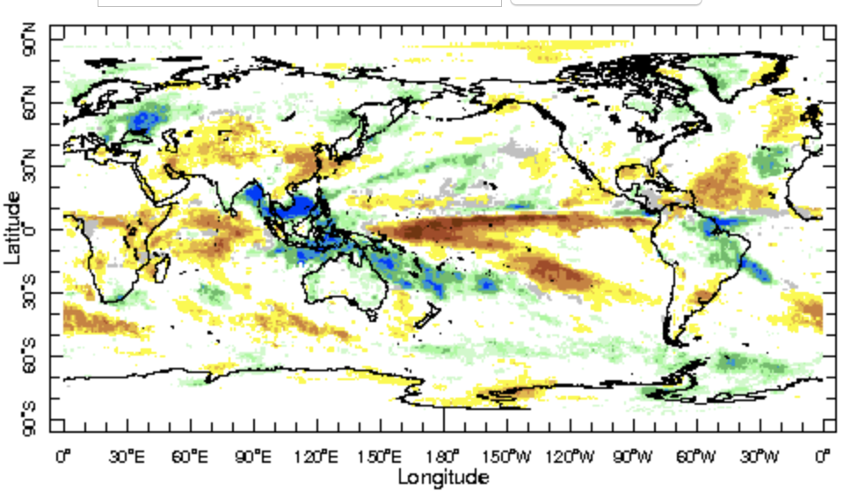
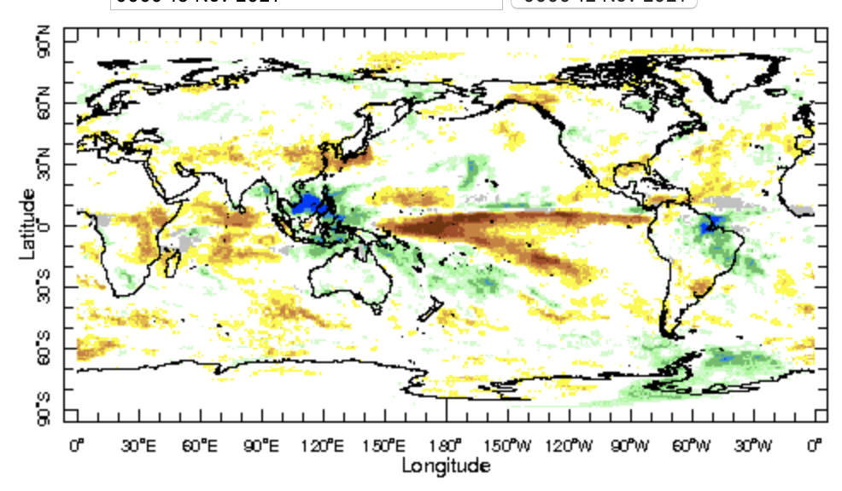
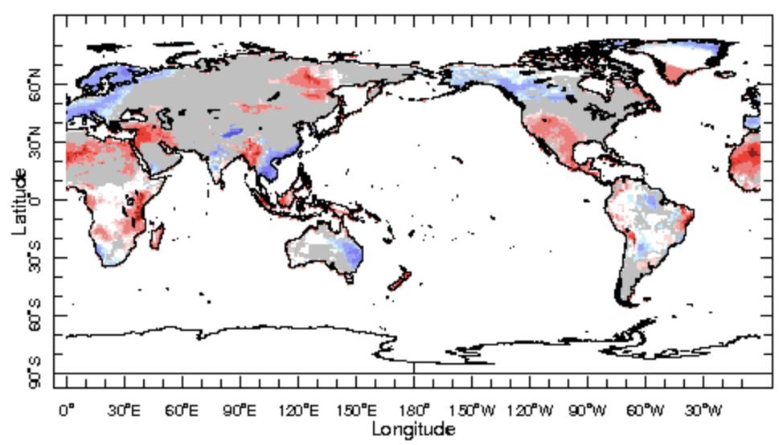
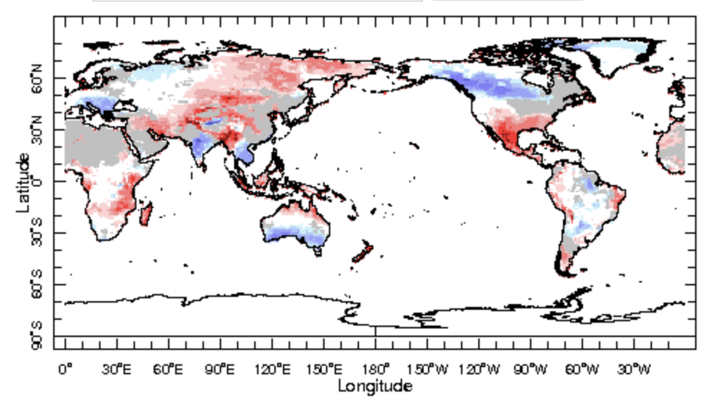
IRI Sub-seasonal Forecast : Updated today
Forecast initialization date Nov 17th
Week 2+3 (27Nov.-10 Dec.)
Week 3+4( 4 Dec.-17 Dec.)

Slide 10
Summary
SST and Circulation over East Pacific consistent with La-Ñina
MJO related convection and circulation have strengthened over the past week and are currently active in phases 4-5 at the Maritime continent
MJO will not be able to move further eastward due to cold SST anomalies in the central west Pacific and is likely to die over the Maritime Continent in the next two weeks
Europe is likely to experience cold and dry weather over the next two weeks
Canada and parts of northwest of the United States is likely to experience wet and cold weather over the next two weeks
Central and East Africa are likely to experience above normal temperature

