Slide 1
IRI Climate Briefing: March. 18, 2022
Sub-seasonal Update
Bohar Singh
Acknowledgement:
Jing Yuan
Dr. Andrew Robertson
Jeff Turmelle
bohar@iri.Columbia.edu

Slide 2
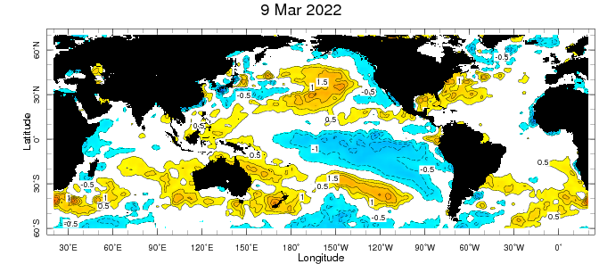
Sub-seasonal climate drivers: State of Climate
Cold anomalies in eastern and central Pacific,
Warm-pool shrunk to the west
SST anomalies in tropical Indian and Atlantic Ocean are near zero

Slide 3
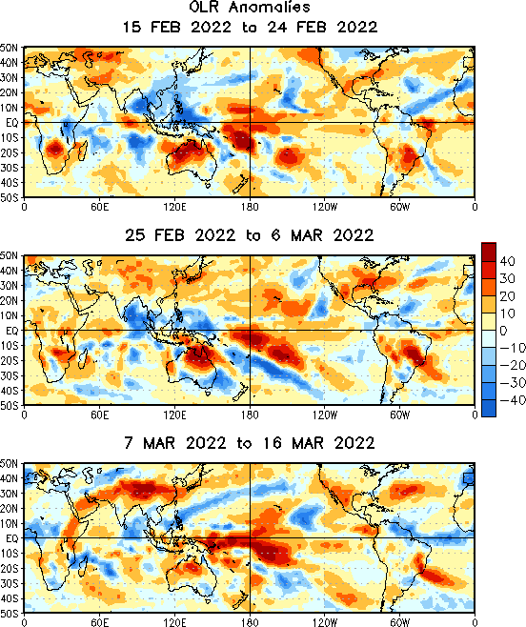
State of the climate: OLR Anomalies
Clear-sky over Eastern-to-central Pacific.
Cloudiness at north of maritime continent.
Clear sky is well west of date-line.
Clear sky over western and southern CONUS.
More north-westward shift in cloudiness.
Clear sky over CONUS spread northward
except costal states of north-western.
More north-westward shift in cloudiness.
Clear sky over CONUS spread northward
except costal states of north-western.

Slide 4
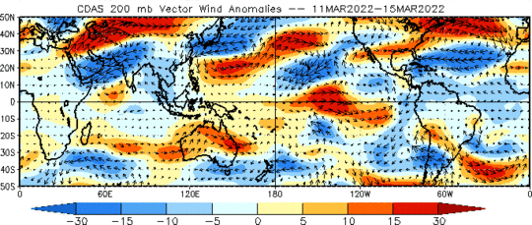
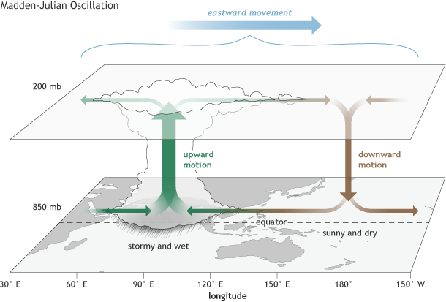
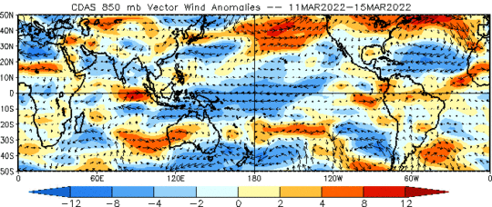
Sub-seasonal climate drivers
Upper level
Upper-level divergence in the Indian and west Pacific Ocean;
At lower level, the winds are
easterlies in the central and east Pacific Ocean and westerlies in Indian Ocean
Lower level

Slide 5
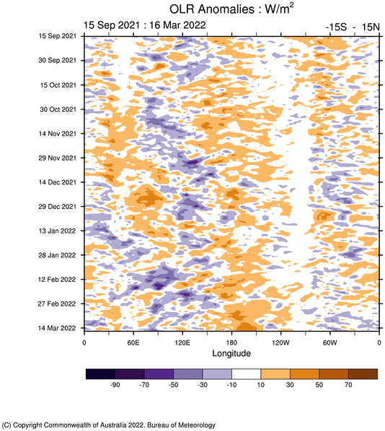
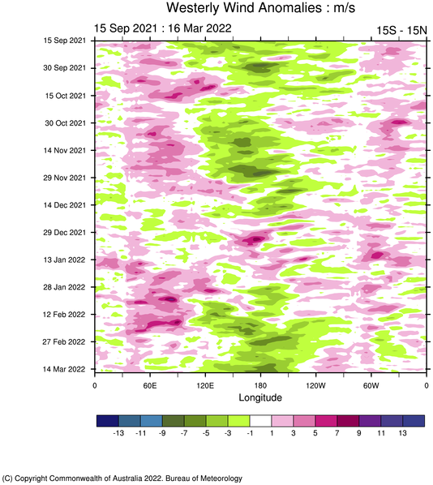
Current and Past evolution of the MJO
Circulation suggest active state of MJO, while cloudiness not

Slide 6
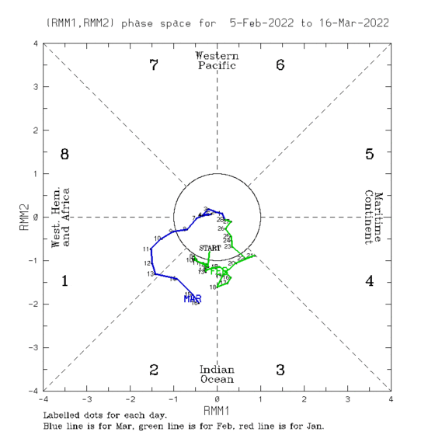
Current and Past evolution of the MJO
Wheeler-Hendon Indices
MJO has been emerging from past week
Currently, MJO is active in phase 2
RMM index is moderately strong

Slide 7
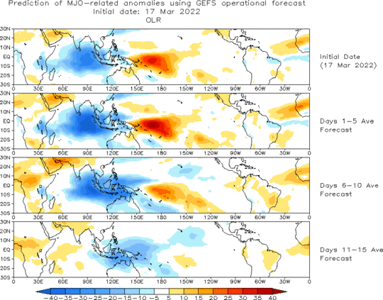
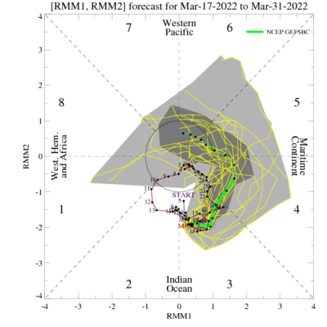
MJO 15-day Forecast from NCEP GEFS model
The ensemble mean RMM forecast suggest propagation of MJO in phase 4 and 5
For the next two weeks, the MJO signal is likely be active

Slide 8
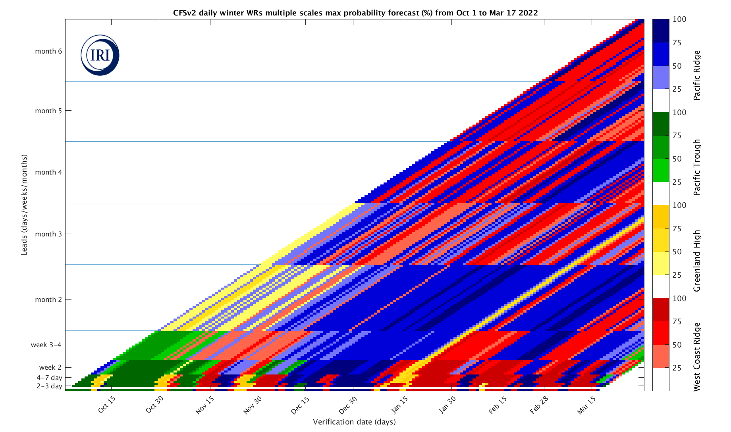
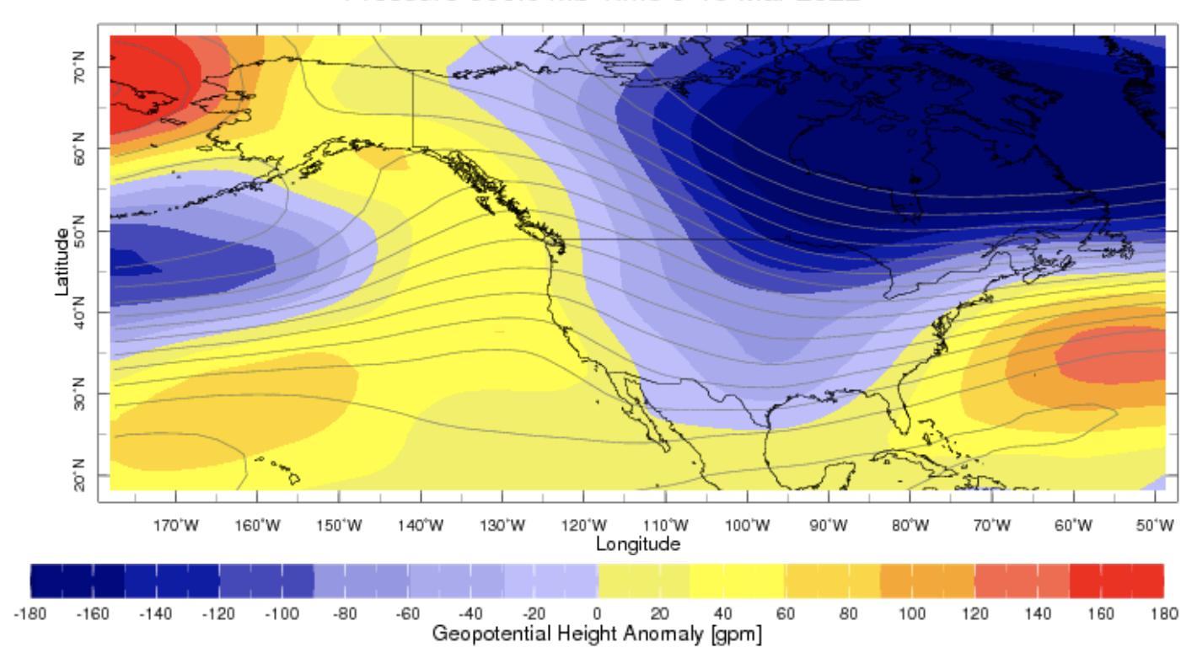
Sub-seasonal Forecast: Weather Regimes
9-15 March
West coast ridge is very week seems it is transitioning into another type

Slide 9
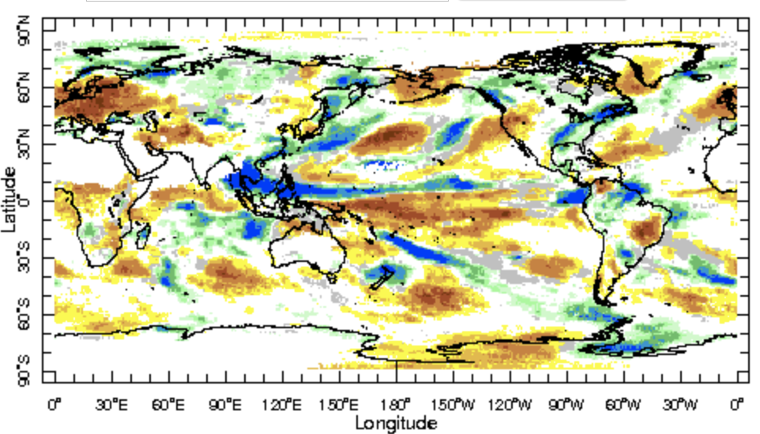
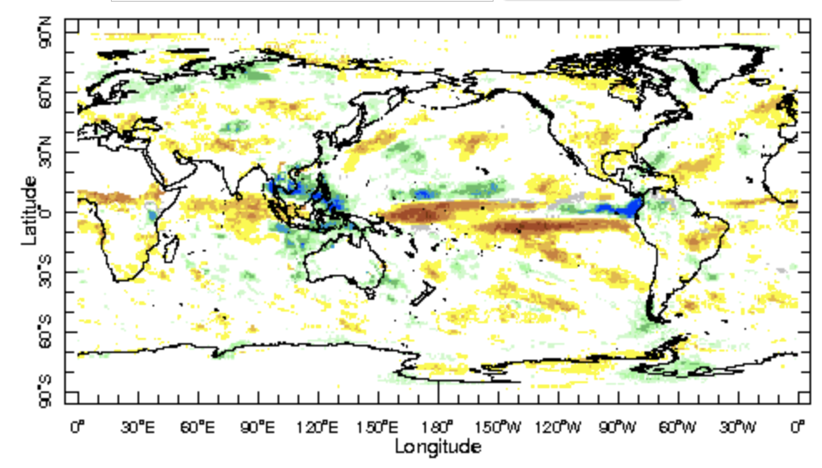
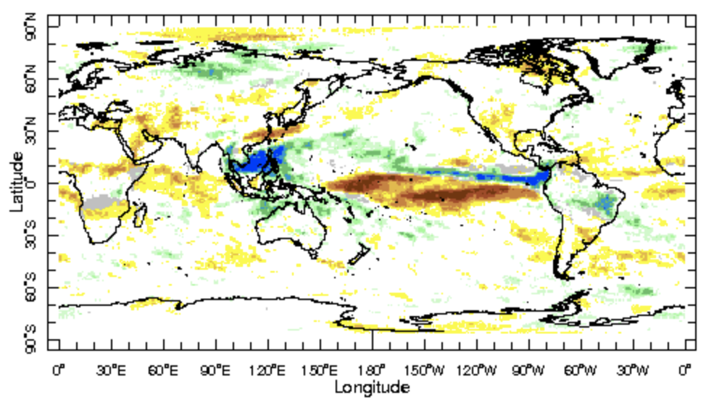
IRI Sub-seasonal Forecast: Precipitation
Week:1: (19-25 Mar).
Forecast issue date Mar 18th
Week:2 (26 Mar-1 Apr.)
Week:3+4 (2 Apr.-15 Apr.)
North-eastward propagation of OLR anomalies in
West Pacific is likely
West Africa is likely dry in next month’s forecast
Above normal precipitation is likely north of Maritime
continent in week 3+4, Dry rainfall anomalies are
likely over WUS

Slide 10
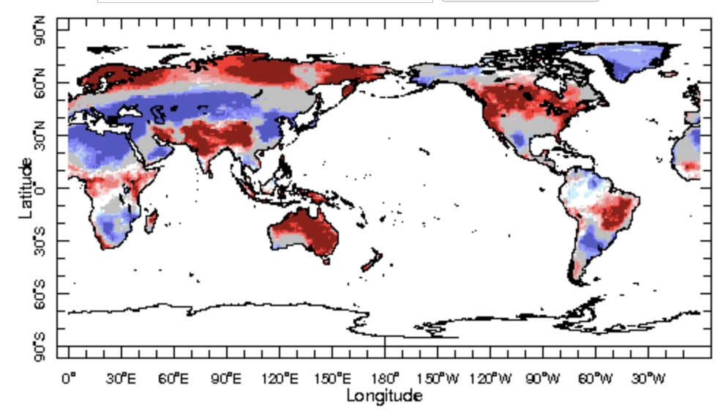
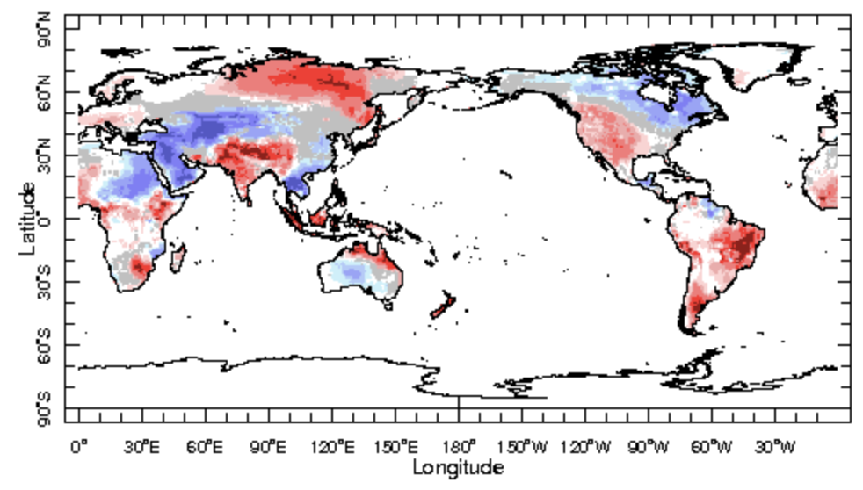
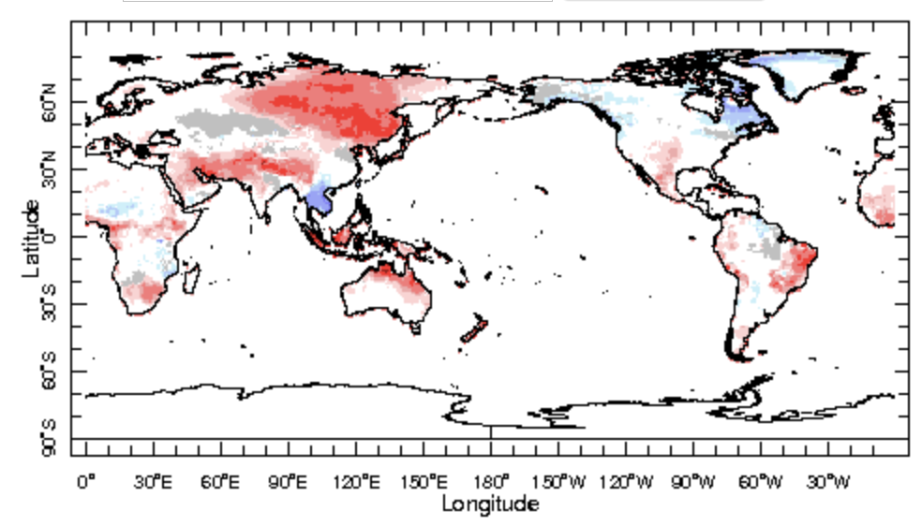
IRI Sub-seasonal Forecast : Near-Surface Temperature
Week:1: (19-25 Mar).
Forecast issued on Mar 18th
Week:2 (26 Mar-1 Apr.)
Week:3+4 (2 Apr.-15 Apr.)
Above normal temperature is likely over northwest United States over the next week and below normal next week
Above normal average temperature is likely South Asia

Slide 11
Summary
SST and Circulation over East Pacific consistent with La-Ñina
MJO related convection and circulation are currently active
MJO likely to be in north-west Pacific in the next two weeks
Northwest of the United States and northern Canada is likely to experience dry and warm weather over the next two weeks.
South Asia likely to get above normal temperature from week 1-2 and week 3-4

