Slide 1
IRI Climate Briefing: June. 16, 2022
Sub-seasonal Update
Bohar Singh
Acknowledgement:
Jing Yuan
Dr. Andrew Robertson
Jeff Turmelle
bohar@iri.Columbia.edu

Slide 2
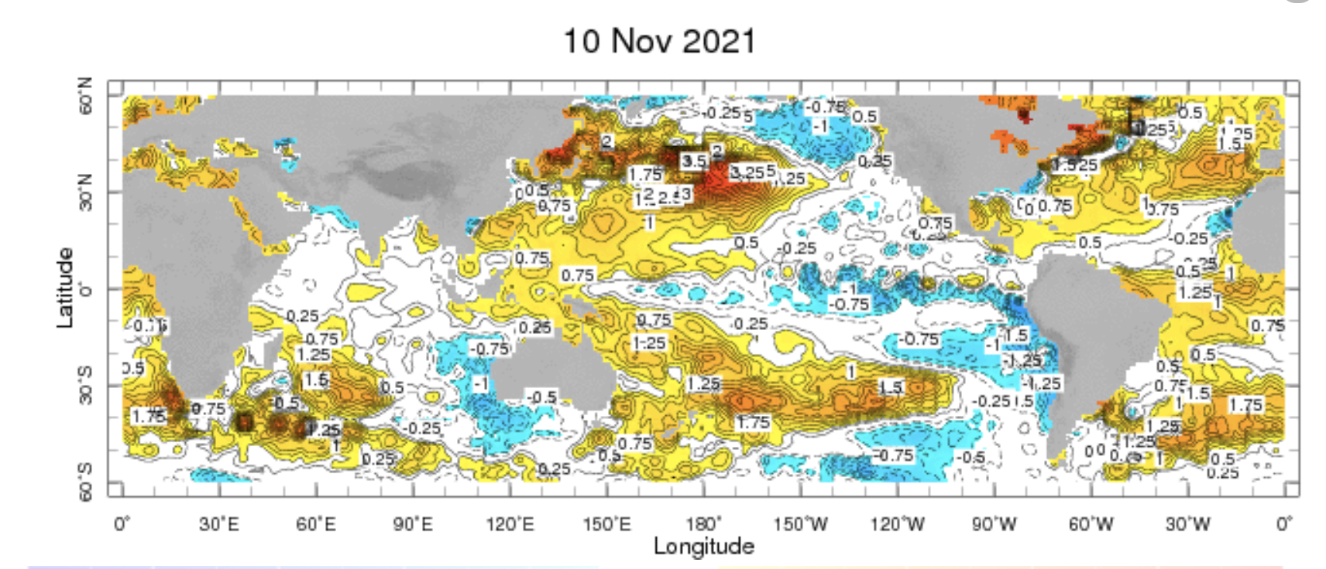
Sub-seasonal climate drivers: State of Climate
(7-13 jun.)
Cold anomalies in eastern and central Pacific are weaker
Warm-pool and sub-tropical pacific are warm
SST anomalies in Atlantic Ocean are also stronger

Slide 3
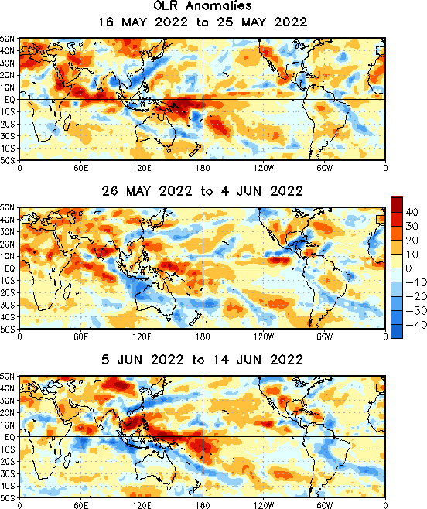
State of the climate: OLR Anomalies

Slide 4
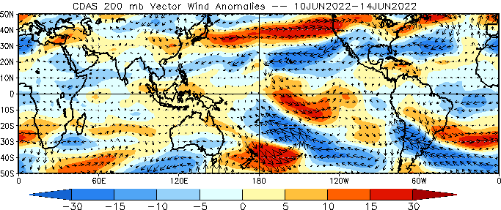
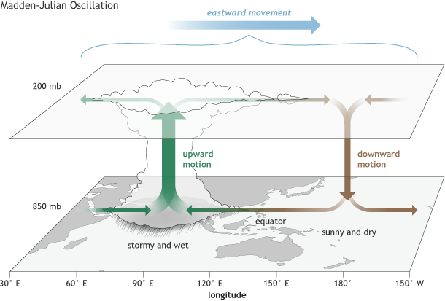
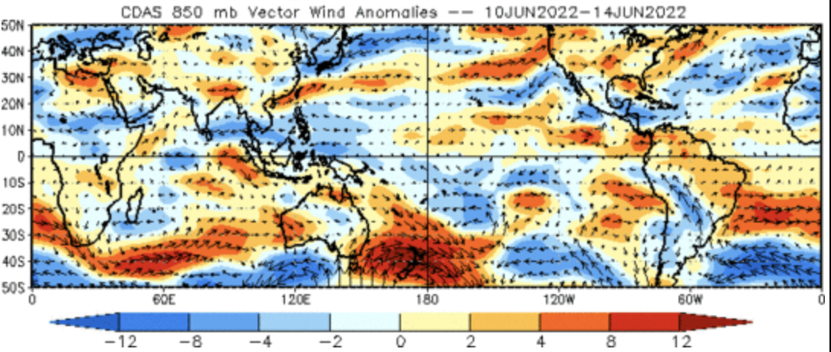
Sub-seasonal climate drivers
Upper level
No upper-level divergence in the Indian and west Pacific Ocean indicating inactive MJO
Lower level

Slide 5
Current and Past evolution of the MJO
Circulation and cloudiness suggest less coherent organized convection

Slide 6
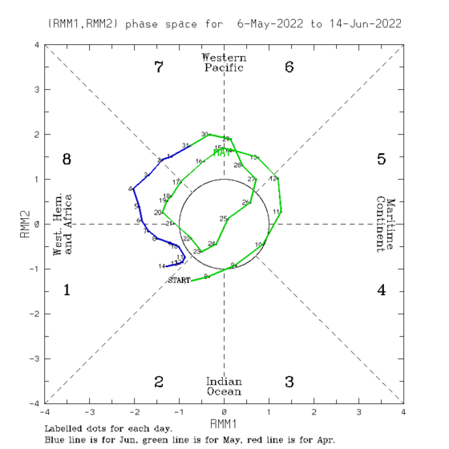
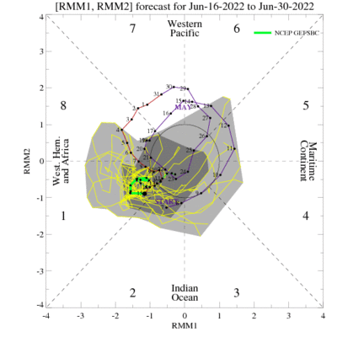
Current and Past evolution of the MJO
Wheeler-Hendon Indices
MJO 15-day Forecast from NCEP GEFS model
MJO index in moderately above 1 from past week

Slide 7
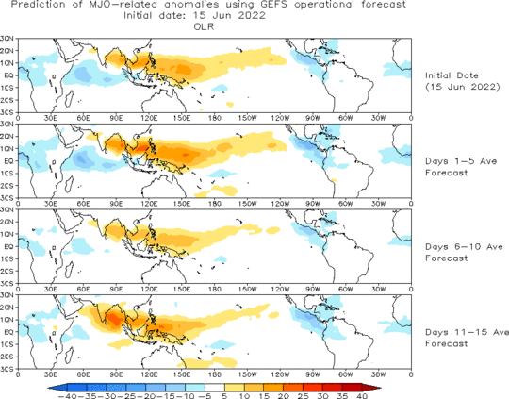
MJO 15-day Forecast from NCEP GEFS model
The GEFS forecast suggest weakening of MJO in phase 1 For the next weeks.

Slide 8
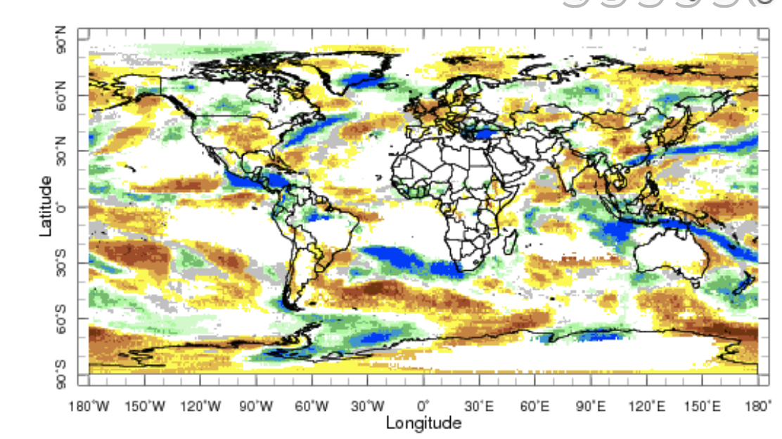
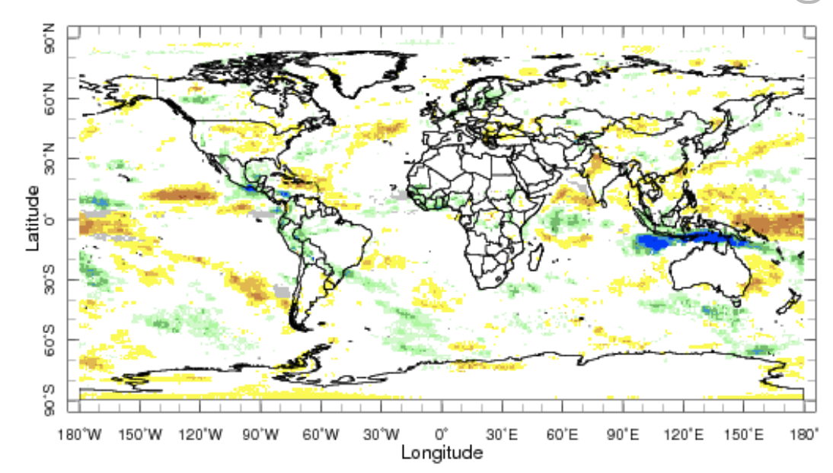
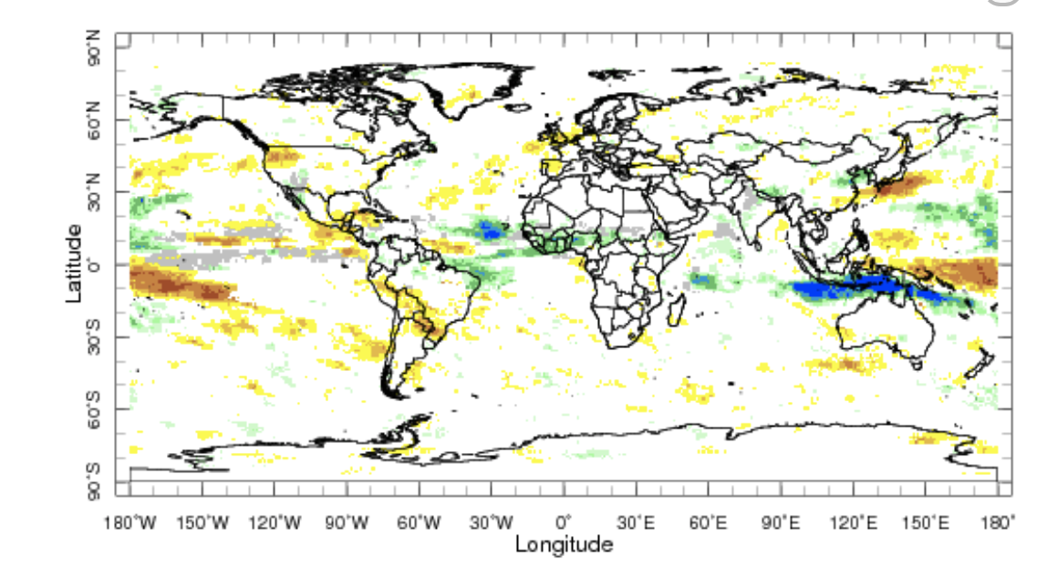
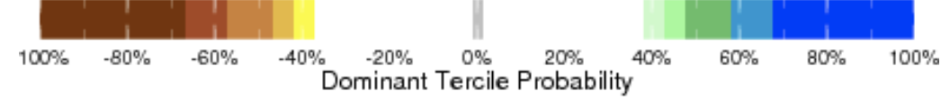
IRI Sub-seasonal Forecast: Precipitation
Week:1: (11-17 Jun.).
Forecast issue date Jun 10th
Week:2 (18 -24 Jun.)
Central and eastern USA is likely to get below normal
rainfall in next two weeks
Above normal precipitation is likely south of Maritime
continent in week 2 and week 3+4,
West African monsoon region is likely to get above normal
rainfall during rest of Jun and early july
Dry rainfall anomalies are likely over WUS weeks 2 and
weeks 3+4
Week:3+4 (25 Jun.-8 Jul.)

Slide 9
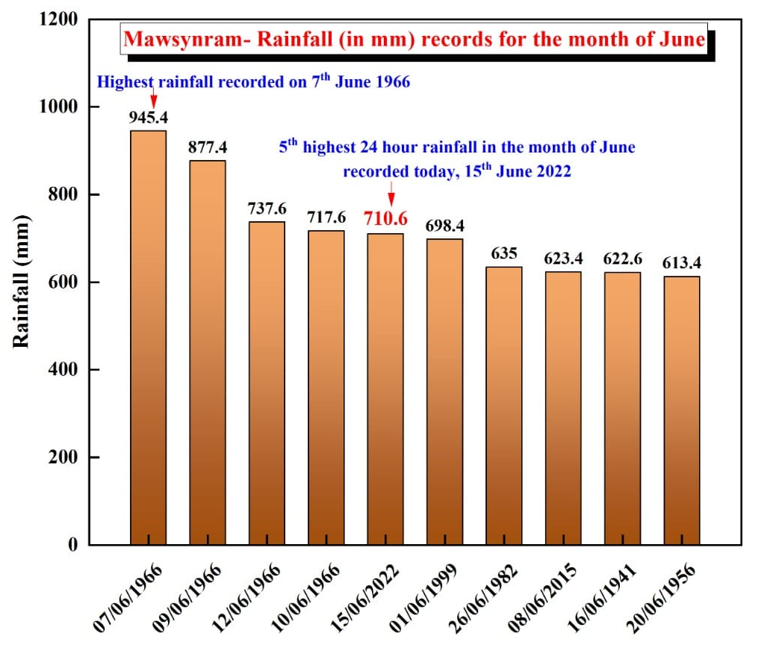
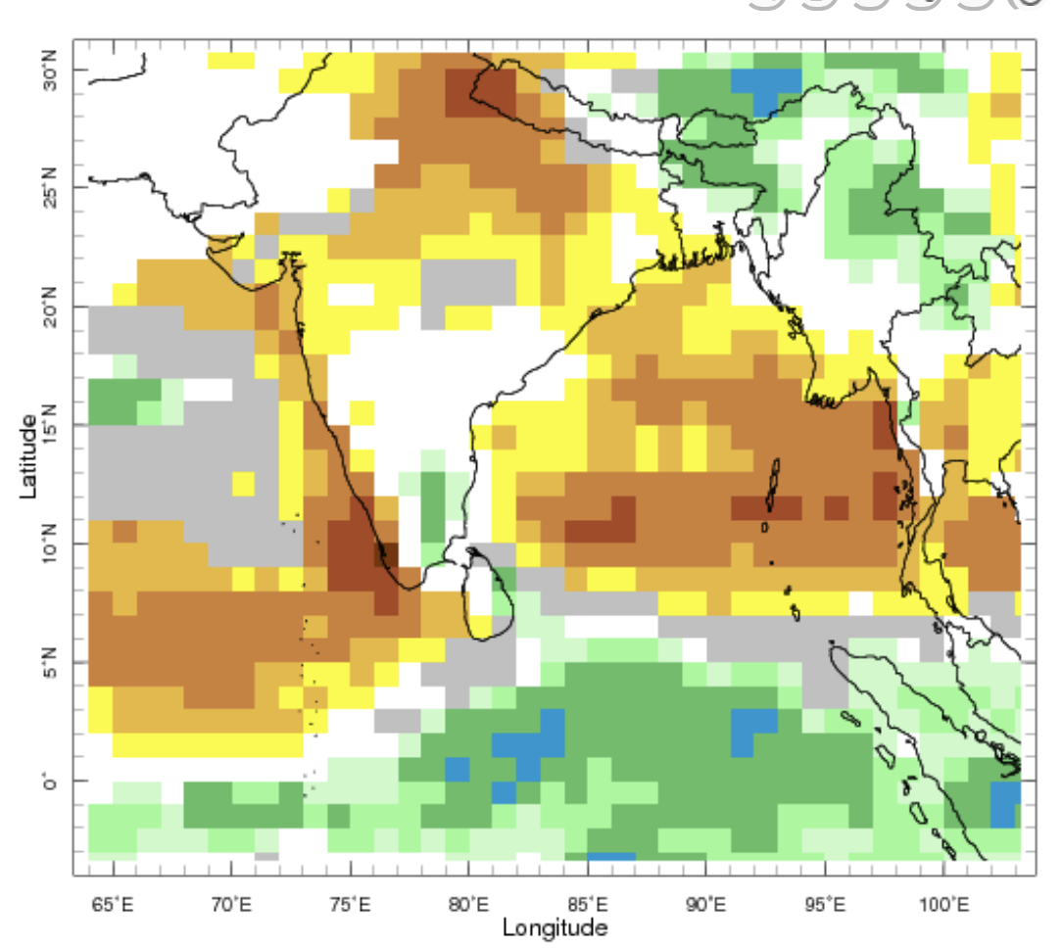
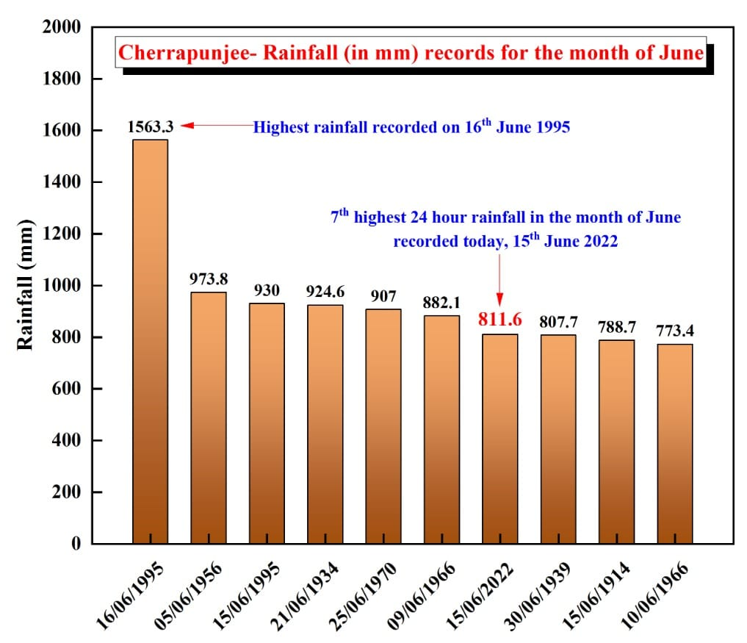
IRI Sub-seasonal Forecast: Precipitation
Week:1: (11-17 Jun.).
Forecast issue date Jun 10th

Slide 10
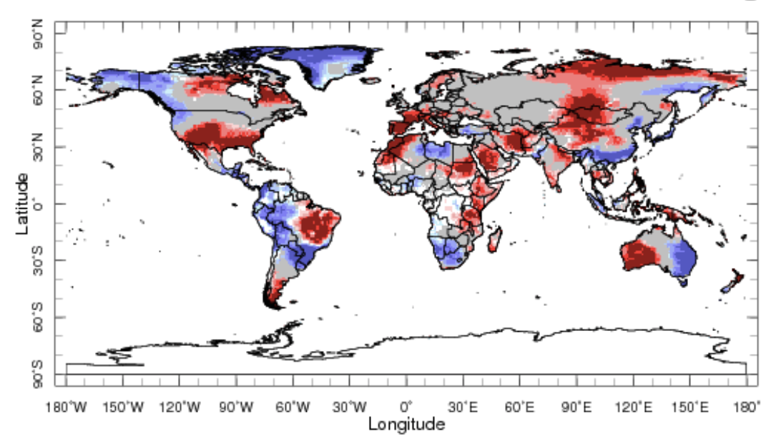
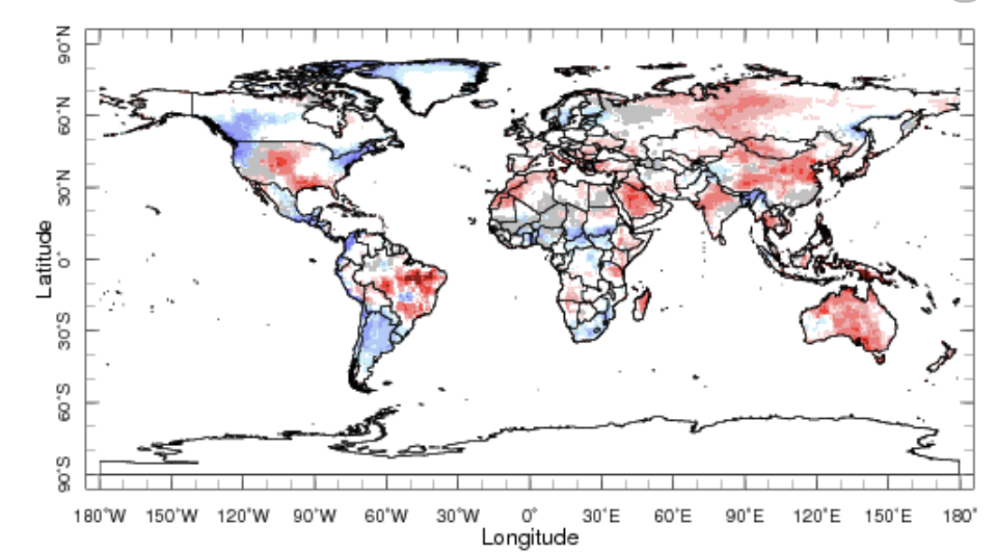
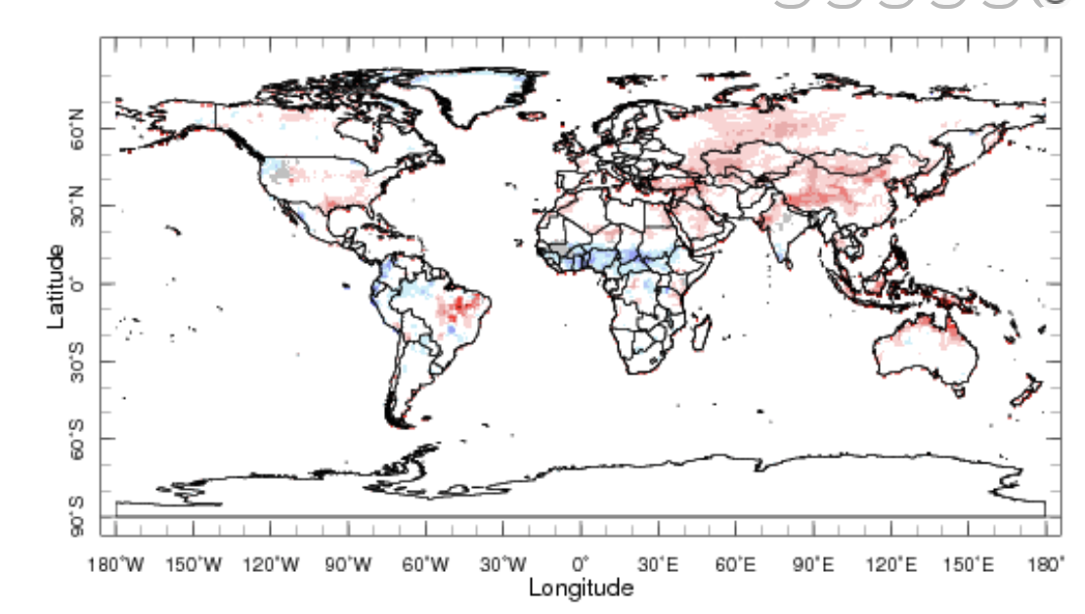
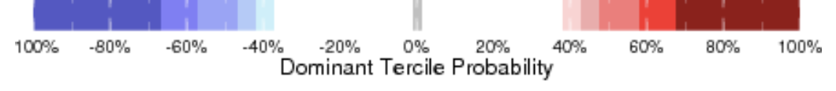
IRI Sub-seasonal Forecast : Near-Surface Temperature
Week:1: (11-17 Jun.).
Forecast issue date Jun 10th
Week:2 (18 -24 Jun.)
Above normal temperature is likely over southern states of USA during week 1.
Above normal average temperature is likely over China and north during next 4 weeks
Temperature over greater horn Africa is expected to be above normal for next two weeks
Below normal temperature is likely over West African monsoon region over next four weeks
Week:3+4 (25 Jun.-8 Jul.)

Slide 11
Summary
MJO related convection and circulation are currently active most likely to be in-active during next two weeks.
Central and eastern USA is likely to get below normal rainfall in next two weeks
West African monsoon region is likely to get above normal rainfall during rest of Jun and early July
Northwest of the United States and northern Canada is likely to experience cold weather over the next two week.
South-East Asia likely to experience above normal temperature from week 1-2 and week 3-4.
South-western United States likely experience above normal near surface temperature next few weeks.

