Slide 1
IRI Climate Briefing: Jul. 21, 2022
Sub-seasonal Update
Bohar Singh
Acknowledgement:
Jing Yuan
Dr. Andrew Robertson
Jeff Turmelle
bohar@iri.Columbia.edu

Slide 2
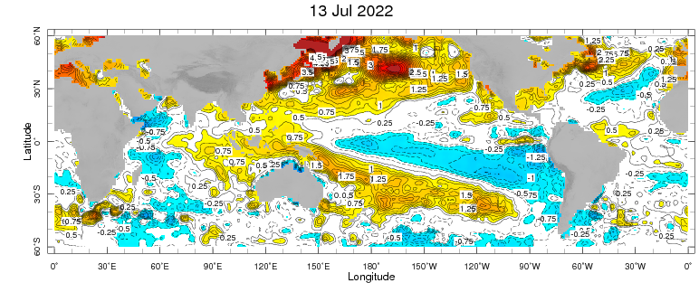
Sub-seasonal climate drivers: State of Climate
(10-16 July)
Cold anomalies in eastern and central Pacific
Warm sub-tropical pacific, SST anomalies in North Atlantic Ocean are also stronger
La-niña like condition are observed and,
The Indian Ocean Dipole (IOD) index has been very close to or exceeded negative IOD
thresholds (i.e. at or below −0.4 °C) over the past six weeks

Slide 3
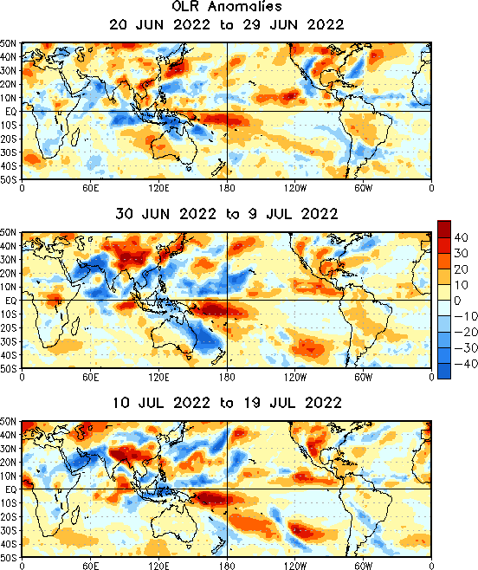
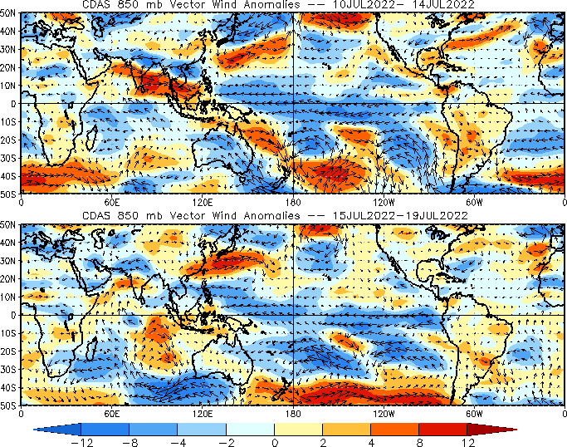
State of the climate: OLR Anomalies

Slide 4
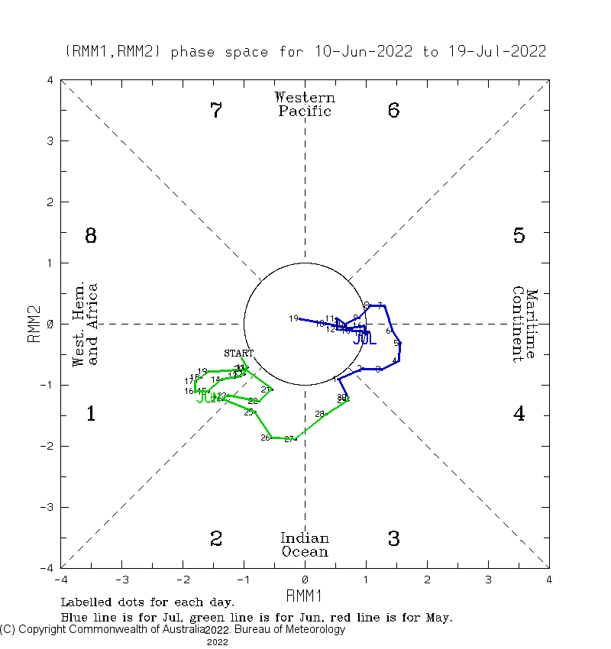
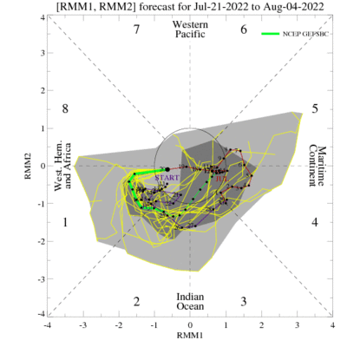
Current and Past evolution of the MJO Wheeler-Hendon Indices
MJO 15-day Forecast from NCEP GEFS model
MJO index in moderately above 1 from past week

Slide 5
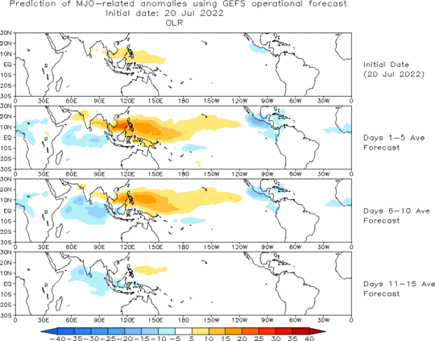
MJO 15-day Forecast from NCEP GEFS model
The GEFS forecast suggest weakening of MJO in phase 2 For the next weeks.

Slide 6
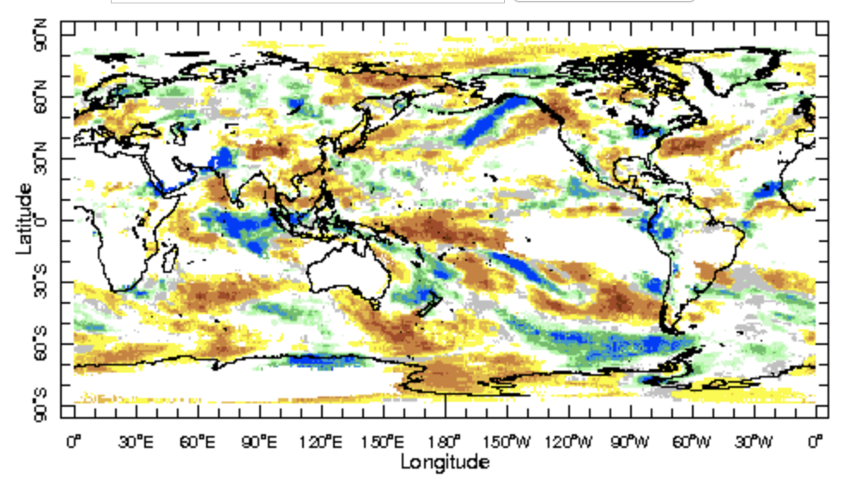
IRI Sub-seasonal Forecast: Precipitation (week 1)
Week:1: (23- 29. Jul.).
Forecast start date Jul 22nd
Above normal rainfall is likely over north-west of India and central Indian ocean
Above normal precipitation is likely South America’s Peru, Columbia, Ecuador and Chile
Senegal and Mauritania in West African monsoon region is likely to get above normal
rainfall
Dry rainfall anomalies are likely over NW-US

Slide 7
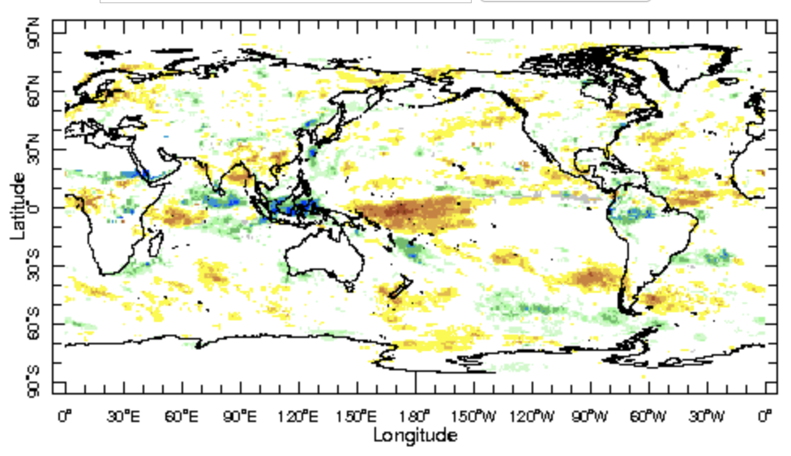
IRI Sub-seasonal Forecast: Precipitation (week 2)
Week:2: (30 Jul- 5. Aug.).
Forecast start date Jul 22nd
Above normal rainfall is likely over maritime continent and central Indian ocean
Above normal precipitation is likely South America’s Peru, Columbia, Ecuador and north of Brazil
West African monsoon region is likely to get below normal
rainfall
Dry rainfall anomalies are likely over NW-US

Slide 8
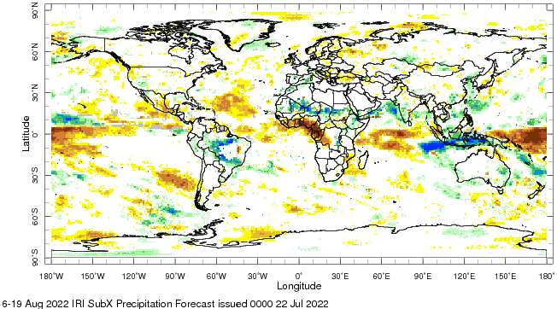
IRI Sub-seasonal Forecast: Precipitation (week 1)
Week:34: (6- 19. Aug.).
Forecast start date Jul 22nd
Above normal rainfall is likely over maritime continent and Indian peninsular region
Above normal precipitation is
likely over northern parts of
South America
North African region is likely
to get above normal
rainfall
Dry rainfall anomalies are
likely in western African
Monsoon region

Slide 9
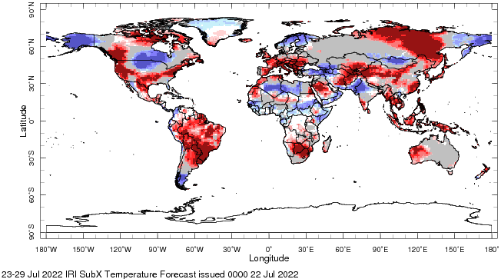
IRI Sub-seasonal Forecast : Near-Surface Temperature (week:1)
Forecast issue date Jul 22nd
Above normal near surface temperature is likely over western, southwest USA. And northwest Canada
Above normal near surface temperature is likely over south America
Above normal near surface temperature is likely Europe
Below normal near surface temperature is likely northern Indian and Pakistan regions

Slide 10
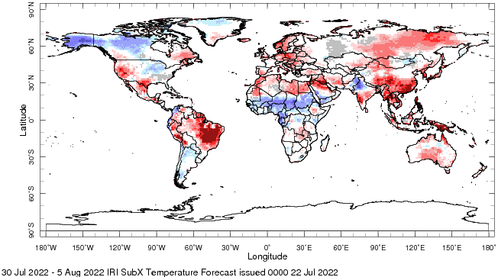
IRI Sub-seasonal Forecast : Near-Surface Temperature (Week:2)
Forecast issue date Jul 22nd
Above normal near surface temperature is likely over western, southwest USA. And northwest Canada
Above normal near surface temperature is likely over northern south America
Above normal near surface temperature is likely Europe
Below normal near surface temperature is likely northern Indian, Pakistan and Northern Africa

Slide 11
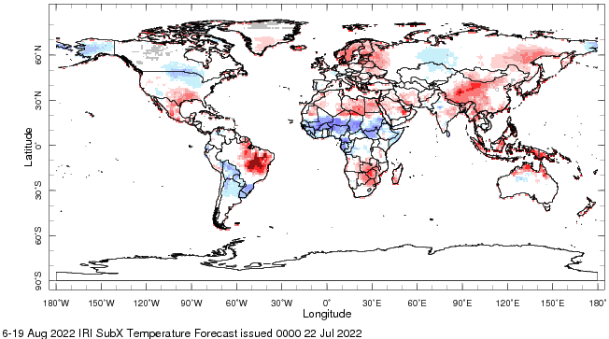
IRI Sub-seasonal Forecast : Near-Surface Temperature (week 3-4)
Forecast issue date Jul 22nd
Above normal near surface temperature is likely over , southwest USA.
Above normal near surface temperature is likely over northeast Brazil
Above normal near surface temperature is likely over East-Asia
Below normal near surface temperature is likely central Africa

Slide 12
Summary
MJO related convection and circulation are currently active most likely to be in-active during next two weeks.
La-Niña is active in East Pacific ocean
IOD is likely to exceeded negative IOD thresholds (i.e. at or below −0.4 °C) over the past six weeks.
Indian subcontinent and Maritime continent are likely to get above normal rainfall from late July to mid August
Above normal near surface temperature is likely over western, southwest USA, northwest Canada. northern South America and Europe.
Northern African region is likely to to below normal temperature from week 2 to 4.

