Slide 1
IRI Climate Briefing: Jan. 20, 2022
Sub-seasonal Update
Bohar Singh
bohar@iri.Columbia.edu

Slide 2
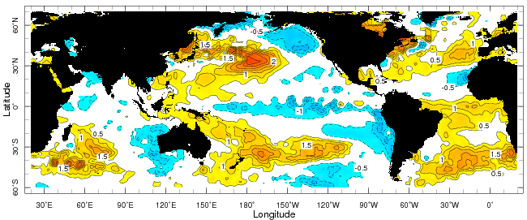
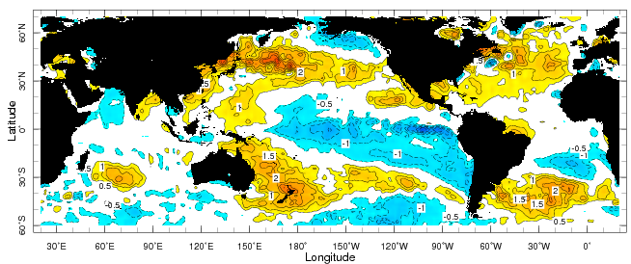
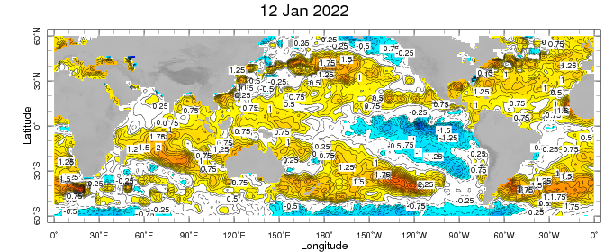
Sub-seasonal climate drivers
Weekly Observed SST anomalies ( 9 – 15) January)
Weekly Observed SST anomalies (7-13 November)
Weekly Observed SST anomalies (5-11 December)
SST in warm pool is increased and the Central Pacific cold anomalies weakened

Slide 3
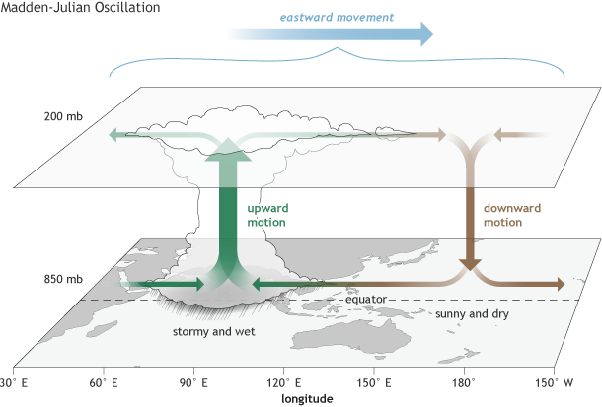
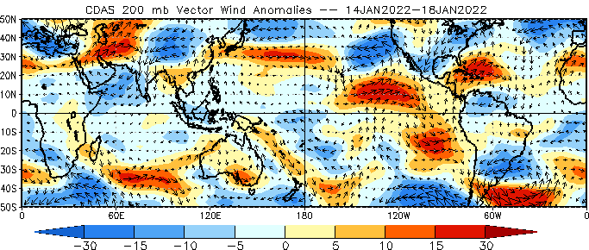
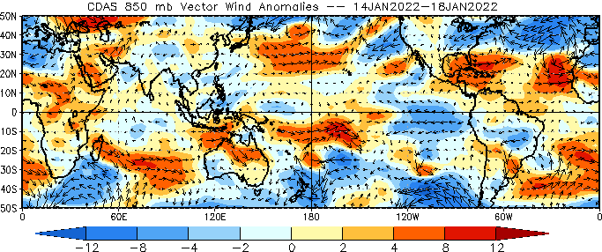
Sub-seasonal climate drivers
Upper level
Lower level
Upper-level circulation is week in the Indian west Pacific Ocean;
At lower level, the winds are
easterlies in the central and east Pacific Ocean

Slide 4
Current and Past evolution of the MJO
OLR anomalies, and lower level circulation suggest inactive state of MJO

Slide 5
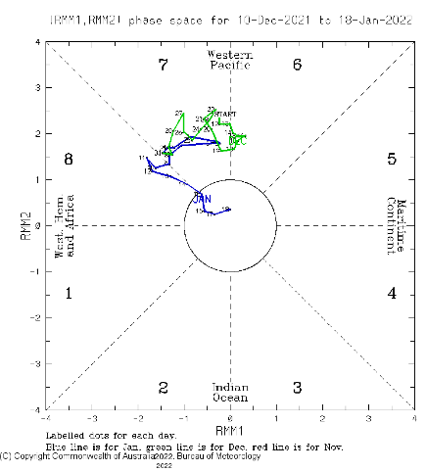
Current and Past evolution of the MJO
Wheeler-Hendon Indices
MJO has been weakened over the
past two weeks
Currently, MJO is inactive
Magnitude of RMM is within unit circle

Slide 6
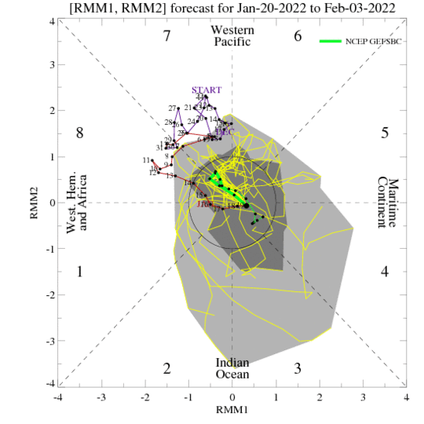
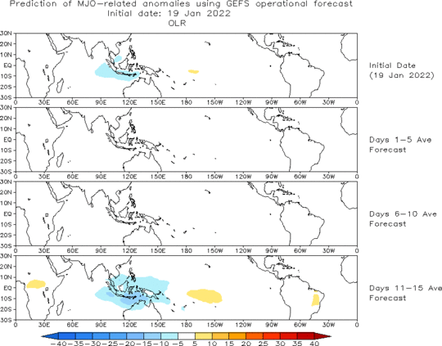
MJO 15-day Forecast from NCEP GEFS model
The ensemble spread of the RMM forecast is very high
For the next two weeks, the MJO signal is likely to be inactive

Slide 7
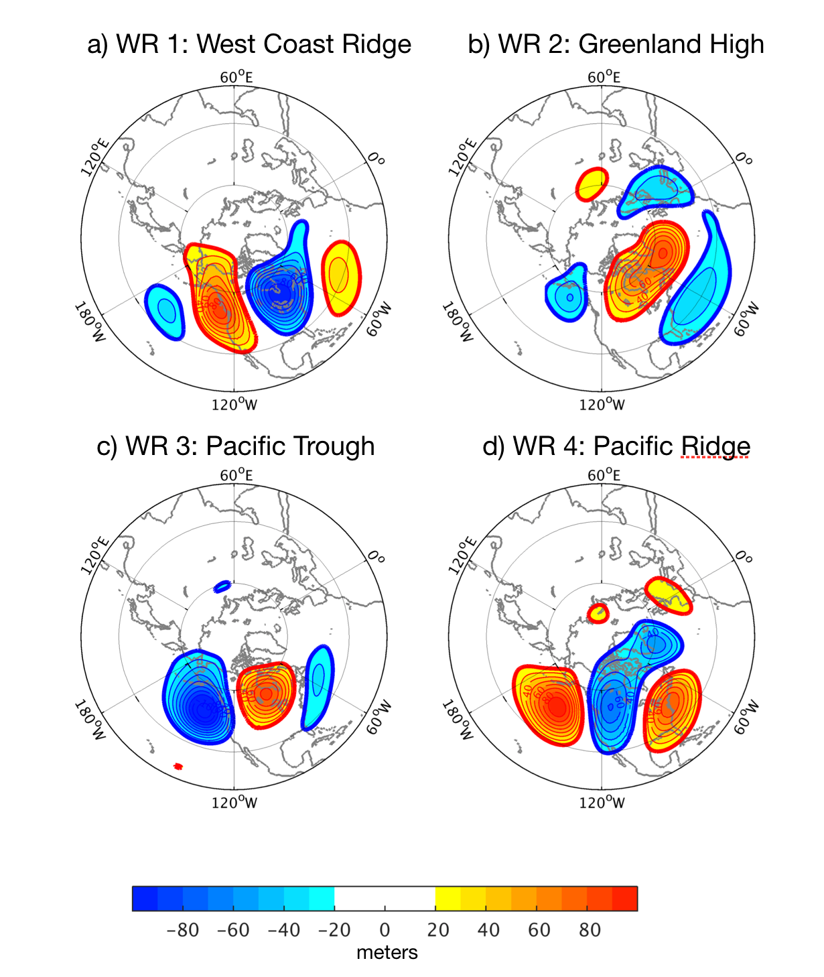
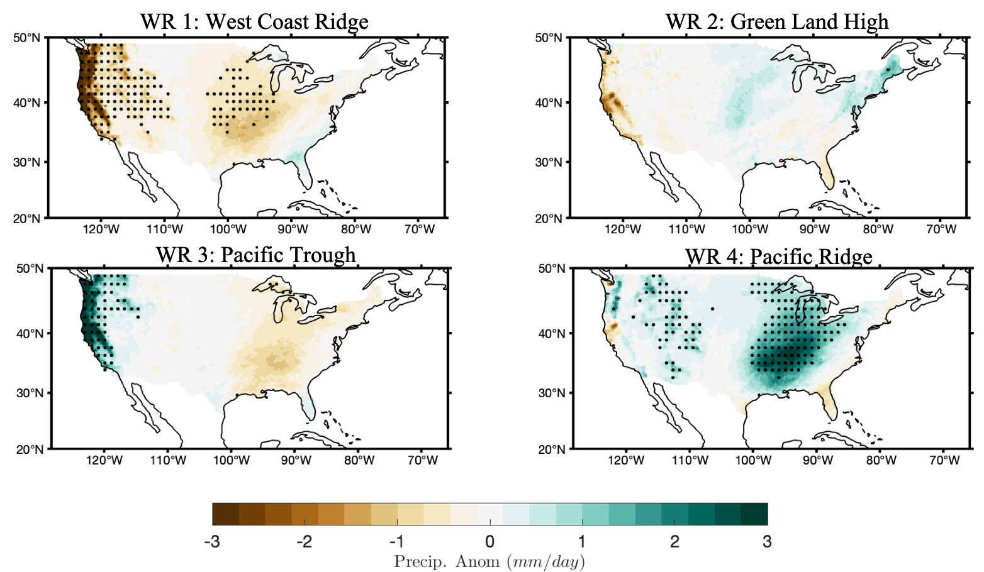
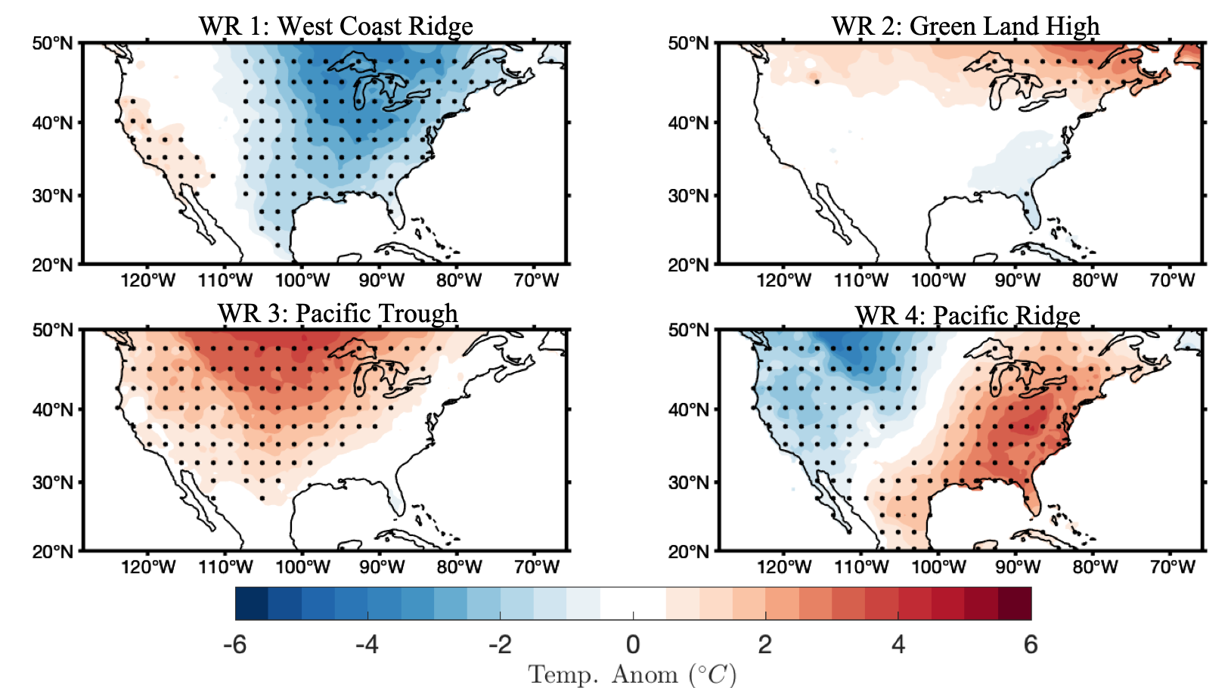
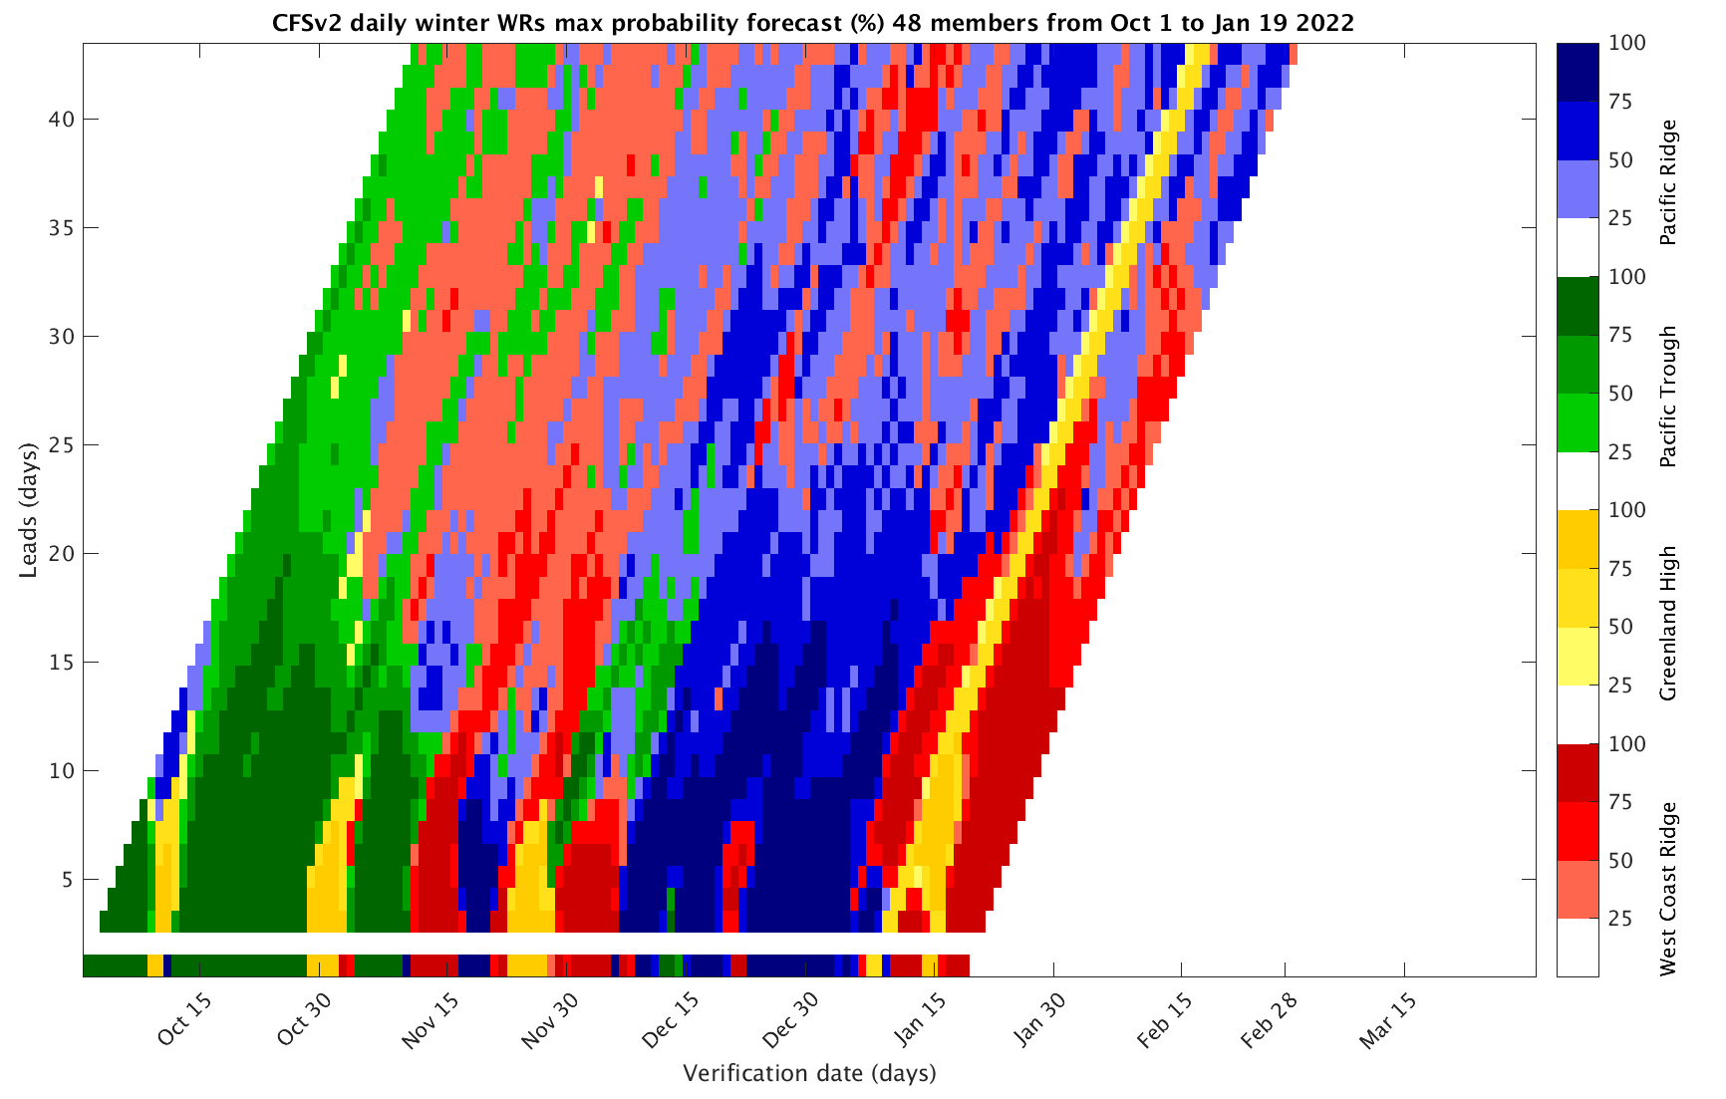
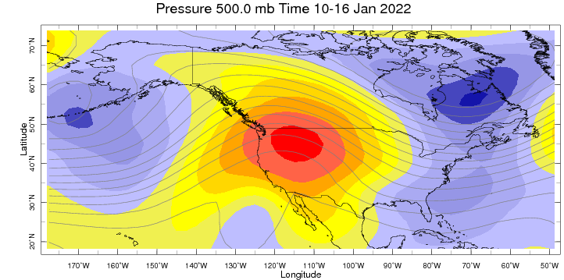
Sub-seasonal Forecast: Weather Regimes
West coast ridge Weather regime is observed, is likely be there over next two week

Slide 8
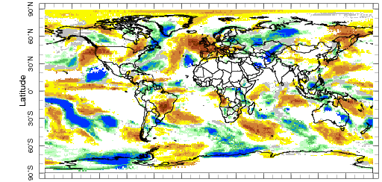
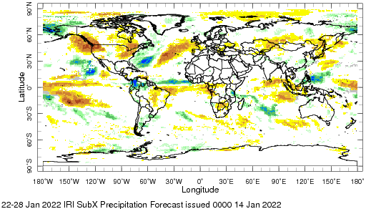
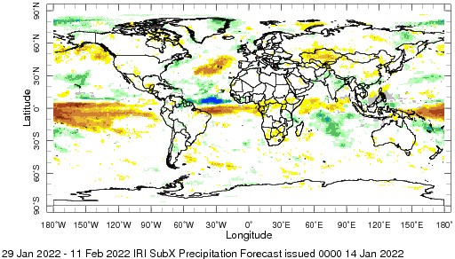
IRI Sub-seasonal Forecast: Precipitation
Week:1: (15-21 Jan).
Forecast issue date Jan 14th
Week:2 (22-28 Jan.)
Week:3+4 (29 Jan.-11 Feb.)
West coast ridge related below normal precipitation is likely over
northwestern and northeast United States
For the next two weeks, the weather over Europe is expected to
be dry
Amazon likely be continued to receive above-average rainfall
during next month
Above normal Precipitation over Afghanistan- Pakistan India
region likely between week 3-4, which is due to western disturbance,.

Slide 9
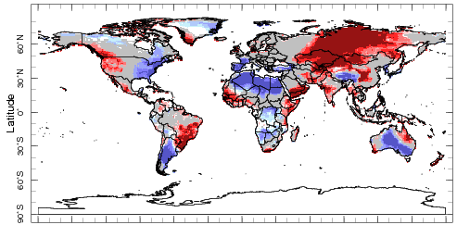
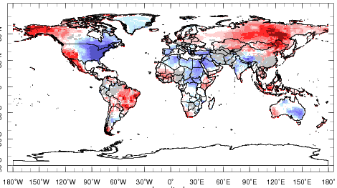
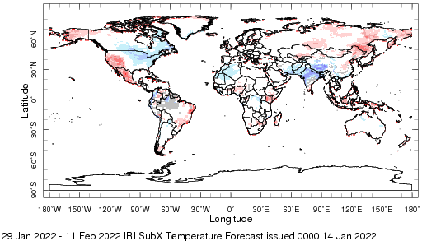
IRI Sub-seasonal Forecast : Near-Surface Temperature
Week:1: (15-21 Dec.).
Forecast starting date Jan 14th
Week:2 (22-28 Nov.)
Week:3+4 (29 Jan.-11 Feb.)
Above normal temperature is likely over northwest United States over
the next month
Eastern side of North America below normal temperature is likely
till one month
Below normal temperature is likely over central and north Africa
Below normal average temperature is likely Suth Asia
Above normal temperature is likely over northern South America

Slide 10
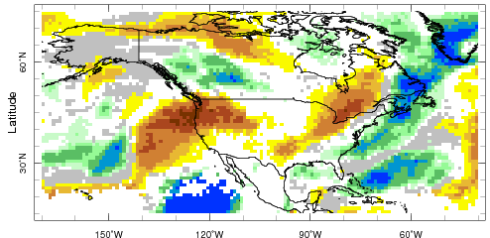
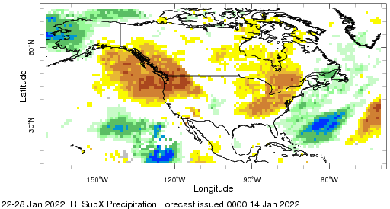
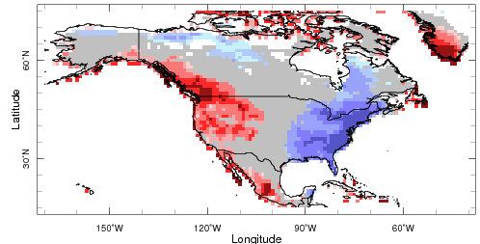
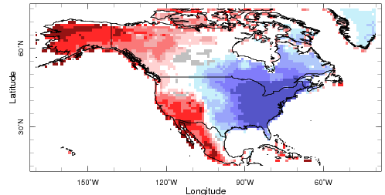
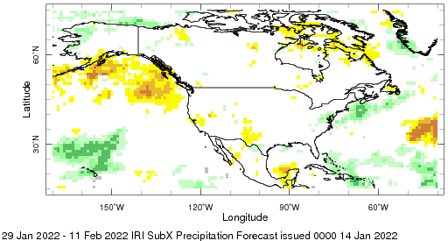
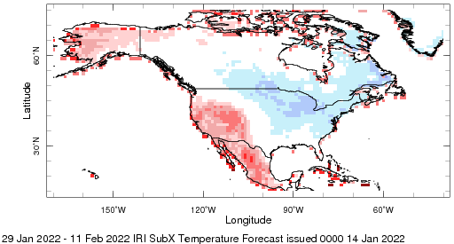
IRI Sub-seasonal Forecast : Attribution
Week:1: (15-21 Jan).
Week:2 (22-28 Jan.)
Week:3+4 (29 Jan.-11 Feb.)

Slide 11
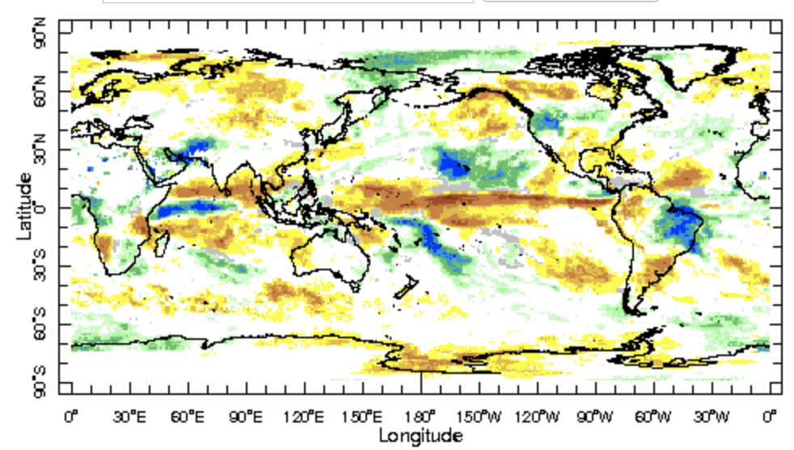
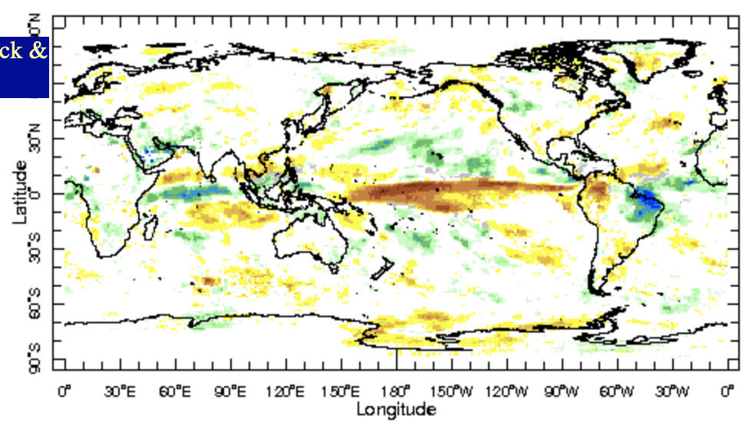

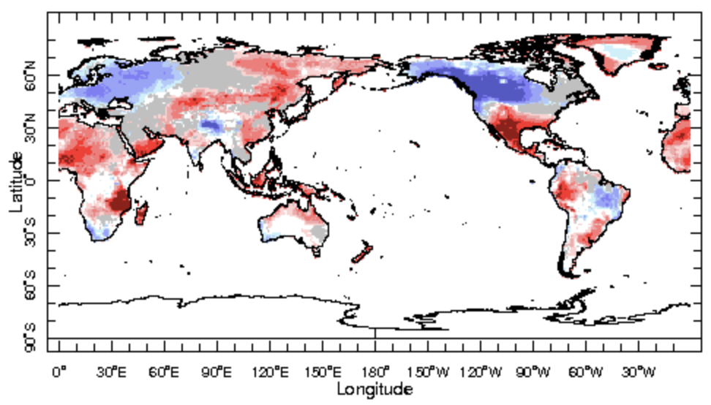
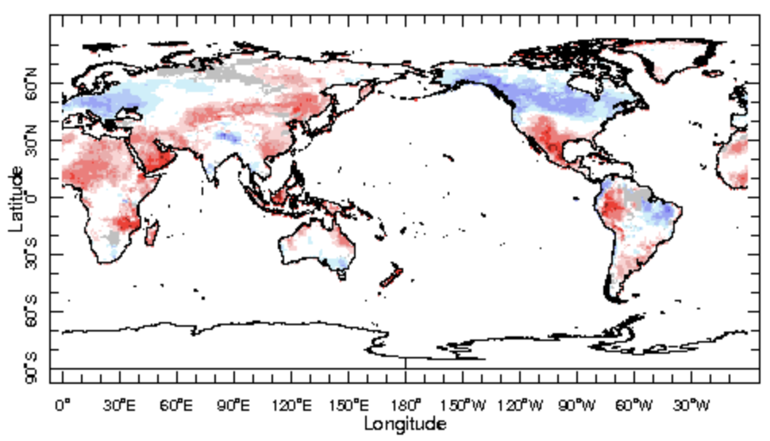

IRI Sub-seasonal Forecast : Updated today
Forecast initialization date Dec 17th
Week 2+3 (27Nov.-10 Dec.)
Week 3+4( 4 Dec.-17 Dec.)

Slide 12
Summary
SST and Circulation over East Pacific consistent with La-Ñina
MJO related convection and circulation have weakened over the past two weeks and are currently inactive
MJO likely to be inactive in west Pacific in the next two weeks
Northwest of the United States and Canada is likely to experience dry and warm weather over the next two weeks
Northeast of the United States and Canada is likely to experience dry and cold weather over the next two weeks
Central and North Africa are likely to experience below normal temperature
Northern parts of south Asia likely to get above normal precipitation in week 3-4

