Slide 1
IRI Climate Briefing: Feb. 17, 2022
Sub-seasonal Update
Bohar Singh
Acknowledgement:
Jing Yuan
Dr. Andrew Robertson
Jeff Turmelle
bohar@iri.Columbia.edu

Slide 2
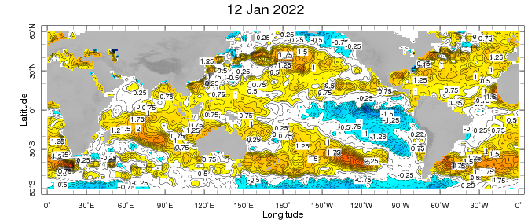
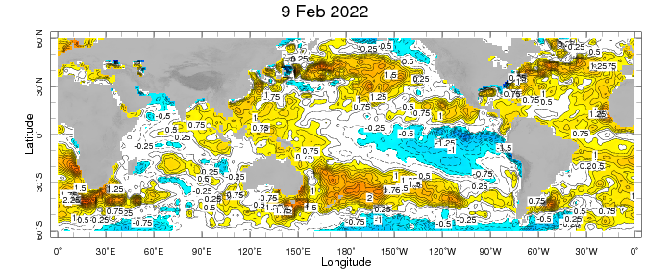
Sub-seasonal climate drivers
Weekly Observed SST anomalies ( 9 – 15) January)
Weekly Observed SST anomalies (6 – 12) February)
SST in warm pool and the Central Pacific cold anomalies weakened

Slide 3
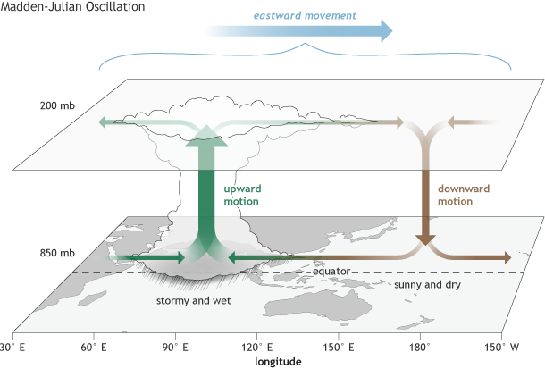
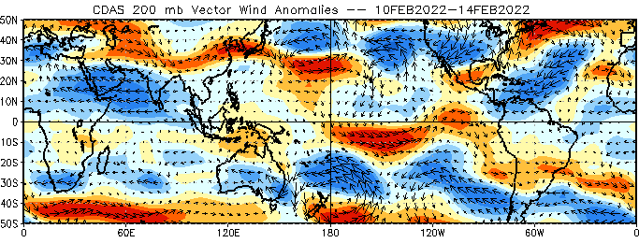
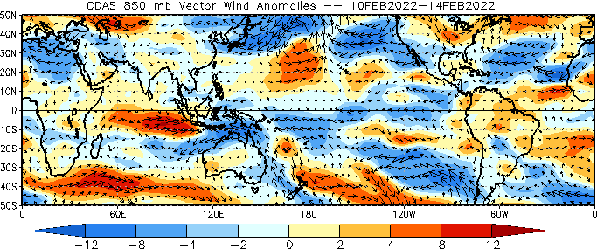
Sub-seasonal climate drivers
Upper level
Upper-level divergence in the Indian and west Pacific Ocean;
At lower level, the winds are
easterlies in the central and east Pacific Ocean and westerlies in Indian Ocean
Lower level

Slide 4
Current and Past evolution of the MJO
OLR anomalies, and lower level circulation suggest active state of MJO

Slide 5
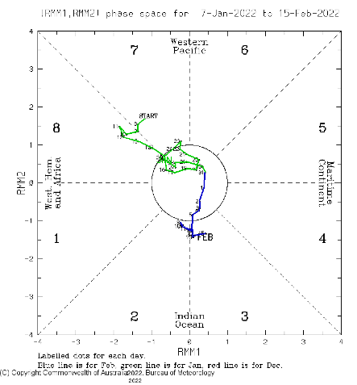
Current and Past evolution of the MJO
Wheeler-Hendon Indices
MJO has been emerging from past two
weeks
Currently, MJO is active in phase 3
RMM index is moderately strong

Slide 6
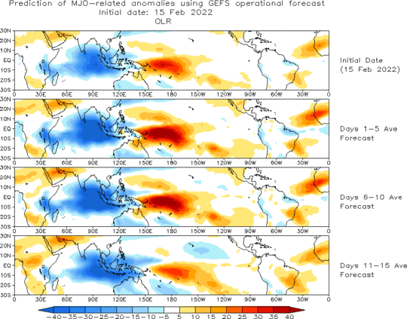
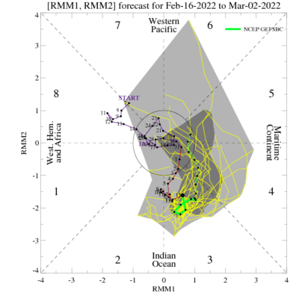
MJO 15-day Forecast from NCEP GEFS model
The ensemble mean RMM forecast suggest propagation of MJO in phase 4 and 5
For the next two weeks, the MJO signal is likely be active

Slide 7
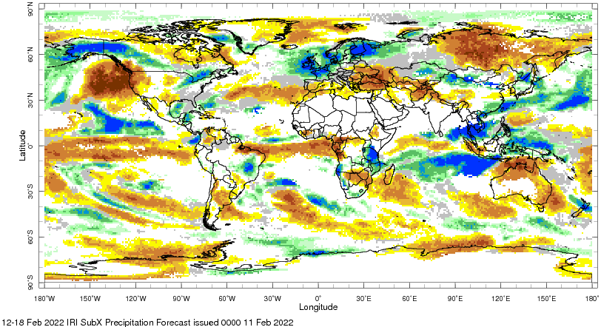
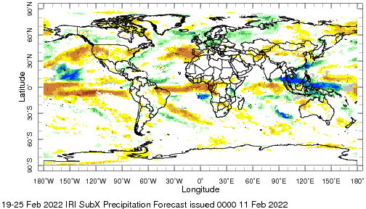
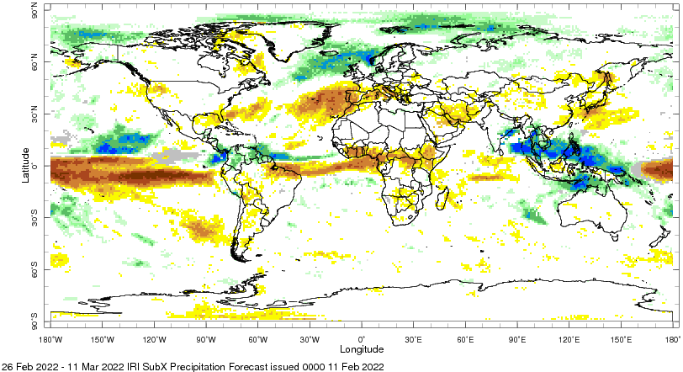
IRI Sub-seasonal Forecast: Precipitation
Week:1: (12-18 Feb).
Forecast issue date Jan 14th
Week:2 (19-25 Feb.)
Week:3+4 (26 Feb.-11 Mar.)
West coast ridge related below normal precipitation is likely over
northwestern United States
For the next two weeks, the weather over Europe is expected to
be wet
Amazon likely be continued to receive below-average rainfall
during next month
Maritime continent is likely to receive above average rainfall
during next month due to active MJO

Slide 8
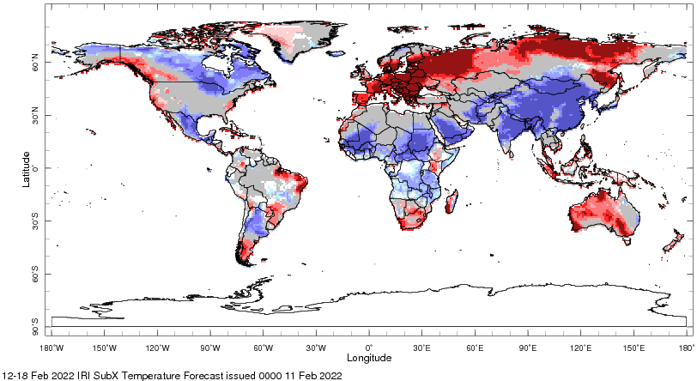
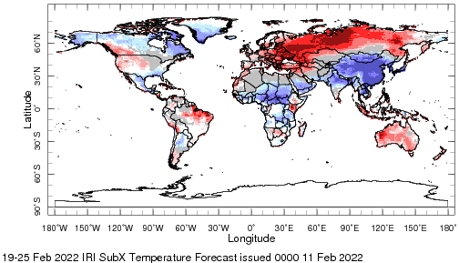
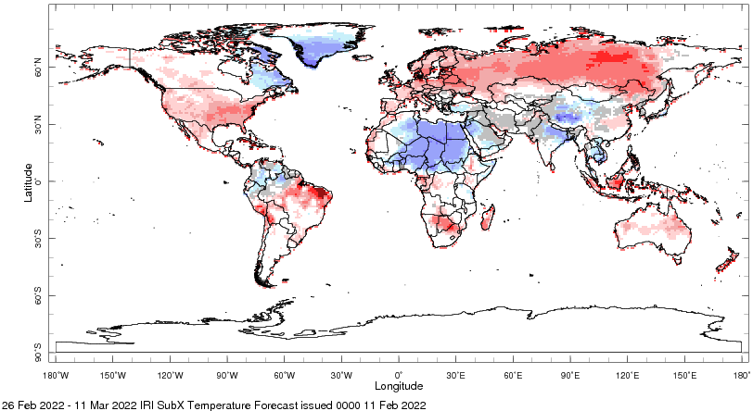
IRI Sub-seasonal Forecast : Near-Surface Temperature
Forecast issued on Feb 11th
Week:2 (19-25 Feb.)
Week:3+4 (26 Feb.-11 Mar.)
Above normal temperature is likely over northwest United States over
the next two weeks
North-eastern side of North America below normal temperature is likely
till next two weeks
Below normal temperature is likely over central to north Africa and Asia
Above normal average temperature is likely over Australian continent
Above normal temperature is likely over United States for week 3 and 4

Slide 9
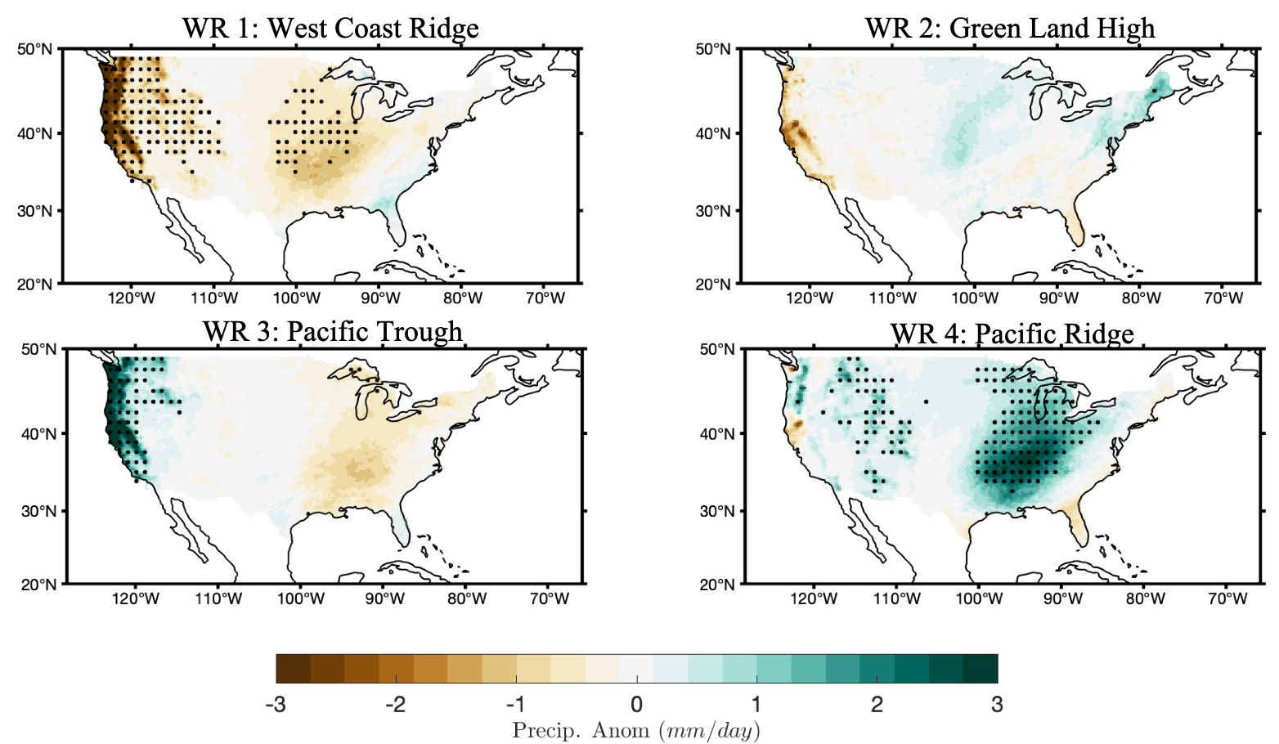
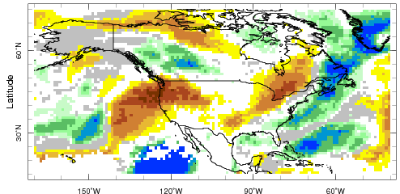
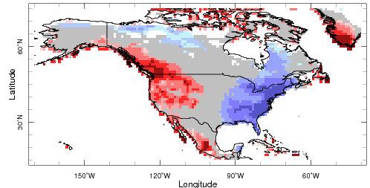
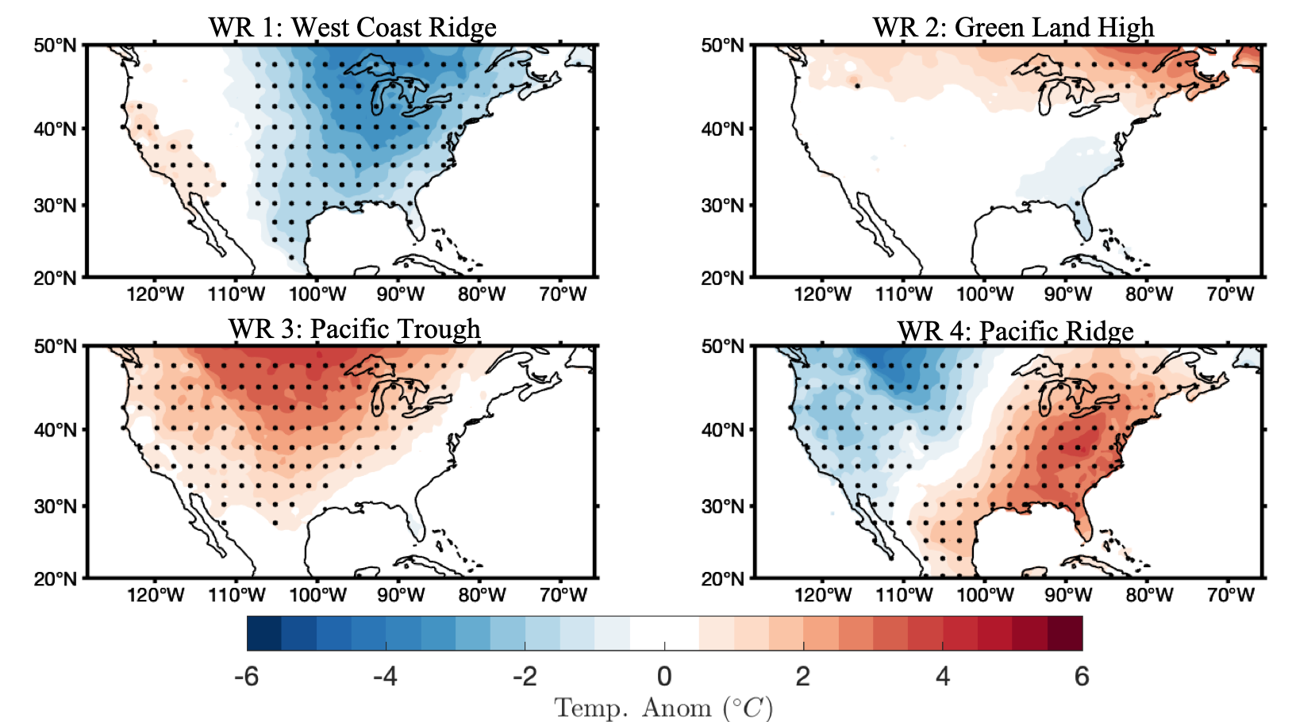
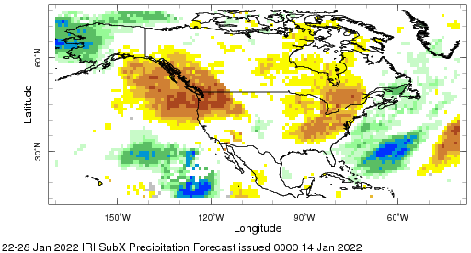
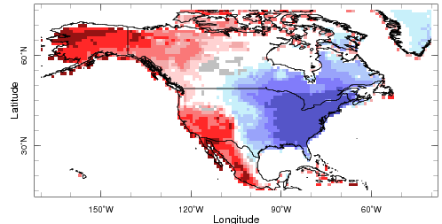
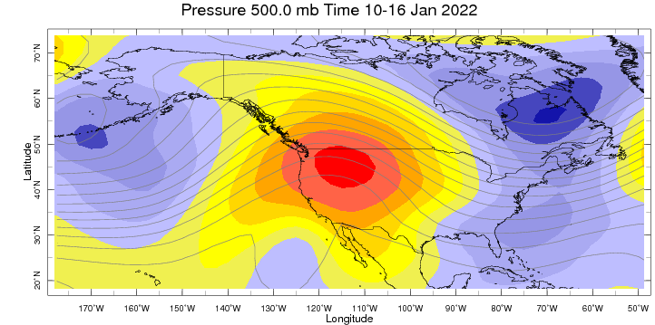
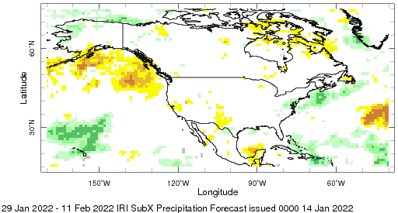
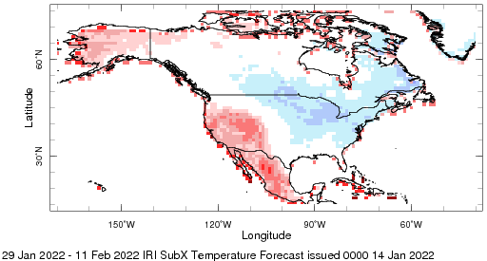
Verifying last month SubX Forecast over CONUS
Week:1: (15-21 Jan).
Week:2 (22-28 Jan.)
Week:3+4 (29 Jan.-11 Feb.)

Slide 10
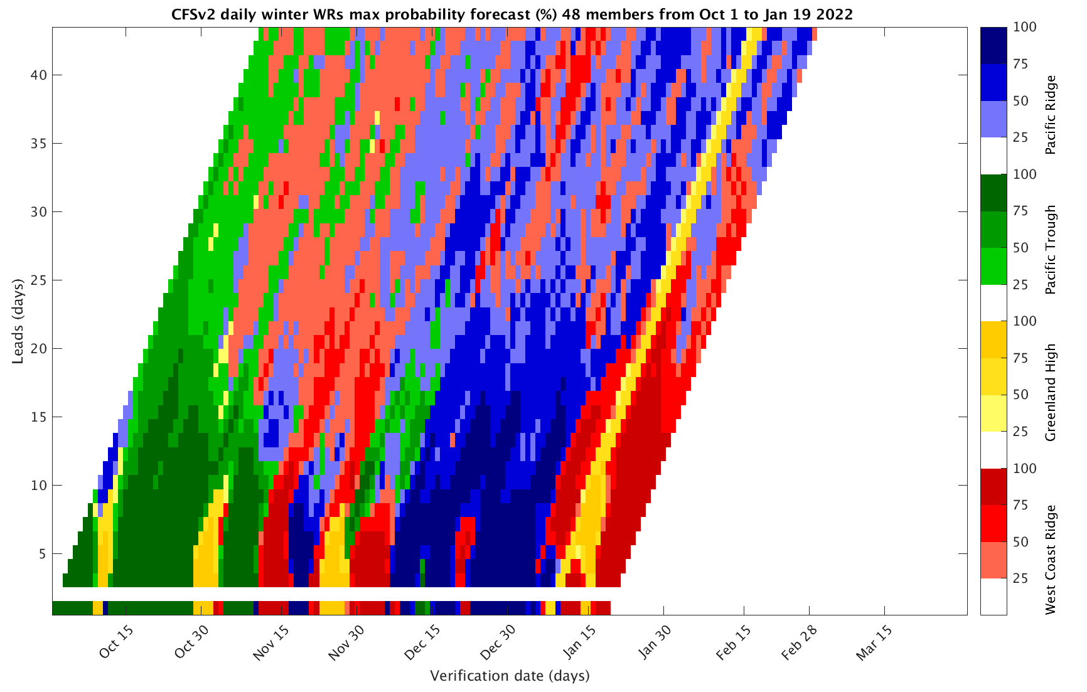
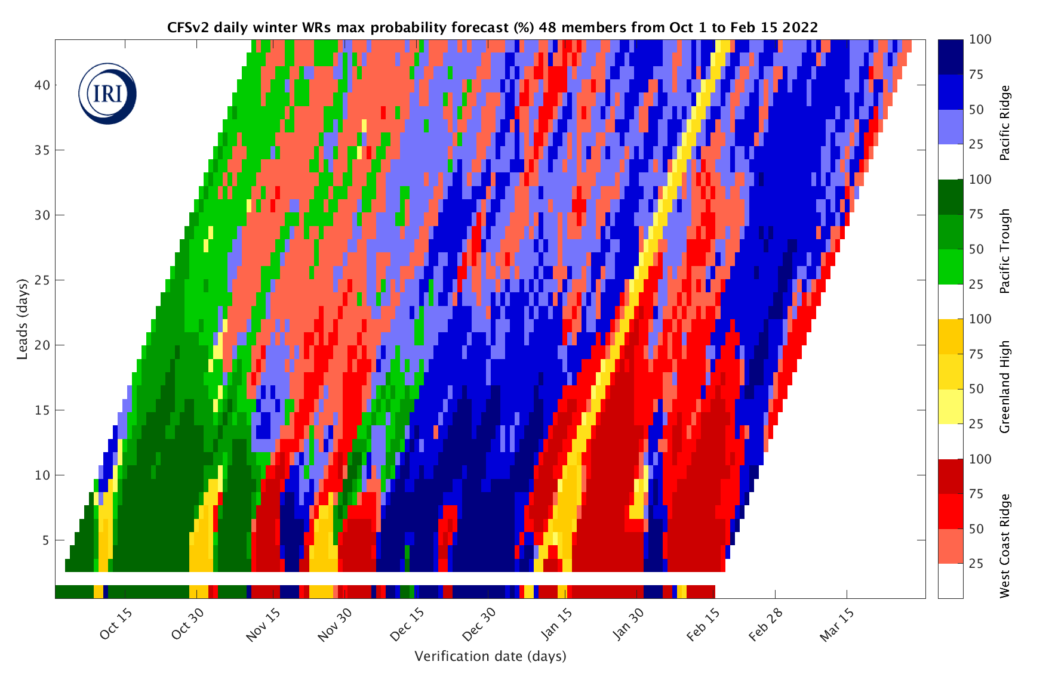
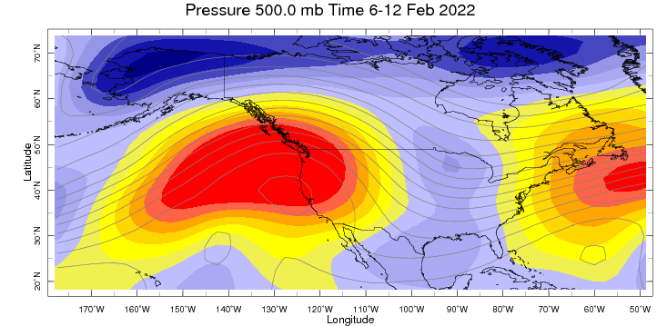
Sub-seasonal Forecast: Weather Regimes
West coast ridge Weather regime is observed, is likely be there over next two week

Slide 11
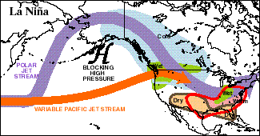
Dry Northwest : Attribution
H
H

Slide 12
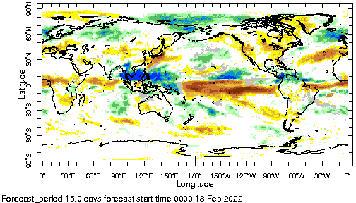
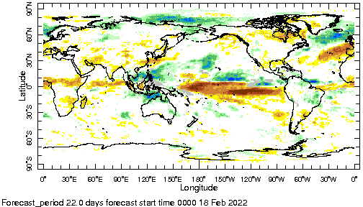

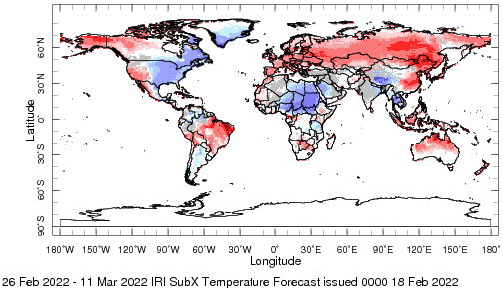
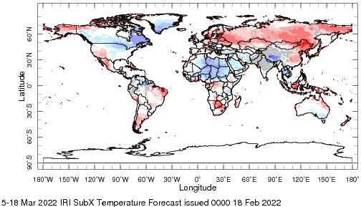

IRI Sub-seasonal Forecast : Updated today
Forecast initialization date Feb 17th
Week 2+3 (26 Feb.-11 Mar.)
Week 3+4( 5 mar.-18 Mar.)

Slide 13
Summary
SST and Circulation over East Pacific consistent with La-Ñina
MJO related convection and circulation become stronger over the past two weeks and are currently active
MJO likely to be active in west Pacific in the next two weeks
Northwest of the United States and Canada is likely to experience dry and warm weather over the next two weeks
Northeast of the United States and Canada is likely to experience dry and cold weather over the next two weeks
Central and North Africa are likely to experience below normal temperature
Northern parts of south Asia likely to get above normal precipitation in week 3-4

Slide 14
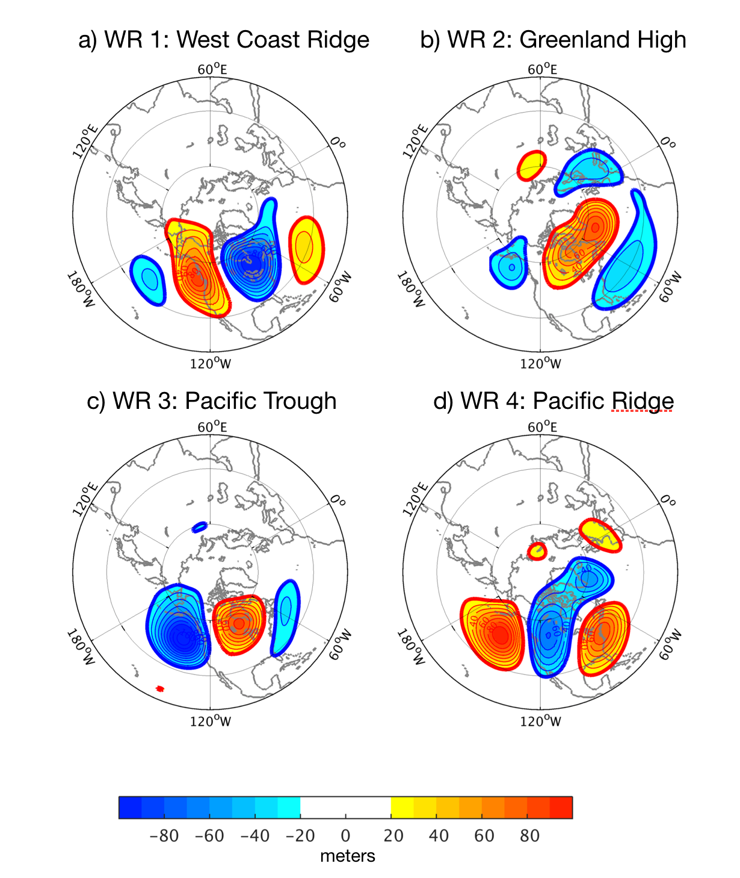
Sub-seasonal Forecast: Weather Regimes
West coast ridge Weather regime is observed, is likely be there over next two week

Slide 15
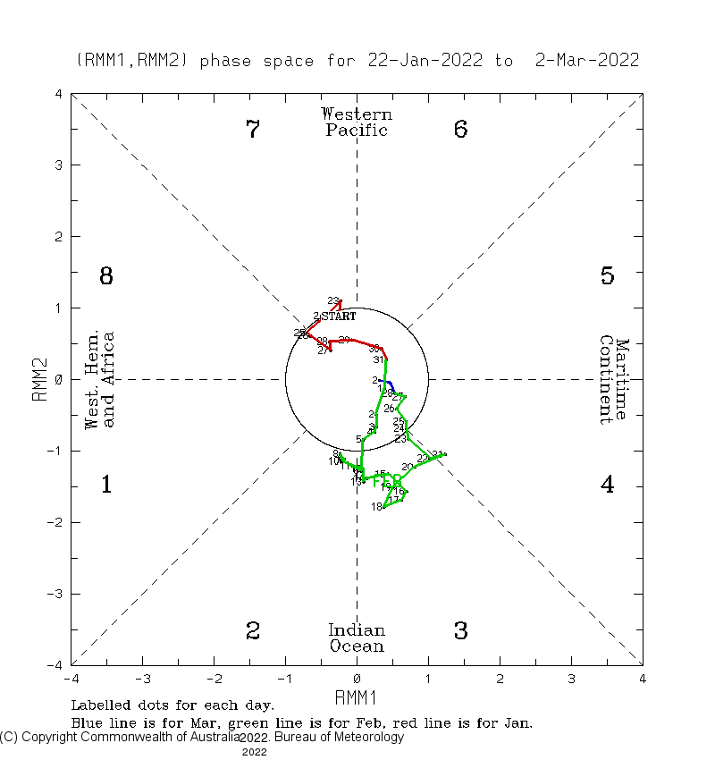
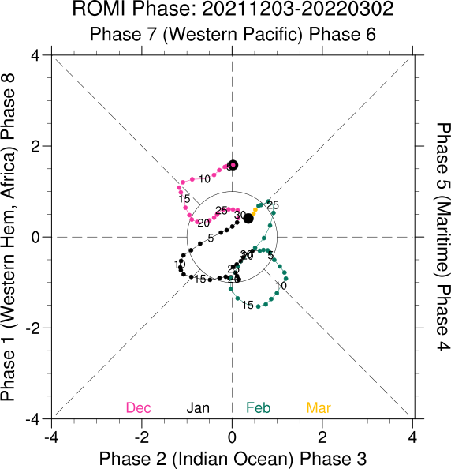

Slide 16
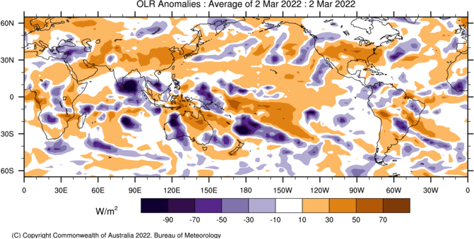

Slide 17
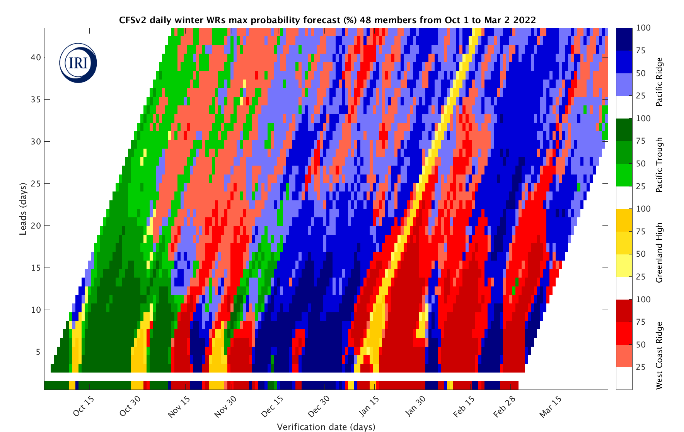
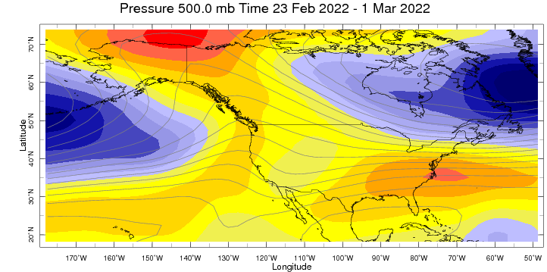

Slide 18
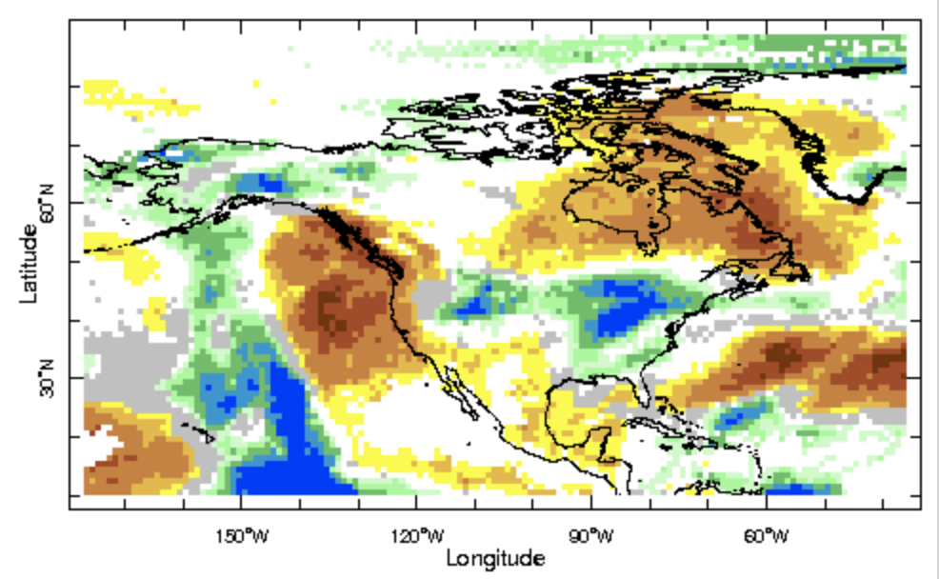
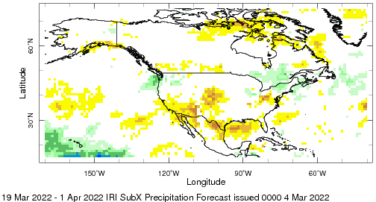
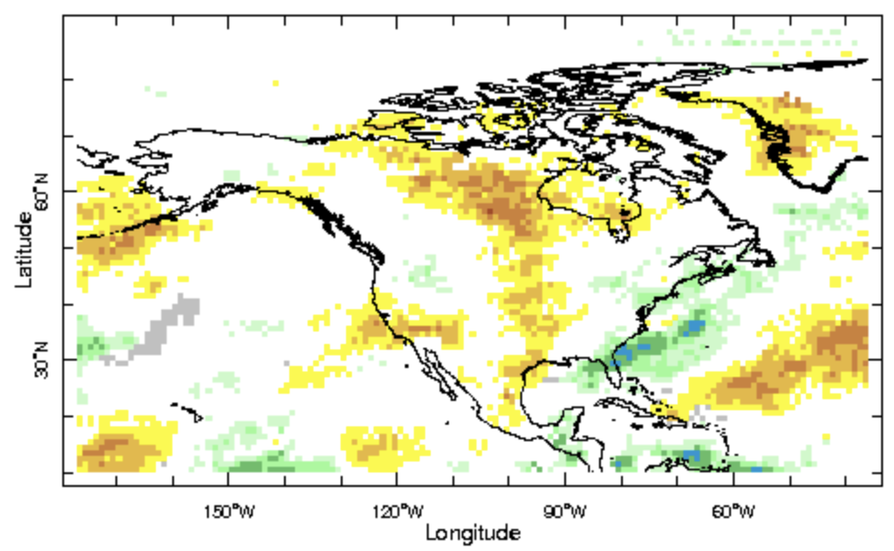
Week 1 : 6-11 march
Week 1 : 19 Mar -1 April
Week 1 : 12-18 march

