Slide 1
IRI Climate Briefing: Dov. 16, 2021
Sub-seasonal Update
Bohar Singh
bohar@iri.Columbia.edu

Slide 2
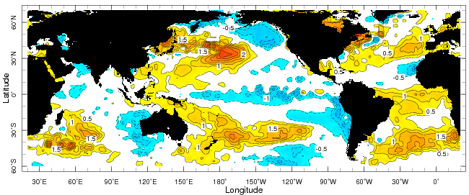
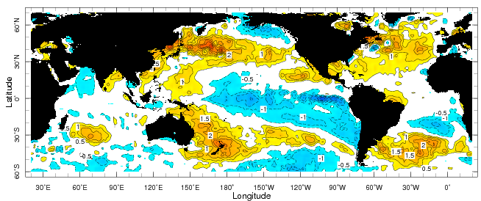
Sub-seasonal climate drivers
Weekly Observed SST anomalies (7-13 November)
Weekly Observed SST anomalies (5-11 December)
SST in warm pool is decreased and the Central Pacific cold anomalies become stronger

Slide 3
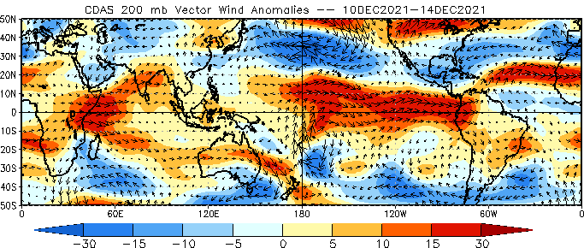
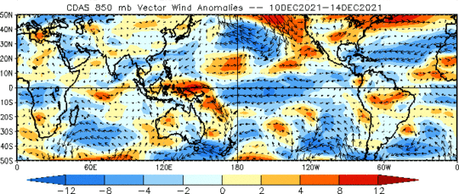
Sub-seasonal climate drivers
Upper-level westerlies are strong in the Indian east Pacific Ocean;
At lower level, the winds are
easterlies in the central and east Pacific Ocean
Upper level
Lower level

Slide 4
Current and Past evolution of the MJO
OLR anomalies, and lower level circulation suggest active MJO over Maritime continent

Slide 5
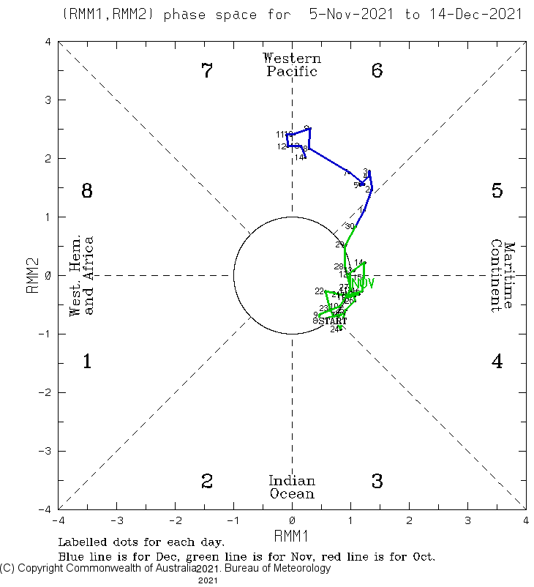
Current and Past evolution of the MJO
Wheeler-Hendon Indices
MJO has been strengthened over the
past two weeks
Currently, MJO is active over the
western Pacific Ocean
Magnitude of RMM is high

Slide 6
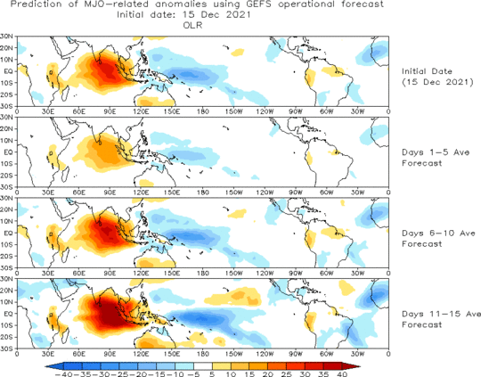
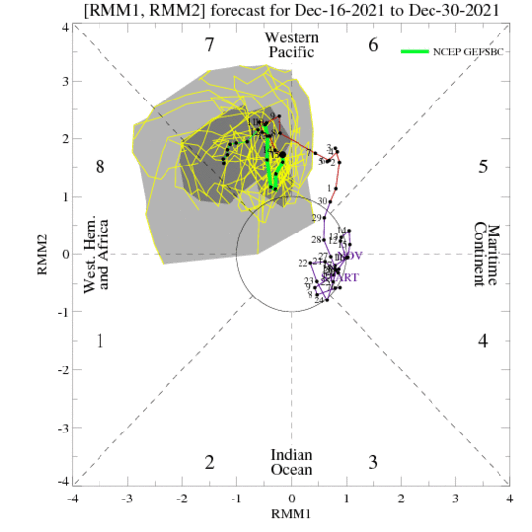
MJO 15-day Forecast from NCEP GEFS model
The ensemble spread of the RMM forecast is very high; forecasted to be active in phase 7
For the next two weeks, the MJO signal is likely to become stronger any further eastward propagation

Slide 7
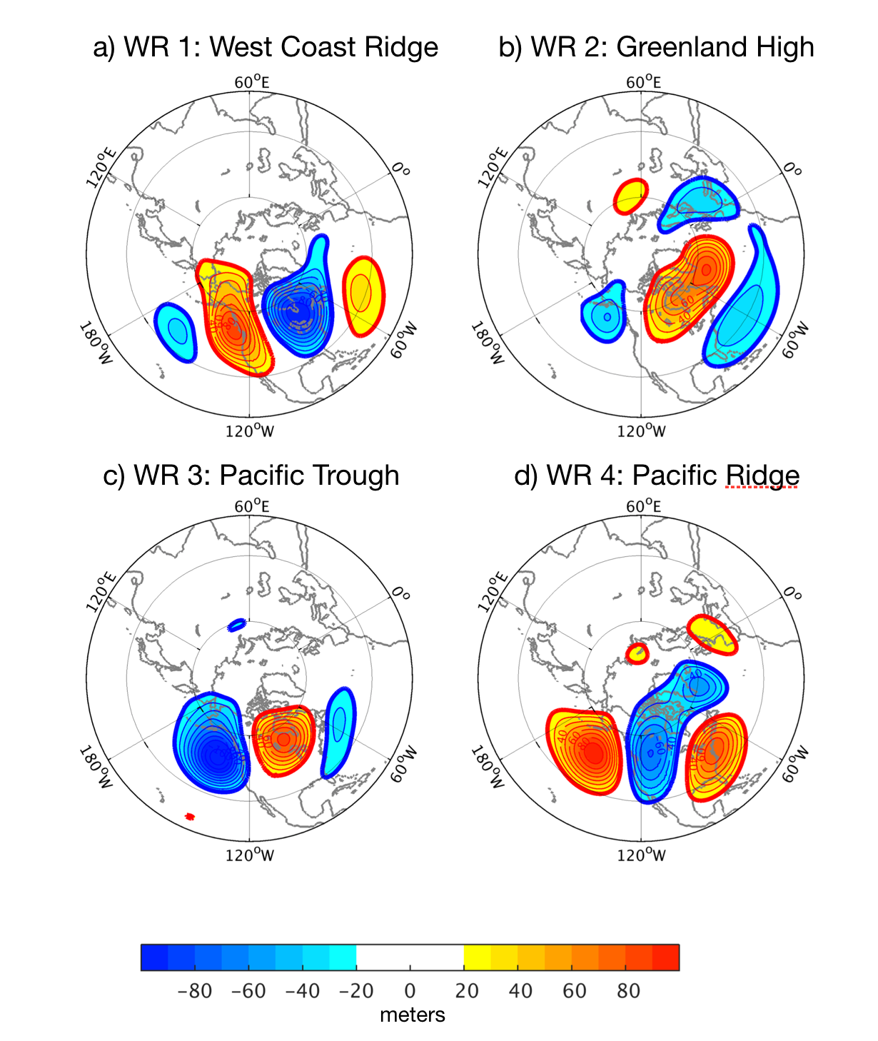
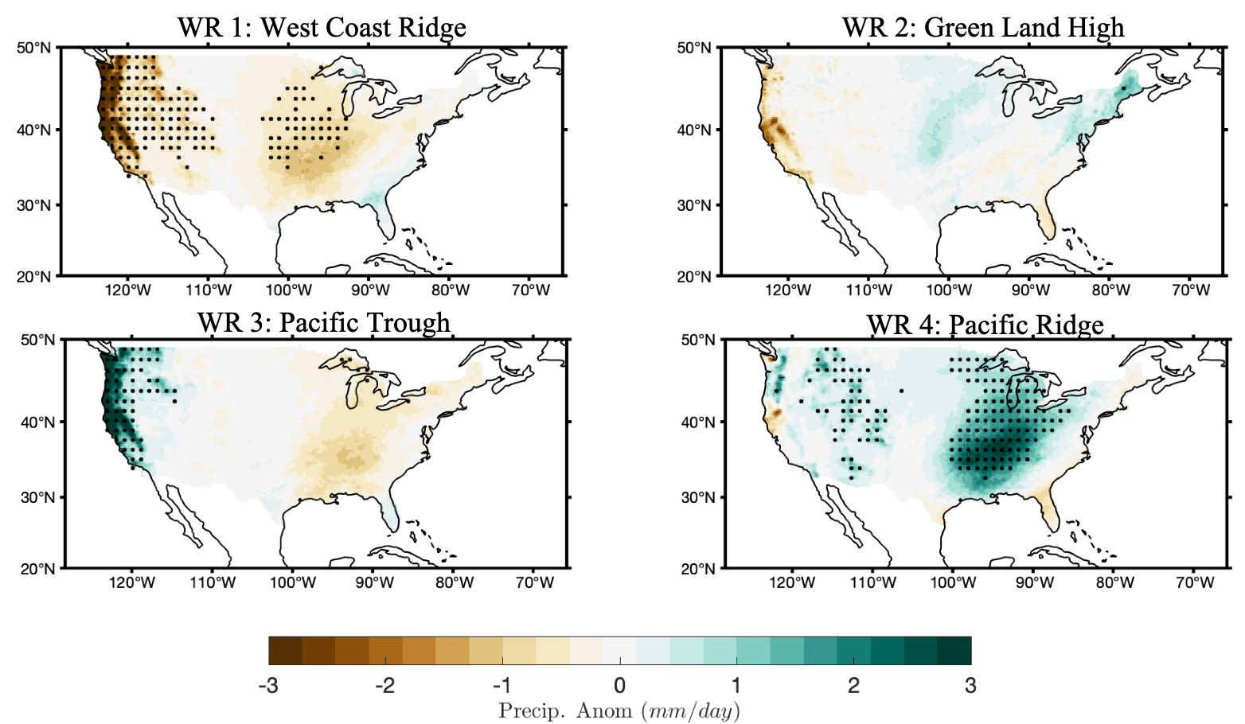
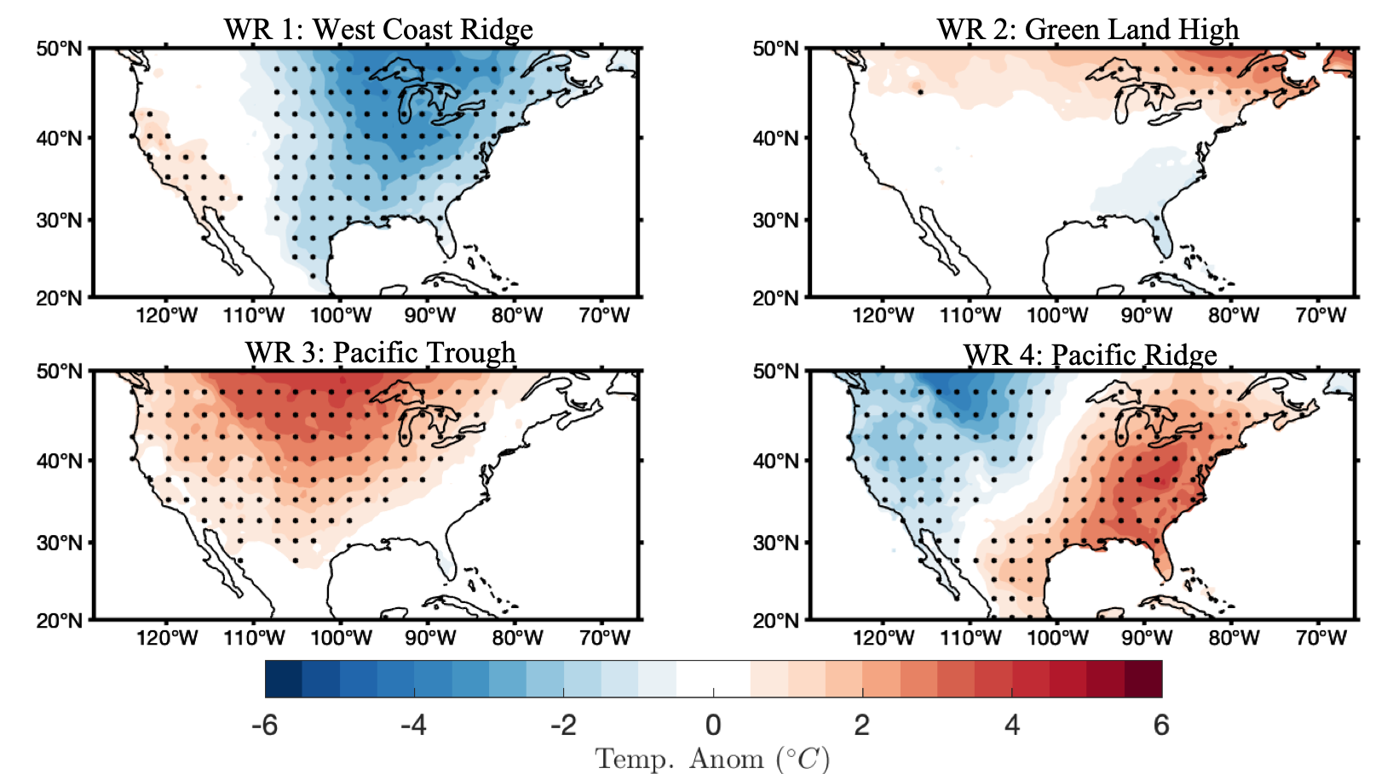
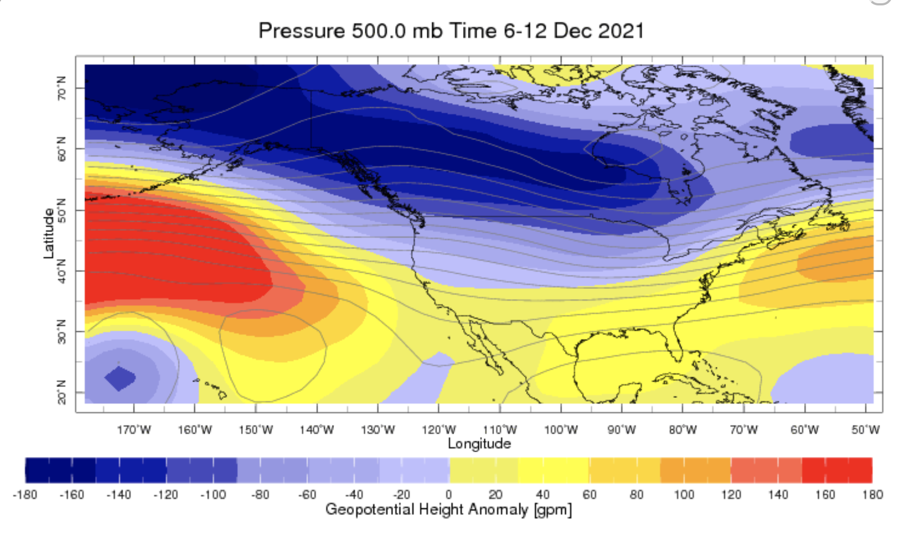
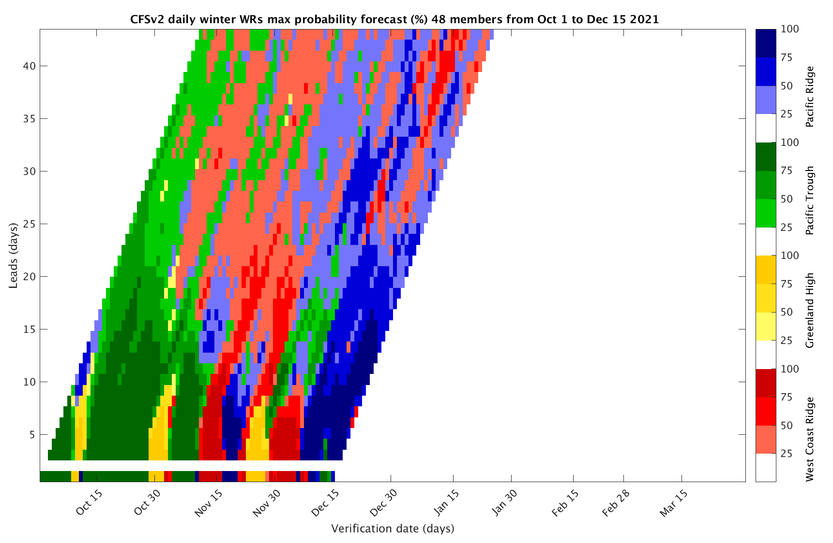
Sub-seasonal Forecast: Weather Regimes
Pacific ridge Weather regime is observed
Pacific ridge WR is likely be there over next two week
Location of WR is conducive for the rainfall over western United States and Ohio valley region
https://wiki.iri.columbia.edu/index.php?n=Climate.S2S-WRs

Slide 8
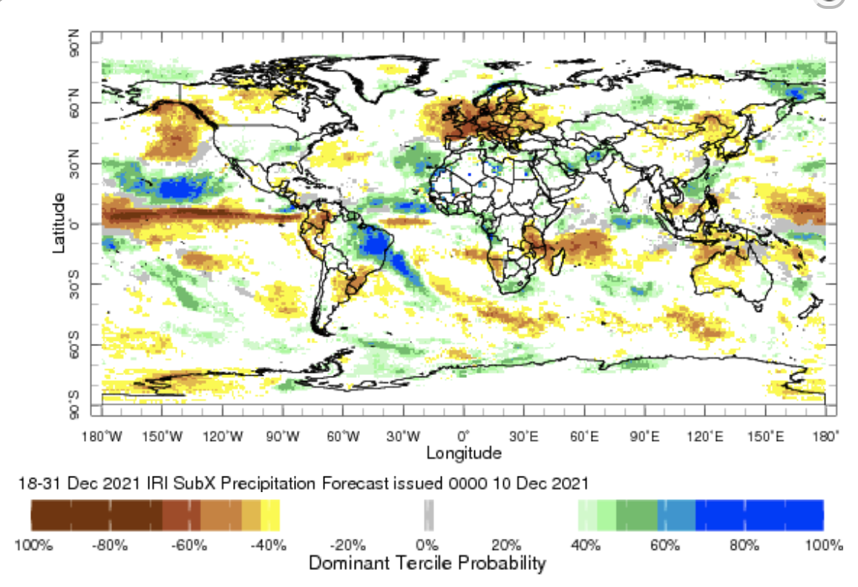
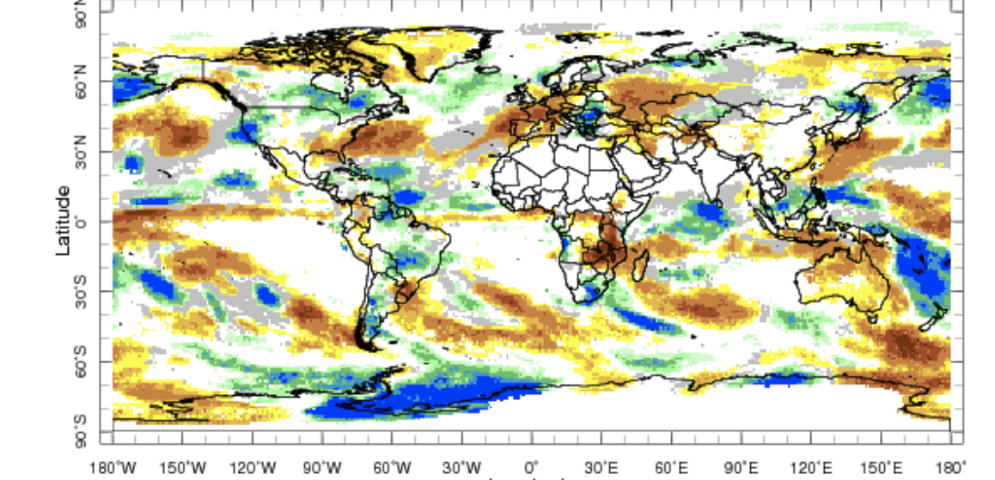
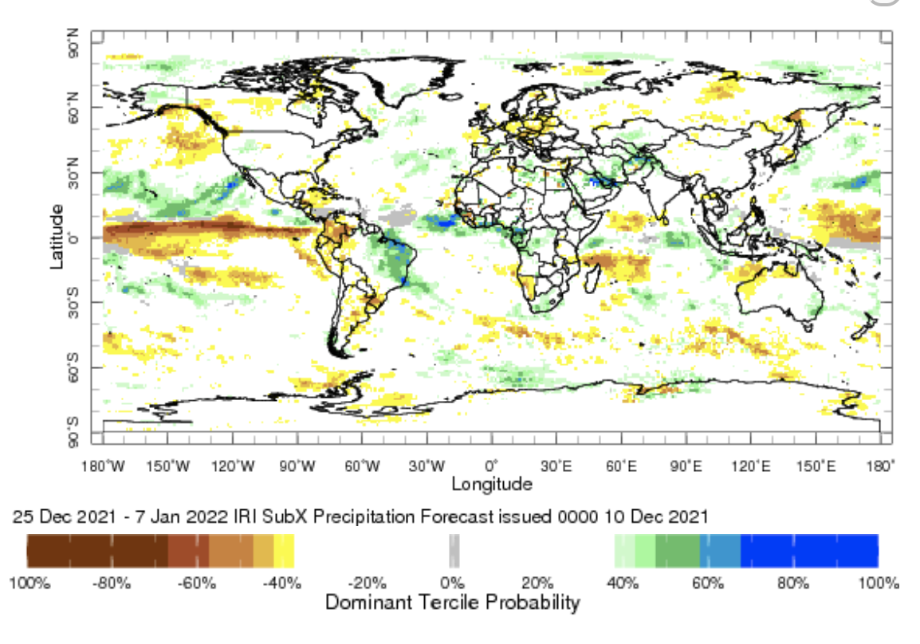
IRI Sub-seasonal Forecast: Precipitation
Week:1: (11-17 Dec).
Forecast issue date Dec 10th
Week:2 (18-31 Dec.)
Week:3+4 (25 Dec.-7 Jan.)
MJO related, above-normal precipitation is likely over
western and Midwest United States
For the next two weeks, the weather over Europe is expected to be dry
Amazon likely be continued to receive above-average rainfall
during next month
Precipitation over Afghanistan- Pakistan region likely between week
2-4, which is due to western disturbance,

Slide 9
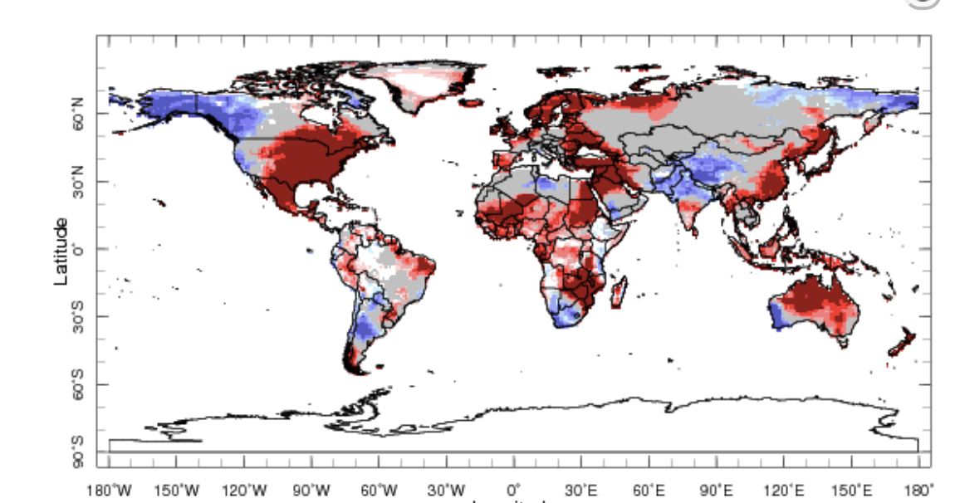
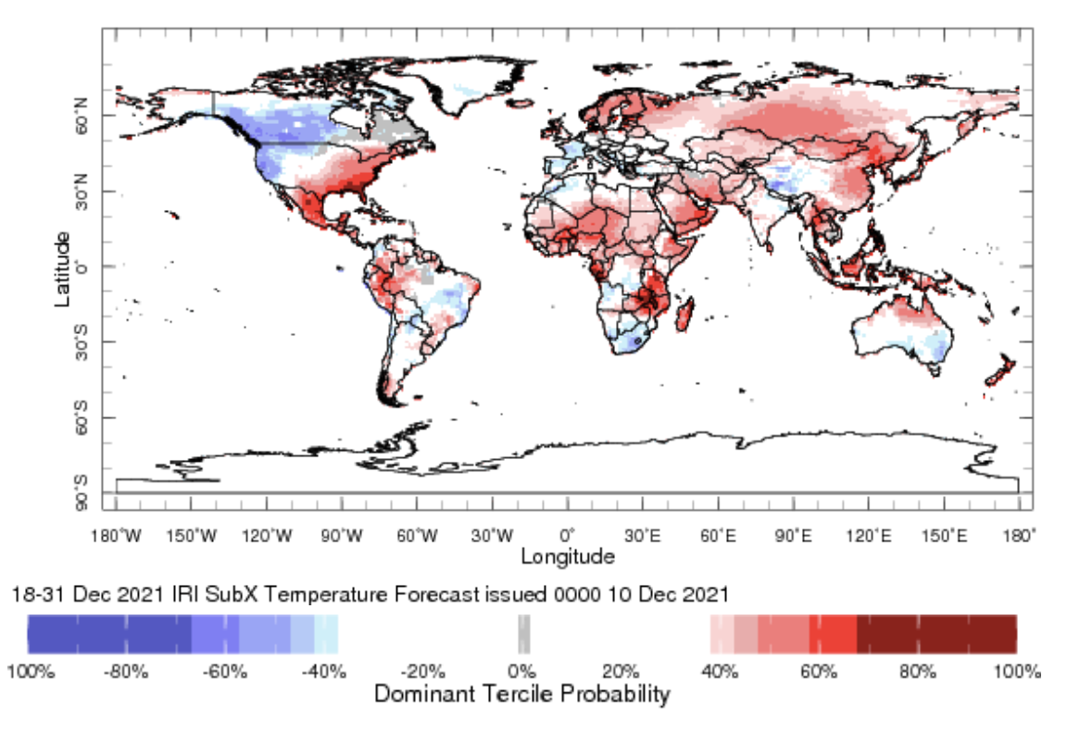
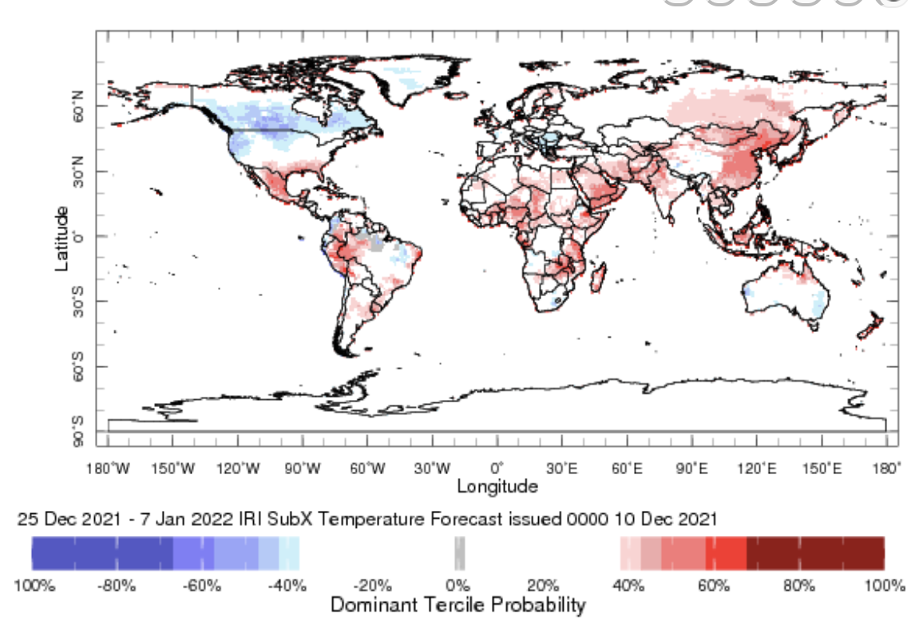
IRI Sub-seasonal Forecast : Near-Surface Temperature
Week:1: (11-17 Dec.).
Forecast starting date Dec 10th
Week:2 (18-31 Nov.)
Week:3+4 (25 Dec.-7 Jan.)
Below normal temperature is likely over western Canada
and United States
Above normal temperature is likely over eastern United States
Above average temperature is likely over central and north Africa

Slide 10
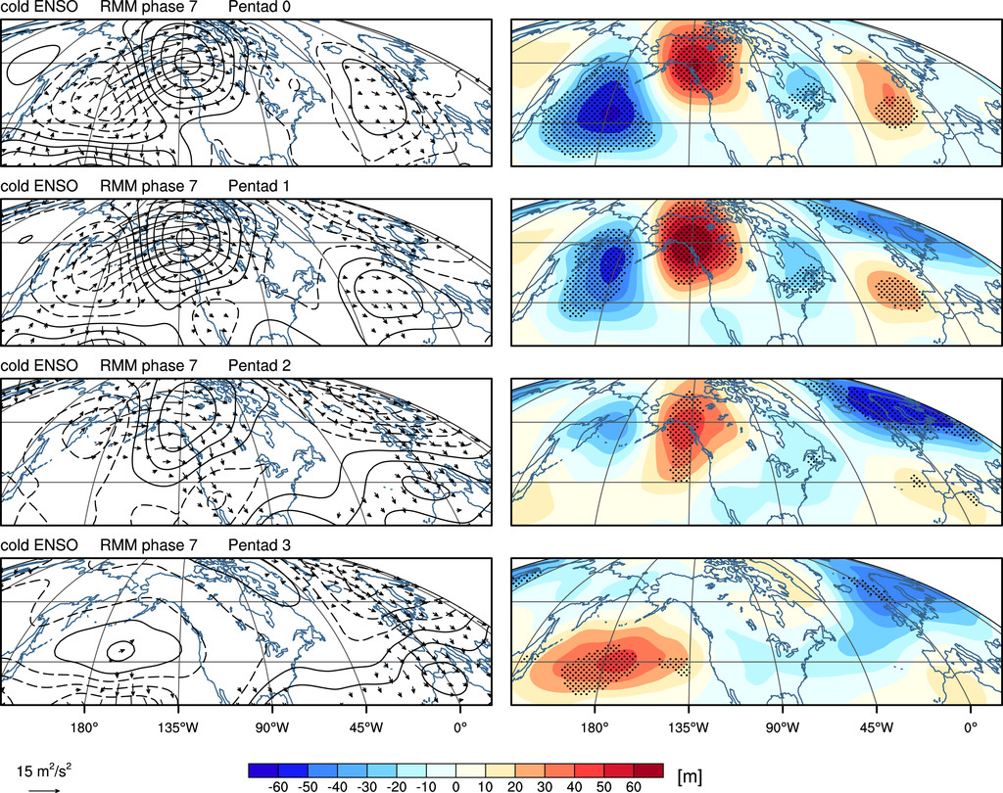
IRI Sub-seasonal Forecast : Attribution
MJO composite during La-Niña conditions
Henderson, and Maloney (2018)

Slide 11
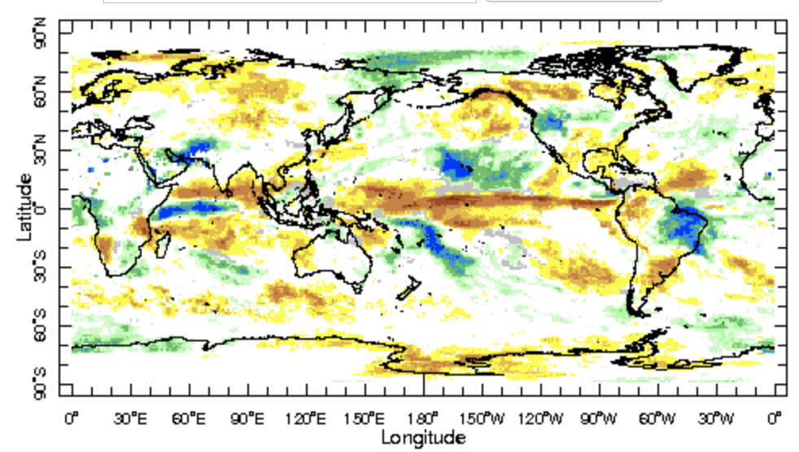
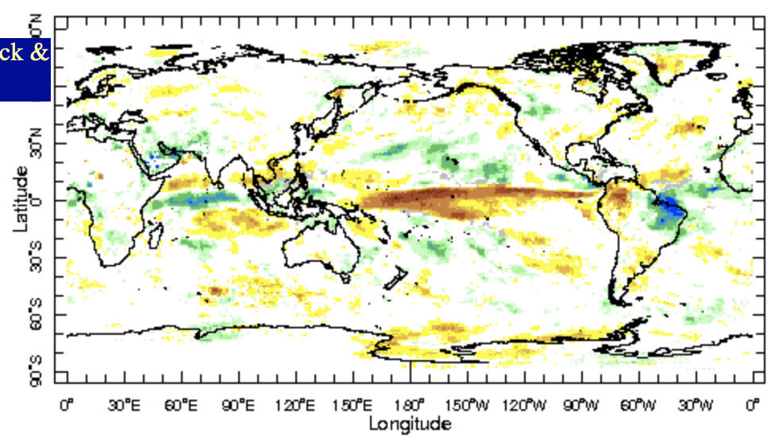

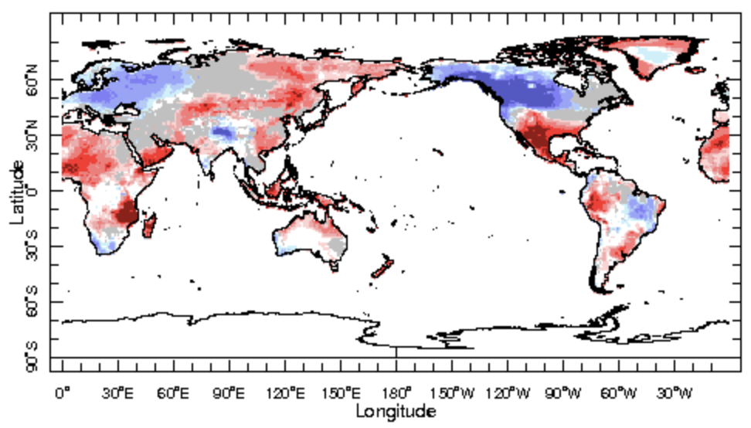
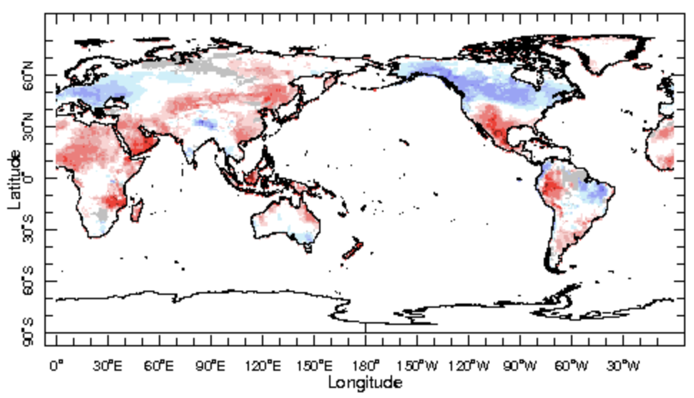

IRI Sub-seasonal Forecast : Updated today
Forecast initialization date Dec 17th
Week 2+3 (27Nov.-10 Dec.)
Week 3+4( 4 Dec.-17 Dec.)

Slide 12
Summary
SST and Circulation over East Pacific consistent with La-Ñina
MJO related convection and circulation have strengthened over the past two weeks and are currently active in phases 7 at the Maritime continent
MJO will not be able to move further eastward due to cold SST anomalies in the central west Pacific and is likely to be active in west Pacific in the next two weeks
Canada and parts of northwest of the United States is likely to experience wet and cold weather over the next two weeks
Central and North Africa are likely to experience above normal temperature

