Slide 1
IRI Climate Briefing: Sep. 15, 2022
Sub-seasonal Update
Bohar Singh
Acknowledgement:
Dr. Andrew Robertson
Jing Yuan
Jeff Turmelle
bohar@iri.Columbia.edu

Slide 2
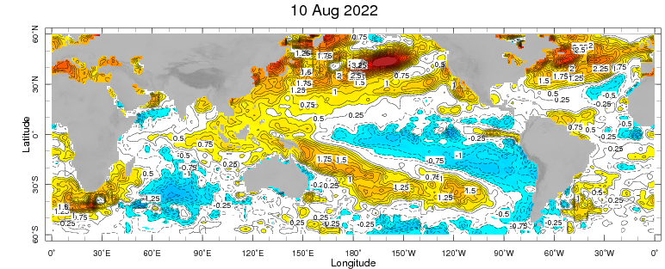
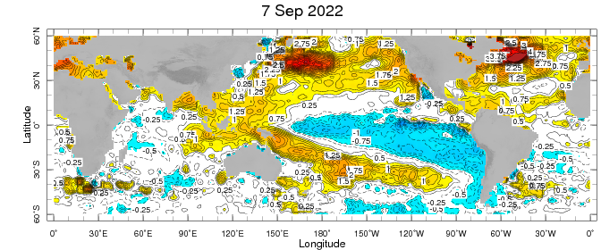
Sub-seasonal climate drivers: State of Climate
Cold anomalies present in eastern and central Pacific and getting stronger
West Pacific warm anomalies retracted and gets stronger as compared to last month
Warm SST anomalies are present sub-tropical pacific, North Atlantic Ocean

Slide 3
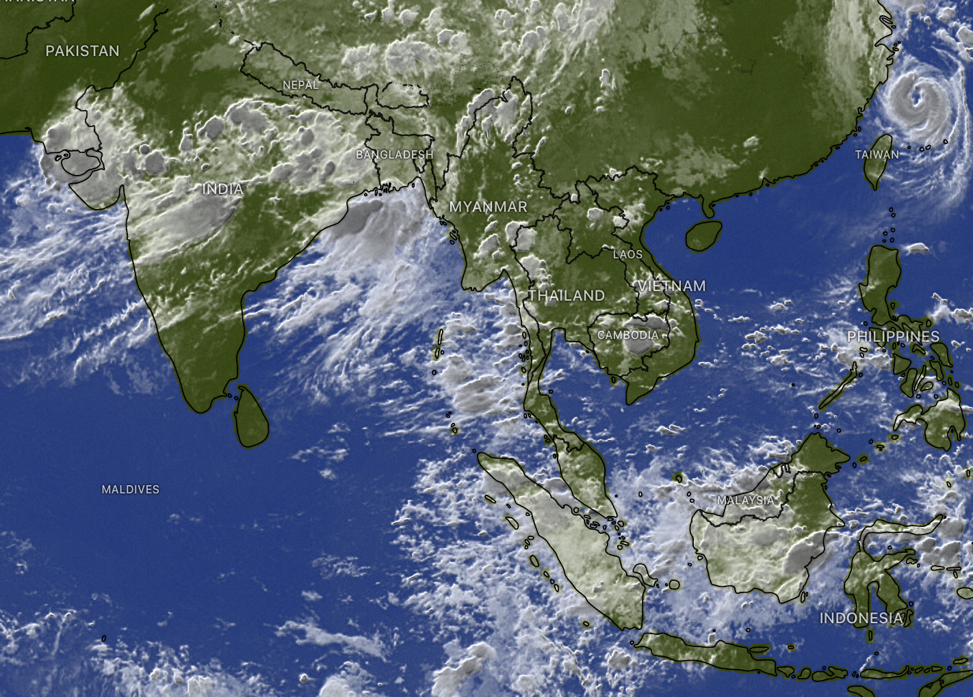
State of the climate: Cloudiness and circulation
13th September
Source : CPC
Source: windy
Northward propagation of convection is observed over Indian subcontinent
Convective clouds band observed in Maritime continent
Cloudiness is observed in the north American Monsoon region and south-to-northeast United States

Slide 4
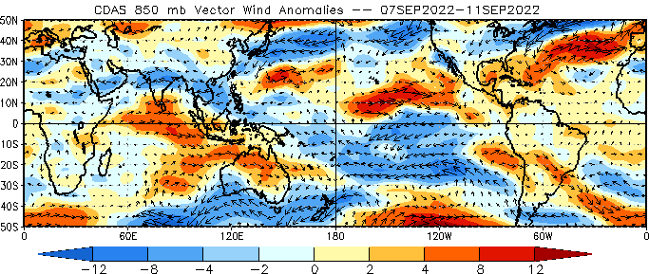
State of the climate: Circulation (850 hPa)
Source : CPC

Slide 5
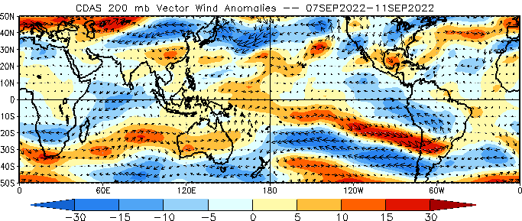
State of the climate: Circulation (200 hPa)
Source : CPC

Slide 6
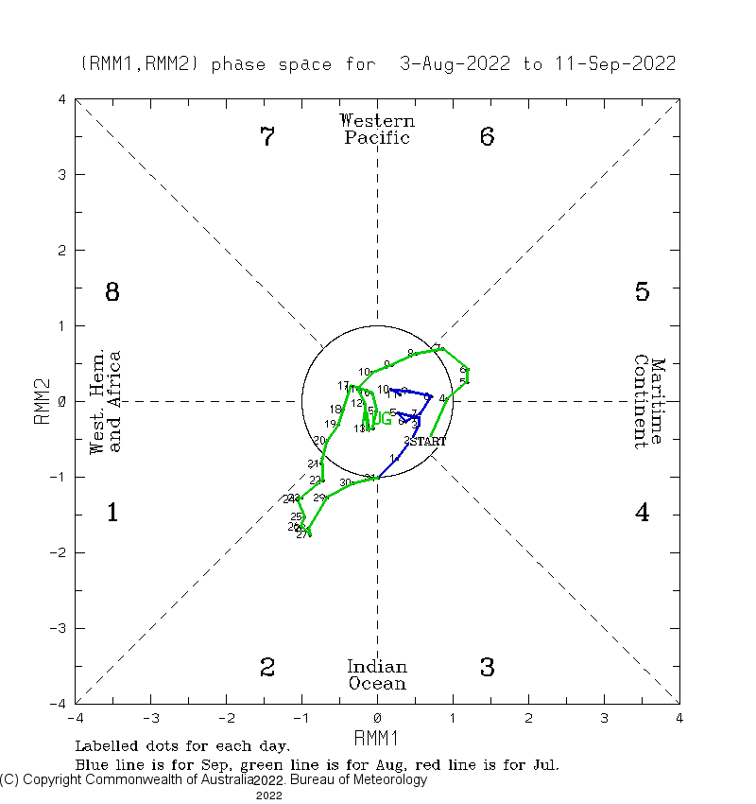
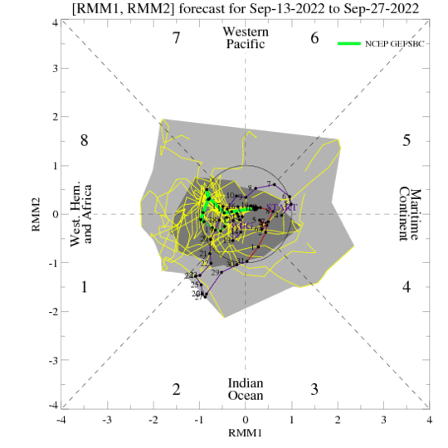
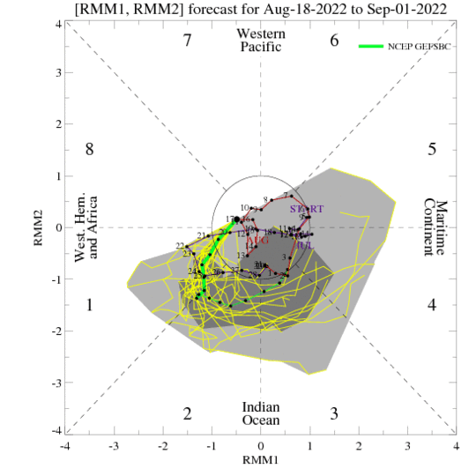
Current and Past evolution of the MJO Wheeler-Hendon Indices
MJO 15-day Forecast from NCEP GEFS model
Currently MJO is within unit circle and expected to be remain same

Slide 7
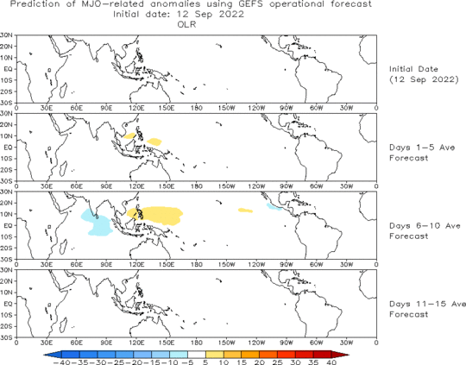
MJO 15-day Forecast from NCEP GEFS model
The GEFS forecast suggest in-active MJO in the next two weeks.

Slide 8
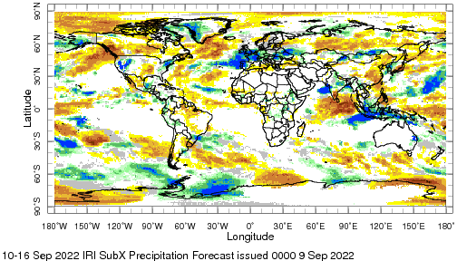
IRI Sub-seasonal Forecast: Precipitation (week 1)
Week:1: (10-16. Sep.).
Forecast issue date: Sep 9th
Above normal rainfall is likely over central and northern India
West African monsoon region is likely to get below normal
rainfall
Above normal rainfall anomalies are likely over NW, and NE Western United States

Slide 9
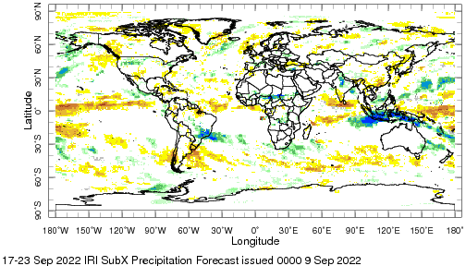
IRI Sub-seasonal Forecast: Precipitation (week 2)
Week:2: (17-23 Sep.).
Forecast issued date Sep 9th
Above normal rainfall is likely over maritime continent and northern India
Sub Saharan Africa and/ southern Brazil region is also likely to get above normal rainfall
Dry rainfall anomalies are likely over NW Canada

Slide 10
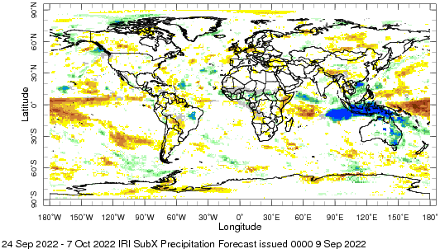
IRI Sub-seasonal Forecast: Precipitation (week 3 &4)
Week:34: (24 Sep- 7 Oct.).
Forecast issue date: Sep 9th
Above normal rainfall is likely over maritime continent and eastern Australia region
Wet rainfall anomalies are
likely in Alaskan region
Wet rainfall anomalies are
likely in sub central Africa
Dry rainfall anomalies are
equatorial Pacific Ocean

Slide 11
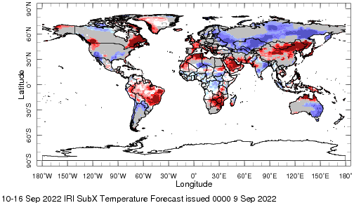
IRI Sub-seasonal Forecast : Near-Surface Temperature (week:1)
Week:1: (10-16. Sep.).
Forecast issue date: Sep 9th
Above normal near surface temperature is likely over Northwest USA, eastern Canada and Alaska
Above normal near surface temperature is likely over Brazil
Below normal near surface temperature is likely Indian and Pakistan regions
Below normal near surface temperature is likely over Eastern Australia
Below normal near surface temperature is likely central Africa

Slide 12
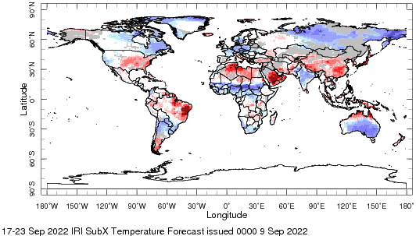
IRI Sub-seasonal Forecast : Near-Surface Temperature (Week:2)
Week:2: (17-23 Sep.).
Forecast issued date Sep 9th
Above normal near surface temperature is likely over southern and southeast states in the United States
Above normal near surface temperature is likely over China, northern Africa and large parts of South America
Below normal near surface temperature is likely over sub Saharan Africa
Below normal near surface temperature is likely Southern Australia, India, eastern parts of Canada and Russia

Slide 13
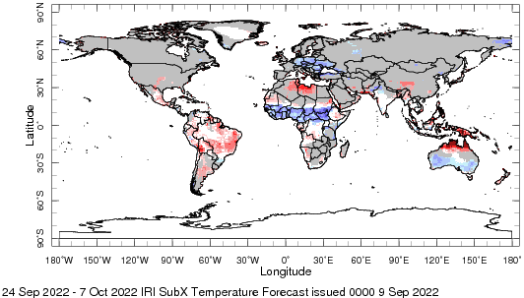
IRI Sub-seasonal Forecast : Near-Surface Temperature (week 3-4)
Week:34: (24 Sep.-7 Oct.).
Forecast issue date: Sep 9th
Near normal surface temperature is likely over the United States and Canada
Below normal near surface temperature is likely over parts of Europe
Below normal near surface temperature is likely over central Africa
Above normal temperature is likely over Brazil

Slide 14
Summary
La Niña is active
MJO related convection and circulation are currently in-active most likely remain in-active for next two weeks.
Indian subcontinent and Maritime continent are likely to get above normal rainfall from week 1-4
Above normal near surface temperature is likely over China and parts of north Africa for week 1-2.

