Slide 1
IRI Climate Briefing: April. 21, 2022
Sub-seasonal Update
Bohar Singh
Acknowledgement:
Jing Yuan
Dr. Andrew Robertson
Jeff Turmelle
bohar@iri.Columbia.edu

Slide 2
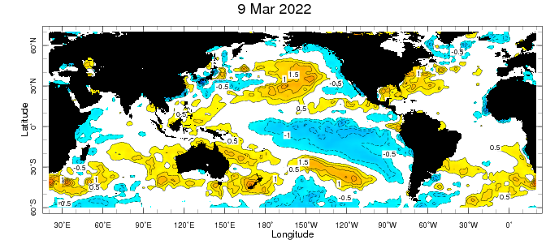
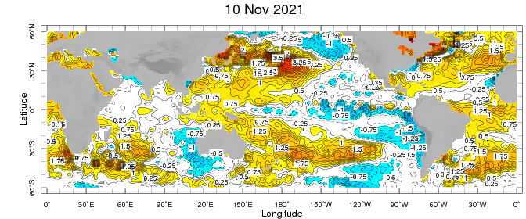
Sub-seasonal climate drivers: State of Climate
Cold anomalies in eastern and central Pacific become weaker
Warm-pool get stronger as compared to last month
SST anomalies in sub-tropical Pacific and Atlantic Ocean are also become stronger

Slide 3
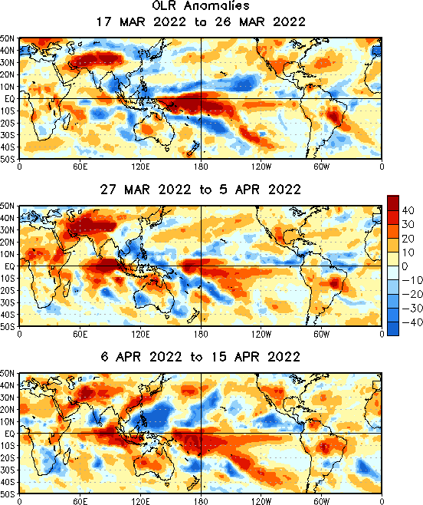
State of the climate: OLR Anomalies
Clear-sky over central Pacific during last month
Northward shift in cloudiness at north of maritime
continent.
Clear sky is well west of date-line.
Clear sky over western and southern United States.
North-eastward shift in cloudiness in northeast
Pacific ocean
Clear sky conditions over eastern Indian Ocean.

Slide 4
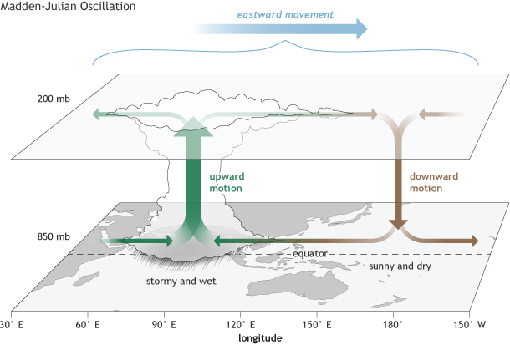
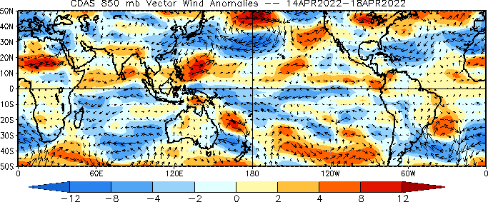
Sub-seasonal climate drivers
H
L
Upper level
No upper-level divergence in the Indian and west Pacific Ocean indicating inactive MJO
At lower level, the winds are
easterlies in the central and west Pacific Ocean
Lower level

Slide 5
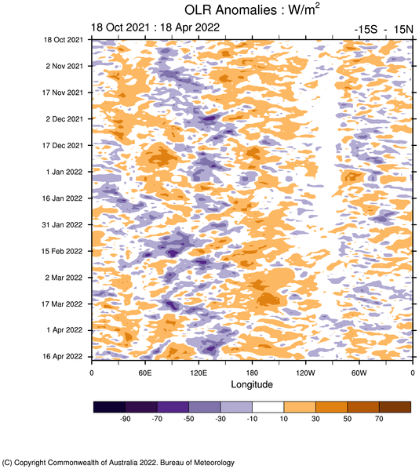
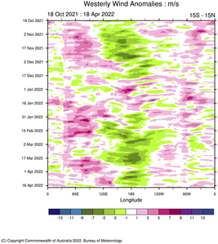
Current and Past evolution of the MJO
Circulation and cloudiness suggest in-active state of MJO

Slide 6
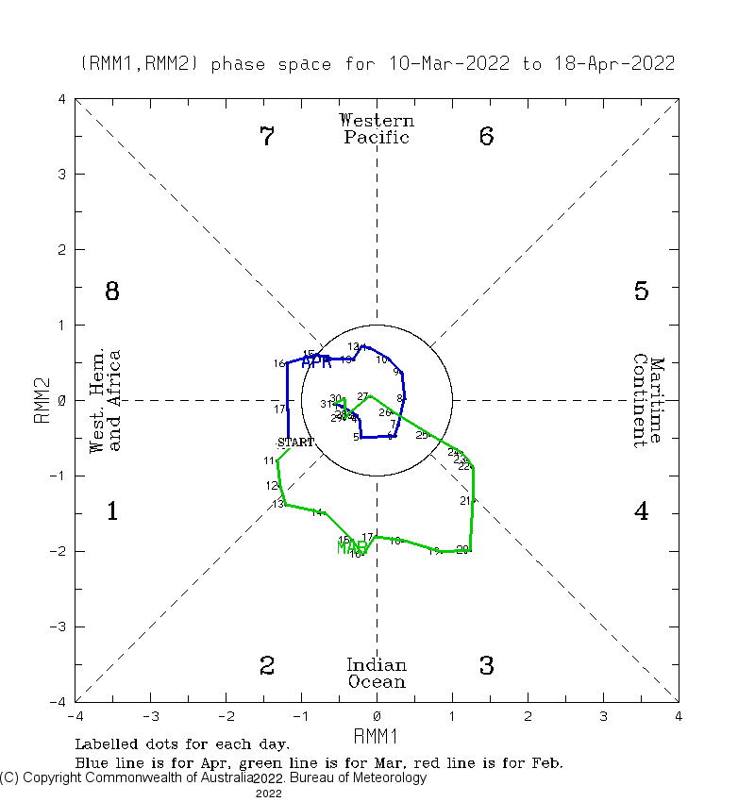
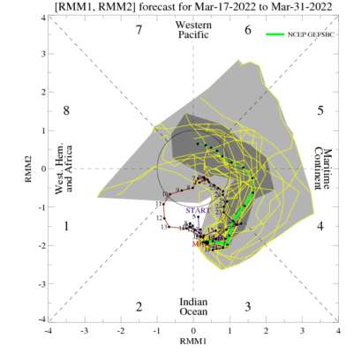
Current and Past evolution of the MJO Wheeler-Hendon Indices
MJO 15-day Forecast from NCEP GEFS model
MJO index in moderately above 1 from past week

Slide 7
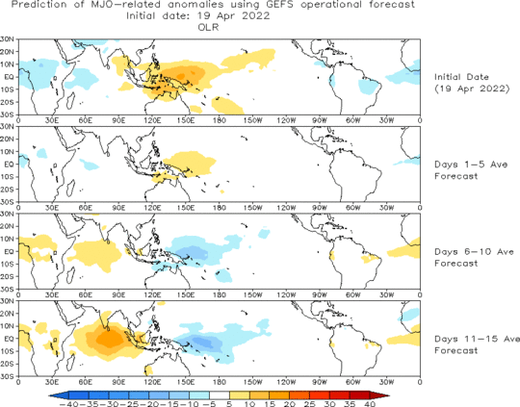
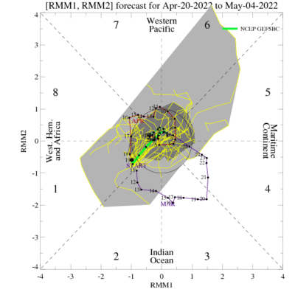
MJO 15-day Forecast from NCEP GEFS model
The ensemble mean RMM forecast suggest weakening of MJO in phase 1 For the next weeks.

Slide 8
Sub-seasonal Forecast: Weather Regimes
!!! Weather Regimes forecast ended on 31st of March 2022 !!!

Slide 9
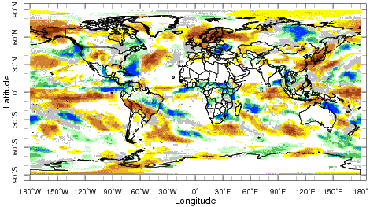
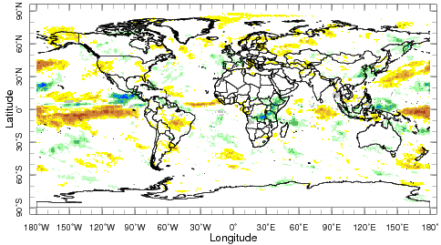
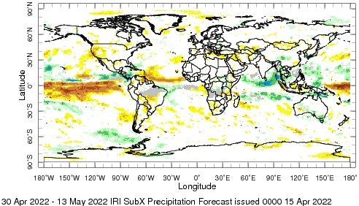
IRI Sub-seasonal Forecast: Precipitation
Week:1: (16-22 Apr.).
Forecast issue date Apr 15th
Week:2 (23 -29 Apr.)
Central and South Africa is likely to get above normal
rainfall in next two weeks
Above normal precipitation is likely north of Maritime
continent in week 3+4,
North-eastward propagation of OLR anomalies in
north-east Pacific is likely
Dry rainfall anomalies are likely over WUS weeks 2 and
weeks 3+4
Week:3+4 (30 Apr.-13 May.)

Slide 10
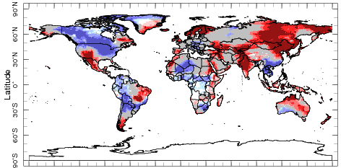
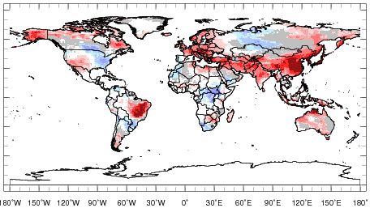
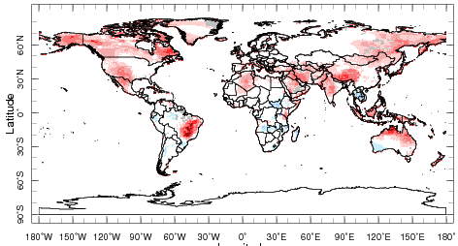
IRI Sub-seasonal Forecast : Near-Surface Temperature
Week:1: (16-22 Apr.).
Forecast issue date Apr 15th
Week:2 (23 -29 Apr.)
Week:3+4 (30 Apr.-13 May.)
Below normal temperature is likely over North America
except southwestern part of United Stated during week 1.
Above normal average temperature is likely over Asia during next 4 weeks
Temperature over central Africa is expected to be below normal for next two weeks
Above normal temperature is likely over northwest United States over the next few weeks

Slide 11
Summary
SST and Circulation over East Pacific become weaker during last month.
MJO related convection and circulation are currently active most likely to be in-active during next two weeks.
Northwest of the United States and northern Canada is likely to experience cold weather over the next week.
South Asia likely to experience above normal temperature from week 1-2 and week 3-4.
South-western United States likely experience above normal near surface temperature next few weeks.

