Slide 1
SPRINGTIME Tornadoes and the global wind oscillation
Victor Gensini, Ph.D.
Associate Professor
Meteorology Program
College of Dupage (NEXLAB)
9 March 2016 Severe Convection & Climate Workshop

Slide 2
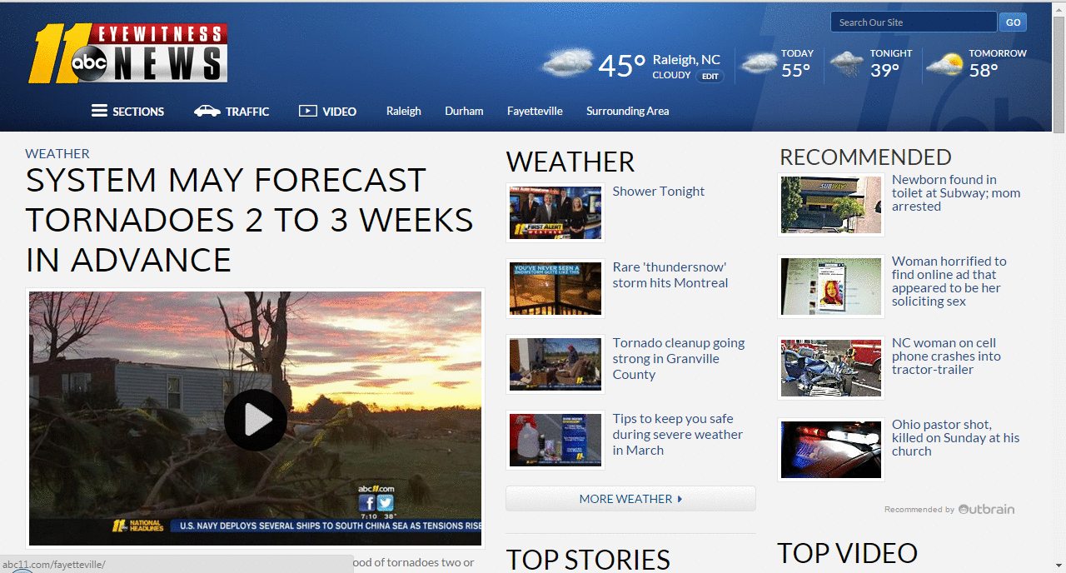
It’s been an interesting week…

Slide 3
What is the Global Wind Oscillation (GWO)?
Based on Atmospheric Angular Momentum (AAM)
AAM first described in the early 80s [Langley et al., 1981]
GWO first described as a Global Synoptic Dynamic Model [Weickmann and Berry, 2007]
GWO terms
Mr (Global Relative Angular Momentum)
dMr/dt (Global Relative Angular Momentum Tendency)
8 GWO Stages similar to half phase space of the MJO
GWO similar to MJO framework, but accounts for other sources of change to the Global AAM budget
Frictional Torque
Mountain Torque
Meridional Momentum Transport

Slide 4
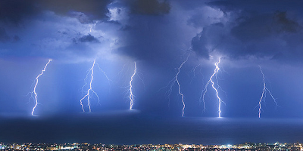
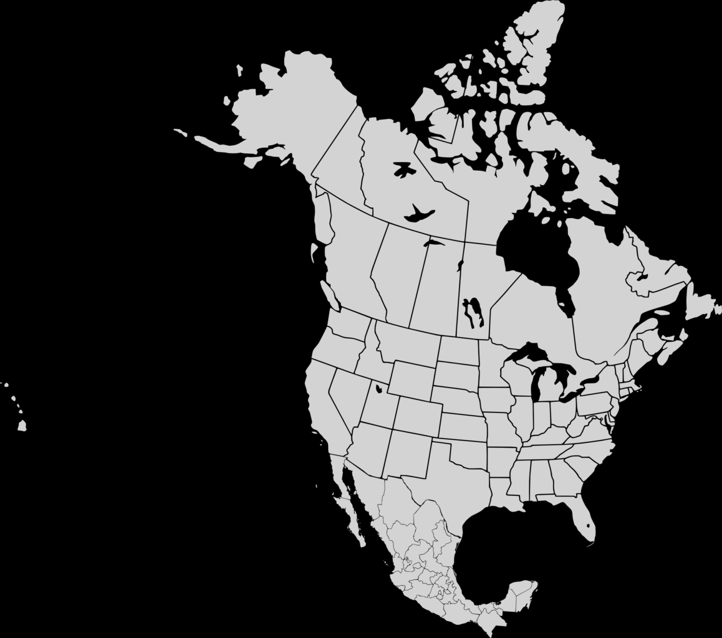
High AAM

Slide 5
Low AAM

Slide 6
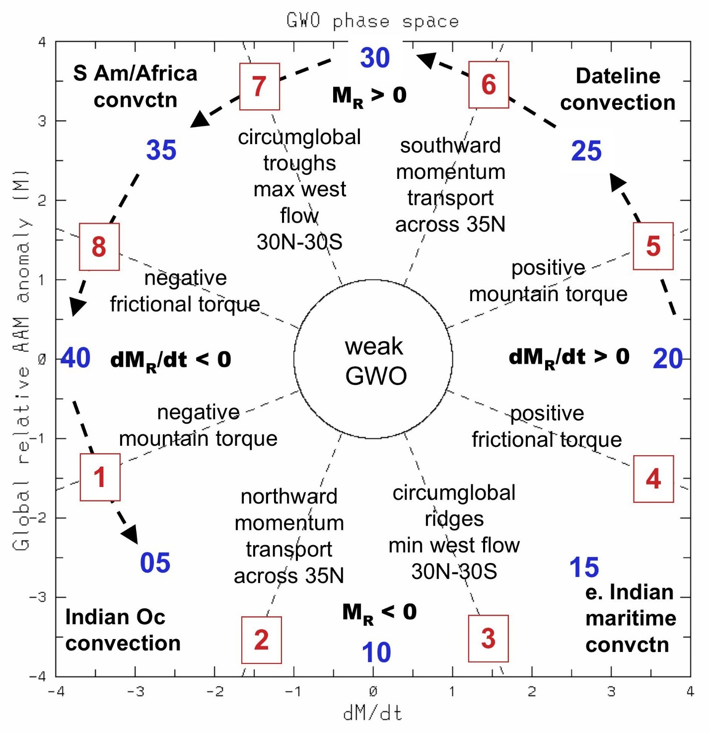
GWO Phase Space
High M_{R} Niño Like
Low M_{R} Niña Like

Slide 7
Research Questions / Data
Does Peak Season U.S. tornado activity vary by GWO Phase?
Reports, Tornado Days, Environments
Does it depend on month?
How does amplitude of the GWO influence variability?
GWO Data from ESRL / Tornado Data from SPC / NARR
1994 – 2013
March / April / May / June

Slide 8
Tornadoes by GWO Phase

Slide 9
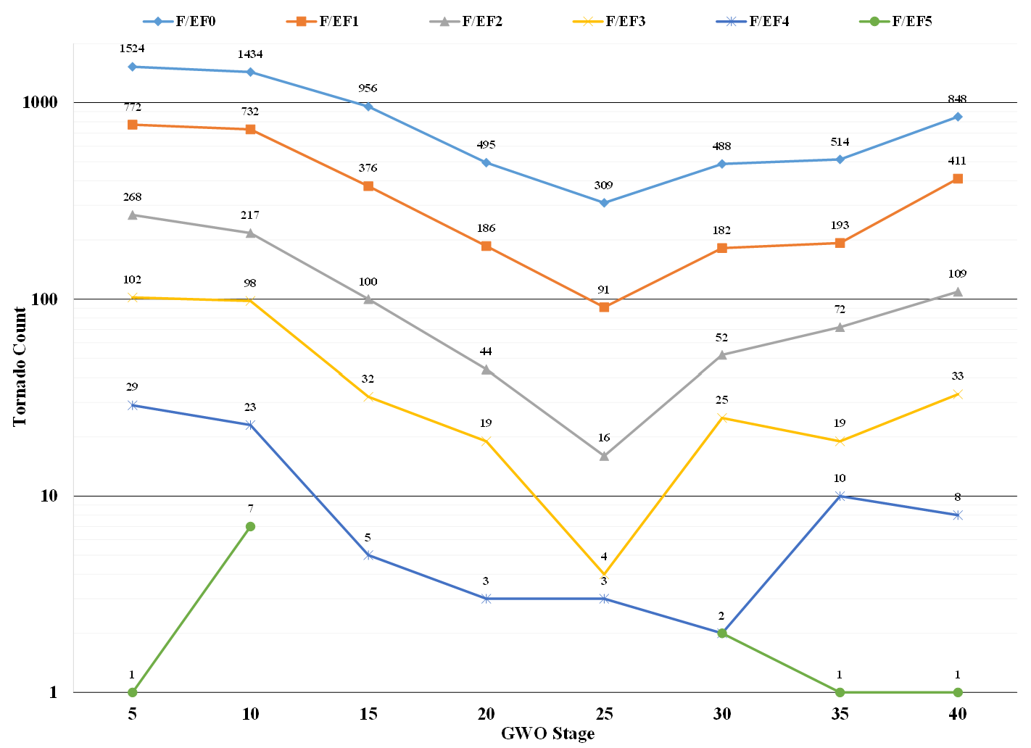

Slide 10
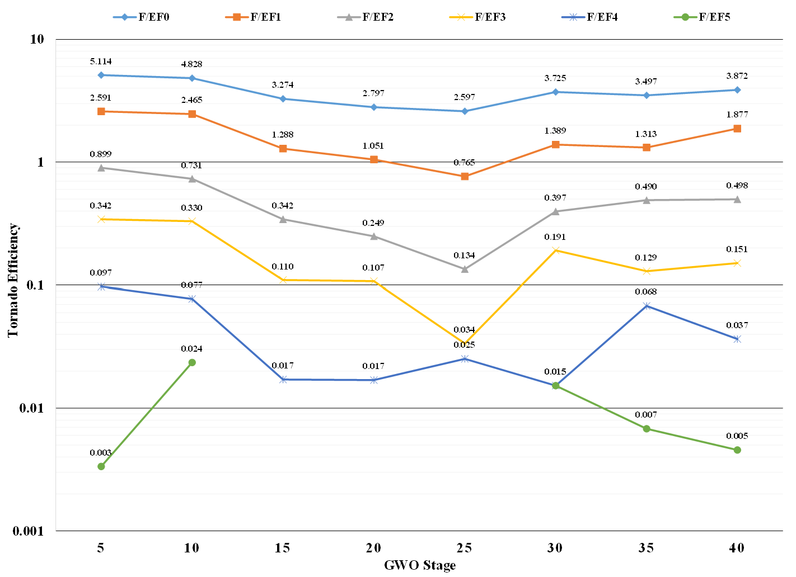
~1 F2/Day
~1 F3/ 3 Days
~1 F2/ 13 Days
~1 F3/ 34 Days

Slide 11
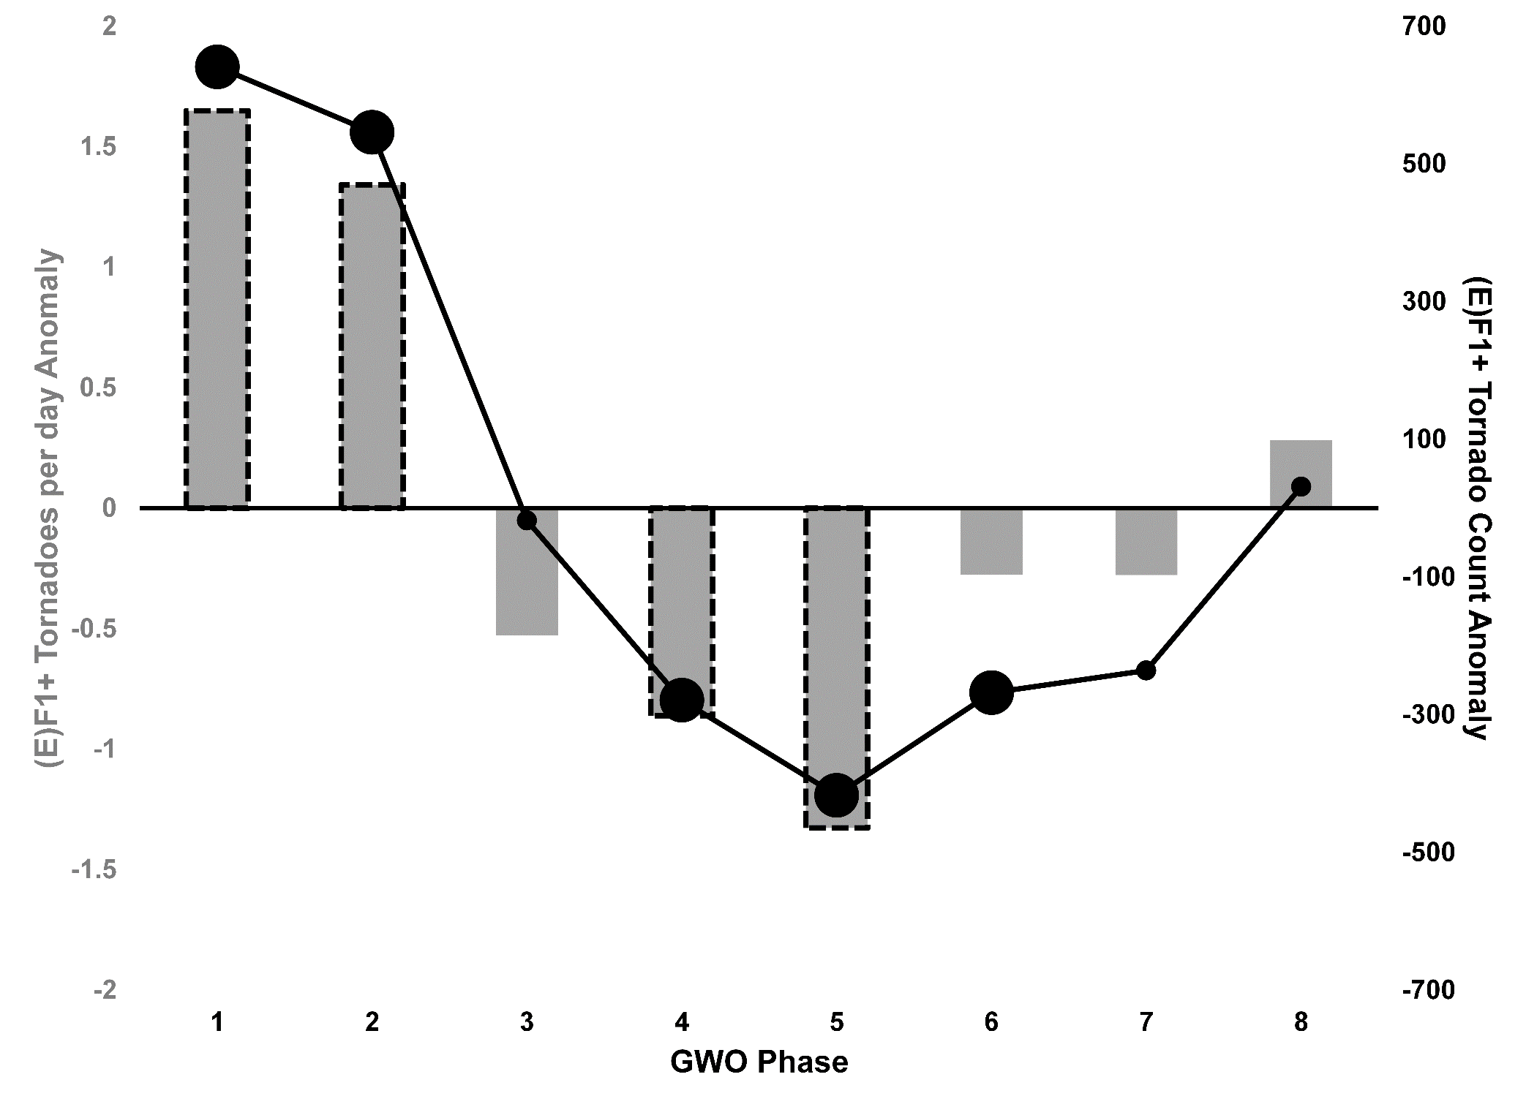

Slide 12
Spatial PLOTS

Slide 13
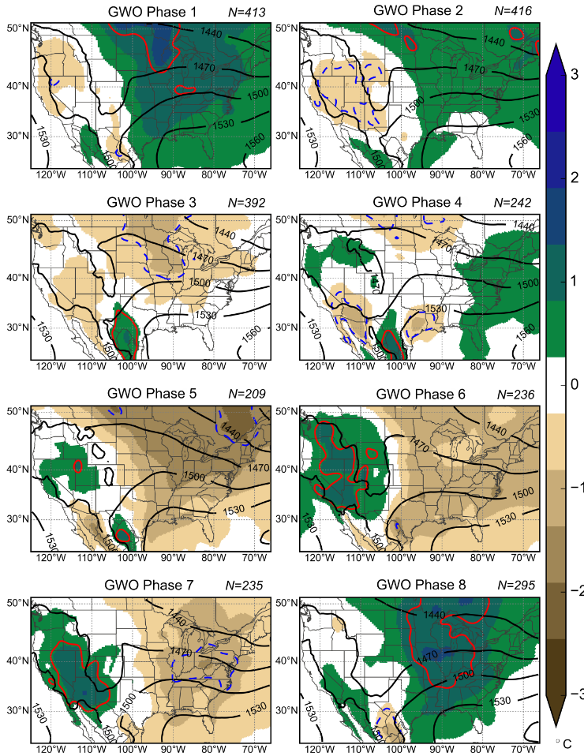
2100 UTC
1994-2013 (March-June)
Surface Td Anomaly (°C)

Slide 14
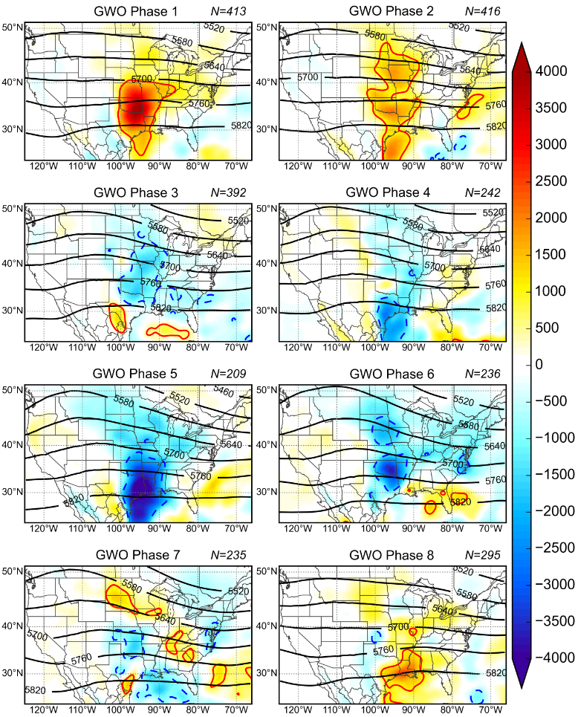
2100 UTC
1994-2013 (March-June)
SBCAPE * 0-6 KM BWD
(NDSEV Anomaly)

Slide 15
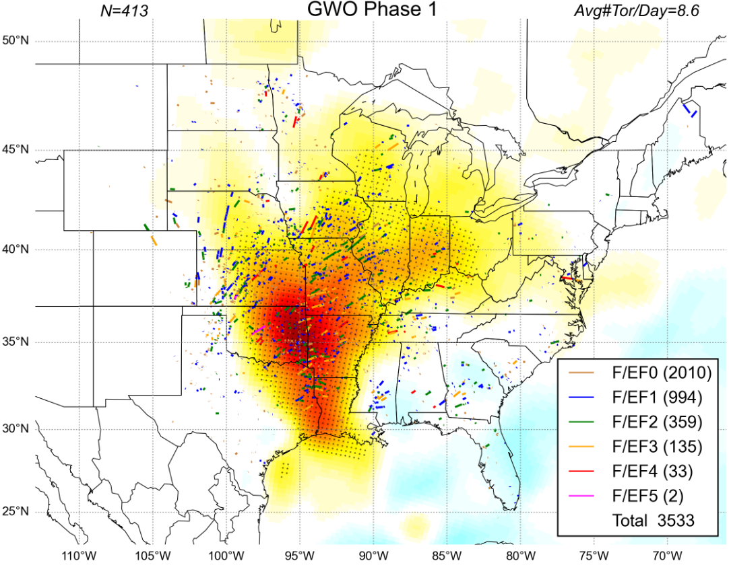

Slide 16
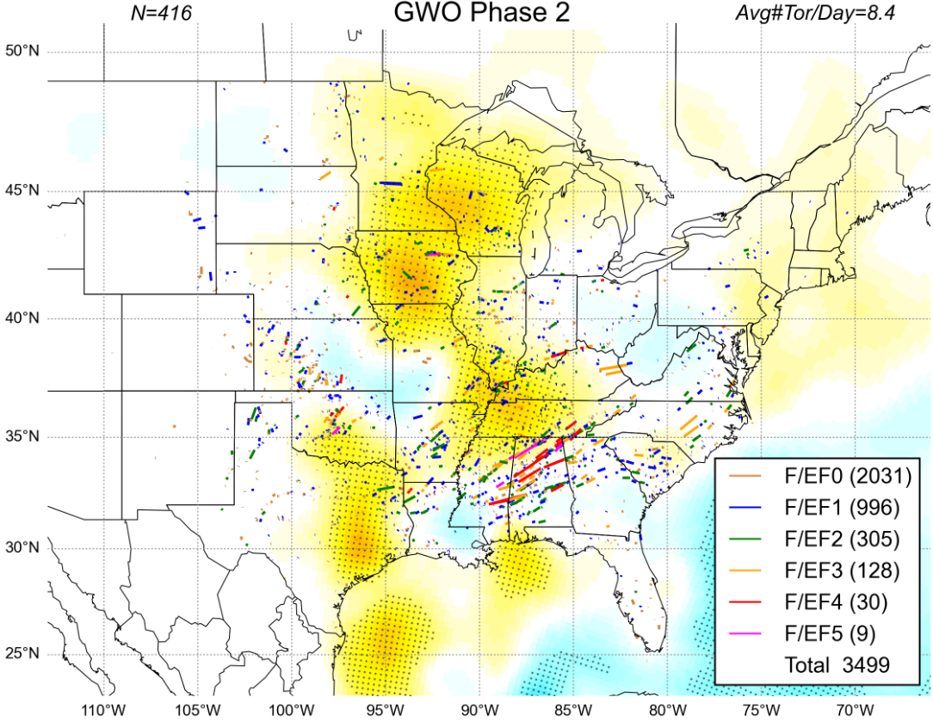

Slide 17
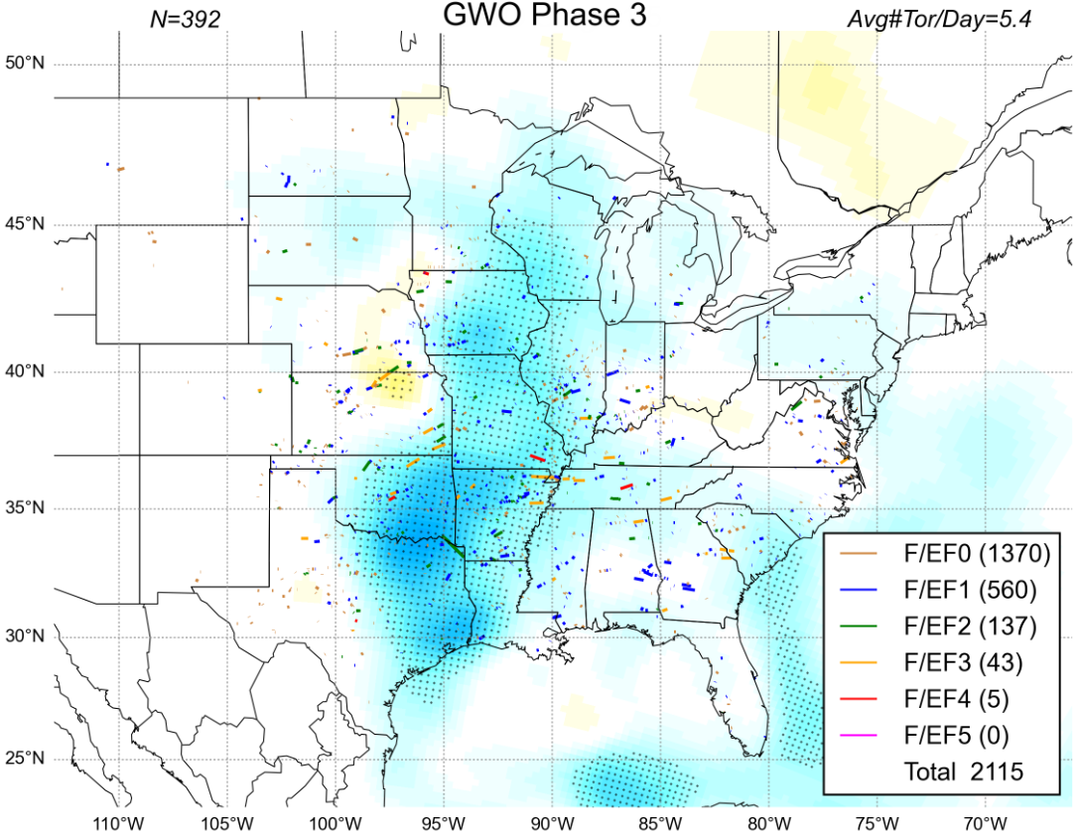

Slide 18
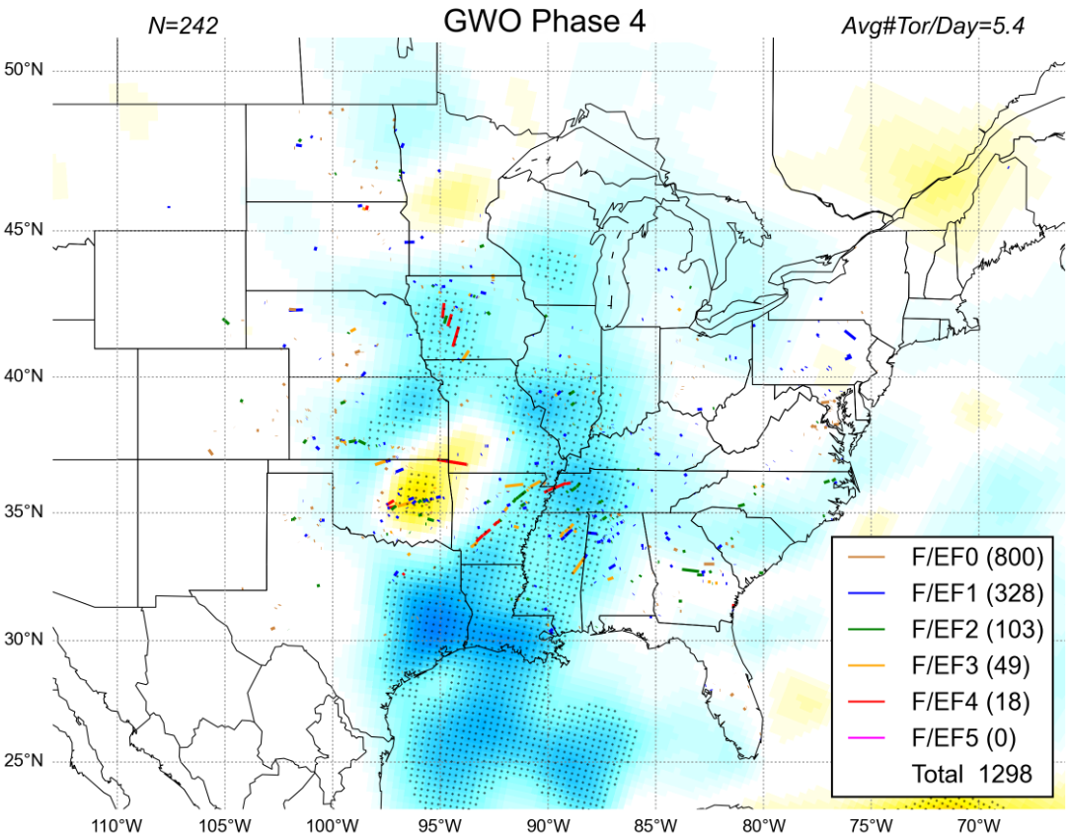

Slide 19
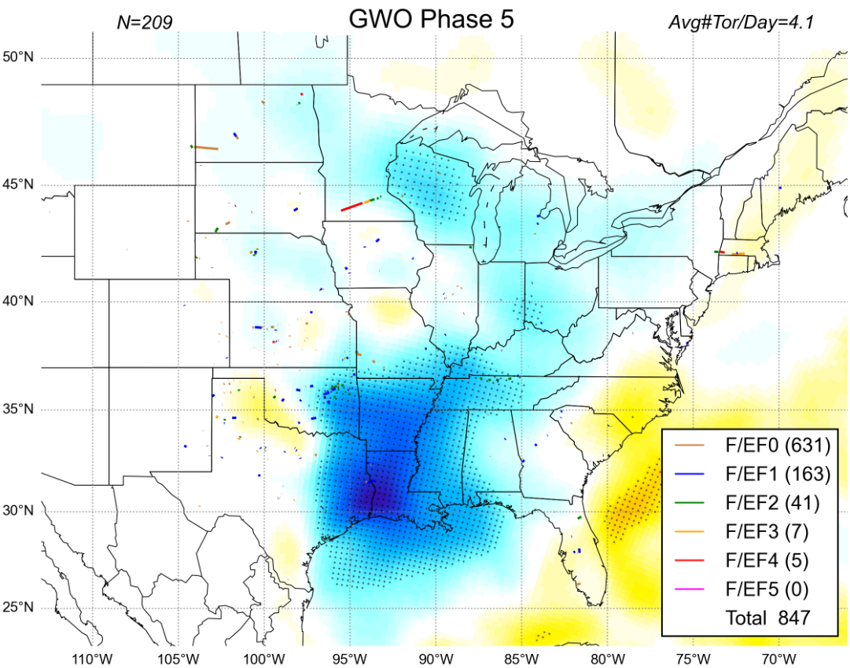

Slide 20
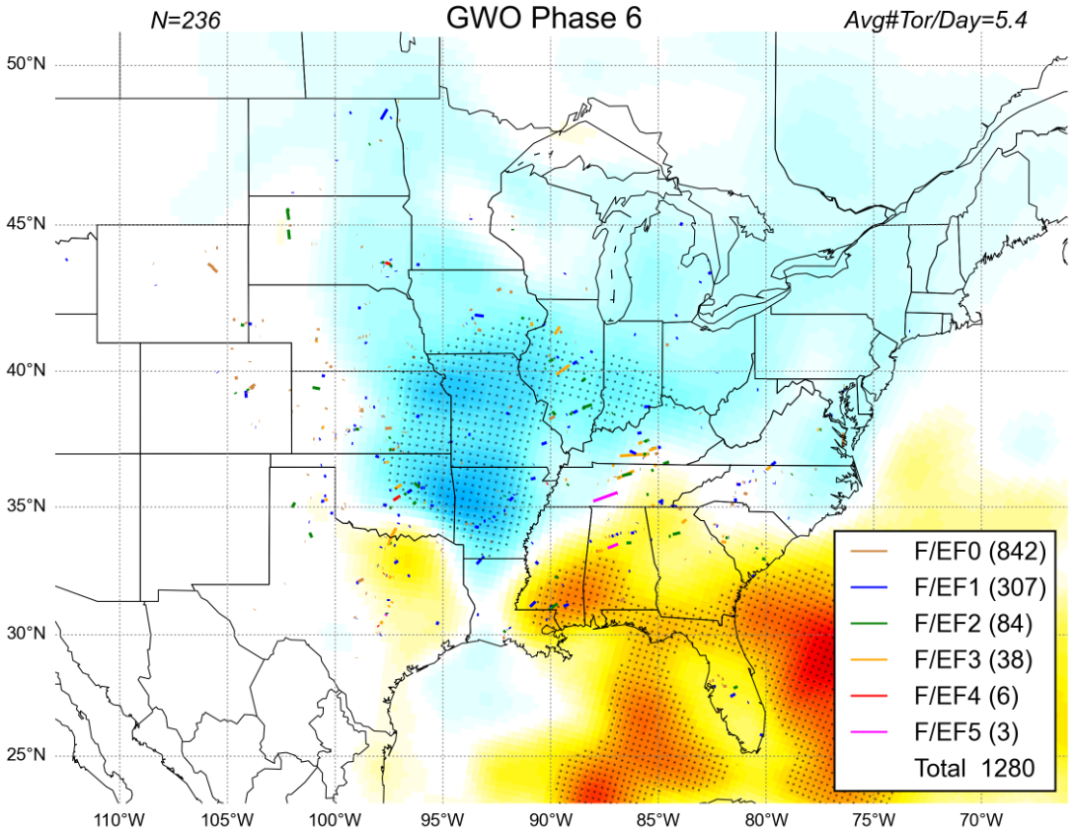

Slide 21
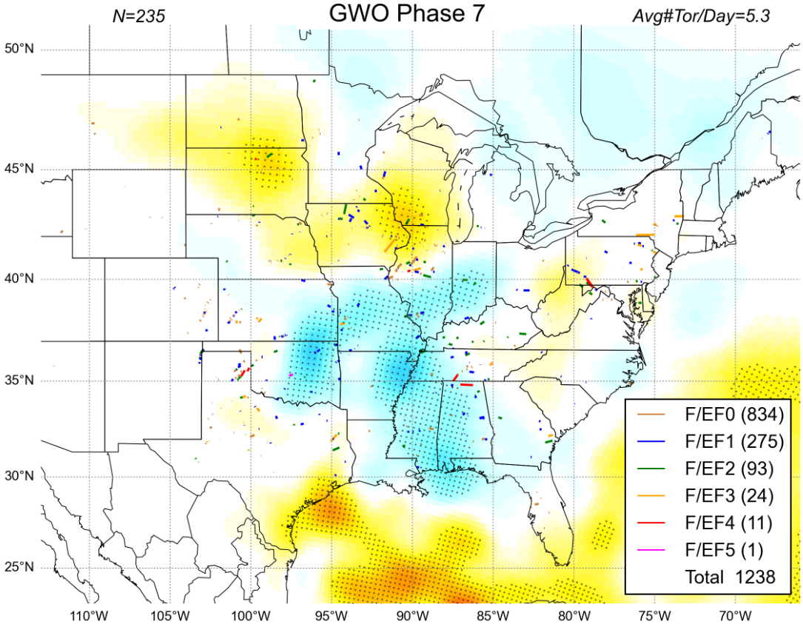

Slide 22
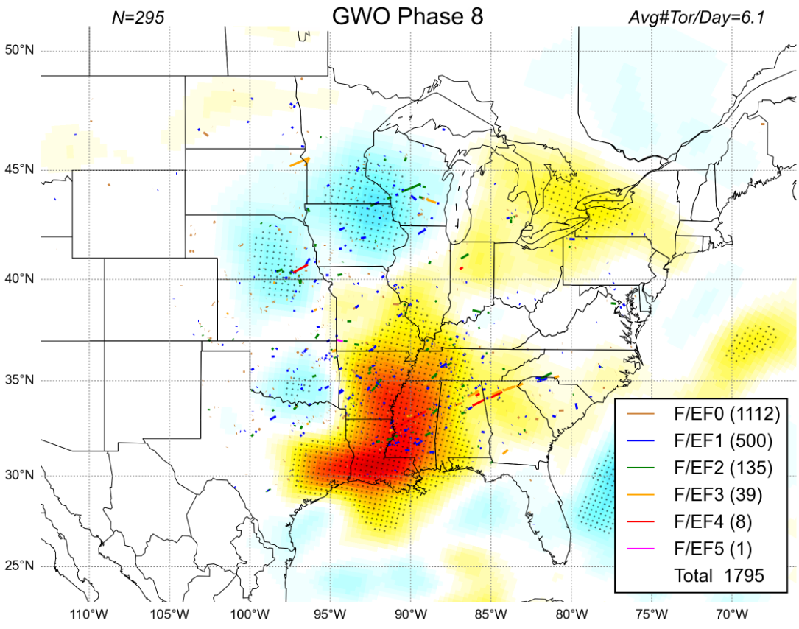

Slide 23
Phase Space

Slide 24
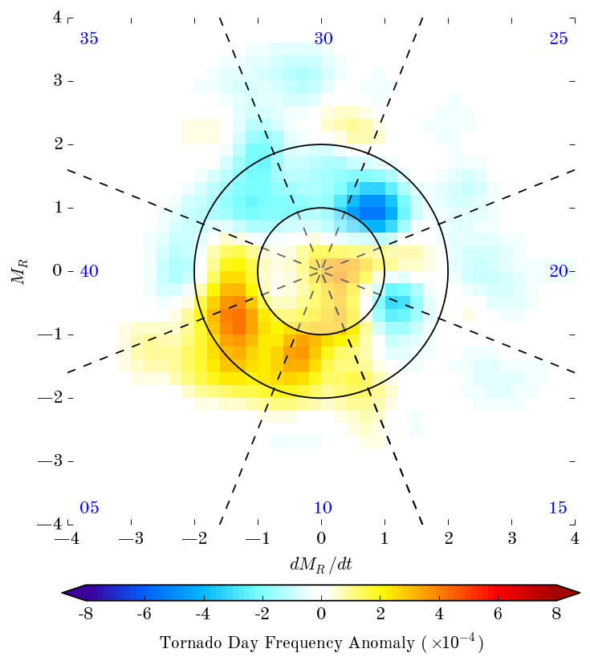
7
6
5
8
1994-2013
March-June ≥F/EF0
4
1
2
3

Slide 25
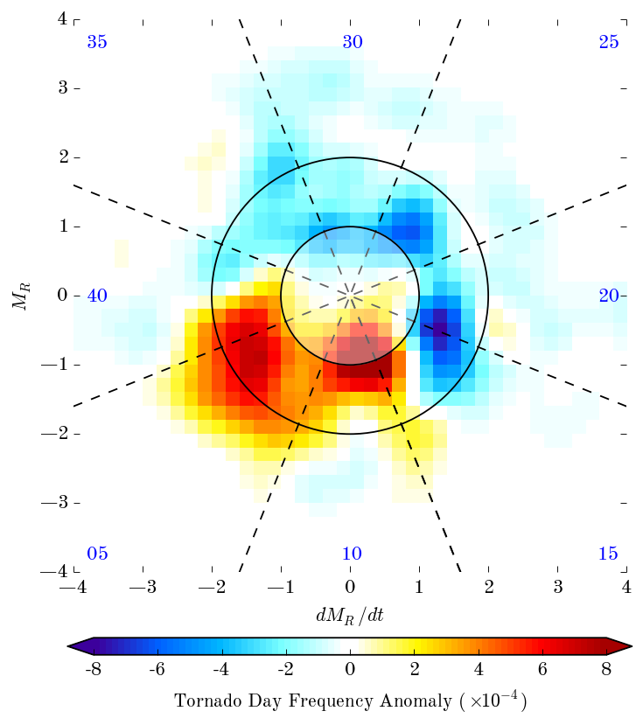
7
6
5
8
1994-2013
March-June ≥F/EF1
4
1
2
3

Slide 26
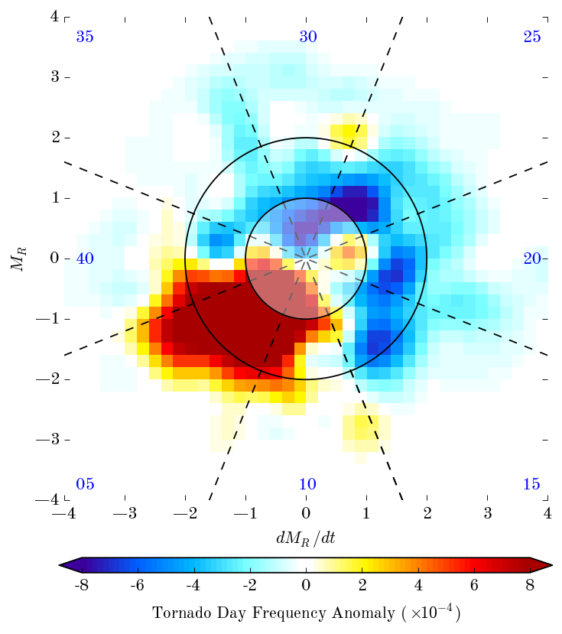
7
6
Decreasing M_{R}
- Torque
+Africa +PNA Pattern
F2 ~8x less likely
5
8
F2 ~3x less likely
DY14
DY7
1994-2013
March-June ≥F/EF2
Start
DY28
4
1
Increasing M_{R}
+ Torque
+E. Indian Ocean -PNA Pattern
F2 ~15x more likely
2
3

Slide 27
Impact of Phase Amplitude

Slide 28
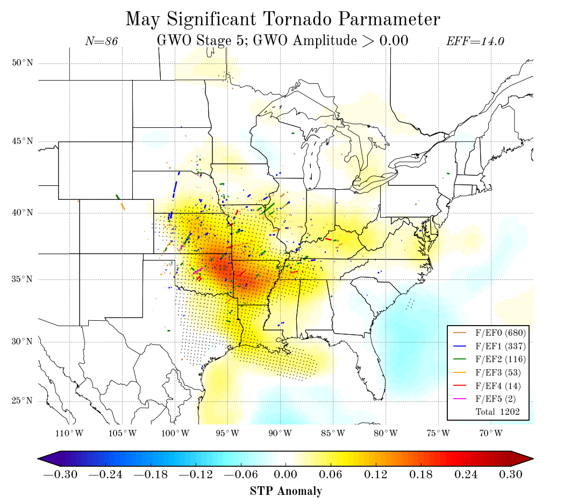

Slide 29
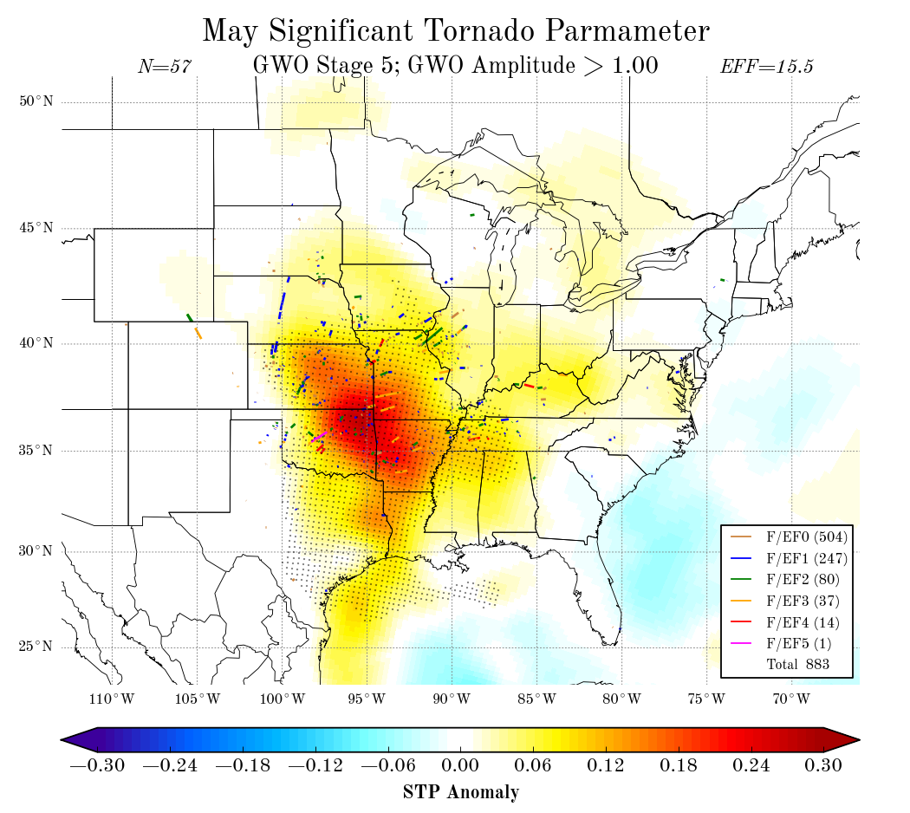

Slide 30
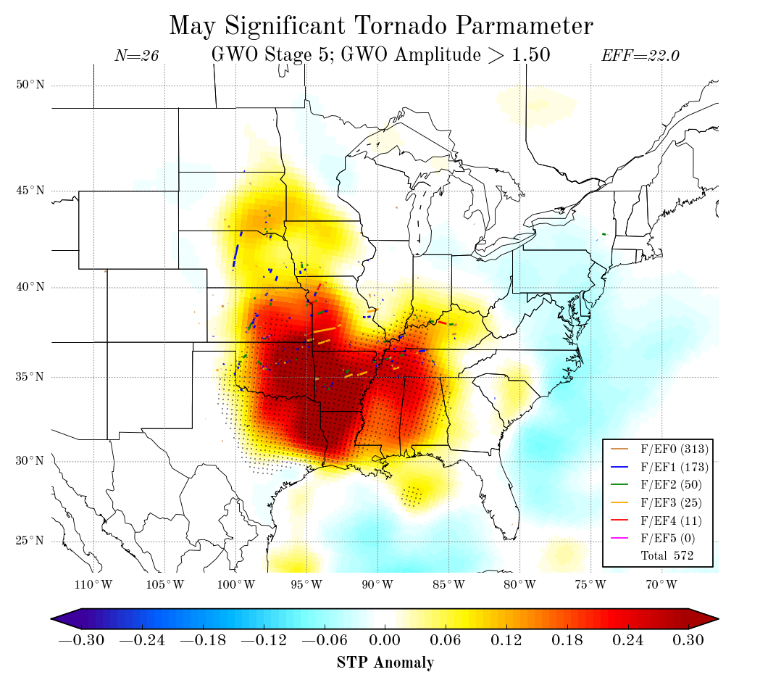

Slide 31
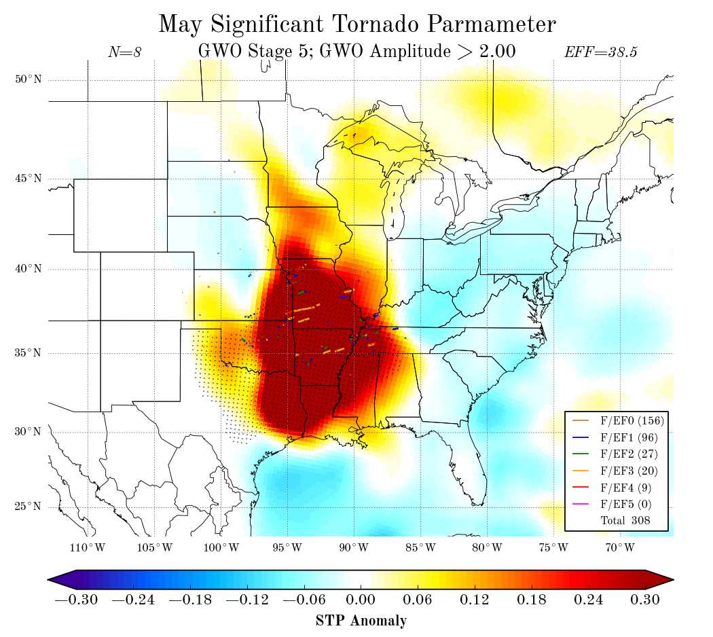

Slide 32
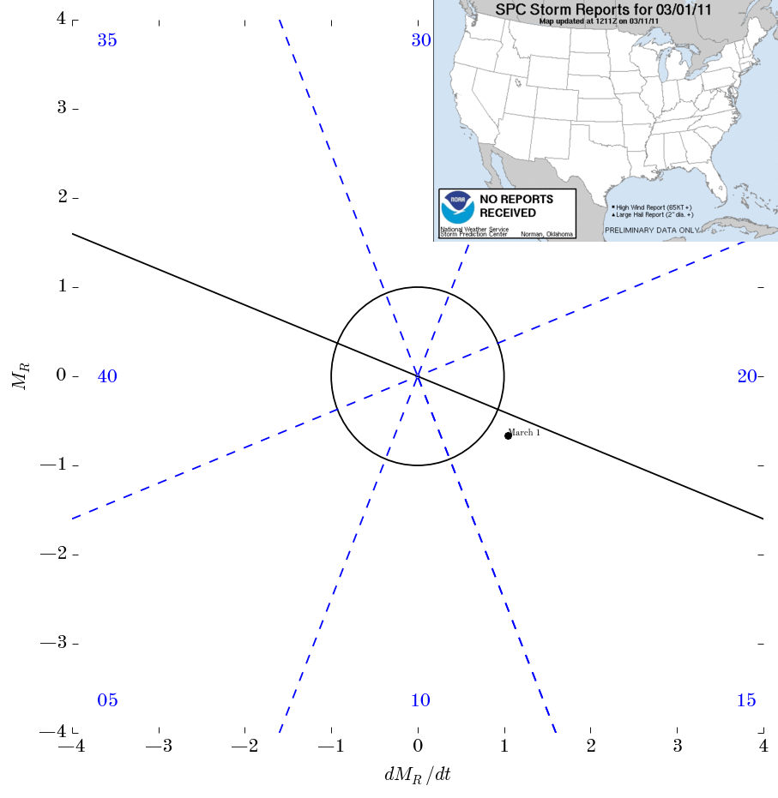
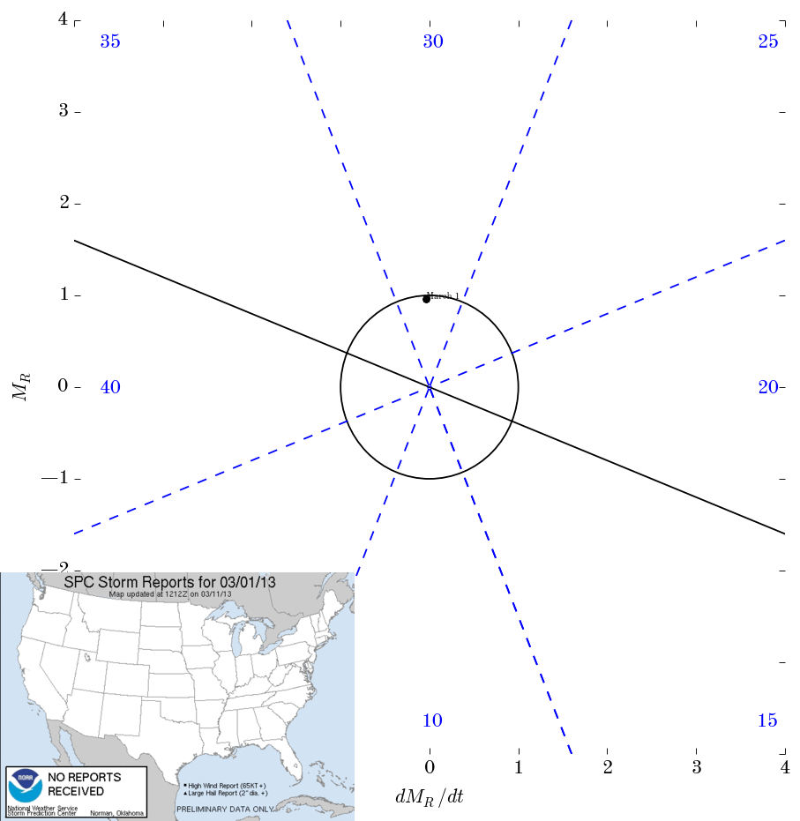
Mar-May 2011
Mar-May 2013

Slide 33
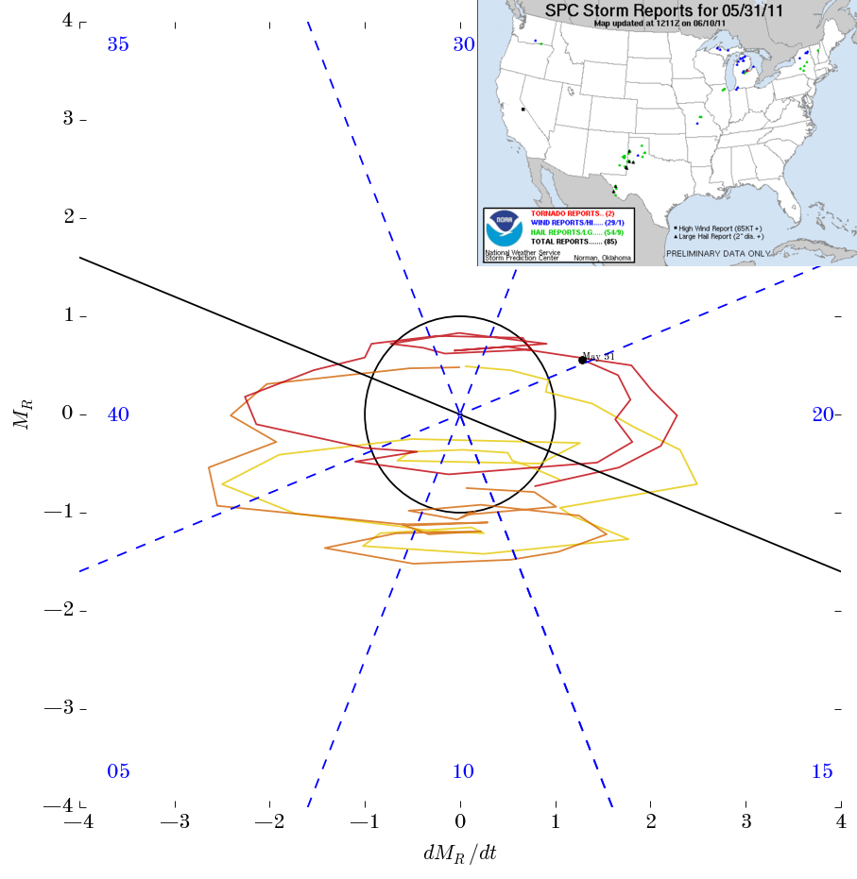
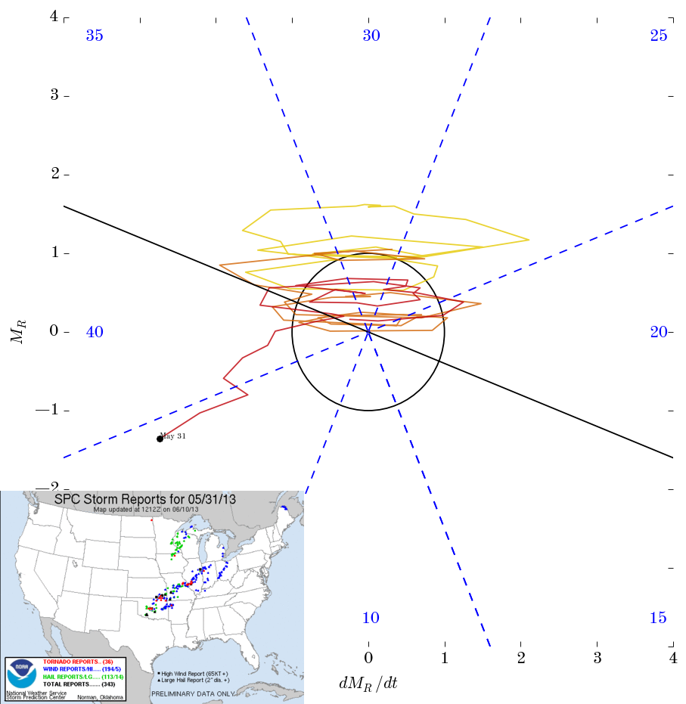
Mar-May 2011
Mar-May 2013
Mar 75
Apr 758
May 326
TOTAL Tornadoes - 1,195
Mar 18
Apr 86
May 267
TOTAL Tornadoes - 371

Slide 34
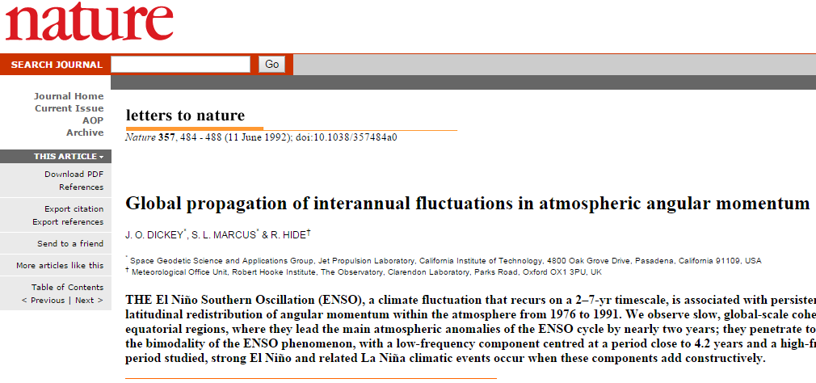
Interannual Variability ?

Slide 35
Summary
GWO Phase explains an order of magnitude in the variability of MAMJ U.S. Tornadoes
Above normal tornado activity in Phases 8-1-2
Below normal tornado activity in Phases 4-5-6
GWO Amplitude appears to be related to tornado day efficiency
↑ Amplitude, ↑ Efficiency

Slide 36
Where do we go from here?
Any subseasonal forecast for tornadoes should incorporate gwo information
Need more GWO monitoring products
Momentum fields often better forecast by models
GWO is not the silver bullet…

Slide 37
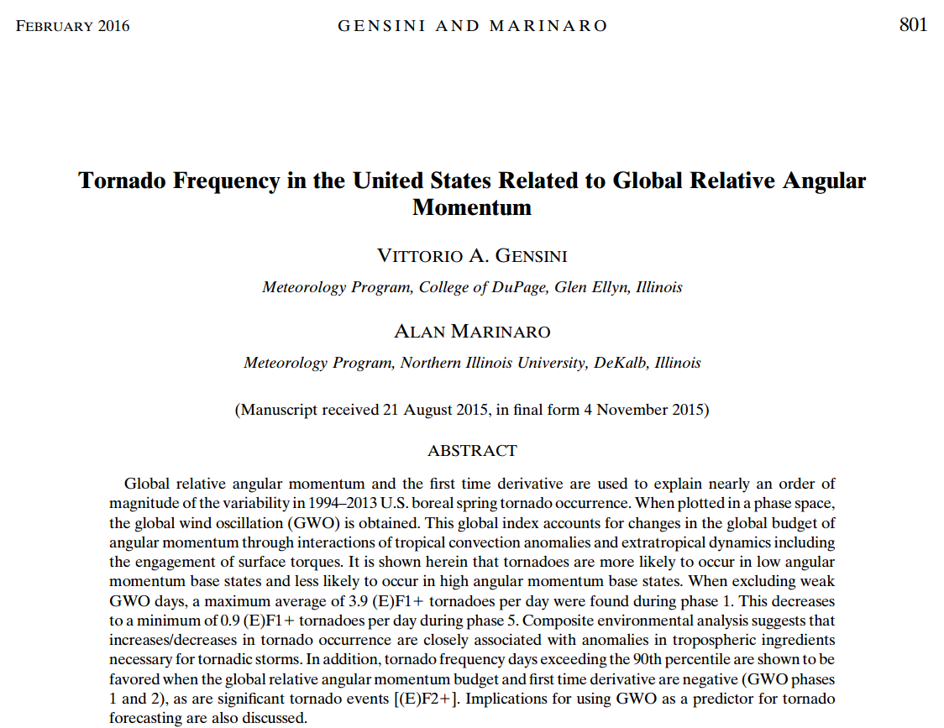
Further Reading in MWR…

Slide 38
forecast?

Slide 39
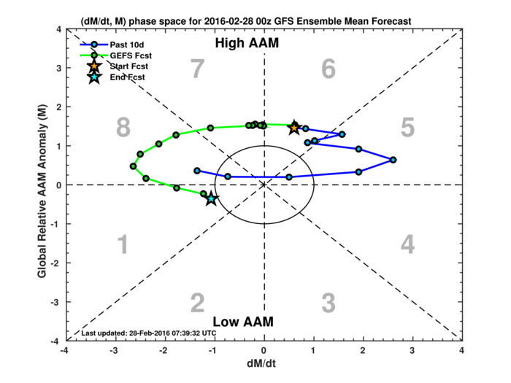

Slide 40
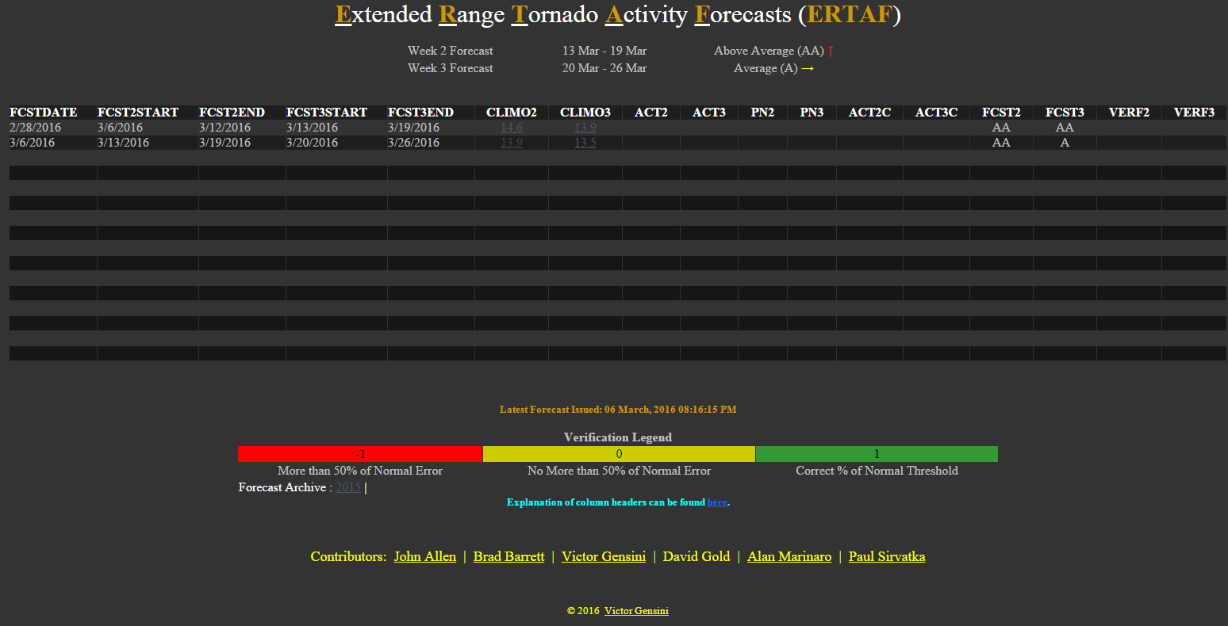
http://weather.cod.edu/~vgensini/ertaf/

Slide 41
Thanks!
@gensiniwx

