Slide 1
Impact of US Temperature Anomalies on Tornado and Hail Occurrence
Harold Brooks
NOAA/NSSL
Harold.brooks@noaa.gov

Slide 3
Forward Into the Past
Naïve thought-past warm periods as analog for future
May give some bounds on expected change
Caution-patterns?
F1+ tornadoes
Days with more than 6 F1+ tornadoes (half of tornadoes)
1.25” hail on 1x1 degree grid-yes/no

Slide 4
Comparisons
Focus on running 3-month periods
Use Kendall’s tau to look for changes with temperature
Use linear regression to get idea of magnitude

Slide 5
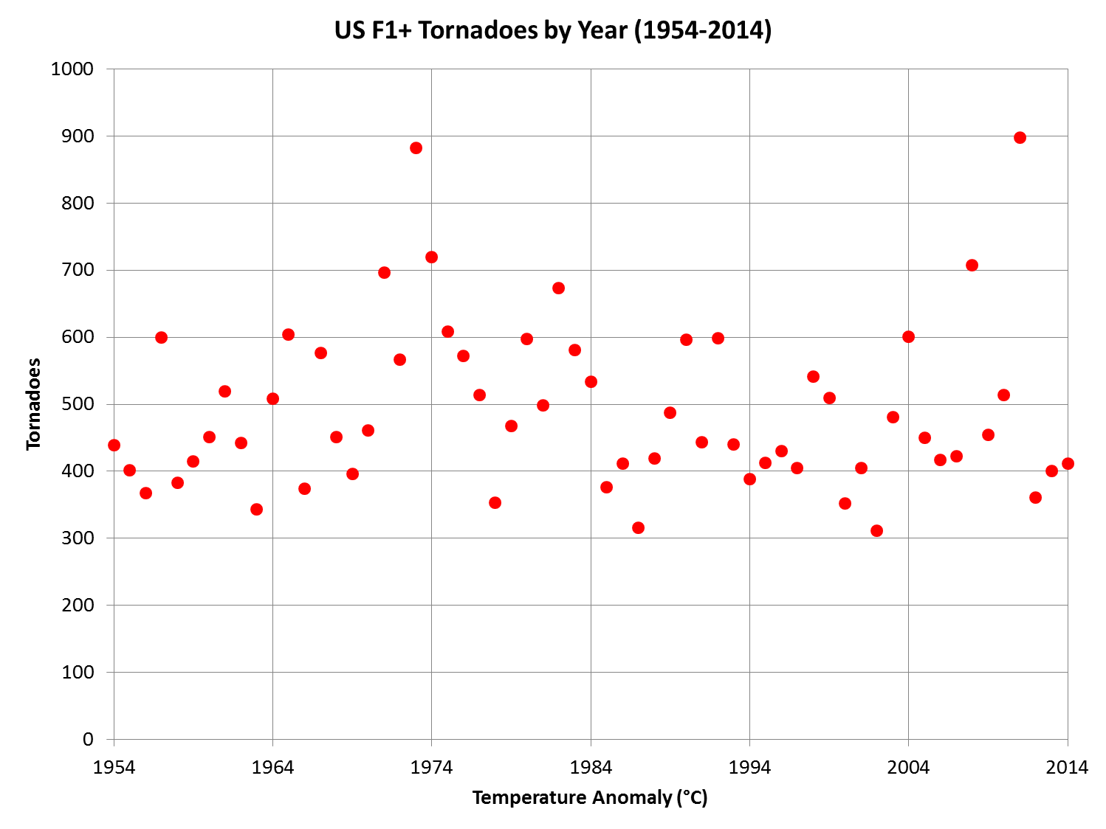

Slide 6
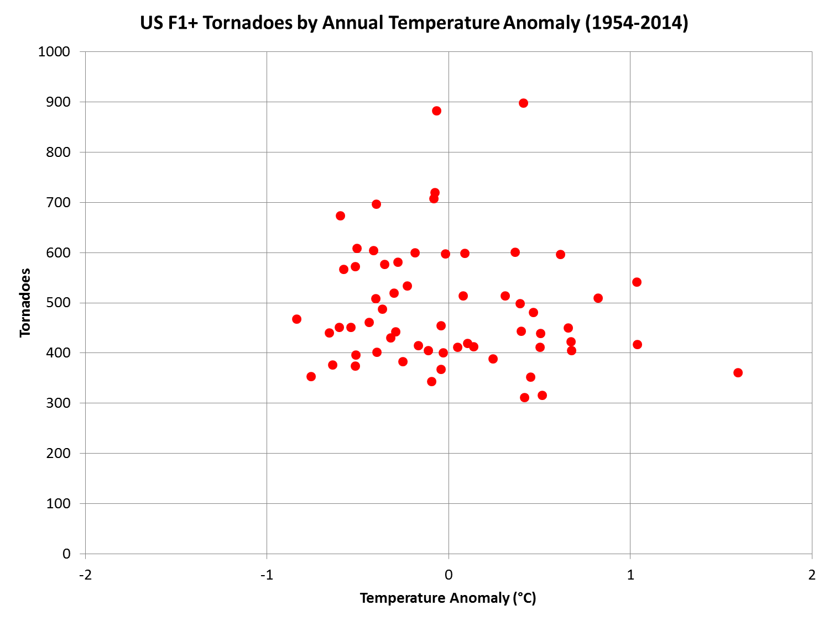

Slide 7
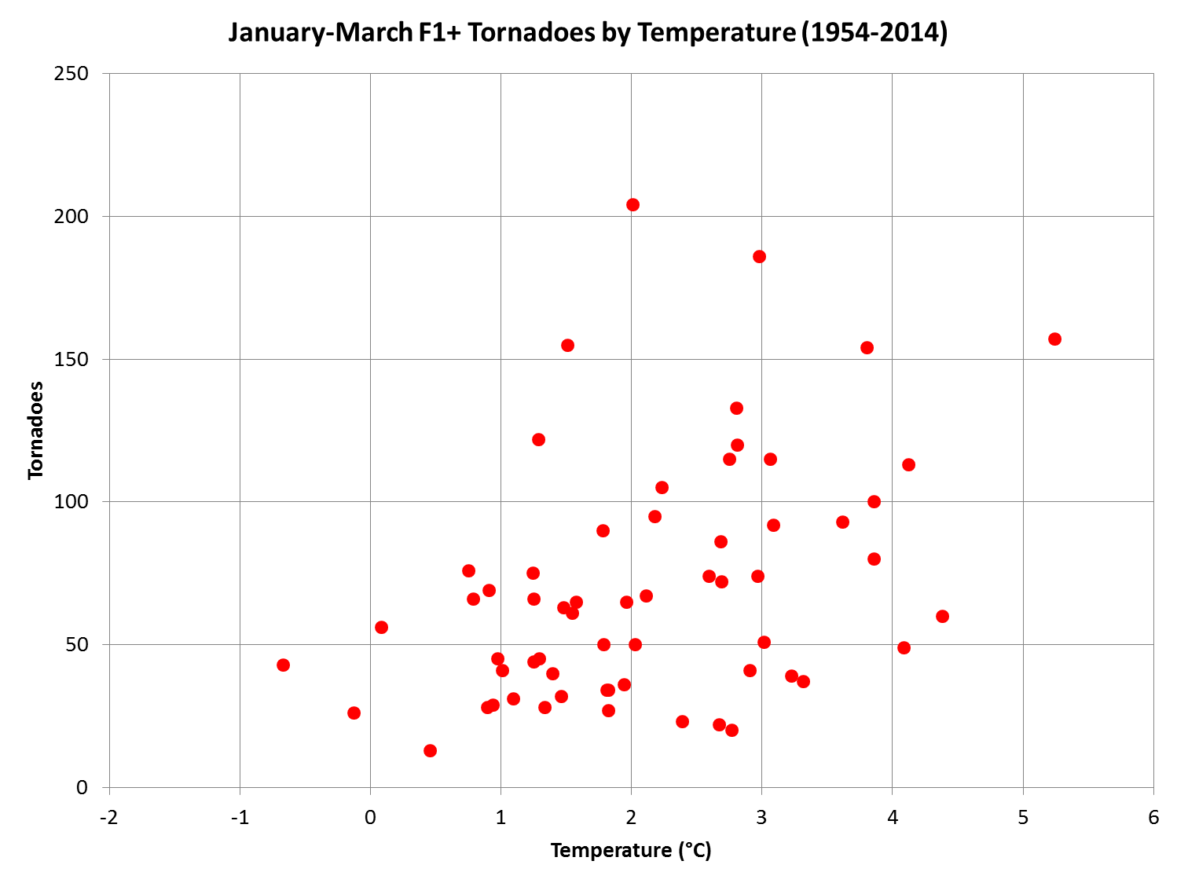

Slide 8
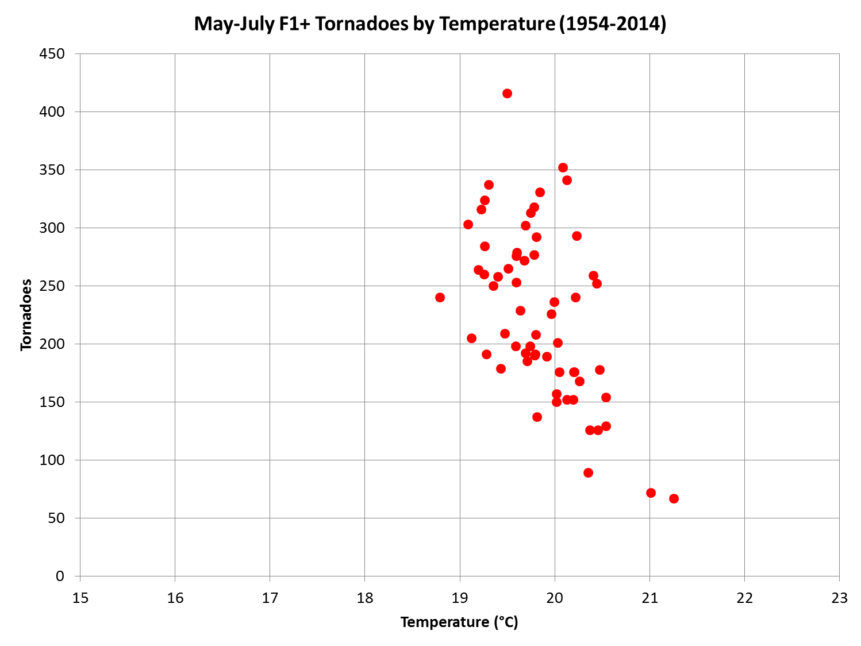

Slide 9
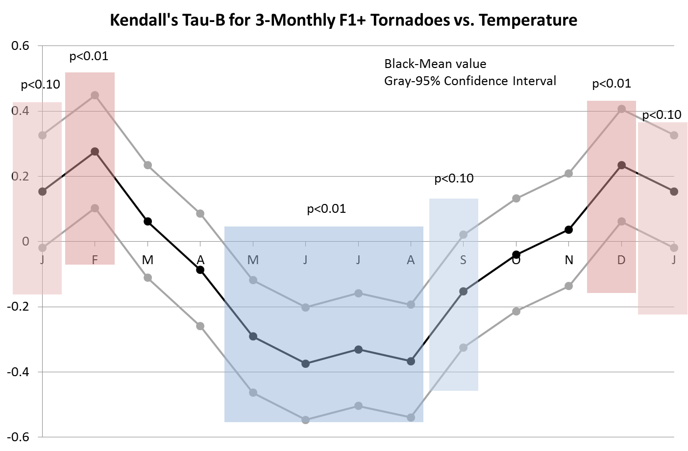

Slide 10
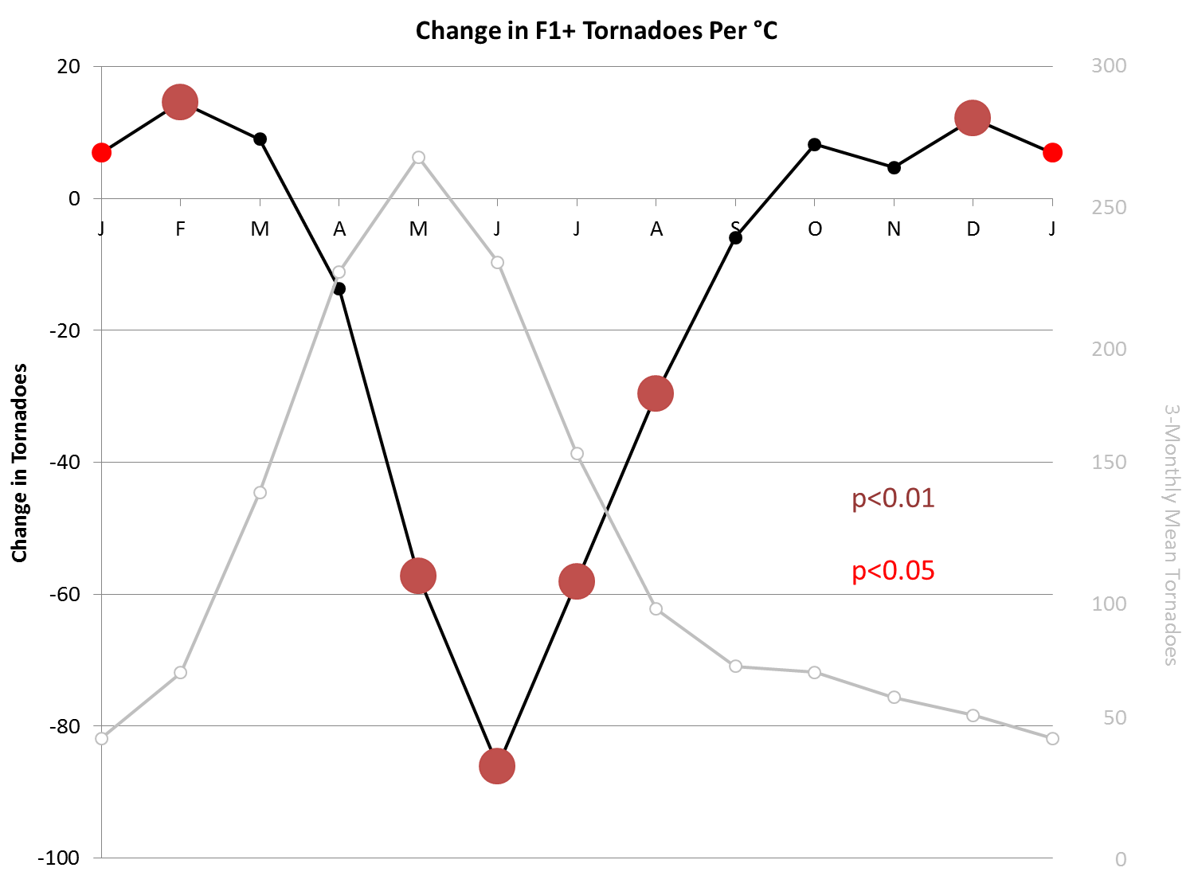

Slide 11
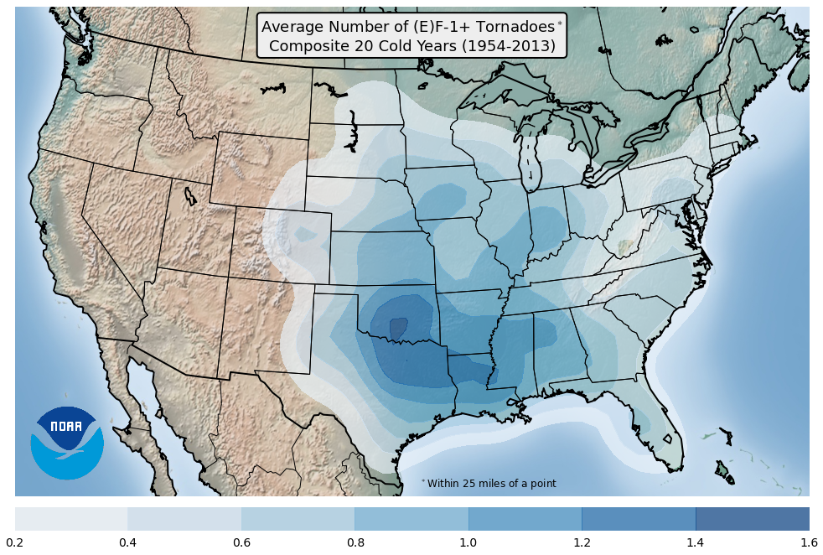

Slide 12
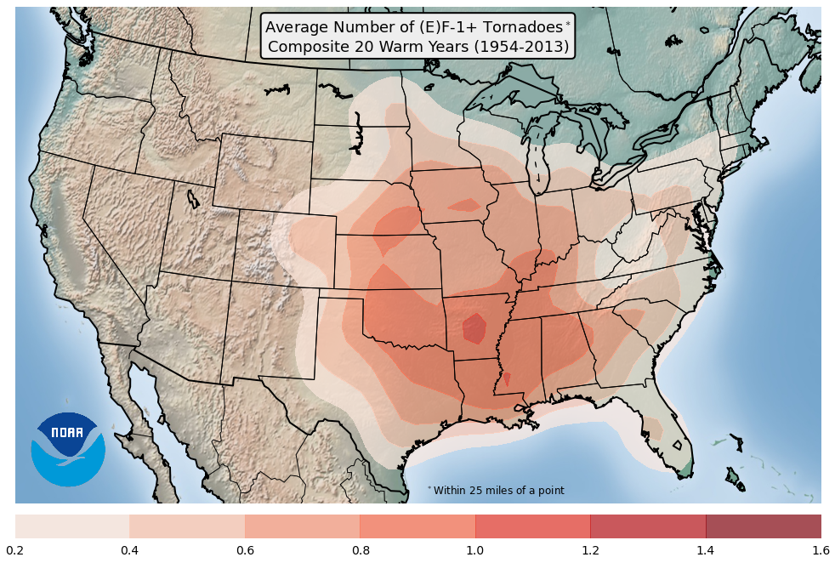

Slide 13
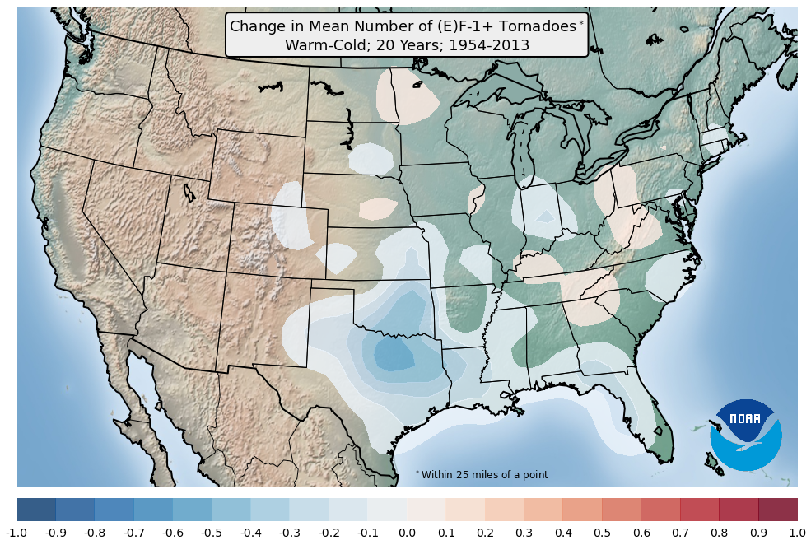

Slide 14
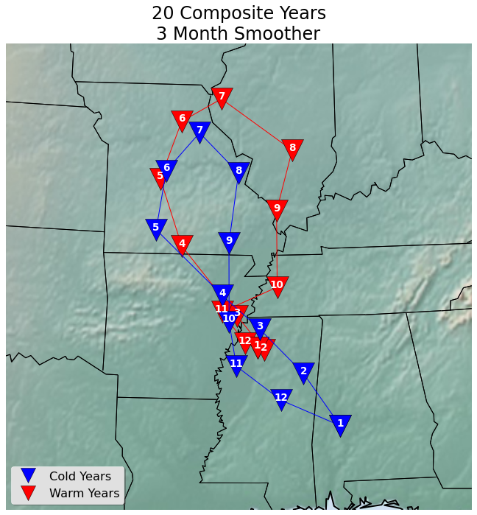

Slide 16
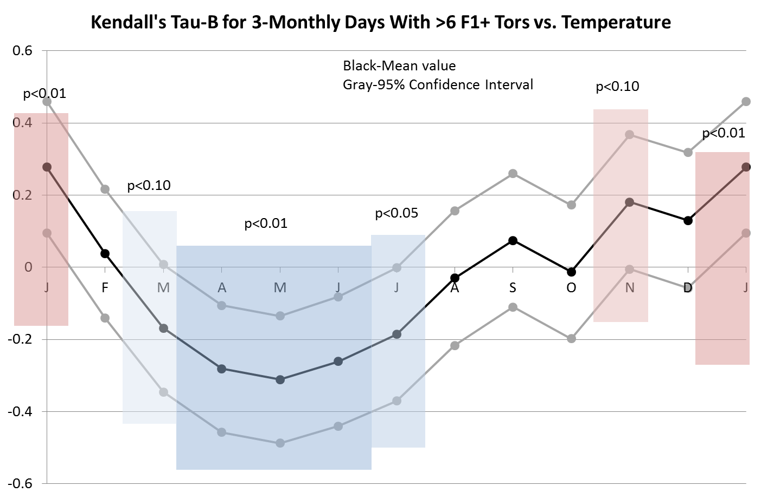

Slide 17
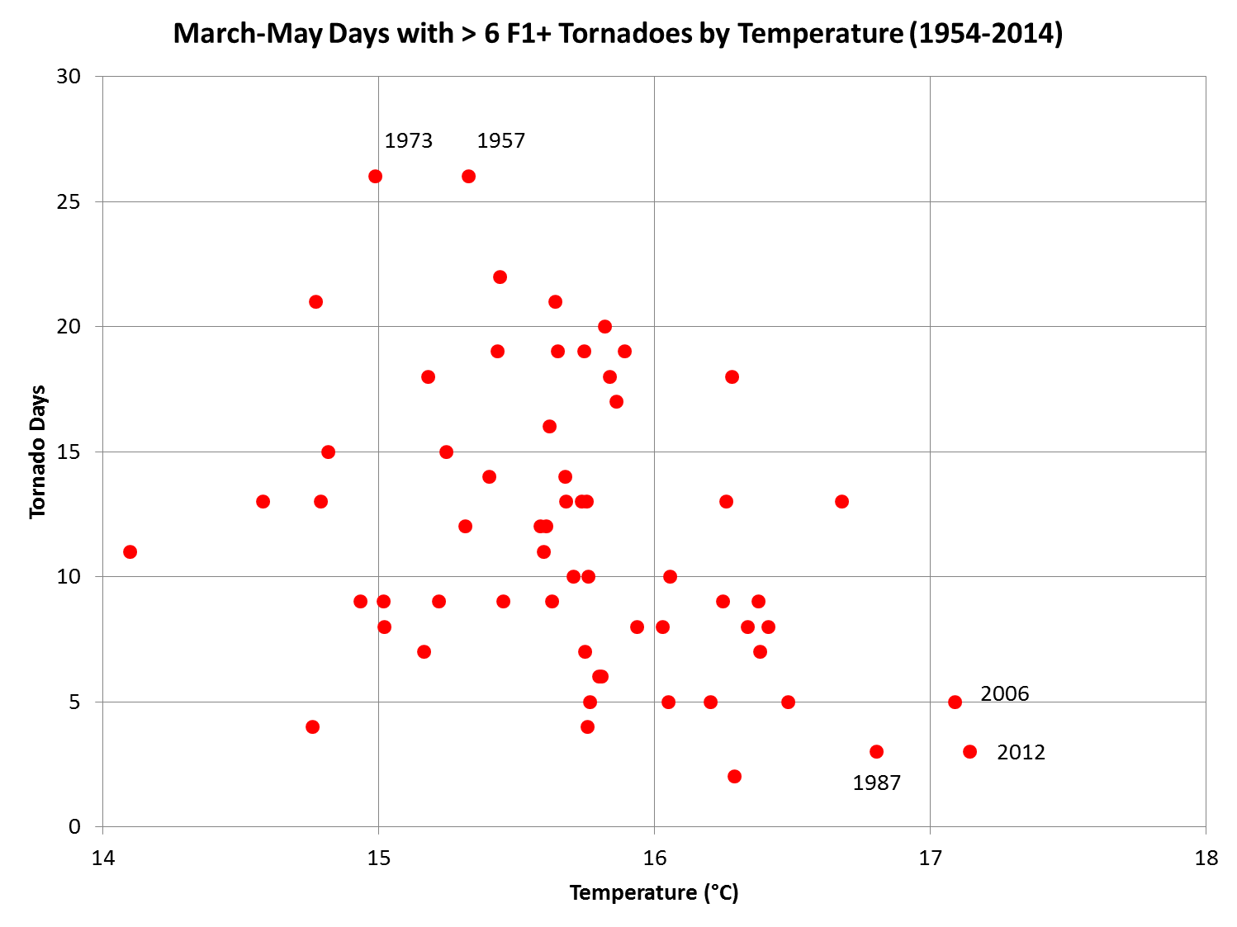

Slide 19
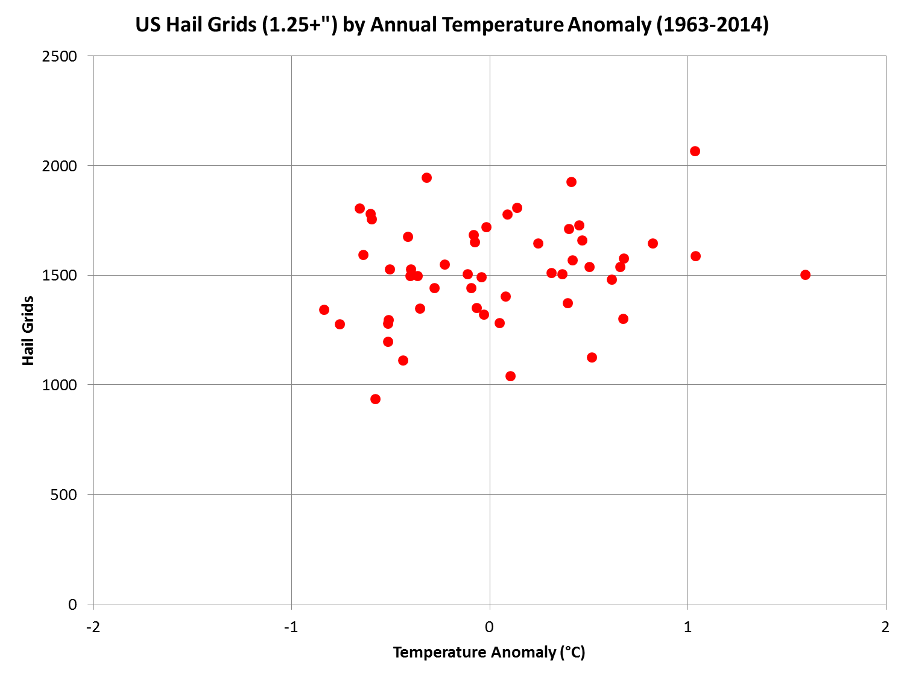

Slide 20
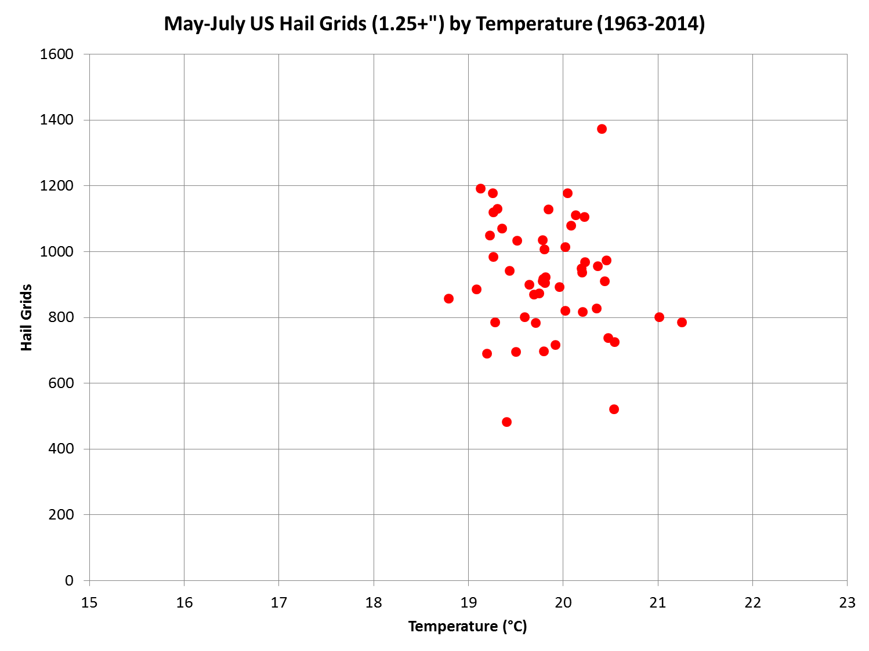

Slide 21
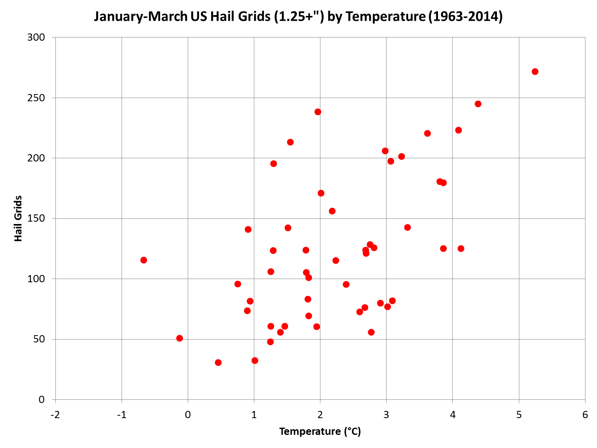

Slide 22
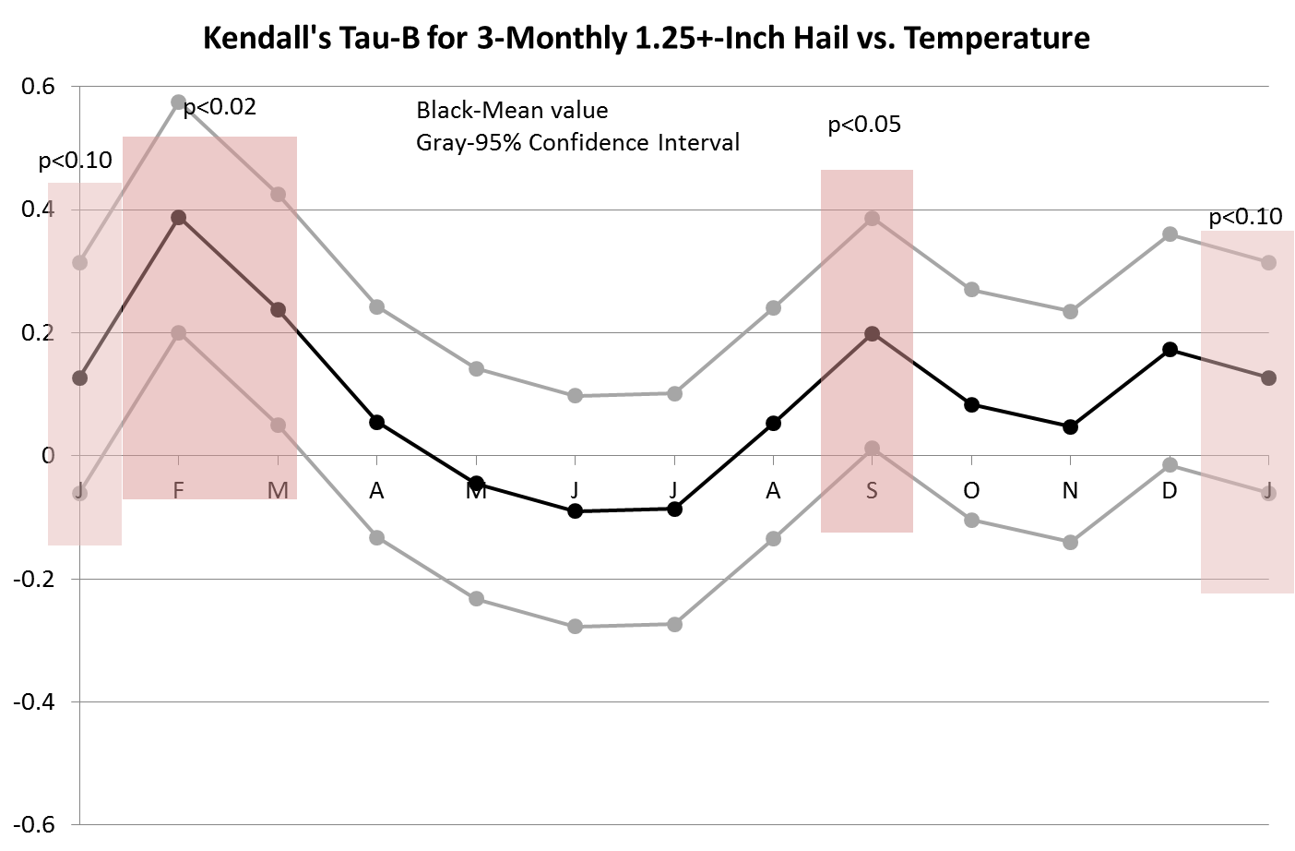

Slide 23
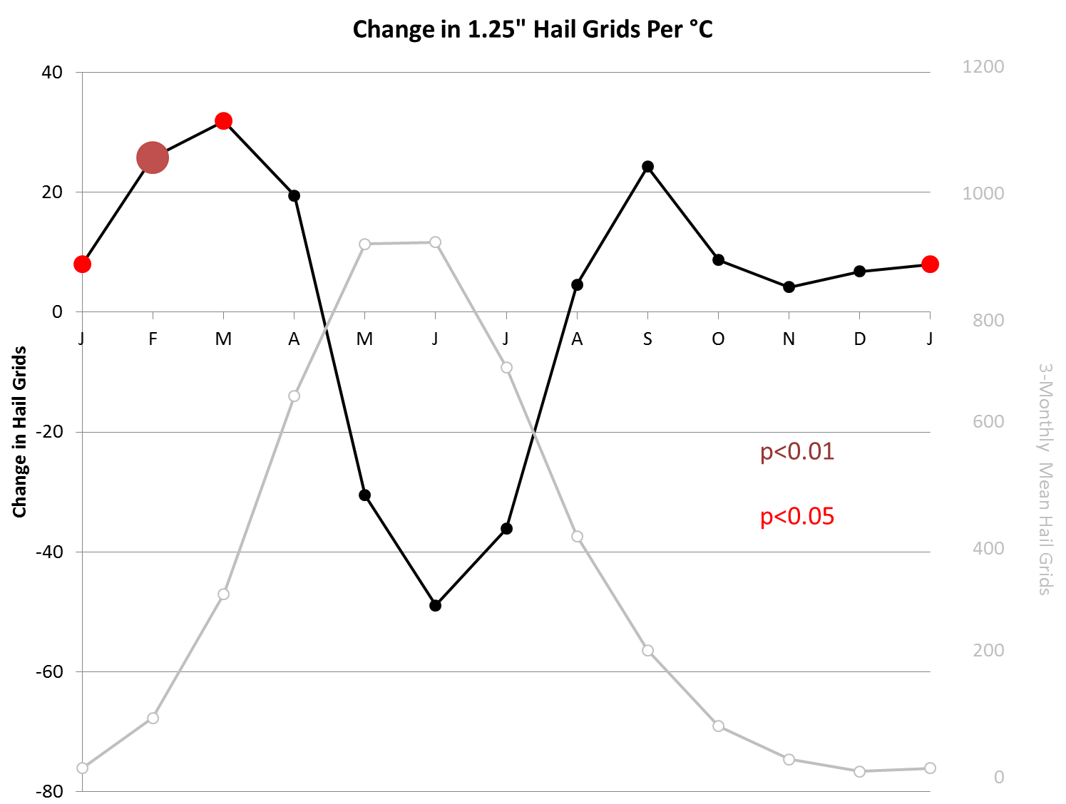

Slide 24
What is reality?
Tornadoes
Warm-season fewer in warm years (30%/°C)
Cool-season more in warm years (15-20%/°C)
Similar pattern for “big” days, shifted earlier (30%/°C)
Hail
Resembles tornado, but not as significant and less signal in summer
Are CPC 3-month temperature forecasts good enough and the tornado relationship strong enough to use this?

