Slide 1


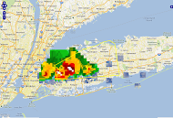
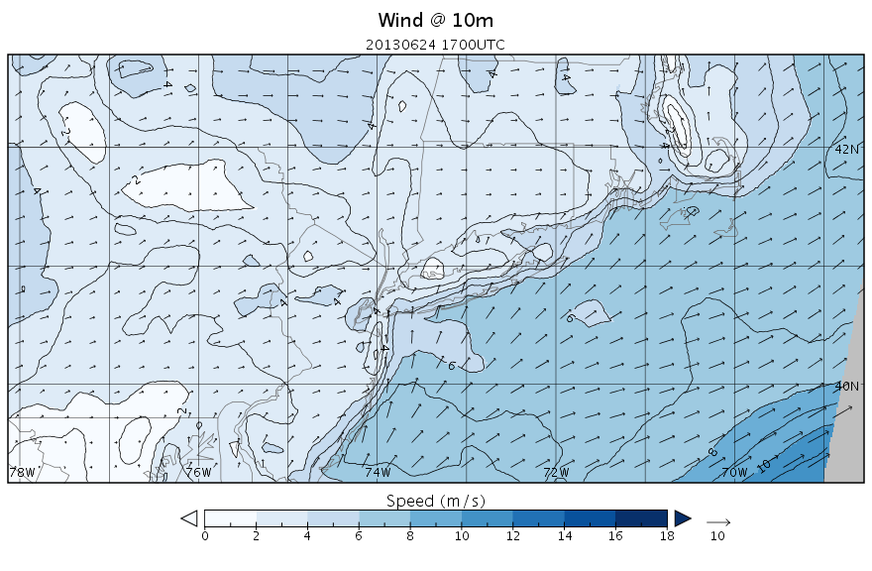
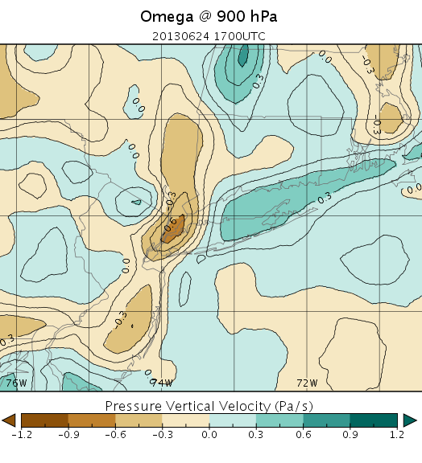
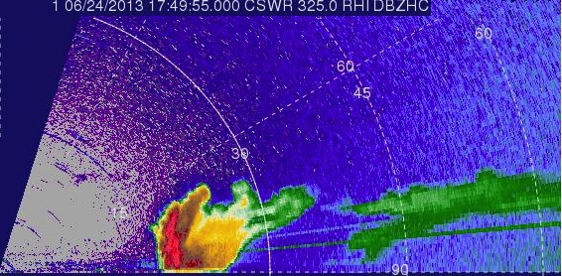
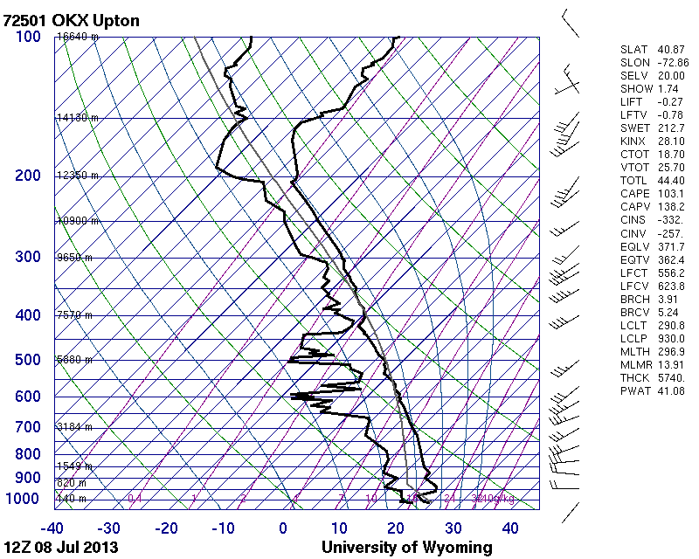
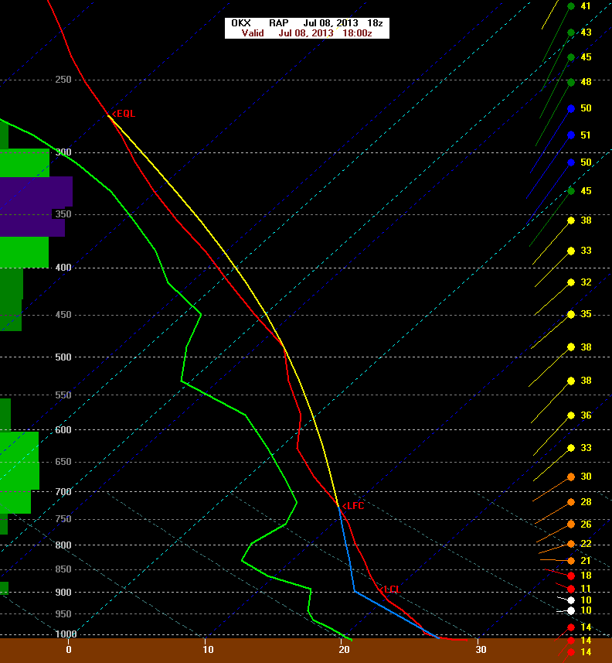
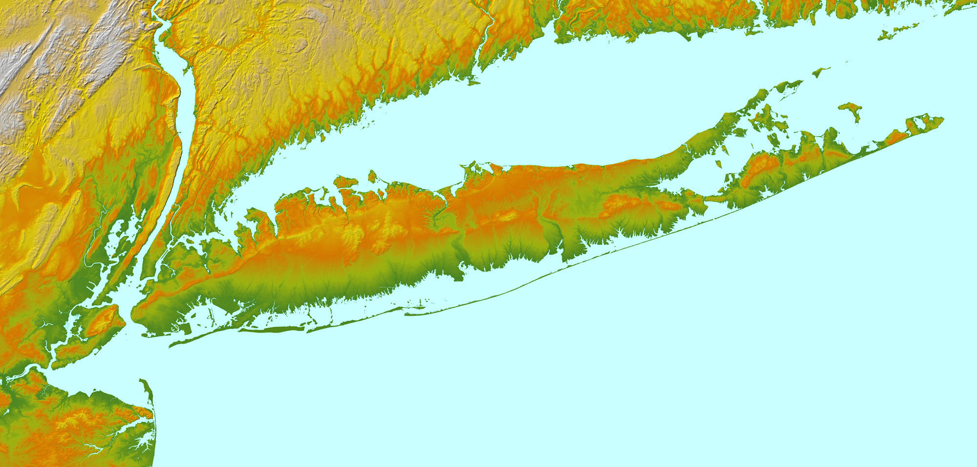
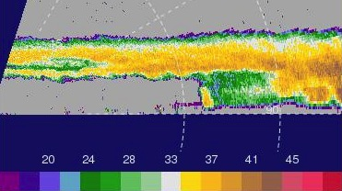
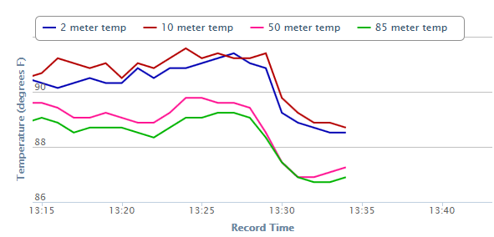
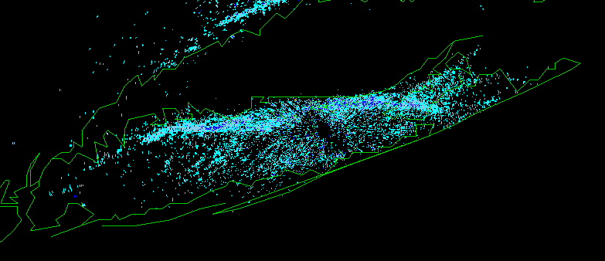
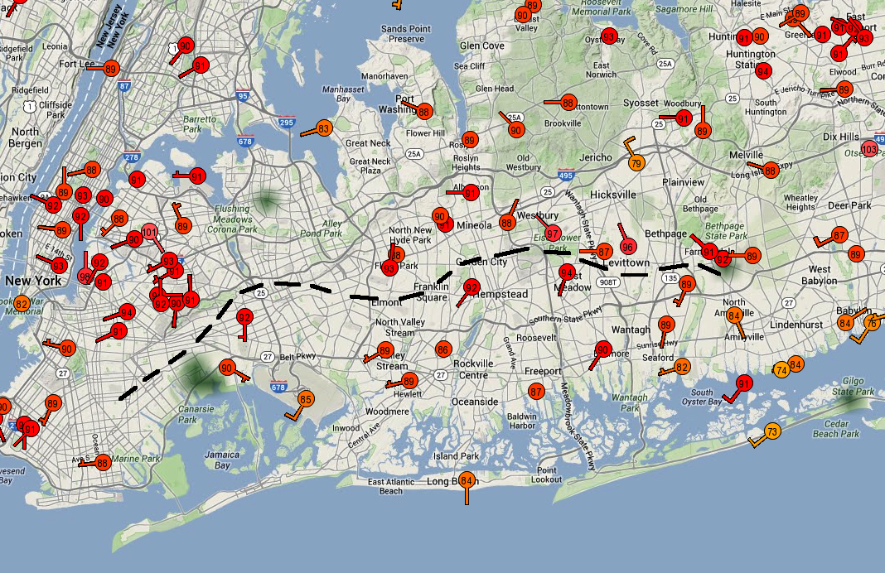
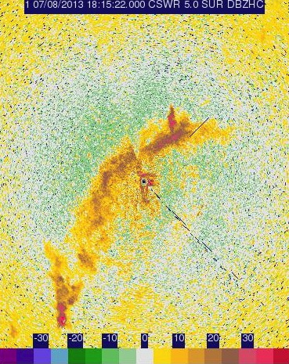
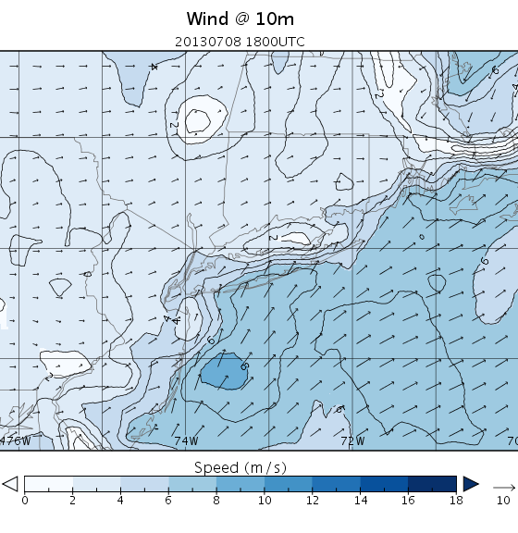
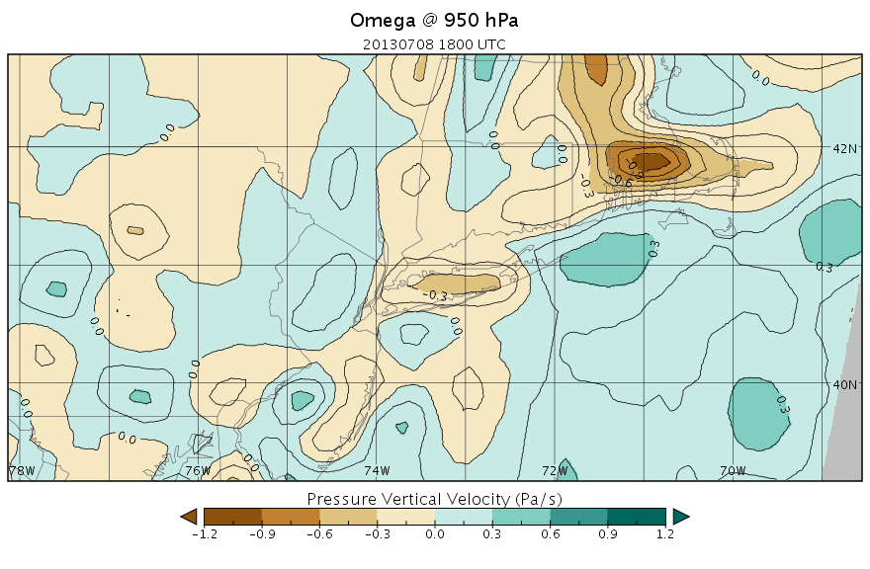
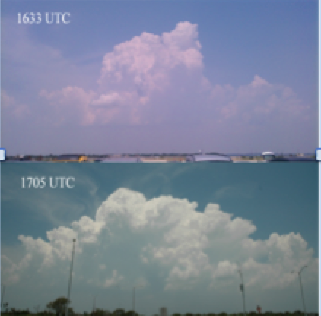
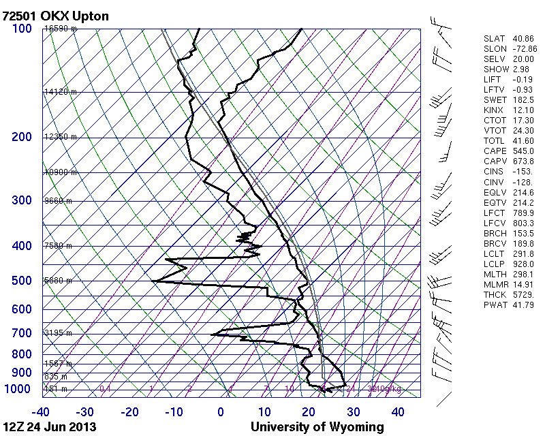
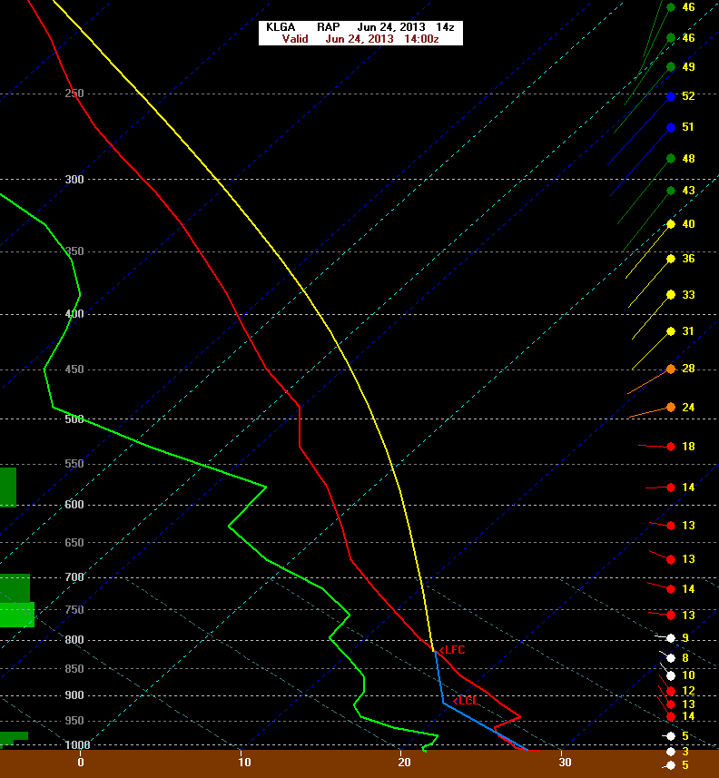
Investigation of Convective Storms over Long Island during the Doppler Radar
for Education and Mesoscale Studies (DREAMS) Project
Brian A. Colle brian.colle@stonybrook.edu; Sara Ganetis, Matthew Sienkiewicz, Michael Colbert, Breanna Zavadoff Stony Brook University – Stony Brook, NY
Kelly Lombardo kelly.lombardo@uconn.edu
University of Connecticut – Avery Point
Background and Motivation
.
Forecasting and understanding warm season convection along the northeastern U.S. coastal area is a challenge.
Observations at temporally and spatially fine resolutions are required to improve understanding of the storm’s physical processes as well as validate numerical simulations, leading to improved forecasts and warnings.
Convective initiation for New York City/Long Island requires mesoscale observations of any boundaries and detailed thermodynamics.
This poster compares two sea breeze case studies of convective storm initiation and non-initation.
Two Case Studies
Severe convection: 24 June 2013
Convection developed mid-day along a sea breeze boundary located across central Long Island (dashed line) and moved eastward.
A severe thunderstorm warning was issued by the NWS for Nassau and western Suffolk counties (warning did not verify).
Vertical cross sections of the pulse storm from the DOW range height indicator (RHI) scans illustrate the core structure, and the associated mammatus clouds.
(a)
(a)
(b)
(a) RAP reanalysis for 1700 UTC on 24 Jun 2013. showing wind speed (m s⁻¹) and direction at the surface, (b) RAP analysis omega (Pa s⁻¹) at 900 hPa.
(c)
(b)
Non-initiation: 8 July 2013
CAPE was limited in the AM (103 J kg⁻¹), with 332 J kg⁻¹ of CIN.
CAPE increased to ~1000 J kg⁻¹ by early afternoon. However, a significant layer of CIN remained from 1000 hPa to 725 hPa.
No convective storms developed.
(a)
(b)
Southern Connecticut
(a) Severe storm over central LI (b) DOW RHI scan at 1750 UTC 24 June
LI Sound
(c) Severe storm’s mammatus clouds (d) DOW RHI scan of severe storm.
(c)
(d)
EPCAL airport
Stony Brook
•
•
•
•
Upton, NWS
(a) OKX sounding at 1200 UTC 8 Jul 2013. (b) RAP analysis sounding at 1800 UTC on 08 Jul 2013. (c) OKX 0.5° elevation radar reflectivity at 1819 UTC on 08 Jul 2013. (d) Sea breeze front as observed from the DOW radar.
JFK
•
Jones Beach
Deployment area for DREAMS
(f)
(c)
(e) Surface temperature and wind observations at 24 June at 1500 UTC
DREAMS Field Project
(e)
OKX
(d)
N
Doppler Radar for Education and Mesoscale Studies was a research and educational field project (NSF Sponsored) held on Long Island, NY from 17 June – 8 July 2013, with 12 field days.
The project educated students on advanced weather radar technology (i.e. Doppler on Wheels; pod), and obtained high resolution datasets of local mesoscale weather phenomena (e.g. severe and non-severe convection; sea breeze boundaries).
(a)
(b)
(f) Temperature trace of sea breeze boundary passage from KOKX (Upton, NWS) illustrating the 1ºC decrease in temperature.
◉ DOW
The OKX sounding at 1200 UTC has 153 J kg⁻¹ CIN extending upwards to 800 hPa and < 500 J kg⁻¹ CAPE. There was 41.8 mm of precipitable water.
By 1400 UTC, CIN in RAP analysis decreased to 93 J kg⁻¹ and CAPE increased to 1743 J kg^{-1.} There was well defined vertical motion in RAP to for CI.
Same as above except for 1200 UTC and 1800 UTC on 8 July 2013.
Conclusions
DREAMS collected some unique datasets of convective initiation (CI) along a sea breeze fronts and other cases with no CI.
The two cases above with CI success and a CI failure both had sufficient CAPE and moisture. CIN was the primary difference. Upward motion was weaker in the CI failure case.
(a)
(b)
(c)
Acknowledgements
We thank the Center for Severe Weather Research (CSWR) located in Boulder, CO, the National Science Foundation, the National Weather Service (NWS) office in Upton, NY (Jeff Tongue), and Lisa Bastiaans of Nassau Community College for their support and participation in this project
Instrumented Long-EZ aircraft; sample flight track during a sea breeze event.
(a) Storm photos. (b) OKX 1200 UTC sounding, and (c) RAP sounding at 1500 UTC

