Slide 1
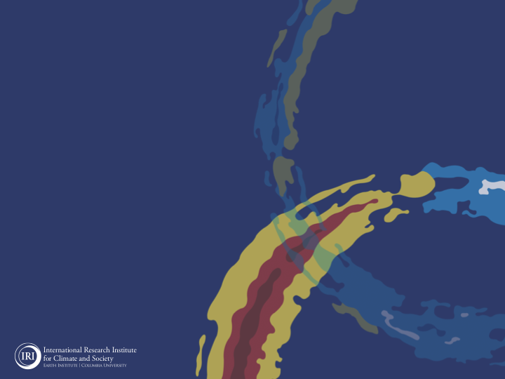

ENSO and Climate Outlook in
September, 2023
El Niño & Pos-IOD → Drought, Heat-Waves, Fires & Deluge, Flash Floods, Landslides
M. Azhar Ehsan
(azhar@iri.columbia.edu)
Associate Research Scientist
IRI ENSO and Climate Forecast Lead
Jeffrey Turmelle and Jing Yuan: forecast processing and web updates
Cuihua Li: Draft PowerPoint development
IRI’s Climate Group, led by Dr. Andrew Robertson:
Forecast system development, ongoing innovation, and verification

Slide 2
Outline
Observed Oceanic and Atmospheric Conditions in
Tropical Pacific
Across the Globe
ENSO Forecast in
NMME (North American Multimodel Ensemble)
IRI ENSO Forecast Tool (Deterministic and Probabilistic)
Seasons Outlook of
SST (Sea surface Temperature)
Precipitation and Temperature
Summary

Slide 3
Observations
Oceanic
Atmospheric

Slide 4
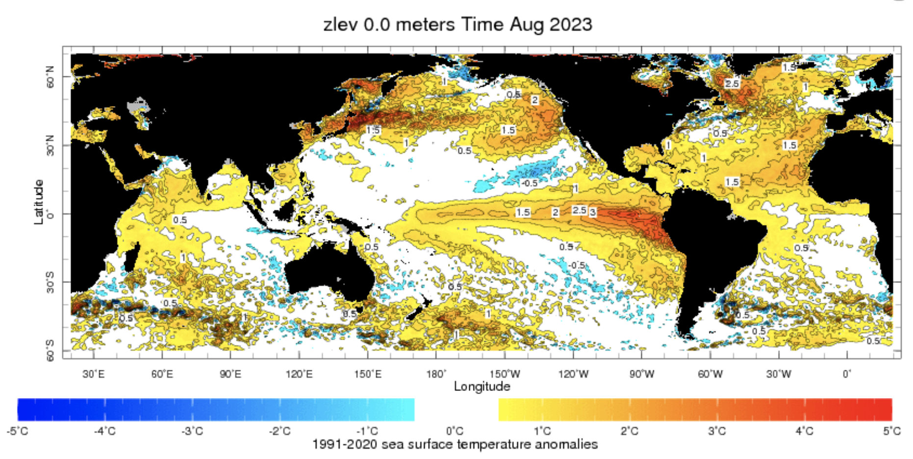
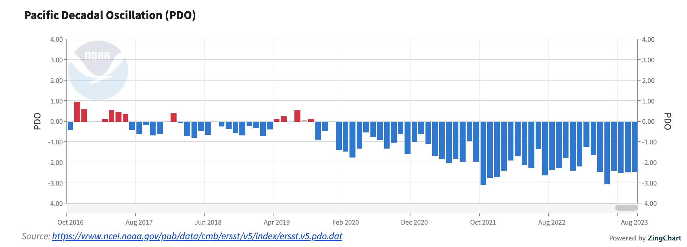
Evolution of Sea Surface Temperature (SST) Anomalies in Monthly (Aug, 2023) Datasets
Highlights:
Warm SSTAs across the Pacific Ocean,
Warm North Atlantic, and Pacific,
Warm/Cold Western/Eastern Indian Ocean

Slide 5
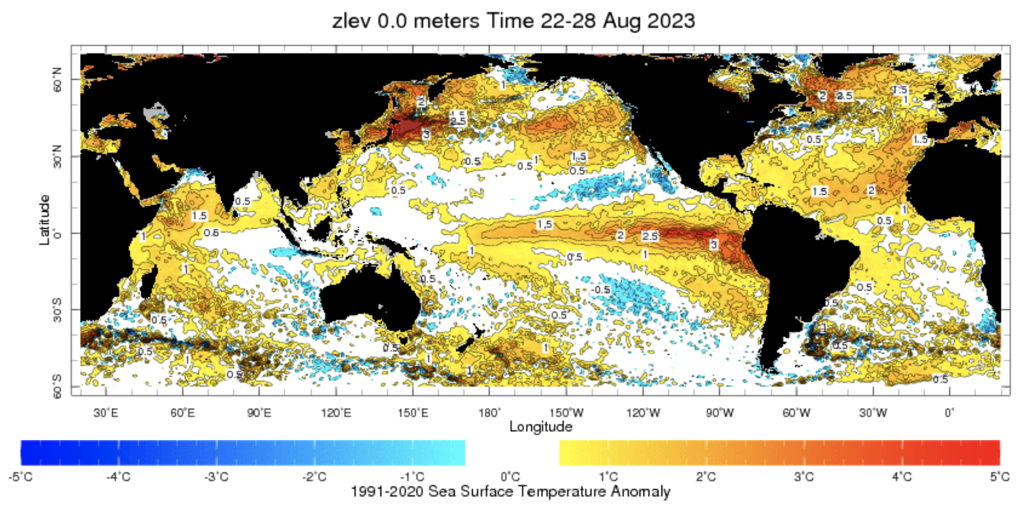
Evolution of Sea Surface Temperature (SST) Anomalies in Weekly (13 Sep, 2023) Datasets
Highlights:
NINO1+2=+2.6, NINO3=+2.2, NINO3.4=+1.6, NINO4=+1.1
Indian Ocean Dipole (IOD) is Positive (+1.25).

Slide 6
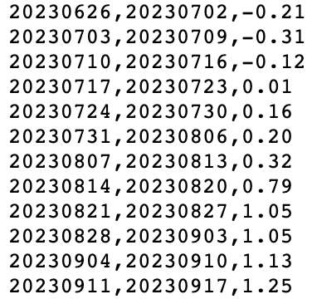
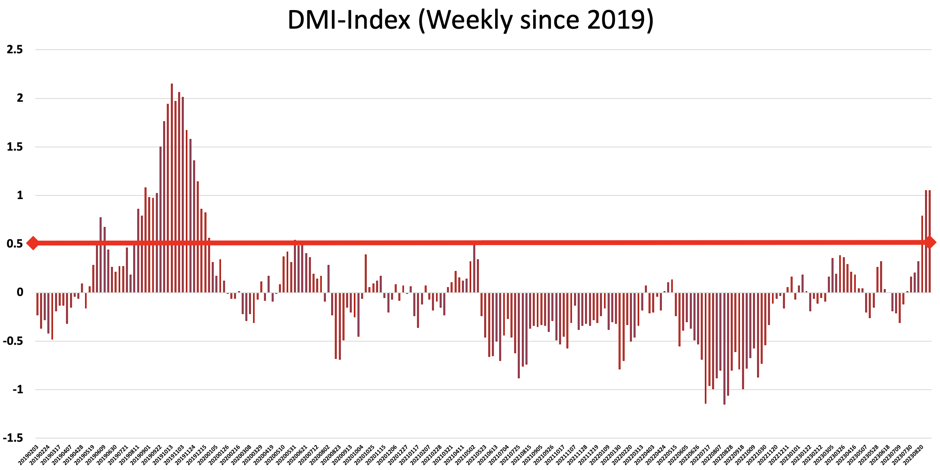
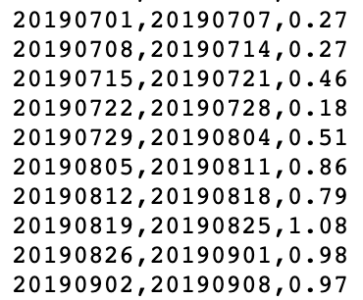
IOD: A comparison between 2019 and 2023
http://www.bom.gov.au/climate/enso/#tabs=Indian-Ocean

Slide 7
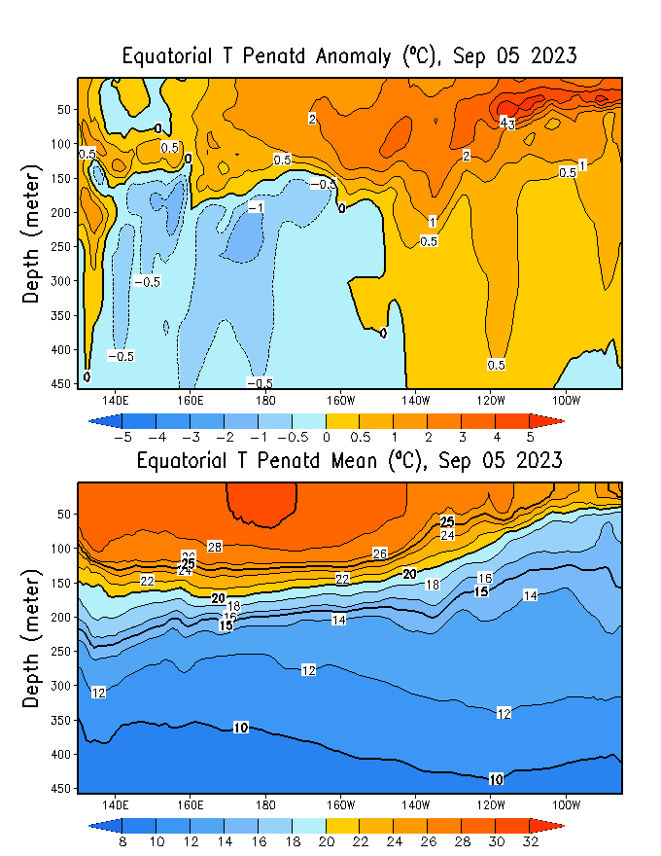
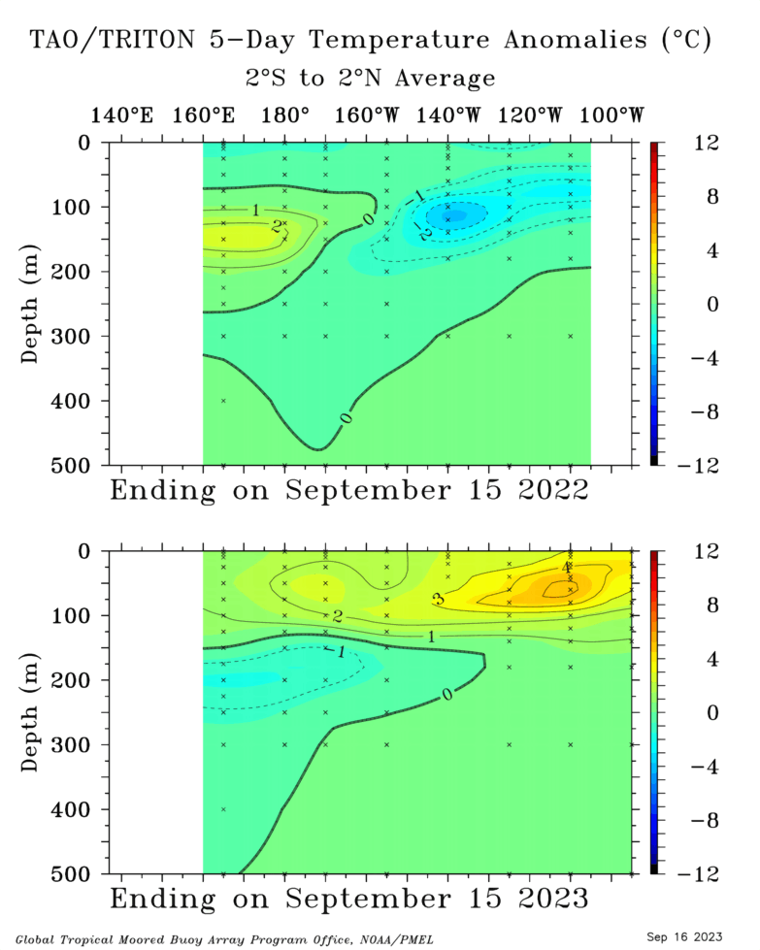
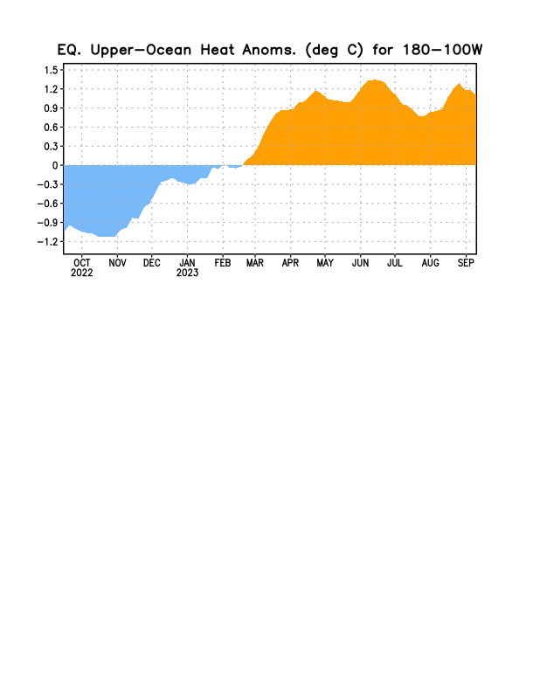
Subsurface Ocean Temperature Evolution
Last Year
TOGA/TAO
Highlights:
Warm temperatures across the Pacific (150 m to surface),
“Enough Fuel” for ongoing El Niño.
Cold temperatures (140E to 160W) at depth.

Slide 8
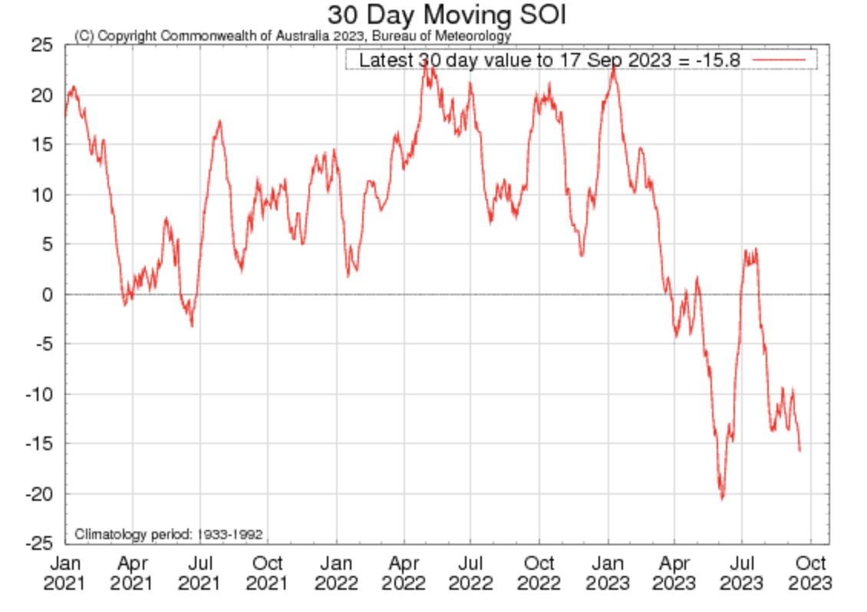
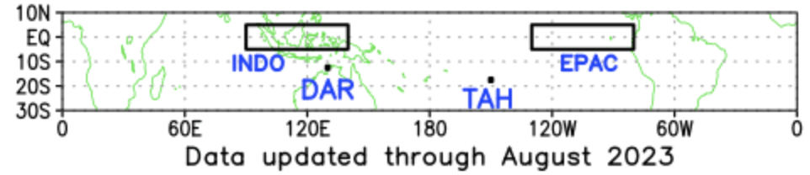
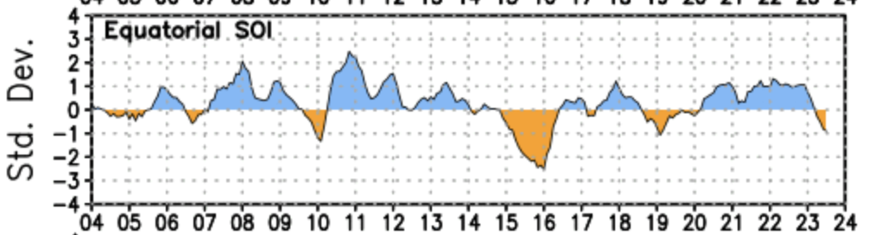
Most recent SOI (Southern Oscillation Index)
Aug, 2023: -12.7
Aug, 2023: -1.3
During El Niño, the pressure becomes below average in Tahiti and above average in Darwin, and the Southern Oscillation Index is negative.
A Sustained Negative values of the SOI above -7 typically indicate El Niño
Source:
https://www.cpc.ncep.noaa.gov/
http://www.bom.gov.au/climate/enso/#tabs=Pacific-Ocean&pacific=SOI

Slide 9
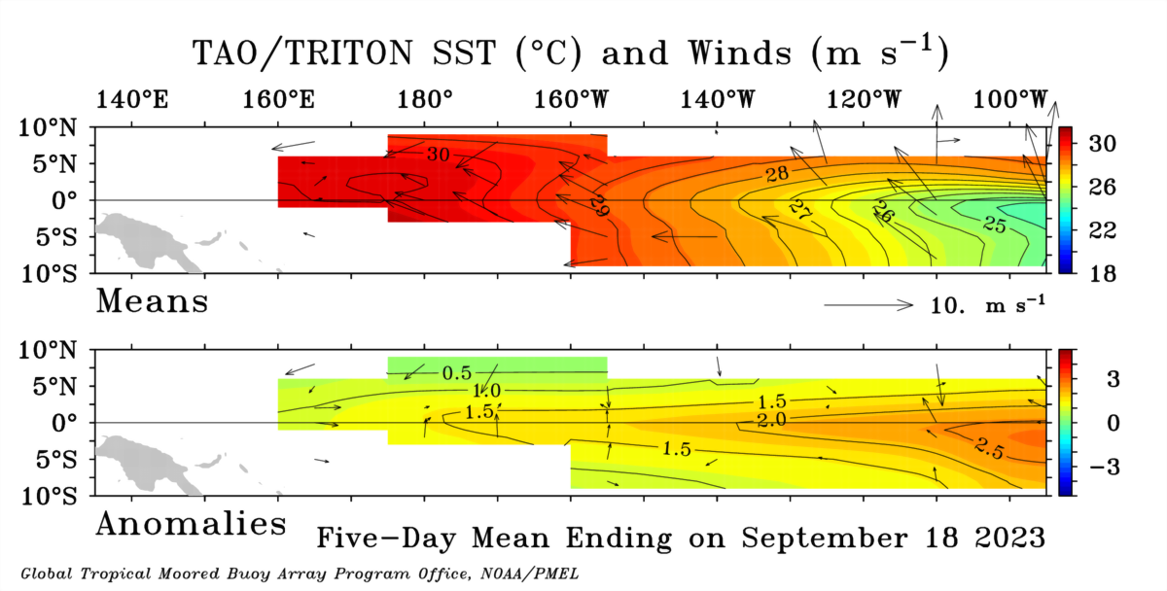
Most recent Lower-Level Winds
Highlights:
The trade winds observed in the 5-day period ending 18 September were Near-Normal in the eastern Pacific, while Weaker than Normal in the western Pacific.
In the tropical Pacific region, El Niño events typically lead to a sustained weakening or even a reversal of trade winds.

Slide 10
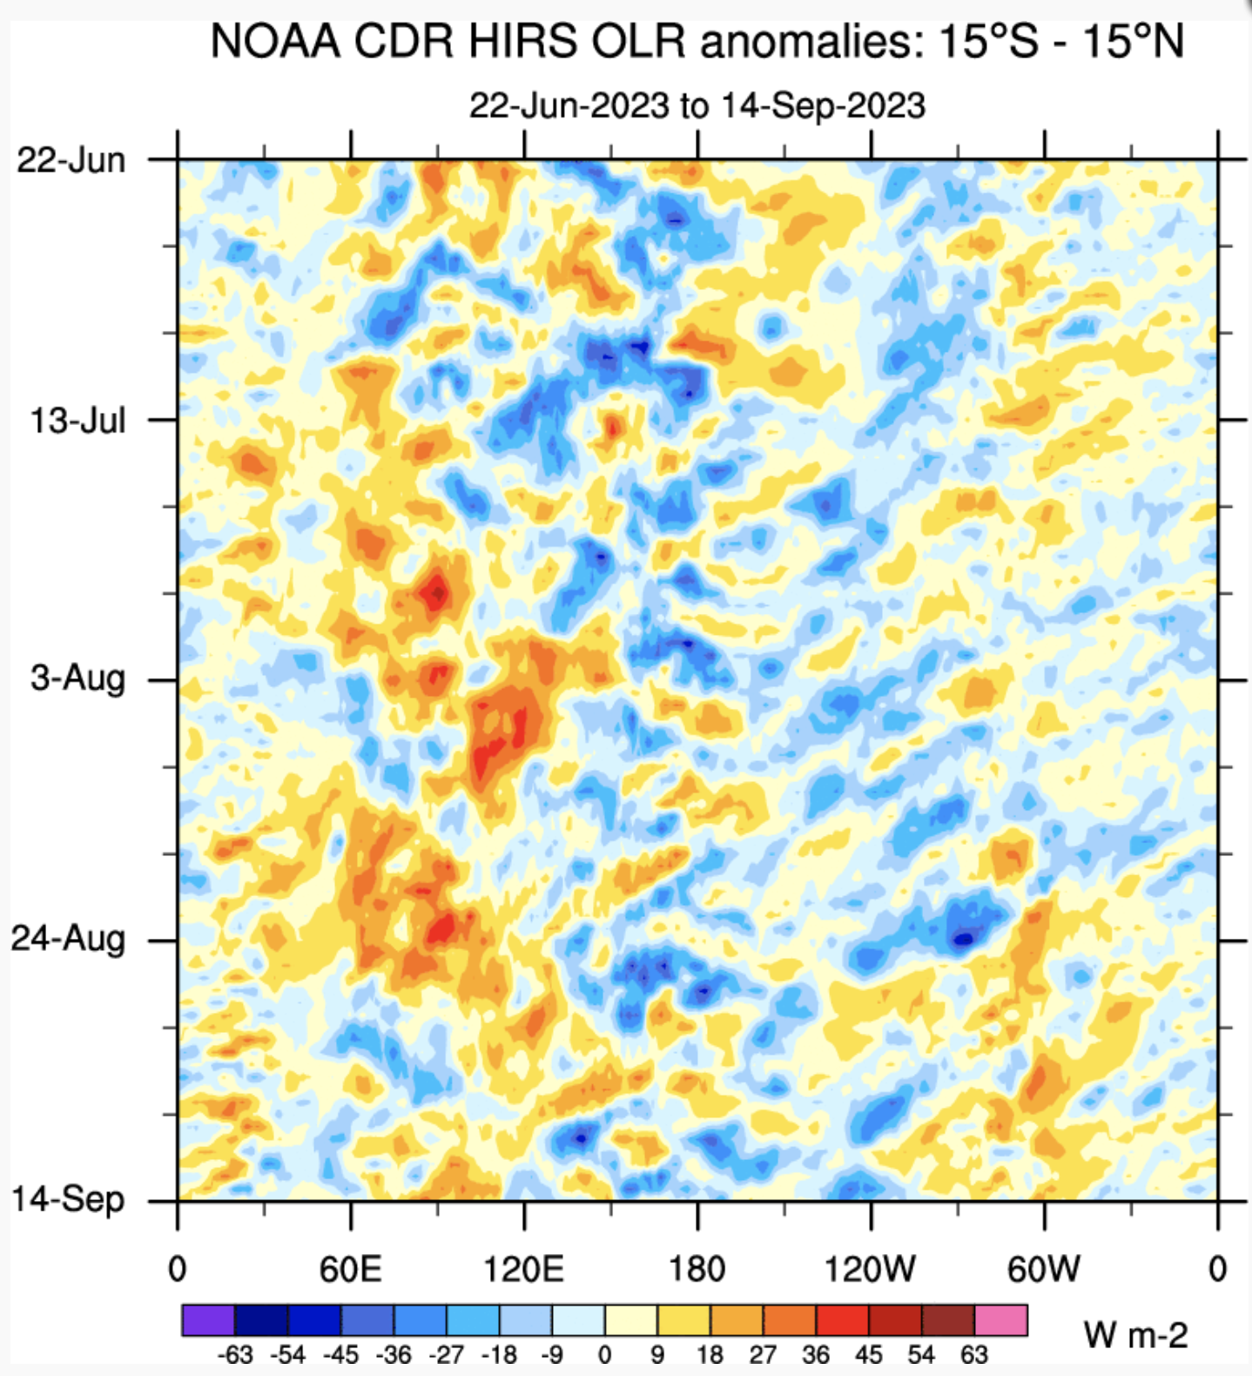
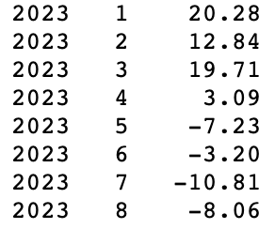
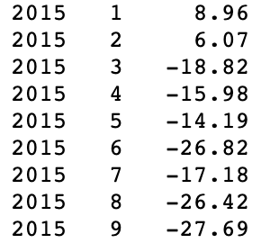
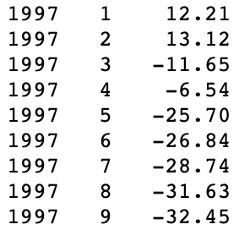
Most recent Outgoing Longwave Radiation (OLR)
Highlights:
Suppressed convection west of 120E, and active over and around Dateline.
+ve (Yellow) mean low cloudiness/below-normal Rainfall
Source:
https://ncics.org/portfolio/monitor/mjo/v1/

Slide 11
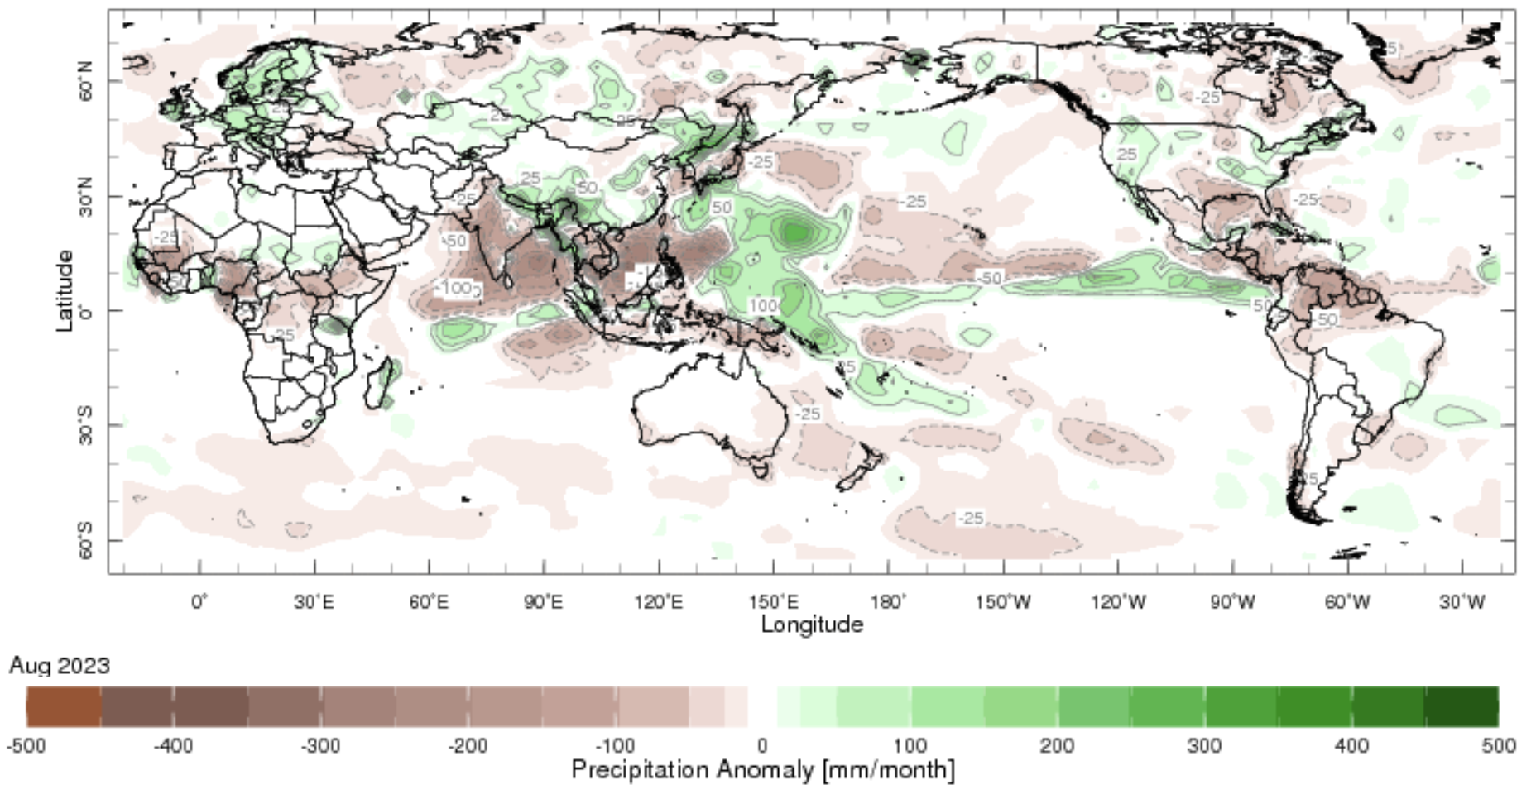
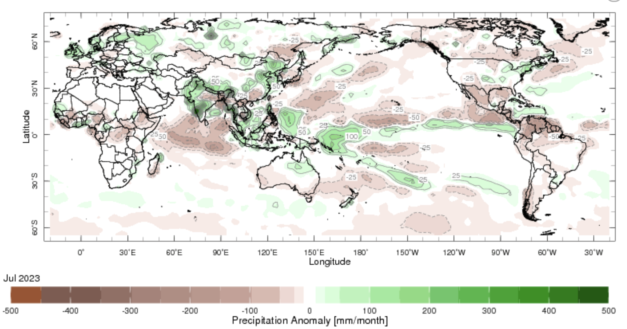
Most recent Precipitation
August, 2023

Slide 12
Forecasts
Nino-34 in NMME,
IRI ENSO Plume,
Probability of Nino-34,
Global SSTs from NMME,
IRI Global Prcp and Temp Probabilistic Forecasts,

Slide 13
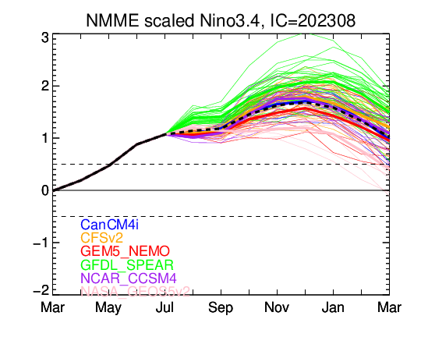
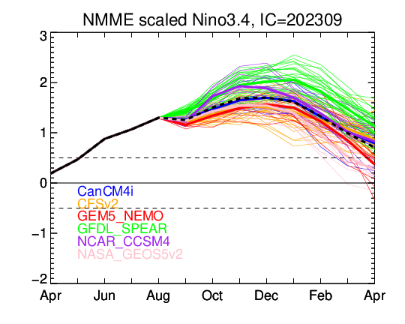
North American Multi Model Ensemble (NMME) ENSO Forecast

Slide 14
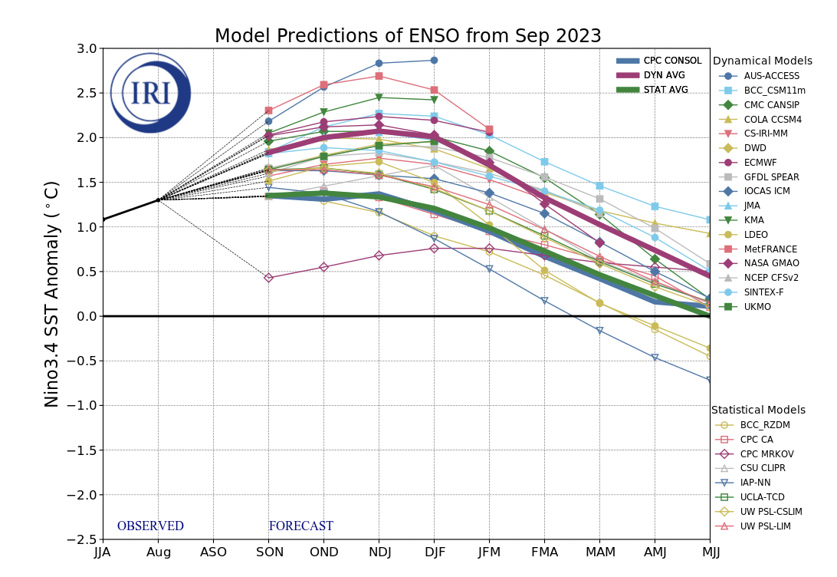
IRI’s ENSO Forecast Sep, 2023
Highlights:
All models showing El Nino at least winter of 2024.
Dynamical Models shows stronger warming as compared to Statistical models.

Slide 15
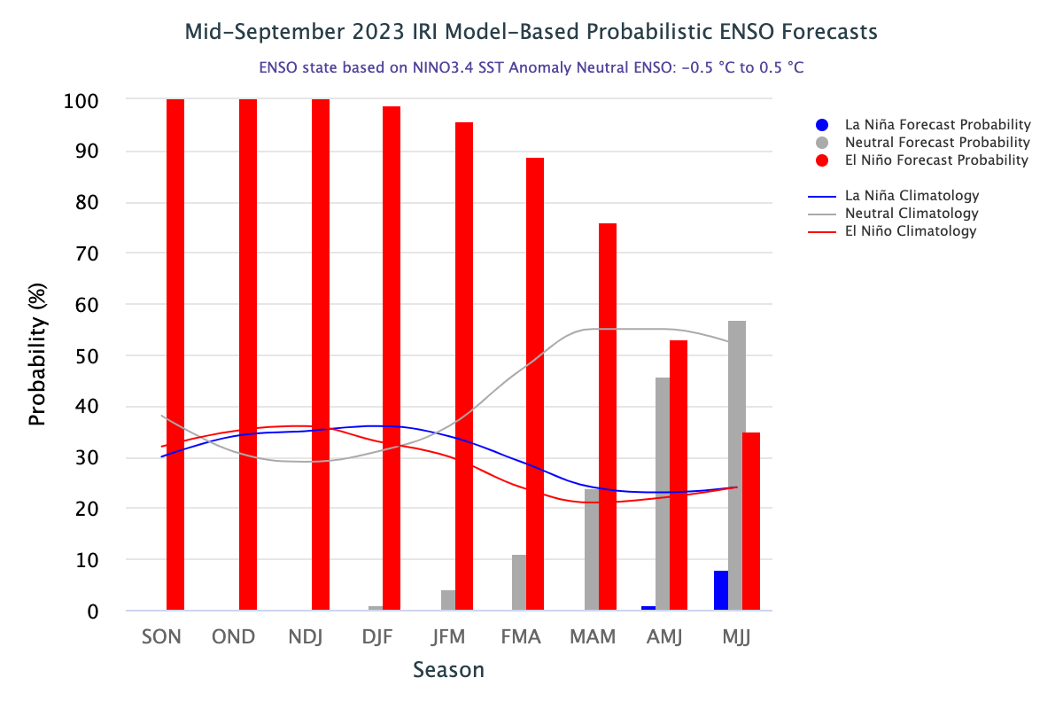
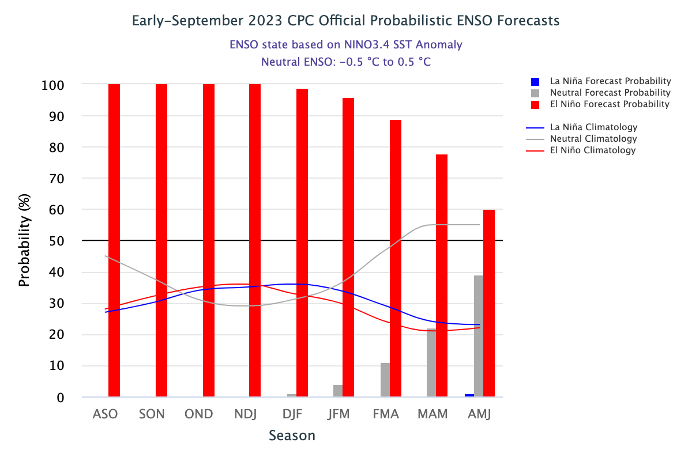
IRI’s ENSO Forecast (Sep, 2023) Probabilities
Highlights:
100% El Nino for Fall/Autumn 2023.
Above 90% during upcoming winter of 2024.
Above 70% in Spring of 2024
Stronger than ENSO-Neutral in late Spring, 2024 (53% chances)
ENSO-neutral (57% chances) in early summer 2024

Slide 16
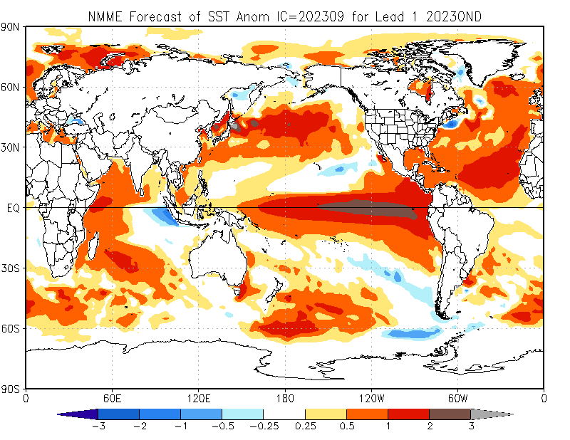
North American Multi Model Ensemble (NMME) SST Forecast

Slide 17
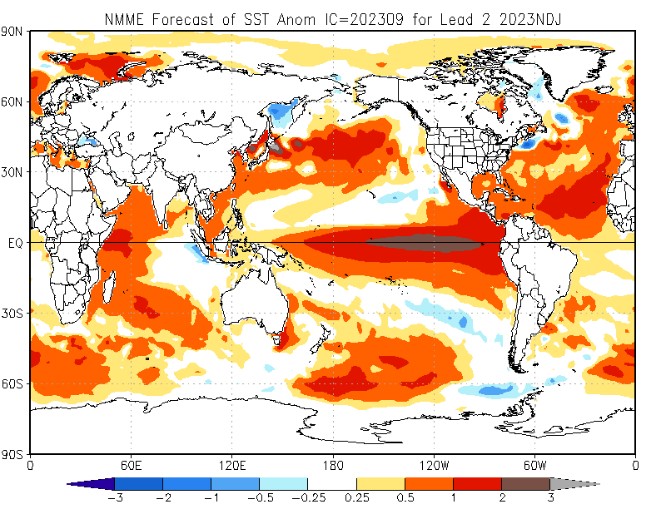

Slide 18
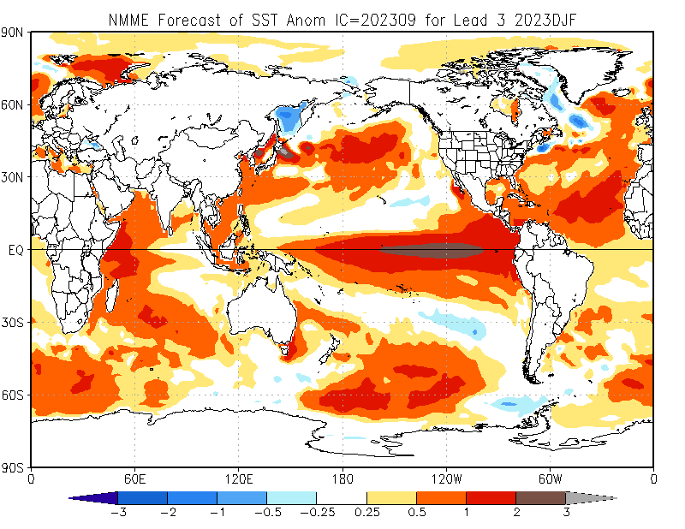

Slide 19
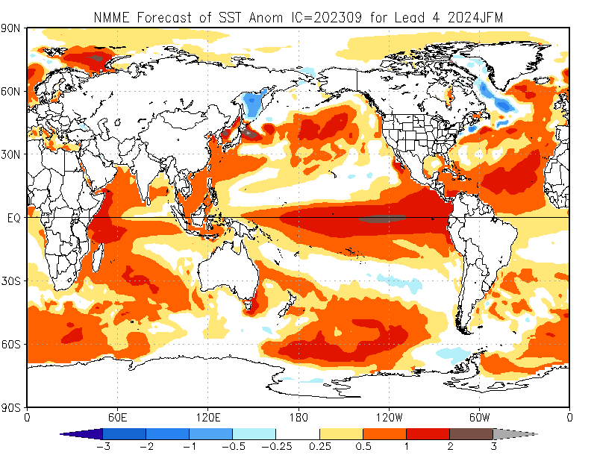

Slide 20
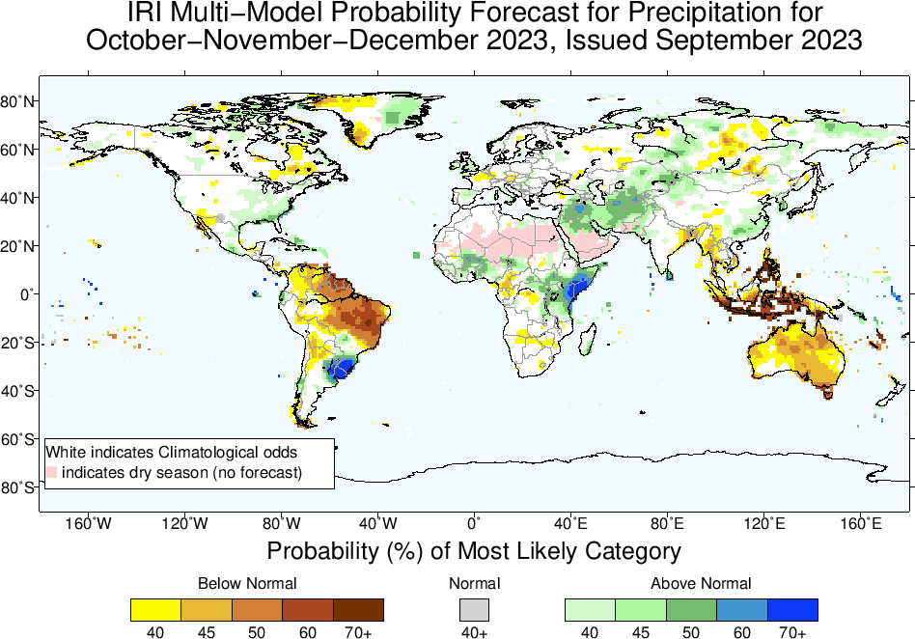
Precipitation Forecasts: Season # 1, Oct to Dec
Highlights:
Shift towards Normal to Above-Normal
Sahel region, Northwest and Northeast Africa
Middle East, central South west Asia, Kazakhstan
Sri Lanka
Uruguay, eastern parts of US
Shift towards Normal to
Below-Normal
Northern South America,
Maritime Continent,
Australia

Slide 21
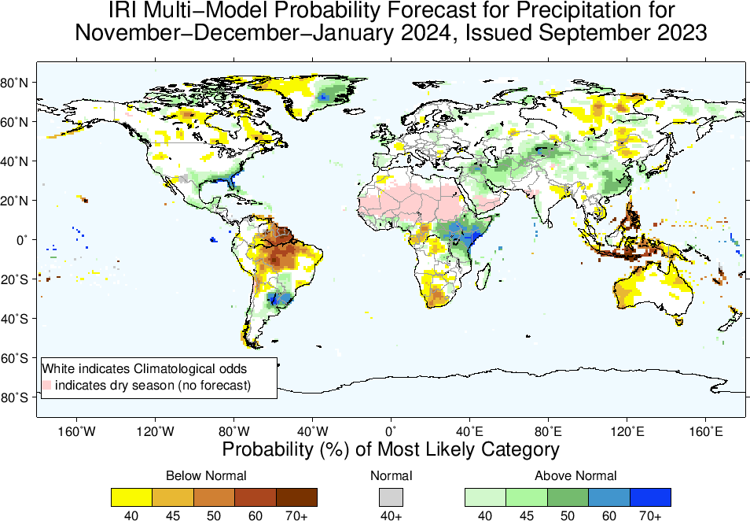
Highlights:
Shift towards Normal to Above-Normal
Sahel region, Northeast Africa
Middle East, central South west Asia, Kazakhstan
Sri Lanka
Uruguay, eastern parts of US
Shift towards Normal to
Below-Normal
Northern South America,
Maritime Continent,
Australia
Precipitation Forecasts: Season # 2, Nov to Jan

Slide 22
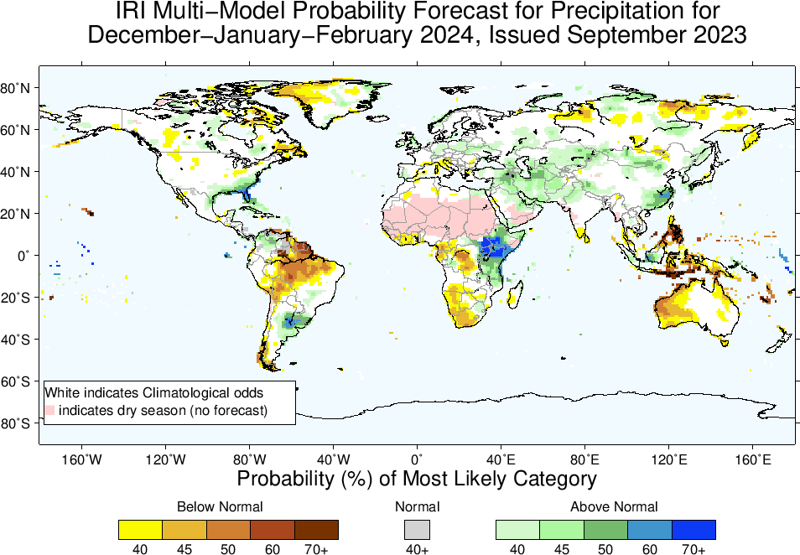
Precipitation Forecasts: Season # 3, Dec to Feb
Highlights:
Shift towards Normal to Above-Normal
Northeast Africa (eastward extended)
Middle East, central South west Asia, Kazakhstan, northern China
Uruguay, eastern parts of US
Shift towards Normal to
Below-Normal
Northern South America,
Maritime Continent,
Australia

Slide 23
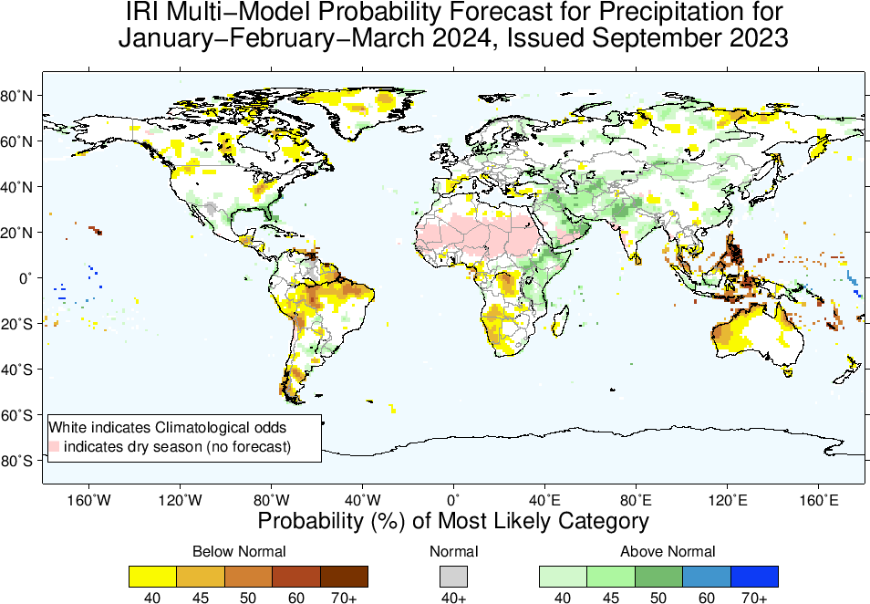
Highlights:
Shift towards Normal to Above-Normal
Northeast Africa (eastward extended)
Middle East, central South west Asia, Kazakhstan, northern China
Uruguay, eastern parts of US
Shift towards Normal to
Below-Normal
Northern South America,
Maritime Continent,
Australia
Precipitation Forecasts: Season # 4, Jan to Mar

Slide 24
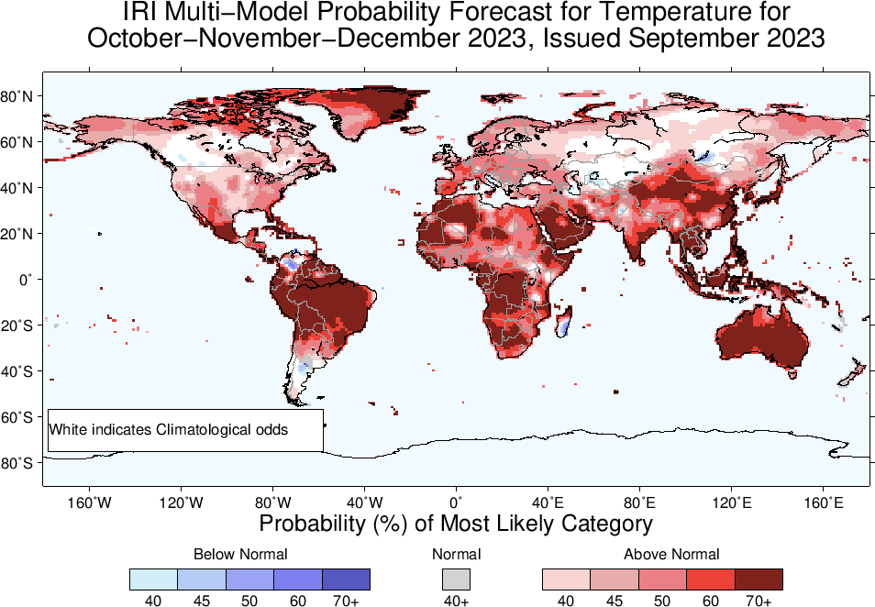
Temperature Forecasts: Season # 1, Oct to Dec
Highlights:
Shift towards Warmer/Above-Normal
Most land areas,
Southeast Asia, the Maritime Continent regions, Northeast South America.
Shift towards Colder/Below-Normal
Northern tip of South America,
Southern parts of Madagascar,
Parts of western Canada

Slide 25
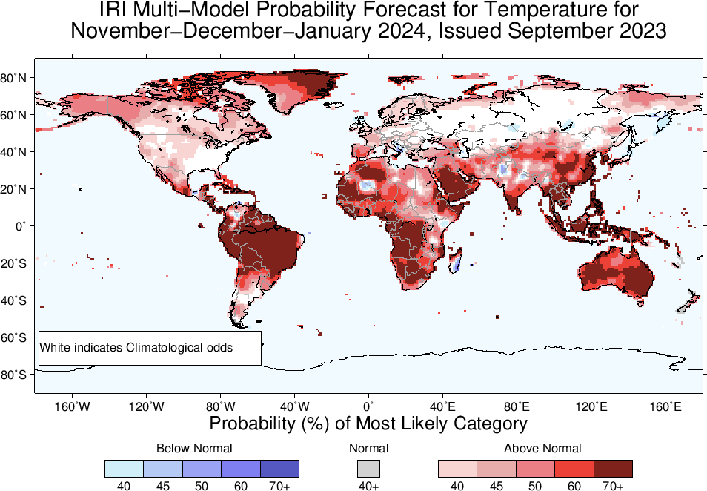

Slide 26
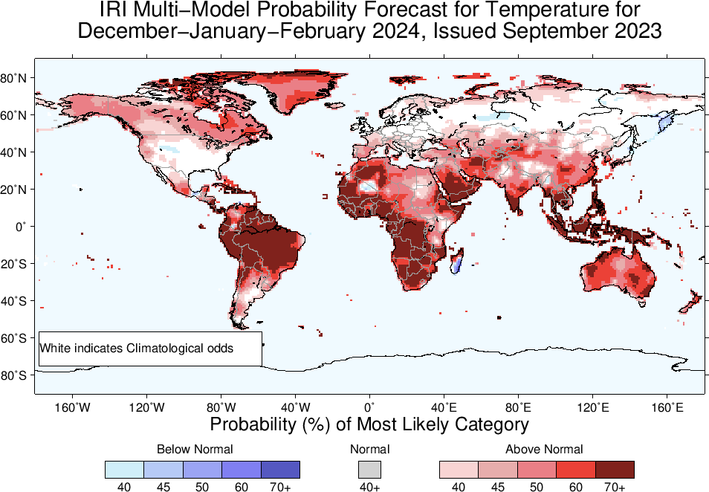

Slide 27
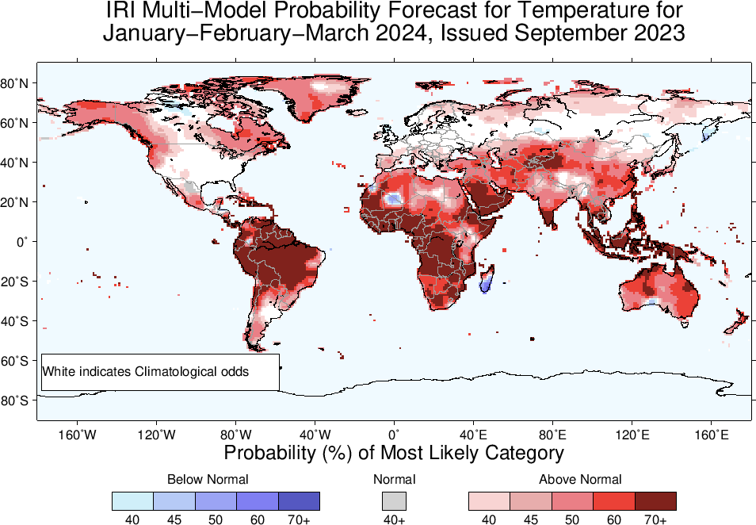

Slide 28
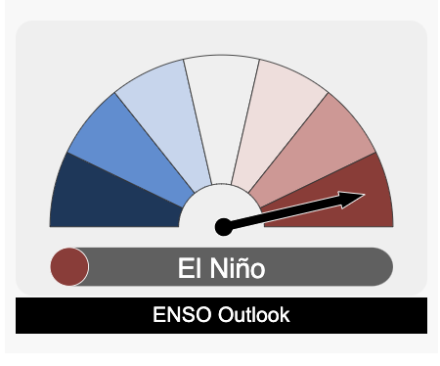
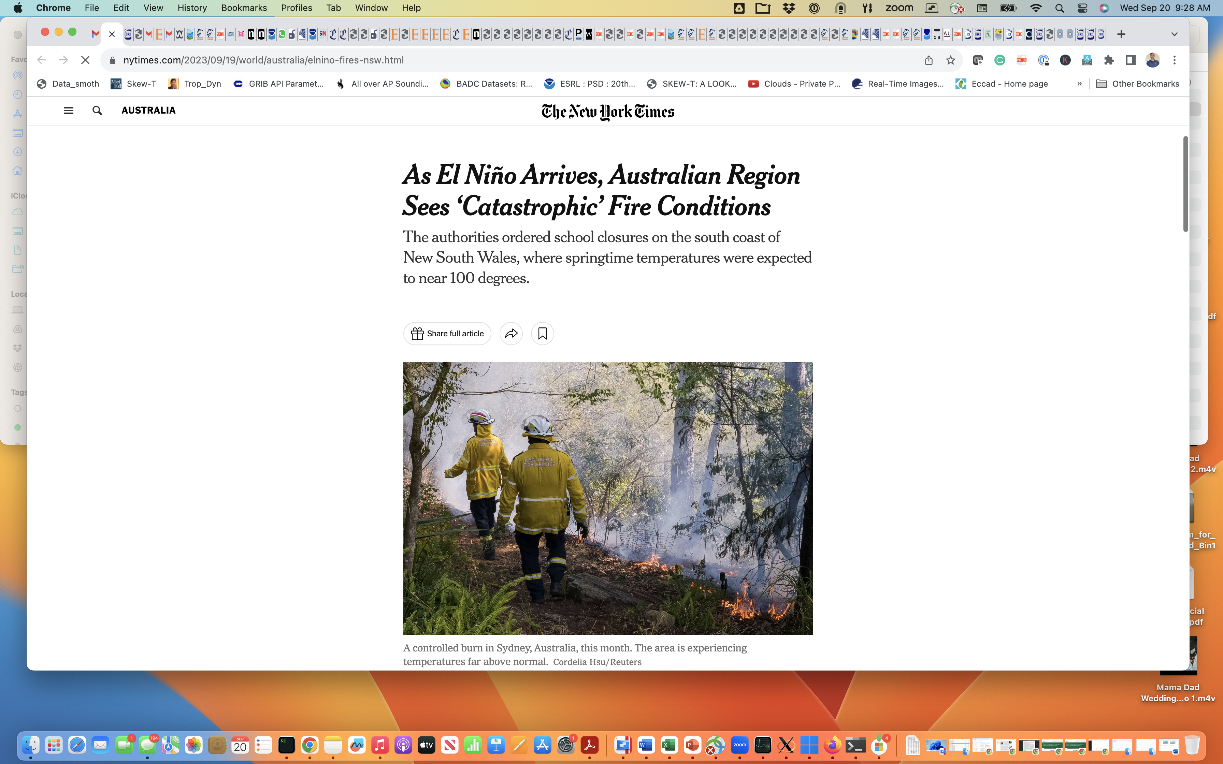
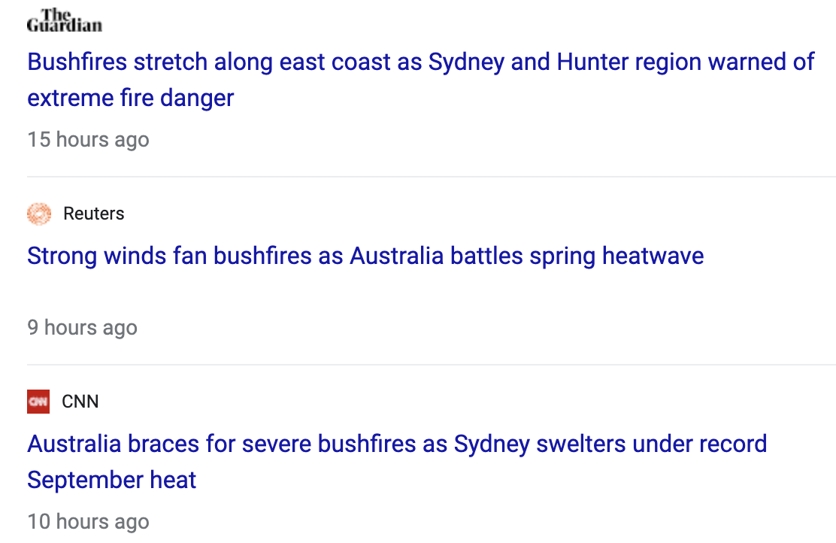
Summary
My Message:
Declare El Nino before the seasons of peak impacts....something about preparedness...
In response to the warming of the central-eastern equatorial Pacific; Atmosphere started to response, but still weaker as compared to the Historical events of same strength.
Source:
https://youtu.be/eNy8rtORUlA?si=d2keWr5zCX-AbalB
http://www.bom.gov.au/climate

