Slide 1
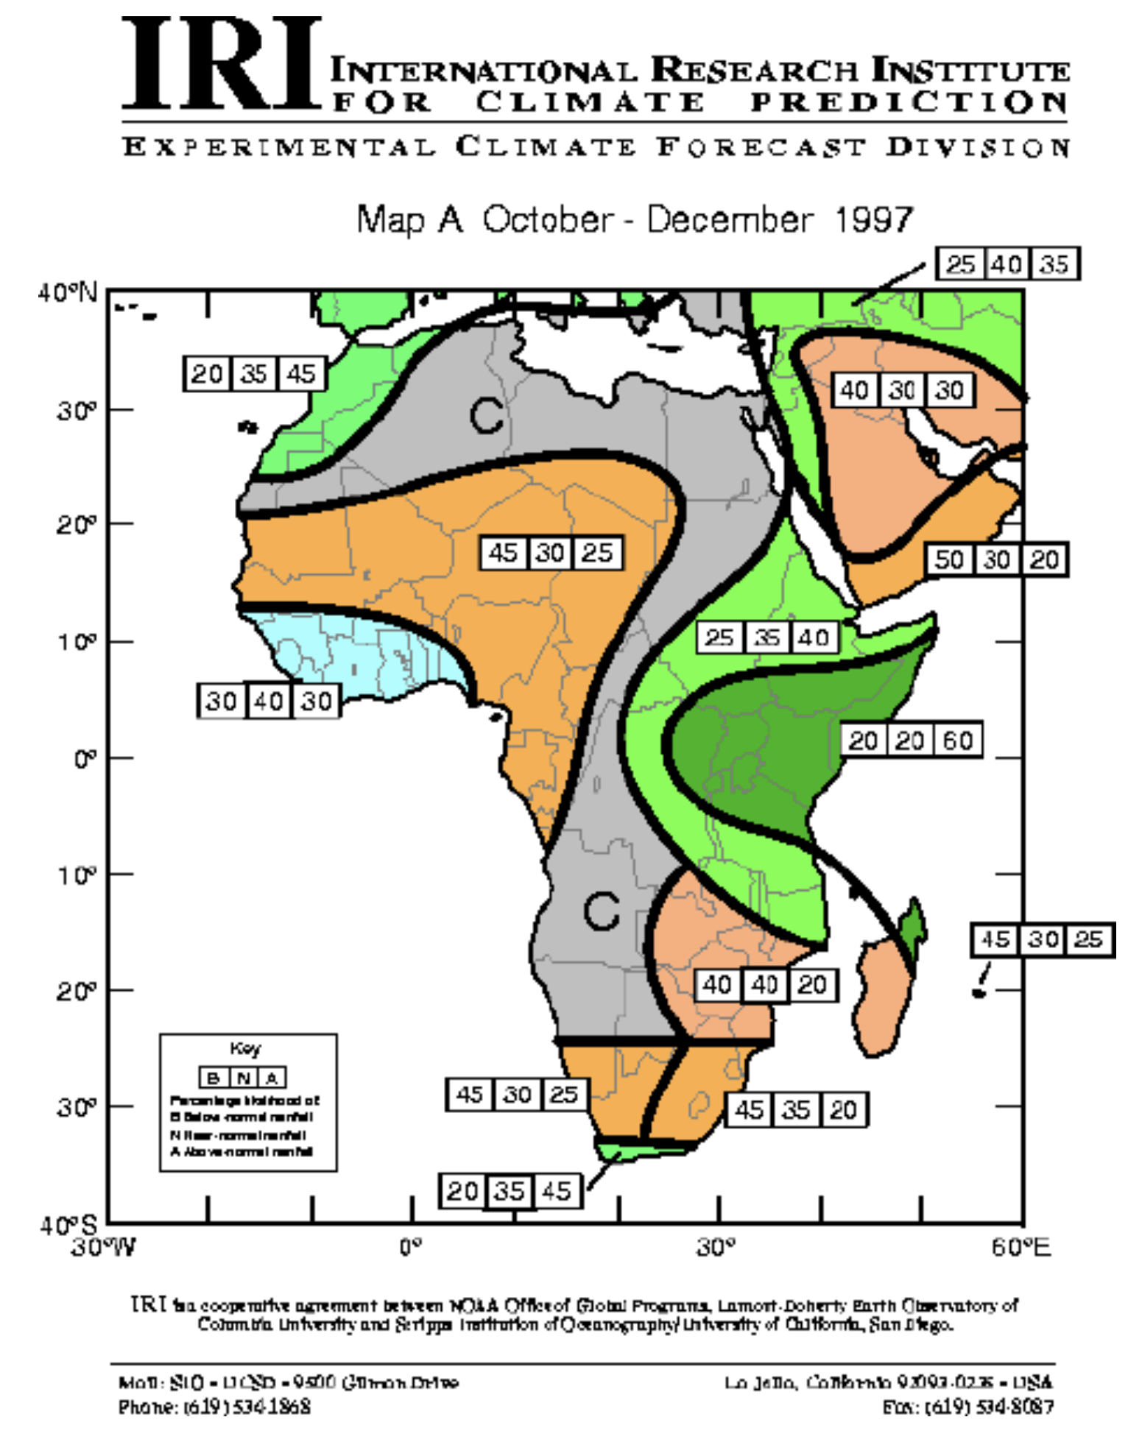
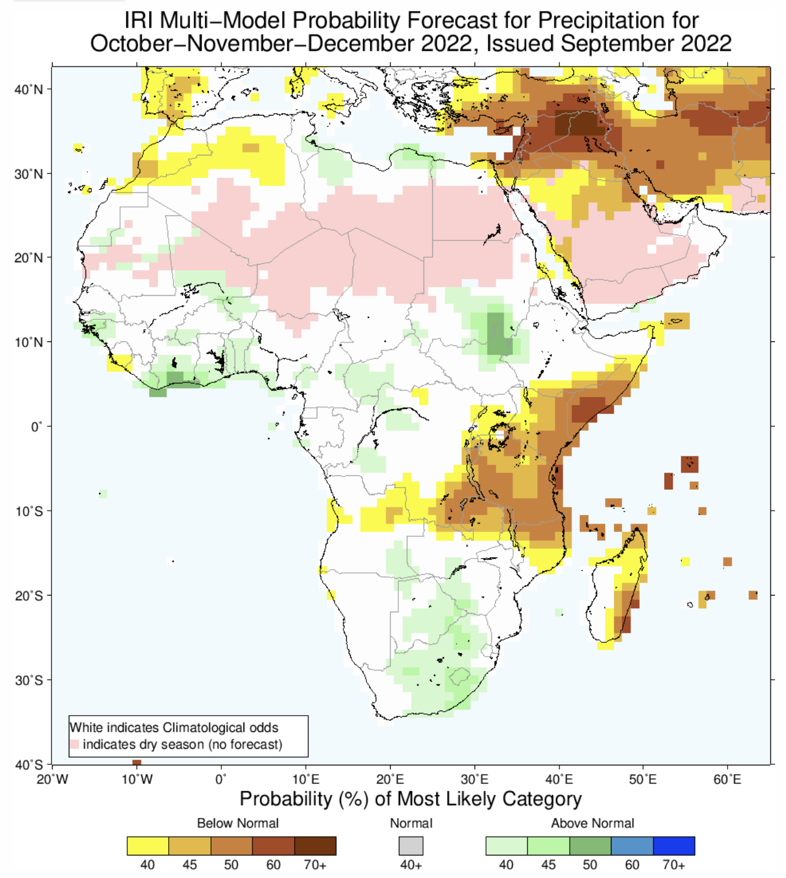
IRI’s Global Real-time Seasonal Forecasts
Of Precipitation and Temperature have been issued by IRI every month continuously since Sep 1997!
Objective synthesis, correction and tailoring of multiple forecast ensembles.

Slide 2
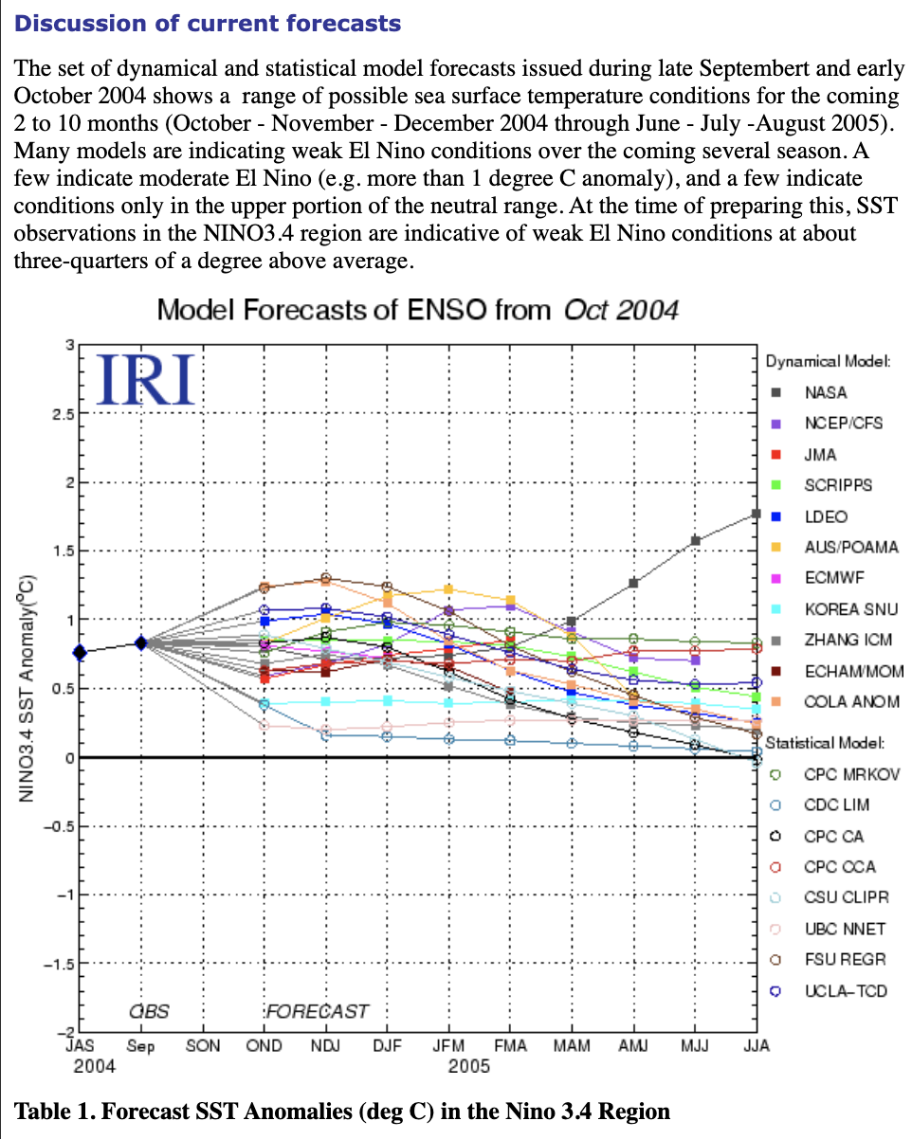
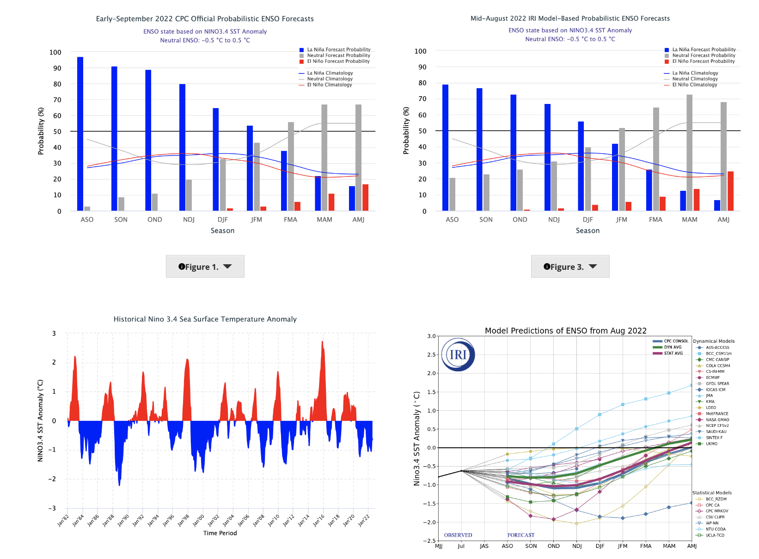
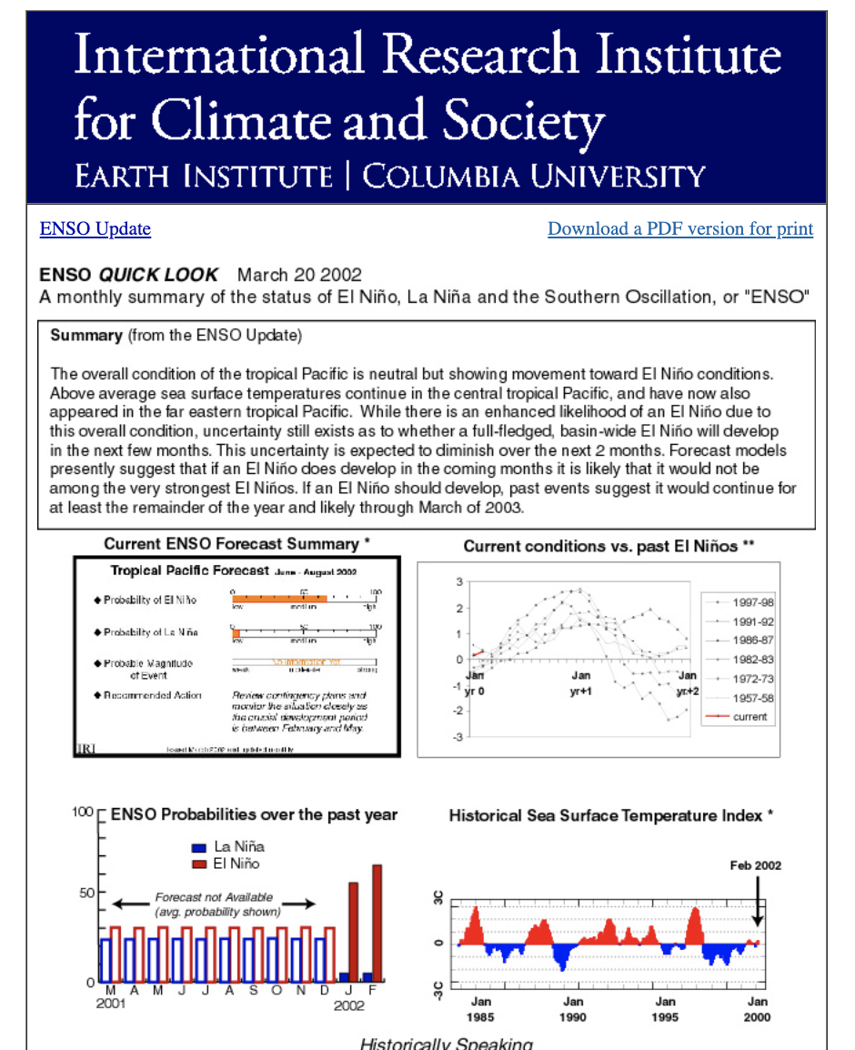
Real-time ENSO Forecast (Issued by IRI every month since Feb, 2002)
The International Research Institute for Climate and Society

Slide 3
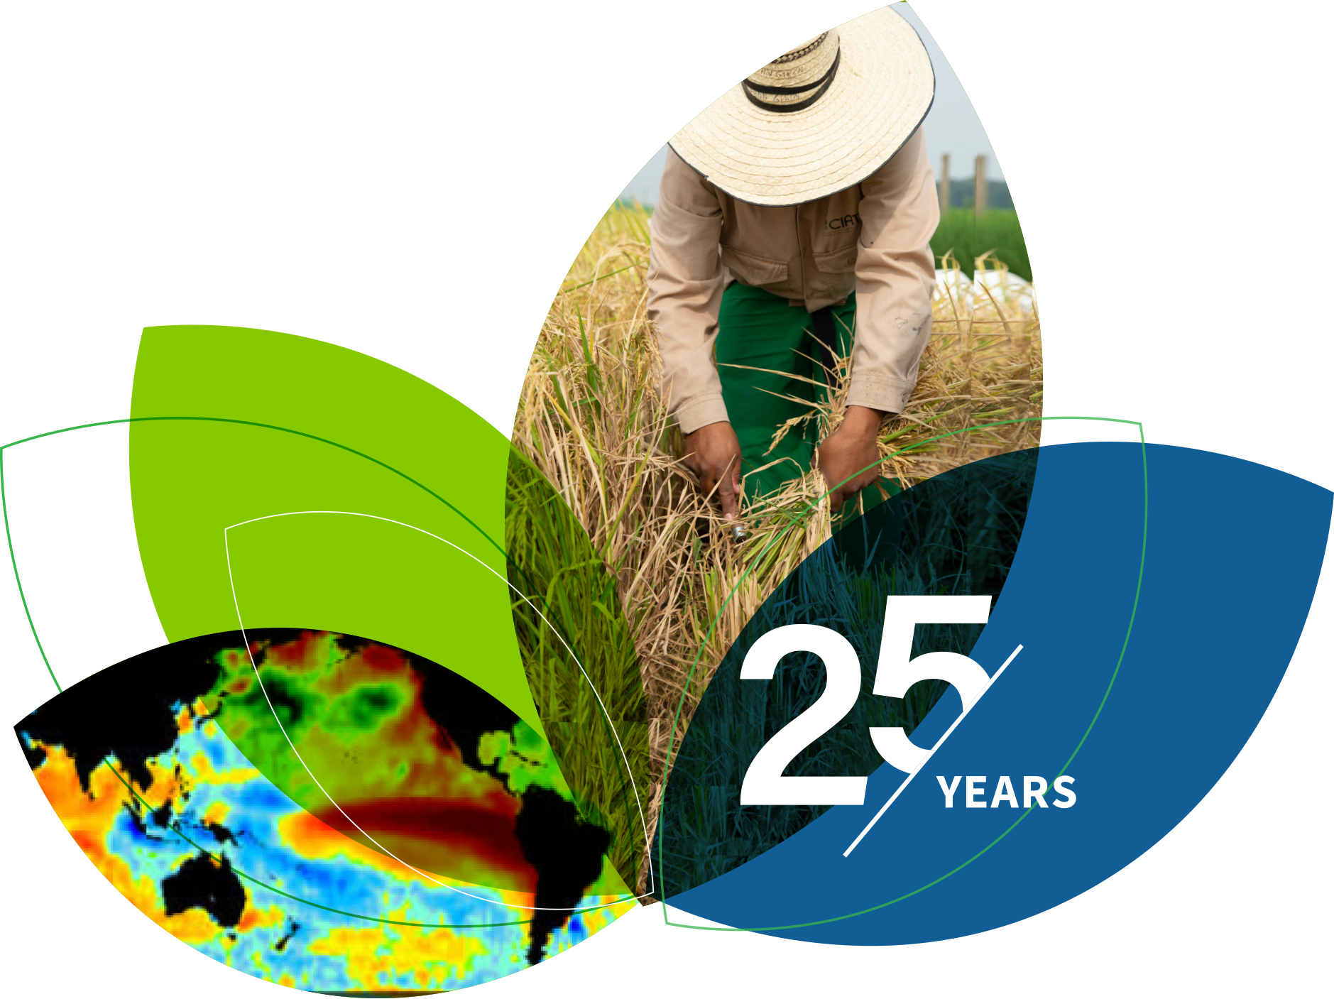
IRI ENSO and Seasonal Climate Outlook September 2022 First Triple-Dip La Niña of 21st Century.
M. Azhar Ehsan
(azhar@iri.columbia.edu)
Associate Research Scientist
IRI ENSO and Climate Forecast Lead
Jeffery Turmelle and Jing Yuan: forecast processing and web updates
Cuihua Li: Draft PowerPoint development
IRI’s Climate Group, led by Dr. Andrew Robertson: Forecast system development, ongoing innovation, and verification

Slide 4
Outline
Observed Oceanic and Atmospheric Conditions in
Tropical Pacific
Across the Globe
ENSO Forecast in
NMME
IRI ENSO Forecast Tool (Deterministic and Probabilistic)
Seasons Outlook of
SST
Precipitation and Temperature
Summary
The International Research Institute for Climate and Society

Slide 5
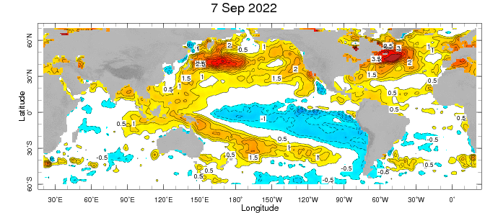
Evolution of EQ. Pacific SST Departures in Weekly OISST Data
In the Pacific Ocean: Below-average SSTs persisted across the central (across the Date Line), surrounded by strong +ve SSTA in the high latitudes.
Indian Ocean: Near-Normal SSTAs in the west (slight -ve) and positive in the East, a –ve Indian Ocean Dipole (-0.79 for week ending on 11 September).
Atlantic Ocean: Patches of positive/Negative SSTAs in the equatorial AO

Slide 6
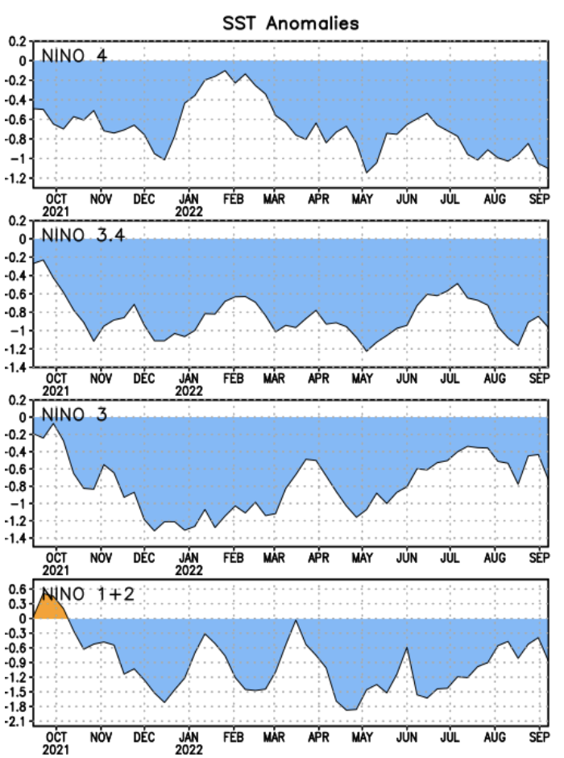
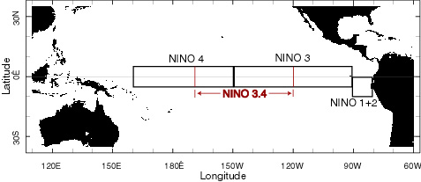
Most Recent SST Departures in different NINO regions (All cooler than the long-term avg,
(1991-2020))
Niño 4
-1.1ºC
Niño 3.4
-1.0ºC
Niño 3
-0.7ºC
Niño 1+2
-0.9ºC
The International Research Institute for Climate and Society

Slide 7
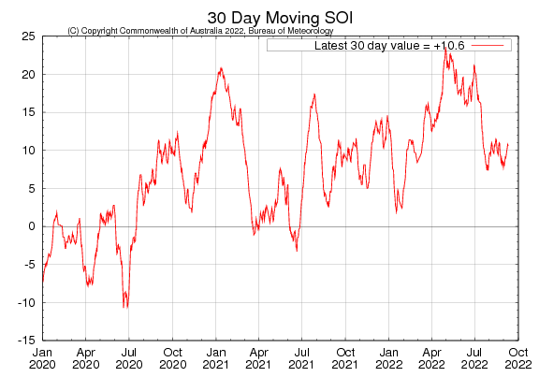
2021
2020
2022
Sustained positive values of the SOI above +7 typically indicate La Niña
The International Research Institute for Climate and Society

Slide 8
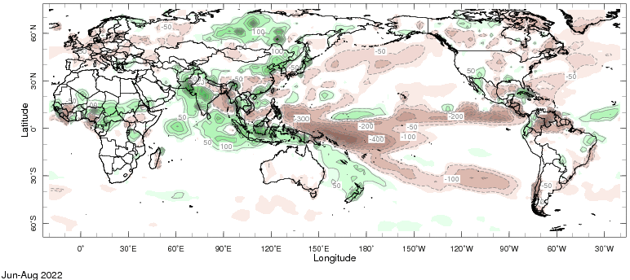
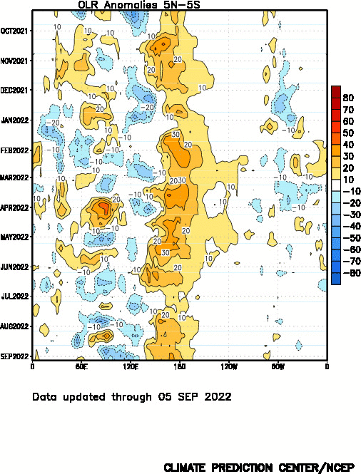
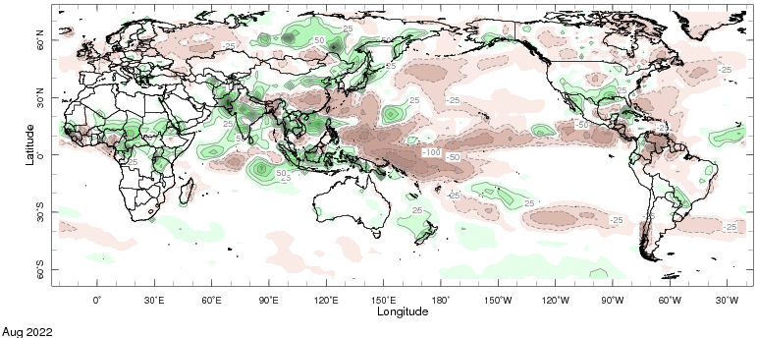

Slide 9
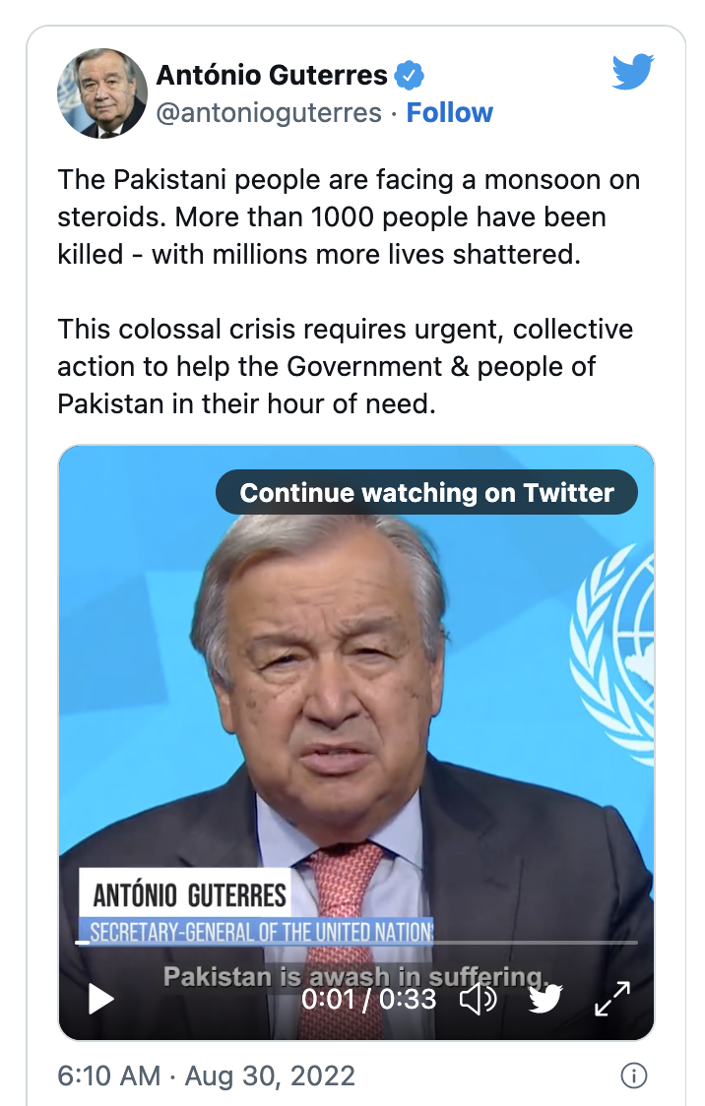
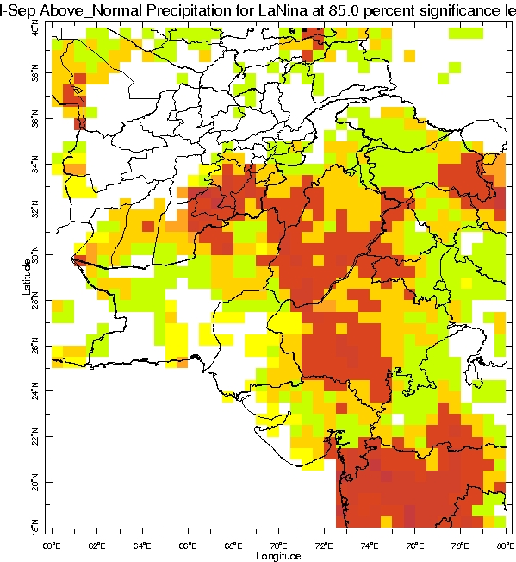
July to August Prcp. For La Nina
https://twitter.com/antonioguterres/status/1564556094680227841?ref_src=twsrc%5Etfw%7Ctwcamp%5Etweetembed%7Ctwterm%5E1564556094680227841%7Ctwgr%5E%7Ctwcon%5Es1_c10&ref_url=https%3A%2F%2Fnews.un.org%2Fen%2Fstory%2F2022%2F08%2F1125752

Slide 10
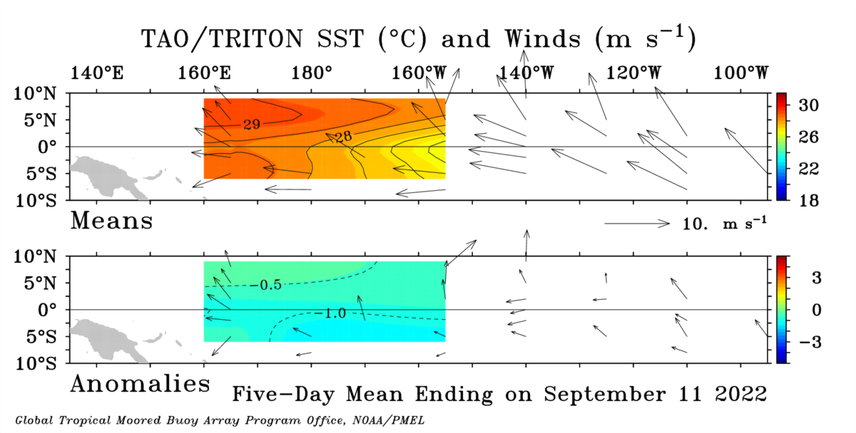

Slide 11
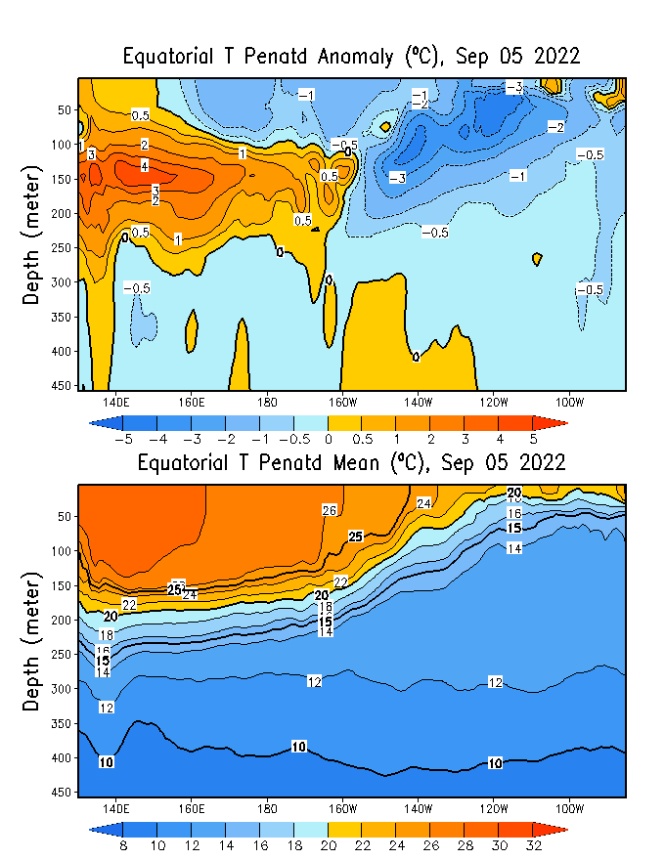
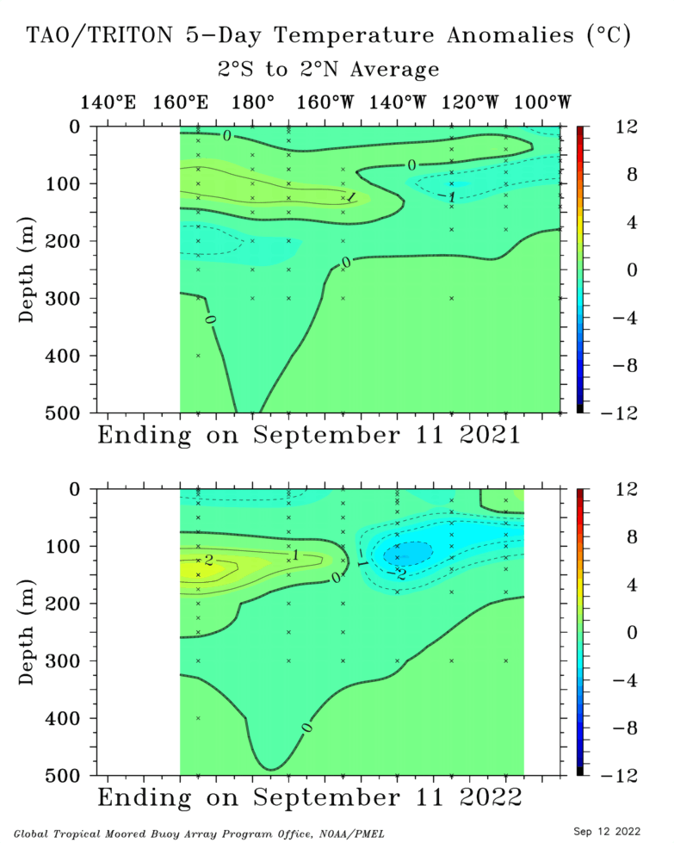

Slide 13
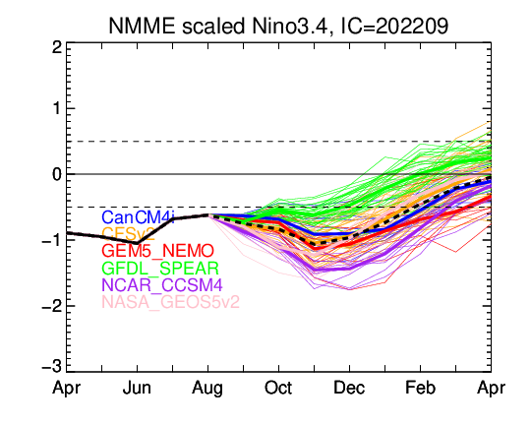

Slide 14
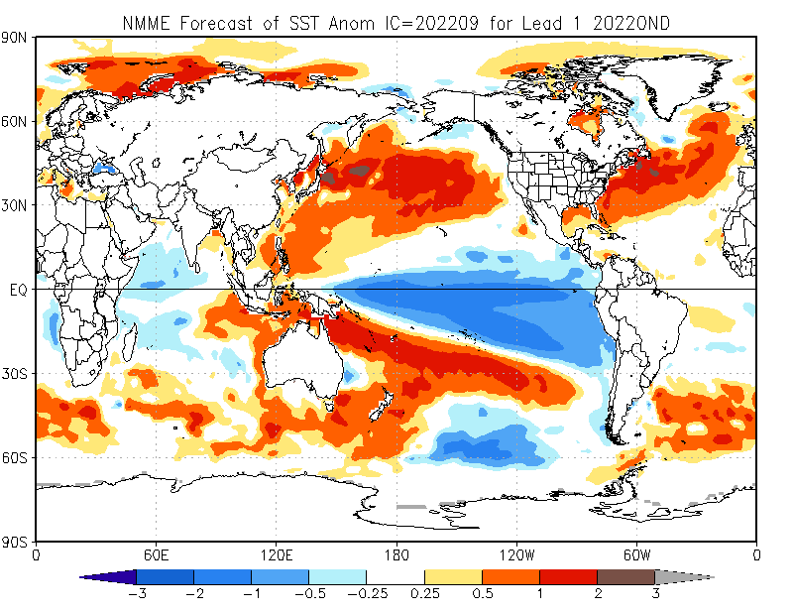

Slide 15
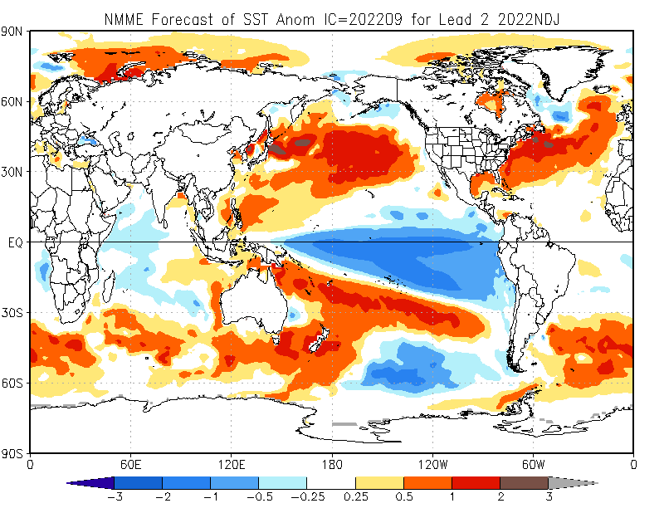

Slide 16
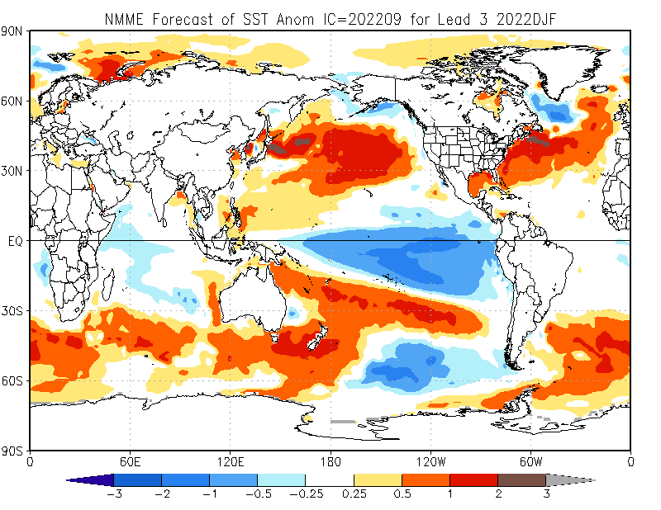

Slide 17
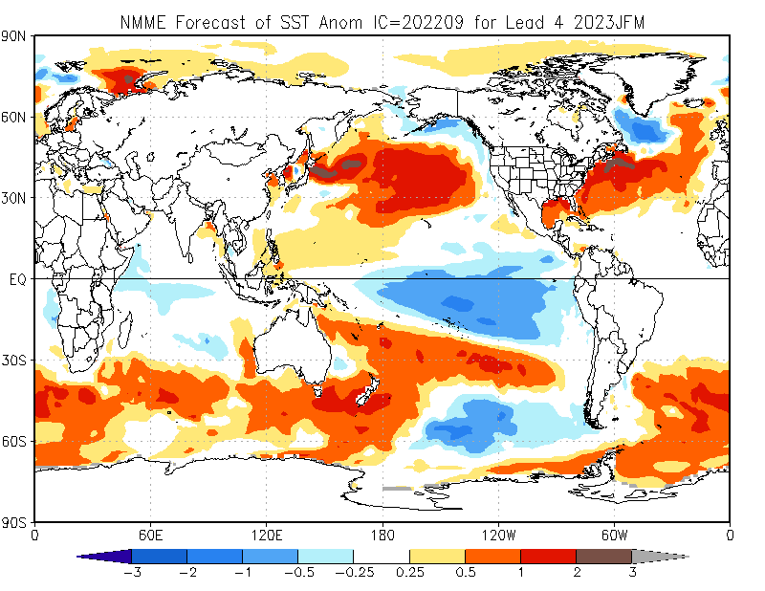

Slide 18
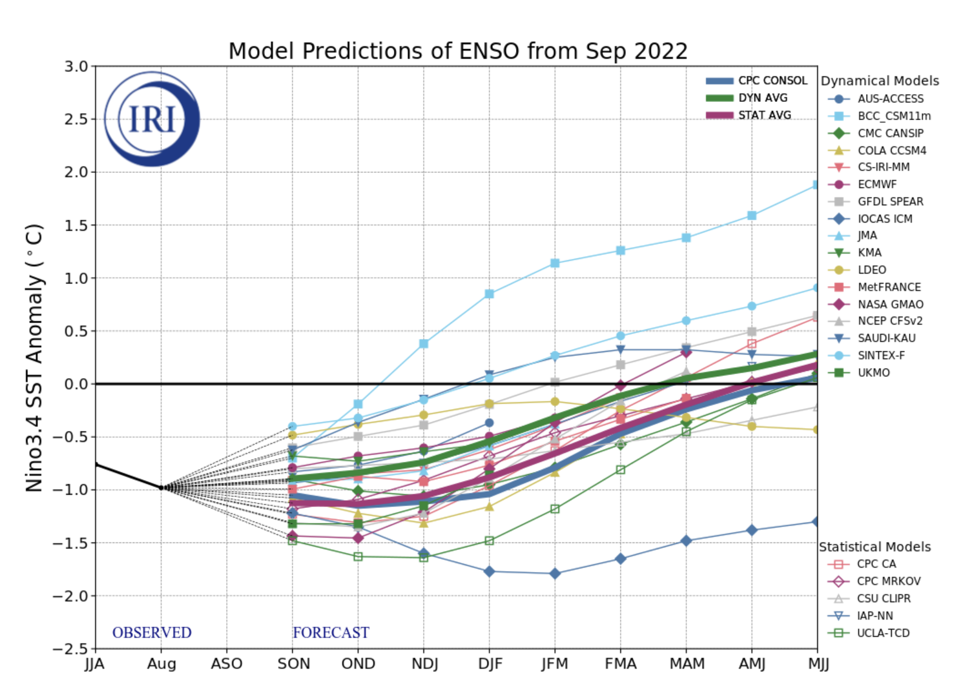
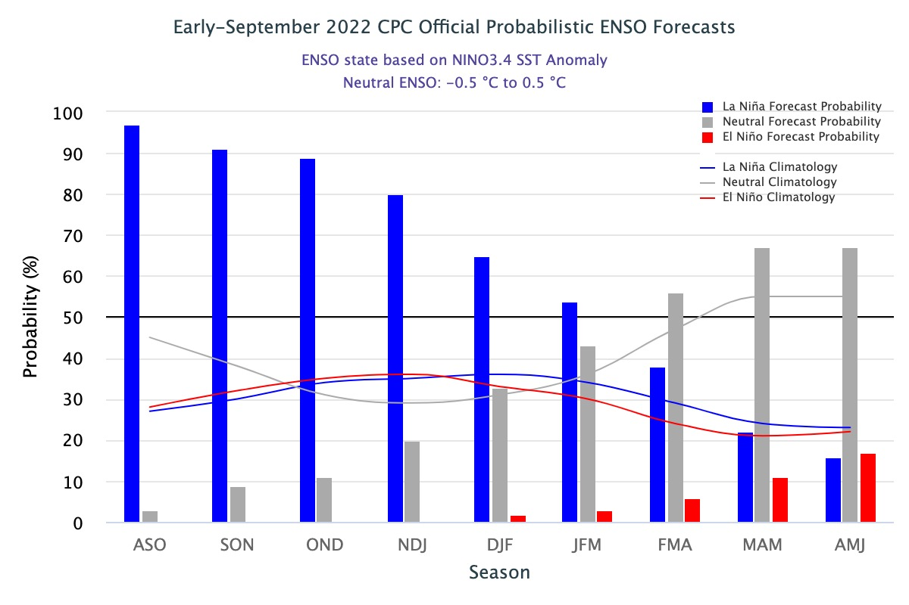
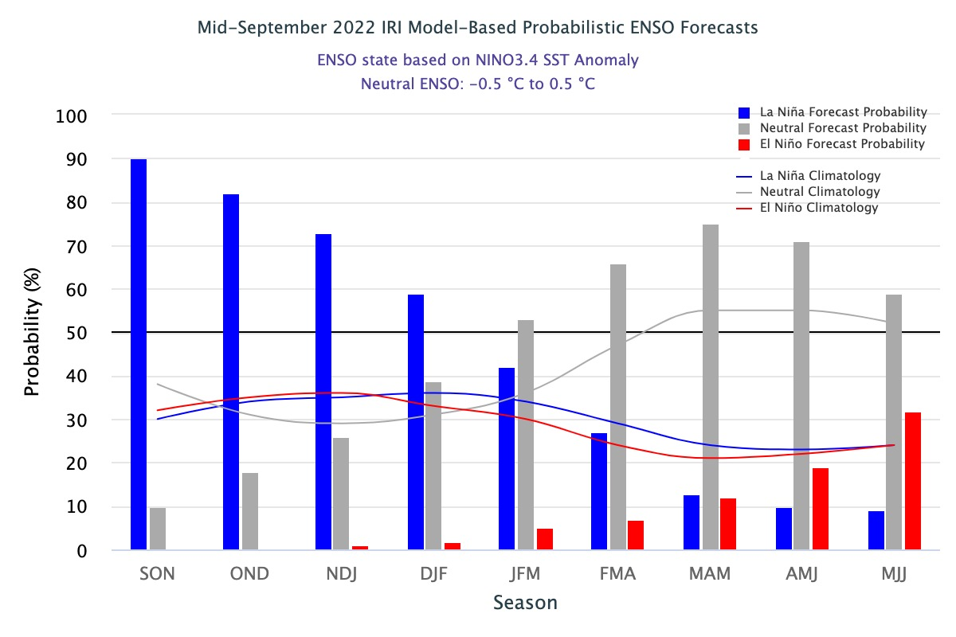
IRI’s ENSO Forecast

Slide 19
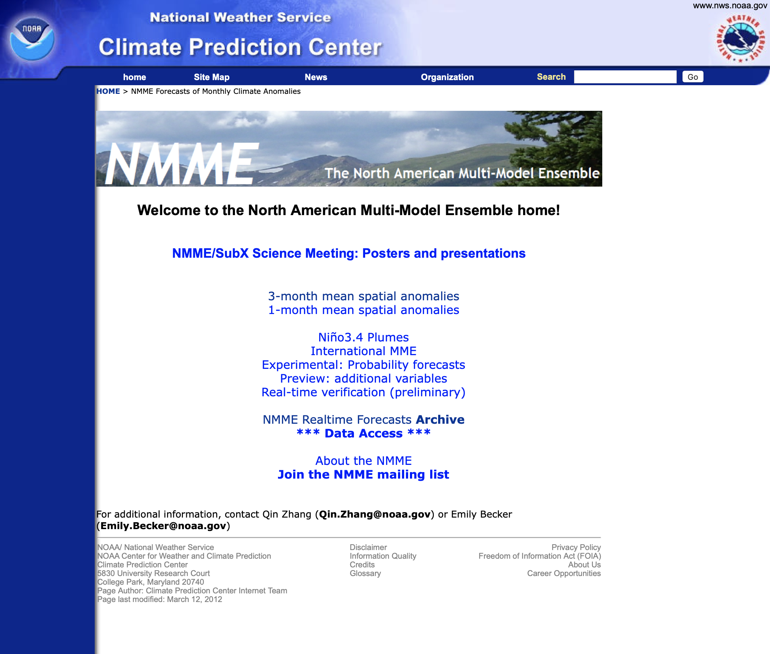
NMME Models used in IRI MME (Prcp & Temp.)
NCEP-CFSv2
CanSIPS-IC3
COLA-RSMAS-CCSM4
GFDL-SPEAR
NASA-GEOSS2S
Available on 8th of each month
The International Research Institute for Climate and Society

Slide 20
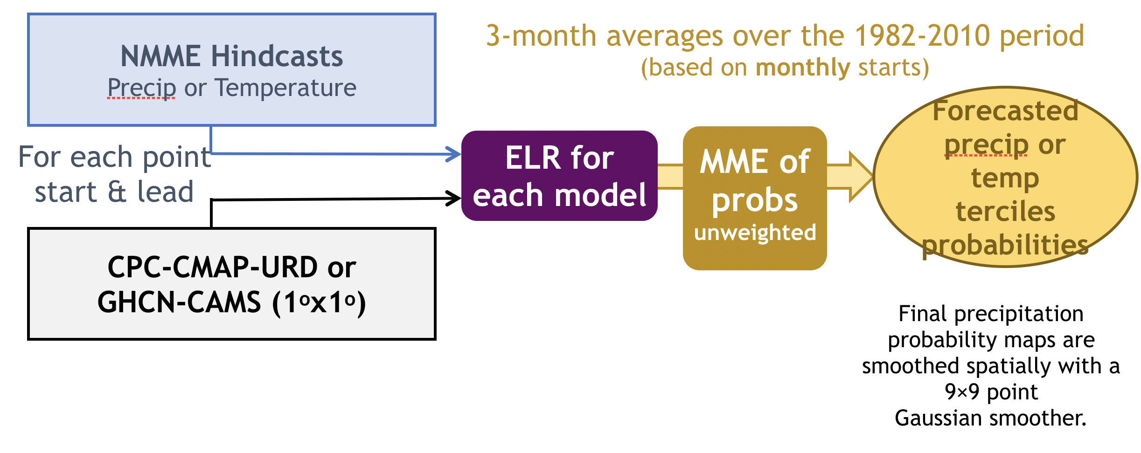
Multimodel Seasonal Forecast Calibration Methodology
IRI MME forecasts are released on the 15th of each month.
The International Research Institute for Climate and Society

Slide 21
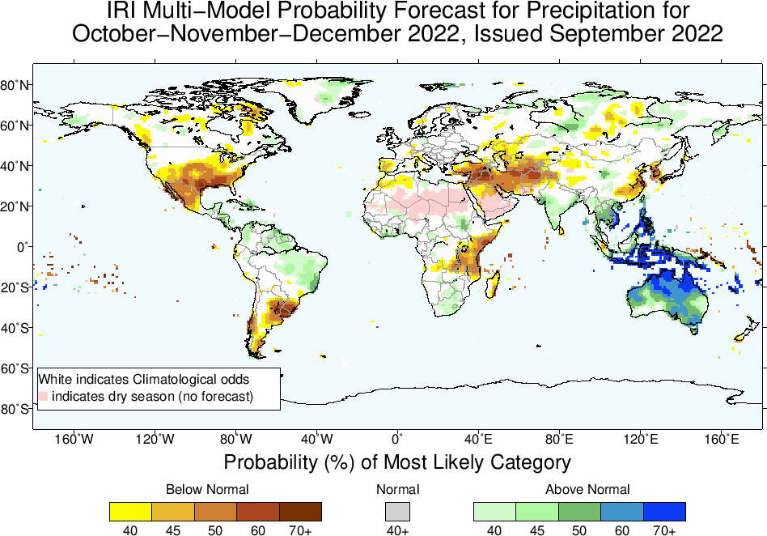

Slide 22
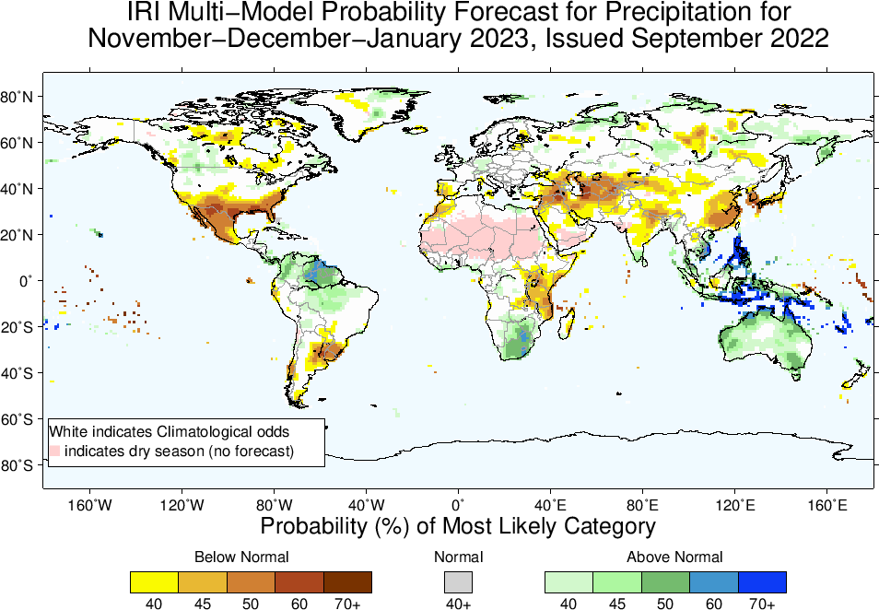

Slide 23
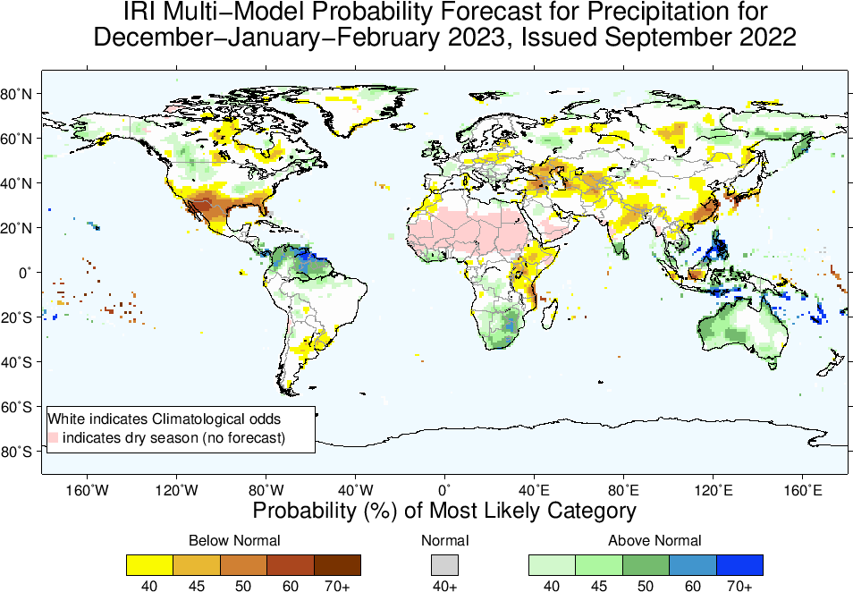

Slide 24
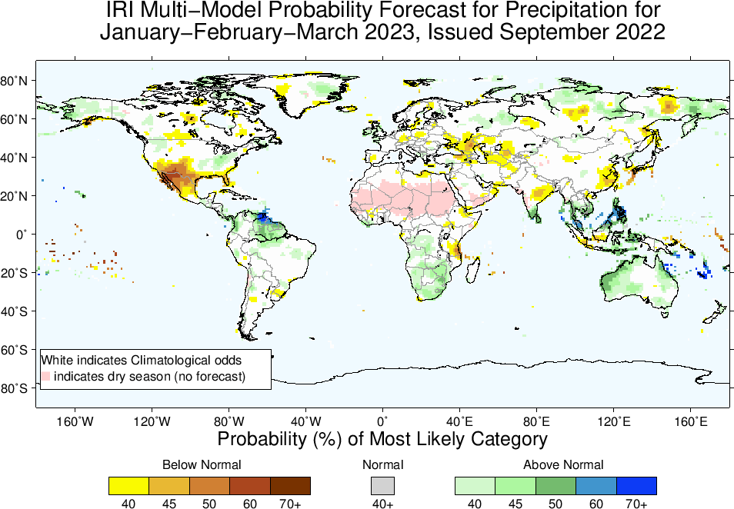

Slide 25
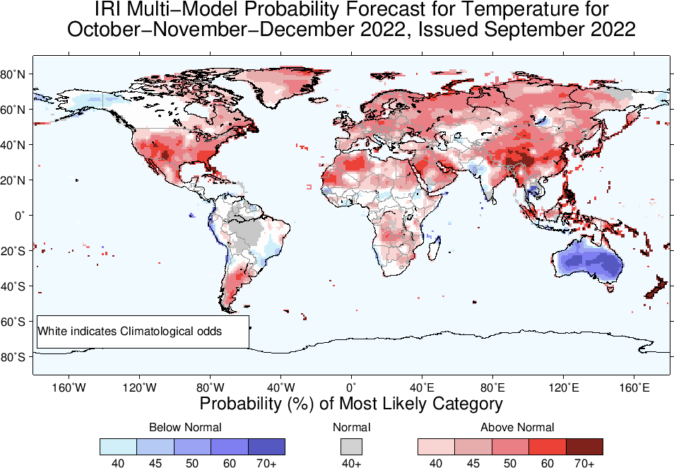

Slide 26
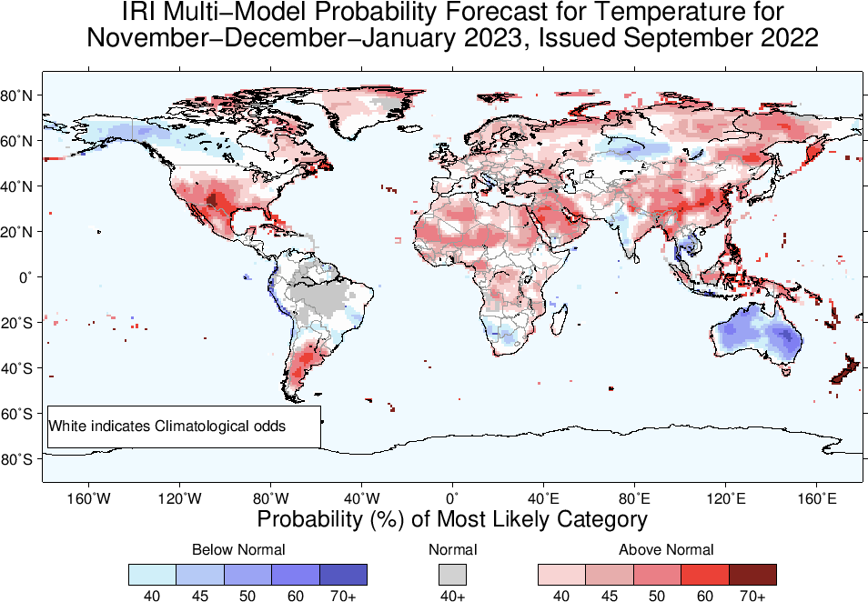

Slide 27
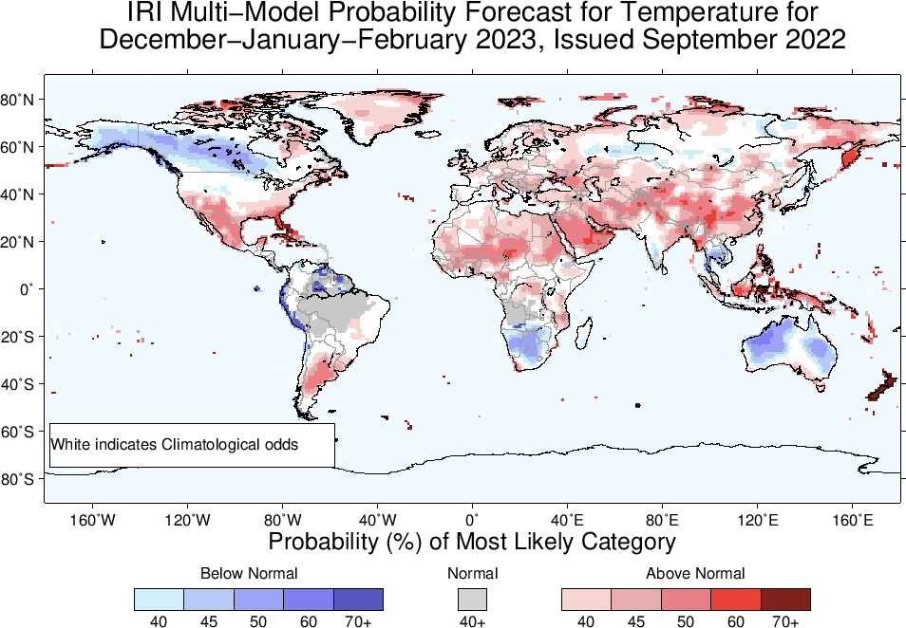

Slide 28
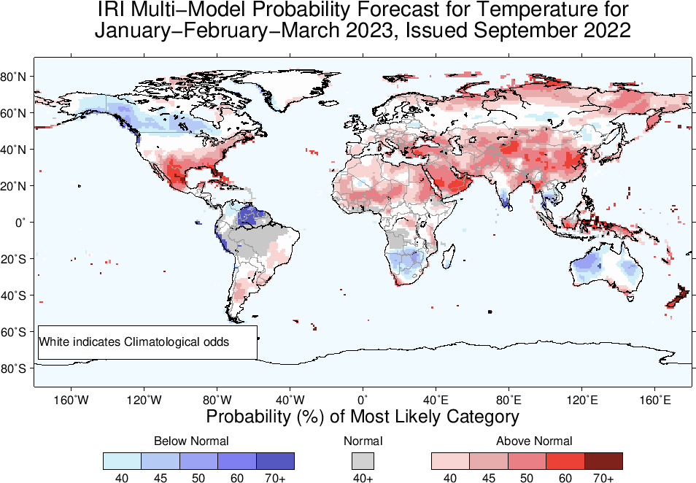

Slide 29
Summary
La Niña ongoing,
Oceanic and Atmospheric conditions strengthening in the favour of La Nina; e.g.,
Sea surface temperatures (SSTs) are below average across the central equatorial Pacific Ocean.
SOI is positive (ticked up), stronger than average trade winds, reduced cloudiness over central Pacific (west of Date-line).
La Niña is favored to continue with high chances during next two seasons with probabilities greater than 70%. Moving forward probabilities for La Niña to continue till next boreal winter is 59%. Qualify for a Triple-Dip Event.
ENSO-Neutral is most favorable starting from JFM-2023 onward (53%).

Slide 30
IRI Climate Briefing: Sep. 15, 2022 Sub-seasonal Update
Bohar Singh

Slide 31
We use three NOAA models initialized every Wednesday
NCEP CFSv2
EMC GEFS
ESRL FIMr1p1
Calibrated probabilistic forecasts are issued every Friday for weekly and biweekly averages of precip. and temperature up to 4 weeks ahead.

Slide 32
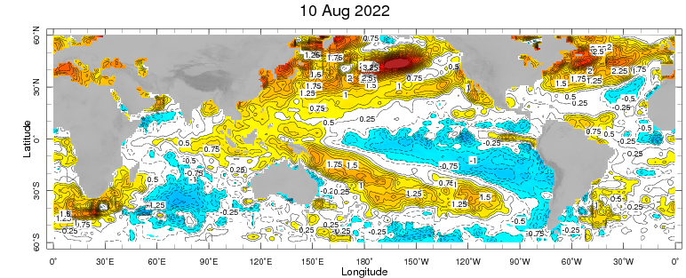
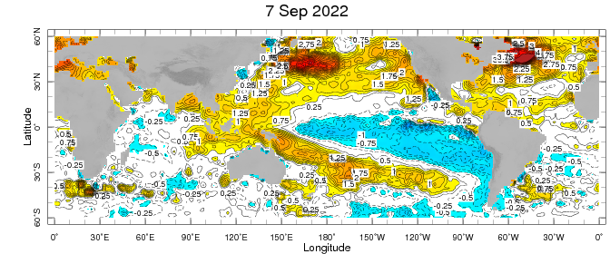
Sub-seasonal climate drivers: State of Climate
Cold anomalies present in eastern and central Pacific and getting stronger
West Pacific warm anomalies retracted and gets stronger as compared to last month
Warm SST anomalies are present sub-tropical pacific and North Atlantic Ocean

Slide 33
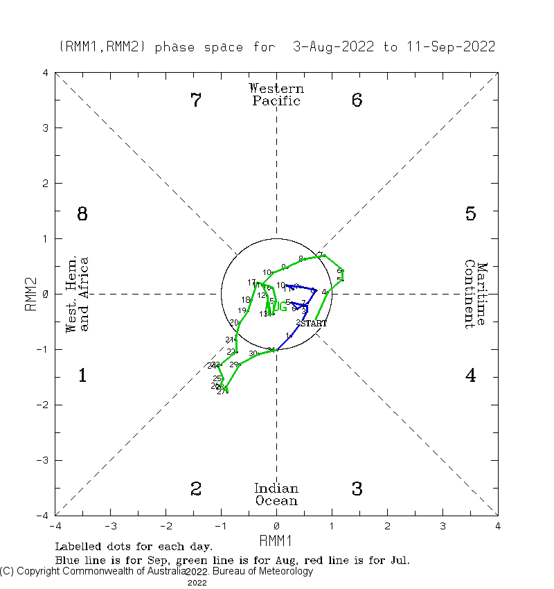
Current and Past evolution of the MJO Wheeler-Hendon Indices
Currently MJO is in-active state

Slide 34
State of the climate: Cloudiness and circulation
Source : CPC
Source: windy
Northward propagation of convection is observed over Indian subcontinent
Convective clouds band observed in Maritime continent
Cloudiness is observed in the north American Monsoon region and south-to-northeast United States

Slide 35
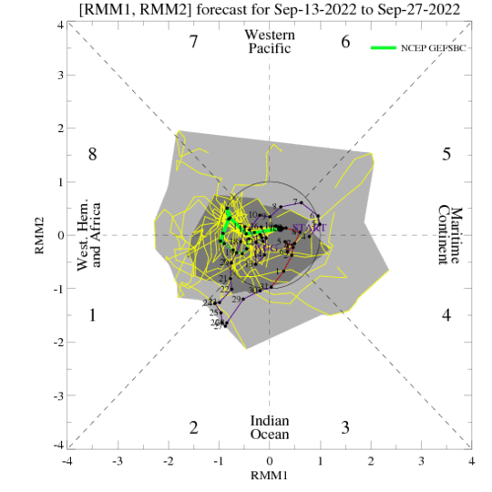
Forecast of MJO: Wheeler-Hendon Indices
MJO 15-day Forecast from NCEP GEFS model
Currently MJO is weak and expected to be remain weak over next two weeks

Slide 36
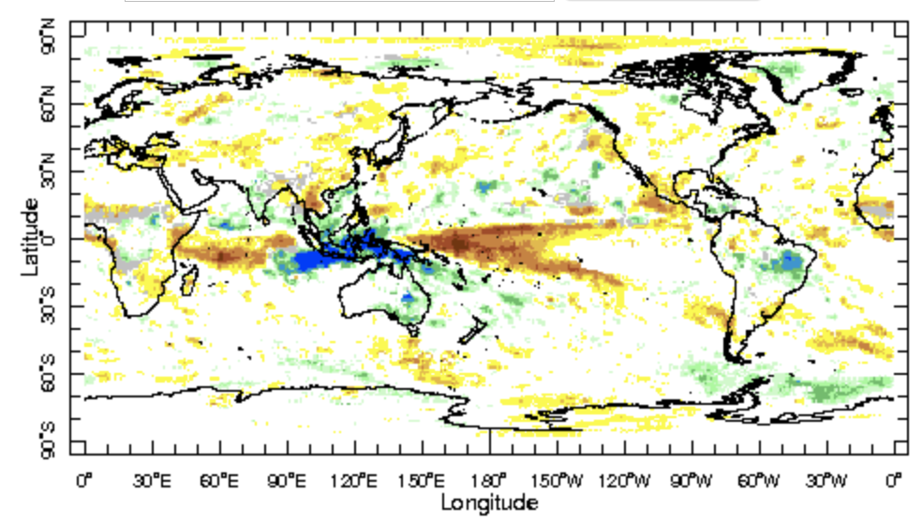
IRI Sub-seasonal Forecast: Precipitation (week 3 &4)
Week:3-4: ( 1- 14 Oct.).
Forecast issue date: Sep 16th
Above normal rainfall is likely over maritime continent and eastern Australia region
Wet rainfall anomalies are
likely in Brazil
Dry rainfall anomalies are likely over equatorial Pacific Ocean, Mexico, south China and greater horn of Africa

Slide 37
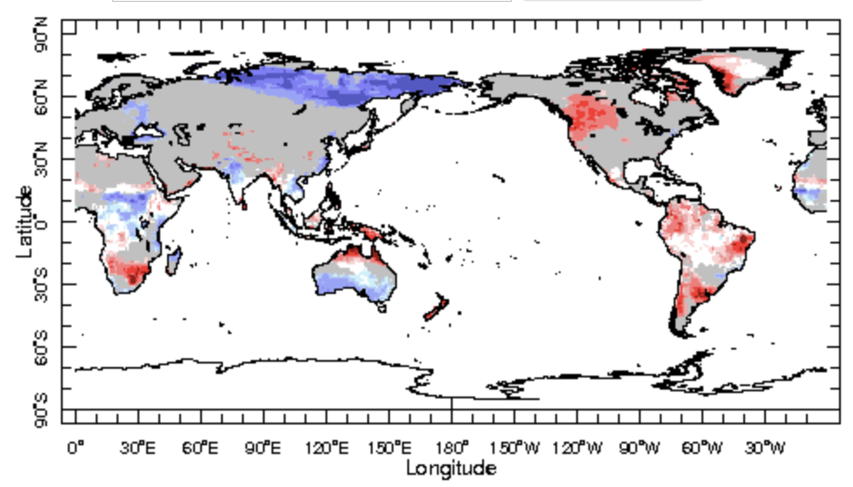
IRI Sub-seasonal Forecast : Near-Surface Temperature (week 3-4)
Week:3-4: (1-14 Oct.).
Forecast issue date: Sep 16th
Below normal near surface temperature is likely over parts of Central India and Russia
Below normal near surface temperature is likely over central Africa and southern Australia
Above normal temperature is likely over NW United states , SW Canada south America, eastern Australia and Maritime Continent

Slide 38
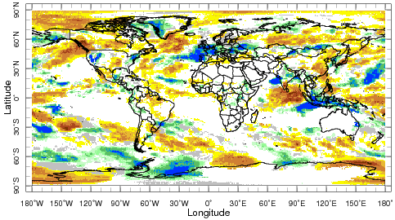
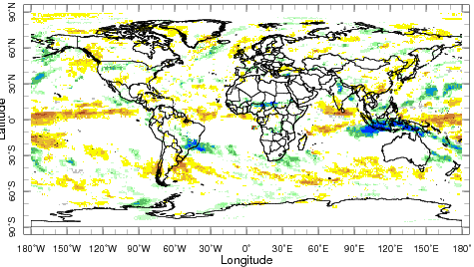
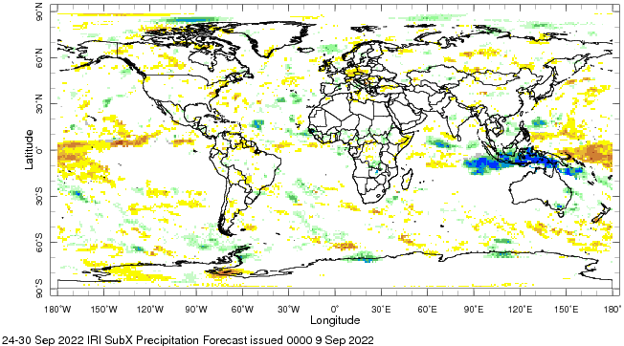
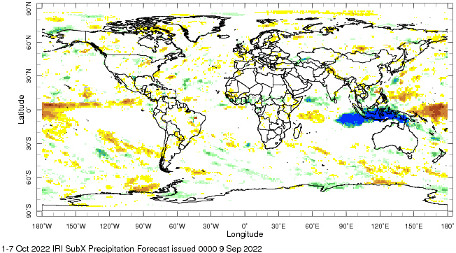
IRI Sub-seasonal Forecast : Precipitation (week 1-4)
Forecast issue date: Sep 9th
Week: 1 (10 -16 Sep.).
Week: 2 (17 - 23 Sep.).
Week: 3 (24 -30 Sep.).
Week: 4 (1 -7 Oct.).

Slide 39
Summary
La Niña is active
MJO related convection and circulation are currently in-active most likely remain in-active for next two weeks.
Indian subcontinent and Maritime continent are likely to get above normal rainfall for week 3-4
South America and greater horn of Africa and south Africa including Madagascar are likely to get below normal rainfall at 3-4 week
Above normal temperature is likely over north Africa, south America, eastern Australia and Maritime Continent at week 3-4 lead time

Slide 40
Thank You!

