Slide 1
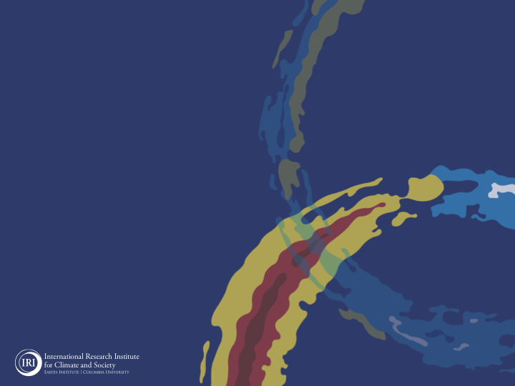
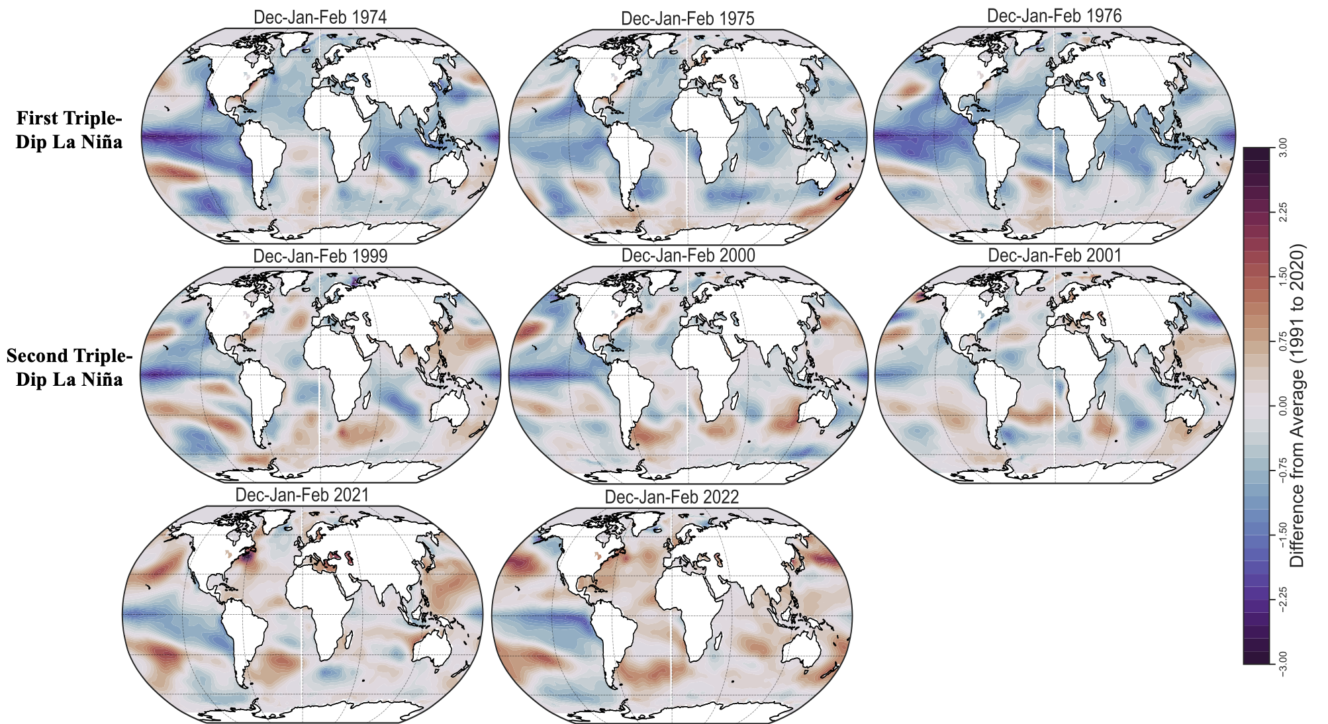
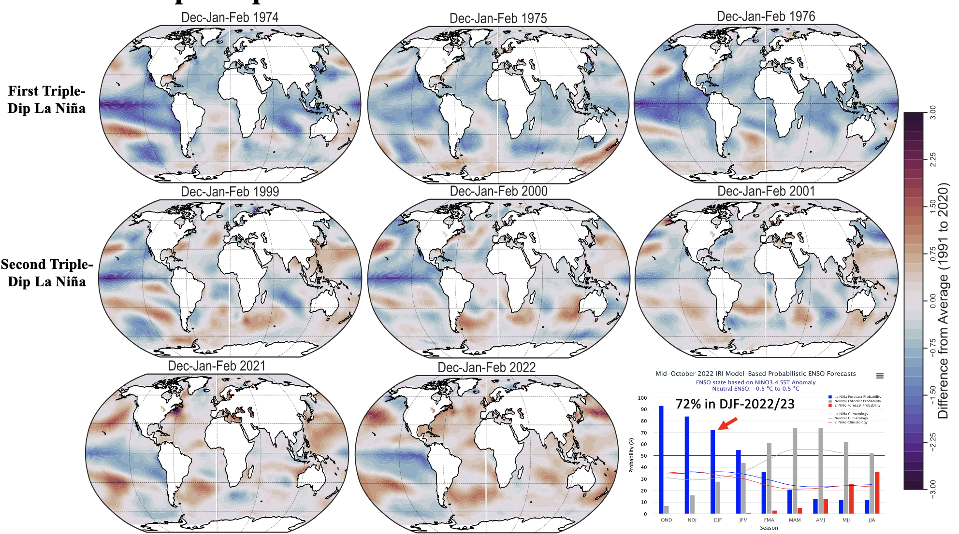
ENSO and Climate Outlook
in October 2022
M. Azhar Ehsan
(azhar@iri.columbia.edu)
Associate Research Scientist
IRI ENSO and Climate Forecast Lead
Jeffery Turmelle and Jing Yuan: forecast processing and web updates
Cuihua Li: Draft PowerPoint development
IRI’s Climate Group, led by Dr. Andrew Robertson: Forecast system development, ongoing innovation, and verification
https://www.history.com/topics/halloween/history-of-halloween

Slide 2
Outline
Observed Oceanic and Atmospheric Conditions in
Tropical Pacific
Across the Globe
ENSO Forecast in
NMME
IRI ENSO Forecast Tool (Deterministic and Probabilistic)
Seasons Outlook of
SST
Precipitation and Temperature
Summary

Slide 3
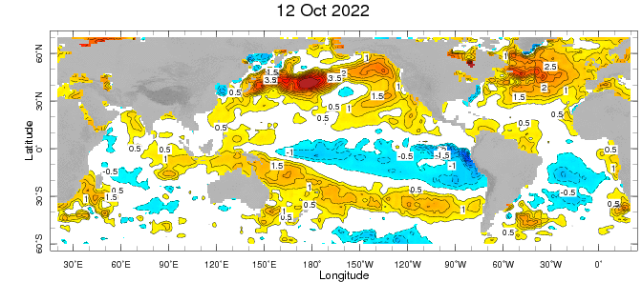
Evolution of EQ. Pacific SST Departures in Weekly OISST Data
In the Pacific Ocean: Below-average SSTs persisted across the central (across the Date Line), surrounded by strong +ve SSTA in the high latitudes.
Stronger Colder SSTAs exists in Eastern Pacific (120W to 80W).
Indian Ocean: Near-Normal (slightly negative) SSTAs in the west and positive in the East, a –ve Indian Ocean Dipole (-0.57 for week ending on 09 OCT-2022).
Atlantic Ocean: Patches of positive SSTAs Near Equator.
Very Strong Anomalies in the Northern Pacific and Atlantic. September PDO -2.27.
https://www.ncei.noaa.gov/access/monitoring/pdo/
http://www.bom.gov.au/climate/enso/#tabs=Indian-Ocean

Slide 4
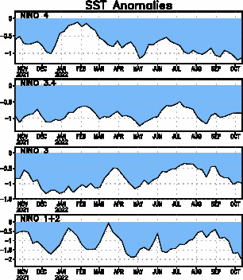
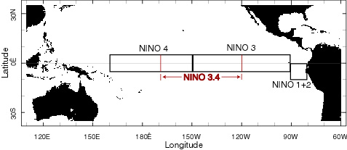
Most Recent SST Departures in different NINO regions (All cooler than the long-term avg, (1991-2020))
Niño 4
-1.1ºC
Niño 3.4
-0.8ºC
Niño 3
-1.0ºC
Niño 1+2
-2.0ºC

Slide 5
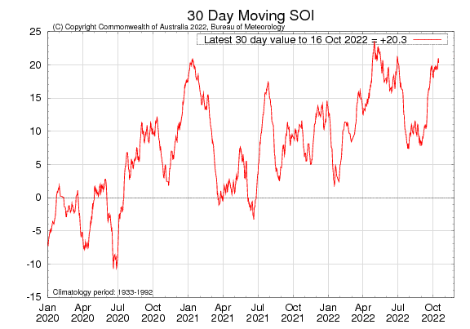
Sustained positive values of the SOI above +7 typically indicate La Niña

Slide 6
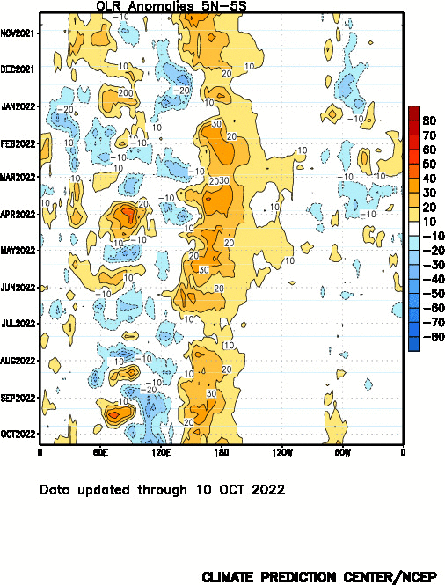

Slide 7
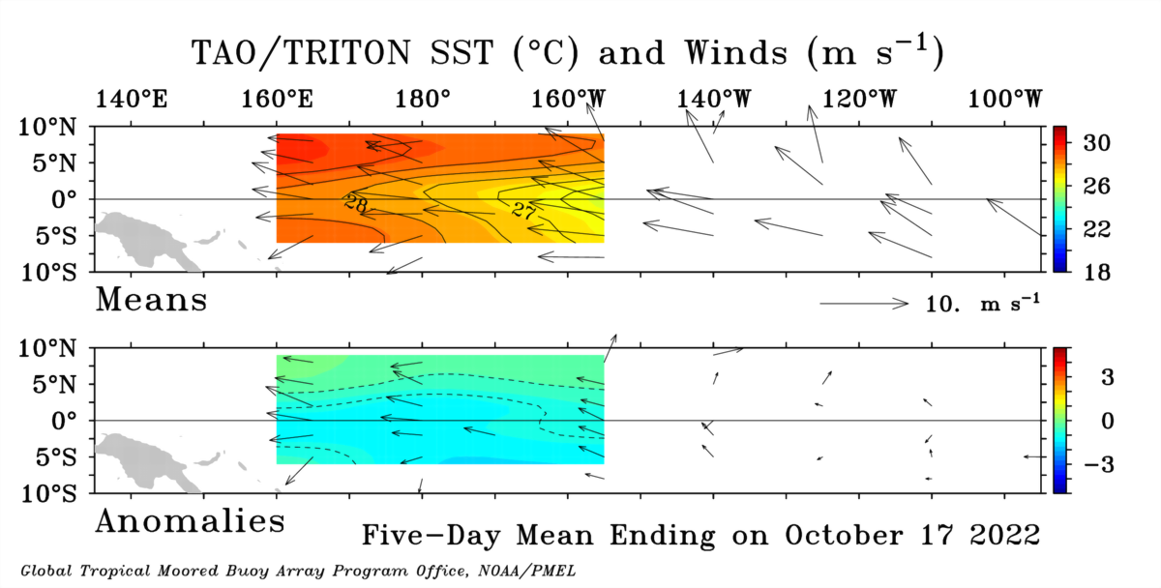

Slide 8
Subsurface Temperature Evolution (Last 4-Months)
( Most Recent )

Slide 9
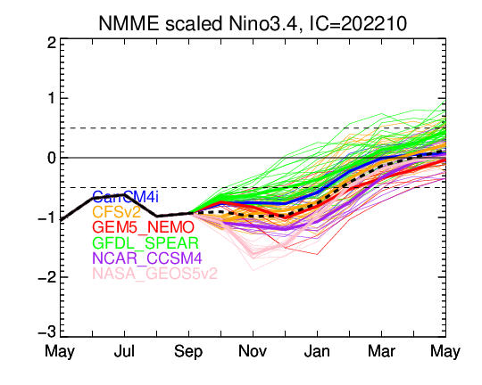
NMME’s ENSO Forecast

Slide 10
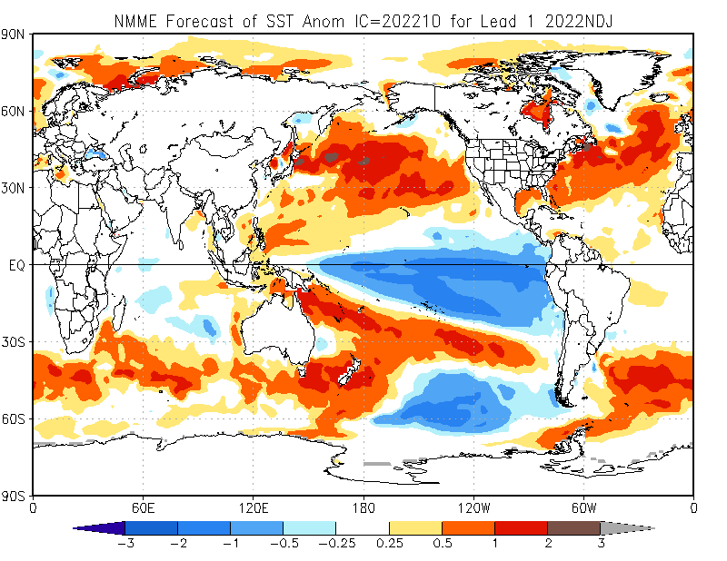

Slide 11
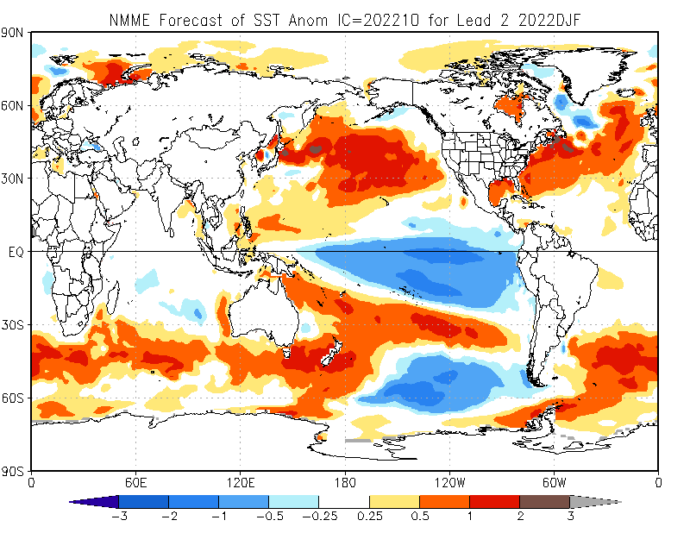

Slide 12
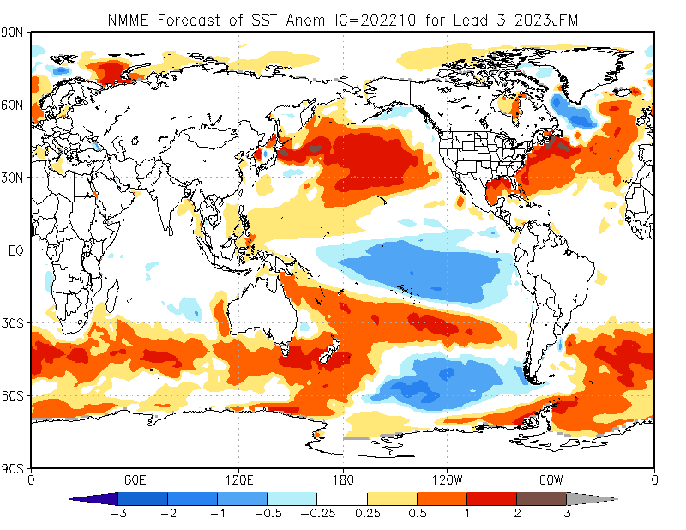

Slide 13
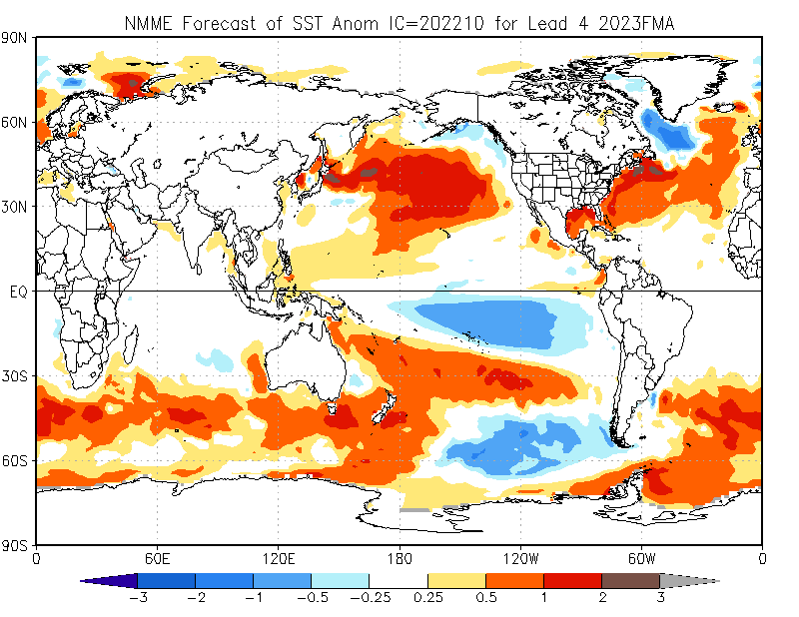

Slide 14
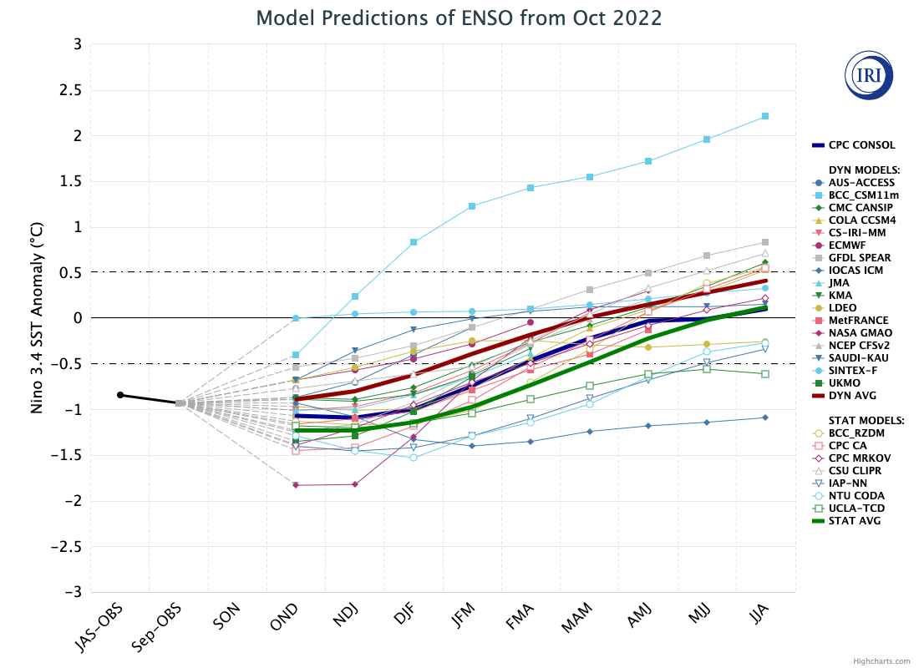
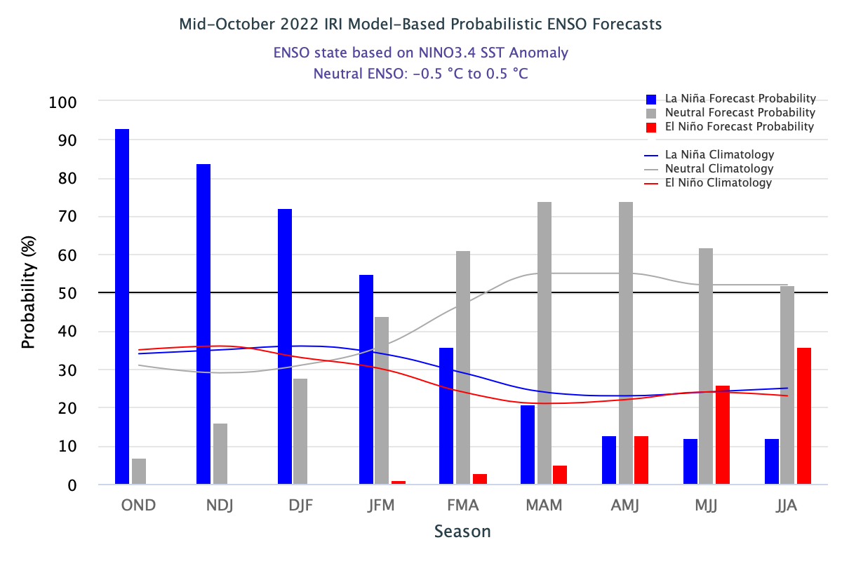
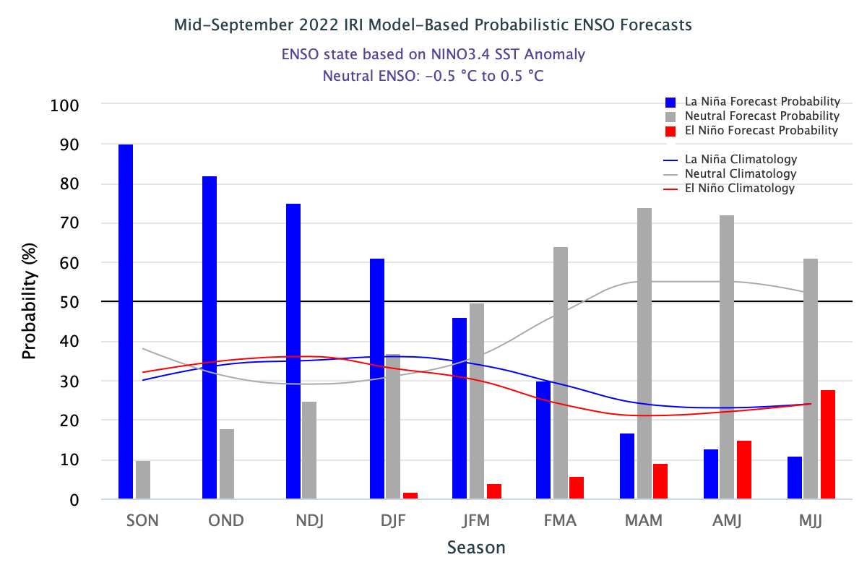
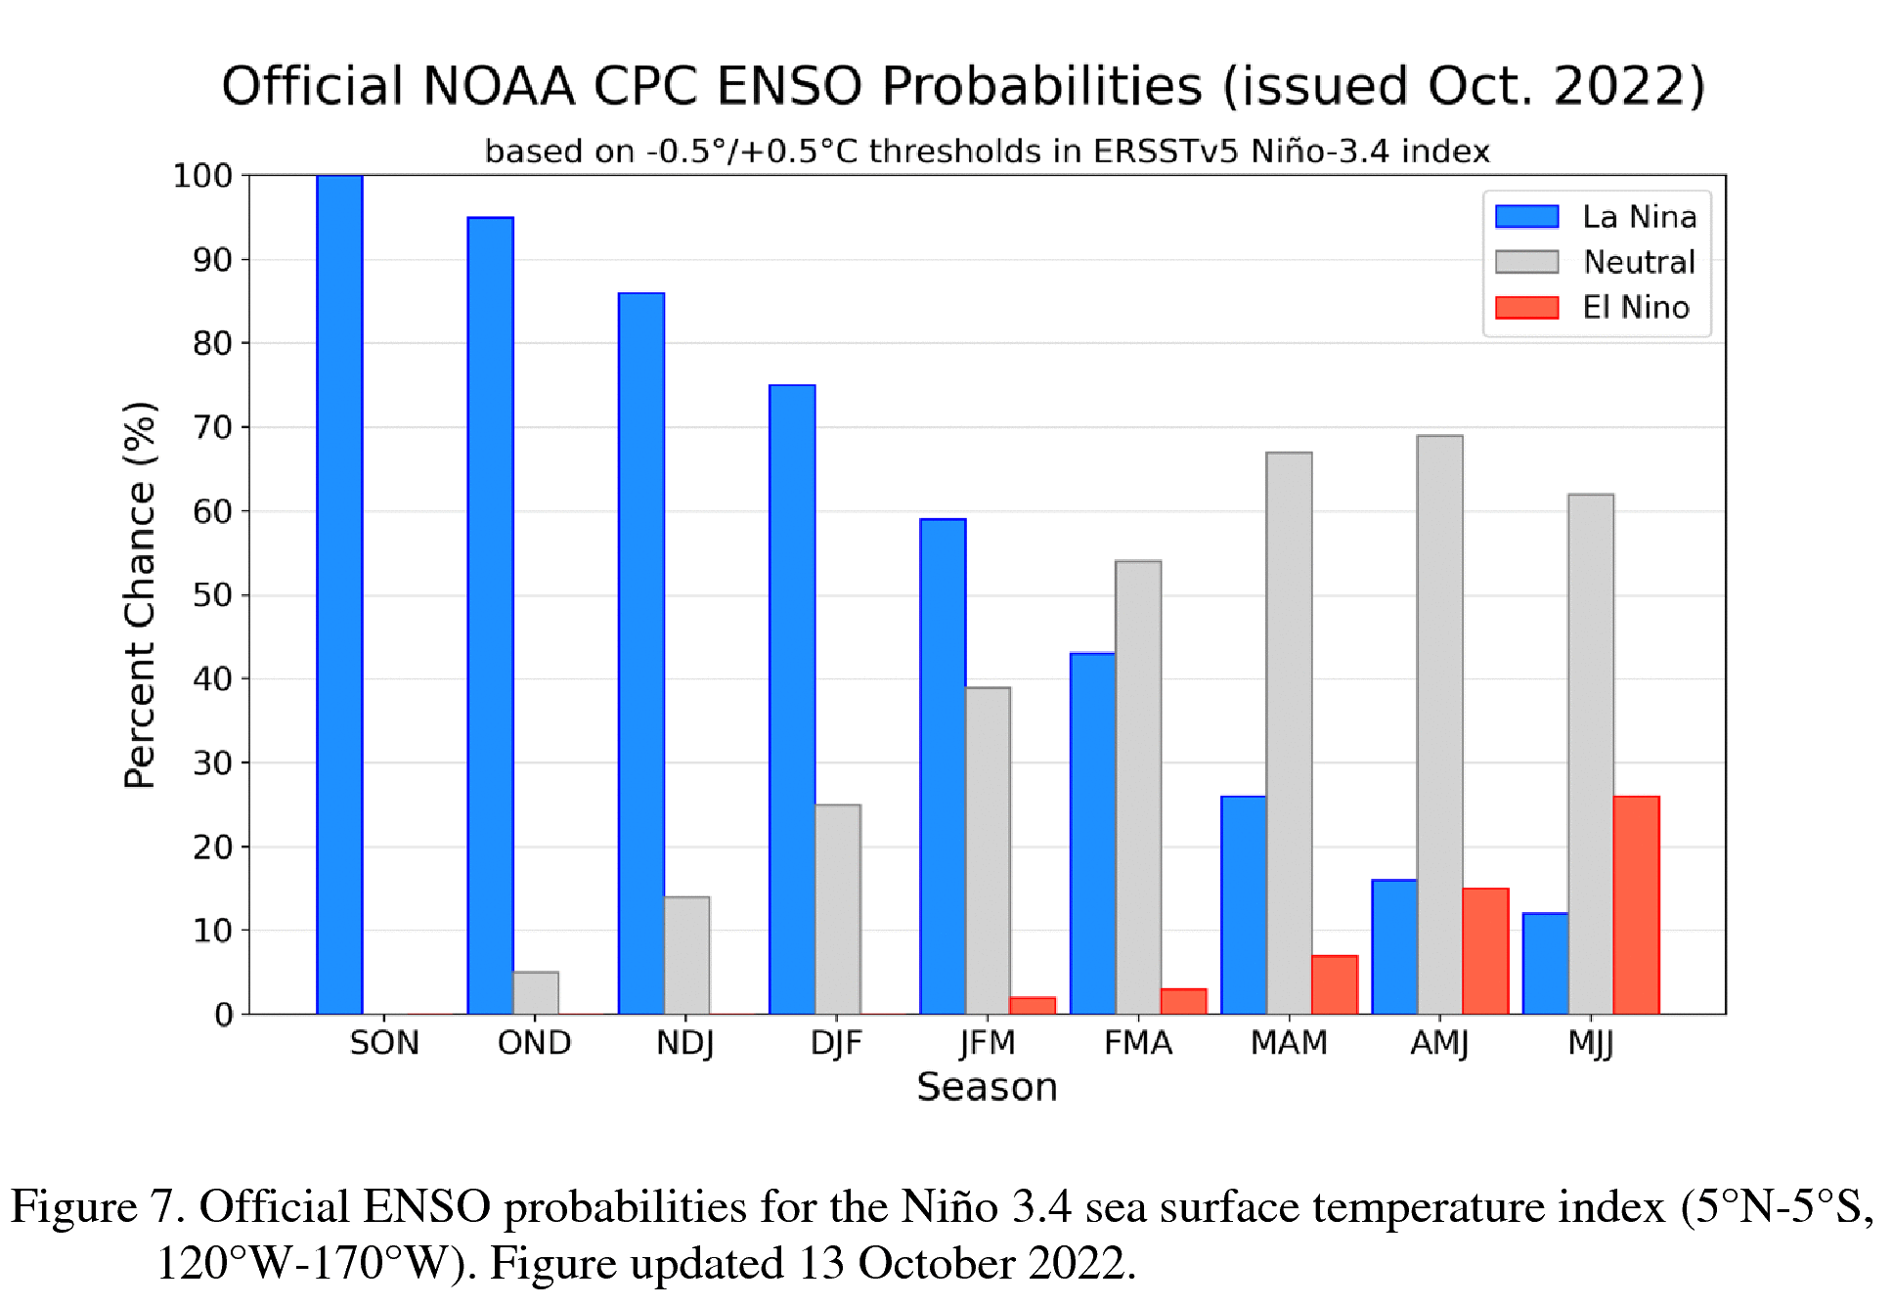
IRI’s ENSO Forecast

Slide 15
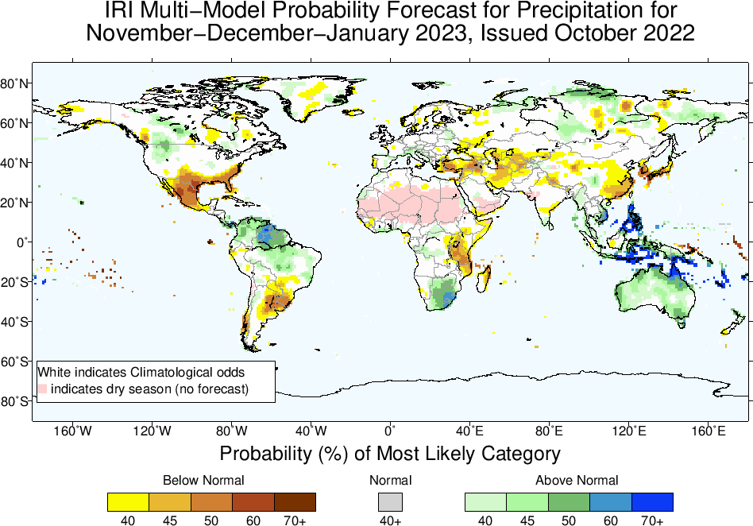

Slide 16
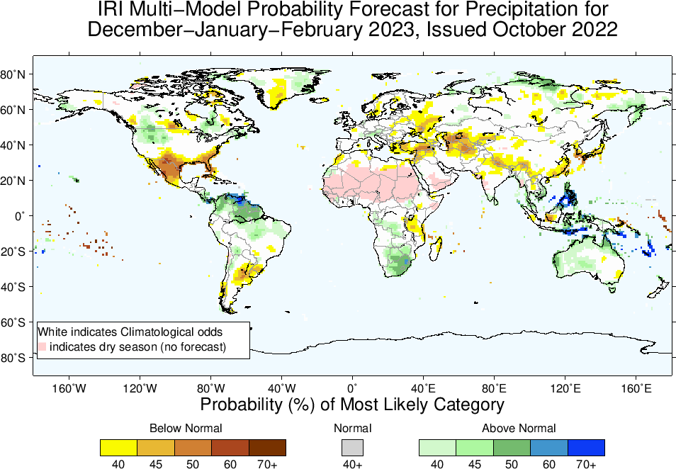

Slide 17
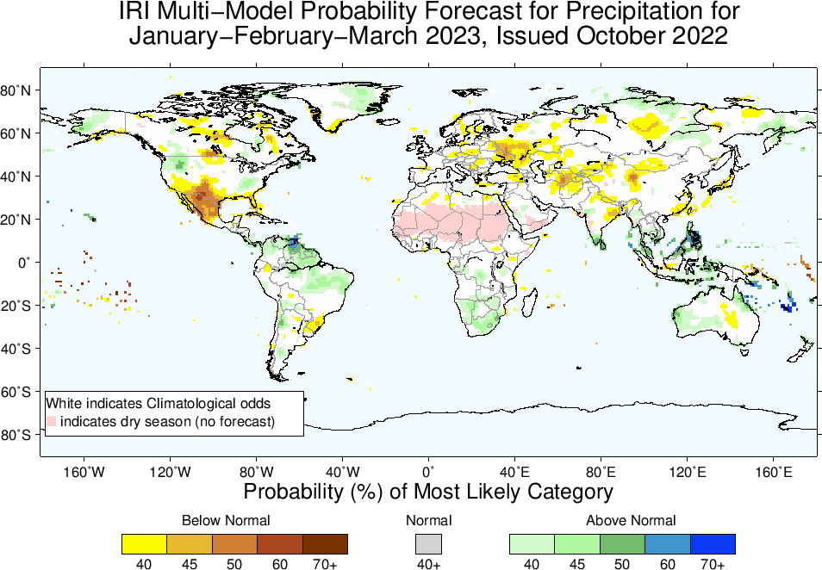

Slide 18
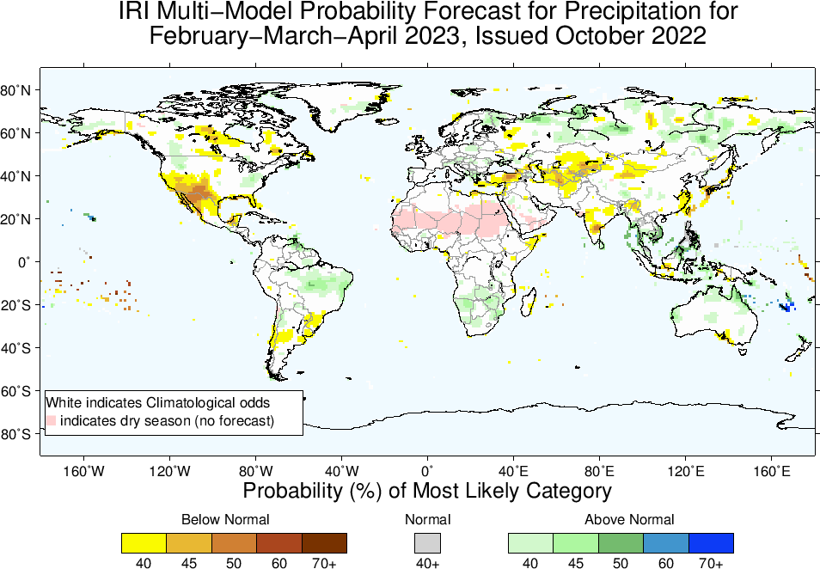

Slide 19
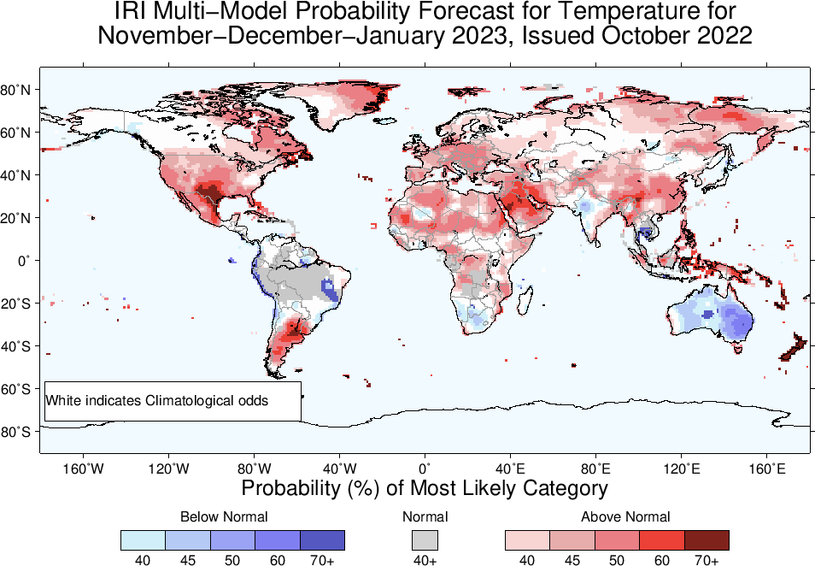

Slide 20
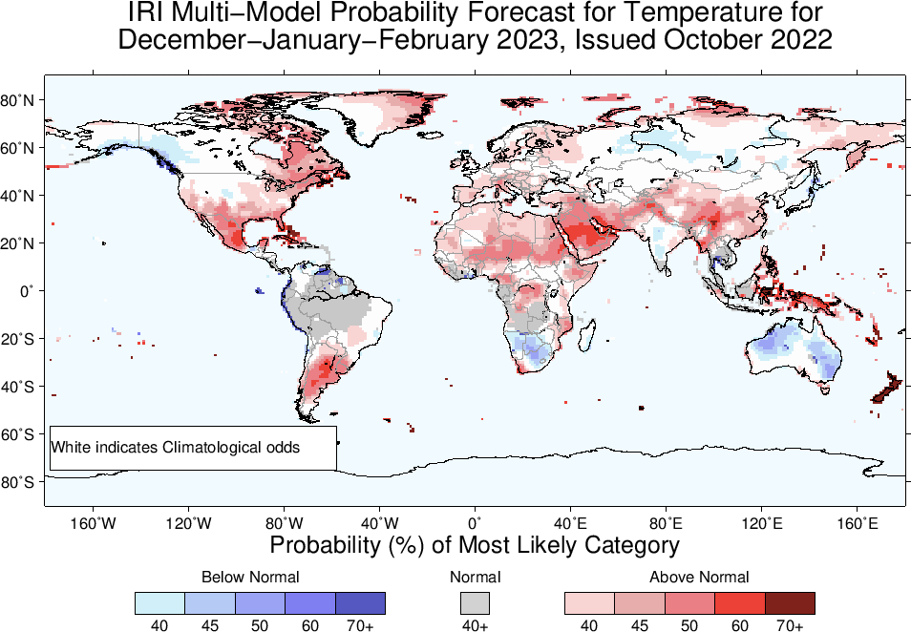

Slide 21
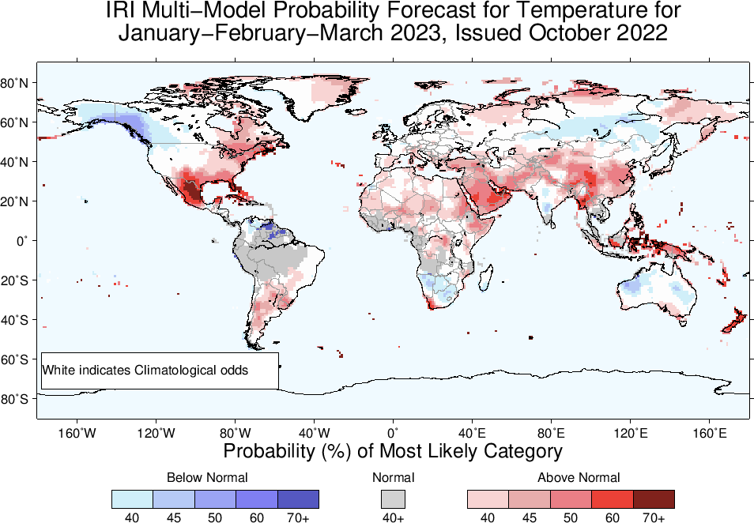

Slide 22
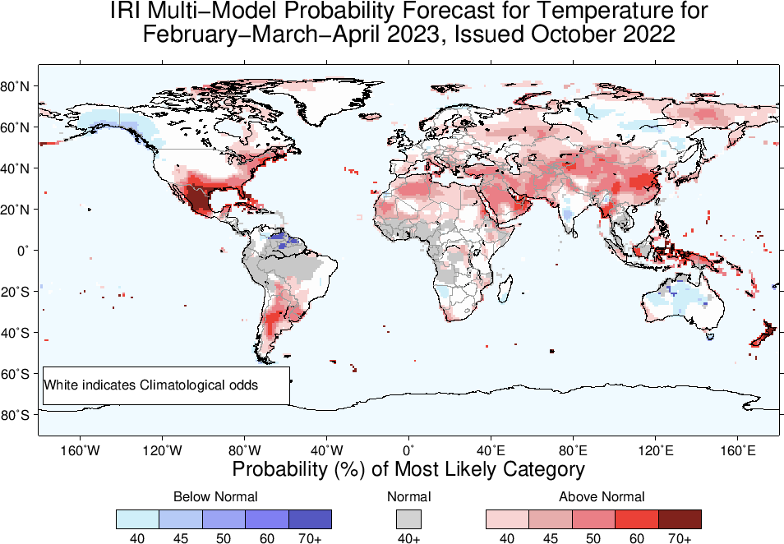

Slide 23
Summary
La Niña is strengthening, because;
Both Oceanic and Atmospheric conditions strengthening in the favour of La Nina; e.g.,
Sea surface temperatures (SSTs) are below average across the central equatorial Pacific Ocean.
SOI is positive (ticked up), stronger than average trade winds, reduced cloudiness over central Pacific (west of Date-line).
La Niña is favored to continue with high chances during next three seasons. La Niña to continue till DJF-2022/23 is NOW 72%, as compared to 56% last month. ENSO-Neutral is most favorable starting from FMA-2023 (55%) onward.
A season away from “triple-Dip of 21st Century”!

