Slide 1
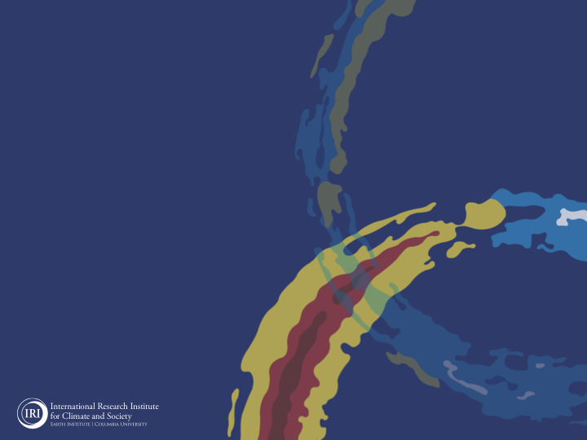
ENSO and Climate Outlook
October 2021:
A La Niña Advisory!
M. Azhar Ehsan
(azhar@iri.columbia.edu)
Associate Research Scientist
IRI ENSO and Climate Forecast Lead
Jeffery Turmelle and Jing Yuan: forecast processing and web updates
Cuihua Li: Draft PowerPoint development
IRI’s Climate Group, led by Dr. Andrew Robertson: Forecast system development, ongoing innovation, and verification

Slide 2
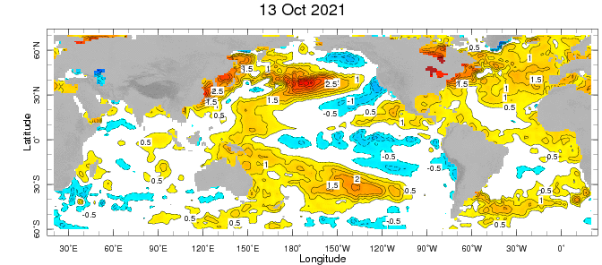
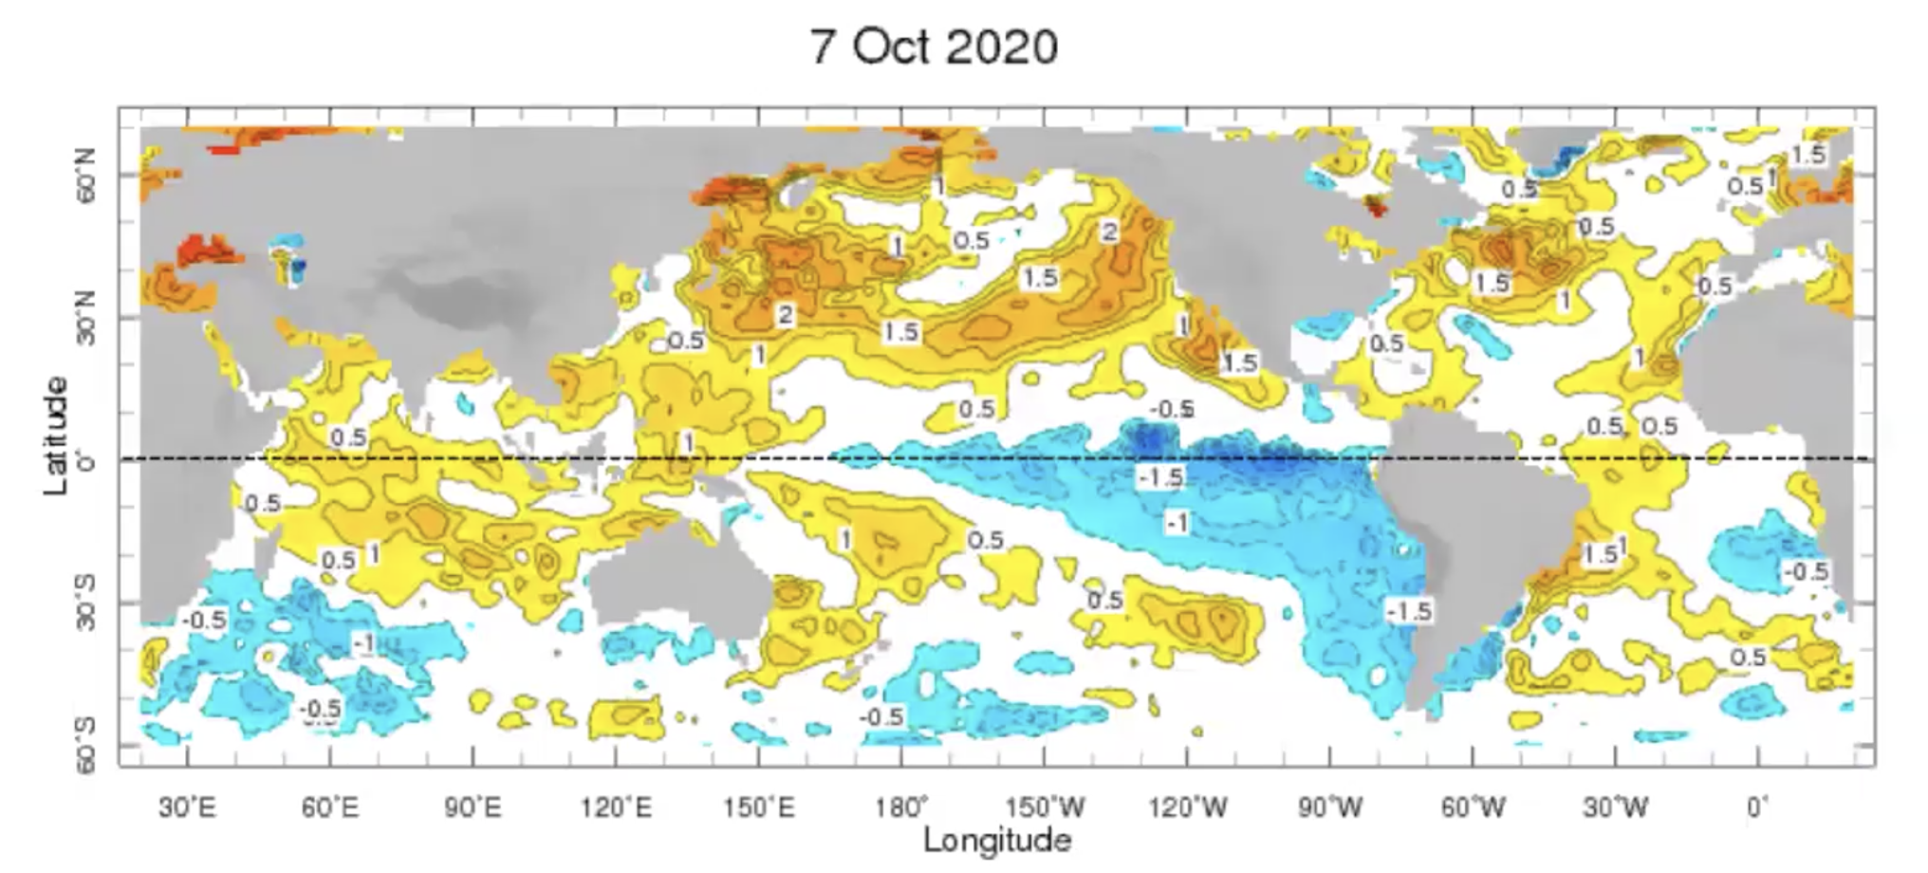
Weekly-average Sea Surface Temperature Anomalies for the Globe:
(OISST v2: 1991-2020 base period)
OCT2020

Slide 3
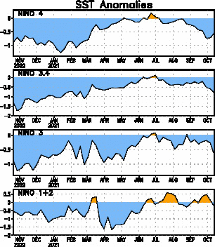
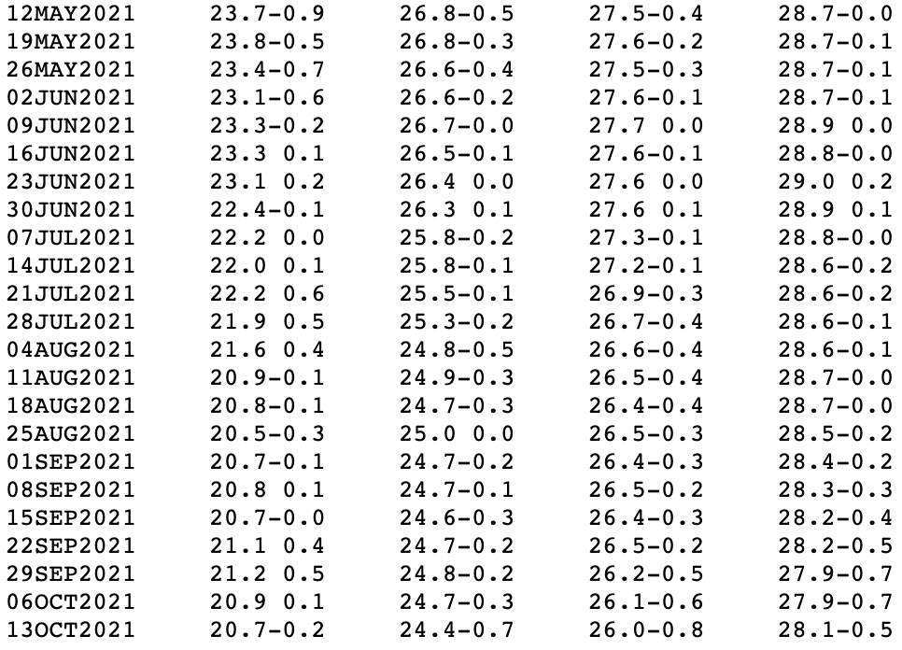
Near Dateline
This is the SST
Index
predicted
NINO3.4 = -0.8 C
Eastern Eq. Pacific
Off Coast of S.America

Slide 4
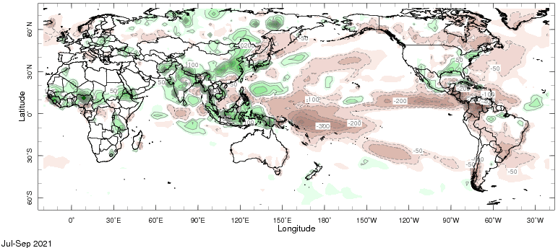
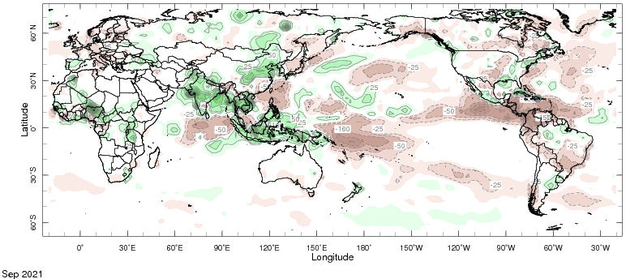
A good Monsoon ☺

Slide 5
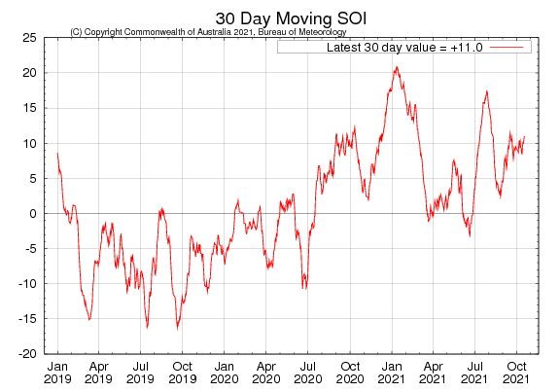
Tahiti_{SLP} – Darwin,AUS_{SLP}

Slide 6
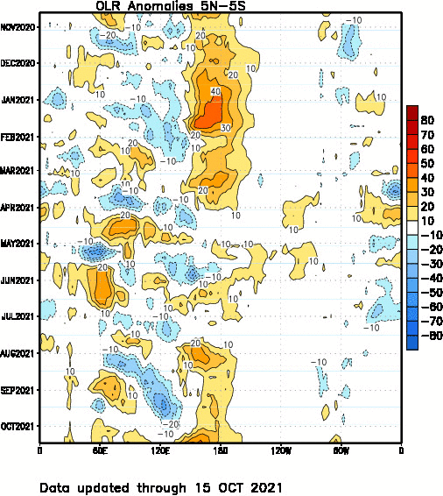
Wetter
Drier

Slide 7
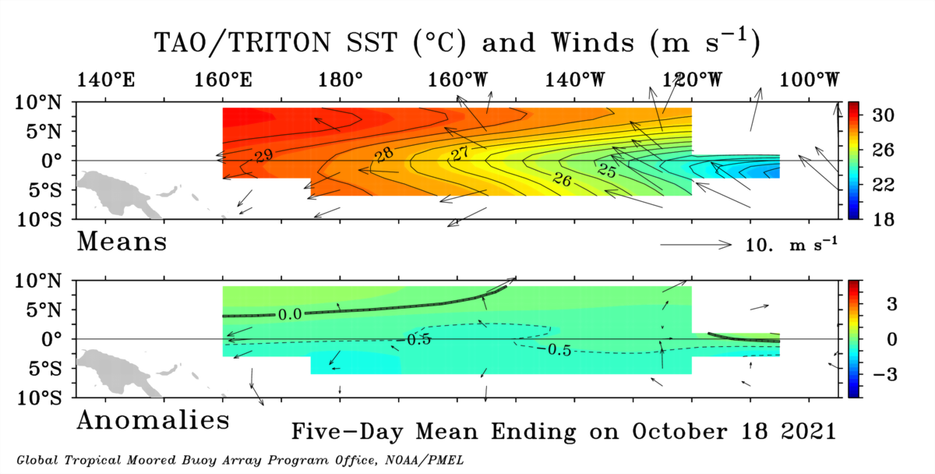
Mean SST (color) and Winds (Vectors)
Anomalous SST (color) and Winds (Vectors)

Slide 9
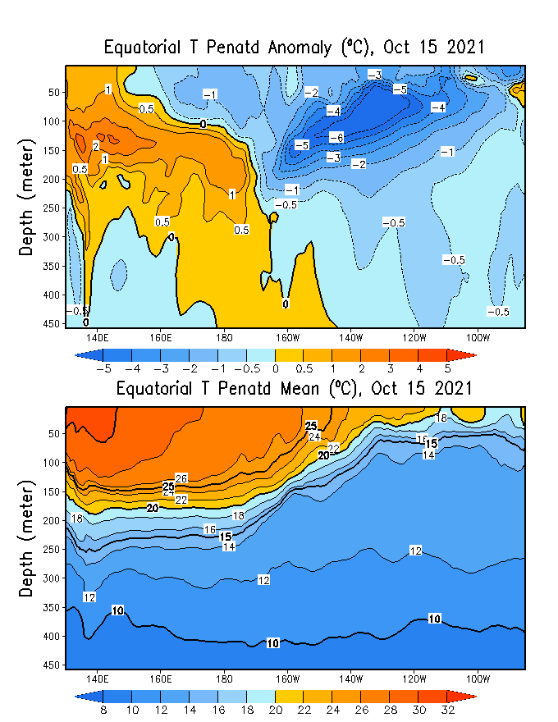
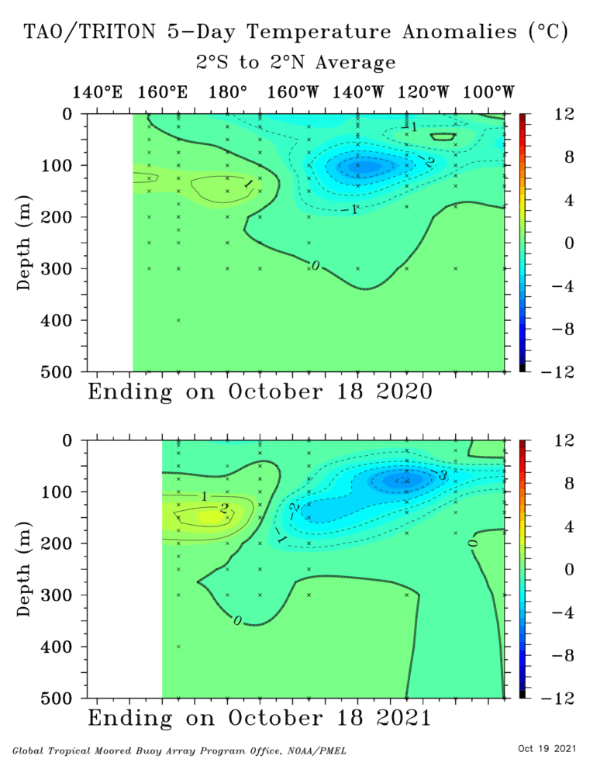
Analysis directly from TOGA-TAO buoy measurements:
Showing spatial distribution of temperature of water in the Subsurface upto 500 meter.
Global Ocean Data Assimilation System (GODAS)
Agreement!
Last year 2020
This year 2021

Slide 10
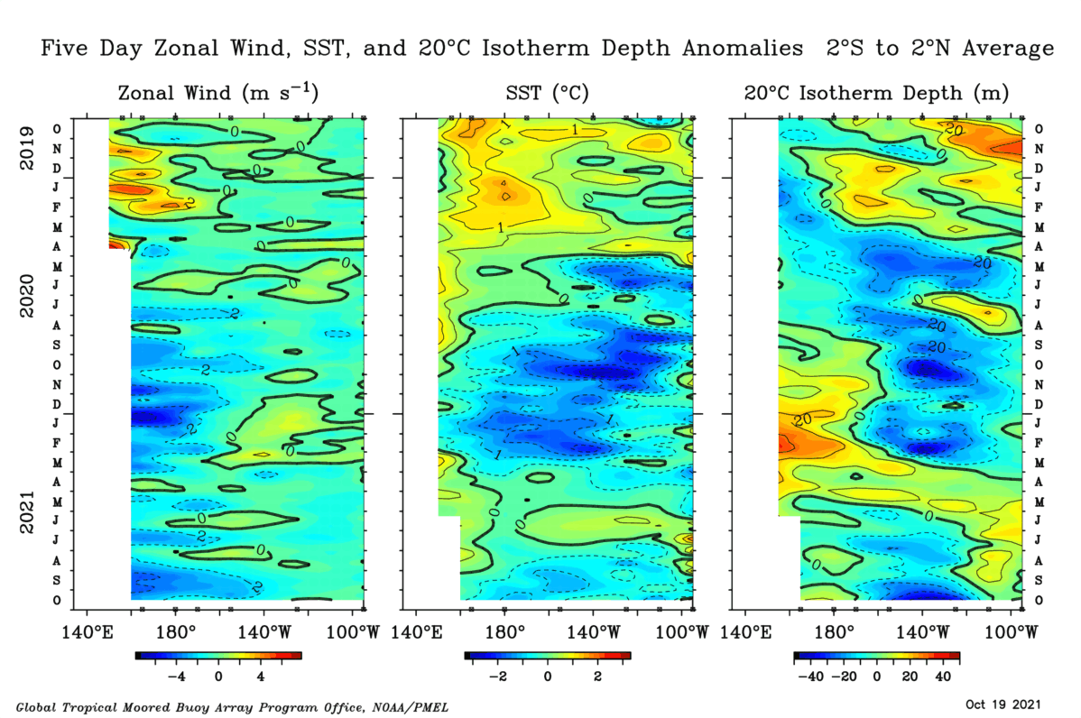
Perfect Ingredients in Place for another La Nina Events, although Weak!
Enhanced Trade Winds implies subsurface will come up,
awe have Below-Average SST Anomalies

Slide 11
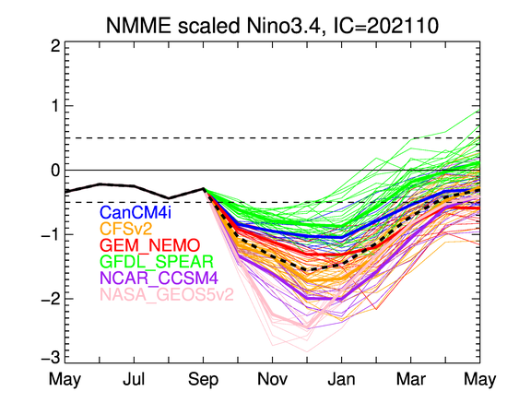
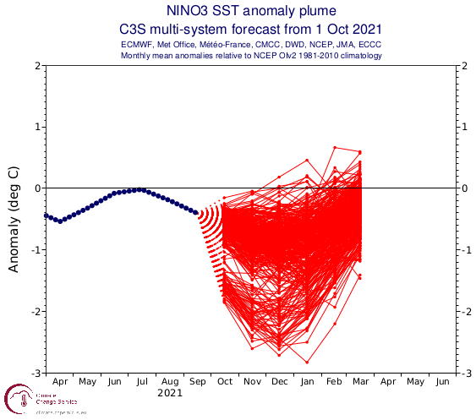
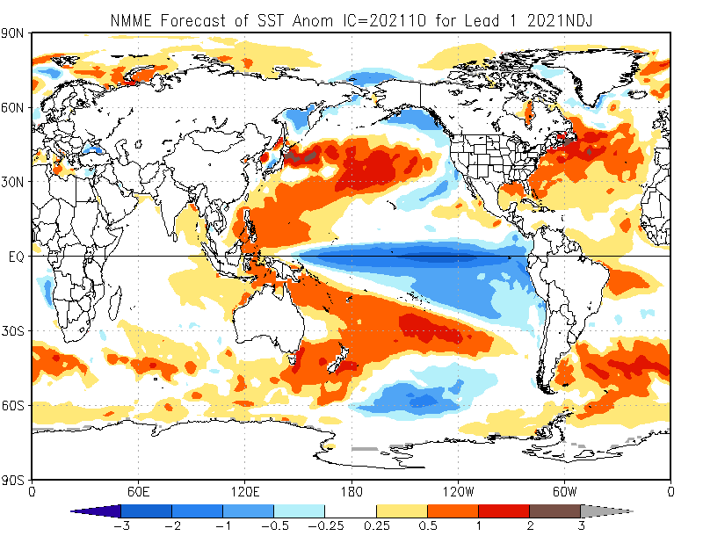
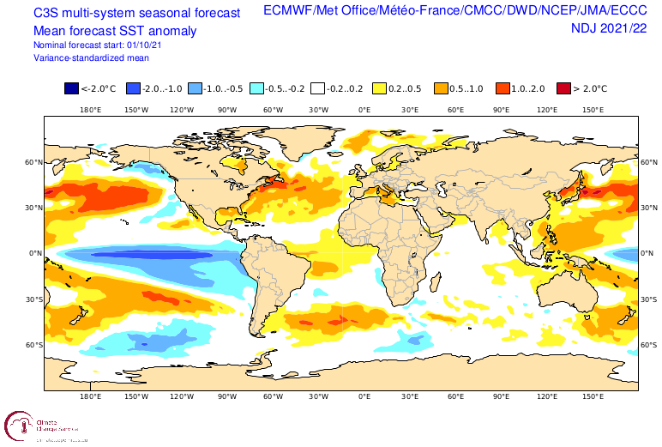

Slide 12
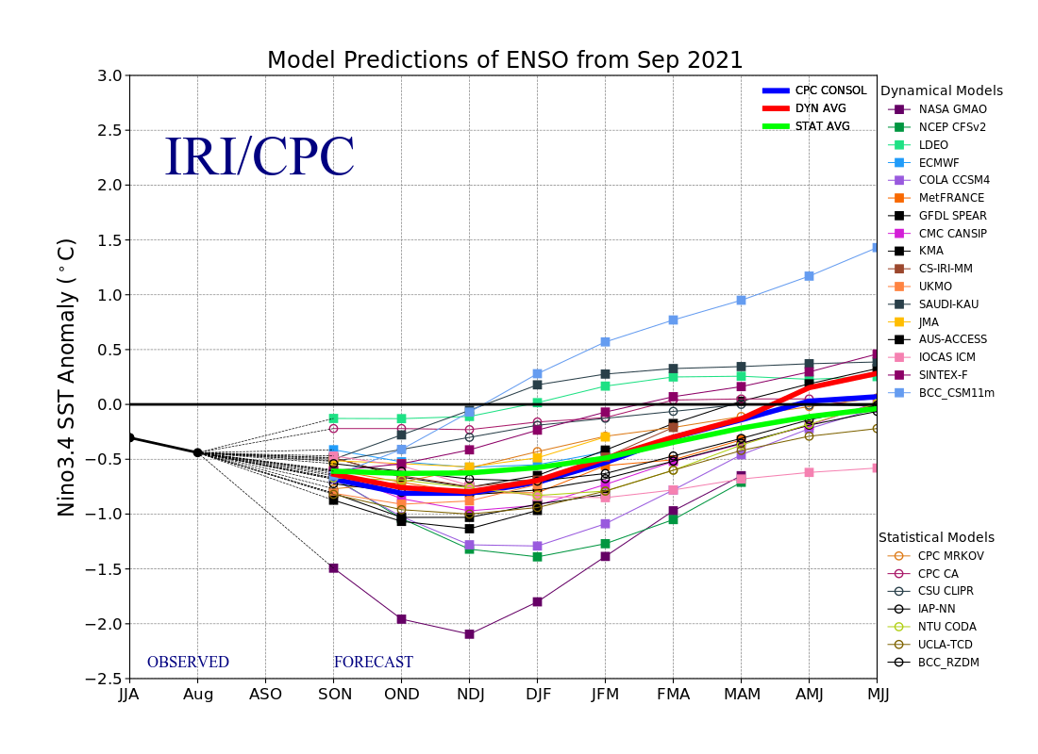
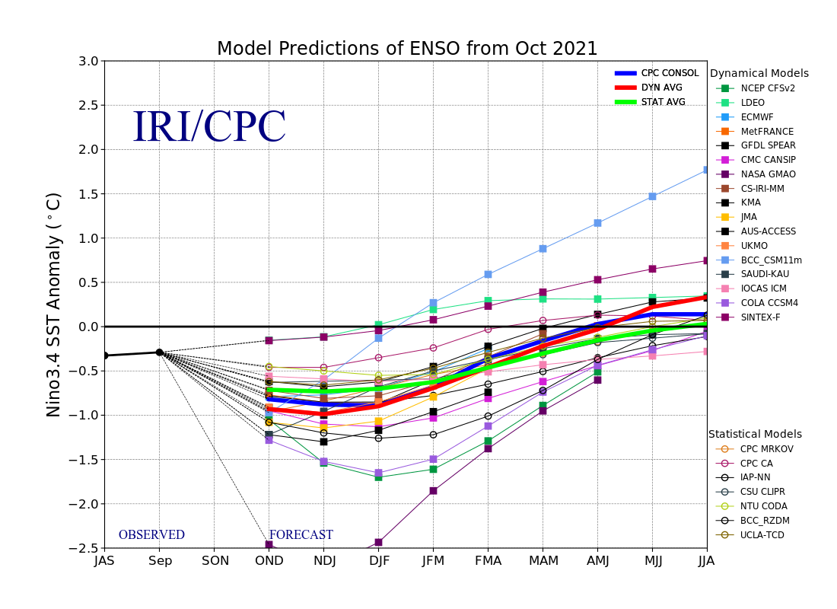
ENSO Plume Diagram

Slide 13
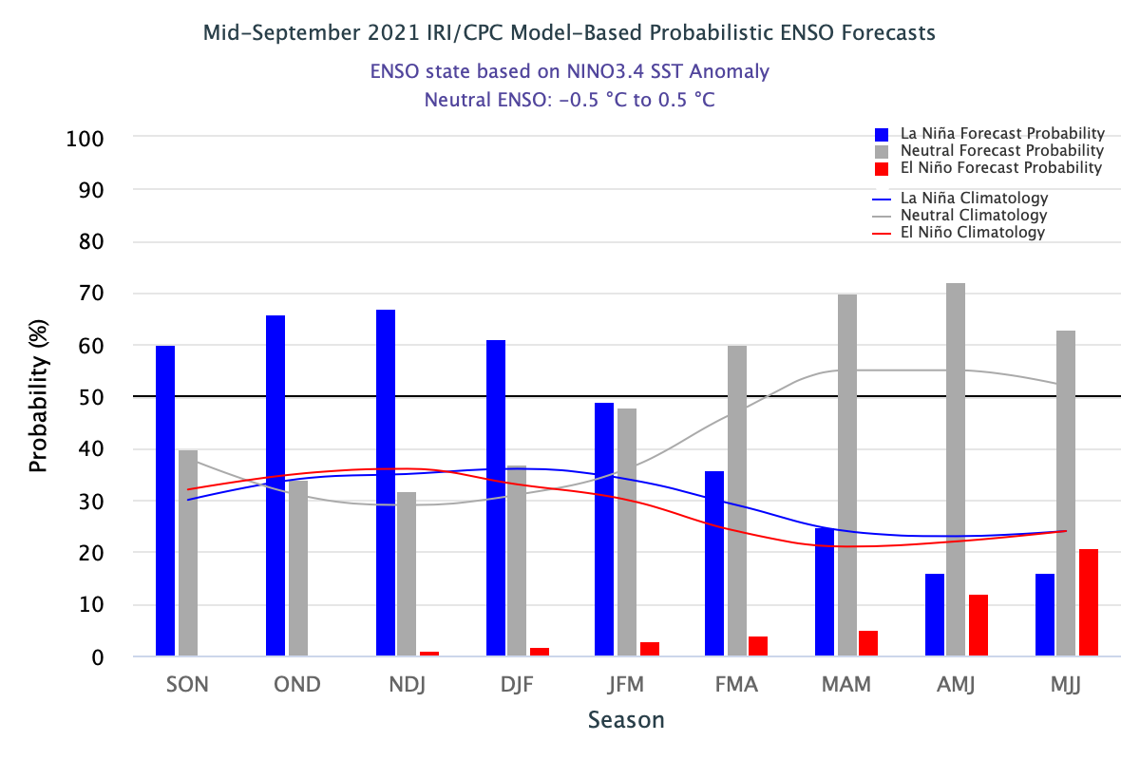
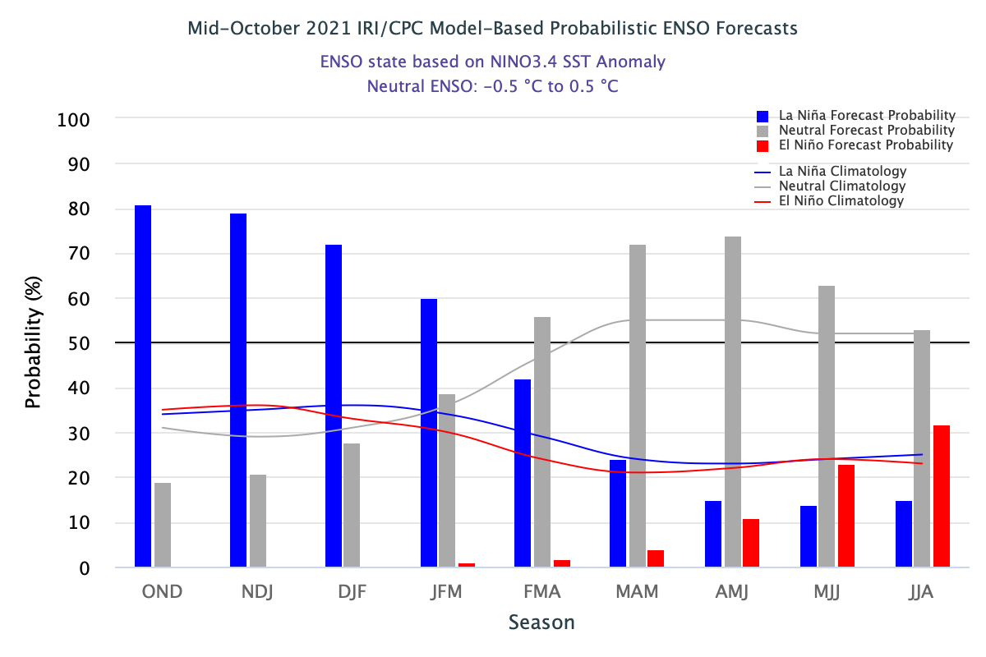
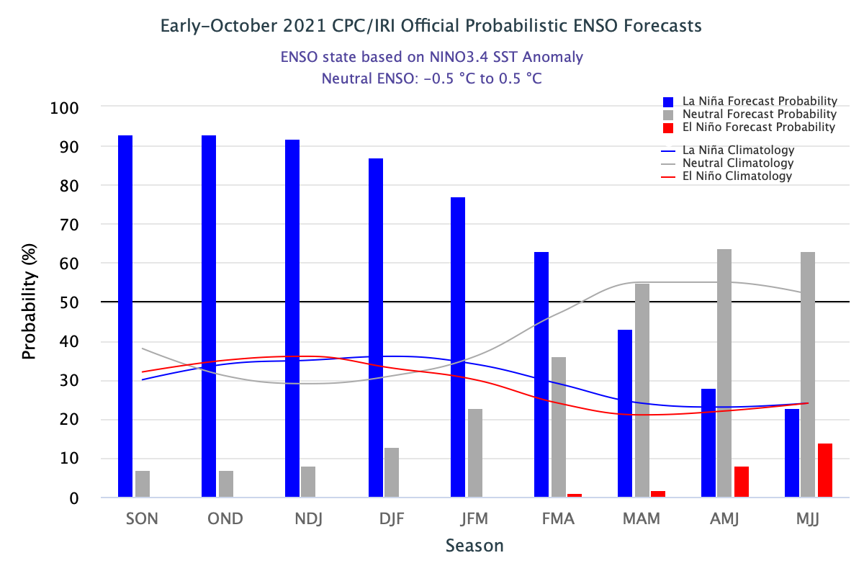

Slide 14
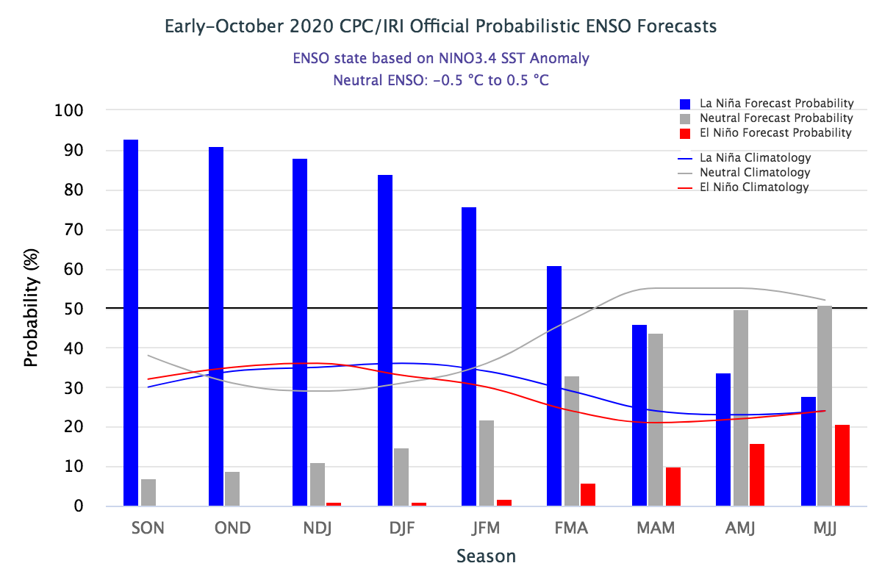
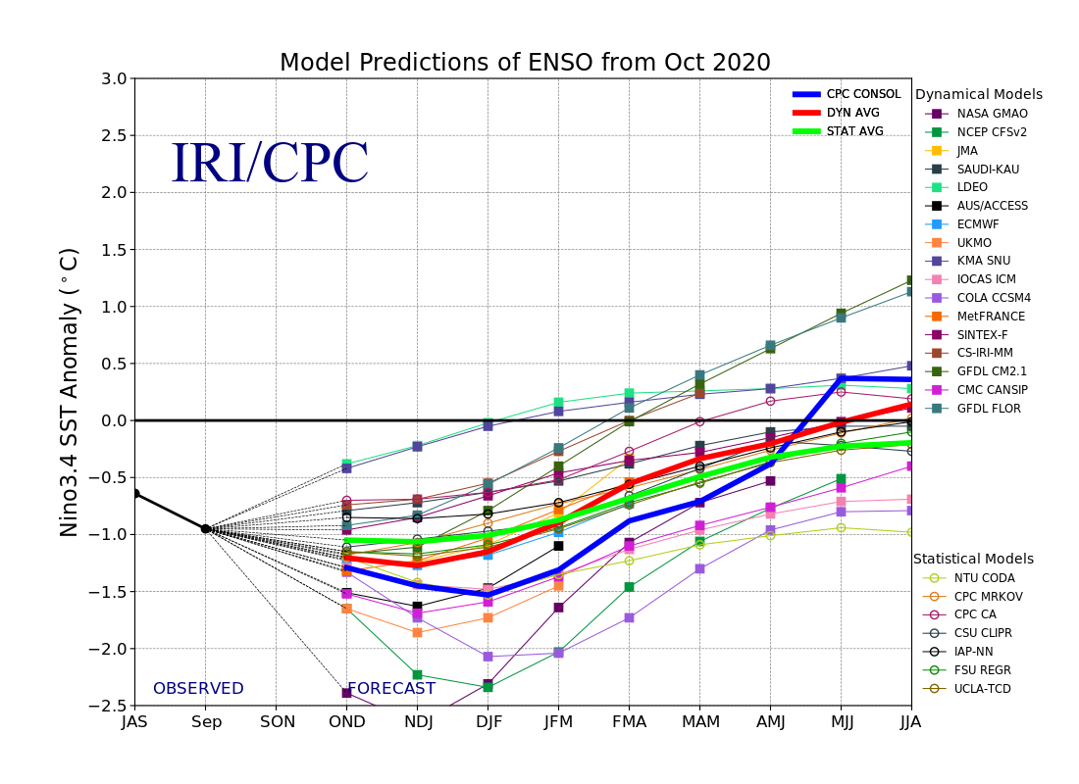
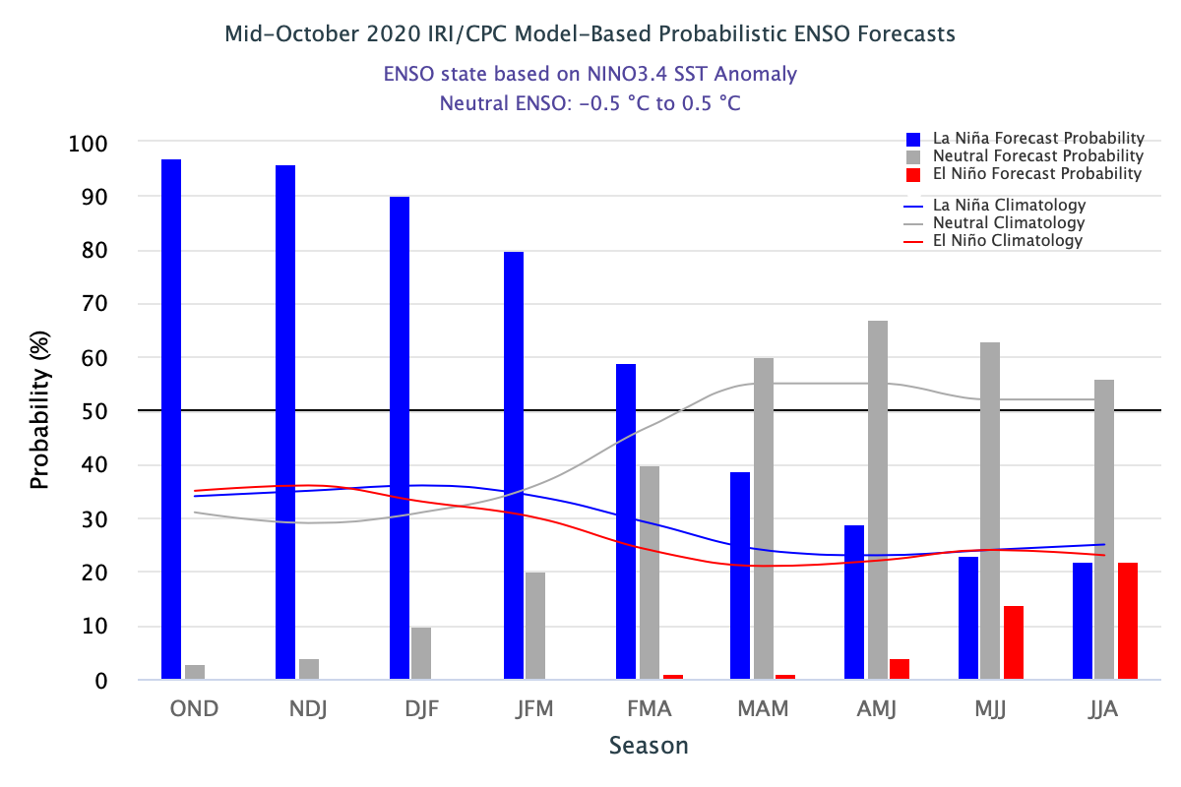
Last year OCT 2020

Slide 16
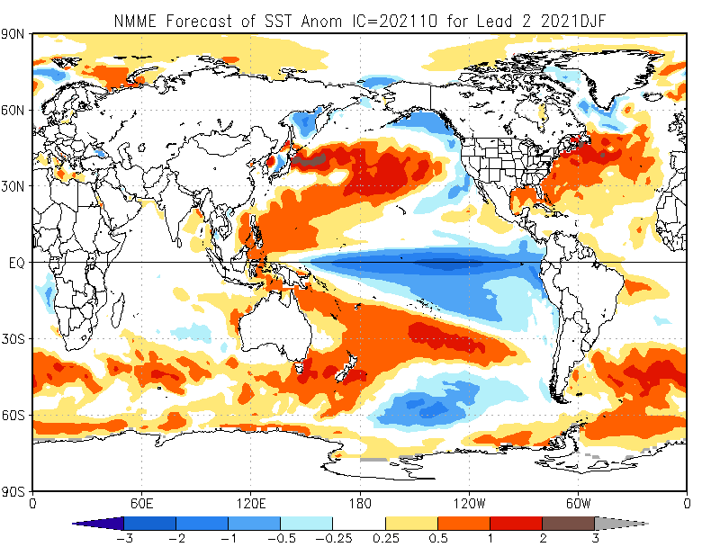

Slide 17
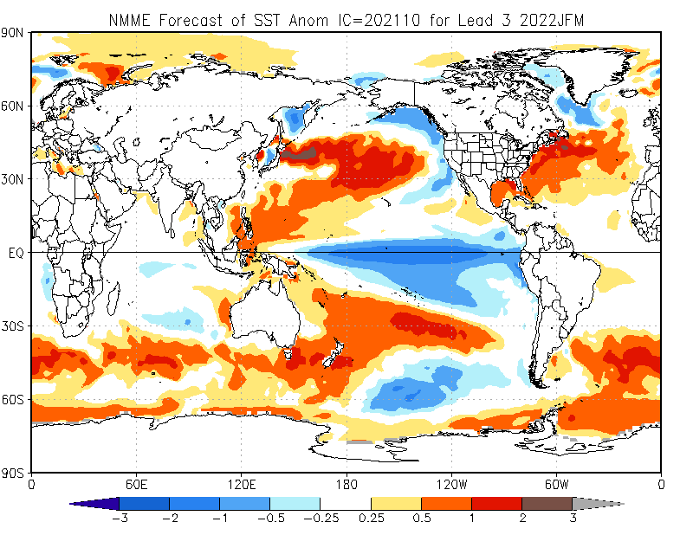

Slide 18
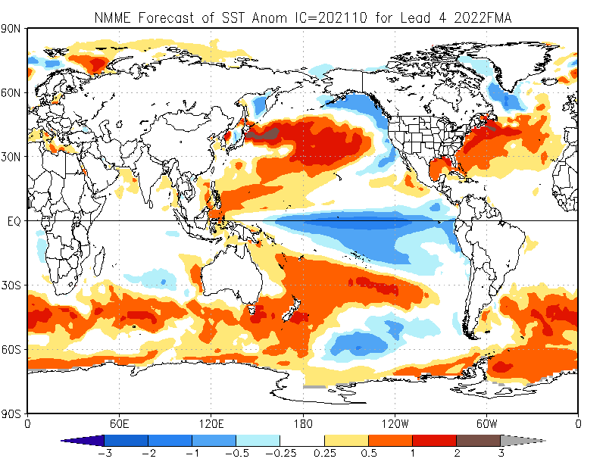

Slide 19
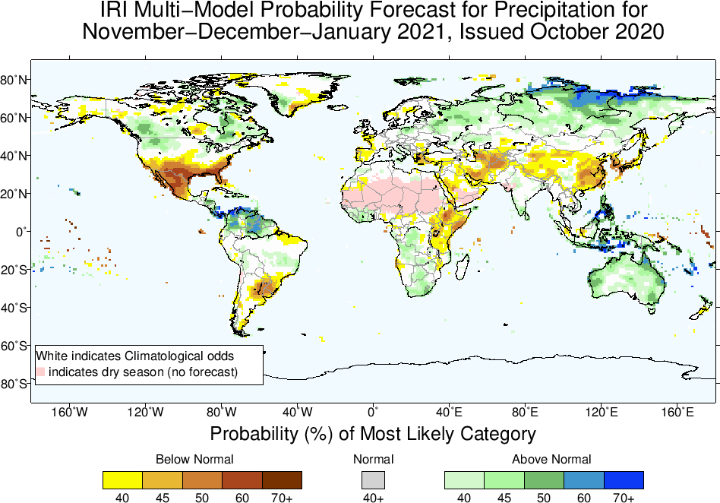
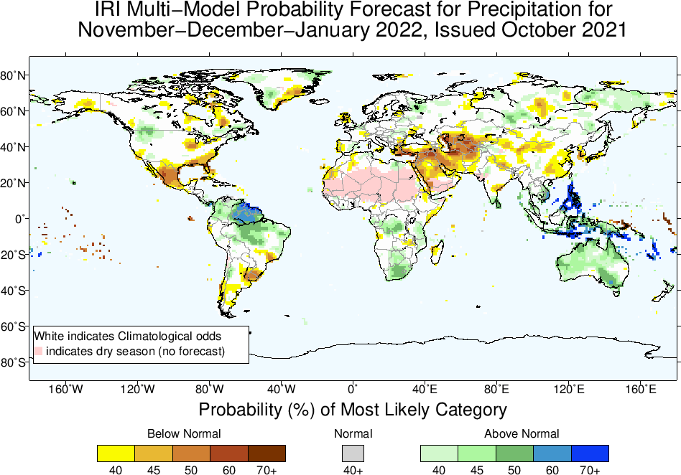
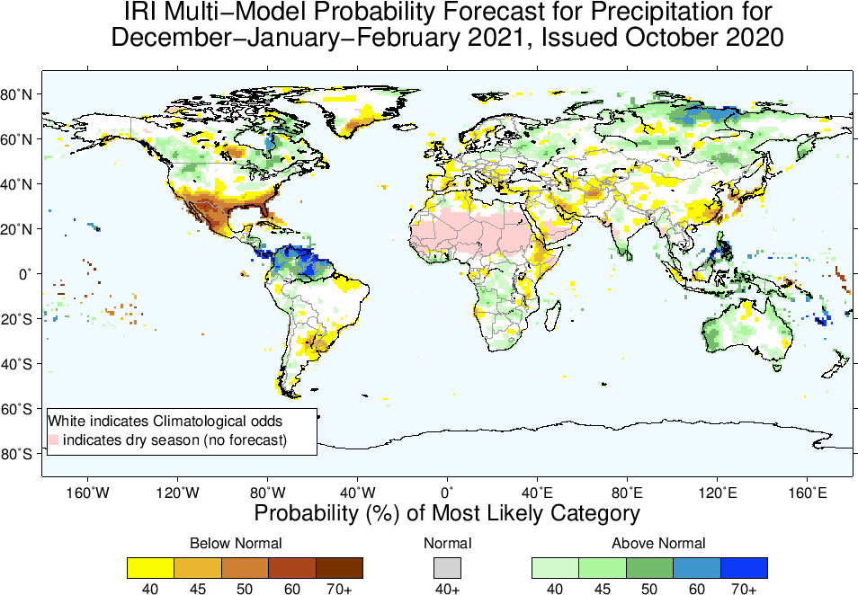
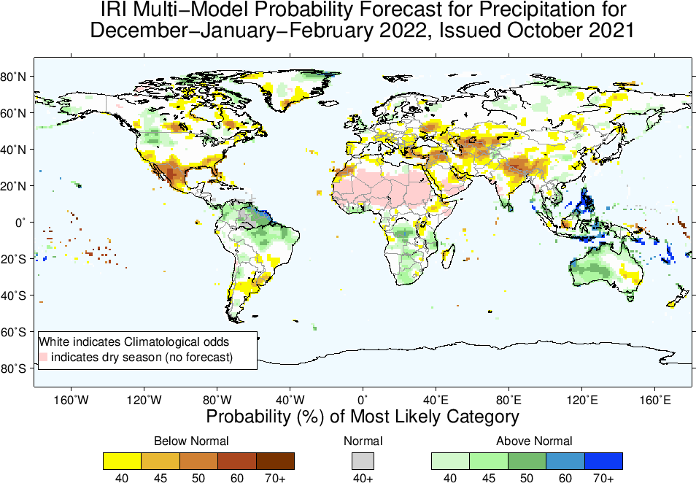
OCT 2020
OCT 2021

Slide 20
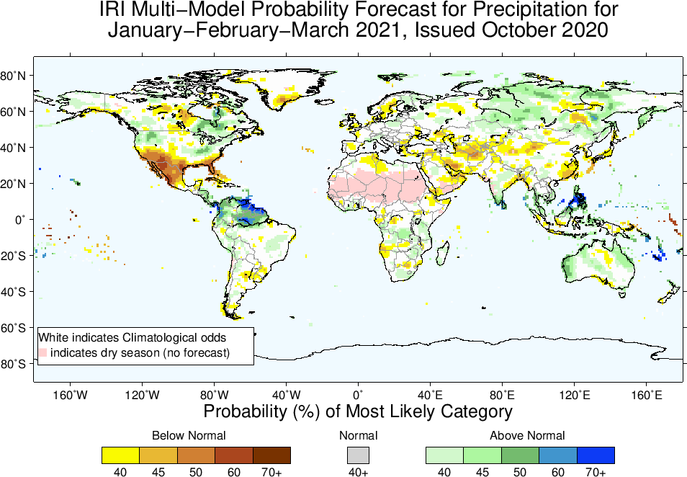
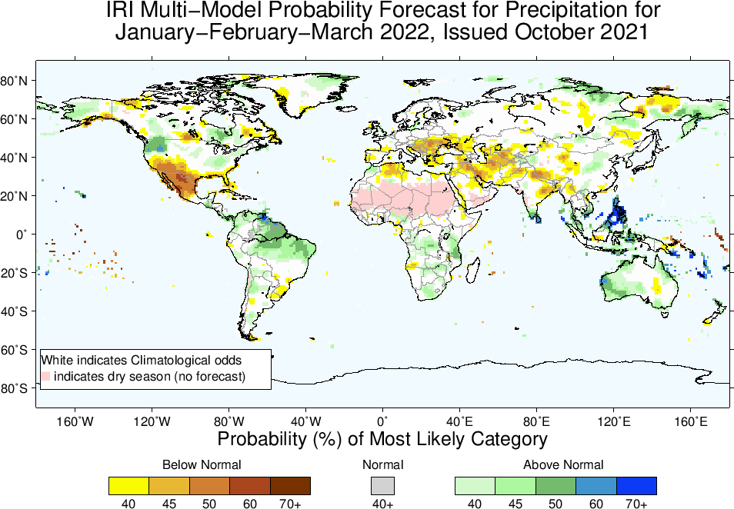
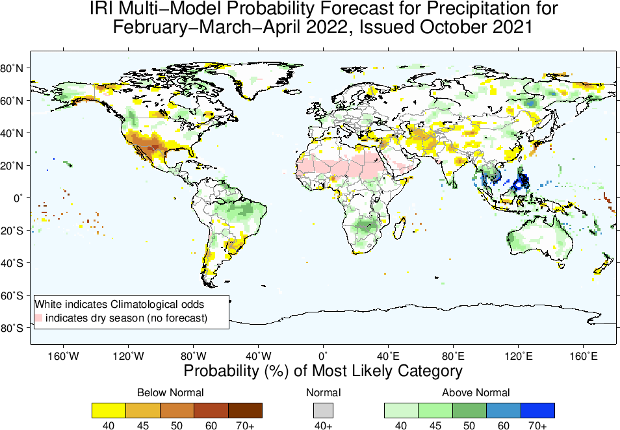
OCT 2020
OCT 2021

Slide 21
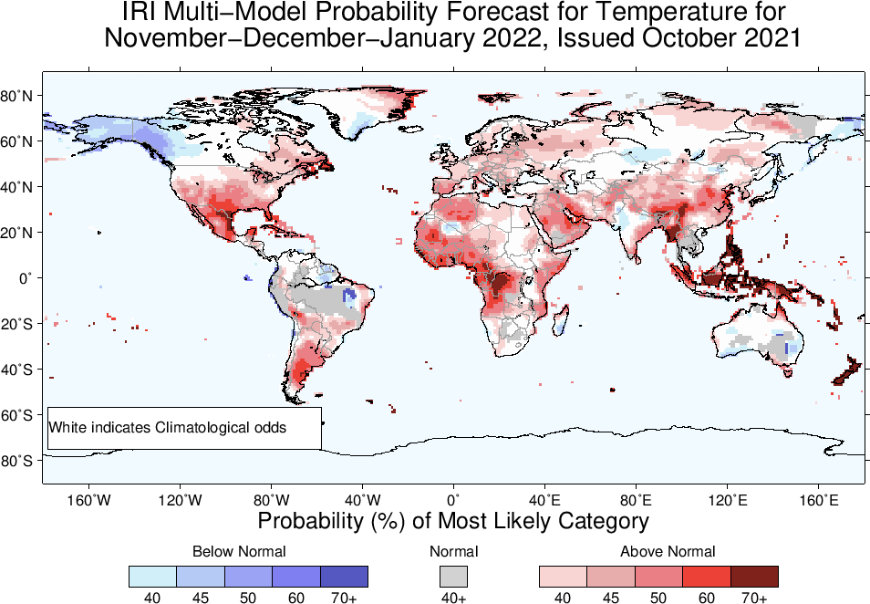

Slide 22
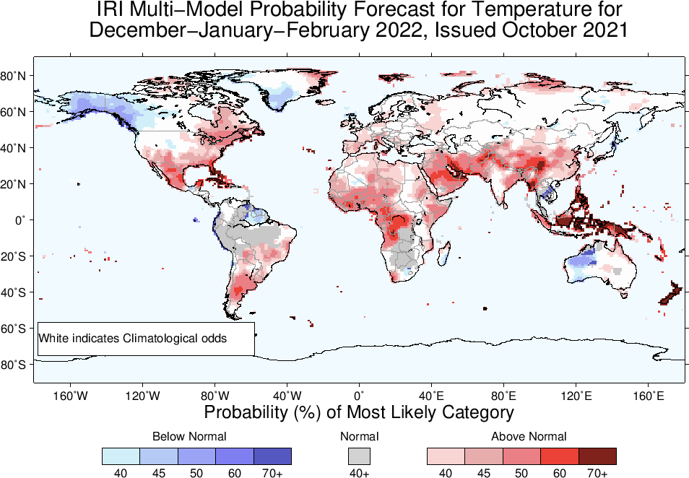

Slide 23
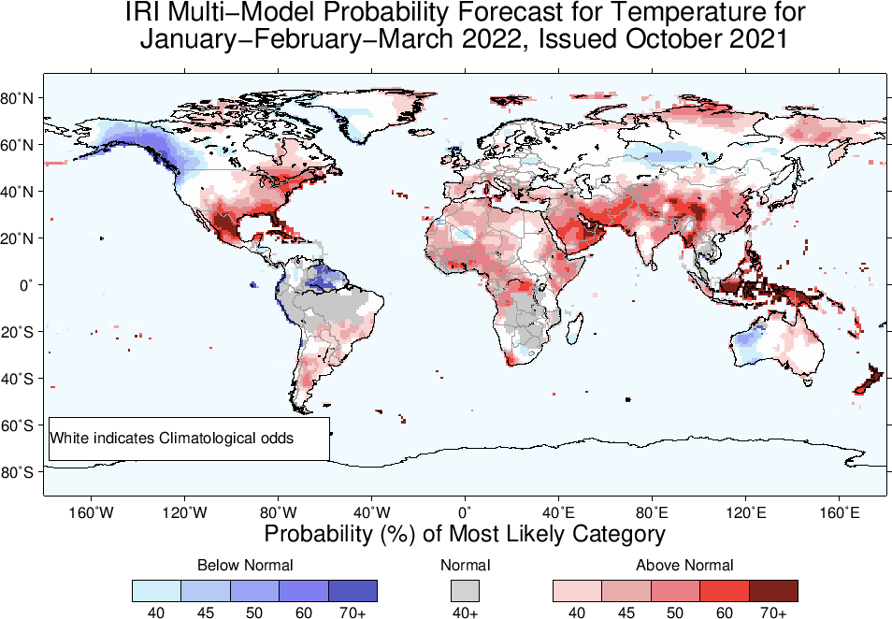

Slide 24
