Slide 1
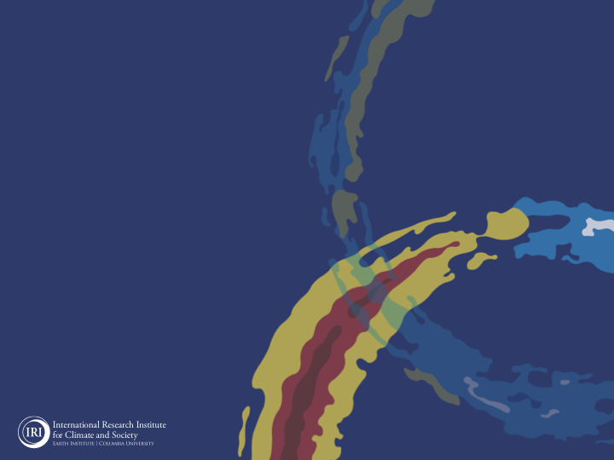
ENSO and Climate Outlook
in November 2022
A rapid demise after Triple-Dipping!!!
M. Azhar Ehsan
(azhar@iri.columbia.edu)
Associate Research Scientist
IRI ENSO and Climate Forecast Lead
Jeffery Turmelle and Jing Yuan: forecast processing and web updates
Cuihua Li: Draft PowerPoint development
IRI’s Climate Group, led by Dr. Andrew Robertson: Forecast system development, ongoing innovation, and verification

Slide 2
Outline
Observed Oceanic and Atmospheric Conditions in
Tropical Pacific
Across the Globe
ENSO Forecast in
NMME
IRI ENSO Forecast Tool (Deterministic and Probabilistic)
Seasons Outlook of
SST
Precipitation and Temperature
Summary

Slide 3
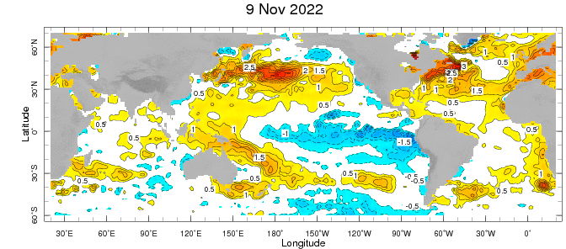
Evolution of EQ. Pacific SST Departures in Weekly OISST Data
In the Pacific Ocean: Below-average SSTs persisted across the central (across the Date Line), surrounded by strong +ve SSTA in the high latitudes.
Stronger Colder SSTAs exists in Eastern Pacific (120W to 80W).
Indian Ocean: Near-Normal (slightly negative) SSTAs in the west and positive in the East, a –ve Indian Ocean Dipole (-0.33for week ending on 06 Nov-2022).
Atlantic Ocean: Patches of positive SSTAs Near Equator.
Strong Anomalies in the Northern Pacific and Atlantic. October PDO -1.8.
https://www.ncei.noaa.gov/access/monitoring/pdo/
http://www.bom.gov.au/climate/enso/#tabs=Indian-Ocean

Slide 4
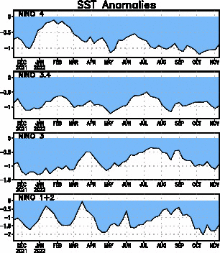
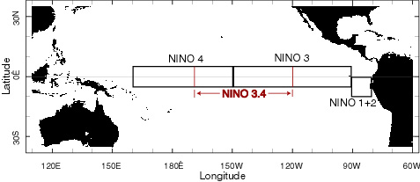
Most recent SST Anom.
Most Recent SST Departures in different NINO regions (All cooler than the long-term avg, (1991-2020))
Niño 4
-0.9ºC
Niño 3.4
-1.0ºC
Niño 3
-0.9ºC
Niño 1+2
-1.4ºC

Slide 5
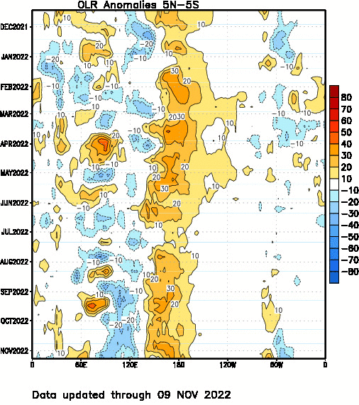
Most recent OLR

Slide 6
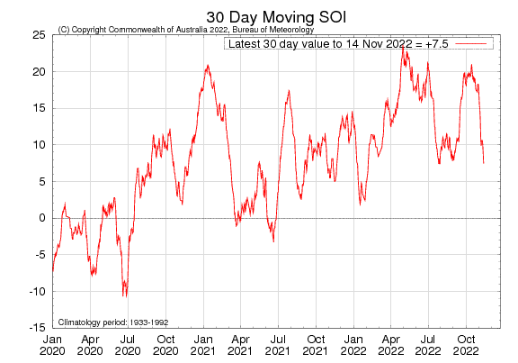
Most recent SOI
Sustained positive values of the SOI above +7 typically indicate La Niña

Slide 7
Subsurface Temperature Evolution (Last 4-Months)
( Most Recent )

Slide 8
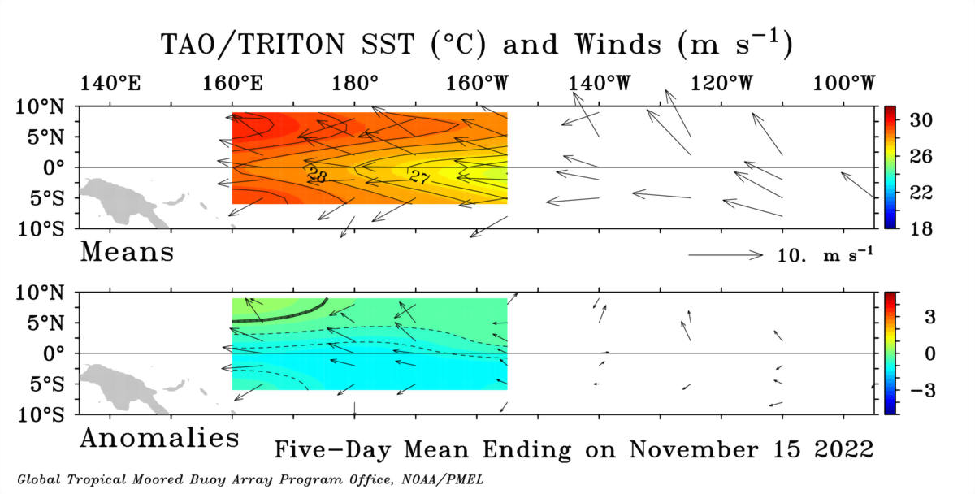

Slide 9
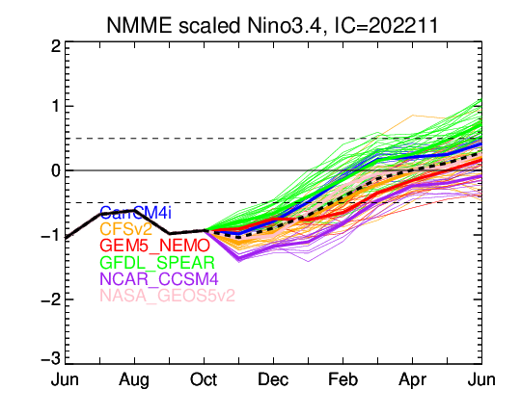
NMME’s ENSO Forecast

Slide 10
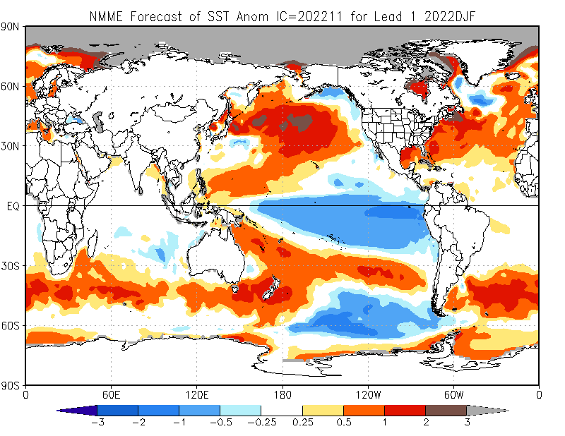

Slide 11
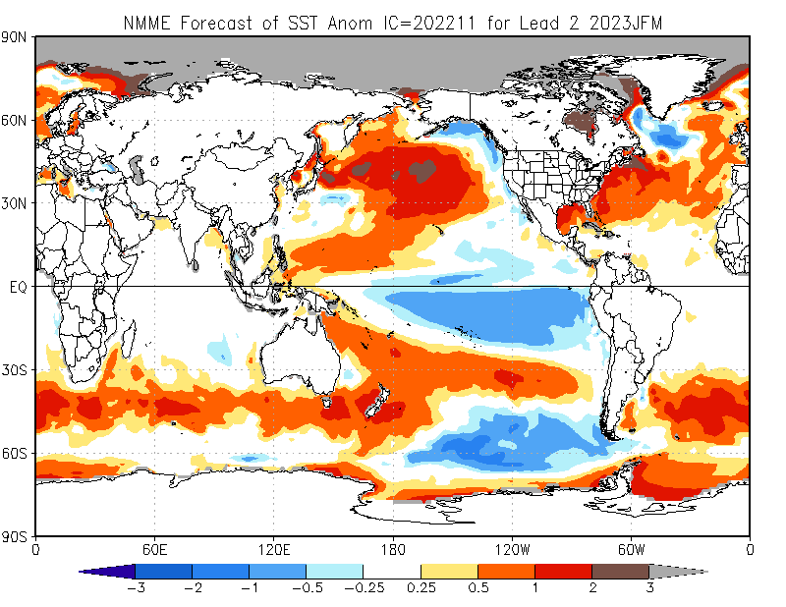

Slide 12
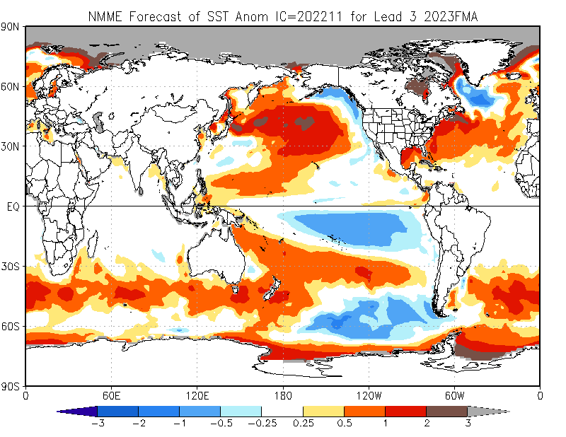

Slide 13
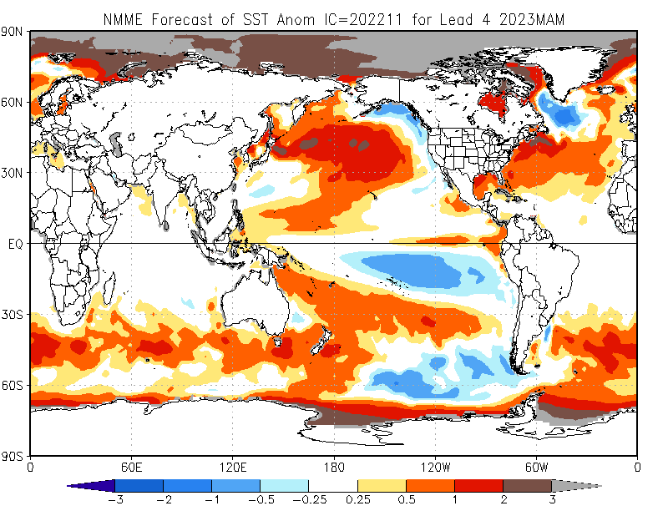

Slide 14
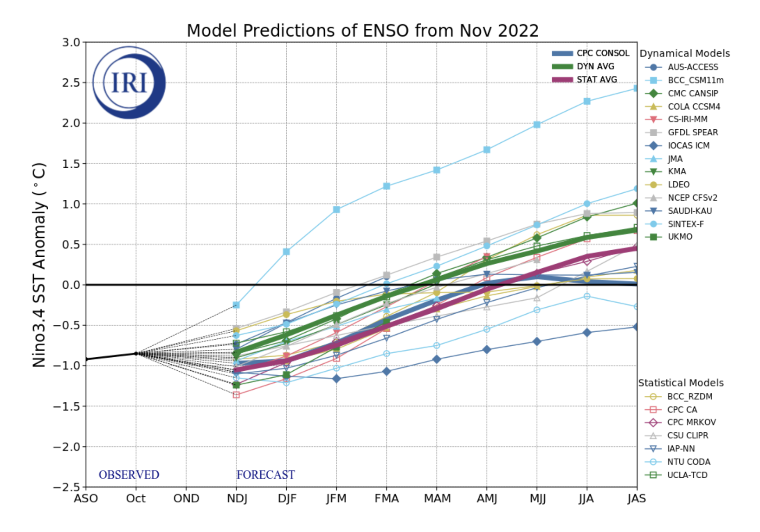
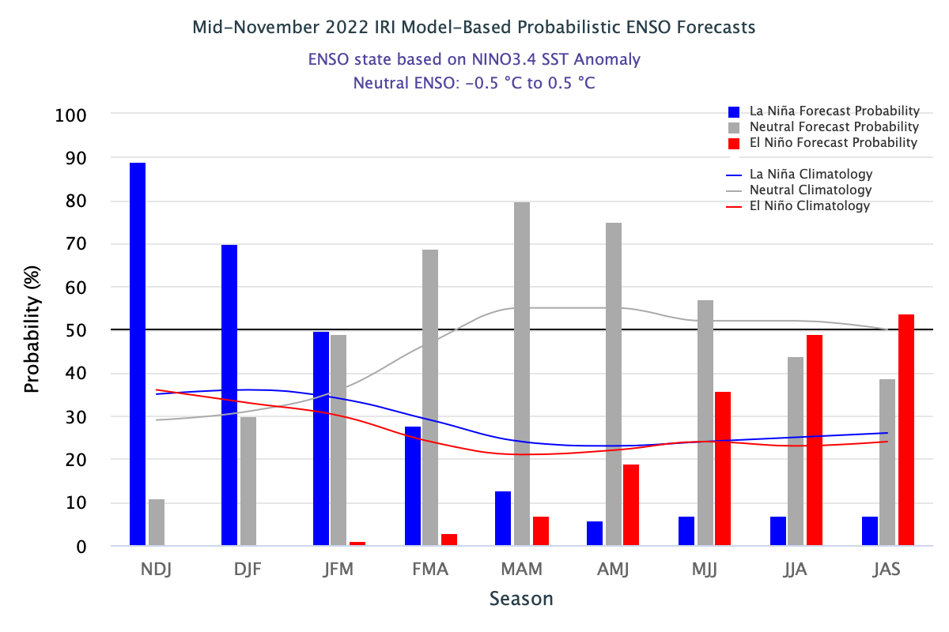
IRI’s ENSO Forecast (Nov, 2022)

Slide 15
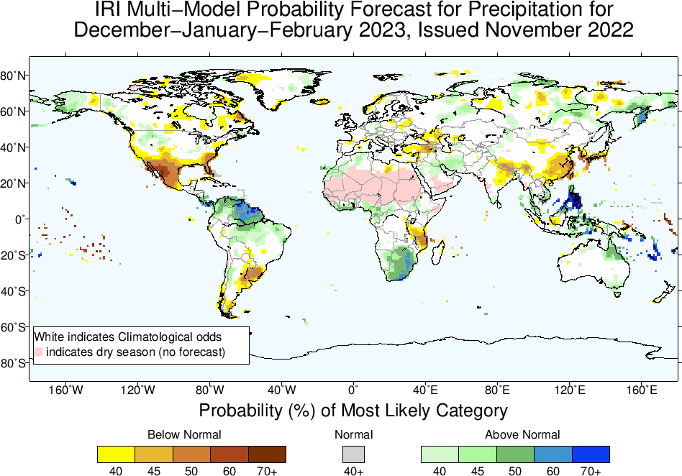

Slide 16
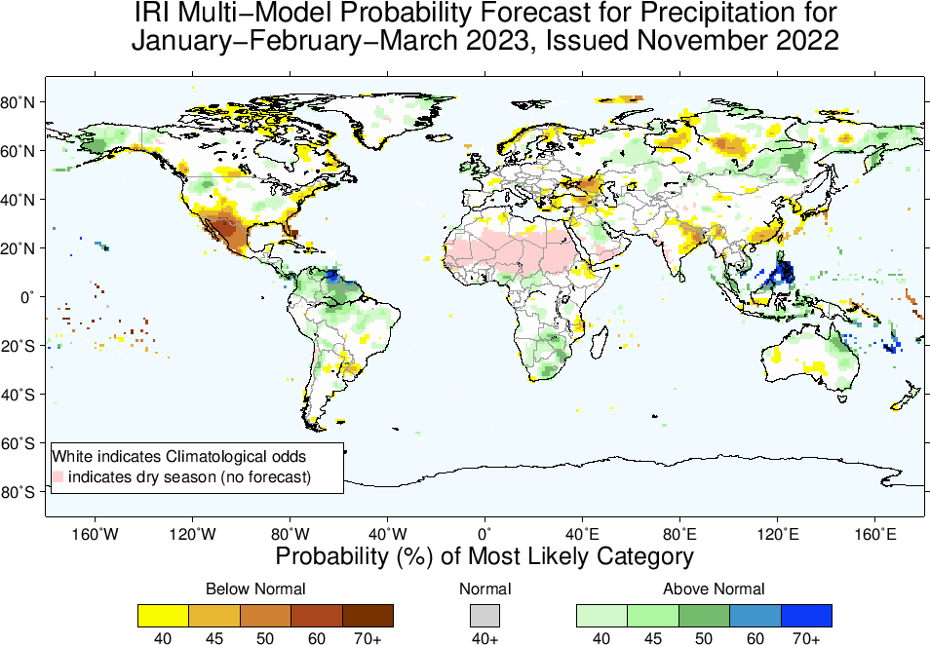

Slide 17
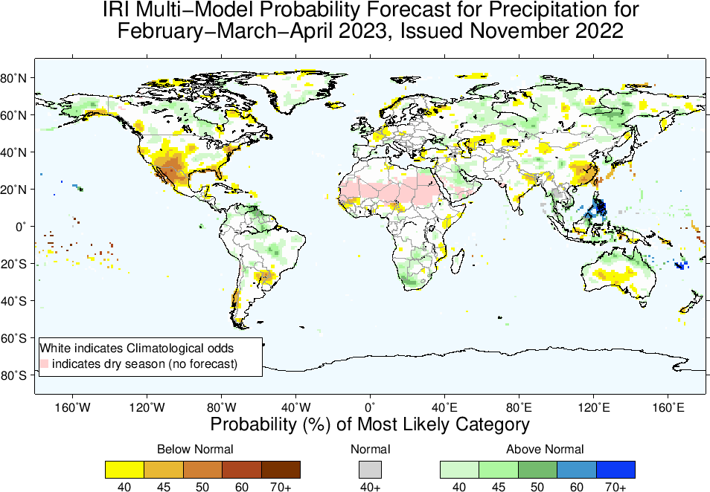

Slide 18
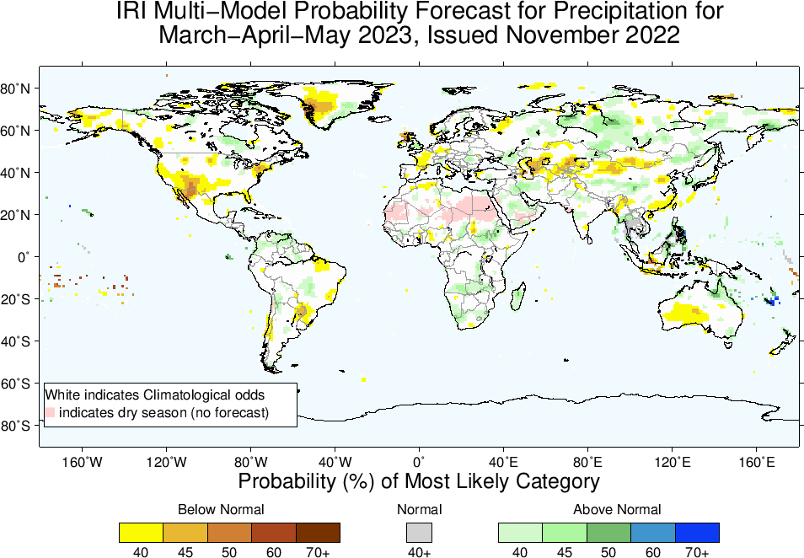

Slide 19
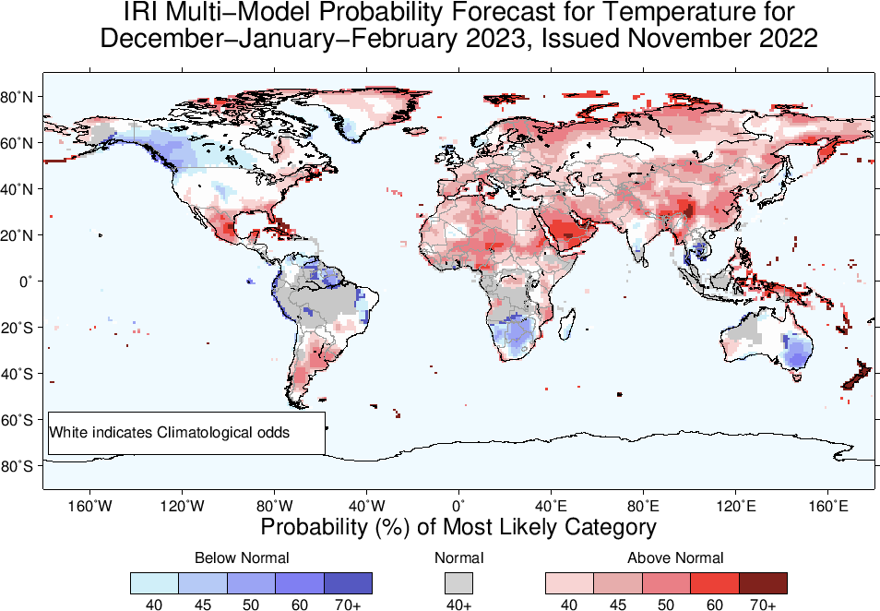

Slide 20
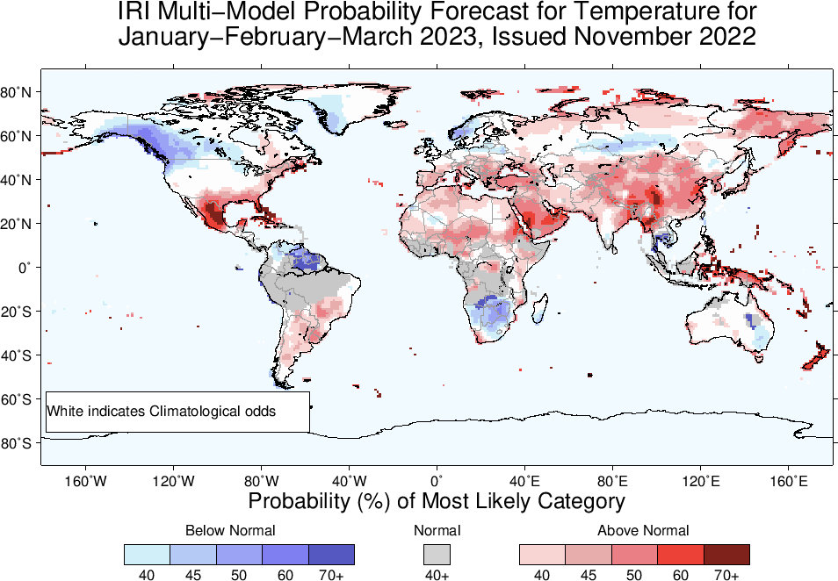

Slide 21
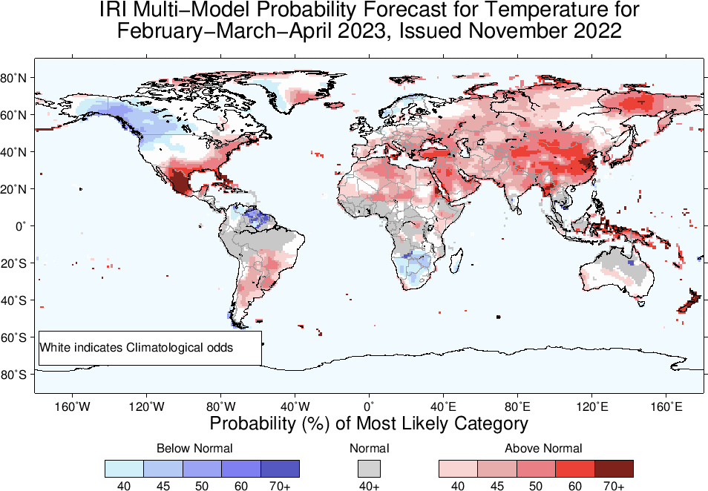

Slide 22
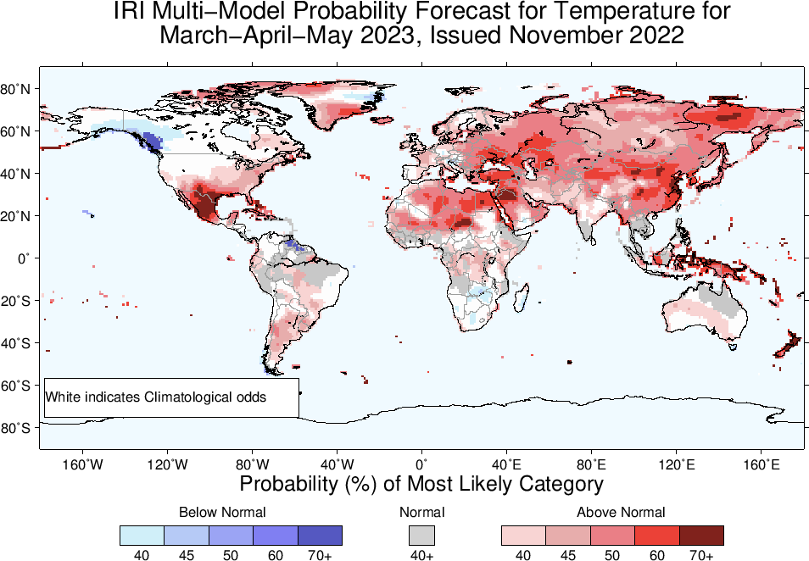

Slide 23
Summary
La Niña continues,
Both Oceanic and Atmospheric conditions show La Nina thresholds; e.g.,
Sea surface temperatures (SSTs) are below average across the central equatorial Pacific Ocean.
SOI is still positive (though ticked down, +7.5), stronger than average trade winds, reduced cloudiness over central Pacific (west of Date-line).
La Niña is favored to continue with high chances during next three seasons. La Niña to continue till DJF-2022/23 is NOW 76%.
This is “triple-Dip of 21st Century”!
ENSO-Neutral is most favorable starting from FMA-2023 (57%) onward.

