Slide 1
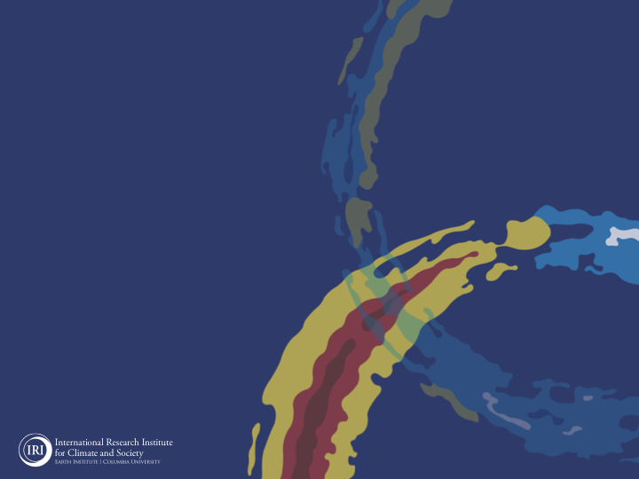
ENSO and Climate Outlook
in May, 2023
M. Azhar Ehsan
(azhar@iri.columbia.edu)
Associate Research Scientist
IRI ENSO and Climate Forecast Lead
Jeffrey Turmelle and Jing Yuan: forecast processing and web updates
Cuihua Li: Draft PowerPoint development
IRI’s Climate Group, led by Dr. Andrew Robertson: Forecast system development, ongoing innovation, and verification
https://en.wikipedia.org/wiki/Weakest_Link_(American_game_show)

Slide 2
Outline
Observed Oceanic and Atmospheric Conditions in
Tropical Pacific
Across the Globe
ENSO Forecast in
NMME
IRI ENSO Forecast Tool (Deterministic and Probabilistic)
Seasons Outlook of
SST
Precipitation and Temperature
Summary

Slide 3
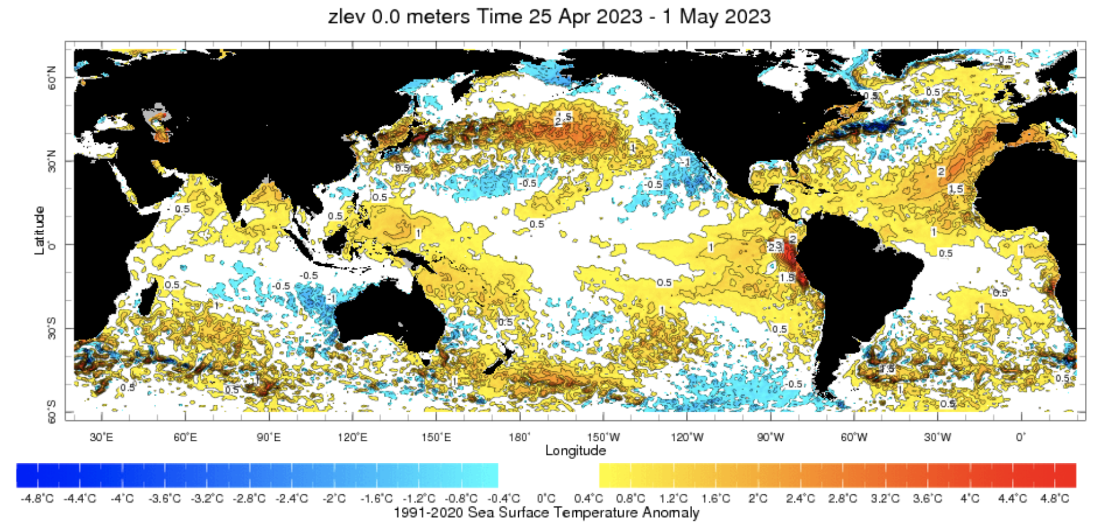
Evolution of SST Anomalies in Weekly Datasets
https://iridl.ldeo.columbia.edu/maproom/Global/Ocean_Temp/Weekly_Anomaly.html?T=28%20Mar%202023%20-%203%20Apr%202023

Slide 4
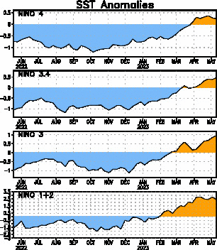
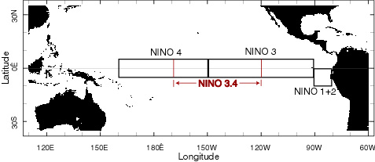
Most recent SST Anom.
Most Recent (10 May, 2023) SST Departures in different NINO regions
Niño 4
0.2ºC
Niño 3.4
0.5ºC
Niño 3
0.9ºC
Niño 1+2
2.7ºC

Slide 5
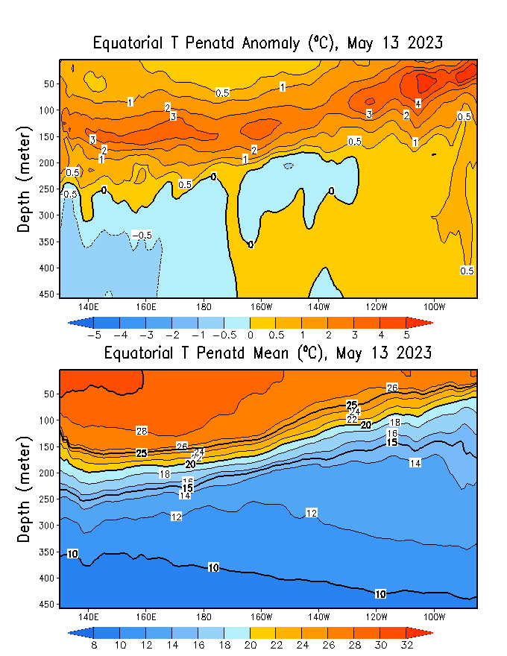
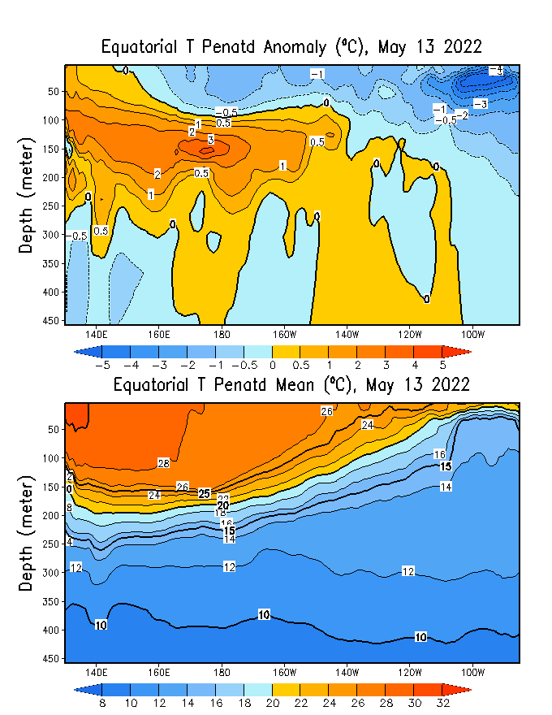
Subsurface Temperature Evolution
Few Points;
Thermocline (layer within the ocean where the temperature changes rapidly with depth, separating warmer surface waters from colder deep waters) in the eastern Pacific is getting deeper. This deepening of the thermocline is associated with a weakening of the trade winds.
Deeper thermocline will contributes to the accumulation of warm surface waters in the central and eastern Pacific.
Reduces the upwelling of cold waters from the deep ocean.
Reinforces the developing El Niño conditions and contributes to the rise in sea surface temperatures in the central-eastern Pacific.

Slide 6
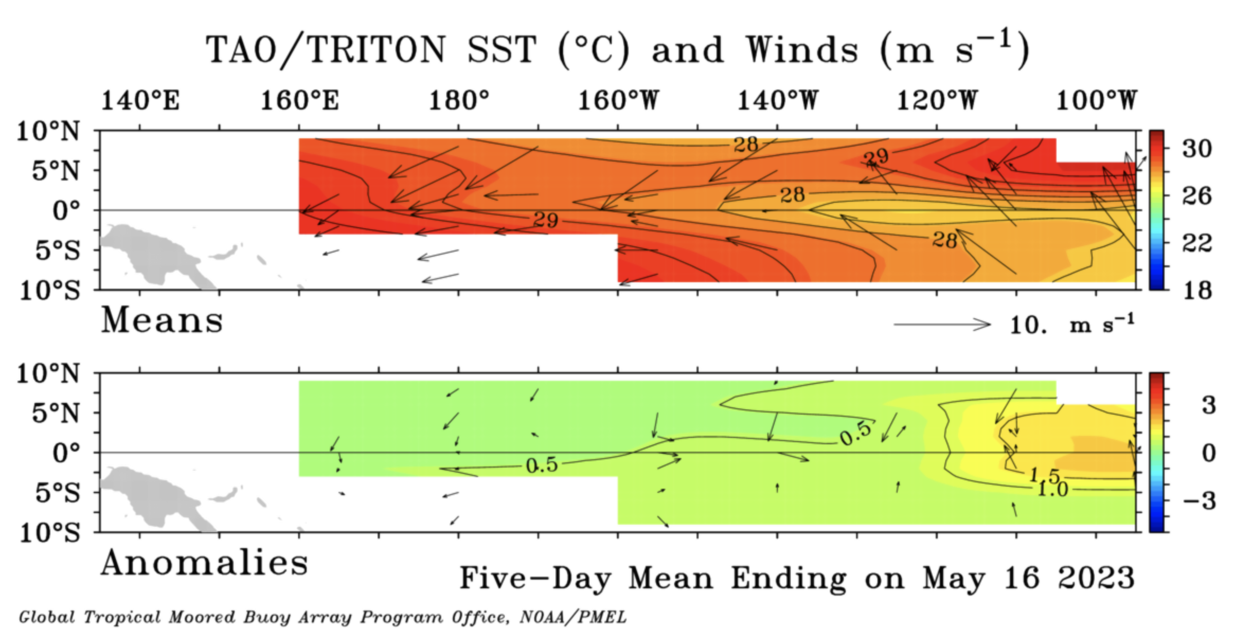
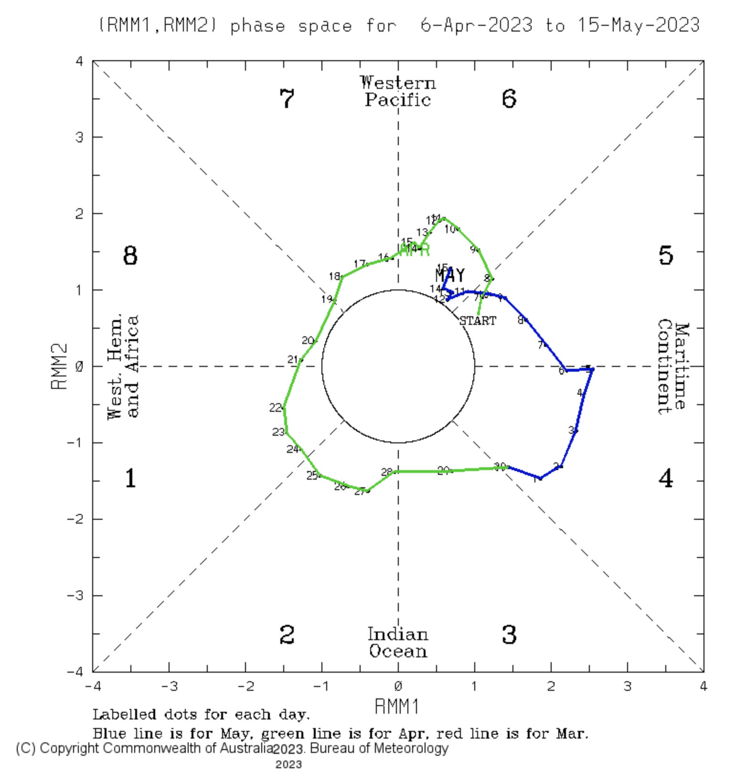
Most recent Lower-Level Winds and MJO
The trade winds observed in the 5-day period ending 16 May 2023 were below average in strength across the tropical. WW and also clear between (160-140 W).
In the tropical Pacific region, El Niño events typically lead to a sustained weakening or even a reversal of trade winds.
http://www.bom.gov.au/climate/mjo/

Slide 7
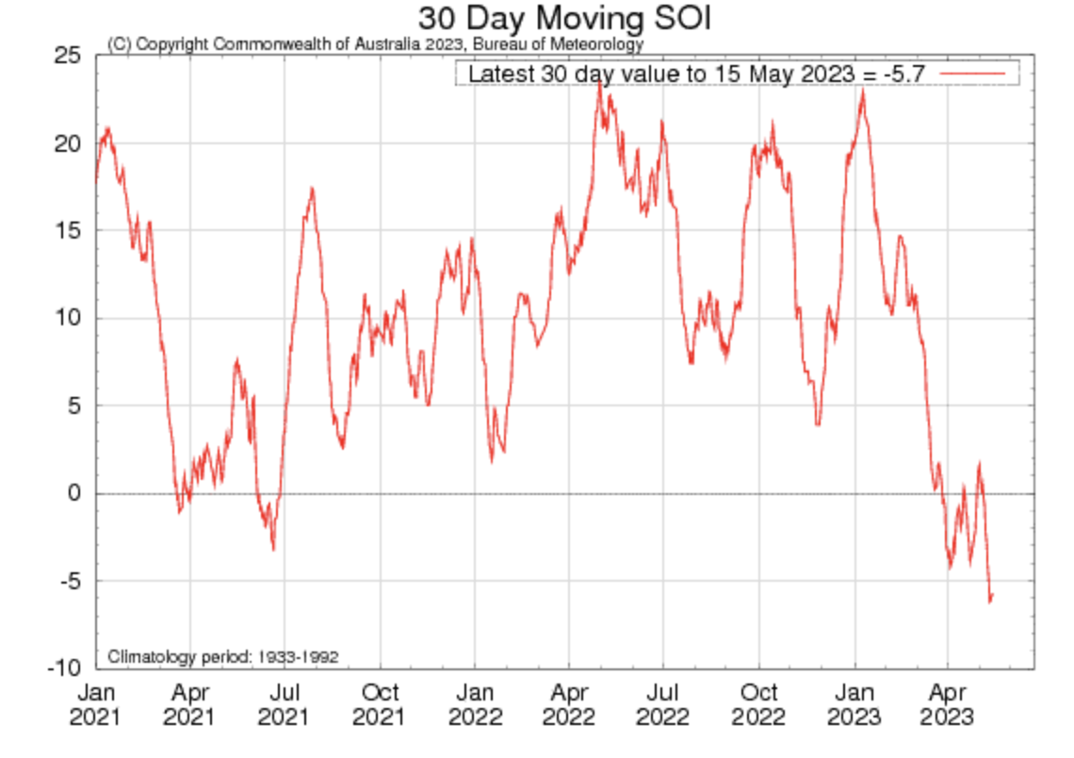
Most recent SOI
Sustained Negative values of the SOI above -7 typically indicate El Niño

Slide 8
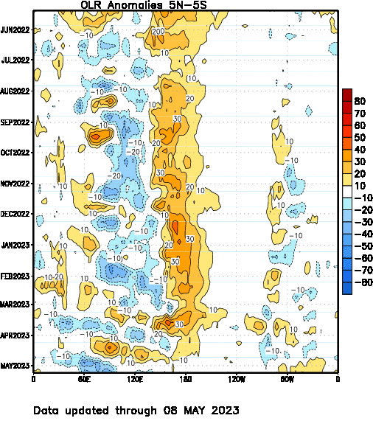
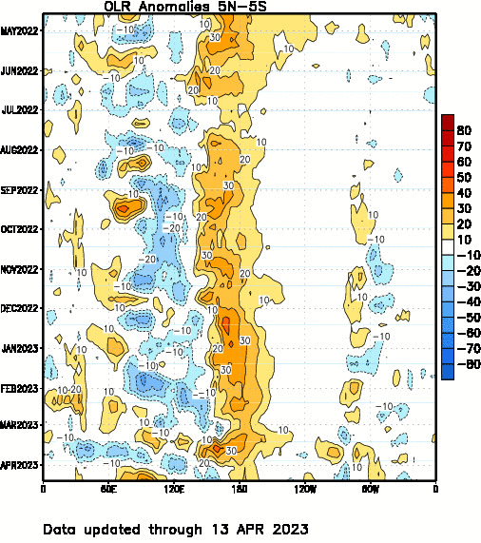
Most recent OLR

Slide 9
Key Message: Ocean Seems Ready, but Atmosphere is still in Neutral Territory.
Consecutive WWBs (Westerly Wind Bursts) in Spring and Early Summer
Build up of Upper Ocean Heat Content in the Equatorial Pacific
Easterly Wind Surge (EWS)
Impact on the Intensity!

Slide 10
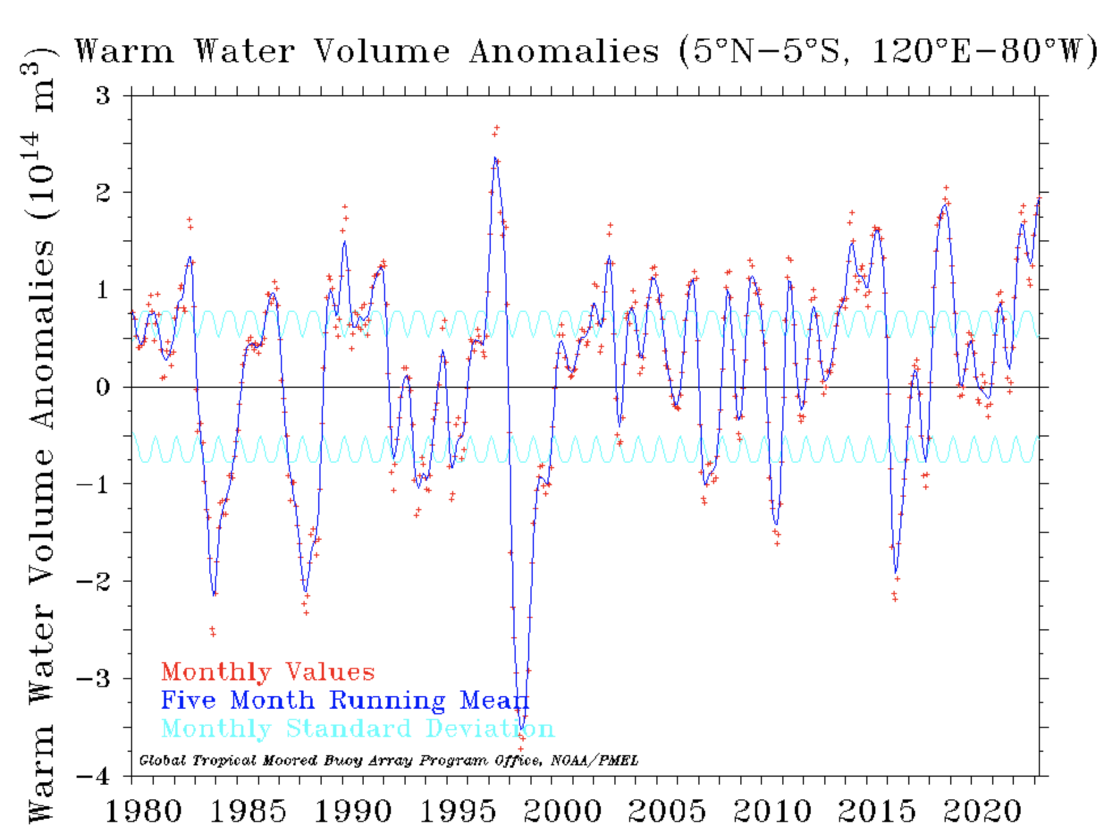
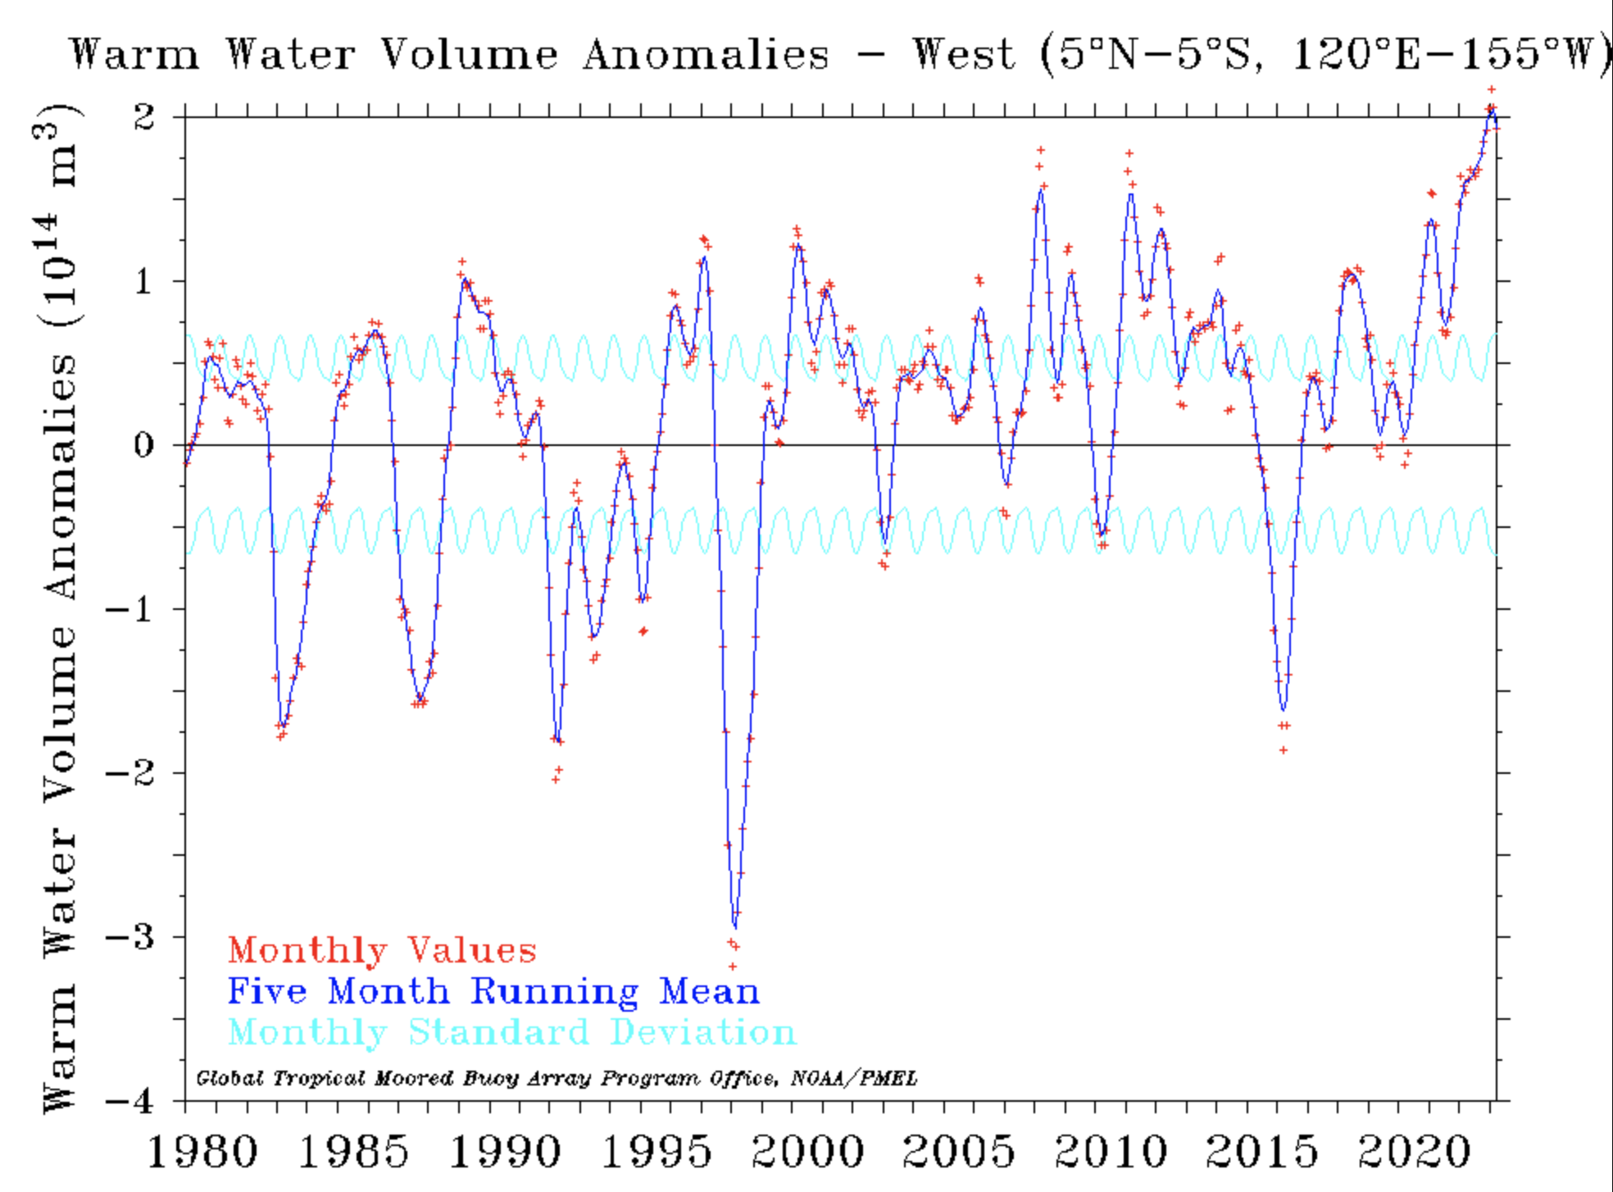
Heat Content in the Upper Ocean
A rare triple-Dip La Niña has just over in tropical Pacific (JAS-2020 to JFM-2023).
This has accumulated a huge amount of WW in the Western Pacific with an intensity even stronger than those preceding the onset of strong El Niños in history.
WWVA Across Pacific
WWVA Across West Pacific
https://www.pmel.noaa.gov/elnino/upper-ocean-heat-content-and-enso

Slide 11
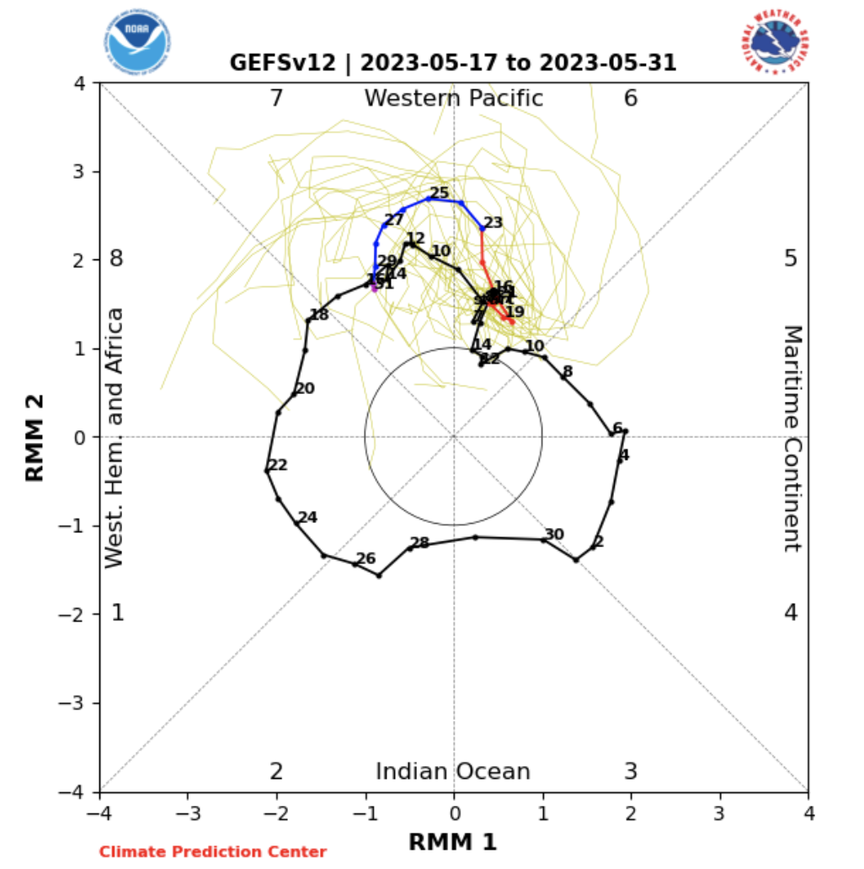
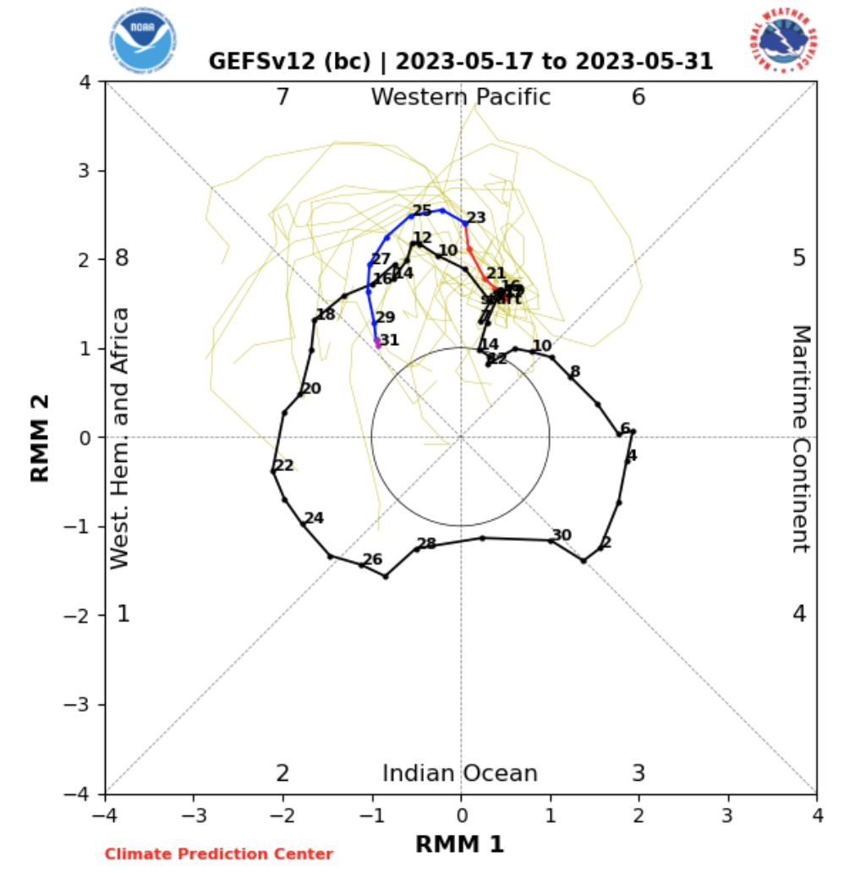
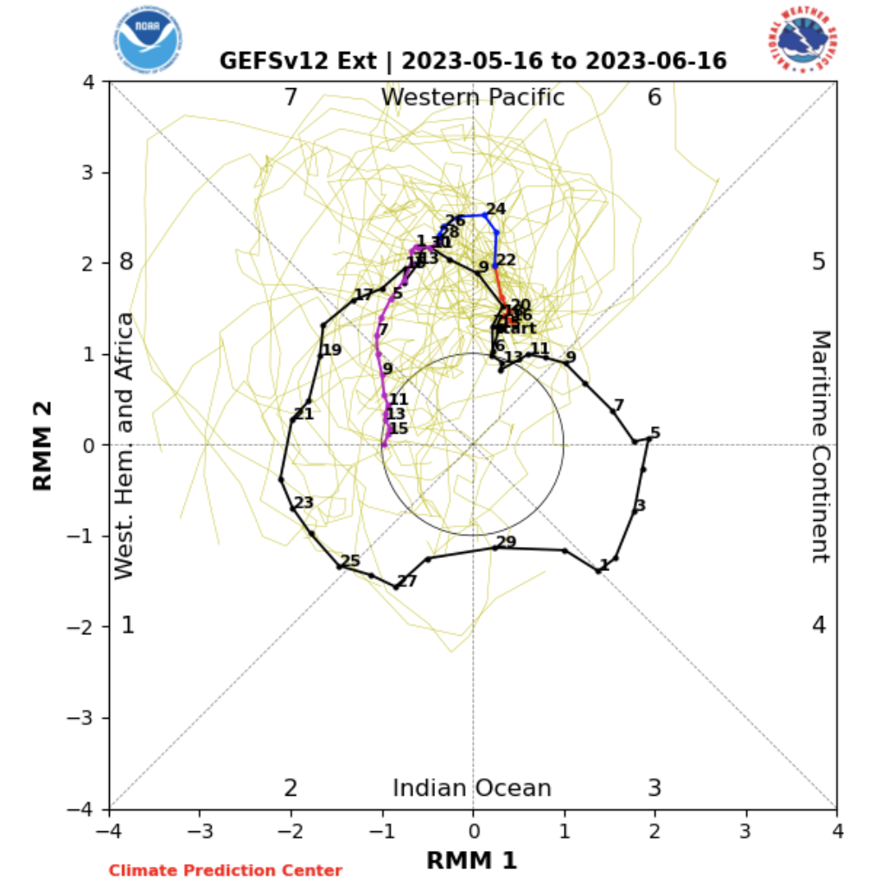
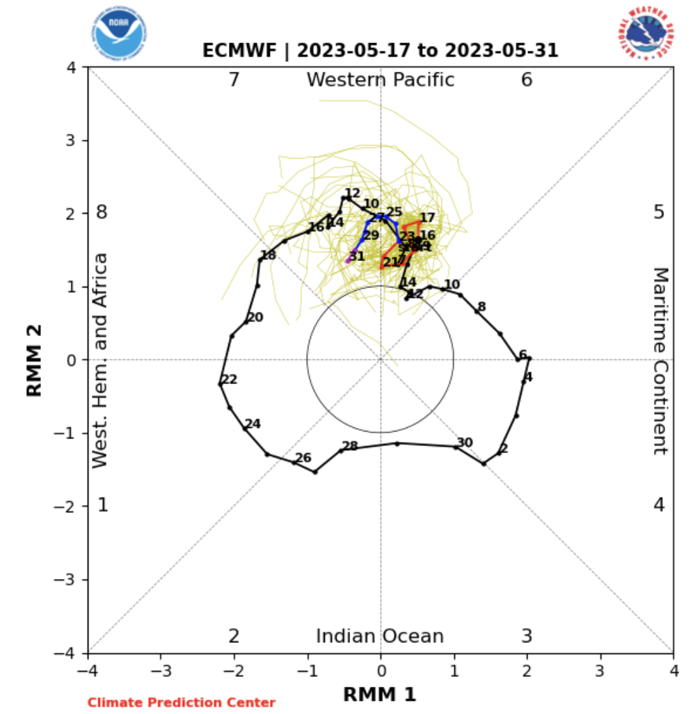
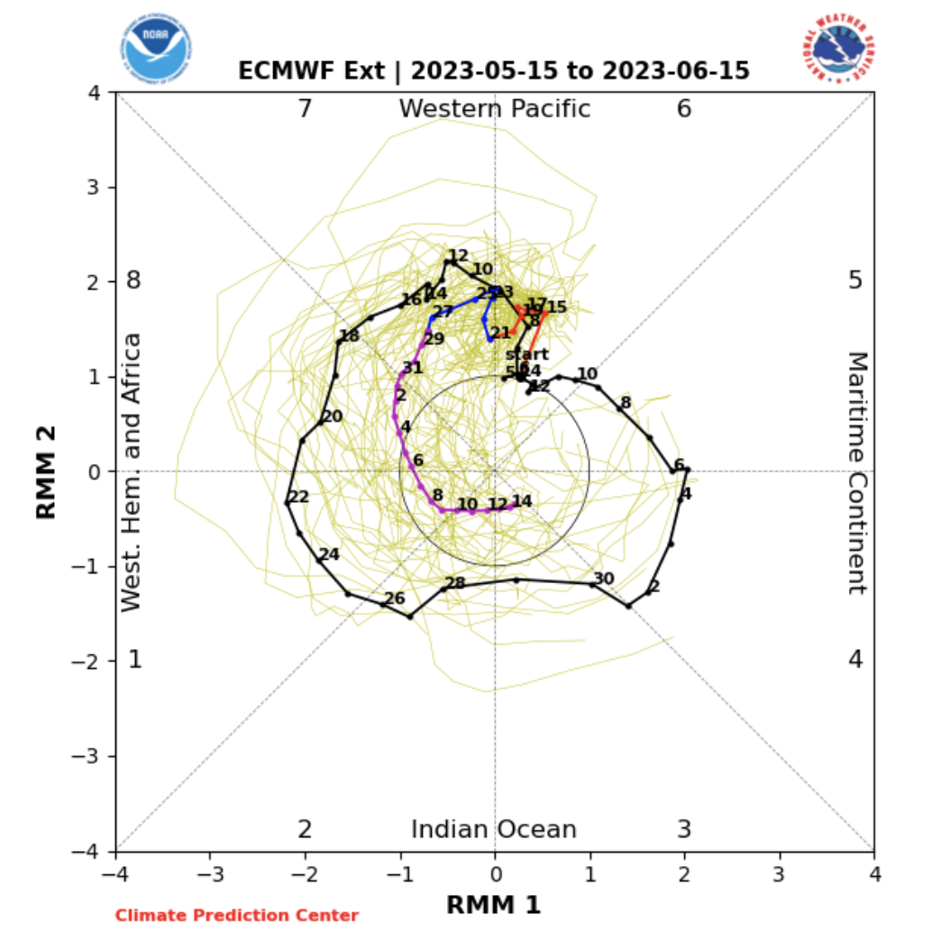
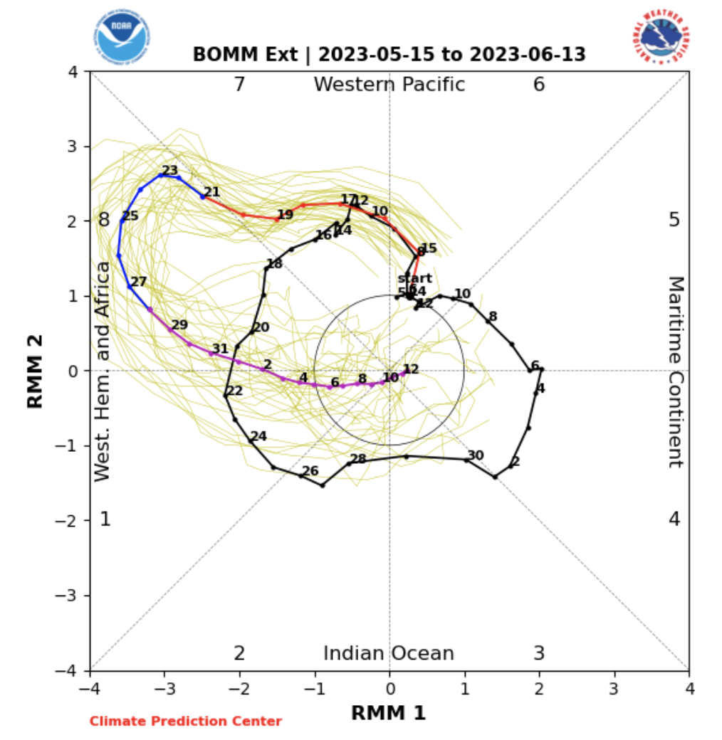
Most recent MJO Forecasts
https://www.cpc.ncep.noaa.gov/products/precip/CWlink/MJO/CLIVAR/clivar_wh.shtml/

Slide 12
Reflections on Intensity, . . .
Heat builds up in the subsurface ocean (A great recharge period due to triple-Dip La Niña), should influence ocean surface. But;
Require a Stimulus (WWB, e.g., MJO)!
3. Few more WWBs could bring a strong
El Nino in 2023.
https://www.cpc.ncep.noaa.gov/products/precip/CWlink/MJO/CLIVAR/clivar_wh.shtml/

Slide 13
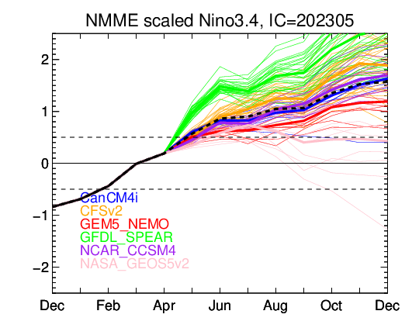
NMME’s ENSO Forecast

Slide 14
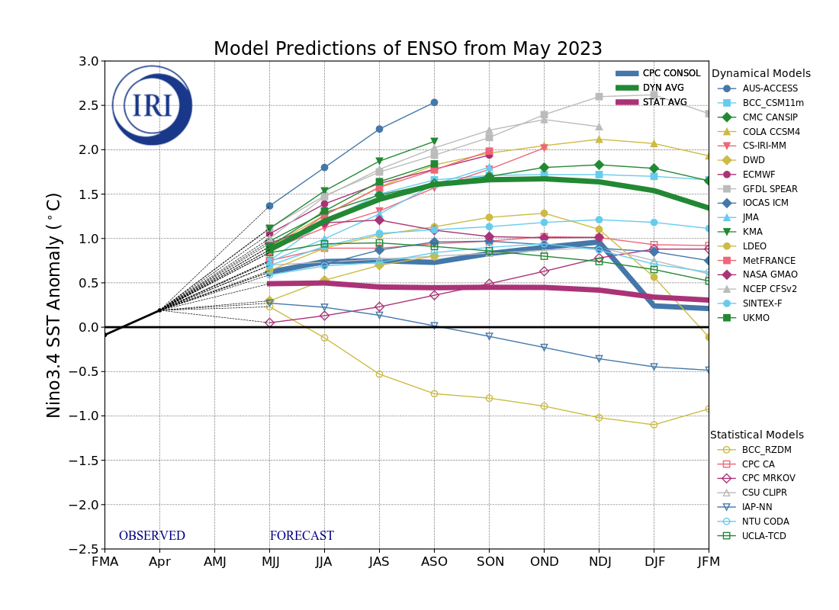
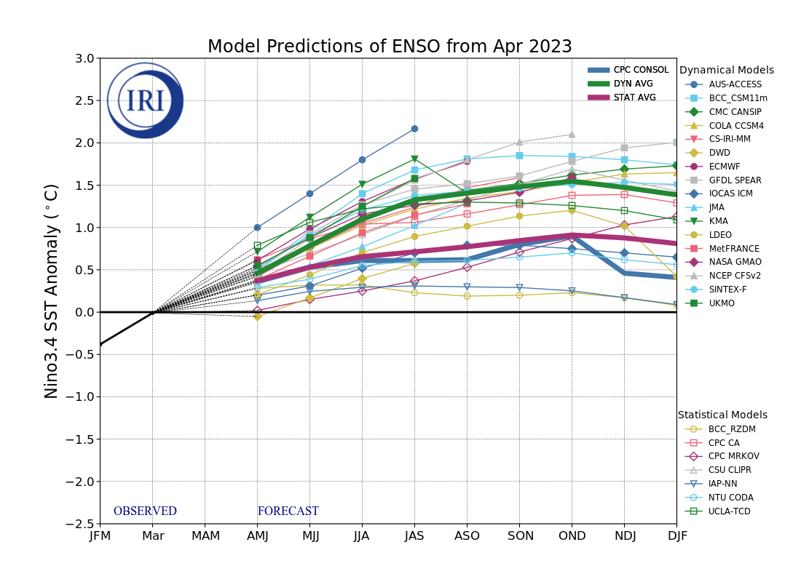
IRI’s ENSO Forecast (May, 2023)

Slide 15
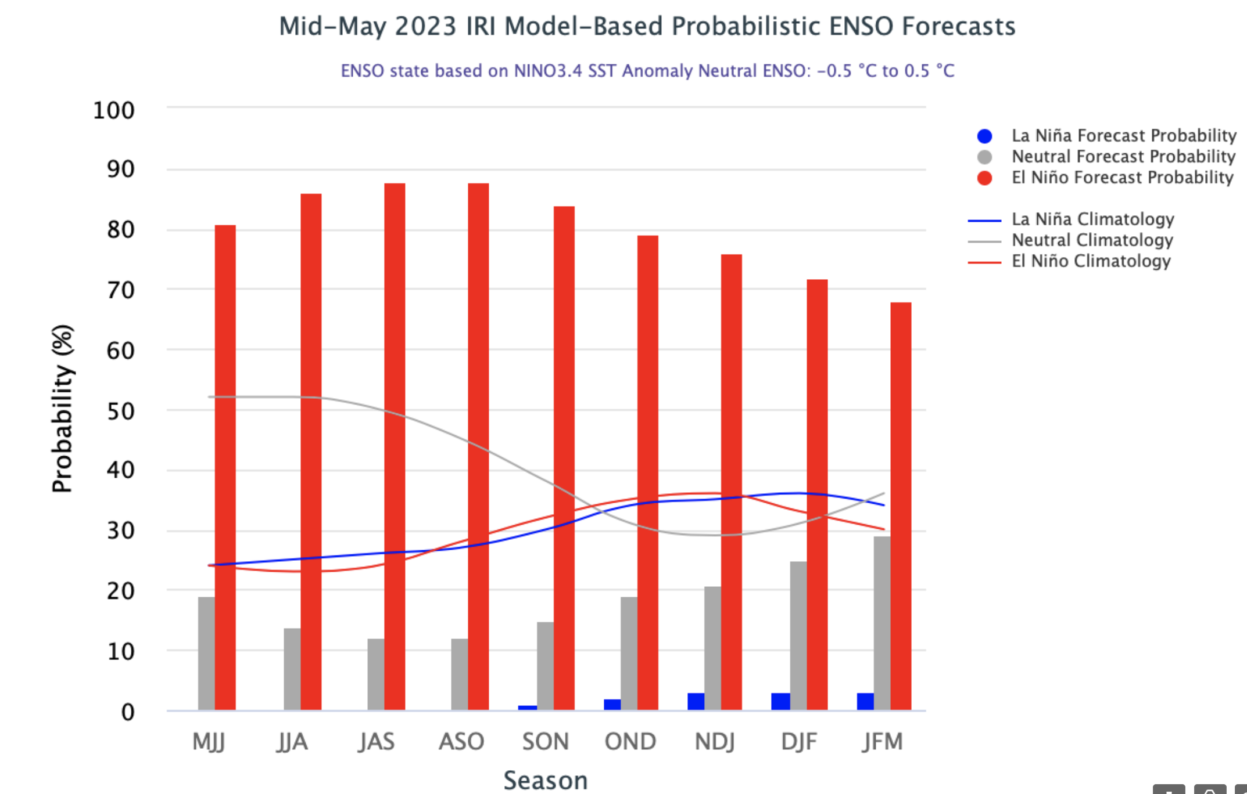
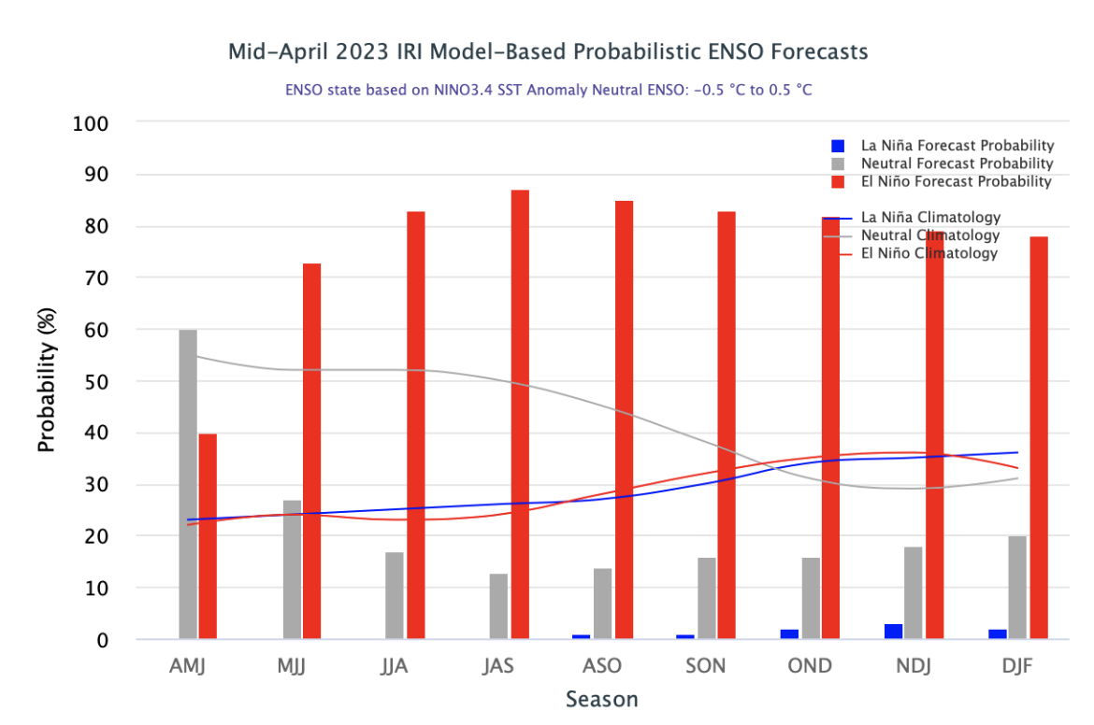
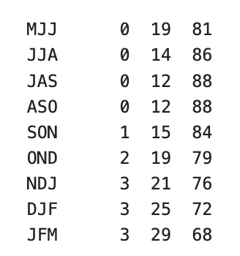
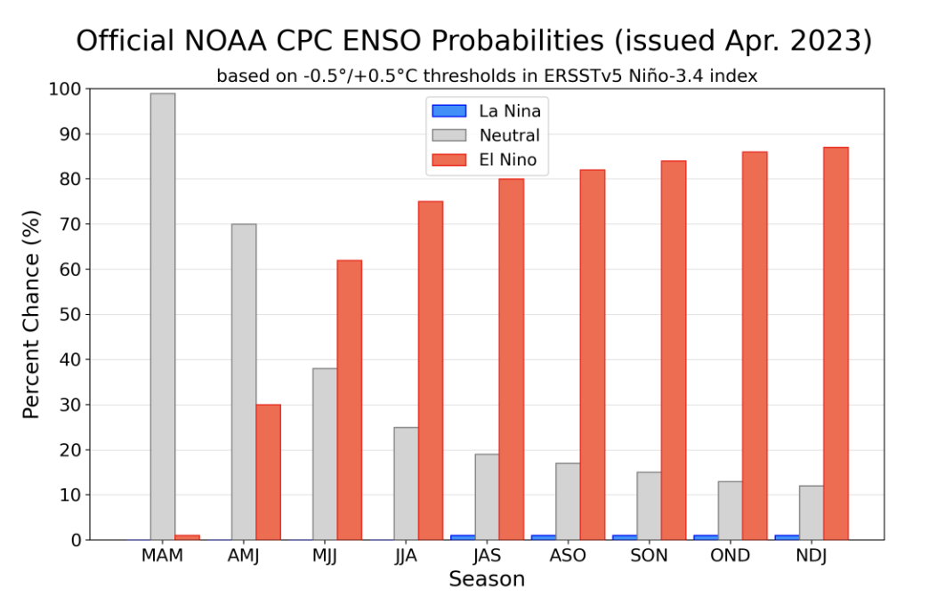
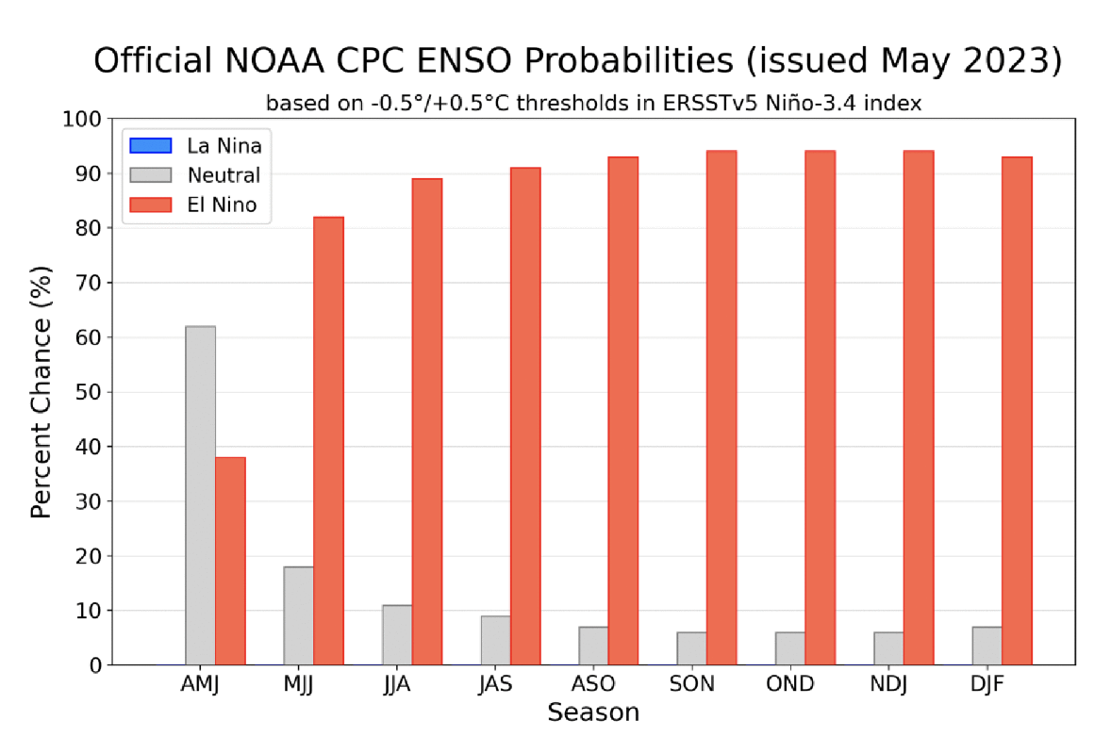
IRI’s ENSO Forecast (May, 2023) Probabilities

Slide 16
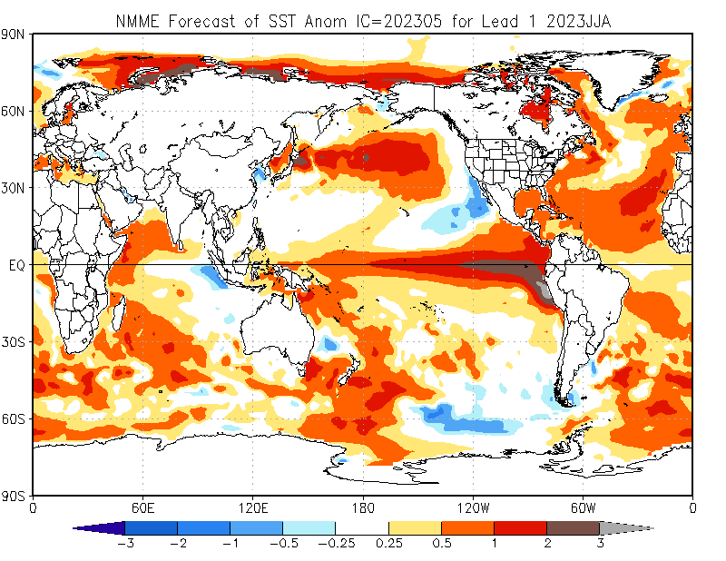

Slide 17
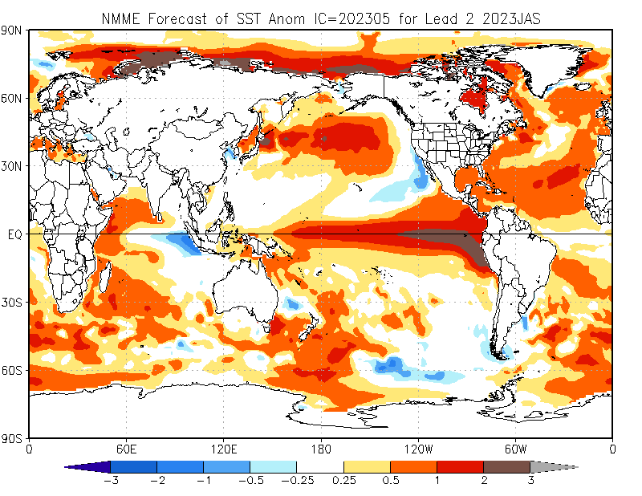

Slide 18
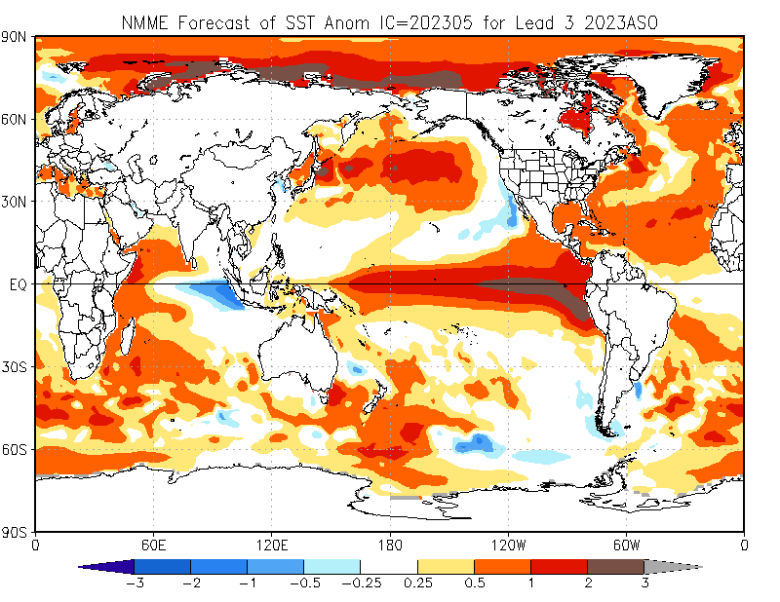

Slide 19
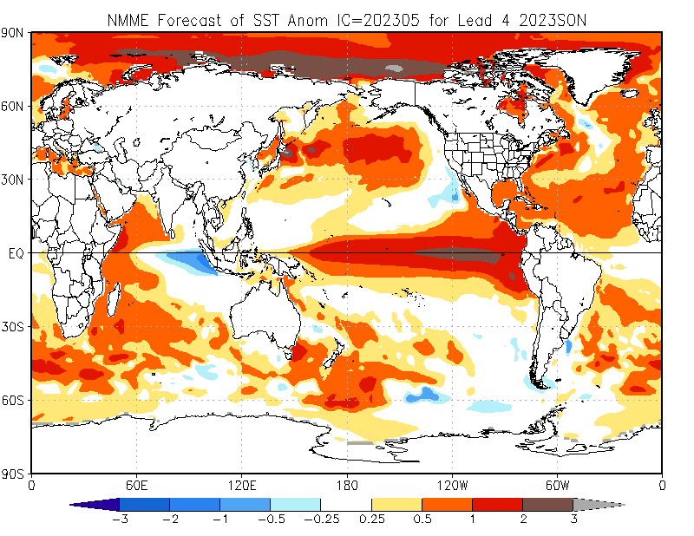

Slide 20
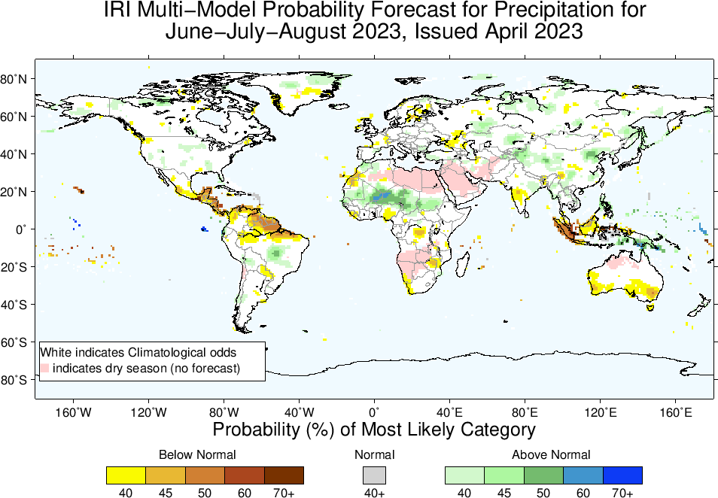
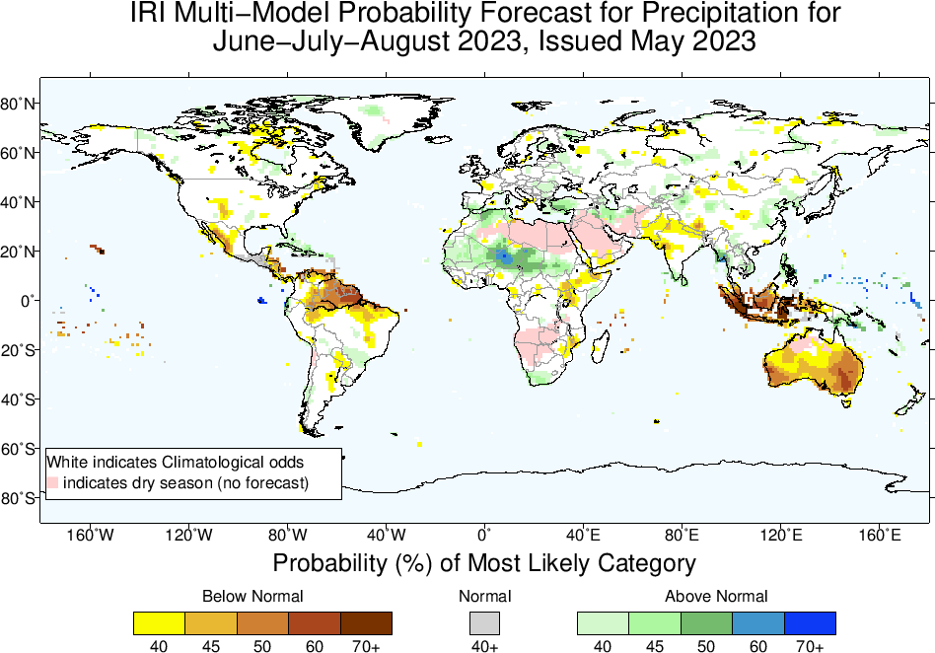
Precipitation Forecasts: Season # 1, Jun to Aug
Highlights:
Shift towards Normal to Above-Normal
Sahel region
Shift towards Normal to
Below-Normal
Northeast South America,
Central America,
South Asia
Maritime Continent,
Australia

Slide 21
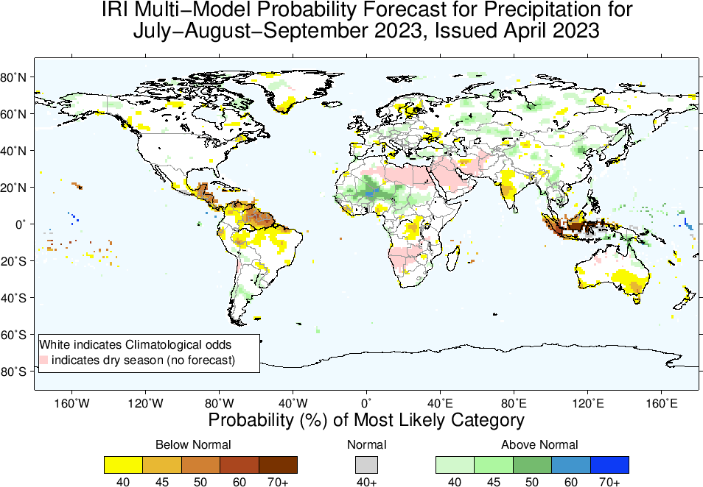
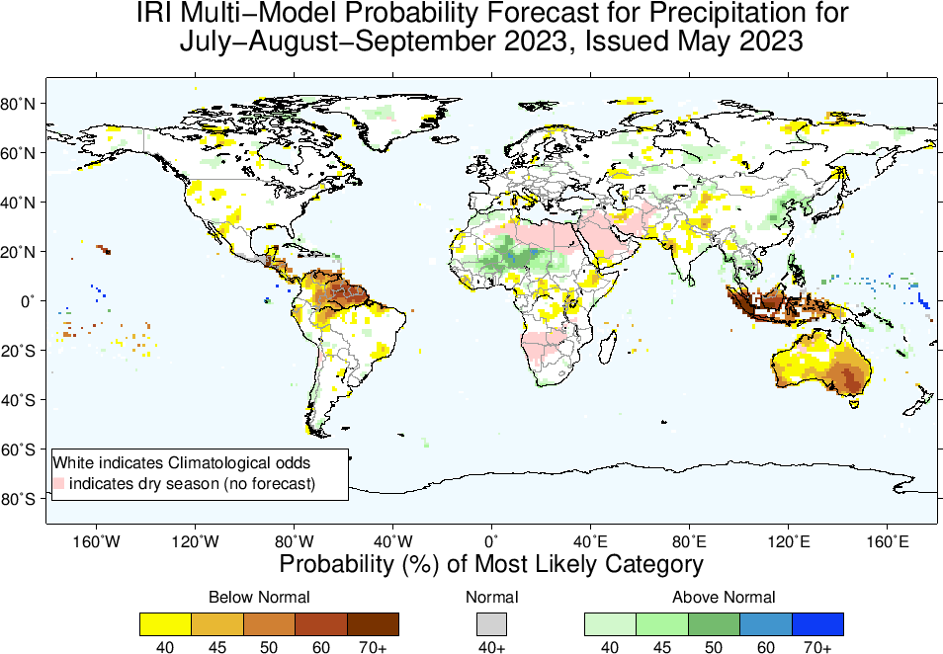
Precipitation Forecasts: Season # 2, Jul to Sep
Highlights:
Shift towards Normal to Above-Normal
Sahel region
north-eastern China
Shift towards Normal to Below-Normal
Northern parts of South America,
Central America,
South Asia,
Maritime Continent,
Australia

Slide 22
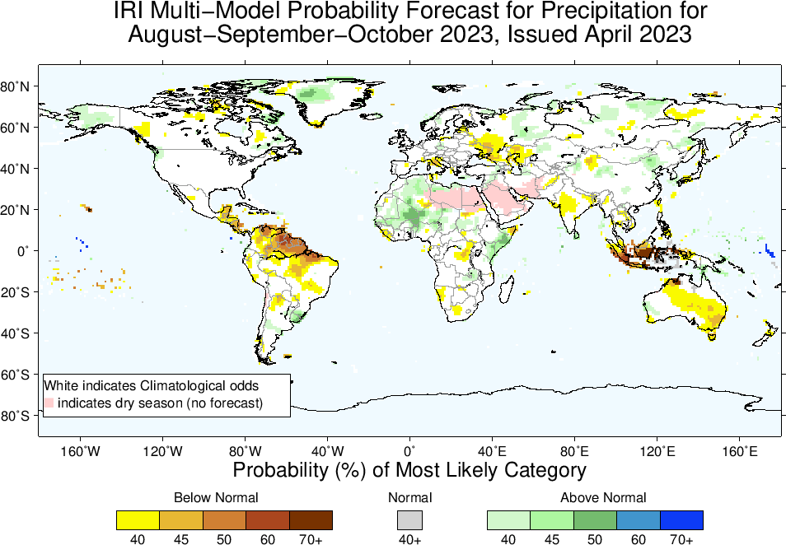
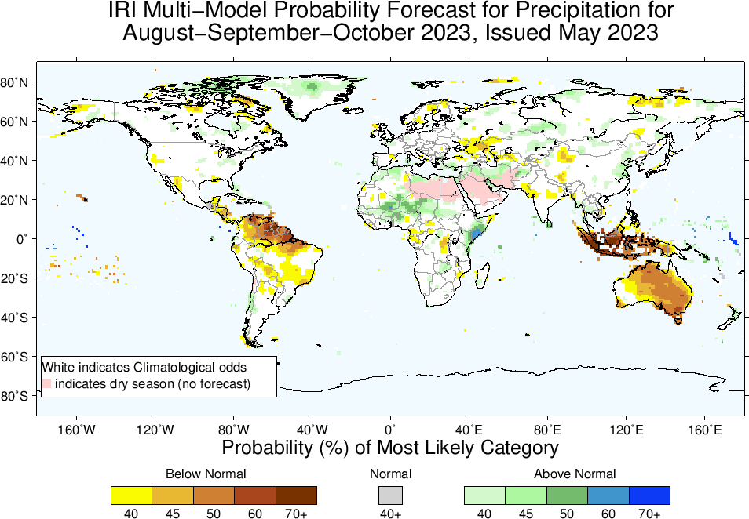
Precipitation Forecasts: Season # 3, Aug to Oct
Highlights:
Shift towards Above-Normal
Sahel region
Northeast Africa
Middle-East/Western SA
Shift towards Below-Normal
Northeast South America,
Central America,
South Asia,
Maritime Continent,
Australia

Slide 23
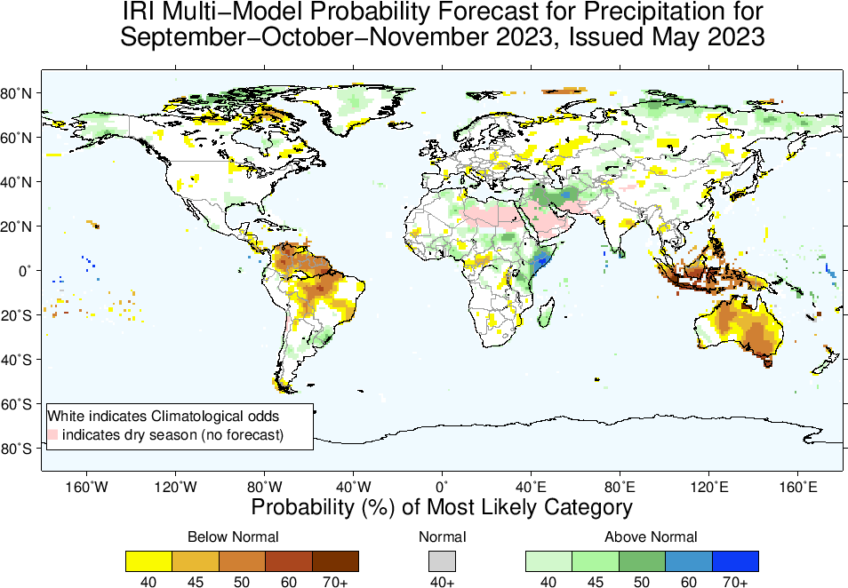
Highlights:
Shift towards Normal to
Above-Normal
Sahel region (Western)
North-east Africa (southeast Ethiopia, Somalia, eastern Kenya)
Middle-East/Western SA
Madagascar
Shift towards Normal to
Below-Normal
North-Northeast South America,
Central America,
South Asia,
Maritime Continent,
Australia
Precipitation Forecasts: Season # 4, Sep to Nov

Slide 24
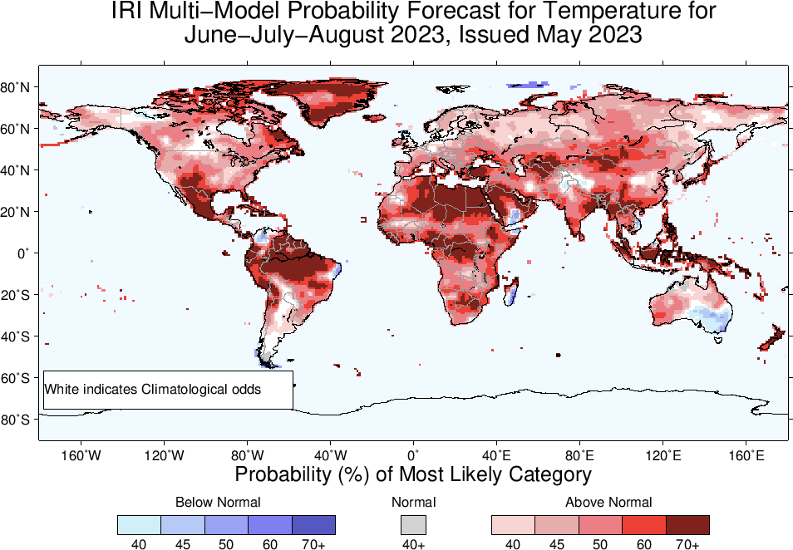
Highlights:
Shift towards Warmer/Above-Normal
Most land areas,
Southeast Asia, the Maritime Continent regions, Northeast South America.
Shift towards Colder/Below-Normal
Northern tip of South America,
Central Pakistan
Most of Madagascar,
Southeast Australia
Temperature Forecasts: Season # 1, Jun to Aug

Slide 25
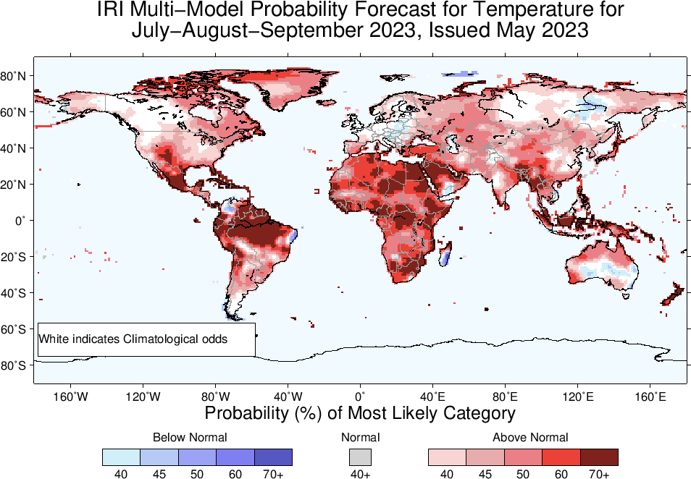

Slide 26
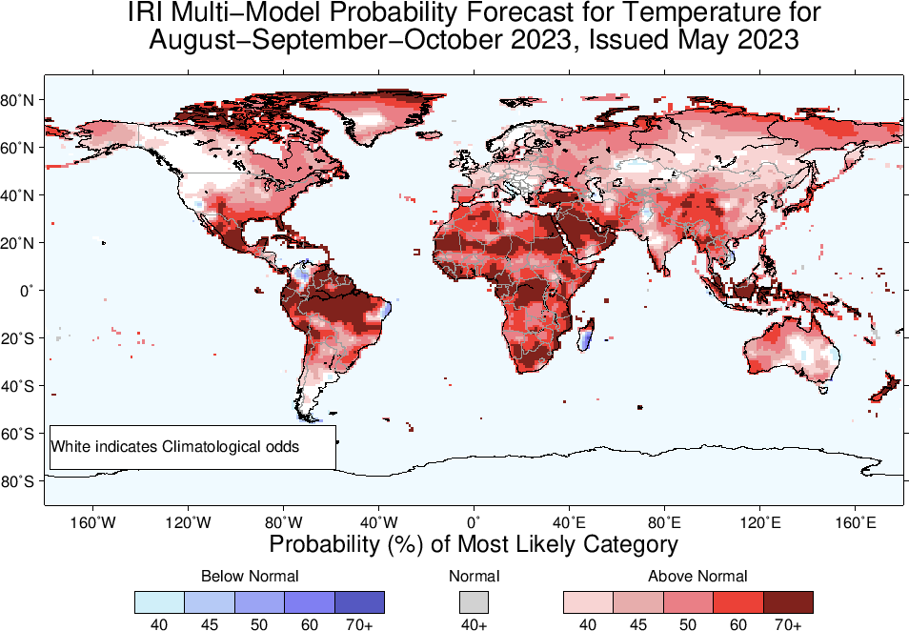

Slide 27
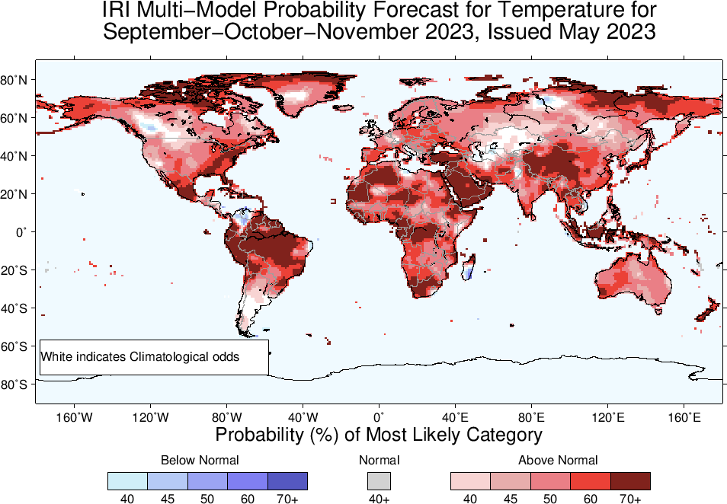

Slide 28
Summary
El Niño is not knocking at the Door!
It is already there.
Sea surface temperatures (SSTs) are in ENSO-neutral range across the central equatorial Pacific Ocean, but warming up gradually. Substantially Warm SSTs across Pacific for example, NINO1+2, 3 and 3.4 are +2.4, +0.9, +0.5.
Warm Sub-Surface across the Pacific.
A weak hint of coupling.
El Niño Watch is in Place!
Weakest Link is weak coupling of O&A!
Observing a vast reservoir of warm water with little or no atmospheric response is one of the worst scenarios.

