Slide 1
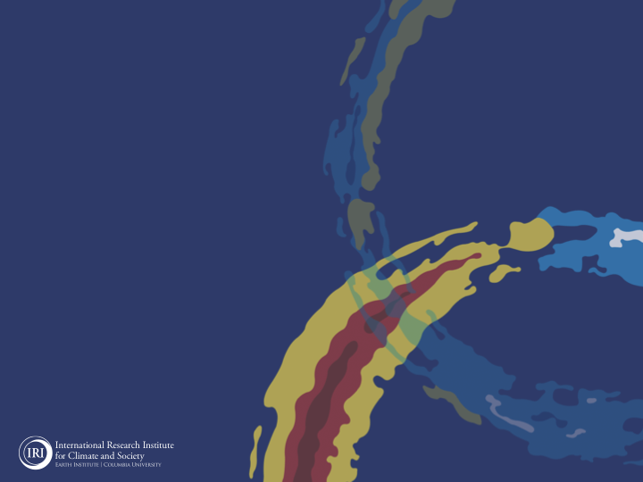

ENSO and Climate Outlook
in May 2022
La Nina Continues,…
And
A Wetter Monsoon ☺
M. Azhar Ehsan
(azhar@iri.columbia.edu)
Associate Research Scientist
IRI ENSO and Climate Forecast Lead
Jeffery Turmelle and Jing Yuan: forecast processing and web updates
Cuihua Li: Draft PowerPoint development
IRI’s Climate Group, led by Dr. Andrew Robertson:
Forecast system development, ongoing innovation, and verification

Slide 2
Outline
Observed Oceanic and Atmospheric Conditions in
Tropical Pacific
Across the Globe
ENSO Plume in
NMME
IRI ENSO Plume and Probabilistic Forecast
Seasons Outlook of
SST
Precipitation and Temperature
Summary

Slide 3
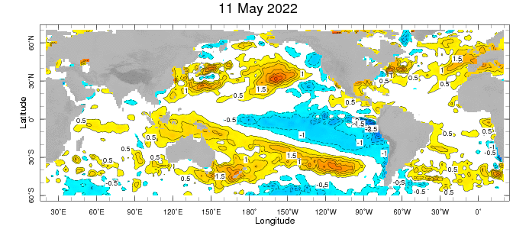
Evolution of EQ. Pacific SST Departures in Weekly OISST Data
(11 May, 2022)
Below-average SSTs persisted across the central to eastern equatorial Pacific Ocean.

Slide 4
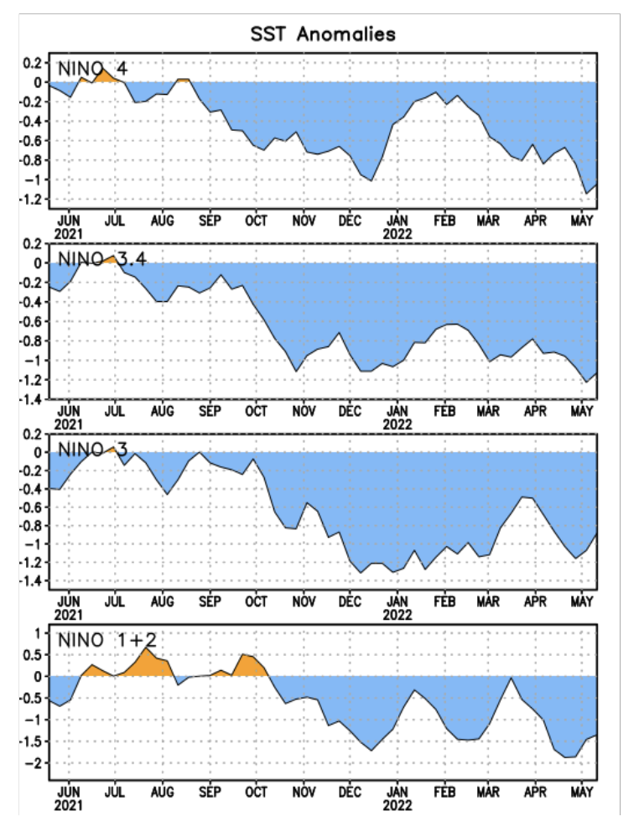
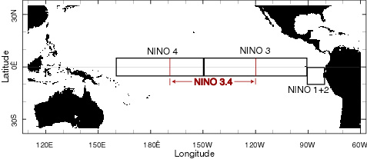
Most Recent SST Departures in different NINO regions (All cooler than the long-term avg, (1991-2020))
Niño 4
-1.0ºC
Niño 3.4
-1.1ºC
Niño 3
-0.9ºC
Niño 1+2
-1.4ºC

Slide 5
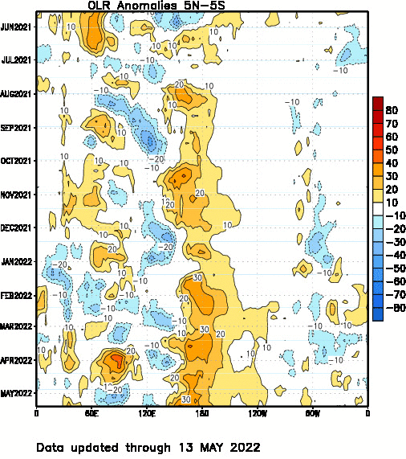
Suppressed convection

Slide 6
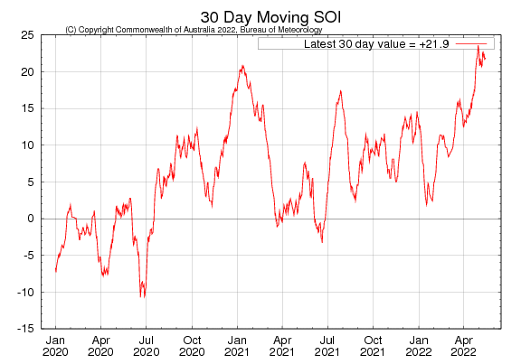
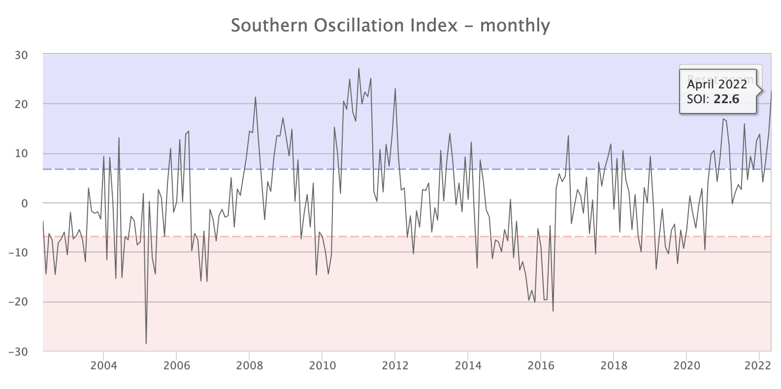
Tahiti_{SLP} – Darwin_{SLP}
ticked Up and sustained.
+7 typically indicate La Niña
+7 and −7 generally indicate Neutral
-7 typically indicate El Niño
http://www.bom.gov.au/climate/enso/soi/

Slide 7
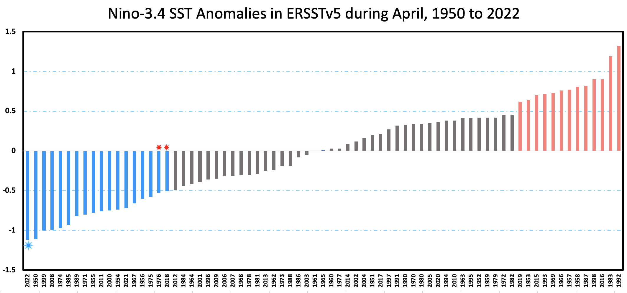
https://www.cpc.ncep.noaa.gov/products/analysis_monitoring/ensostuff/detrend.nino34.ascii.txt

Slide 8
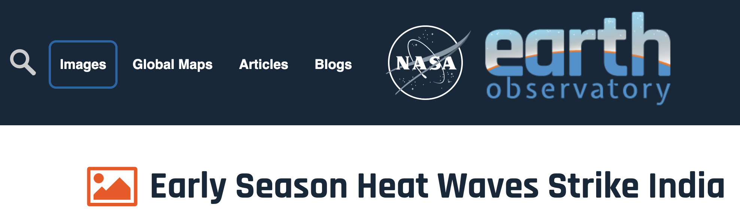
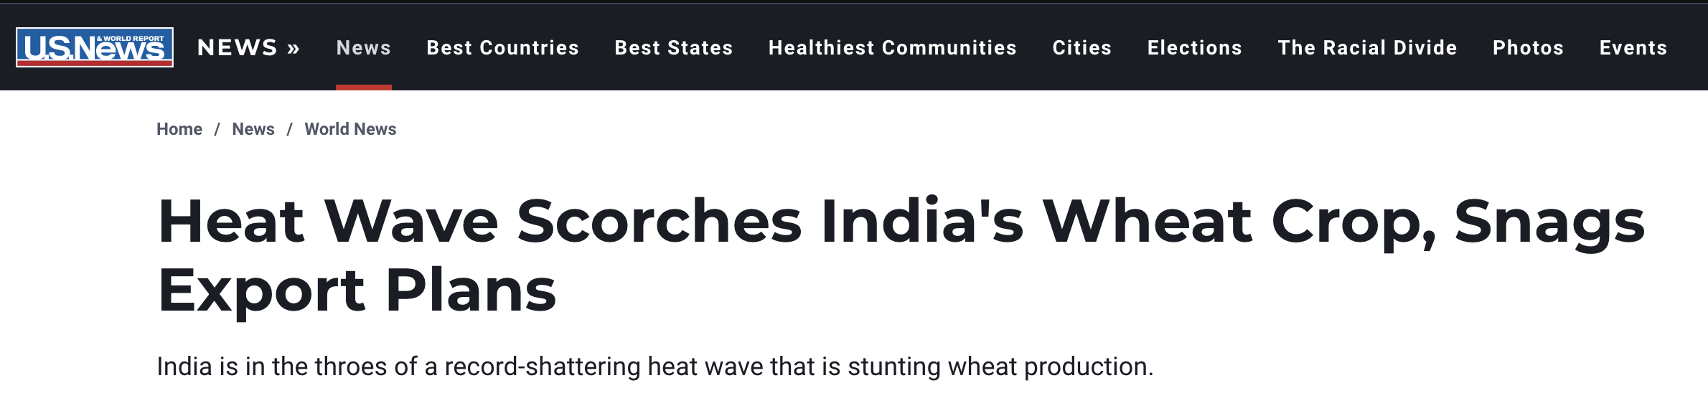
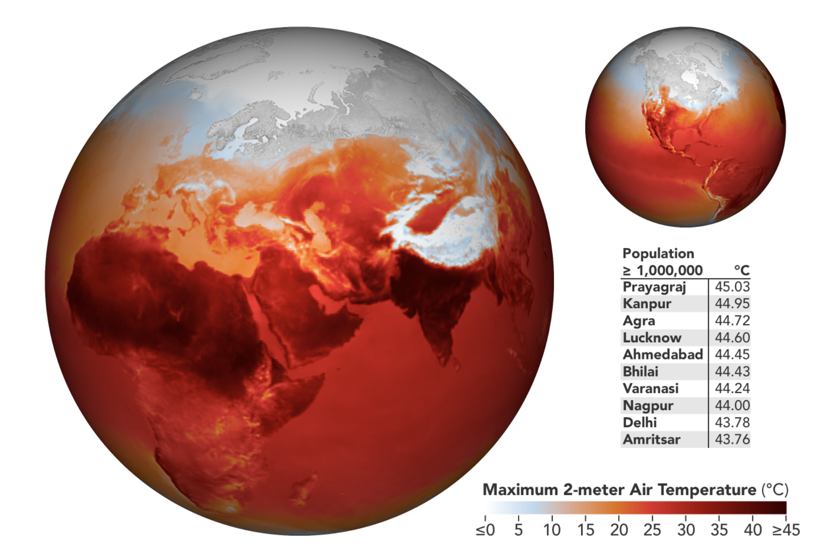
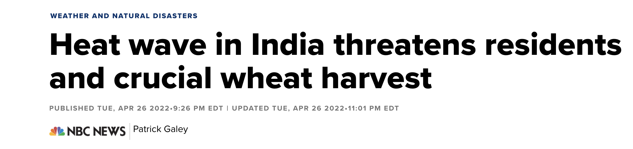
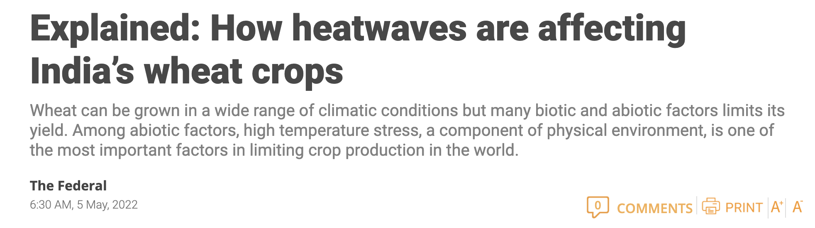
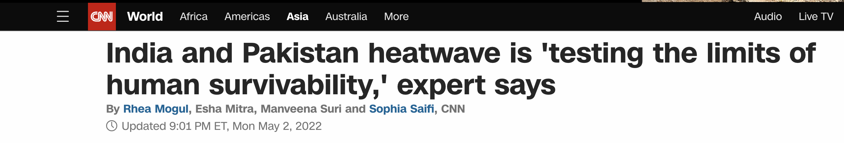
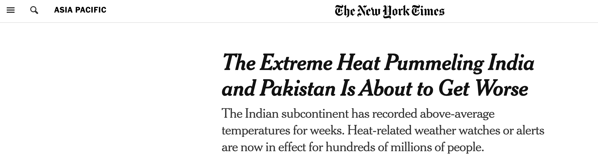


Slide 9
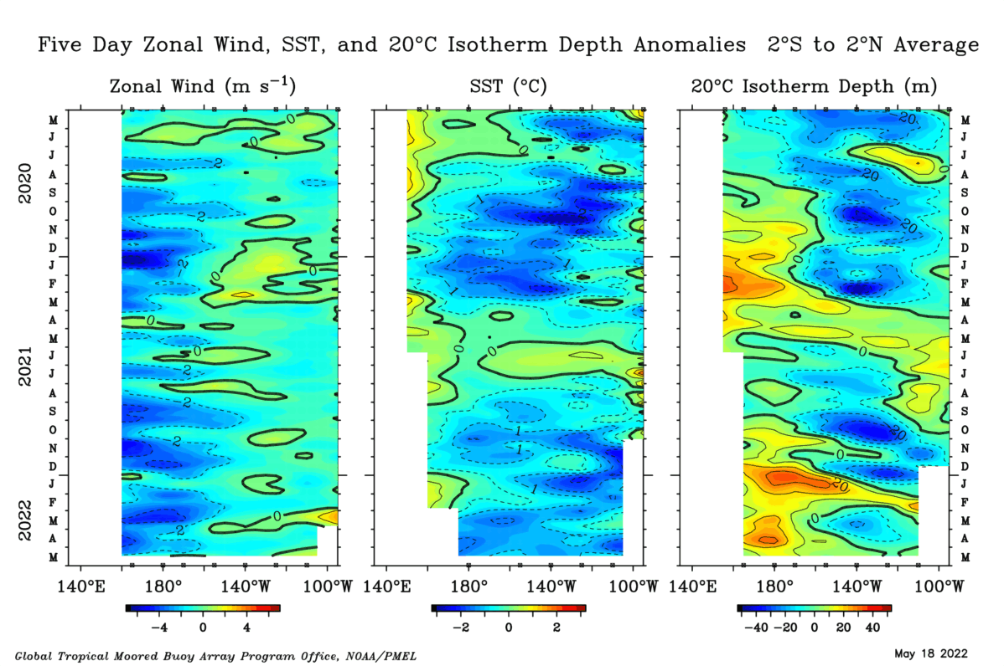

Slide 10
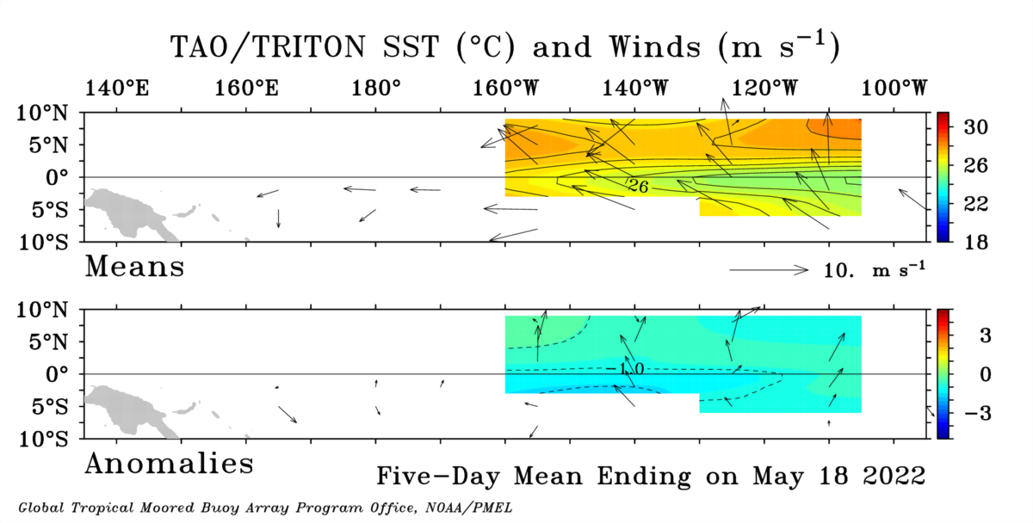

Slide 11
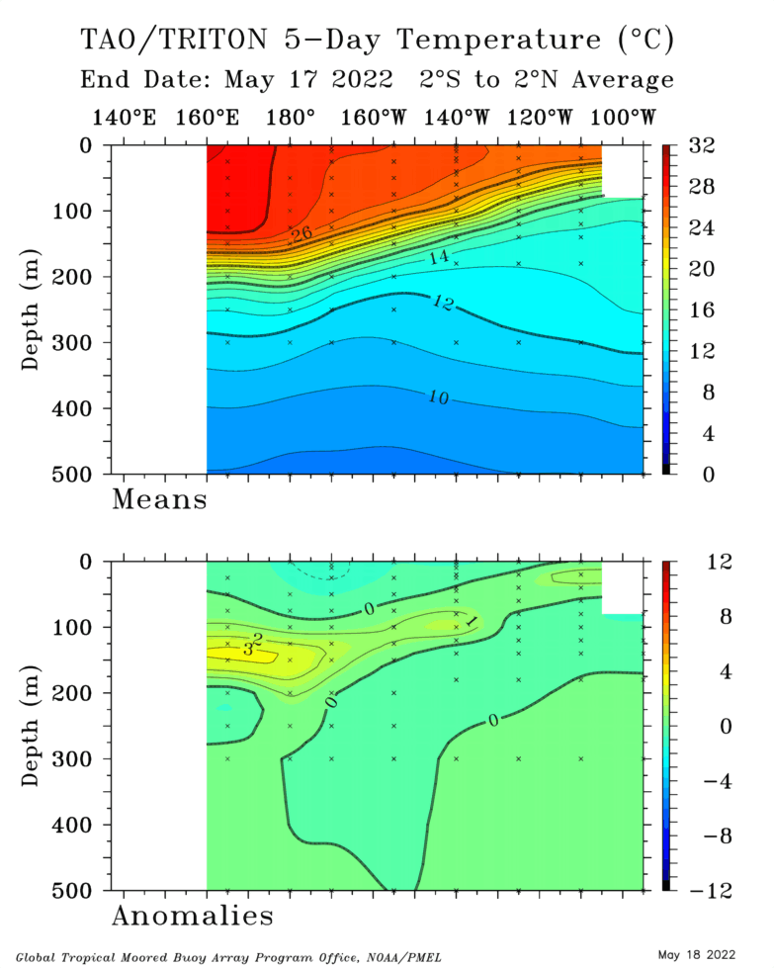
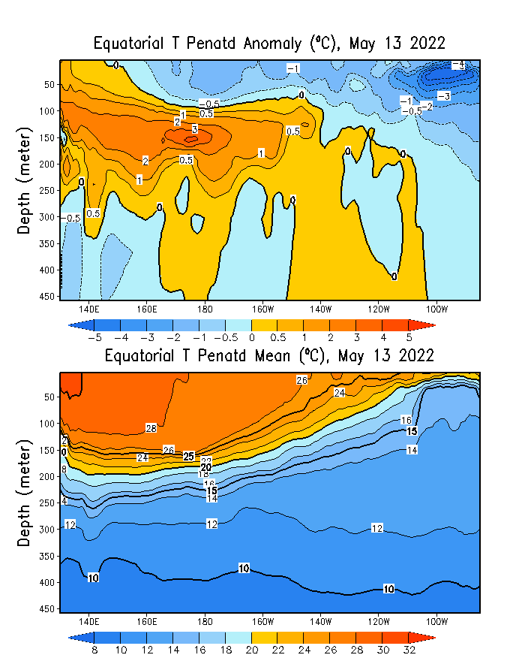
TOGA/TAO
GODAS

Slide 12
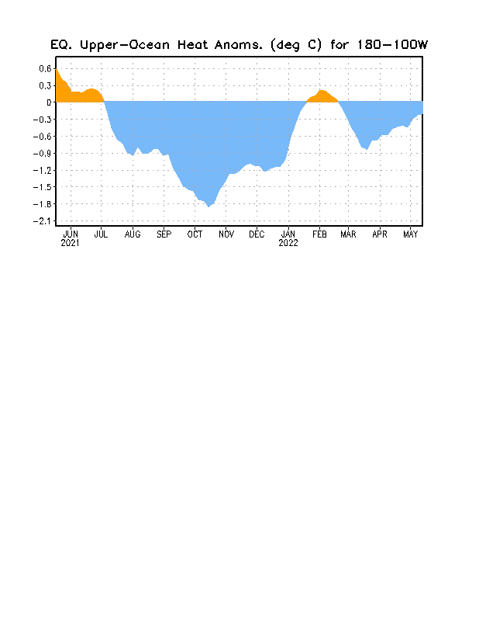
Notes:
Negative subsurface temperature anomalies prevail across the Pacific Ocean (160E to 110 W), and we see -ve temperature anomalies near the surface as well. Positive anomalies are now restricted to the western Pacific and mostly at the depth, slight positive anomalies are also evident in far eastern Pacific.
Central and Eastern Pacific upper-ocean heat content (0-300 meters) is negative, after a slight positive during the month of February.

Slide 13
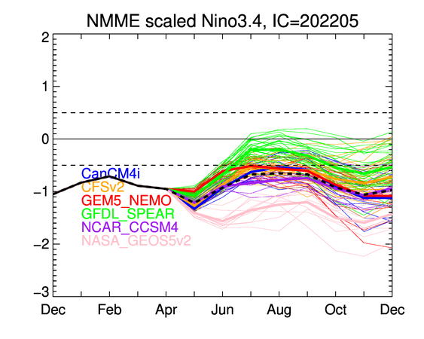

Slide 14
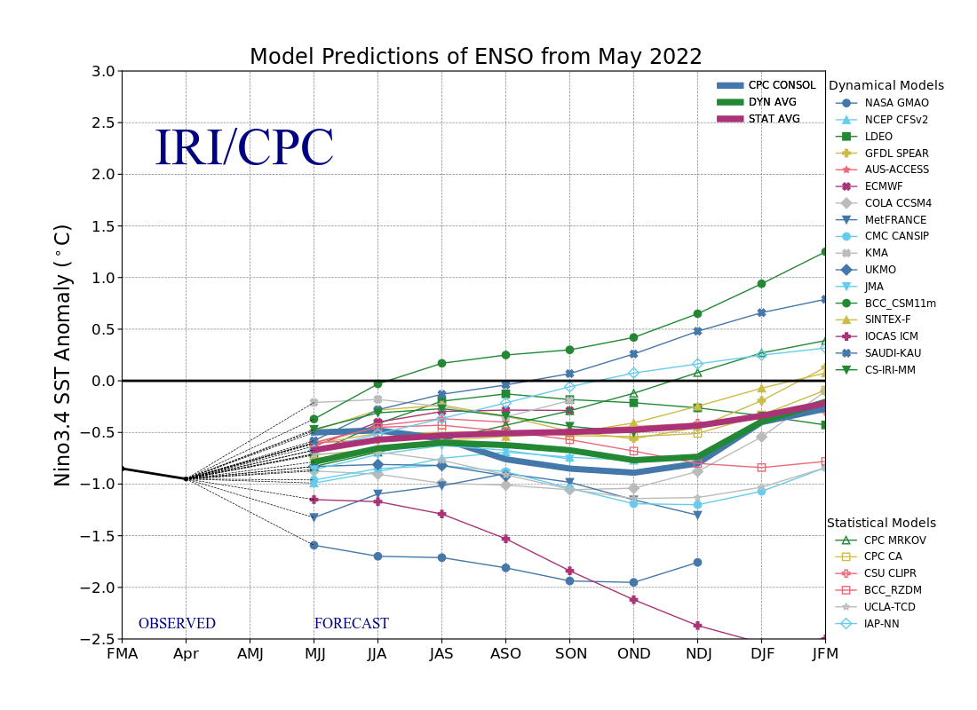

Slide 16
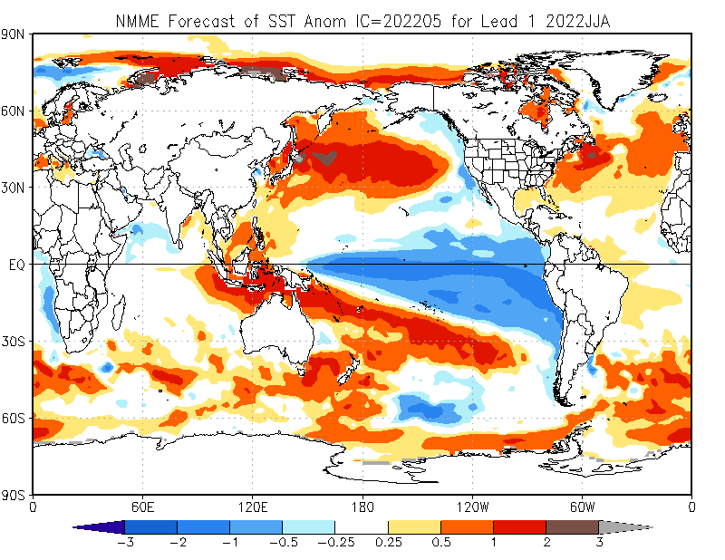

Slide 17


Slide 18
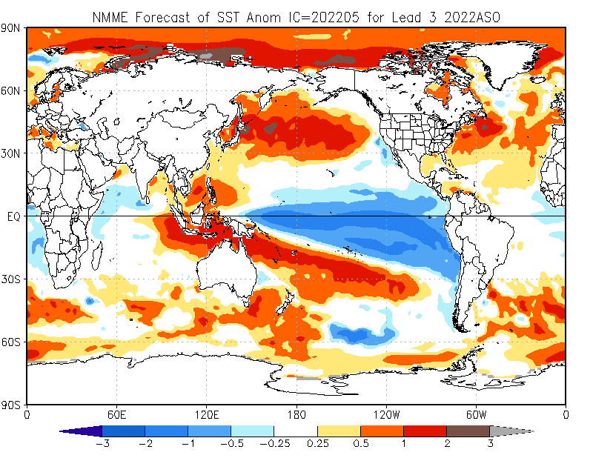

Slide 19
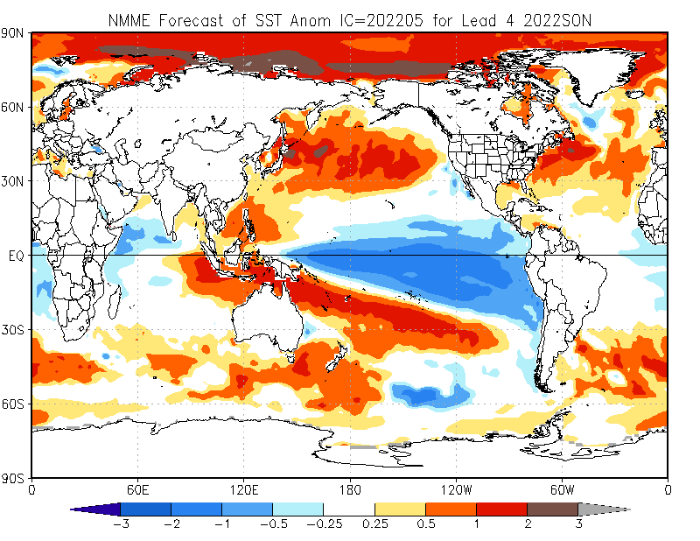

Slide 20
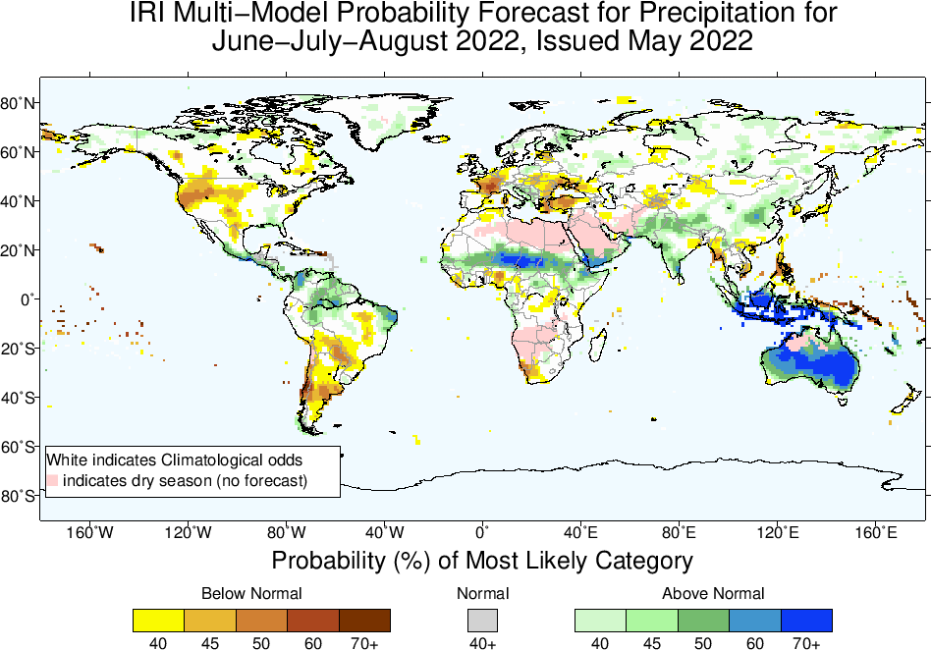

Slide 21


Slide 22
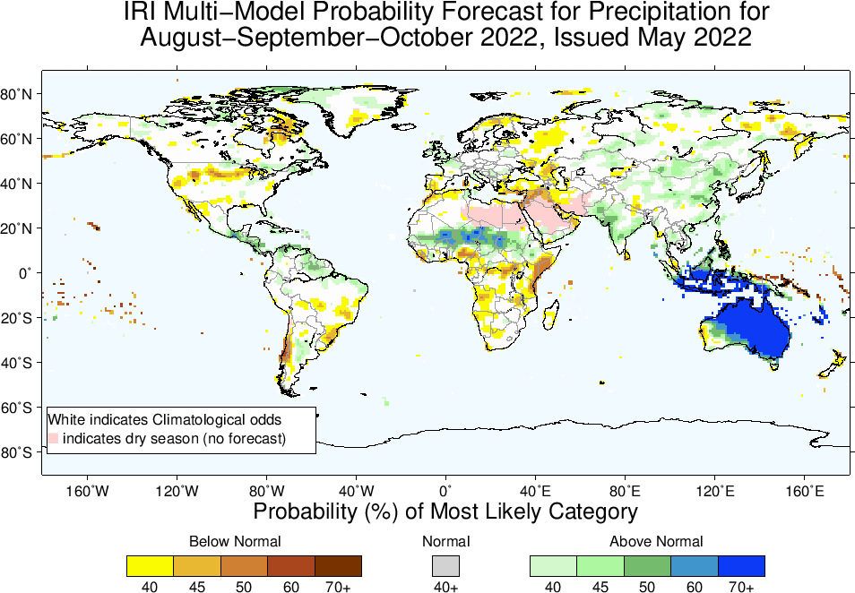

Slide 23
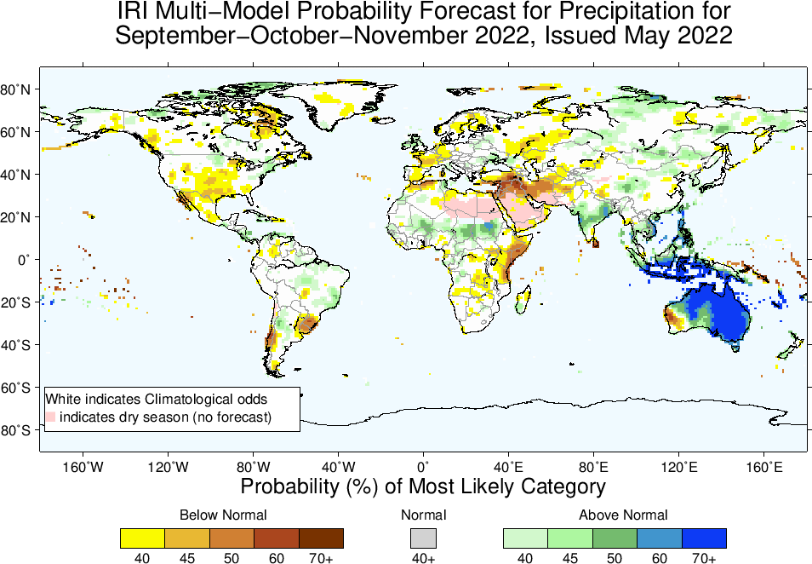

Slide 24
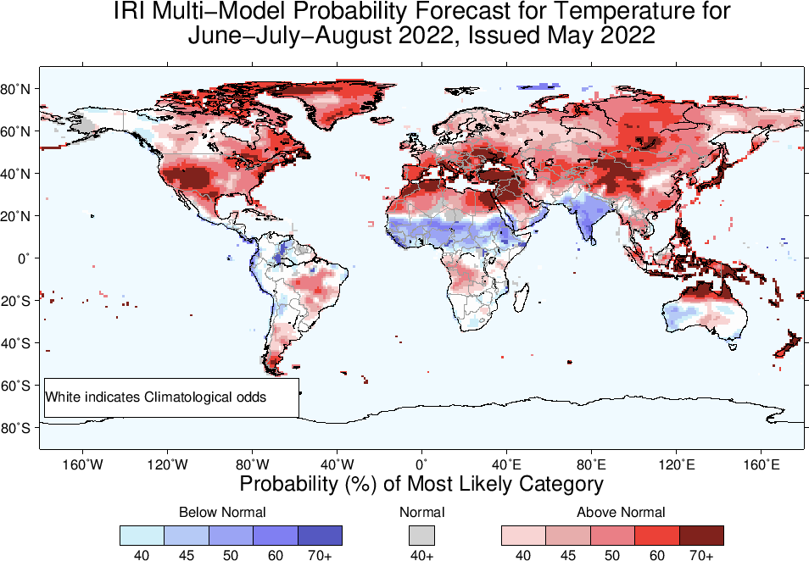

Slide 25


Slide 26
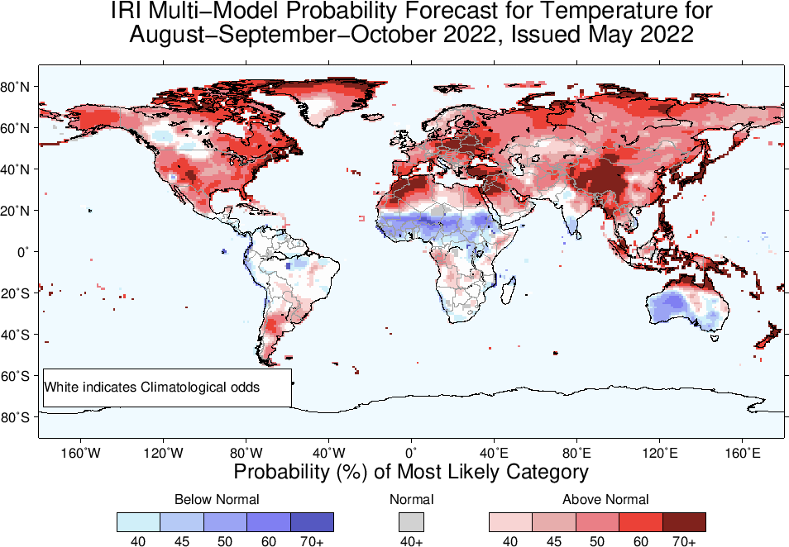

Slide 27
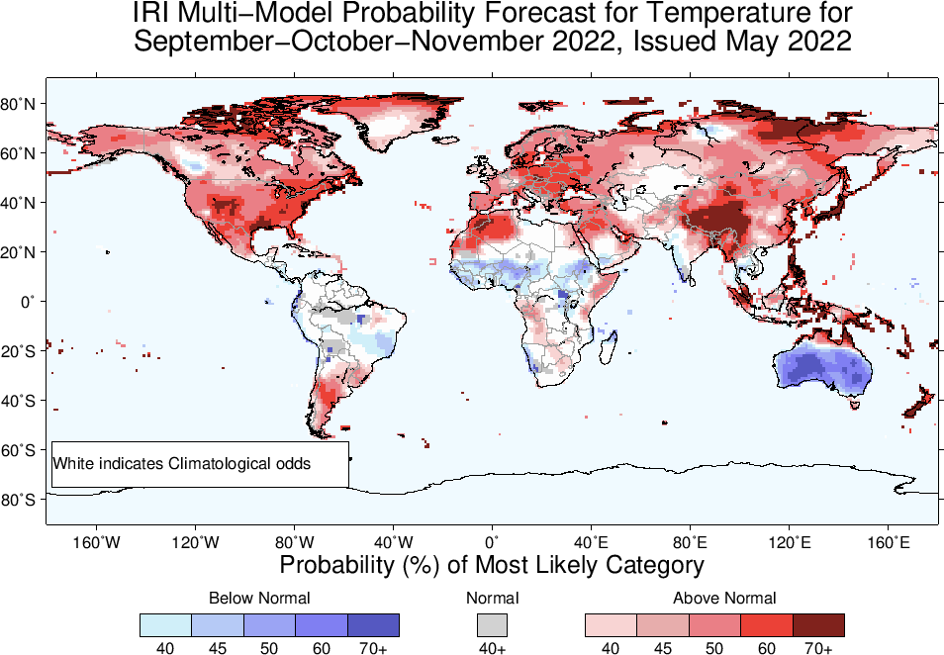

Slide 28
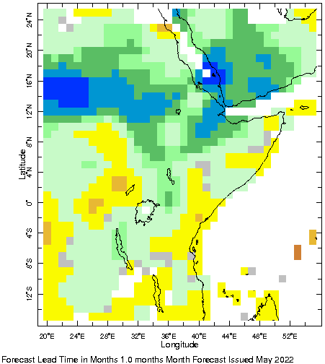
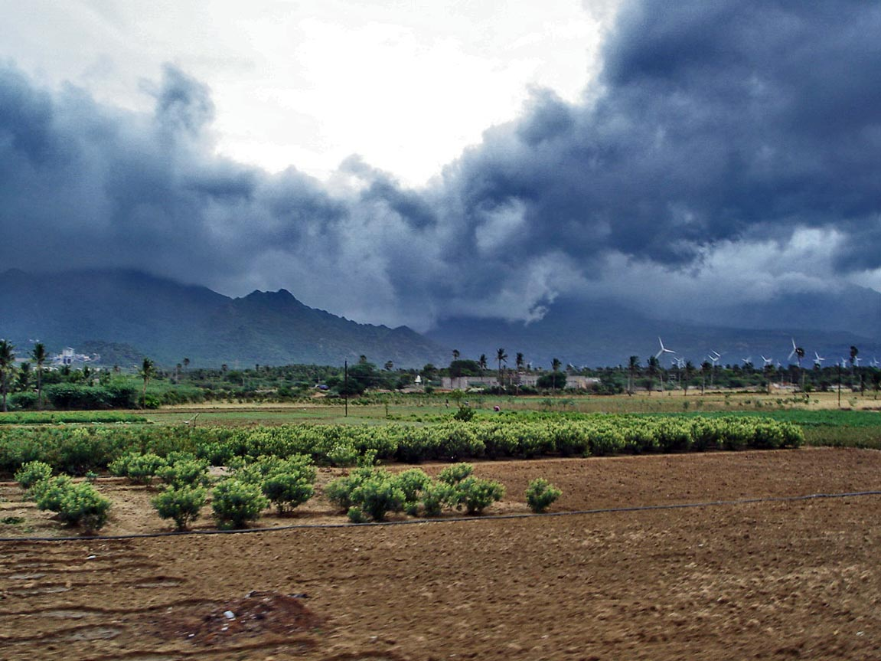
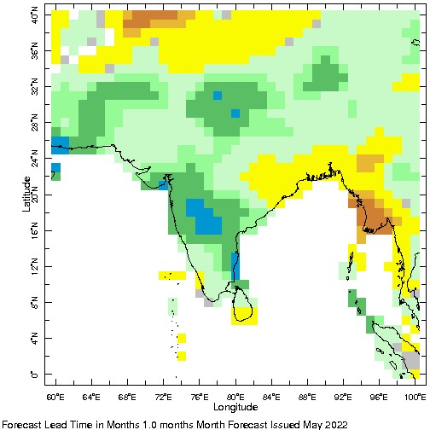
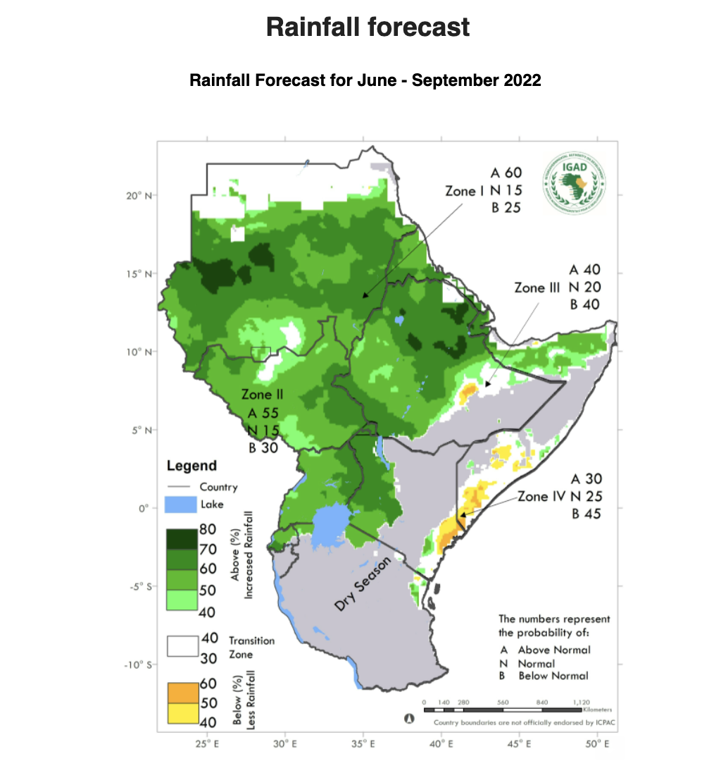

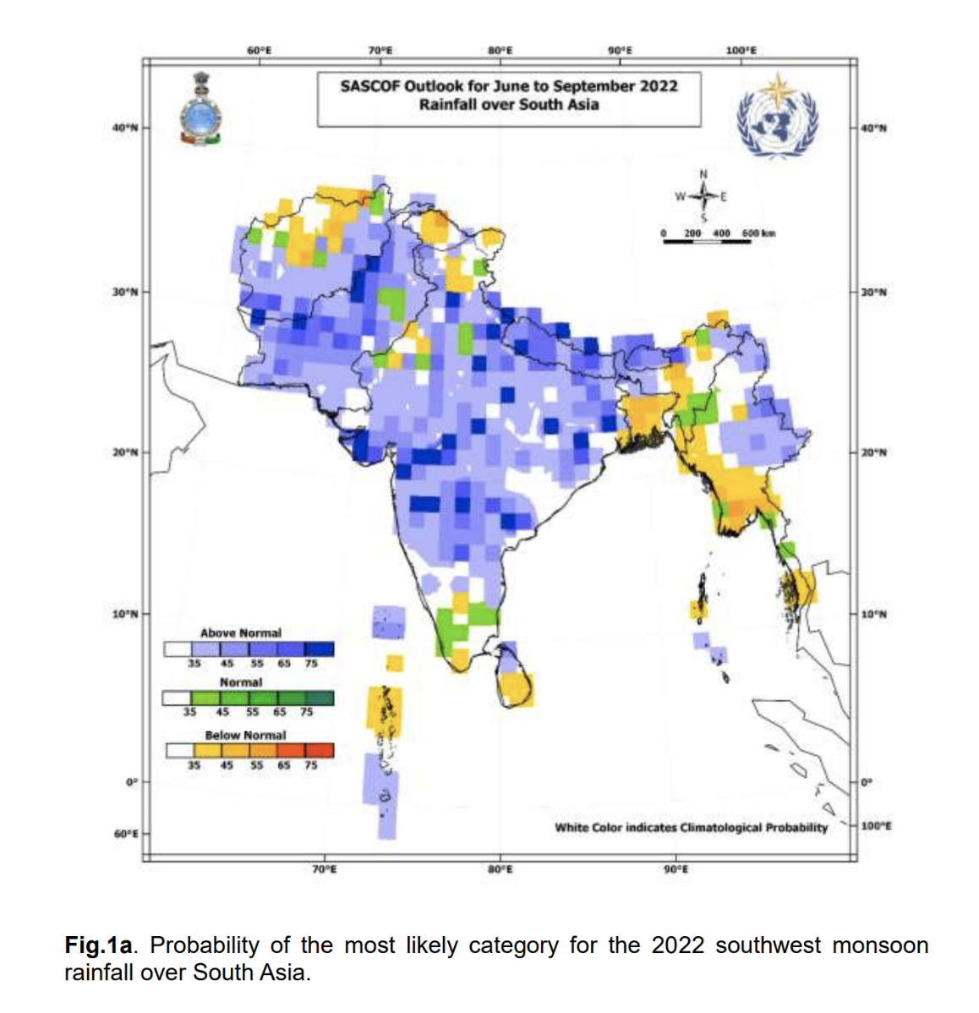
North EastAfrican Monsoon
Monsoon 2022
South Asian Monsoon
https://en.wikipedia.org/wiki/Monsoon
http://iridl.ldeo.columbia.edu/home/.jingyuan/.NMME_4months_forecast/.Precipitation_5models_ELR/.dominant/figviewer.html?map.url=X+Y+fig-+colors+coasts+lakes+-fig
https://www.icpac.net/events/ghacof-61/
http://rcc.imdpune.gov.in/Sascof.html

Slide 29
Summary
La Niña is still there, because; current atmosphere-ocean conditions are consistent for La Nina, i.e.,
Sea surface temperatures (SSTs) are below average across the equatorial Pacific Ocean.
SOI is positive, above-average trade winds, reduced cloudiness over central Pacific.
La Niña is favored to continue with high chances during Jun-Jul-Aug, (62%), while probabilities for La Niña decrease to 50s% in rest of the forecast period, but remain dominant as compared to ENSO-Neutral.
Chances of El Nino are very low during this time.
A wetter Monsoon in Asia and Africa.

