Slide 1
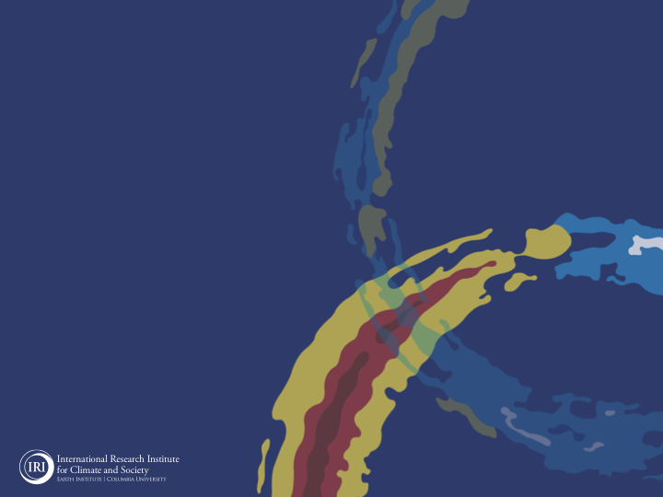
ENSO and Climate Outlook
in March 2023
Good bye La Nina ☹
A Transition from ENSO-neutral to
El Nino!
M. Azhar Ehsan
(azhar@iri.columbia.edu)
Associate Research Scientist
IRI ENSO and Climate Forecast Lead
Jeffrey Turmelle and Jing Yuan: forecast processing and web updates
Cuihua Li: Draft PowerPoint development
IRI’s Climate Group, led by Dr. Andrew Robertson: Forecast system development, ongoing innovation, and verification

Slide 2
Outline
Observed Oceanic and Atmospheric Conditions in
Tropical Pacific
Across the Globe
ENSO Forecast in
NMME
IRI ENSO Forecast Tool (Deterministic and Probabilistic)
Seasons Outlook of
SST
Precipitation and Temperature
Summary

Slide 3
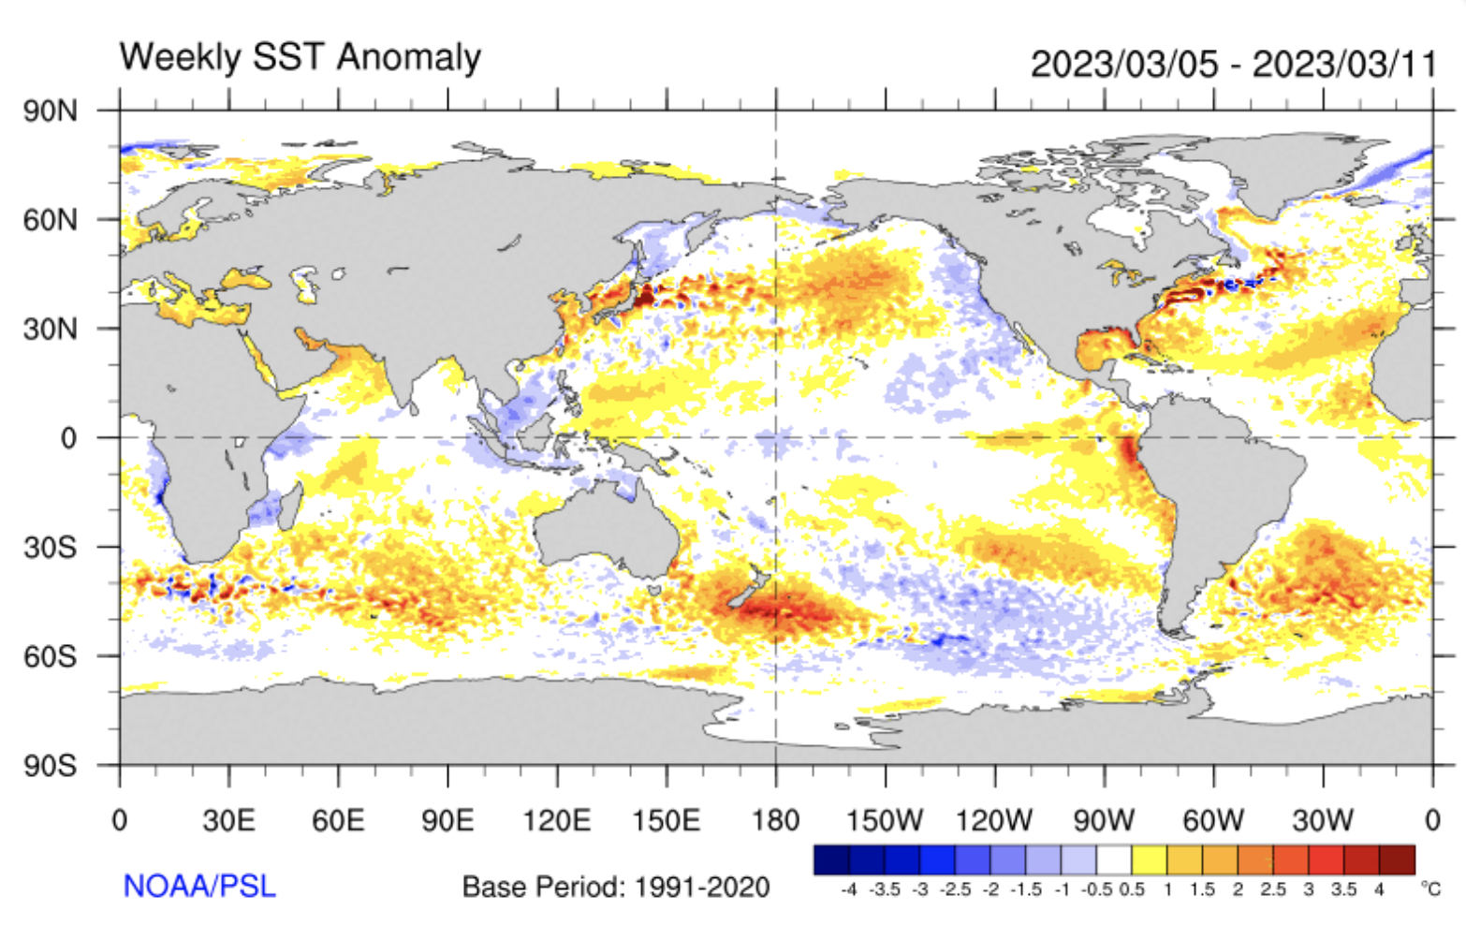
Evolution of EQ. Pacific SST Departures in Weekly OISST Data
https://psl.noaa.gov/map/clim/sst.shtml

Slide 4
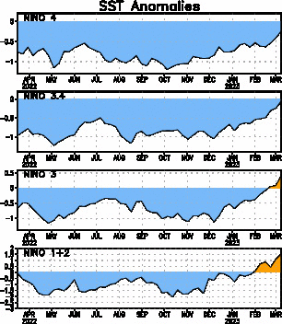
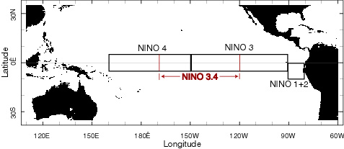
Most recent SST Anom.
Most Recent (08 Mar, 2023) SST Departures in different NINO regions
Niño 4
-0.2ºC
Niño 3.4
-0.1ºC
Niño 3
0.4ºC
Niño 1+2
1.5ºC

Slide 5
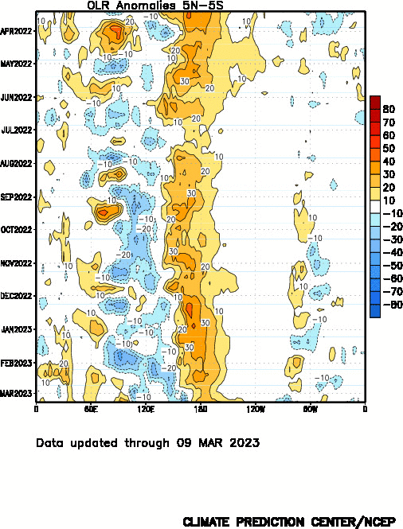
Most recent OLR

Slide 6
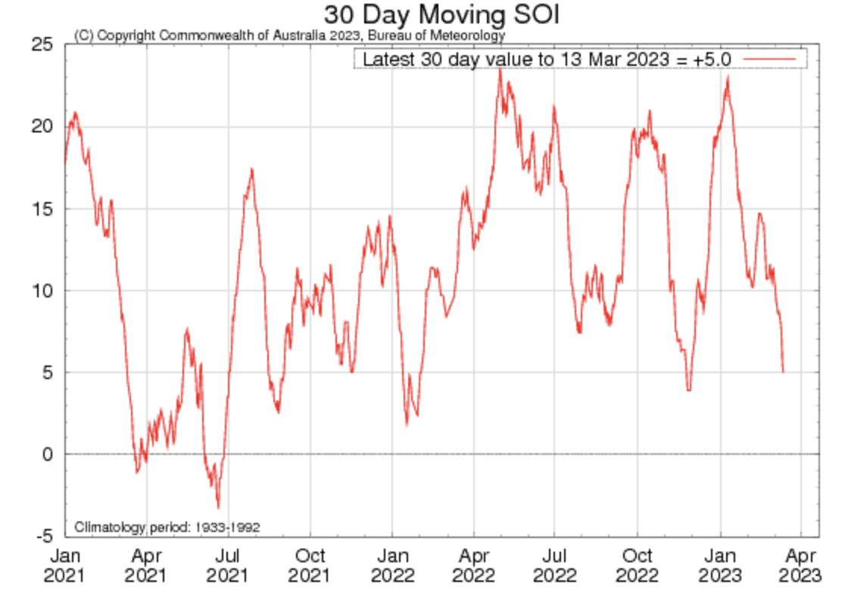
Most recent SOI
Sustained positive values of the SOI above +7 typically indicate La Niña

Slide 7
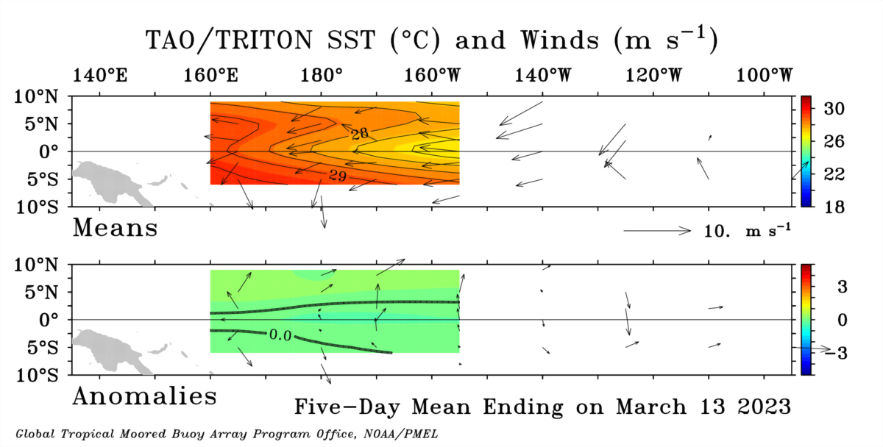
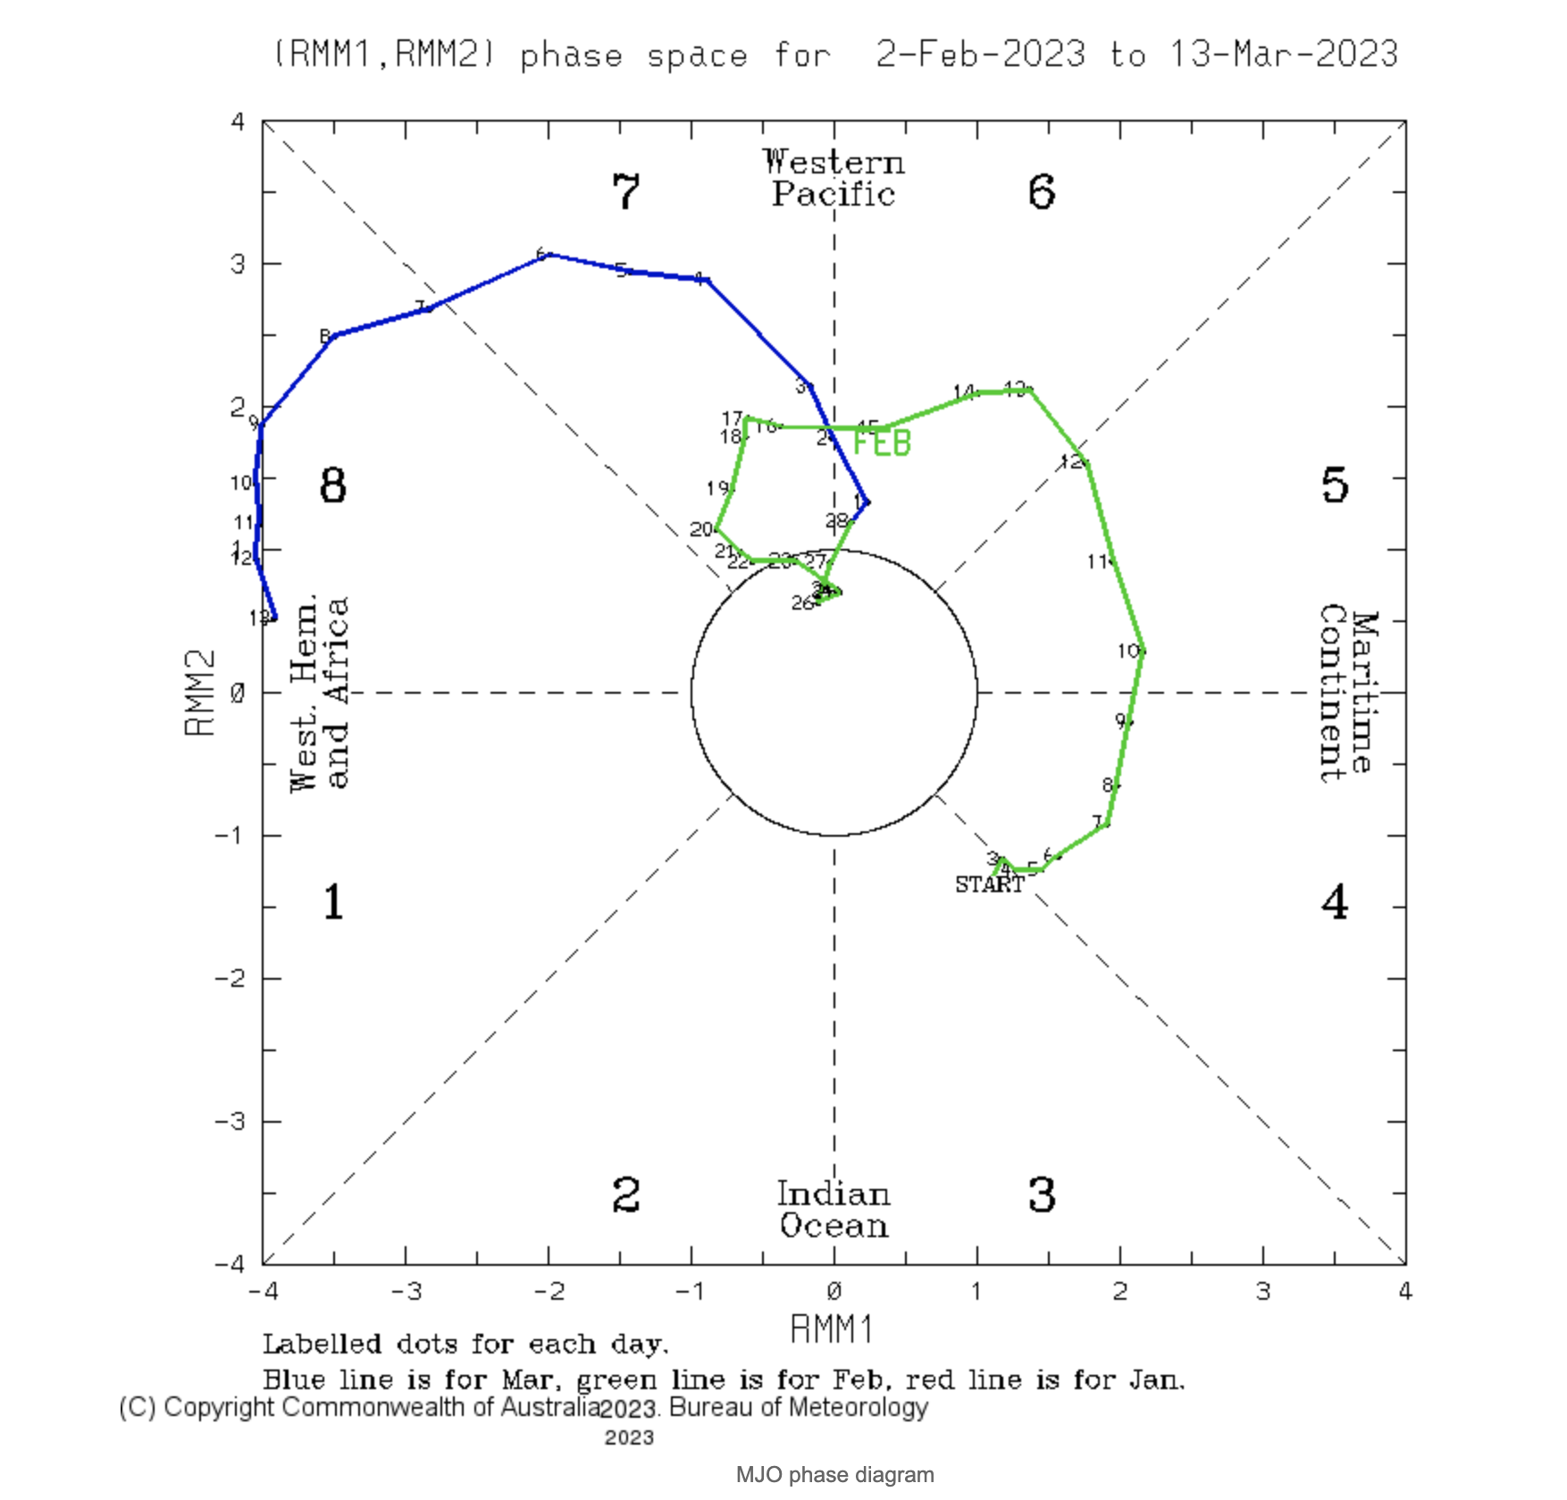
Most recent Lower-Level Winds

Slide 8
Subsurface Temperature Evolution

Slide 9
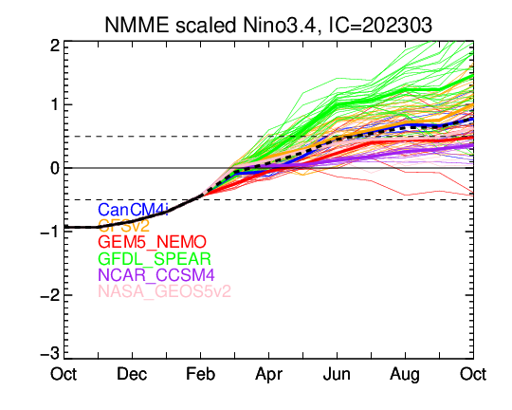
NMME’s ENSO Forecast

Slide 10
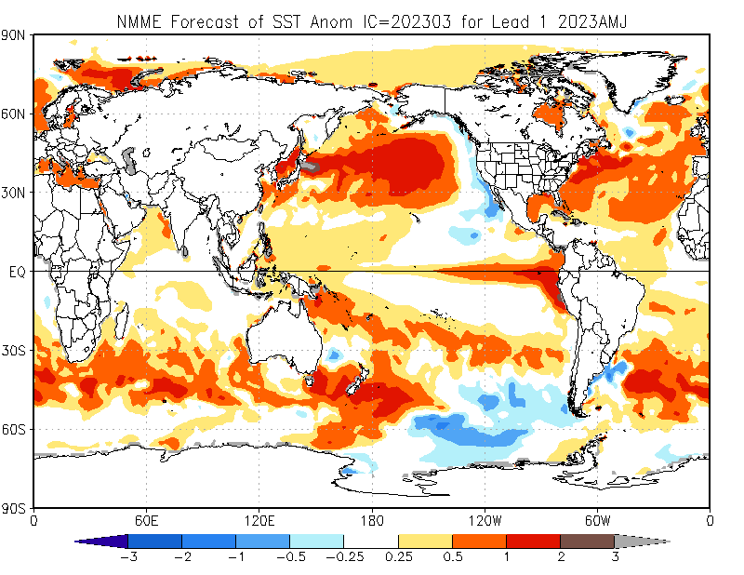

Slide 11
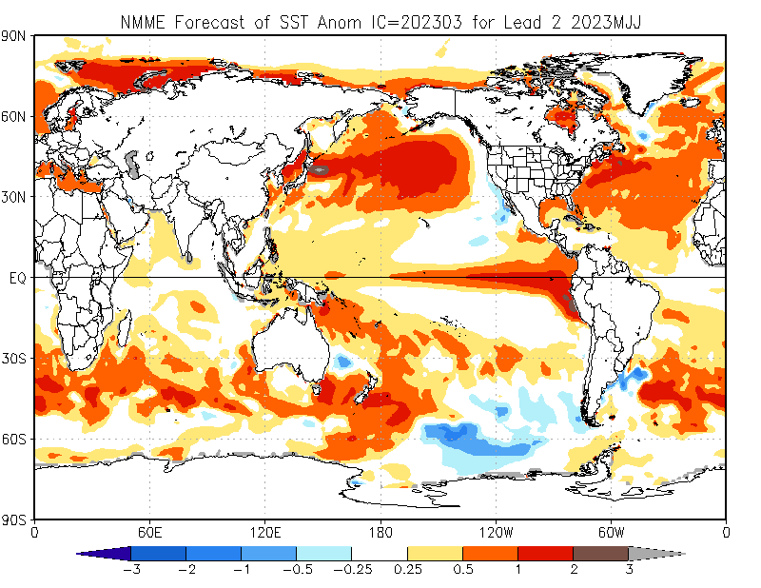

Slide 12
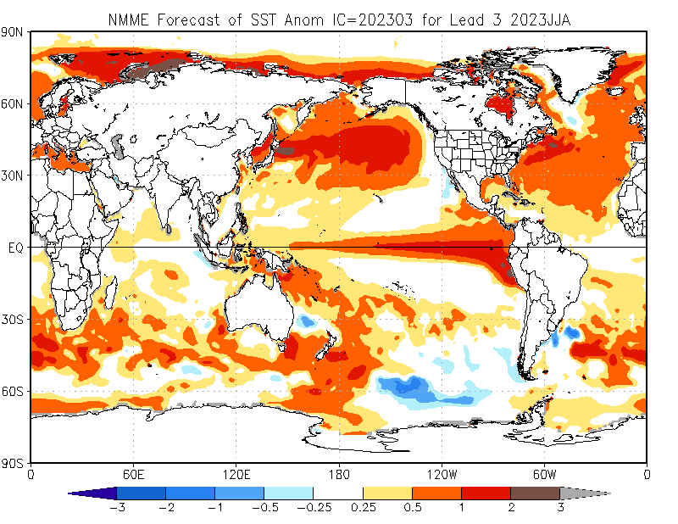

Slide 13
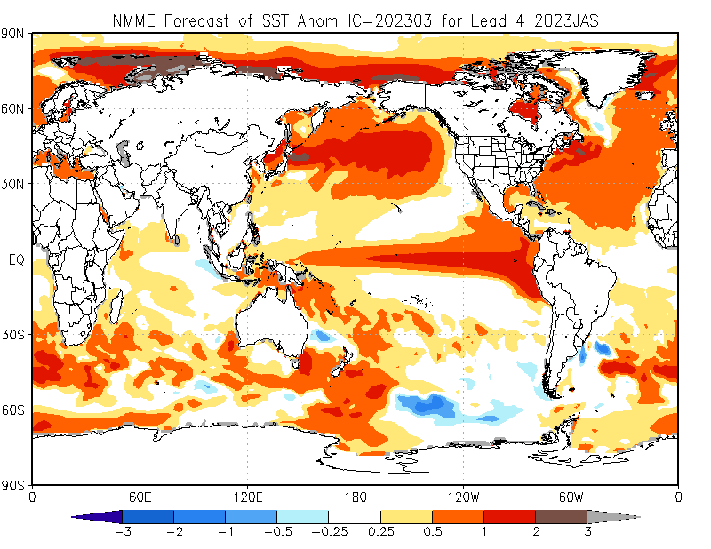

Slide 14
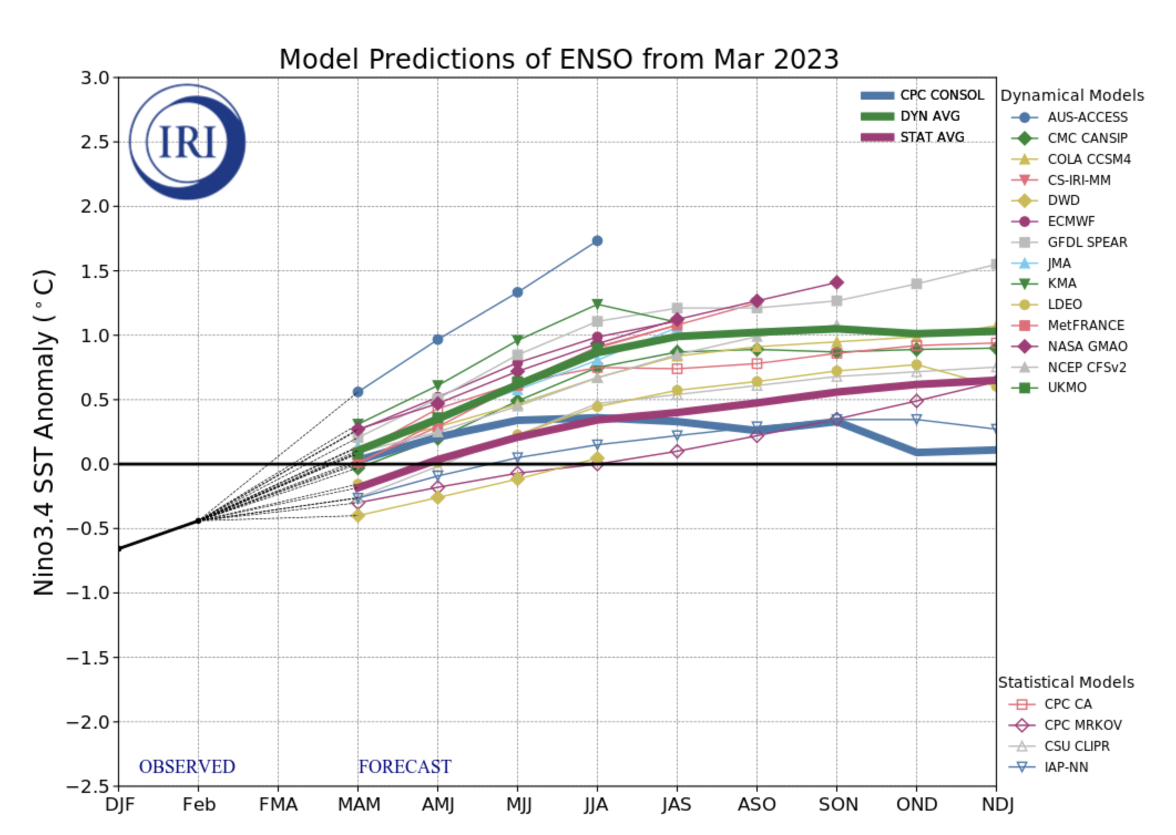
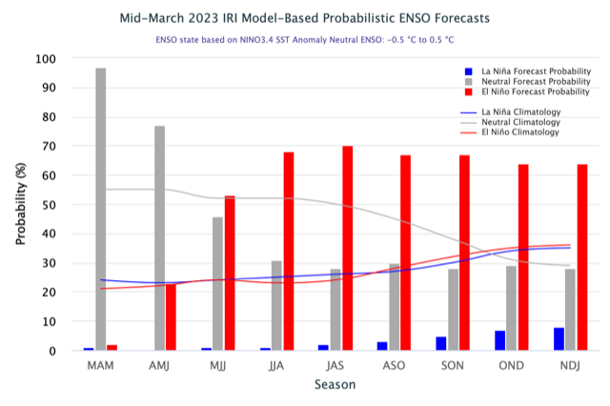
IRI’s ENSO Forecast (March, 2023)

Slide 15
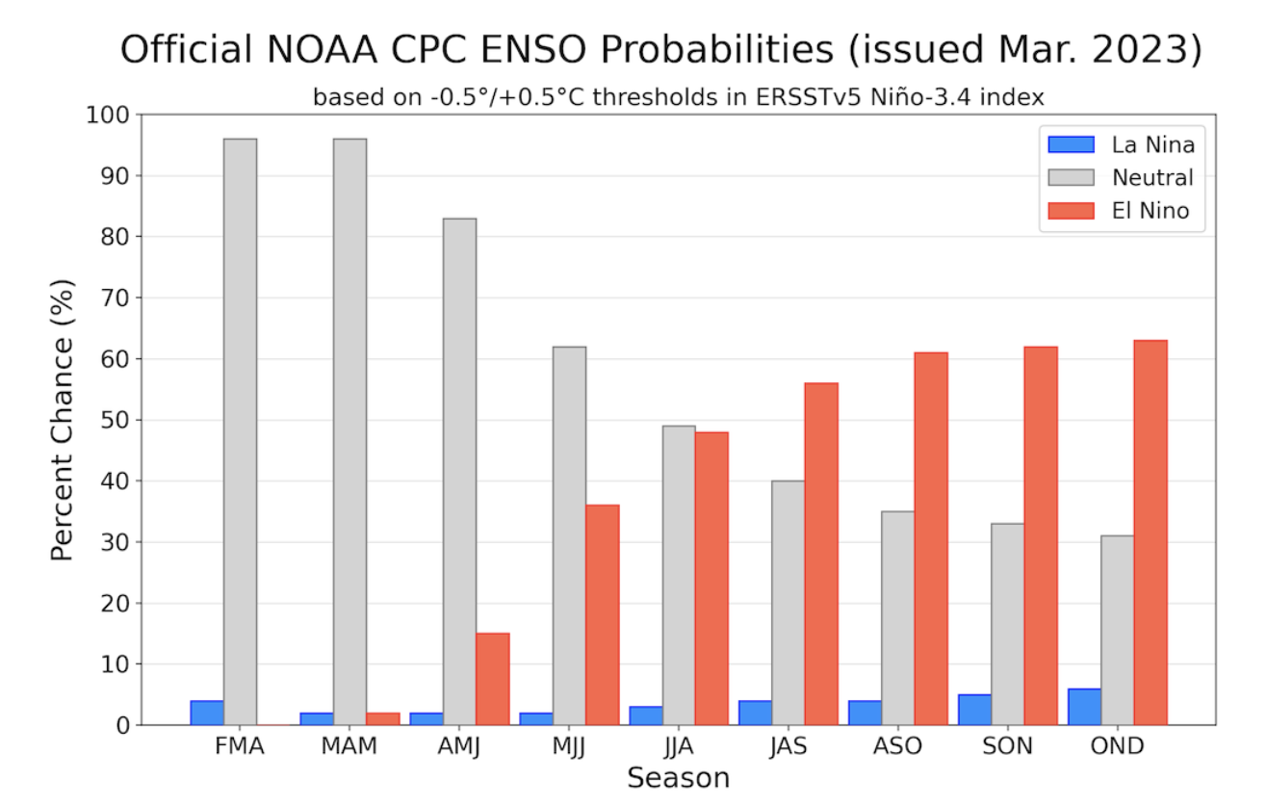
But
No Watch!

Slide 16
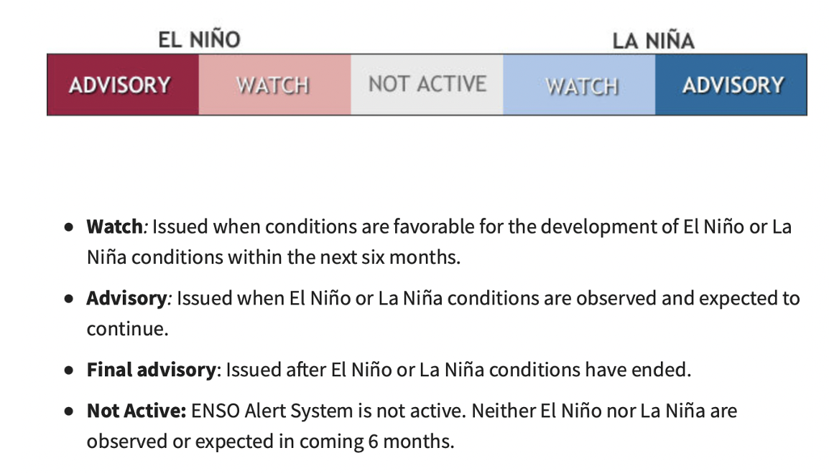
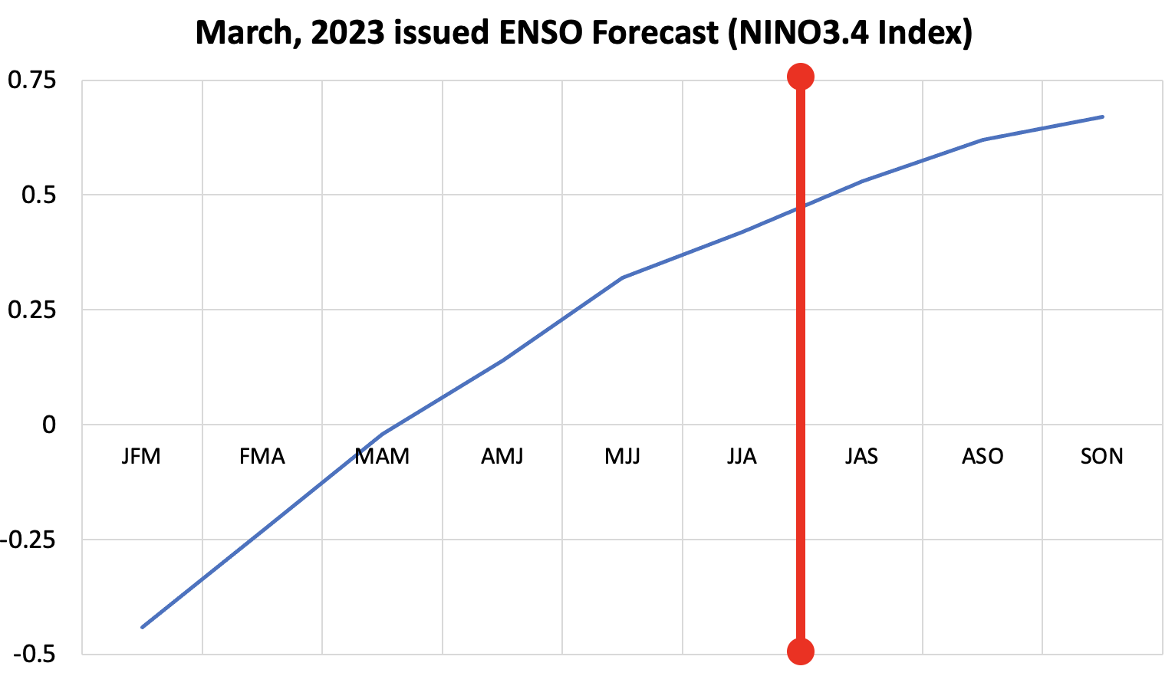
ENSO-team, Mar 2023

Slide 17
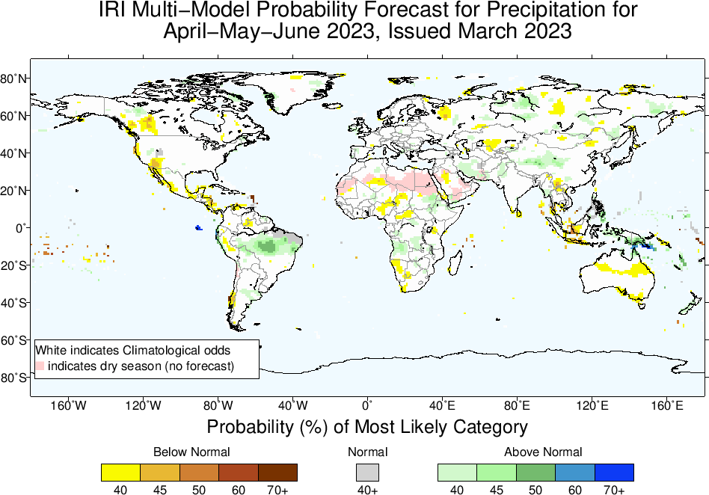

Slide 18
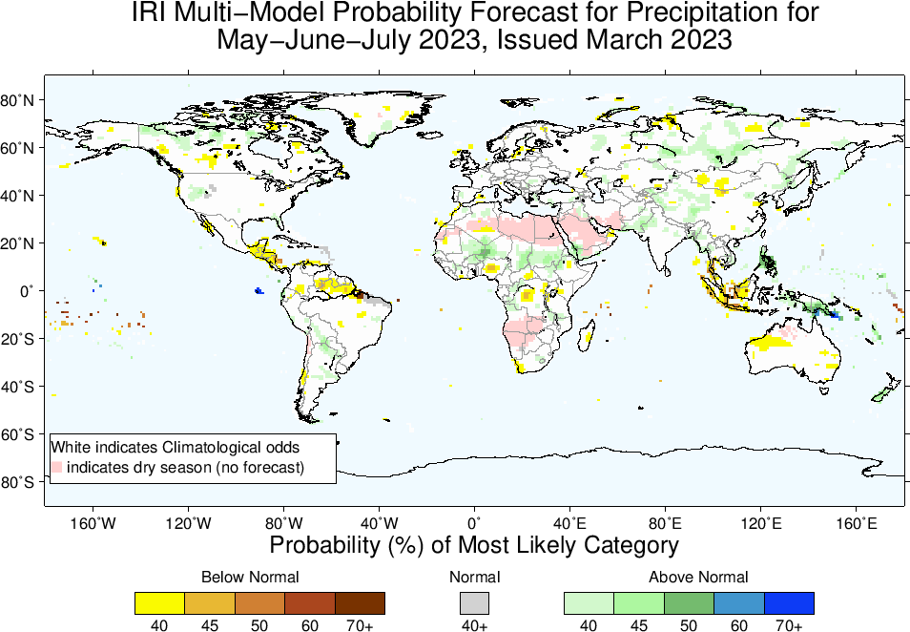

Slide 20
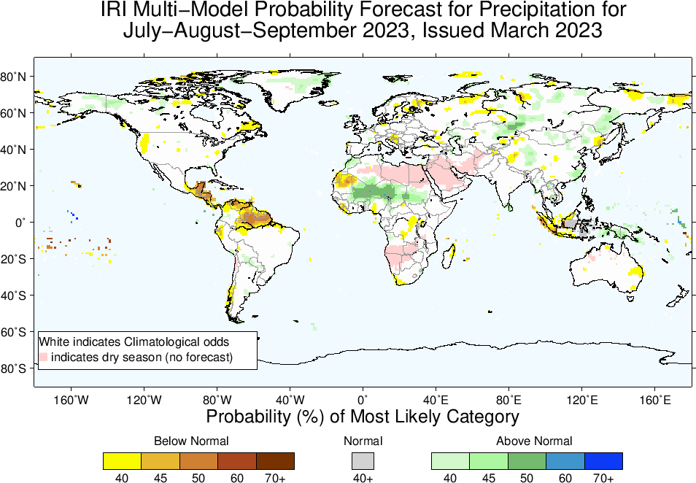

Slide 21
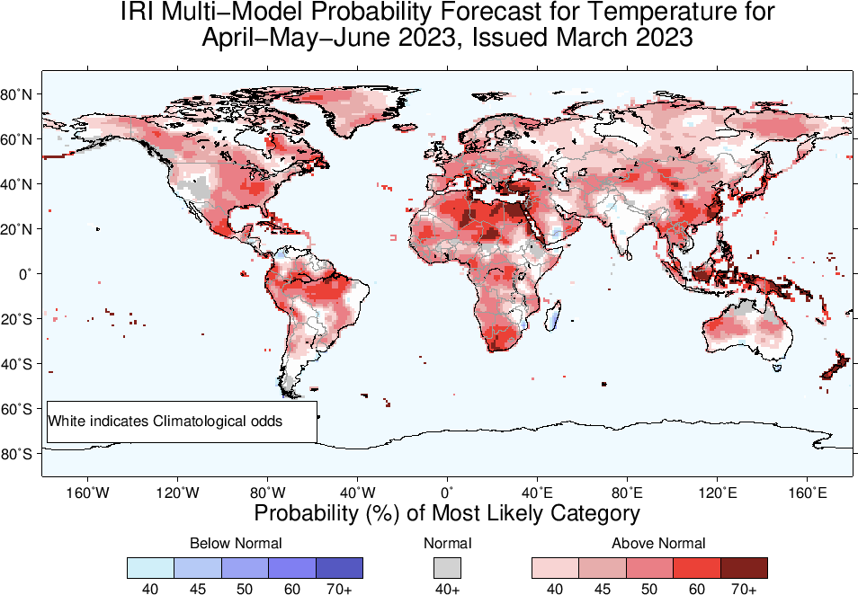

Slide 22
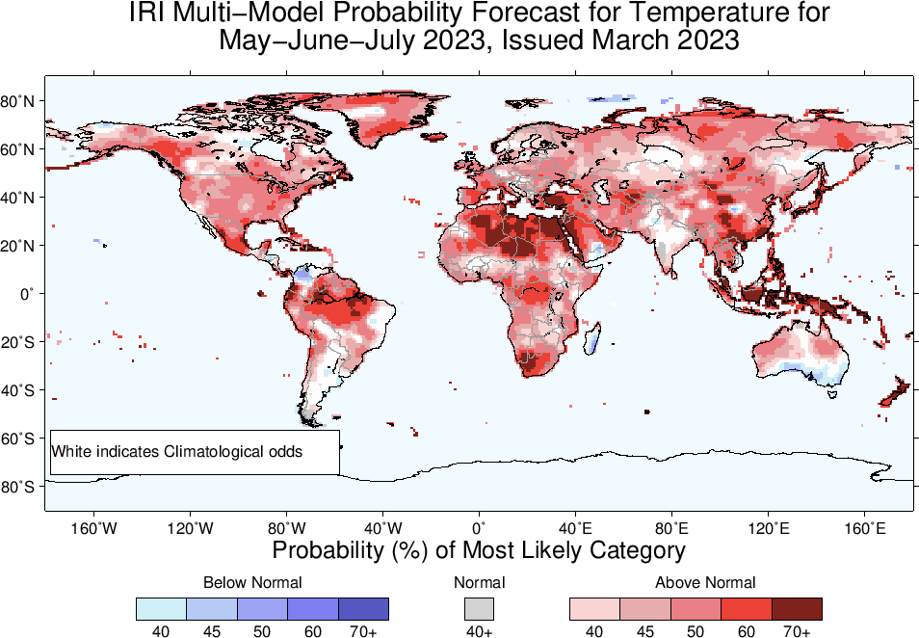

Slide 23
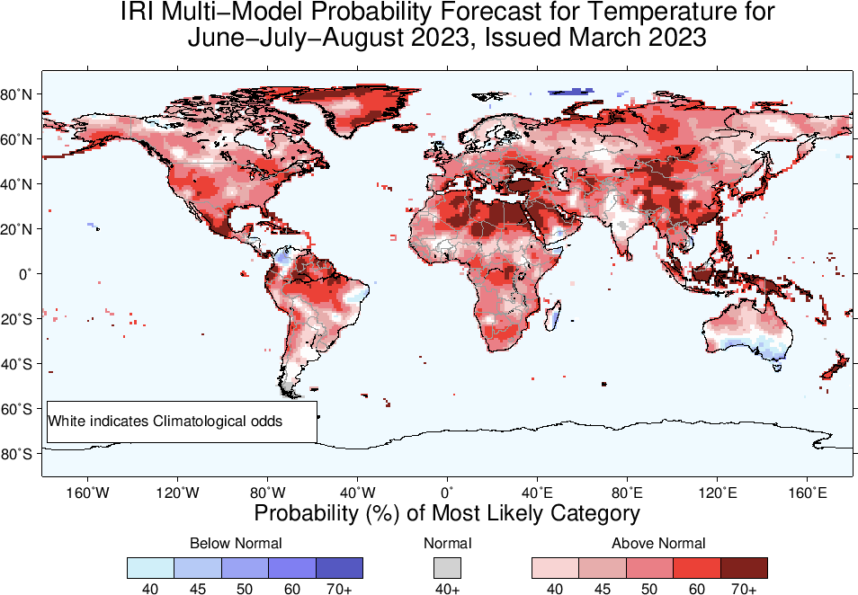

Slide 24
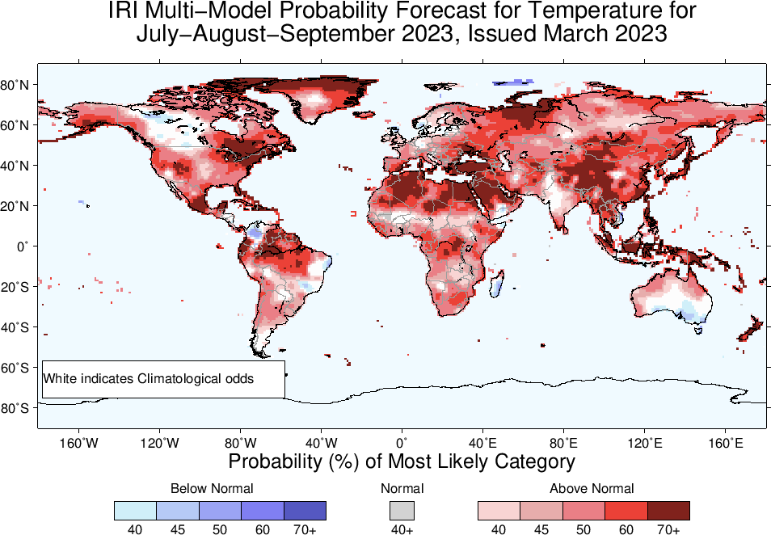

Slide 25
Summary
La Niña is over.
Both Oceanic and Atmospheric conditions show ENSO-neutral state e.g.,
Sea surface temperatures (SSTs) are in ENSO-neutral range across the central equatorial Pacific Ocean.
SOI is in ENSO-neutral range (+5 as of Mar, 16), near-normal/weak trade winds, even some westerlies in central and western Pacific.
Warm Sub-Surface across the Pacific, cold sub-surface is weak and patchy near the easter Pacific. Therefore,
Pacific is in ENSO-neutral state and favored for Apr-Jun, 2023.
El-Nino is most favorable starting from May-Jul 2023 onwards.

