Slide 1
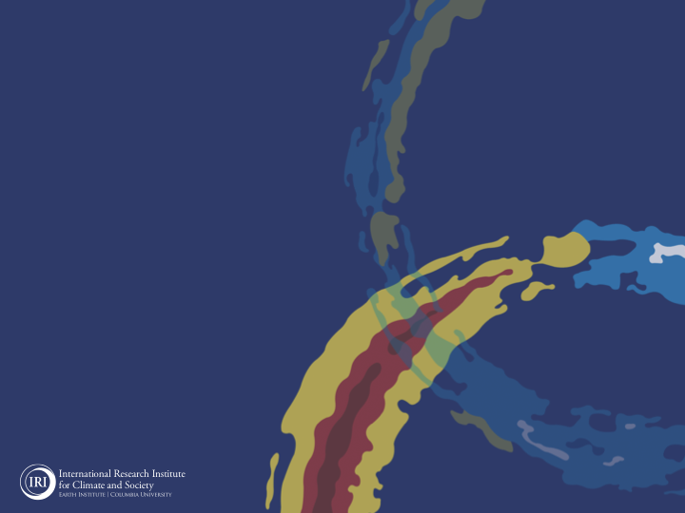

ENSO and Climate Outlook
in June 2022
La Nina Continues,…
M. Azhar Ehsan
(azhar@iri.columbia.edu)
Associate Research Scientist
IRI ENSO and Climate Forecast Lead
Jeffery Turmelle and Jing Yuan: forecast processing and web updates
Cuihua Li: Draft PowerPoint development
IRI’s Climate Group, led by Dr. Andrew Robertson:
Forecast system development, ongoing innovation, and verification

Slide 2
Outline
Observed Oceanic and Atmospheric Conditions in
Tropical Pacific
Across the Globe
ENSO Plume in
NMME
IRI ENSO Plume and Probabilistic Forecast
Seasons Outlook of
SST
Precipitation and Temperature
Summary

Slide 3
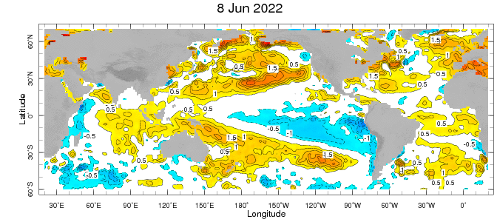
Evolution of EQ. Pacific SST Departures in Weekly OISST Data
Below-average SSTs persisted across the central to eastern equatorial Pacific Ocean, surrounded by +ve SSTA in the high latitudes.
Negative SSTAs, Weakened recently but still there!
Indian Ocean: Negative SSTAs in the west and positive in the East, a –ve Indian Ocean Dipole.
Atlantic Ocean: A positive SSTAs in the equatorial AO

Slide 4
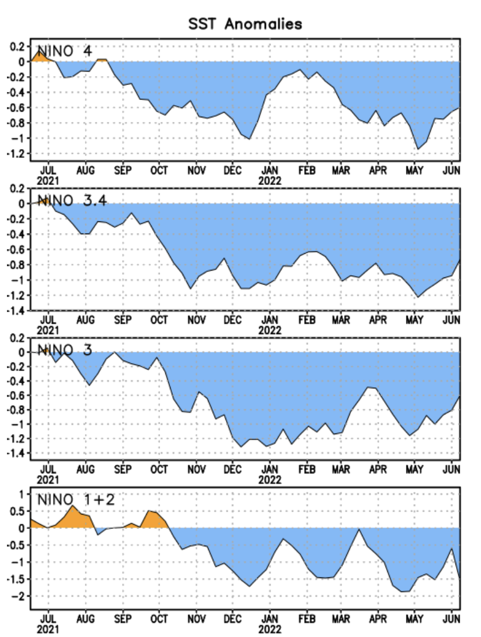
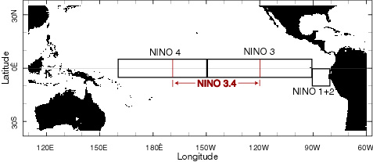
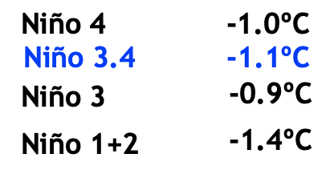
Most Recent SST Departures in different NINO regions (All cooler than the long-term avg, (1991-2020))
Niño 4
-0.6ºC
Niño 3.4
-0.7ºC
Niño 3
-0.6ºC
Niño 1+2
-1.6ºC
Weakened by how much then (May)?

Slide 5
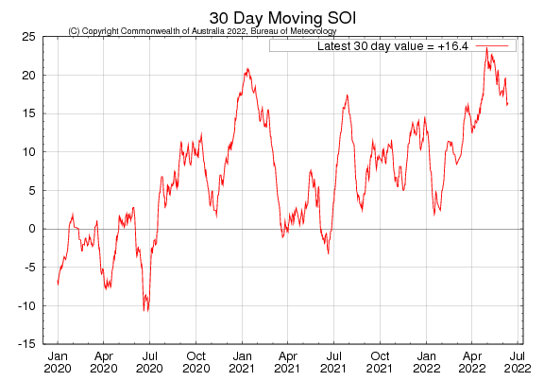
2021
2020

Slide 6
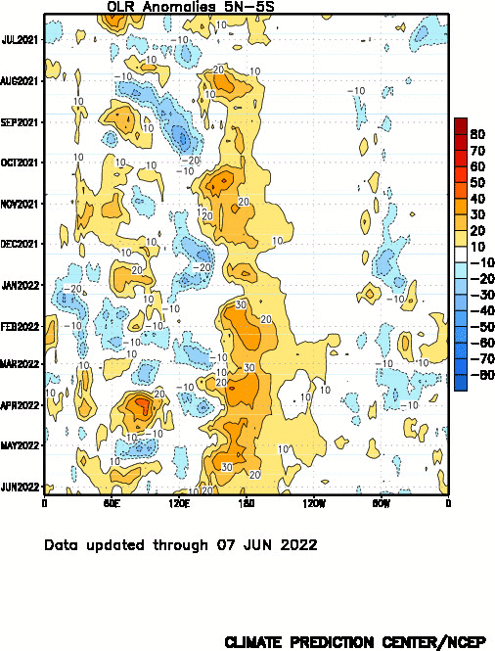
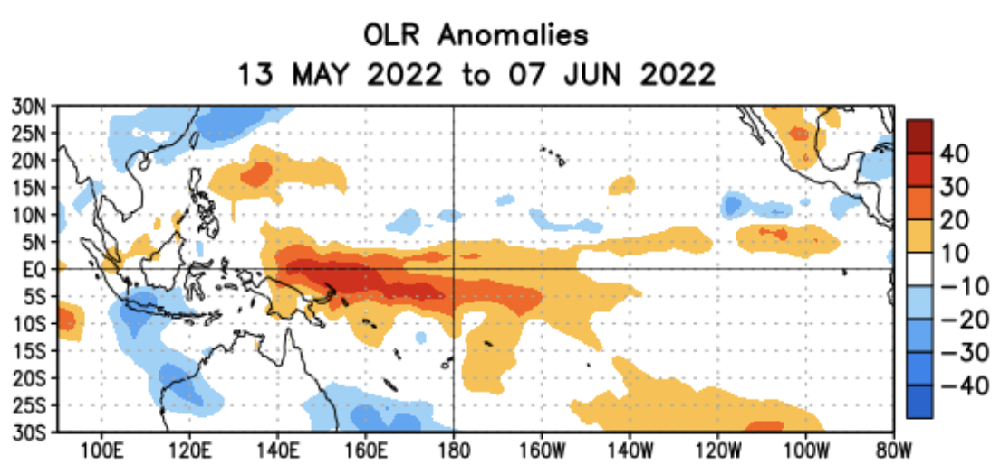
Suppressed convection

Slide 7
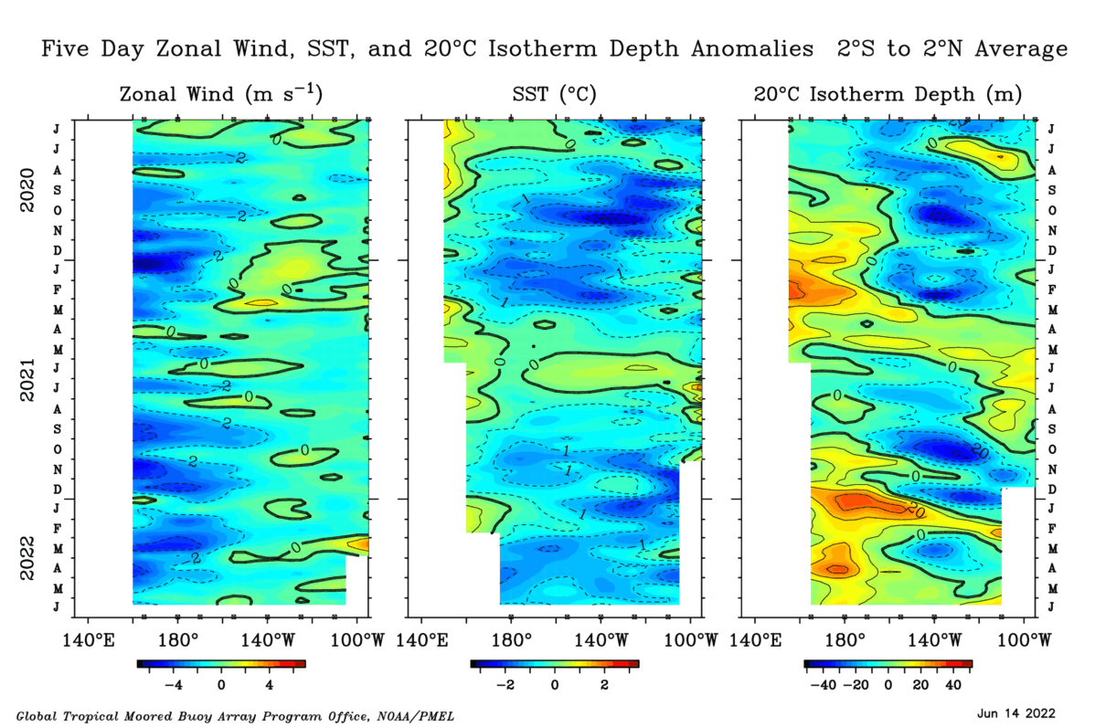

Slide 8
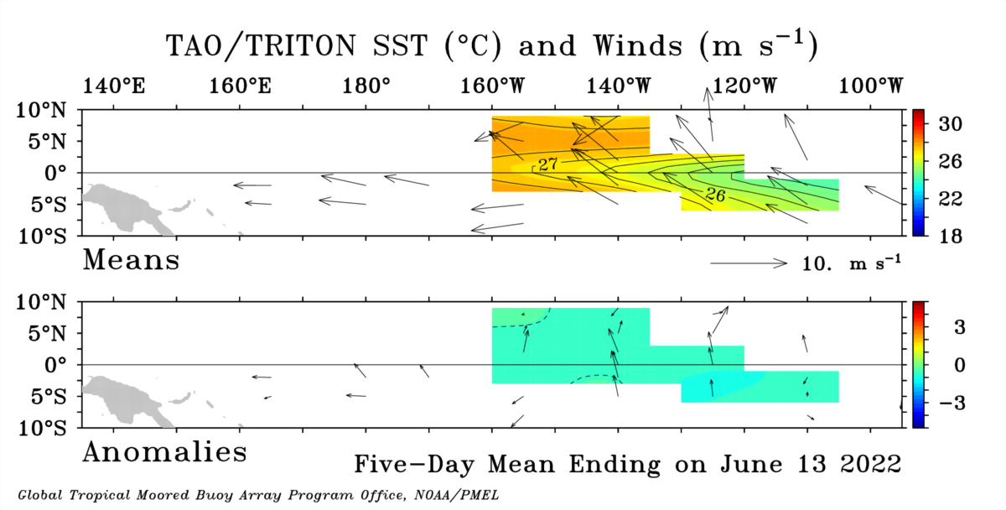
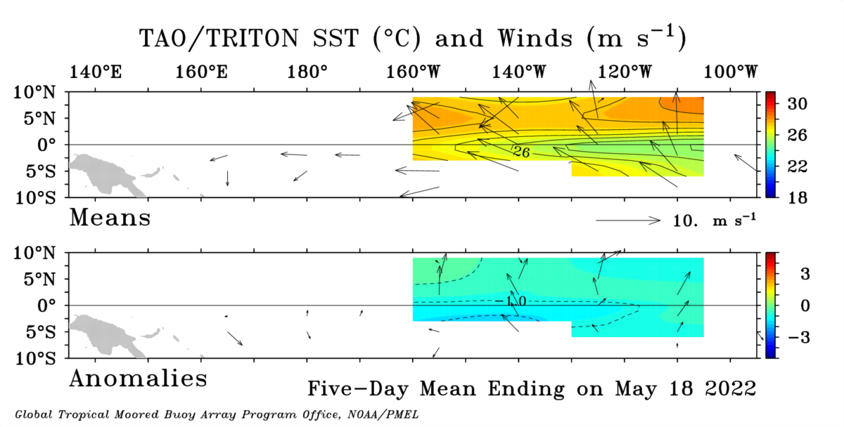

Slide 9
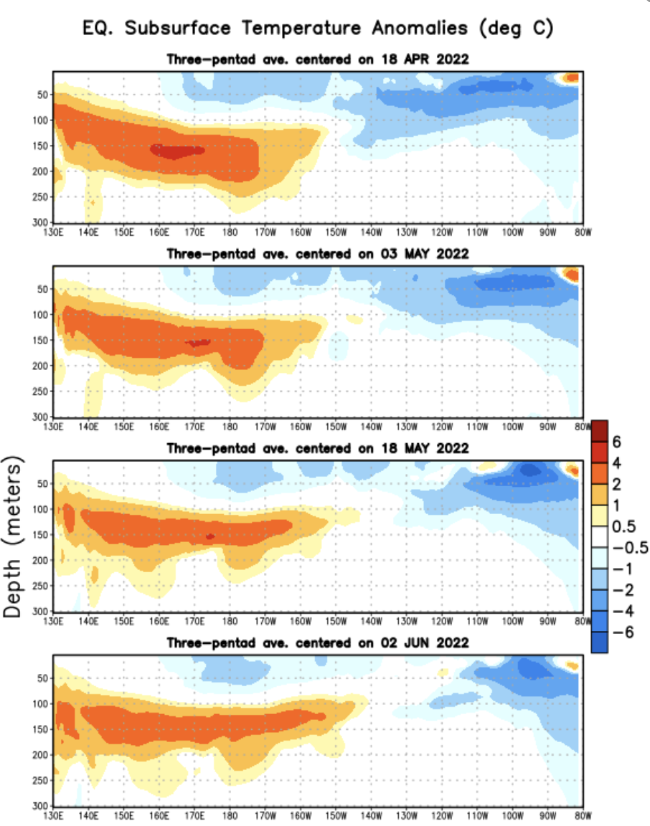
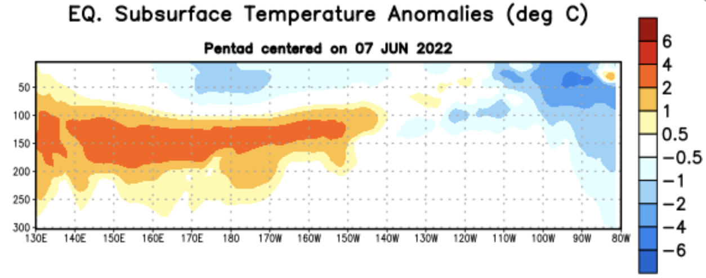
Time

Slide 10
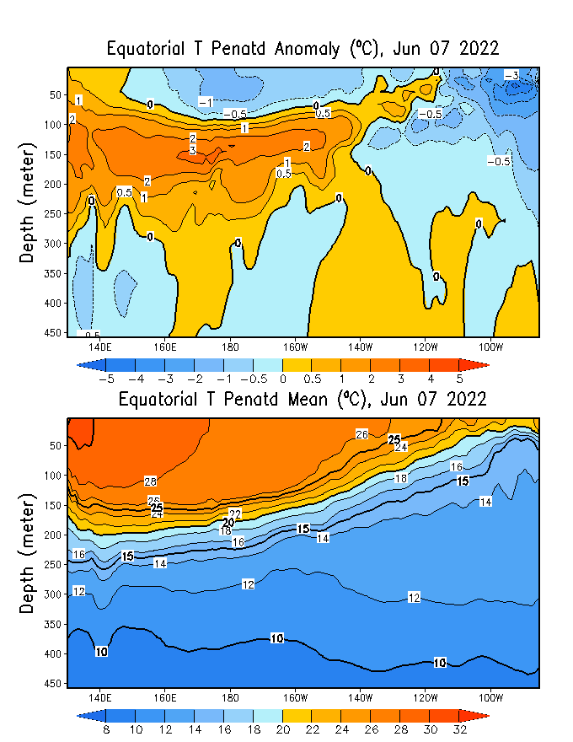
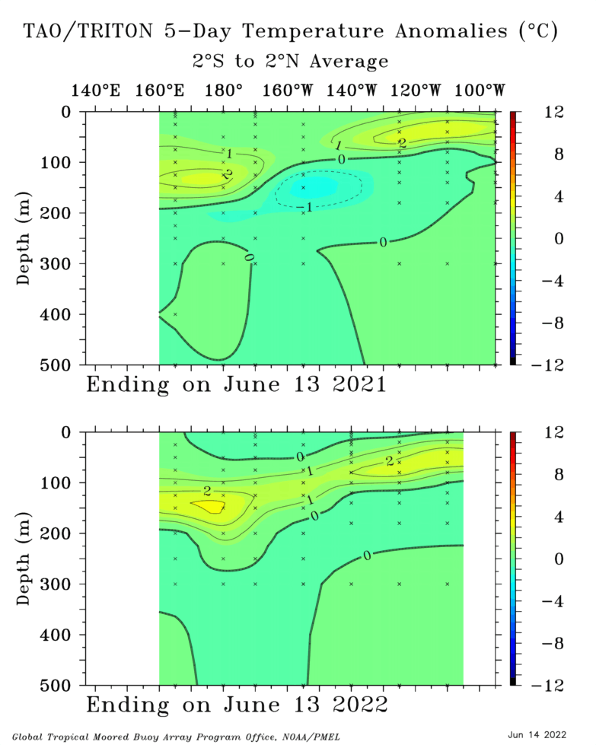
TOGA/TAO
GODAS

Slide 11
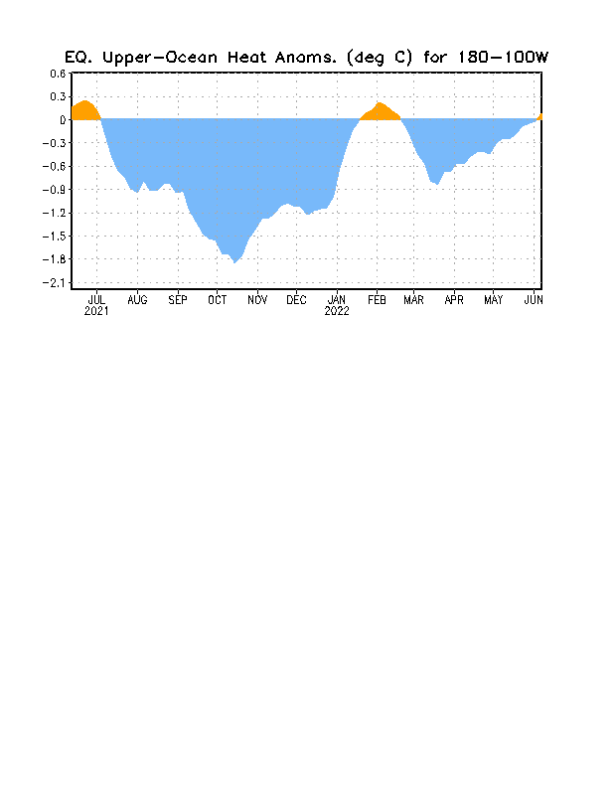
Notes:
Negative subsurface temperature anomalies prevail across the Pacific Ocean (160E to 110 W), and we see -ve temperature anomalies near the surface as well. Positive anomalies are now restricted to the western Pacific and mostly at the depth, slight positive anomalies are also evident in far eastern Pacific.
Central and Eastern Pacific upper-ocean heat content (0-300 meters) is negative, after a slight positive during the month of February.

Slide 12
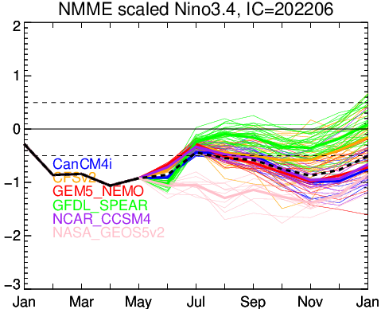
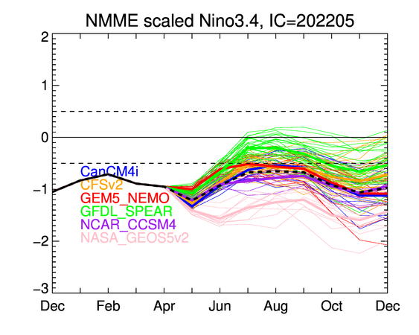

Slide 13
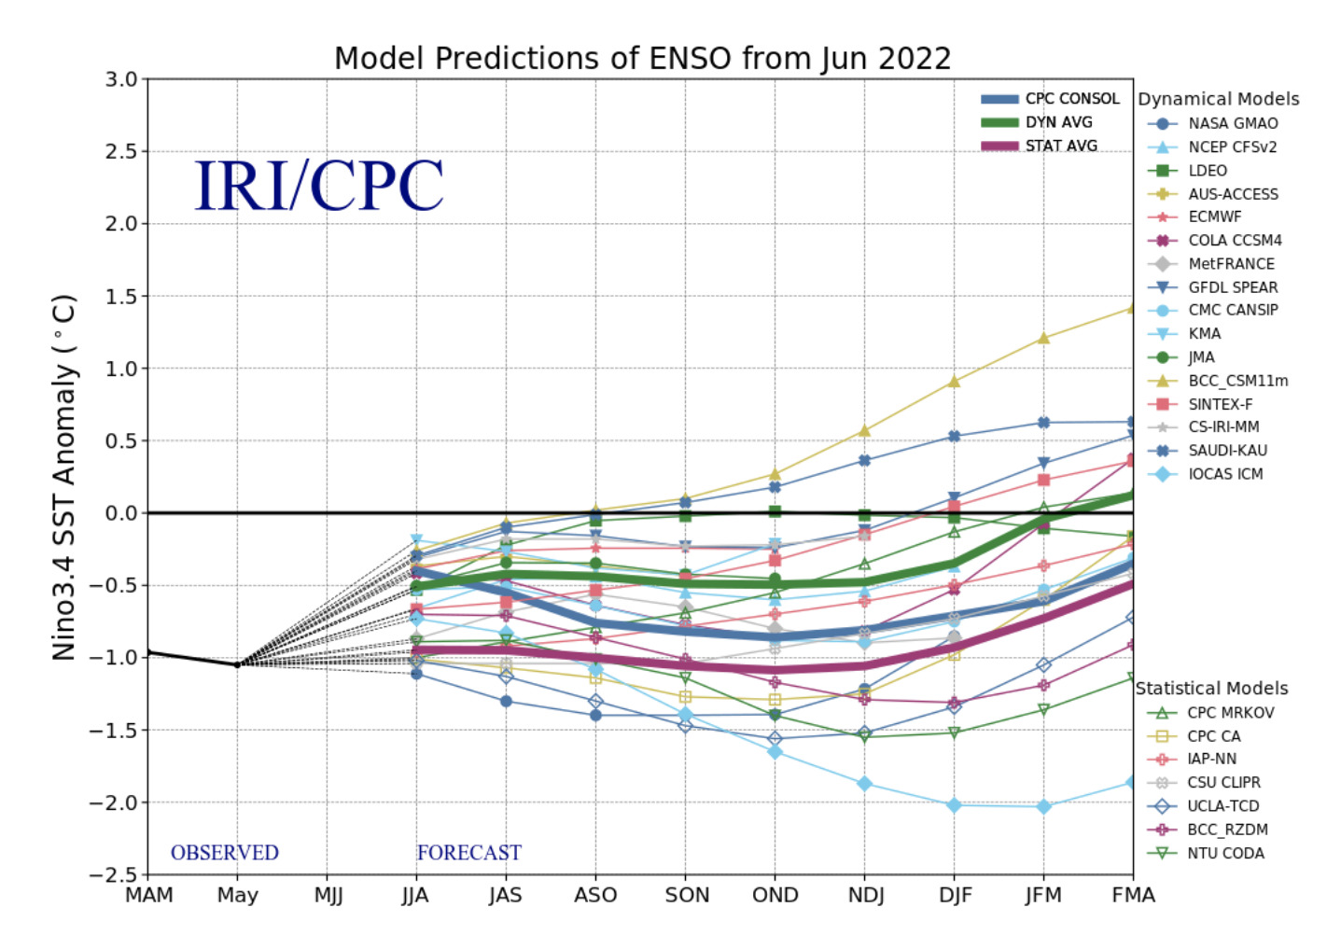
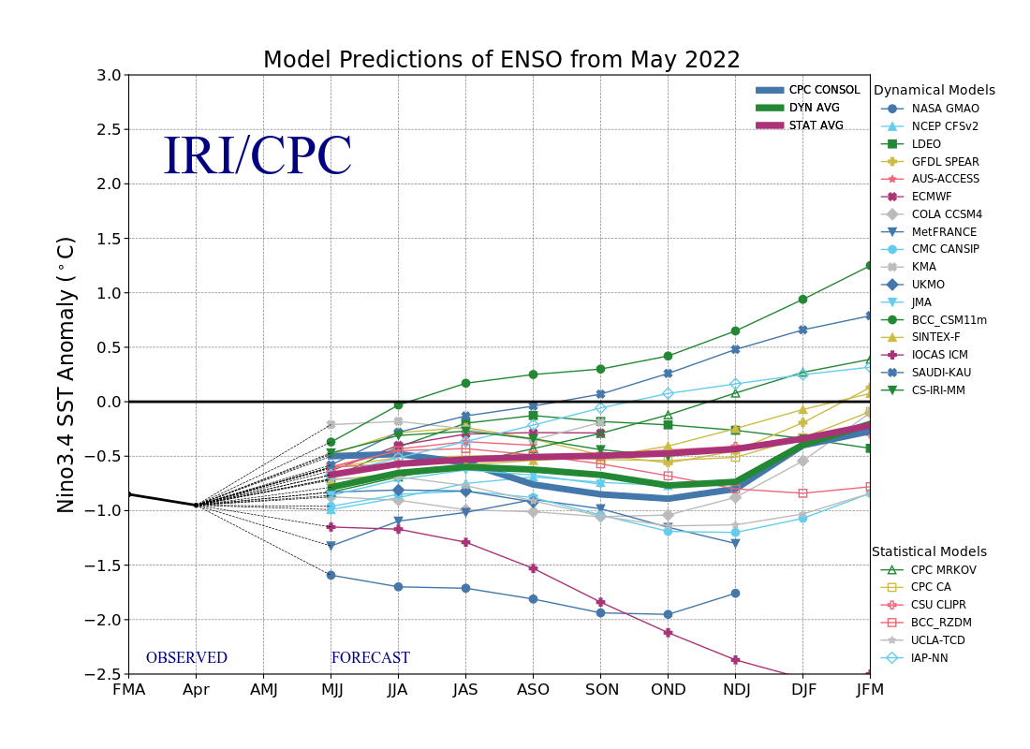
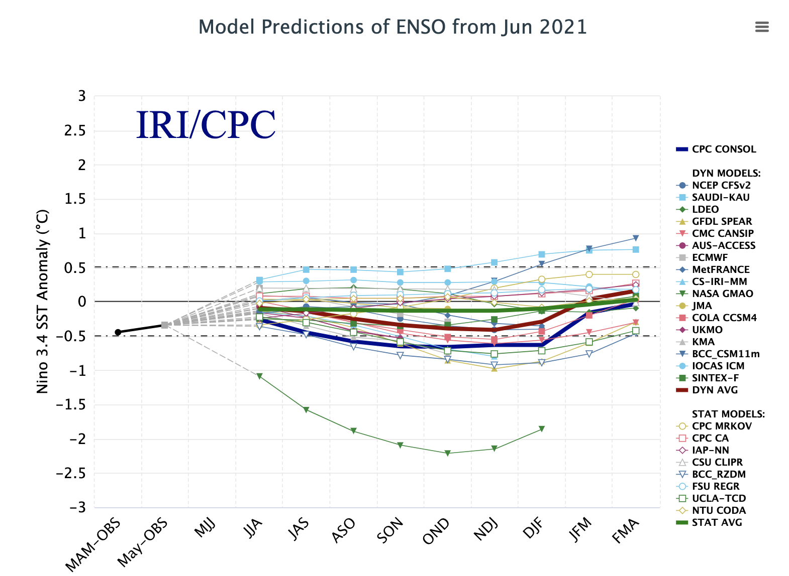

Slide 14
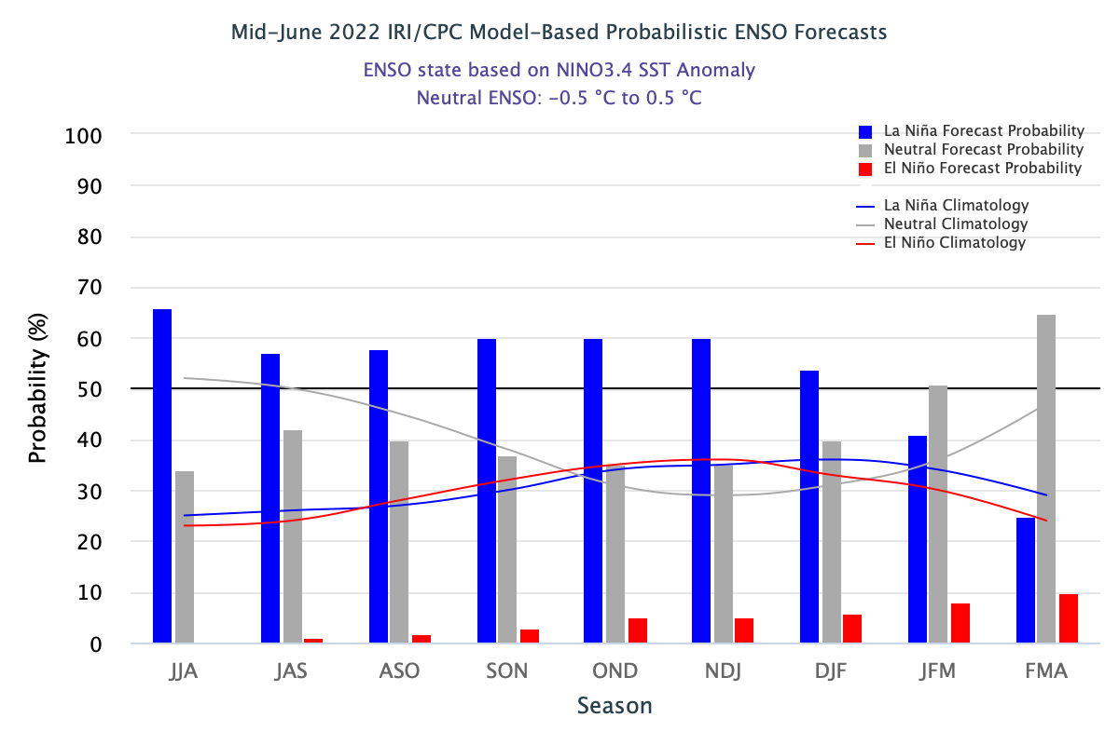
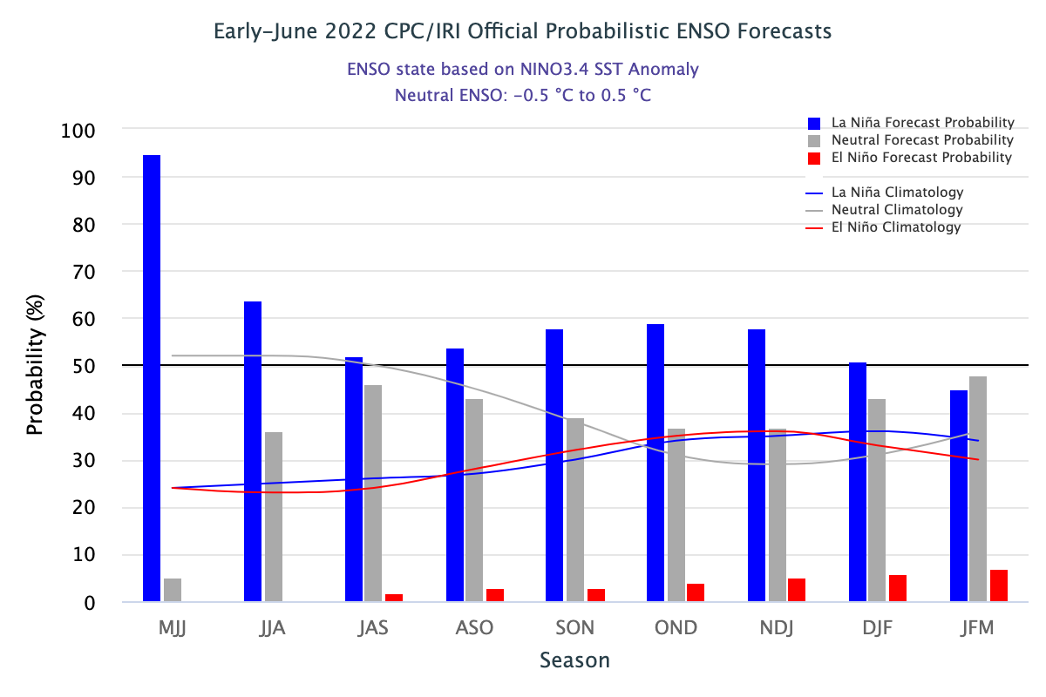

Slide 15
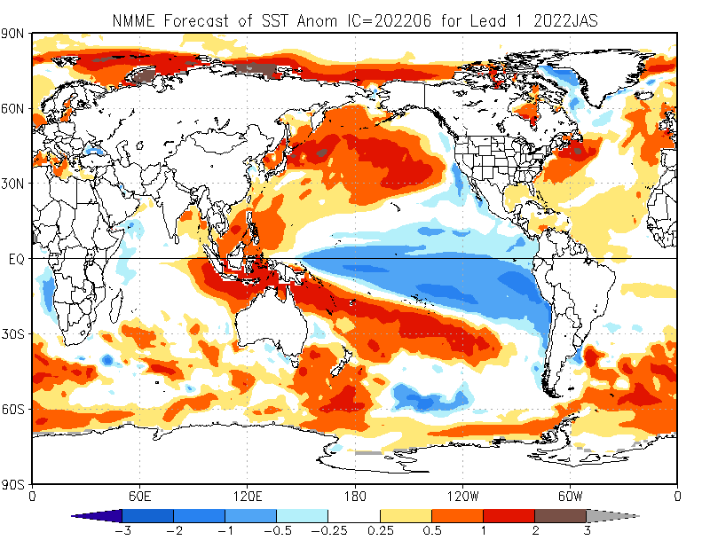

Slide 16
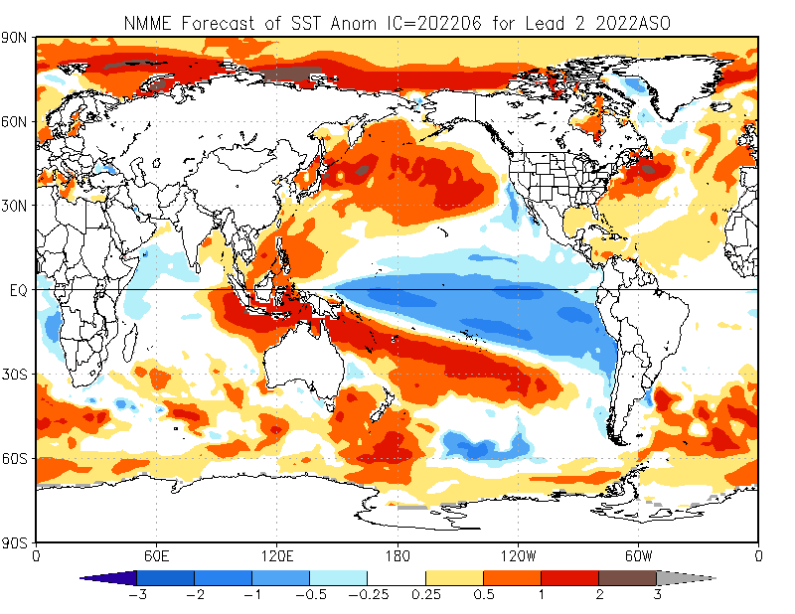

Slide 17
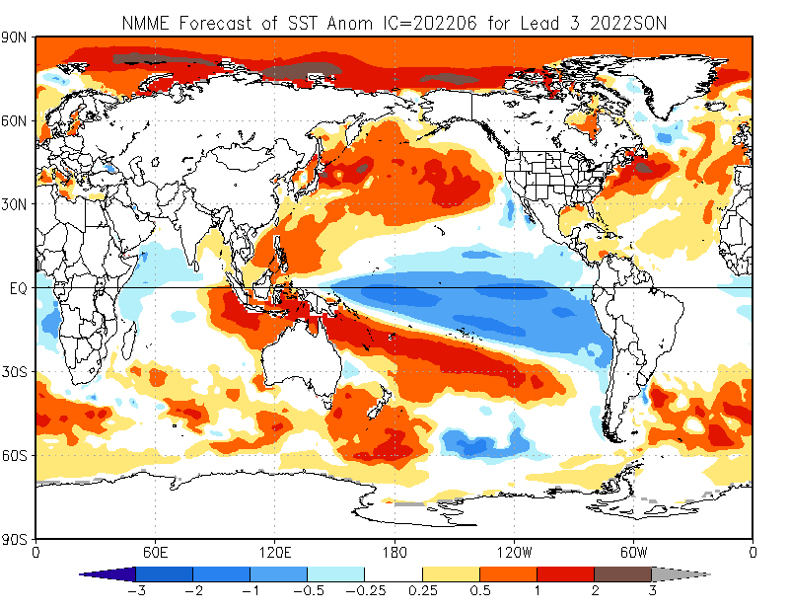

Slide 18
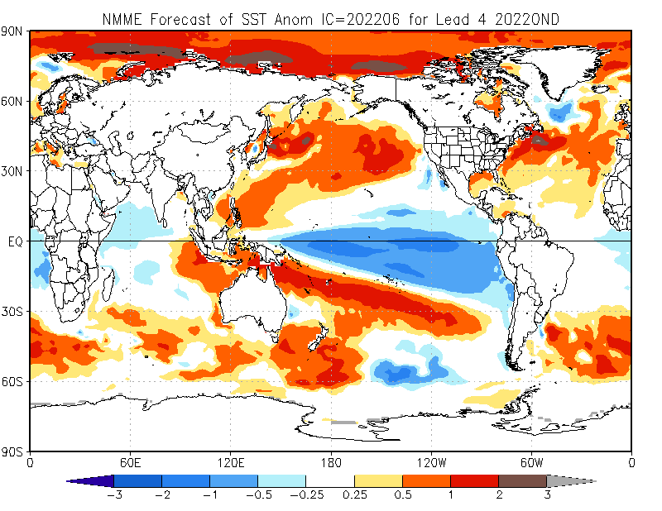

Slide 19
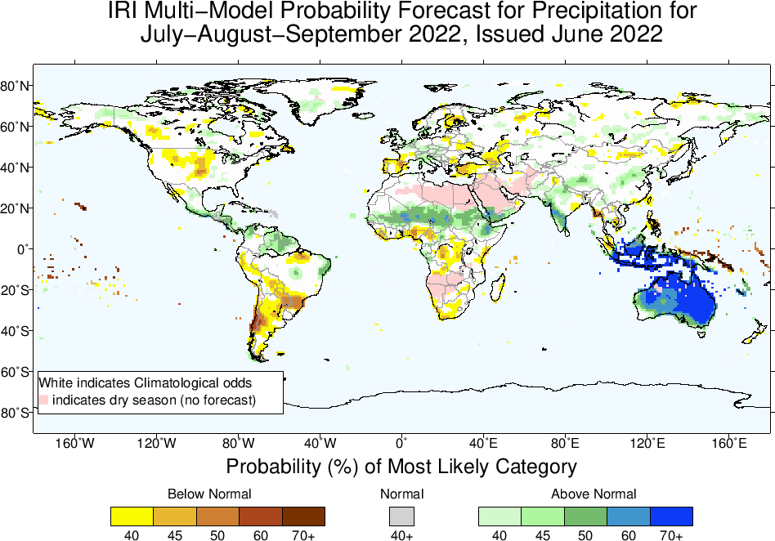

Slide 20
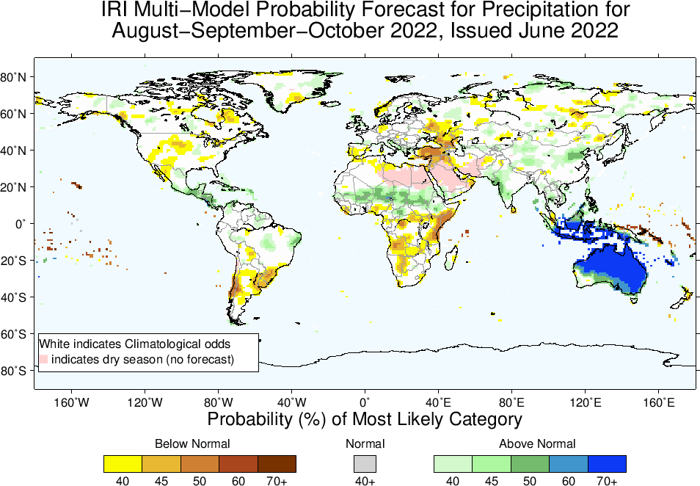

Slide 21


Slide 22
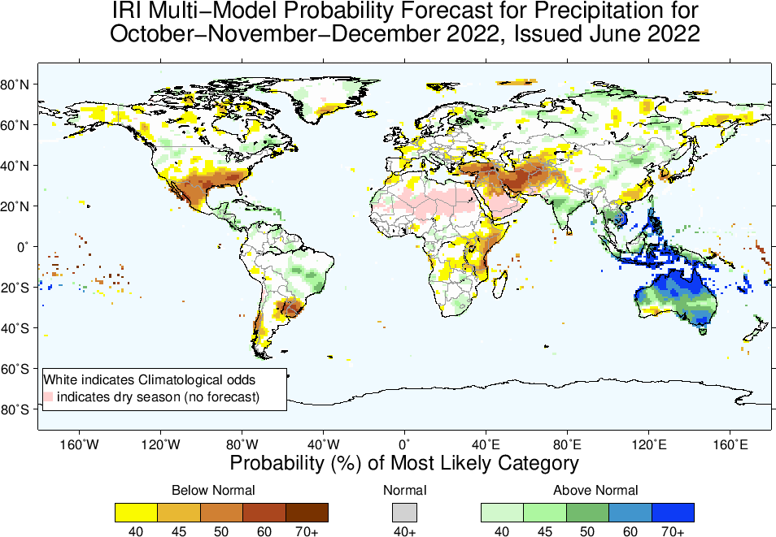

Slide 23
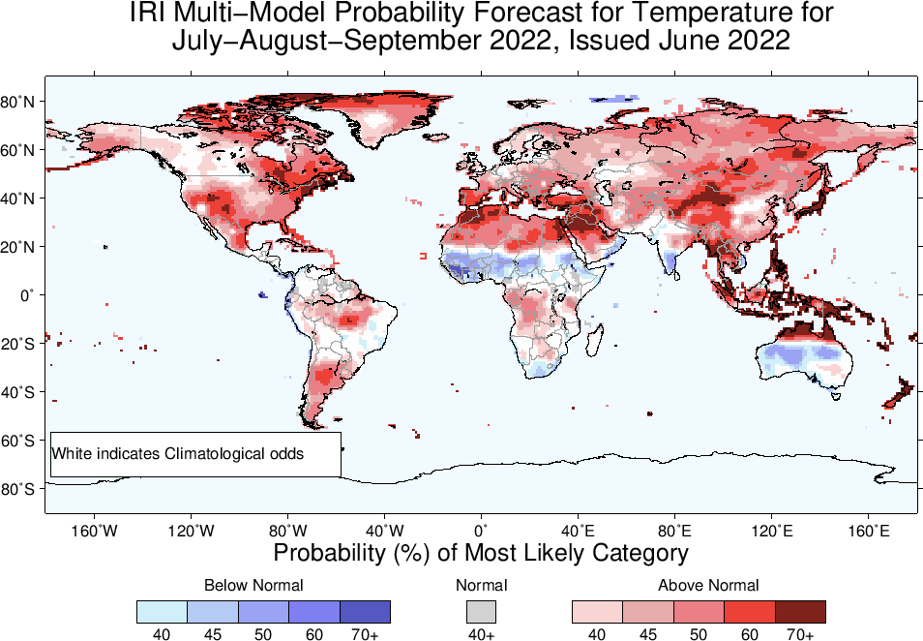

Slide 24
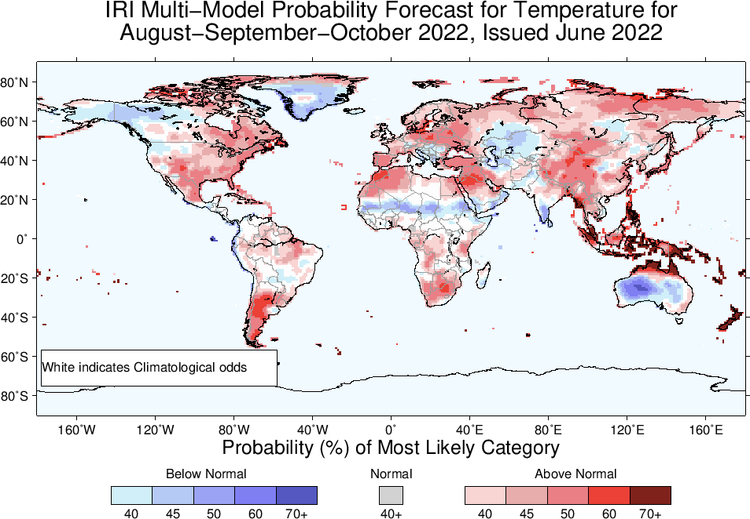

Slide 25
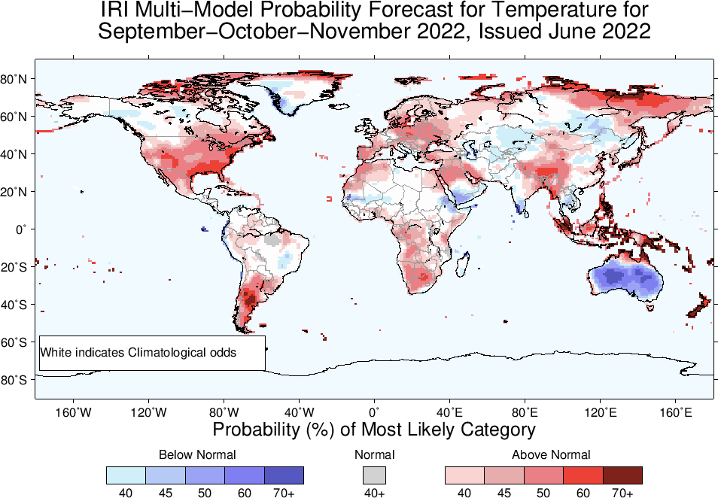

Slide 26
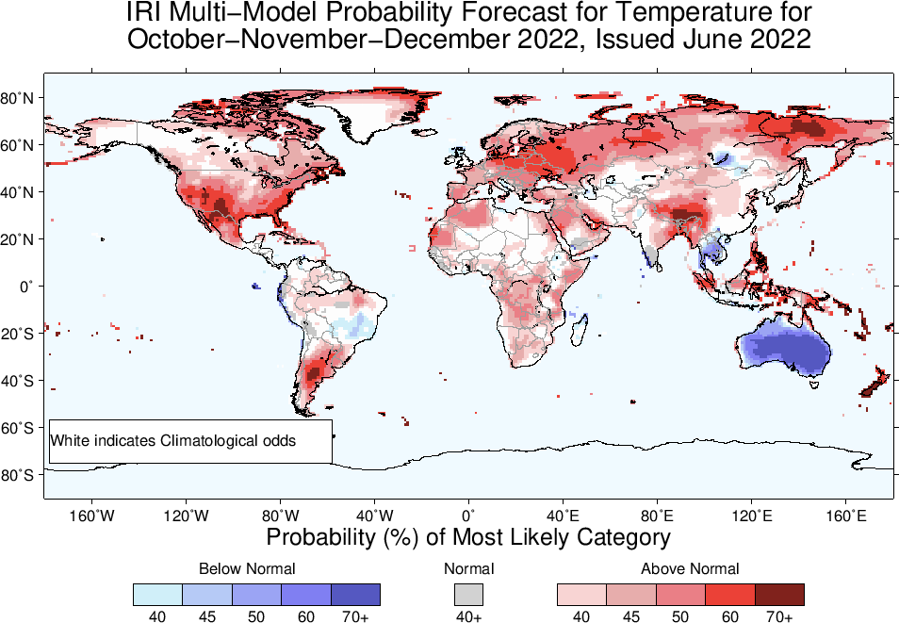

Slide 27

Summary
La Niña is still there, because; current atmosphere-ocean conditions are consistent for La Nina, But;
Though both Oceanic and Atmospheric conditions show a weakening sign, all are within the range of La Nina; e.g.,
Sea surface temperatures (SSTs) are below average across the equatorial Pacific Ocean. SOI is positive, above-average trade winds, reduced cloudiness over central Pacific.
La Niña is favored to continue with high chances during Jul-Aug-Sep, (52%), Moving forward probabilities for La Niña decrease to remain in 50s% (52 to 59%) during Fall, and early winter.
Level evel of uncertainty is quite high among the models, particularly between statistical and dynamical models (within dynamical models itself).

