Slide 1
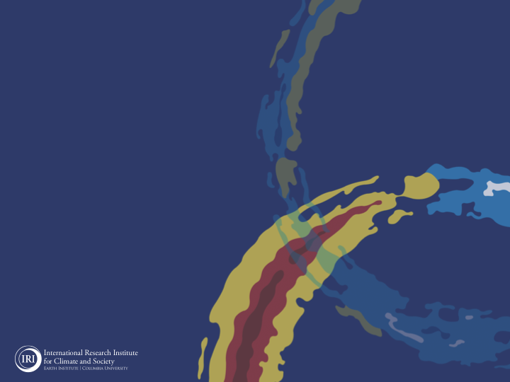

ENSO and Climate Outlook
in July 2022
La Nina survived and strengthen to be a 3rd
Triple-Dip
M. Azhar Ehsan
(azhar@iri.columbia.edu)
Associate Research Scientist
IRI ENSO and Climate Forecast Lead
Jeffery Turmelle and Jing Yuan: forecast processing and web updates
Cuihua Li: Draft PowerPoint development
IRI’s Climate Group, led by Dr. Andrew Robertson:
Forecast system development, ongoing innovation, and verification

Slide 2
Outline
Observed Oceanic and Atmospheric Conditions in
Tropical Pacific
Across the Globe
ENSO Forecast in
NMME
IRI ENSO Forecast Tool (Deterministic and Probabilistic)
Seasons Outlook of
SST
Precipitation and Temperature
Summary

Slide 3
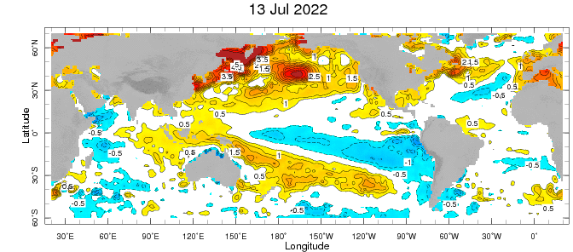
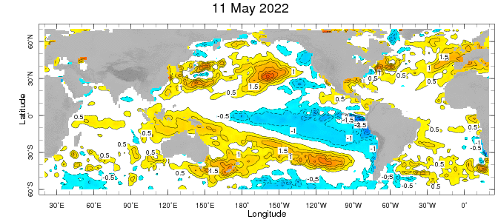
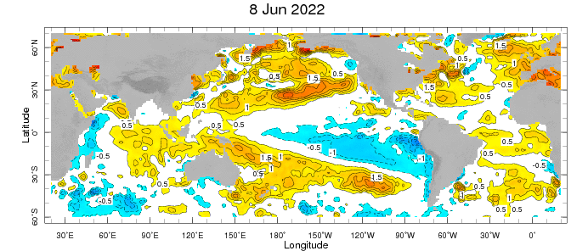
Evolution of EQ. Pacific SST Departures in Weekly OISST Data
In the Pacific Ocean: Below-average SSTs persisted across the central (across the Date Line), surrounded by strong +ve SSTA in the high latitudes.
Near-Neutral SSTAs exists in Eastern Pacific (130W to 90W.
Indian Ocean: Negative SSTAs in the west and positive in the East, a –ve Indian Ocean Dipole.
Atlantic Ocean: A positive SSTAs in the equatorial AO
Gradual Weaking during last several weeks.

Slide 4
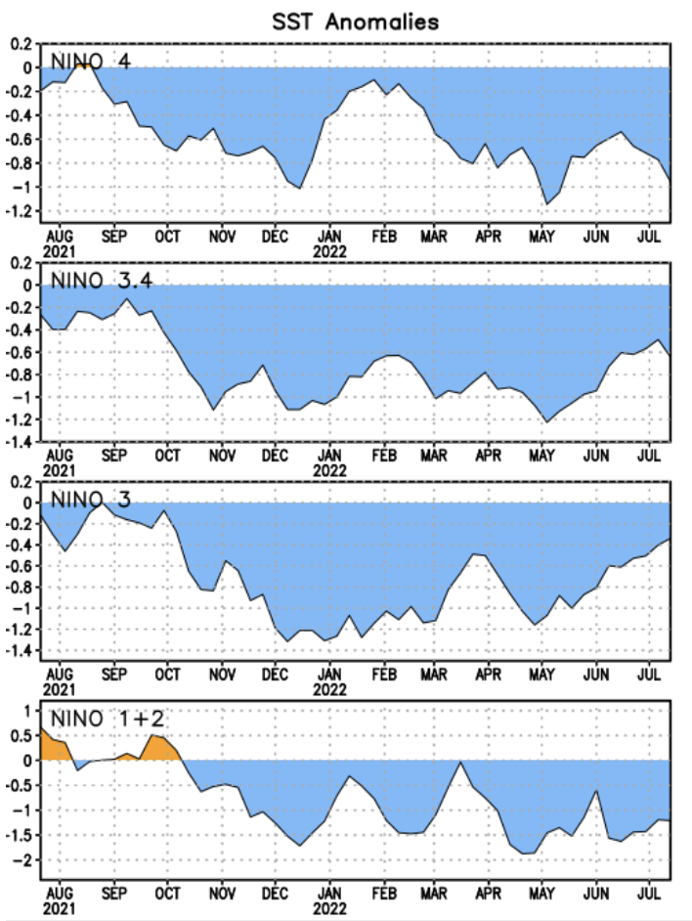
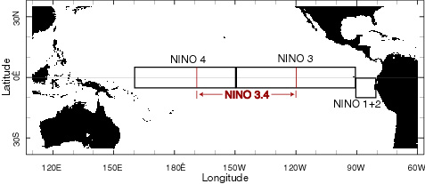
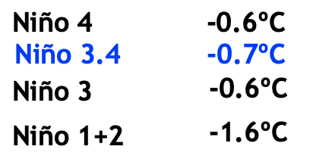
Most Recent SST Departures in different NINO regions (All cooler than the long-term avg, (1991-2020))
Niño 4
-1.0ºC
Niño 3.4
-0.6ºC
Niño 3
-0.3ºC
Niño 1+2
-1.2ºC
Changed by how much (June, 2022)?

Slide 5
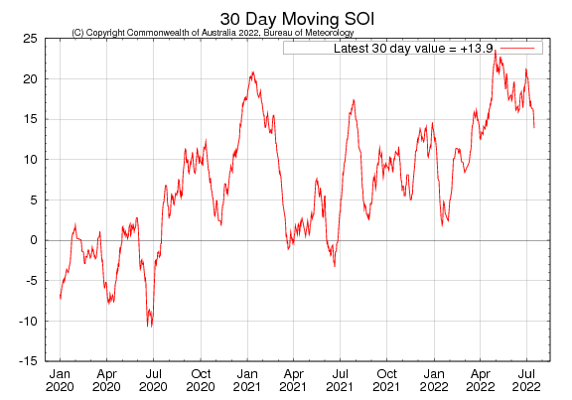
2021
2020

Slide 6
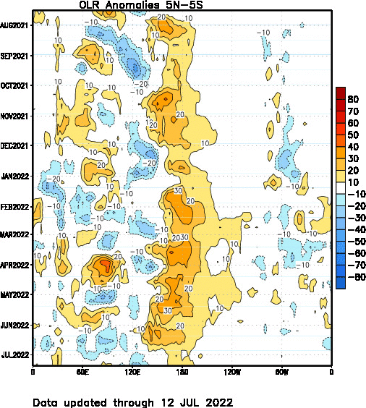

Slide 7
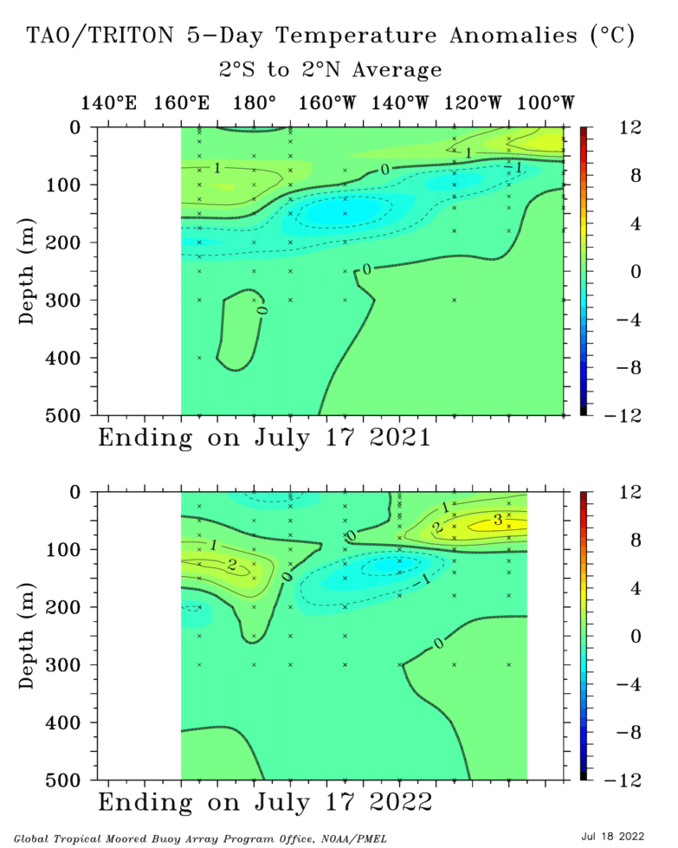
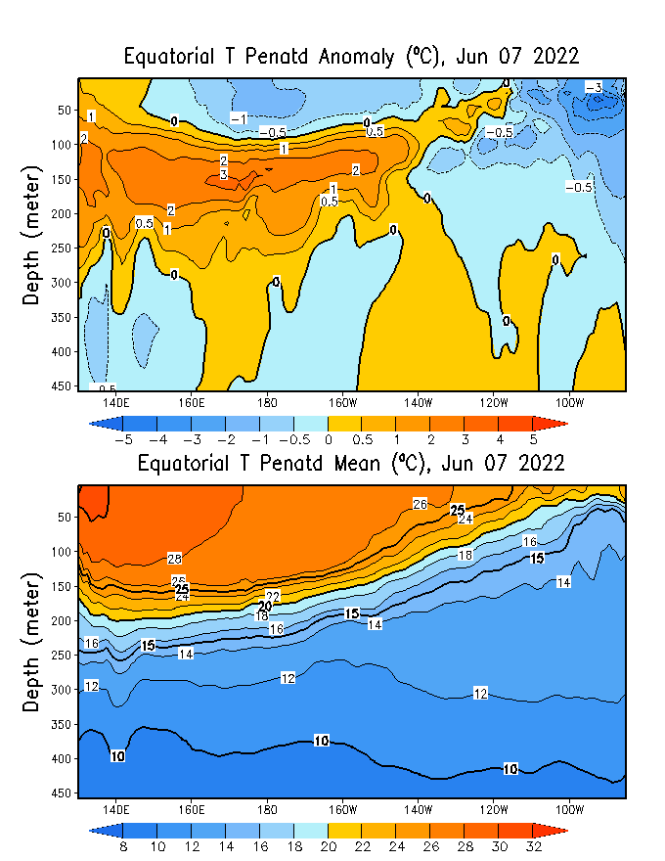
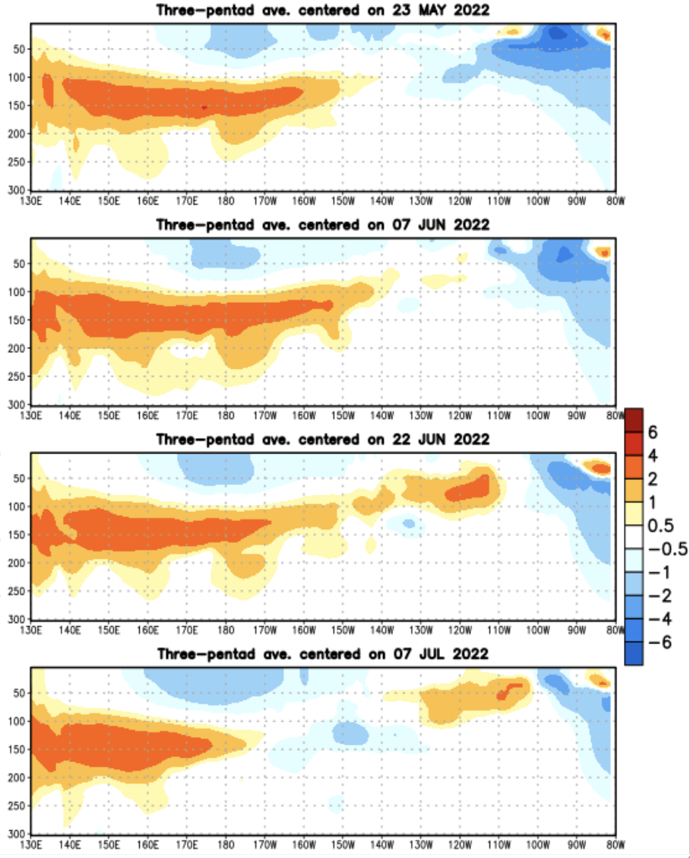
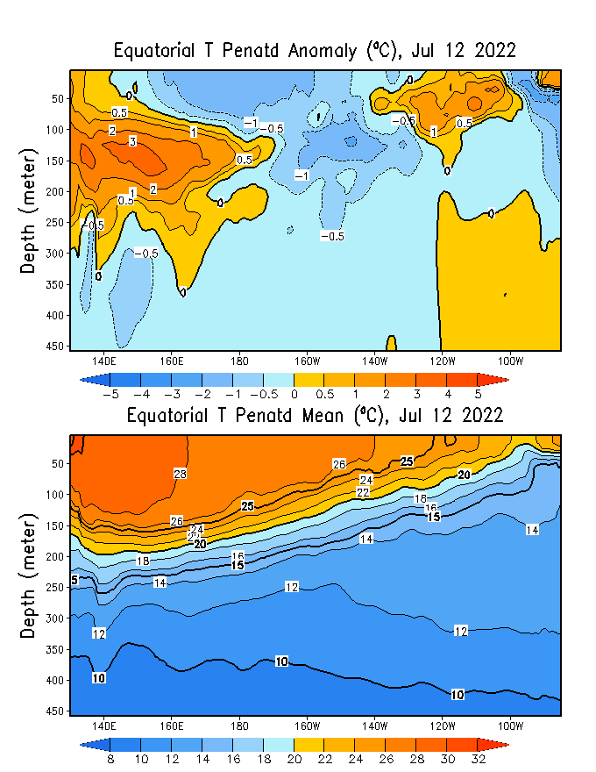
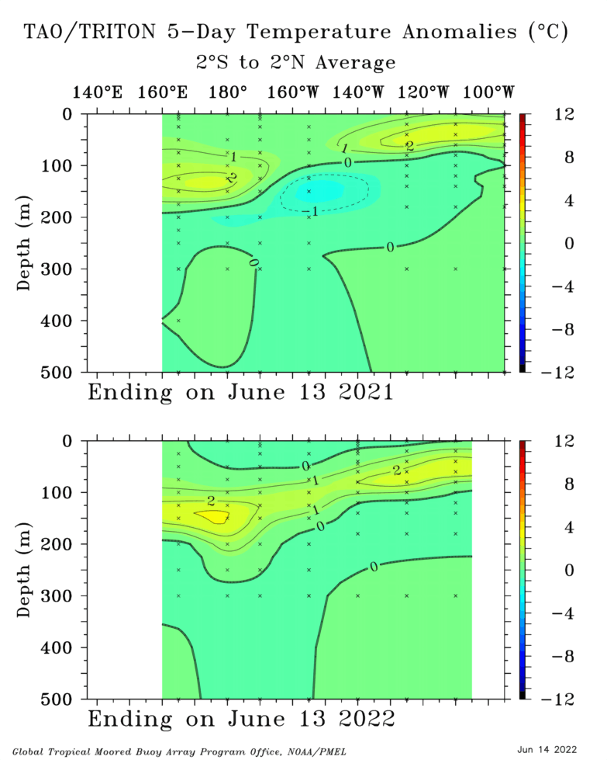
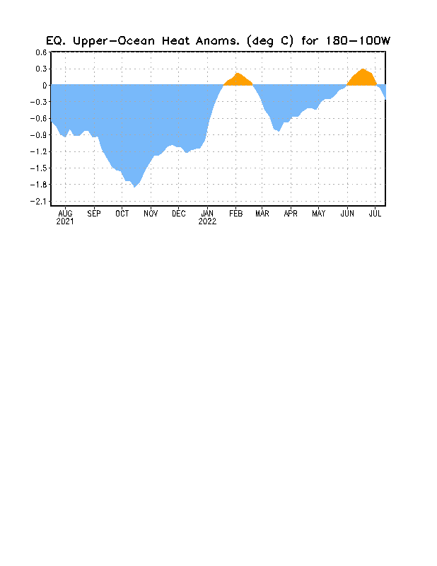
TOGA/TAO
GODAS
Last Month: June 2022

Slide 8
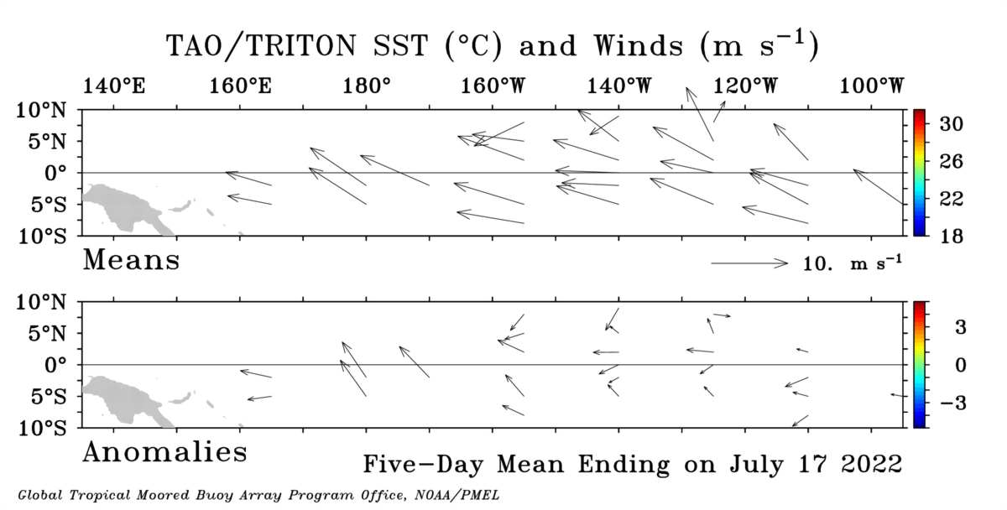
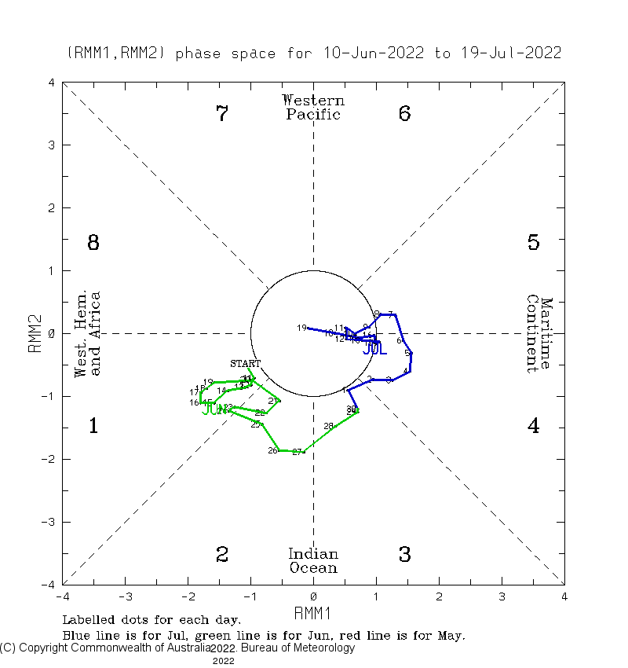
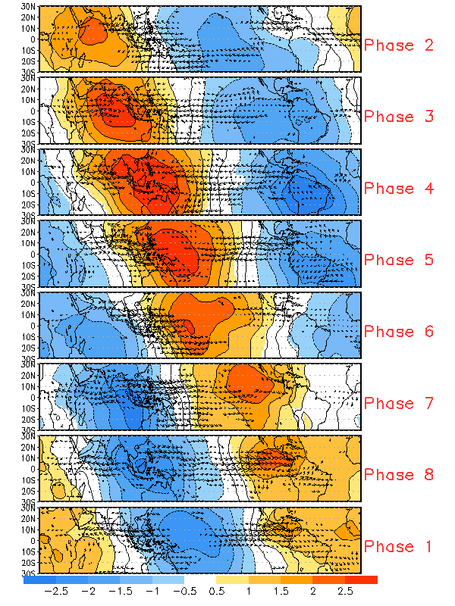

Slide 9
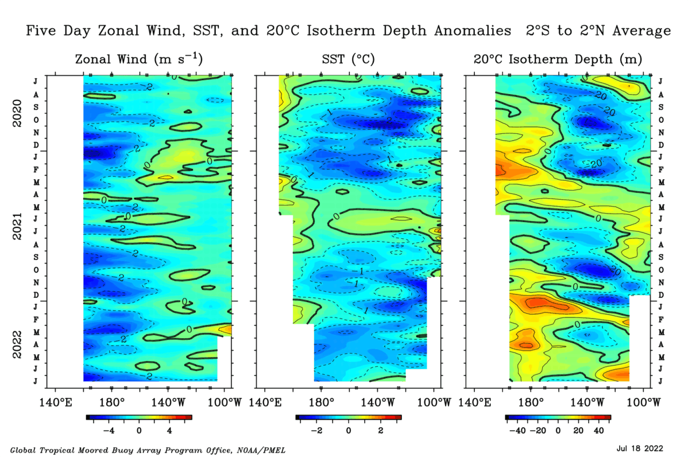

Slide 10
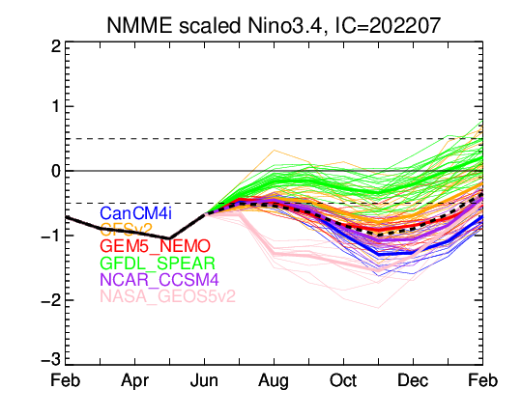
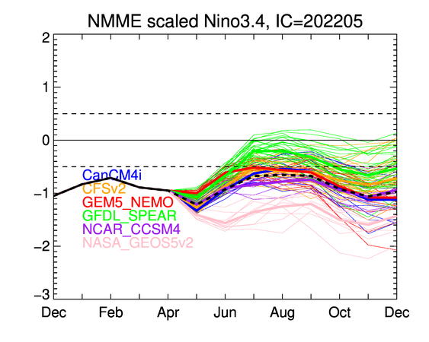
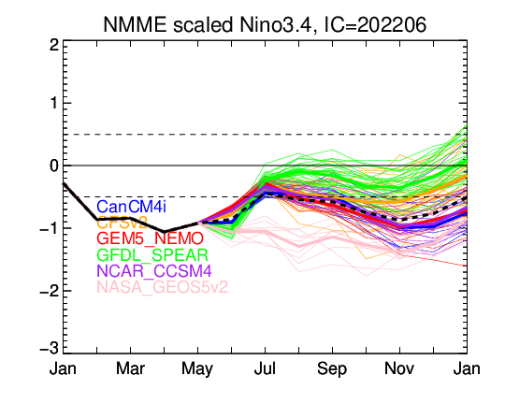

Slide 11
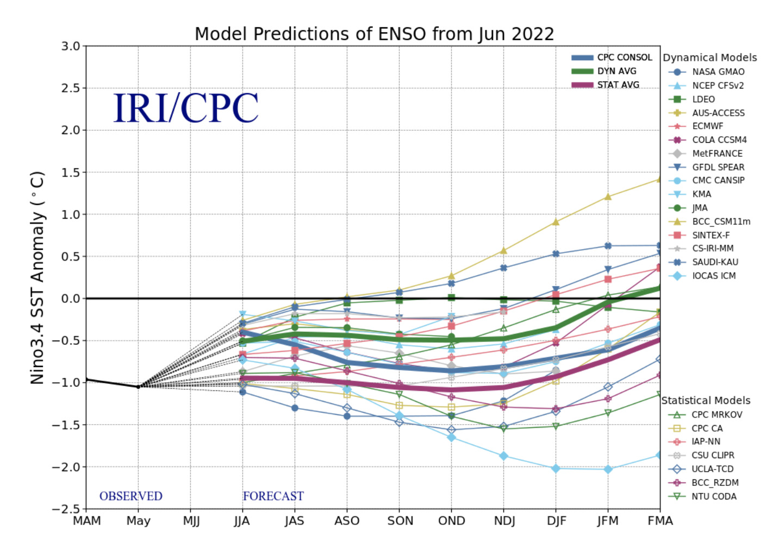
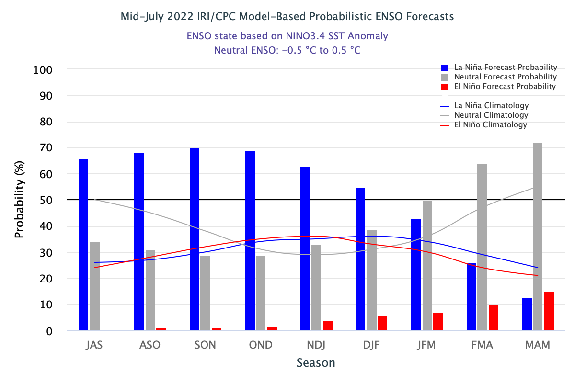

Slide 12
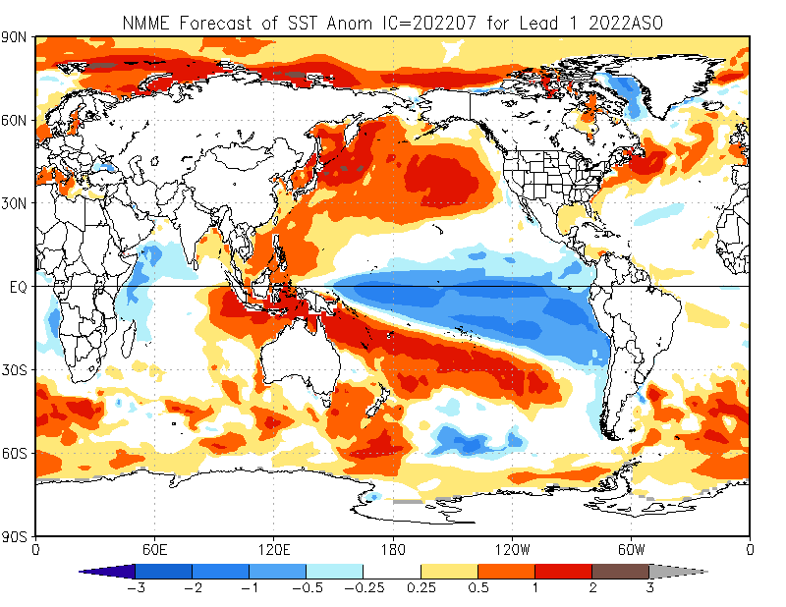
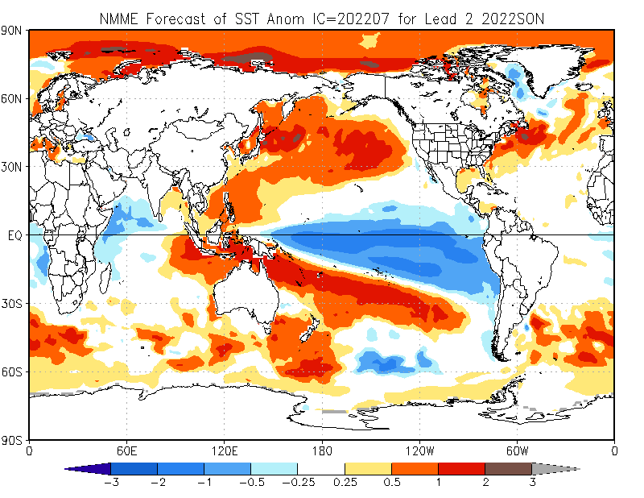
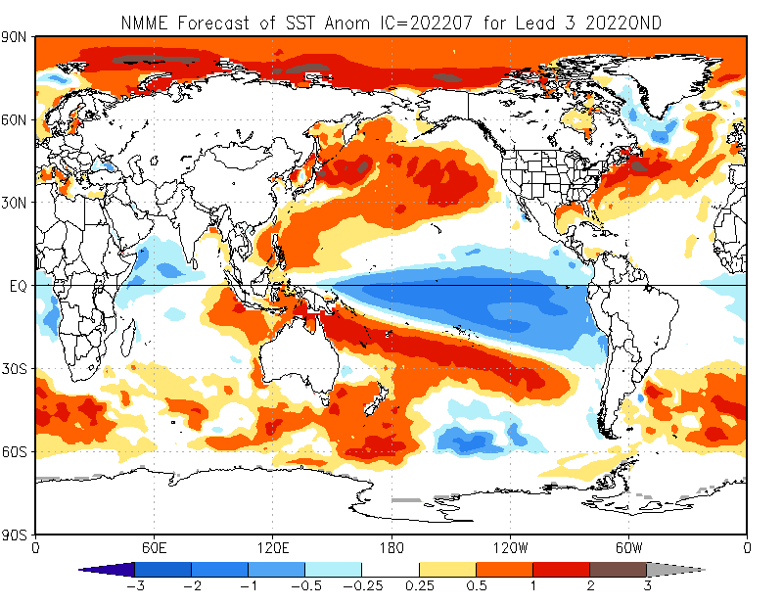
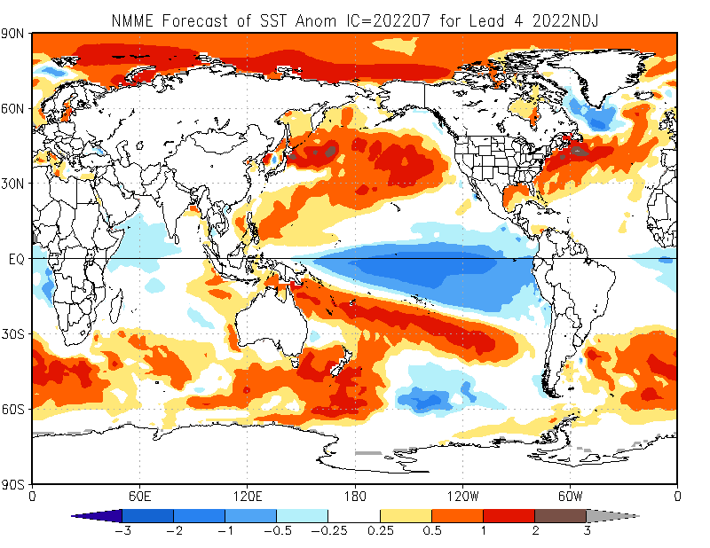

Slide 13
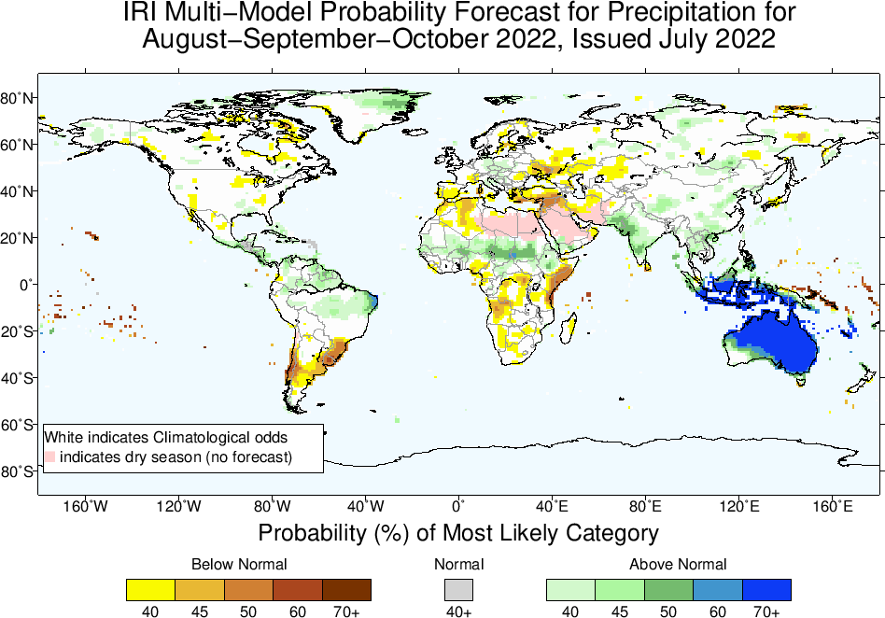
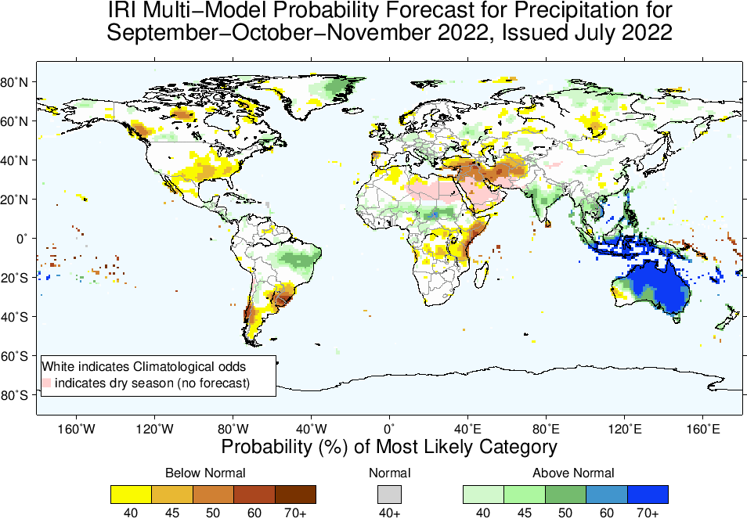
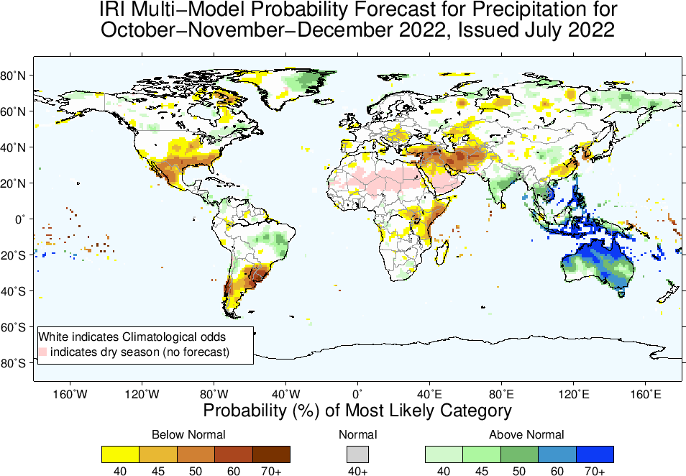
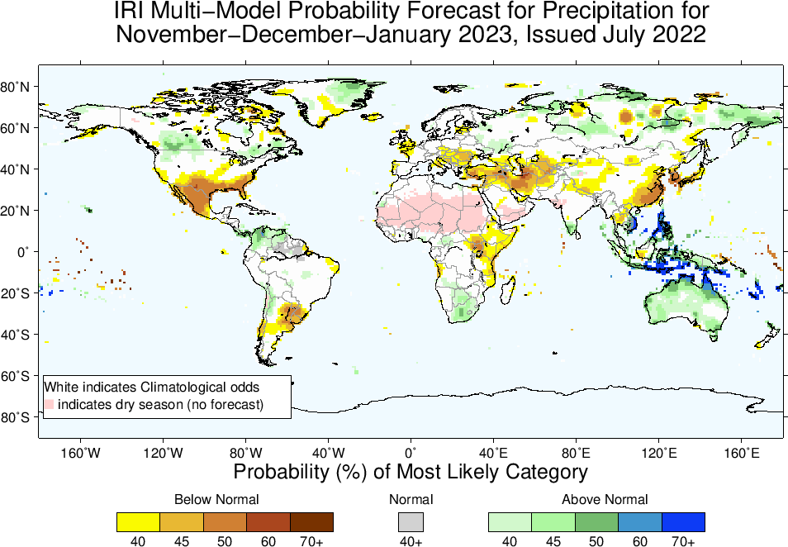

Slide 14
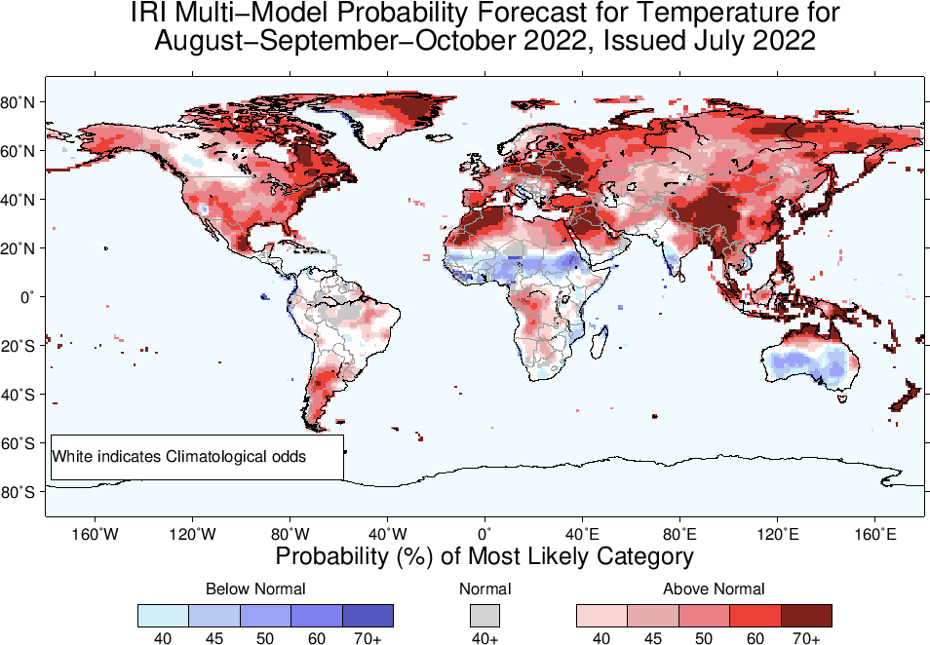
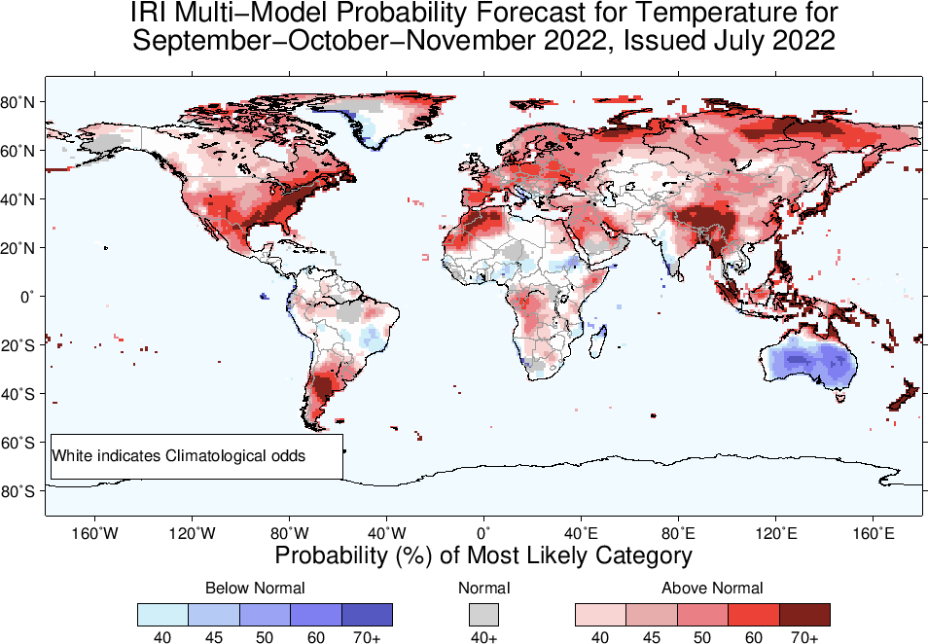
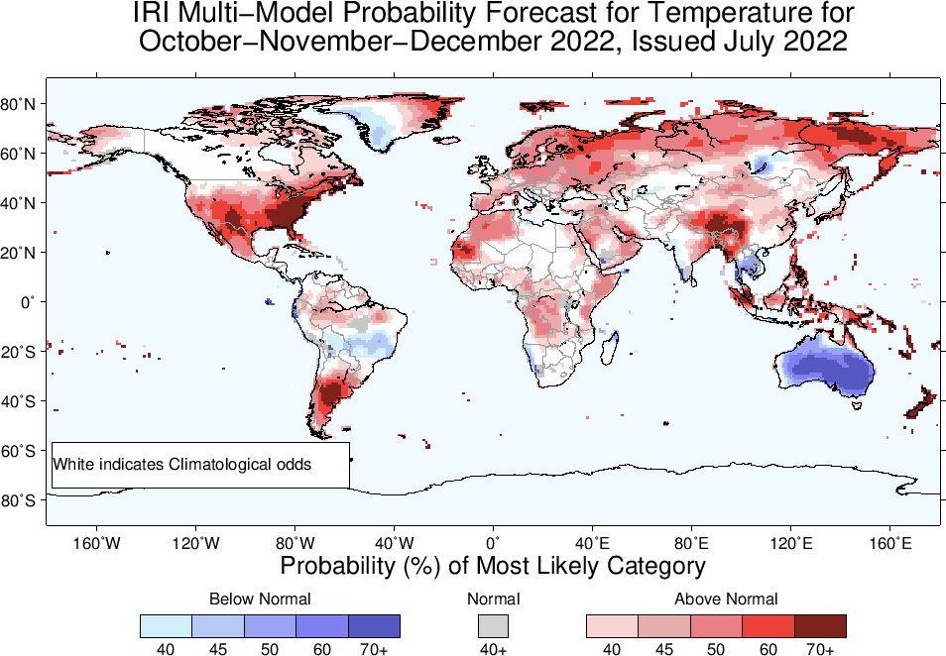
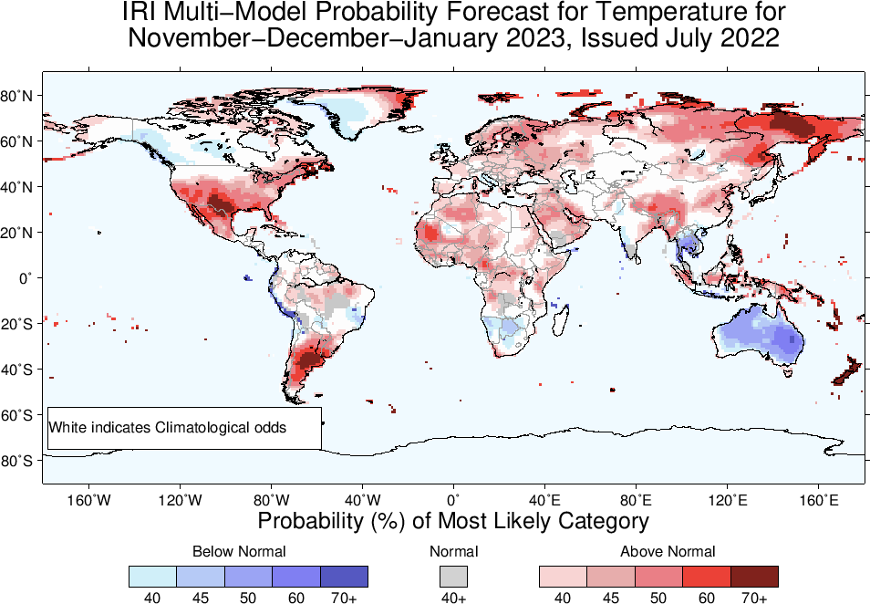

Slide 15
Summary
La Niña survived, So still there, because; current atmosphere-ocean conditions are consistent for La Nina, But;
Both Oceanic and Atmospheric conditions slightly strengthening in the favour of La Nina; e.g.,
Sea surface temperatures (SSTs) are below average across the central equatorial Pacific Ocean. SOI is firmly positive, stronger than average trade winds, reduced cloudiness over central Pacific.
La Niña is favored to continue with high chances during Aug-Sep-Oct, (60%), Moving forward probabilities for La Niña even slightly increases and remain between 62 to 70% till Nov-Dec-Jan, and 55% for DJF 2023.
ENSO-Neutral is most favorable during the first quarter of 2023.
Heading towards 3rd triple-Dip La Nina, wait and see!

