Slide 1
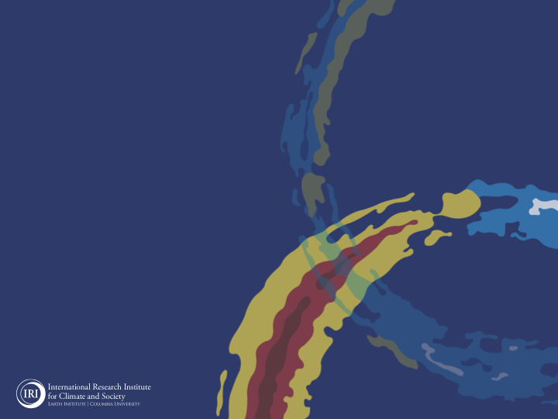
ENSO and Climate Outlook in January, 2024:
El NINO-ENSO-Neutral-LA NINA,…
M. Azhar Ehsan
(azhar@iri.columbia.edu)
Associate Research Scientist
IRI ENSO and Climate Forecast Lead
Jeffrey Turmelle and Jing Yuan: forecast processing and web updates
Cuihua Li: Draft PowerPoint development
IRI’s Climate Group, led by Dr. Andrew Robertson: Forecast system development, ongoing innovation, and verification

Slide 2
Outline
Observed Oceanic and Atmospheric Conditions in
Tropical Pacific
Across the Globe
ENSO Forecast in
NMME
IRI ENSO Forecast Tool (Deterministic and Probabilistic)
Seasons Outlook of
SST
Precipitation and Temperature
Summary

Slide 3
Observations
Oceanic
Atmospheric

Slide 4
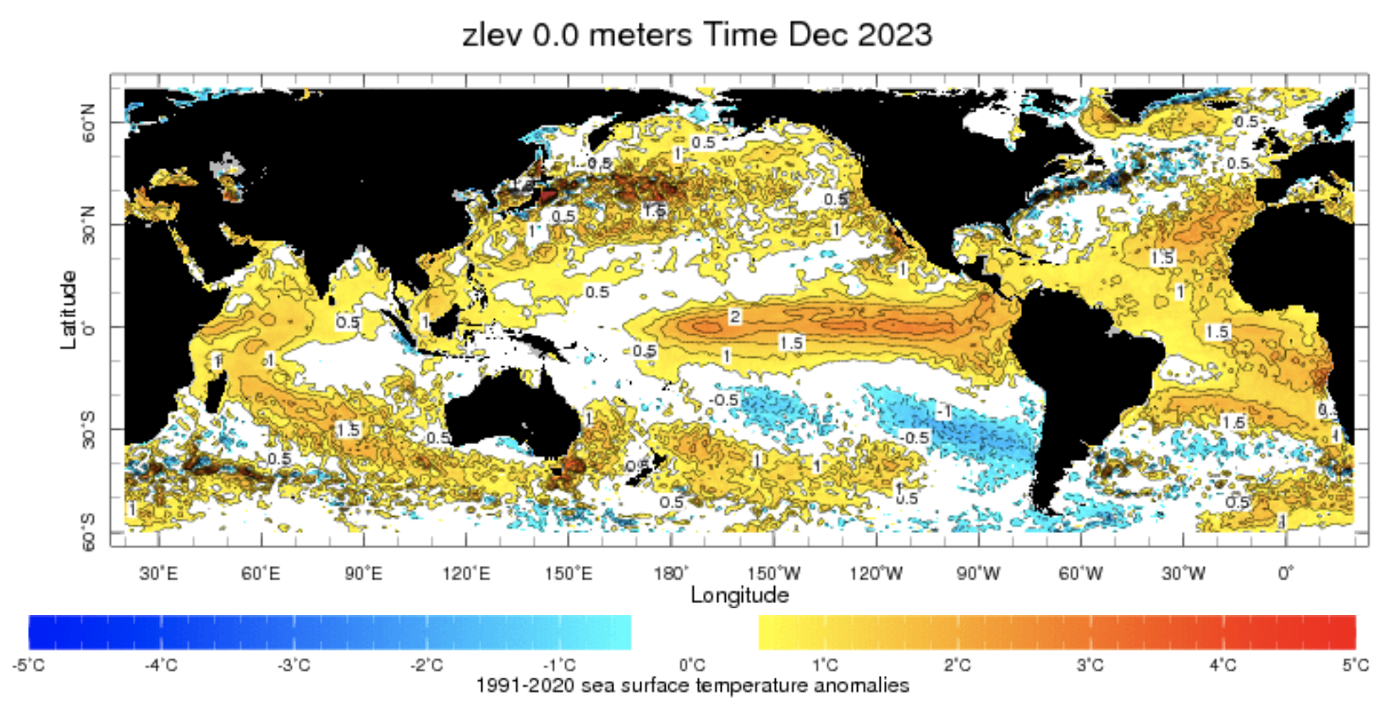
Evolution of SST Departures in Monthly Data
For Dec, 2023
NINO 1+2: +1.41
NINO3: +2.06
NINO3.4: +1.99
NINO4: +1.39
In the Pacific Ocean: Above-Average SSTs persisted across the central (across the Date Line), surrounded by strong +ve SSTA in the high latitudes
Indian Ocean: Above-Average SSTs in the West and Negative in the East, a +ve Indian Ocean Dipole (IOD, +0.64 as of 14 Jan, 2024)
North-Pacific and North Atlantic Ocean: Negative PDO (-1.75), +ve Tropical North Atlantic (TNAI, +0.97)
Source: https://iridl.ldeo.columbia.edu/maproom/Global/Ocean_Temp/ERSST_Anomaly.html

Slide 5
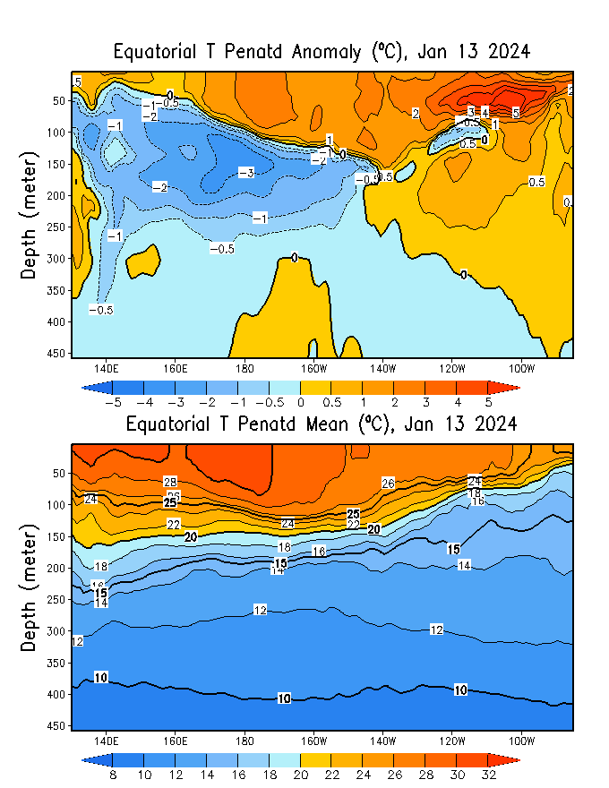
Subsurface Ocean Temperature Evolution
Positive subsurface temperature anomalies dominate in the equatorial Pacific Ocean (Surface to depth).
Negative subsurface temperature anomalies have strengthened in the western Pacific Ocean and expanded to 140ºW, while remaining at depth.

Slide 6
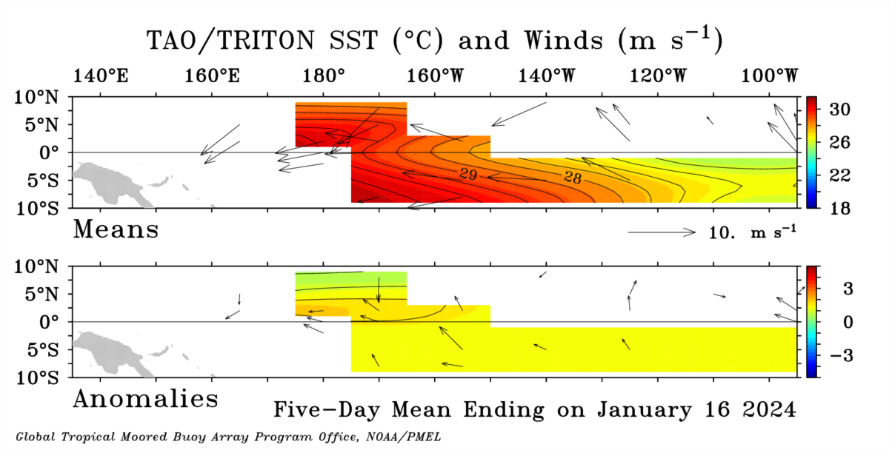
Most recent Sea Surface Temperature (SST) Lower-Level Winds

Slide 7
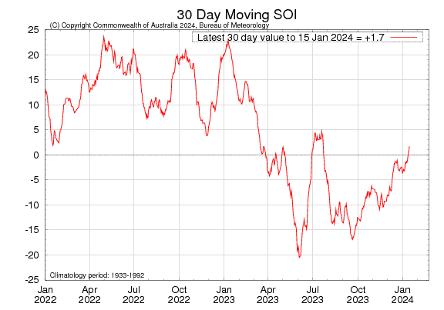
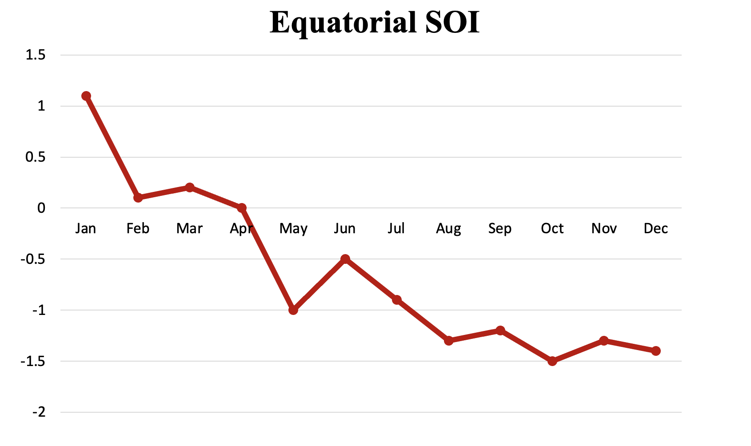
Most recent Southern Oscillation Index (SOI)
During El Niño, the pressure becomes below average in Tahiti and above average in Darwin, and the Southern Oscillation Index is negative.
A Sustained Negative values of the SOI above -7 typically indicate El Niño
Source:
http://www.bom.gov.au/climate/enso/#tabs=Pacific-Ocean&pacific=SOI

Slide 8
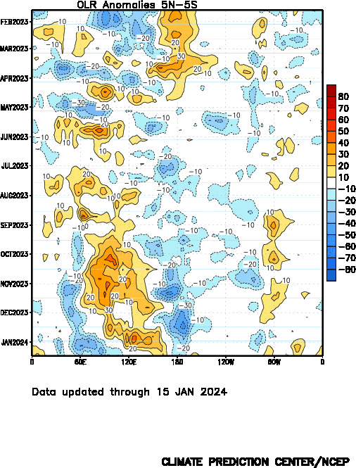
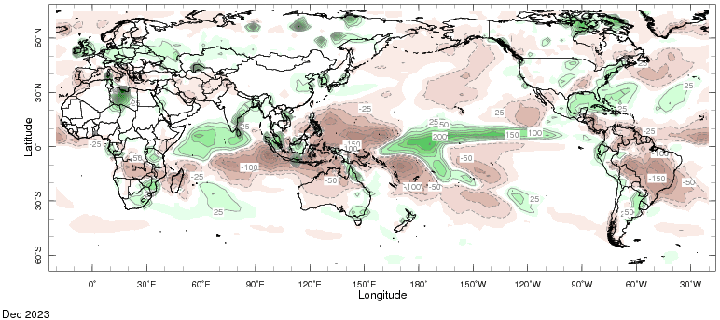
Most recent Outgoing Longwave Radiation (OLR) & Precipitation

Slide 9
Forecasts
Nino-34 in NMME,
IRI ENSO Plume,
Probability of Nino-34,
Global SSTs from NMME,
Prcp. and Temp. outlook from IRI (January, 2024)

Slide 10
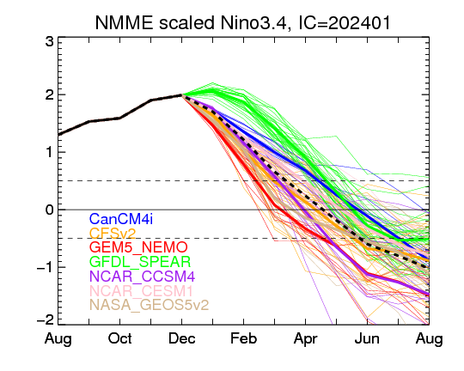
North American Multi Model Ensemble (NMME) ENSO Forecast (Jan, 2024 Initial)

Slide 11
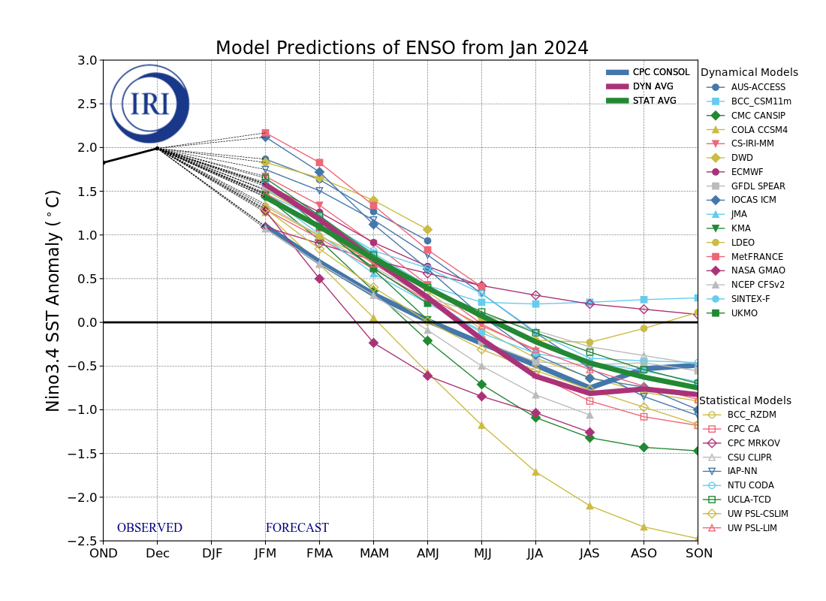
IRI’s ENSO Forecast Jan, 2024

Slide 12
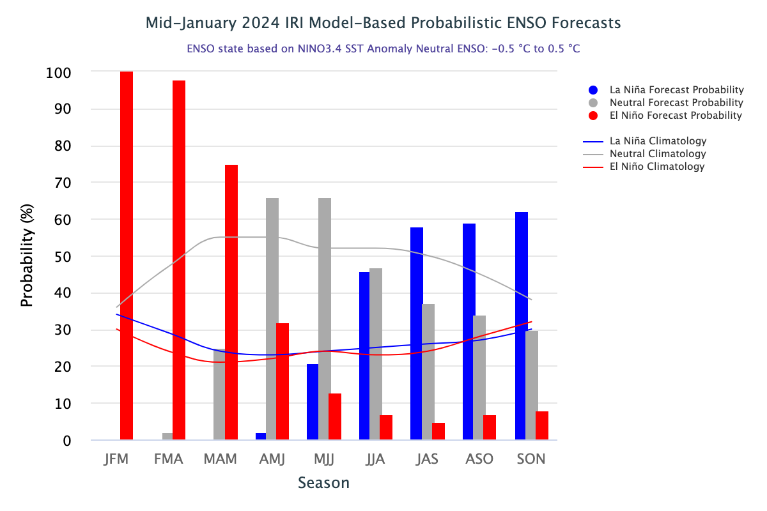
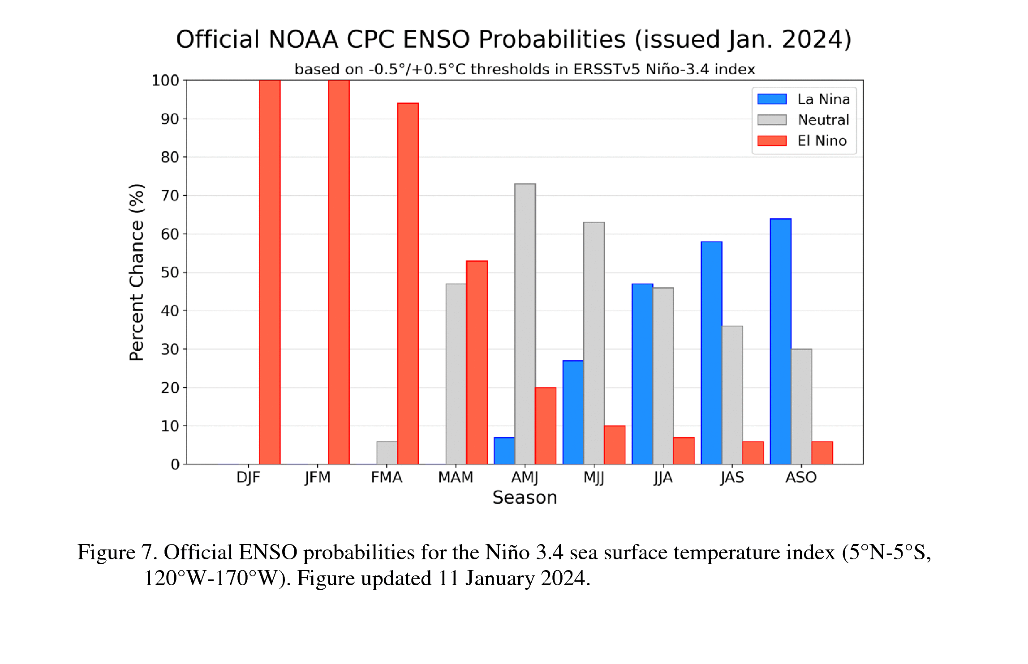
IRI’s Probabilistic ENSO Forecasts (on 19th Jan, 2024)
CPC’s Probabilistic ENSO Forecast
(Released on 11 Jan, 2024)

Slide 13
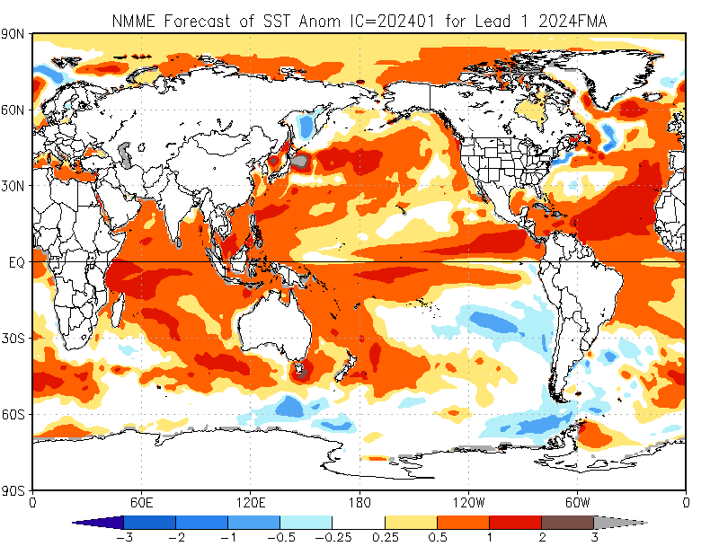
North American Multi Model Ensemble (NMME) SST Forecast

Slide 14
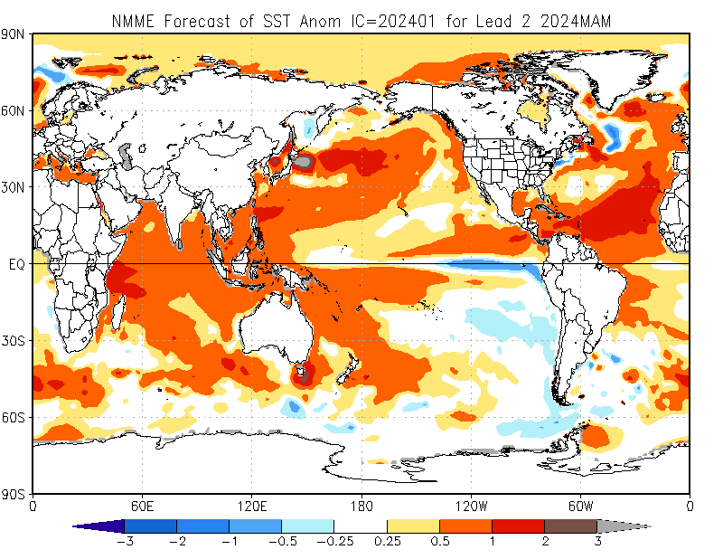

Slide 15
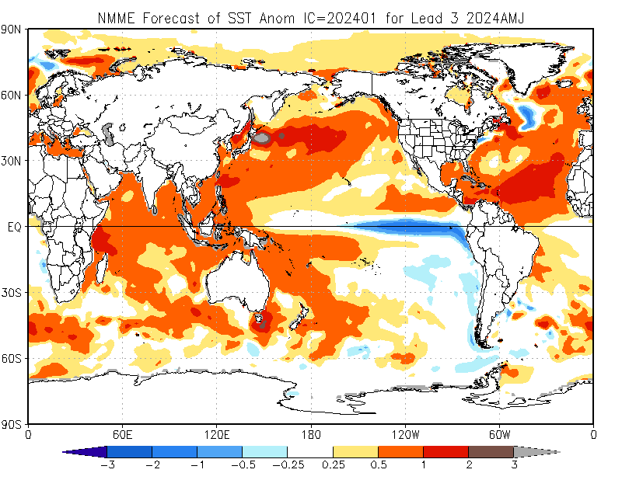

Slide 16
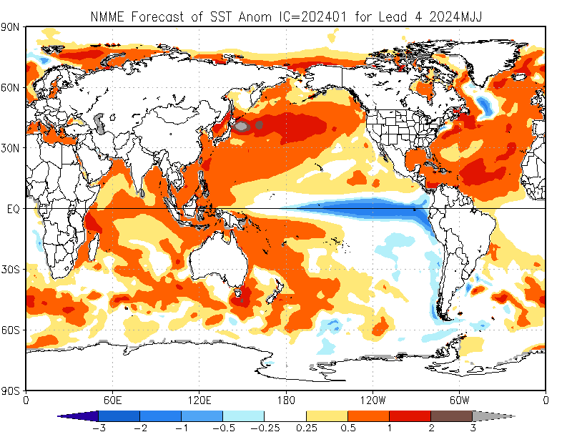

Slide 17
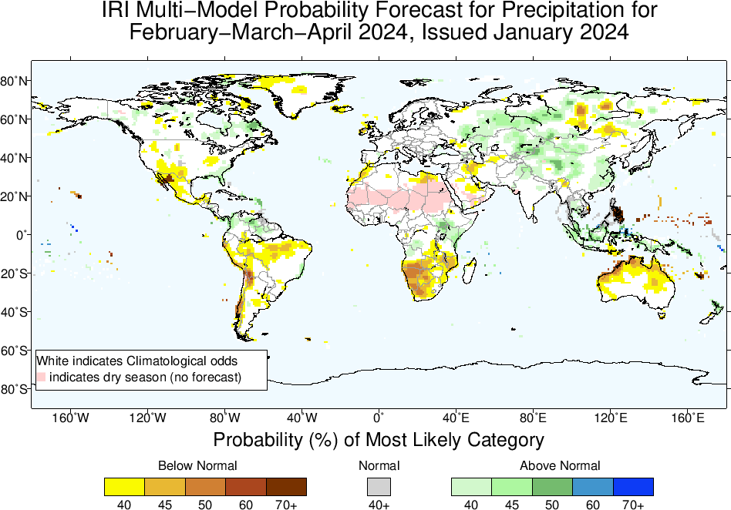
Precipitation Forecasts based on North American Multi Model Ensemble (NMME)

Slide 18
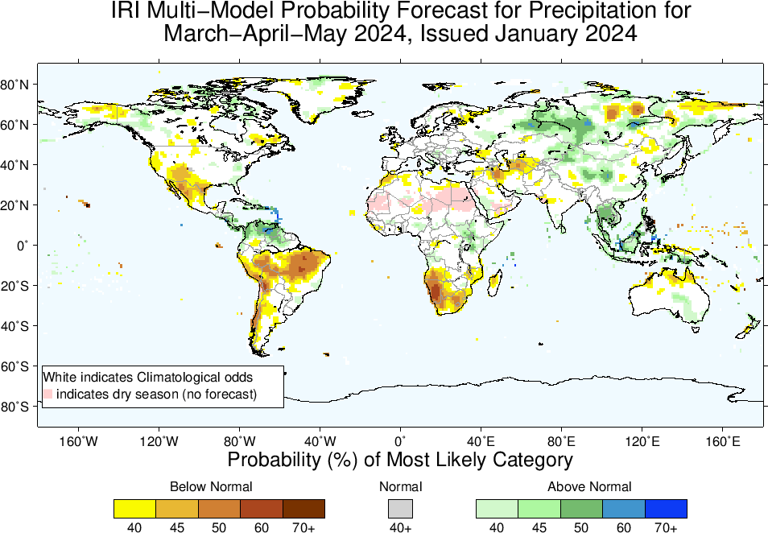

Slide 19
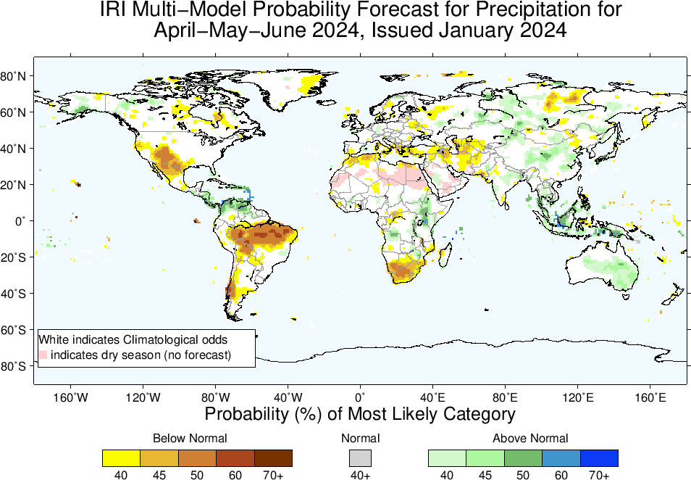

Slide 21
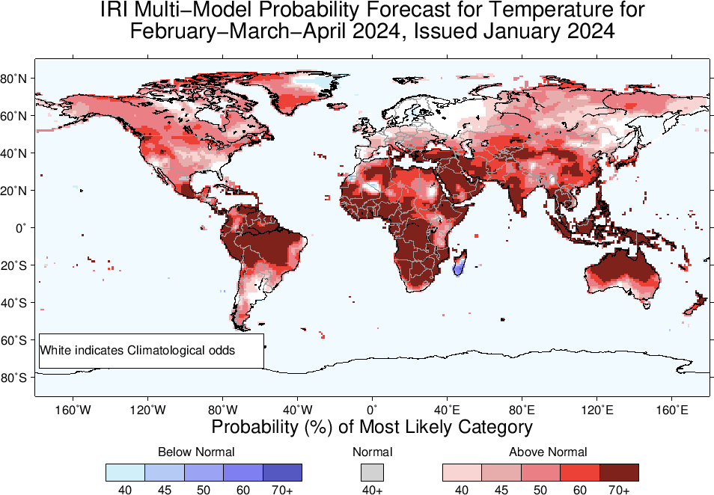
2m-Temperature Forecasts based on North American Multi Model Ensemble (NMME)

Slide 22
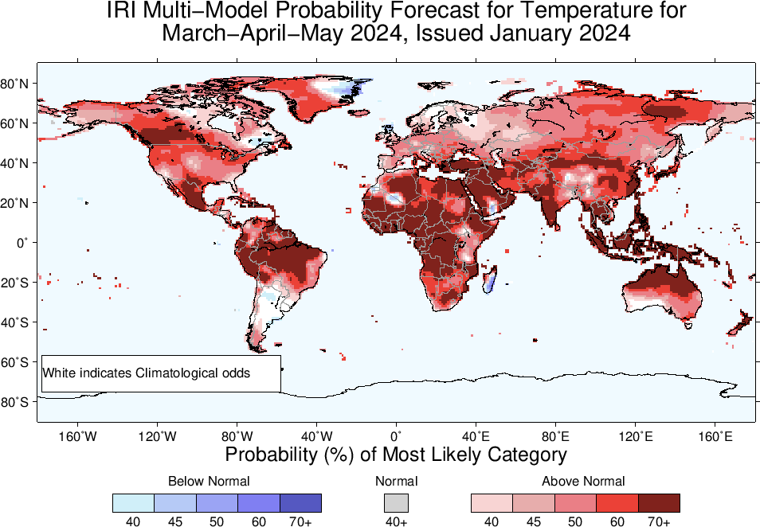

Slide 23
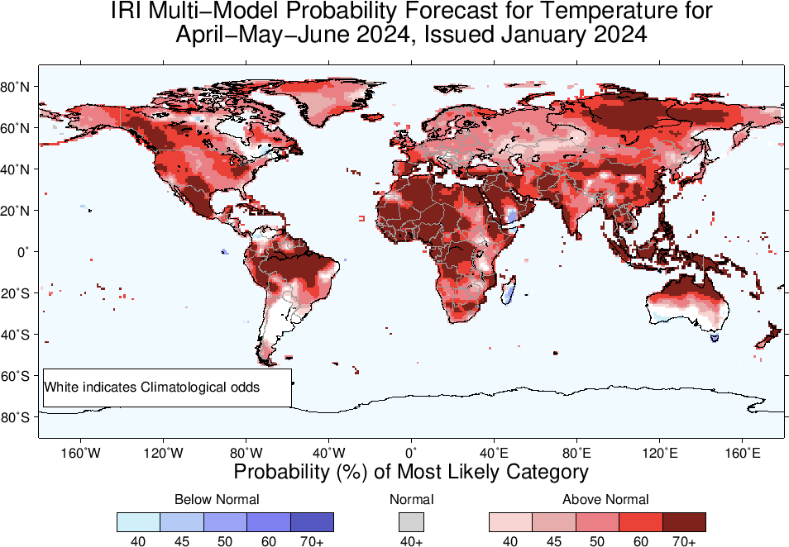

Slide 24
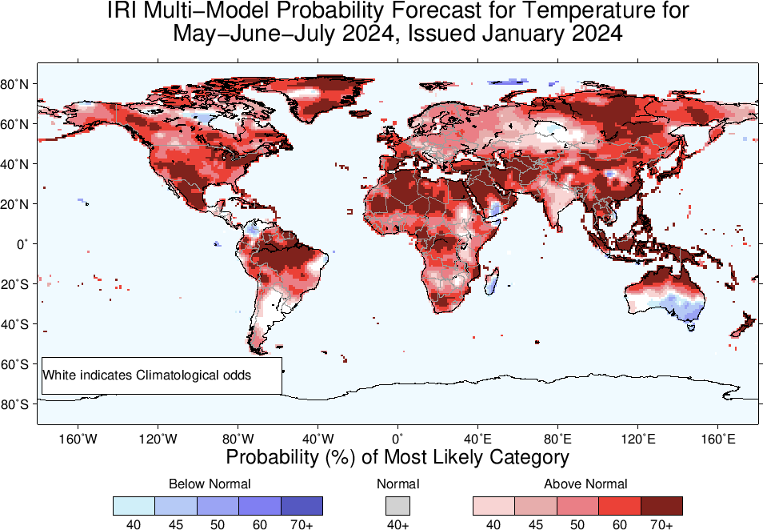

Slide 25
Summary
Current level of warming in the eastern and central Pacific Ocean, reached a “strong” intensity (Dec, NINO3.4 Value is +1.99), while for last Four weeks, it is close to +2.0.
Positive Indian Ocean Dipole also continues, though sharply weakened.
The latest forecasts suggest that the warming will persist through the boreal winter and spring (75% in MAM-2024 (was 84% in Dec, 2023)), sharply weakening thereafter.
ENSO-Neutral is most probable in AMJ, MJJ, and JJA 2024.
LA NINA is most likely from JAS, and remain so onward.
The likelihood stands in the upper 50s, but forecasting at this time of the year is highly uncertain due to the forecasts encountering the Spring Predictability barrier.

