Slide 1
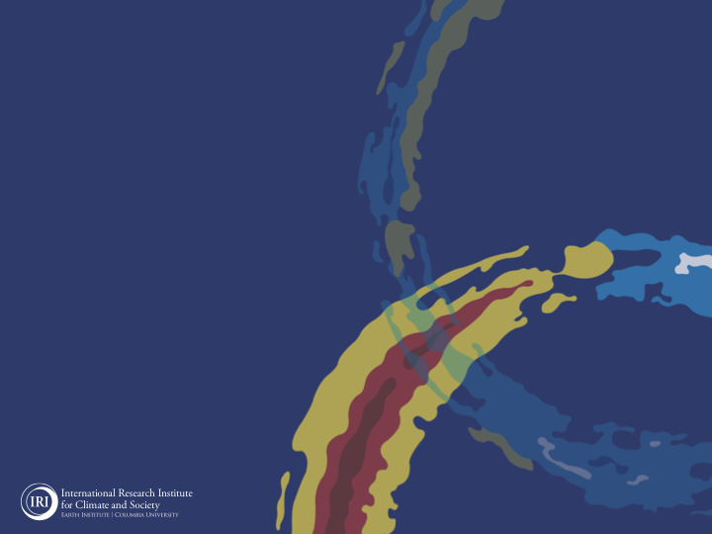
ENSO and Climate Outlook
January 2022!
La Nina conditions still continue.
Weakening, and anticipated Transition in MAM2022!
M. Azhar Ehsan
(azhar@iri.columbia.edu)
Associate Research Scientist
IRI ENSO and Climate Forecast Lead
Jeffery Turmelle and Jing Yuan: forecast processing and web updates
Cuihua Li: Draft PowerPoint development
IRI’s Climate Group, led by Dr. Andrew Robertson: Forecast system development, ongoing innovation, and verification

Slide 2
Outline
Observed Oceanic and Atmospheric Conditions in
Tropical Pacific
Indian and Atlantic Basins
ENSO Plume in
NMME and EU
IRI ENSO Plume
Seasons Outlook of
SST
Precipitation and Temperature
Summary

Slide 3
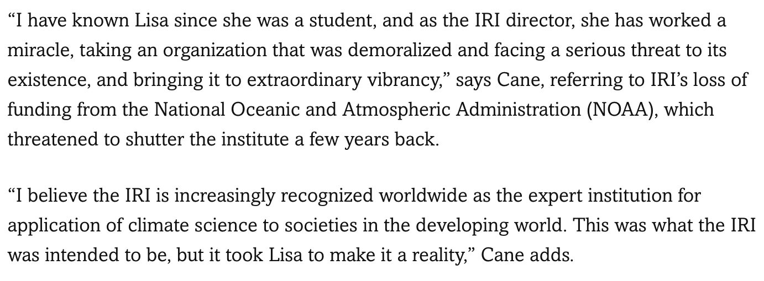
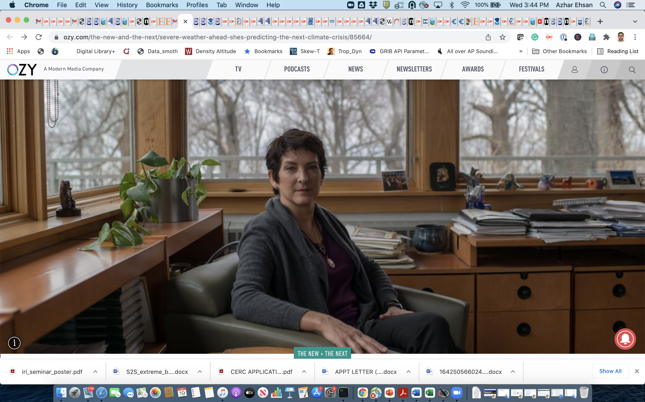
We remember you,
today, tomorrow, and always!

Slide 4
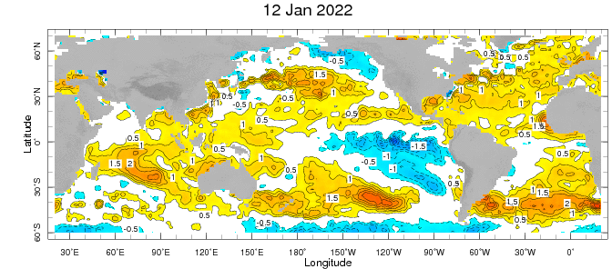
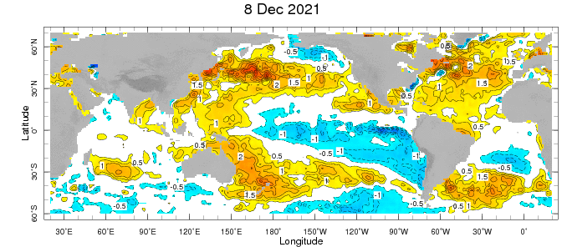
Weekly SST Anomalies ➔
Last Month

Slide 5
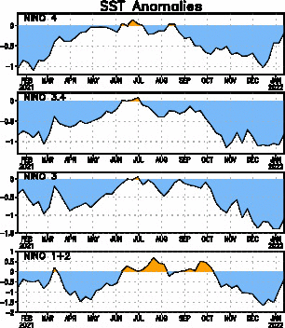
Most recent Value is “-0.8”.

Slide 6
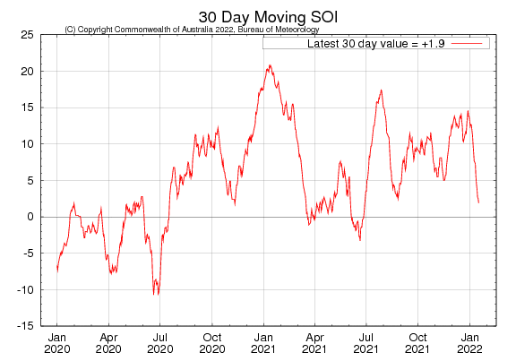
Tahiti_{SLP} – Darwin_{SLP}

Slide 7
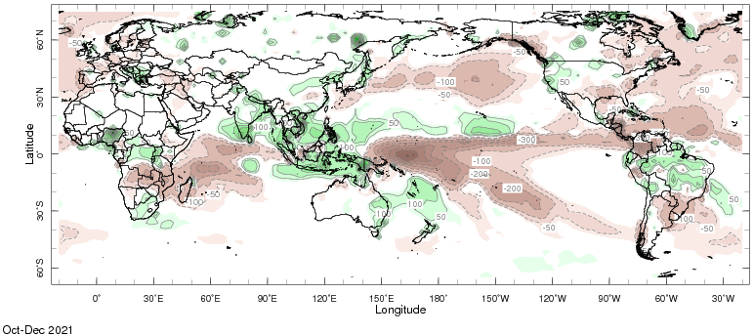
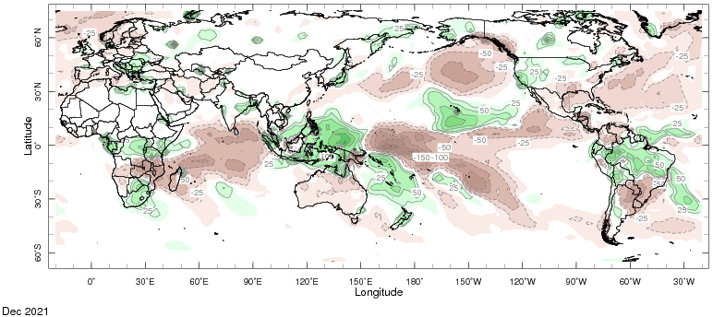

Slide 8
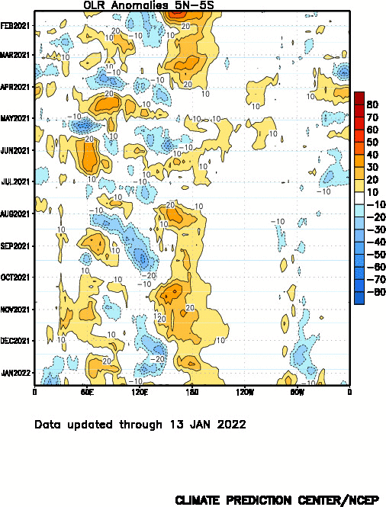

Slide 9
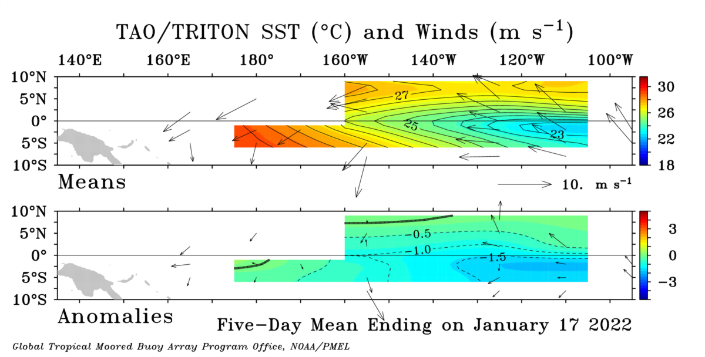

Slide 10
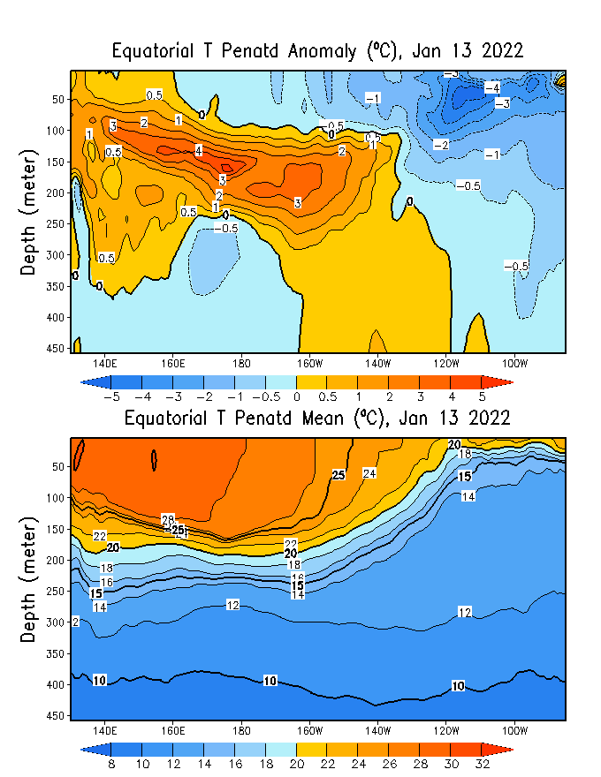
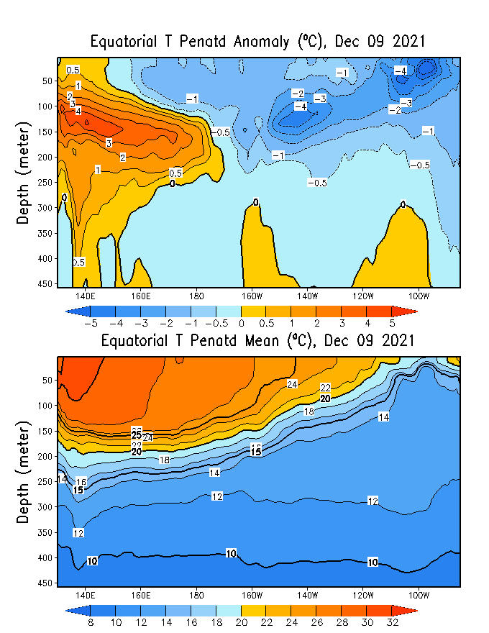
Global Ocean Data Assimilation System (GODAS)
Last Month
Anomaly
Total
GODAS is used to initialize CCSM4 and CFSv2, among others.

Slide 11
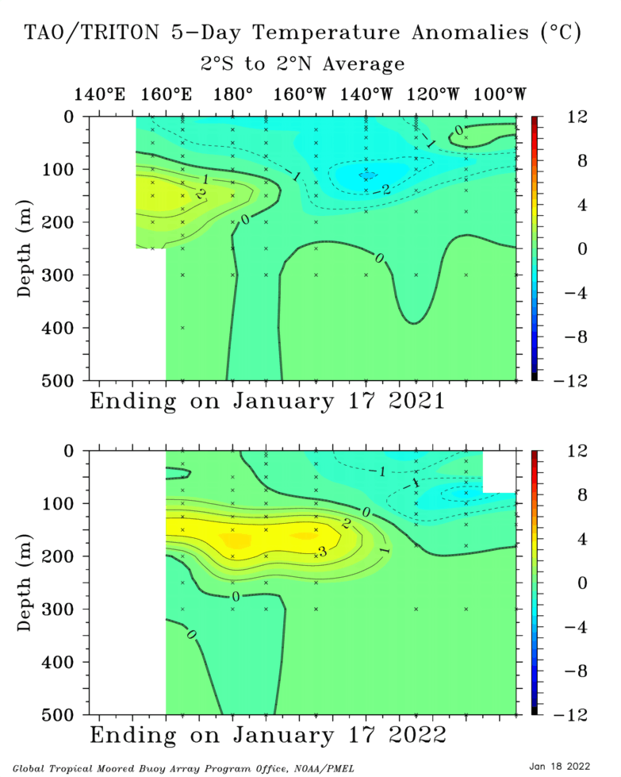
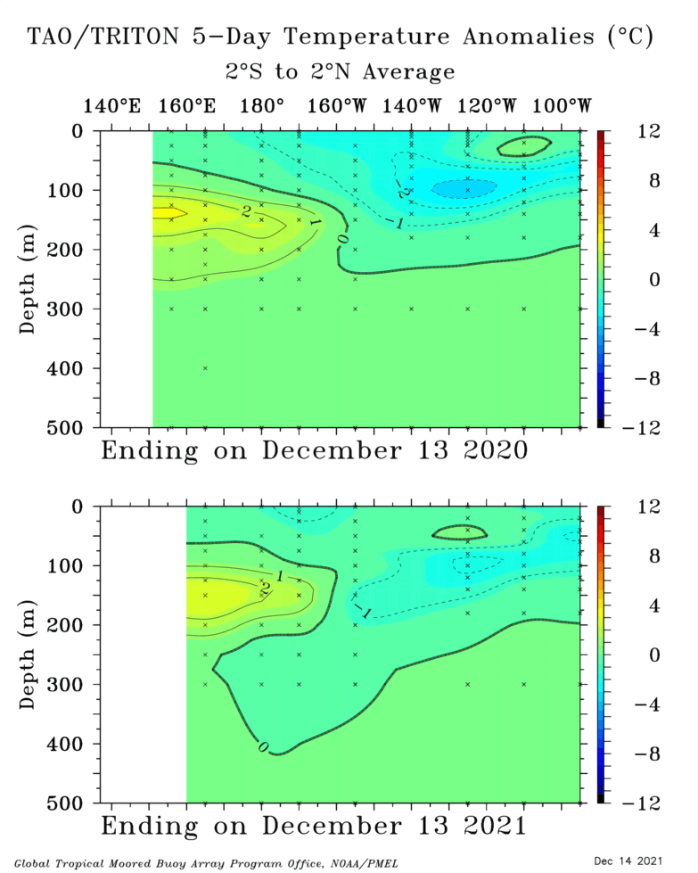
Last Month

Slide 12
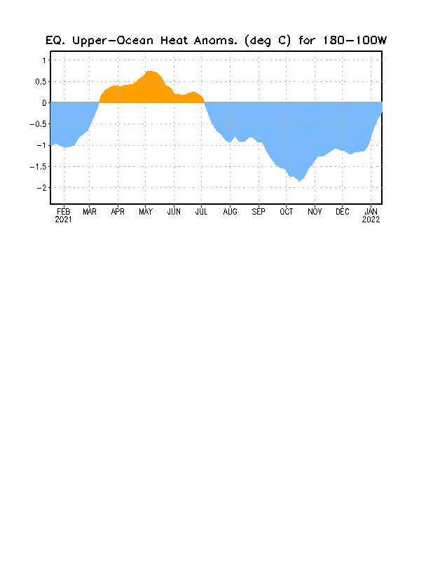

Slide 13
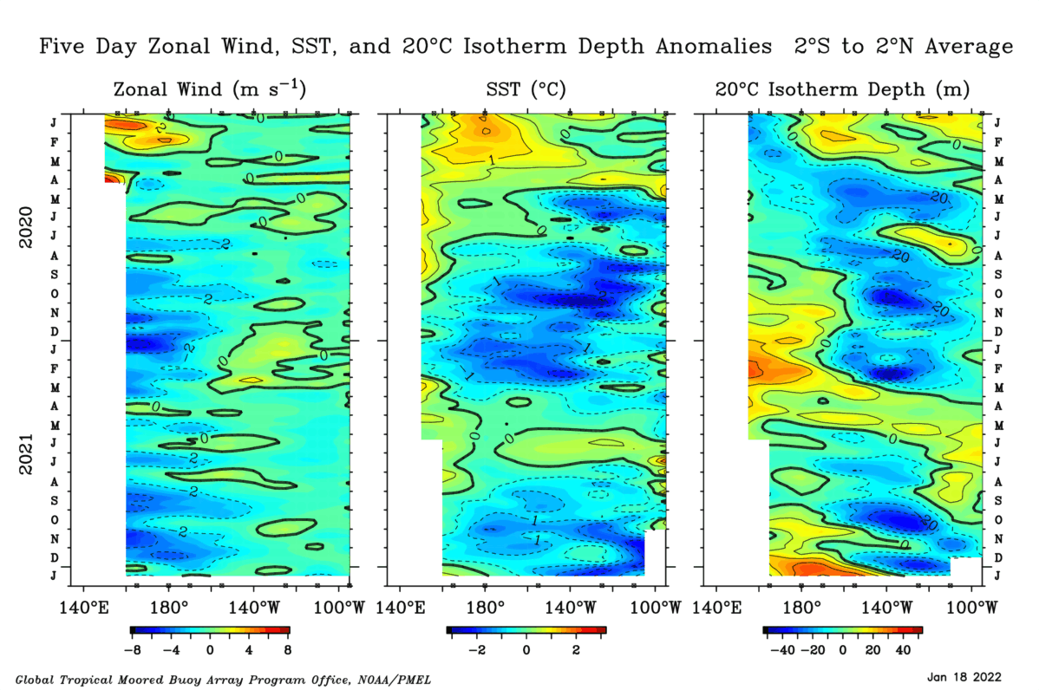

Slide 14
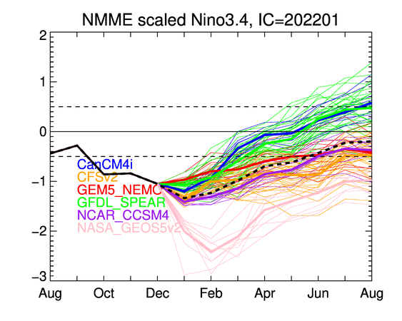

Slide 15
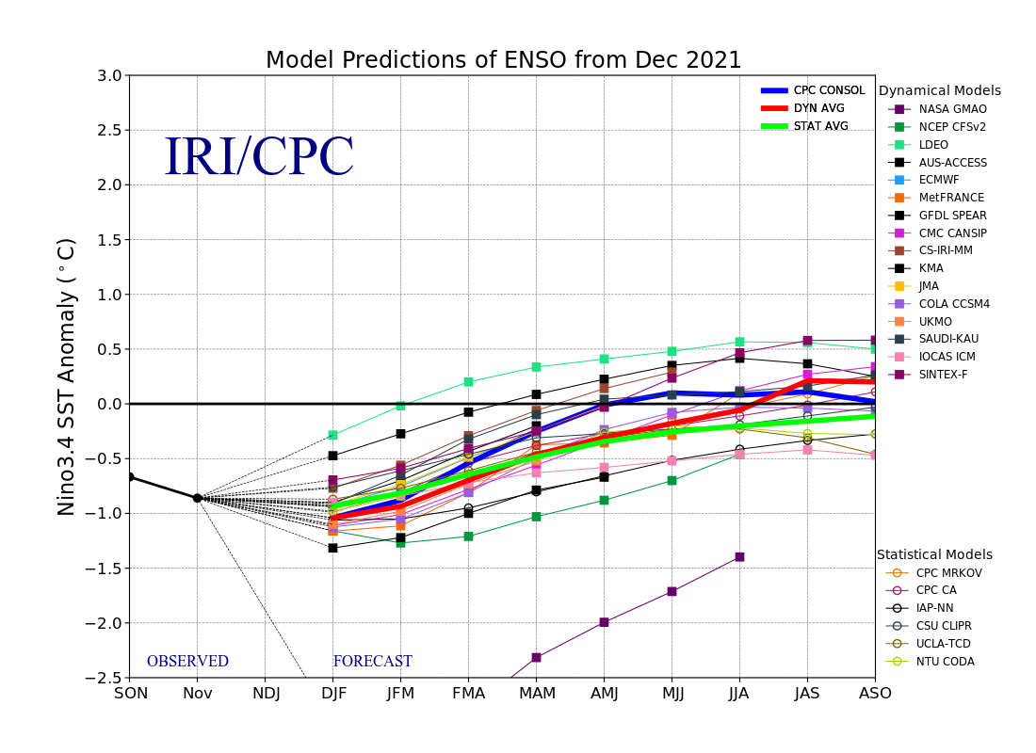

Slide 16
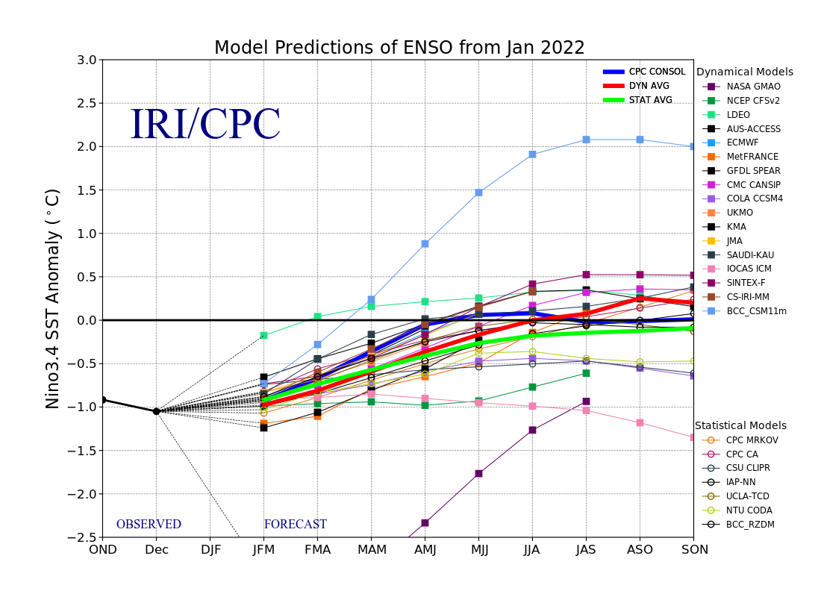

Slide 17
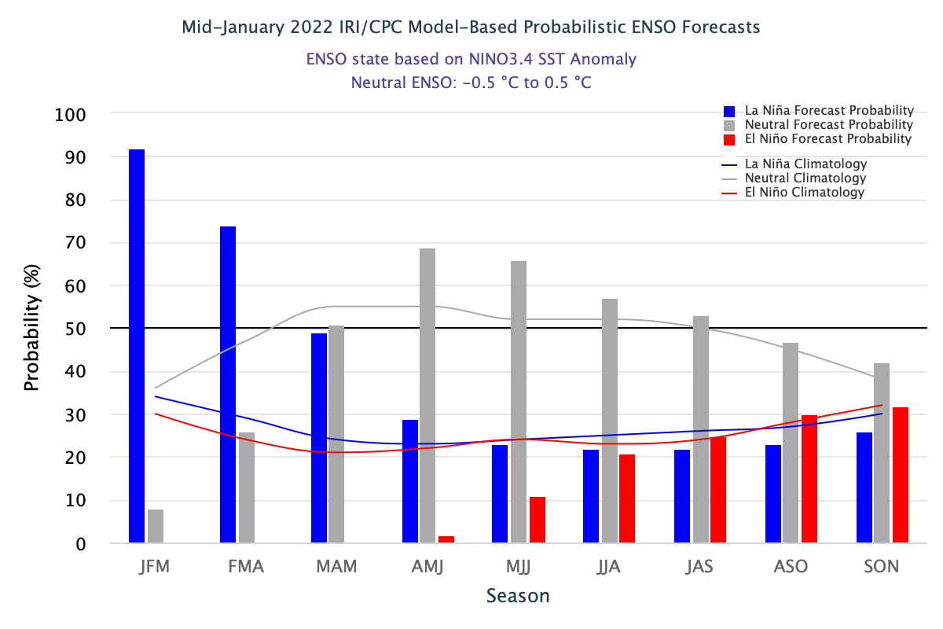
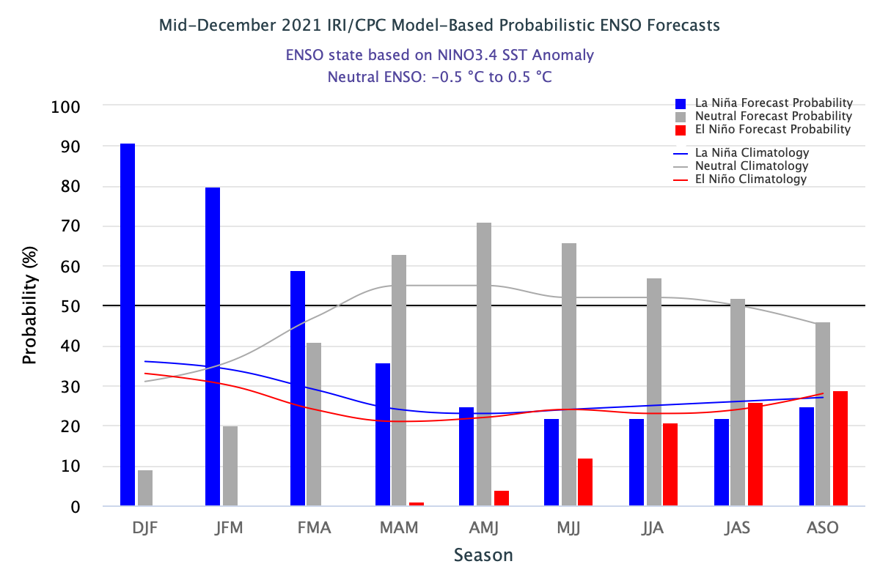

Slide 18
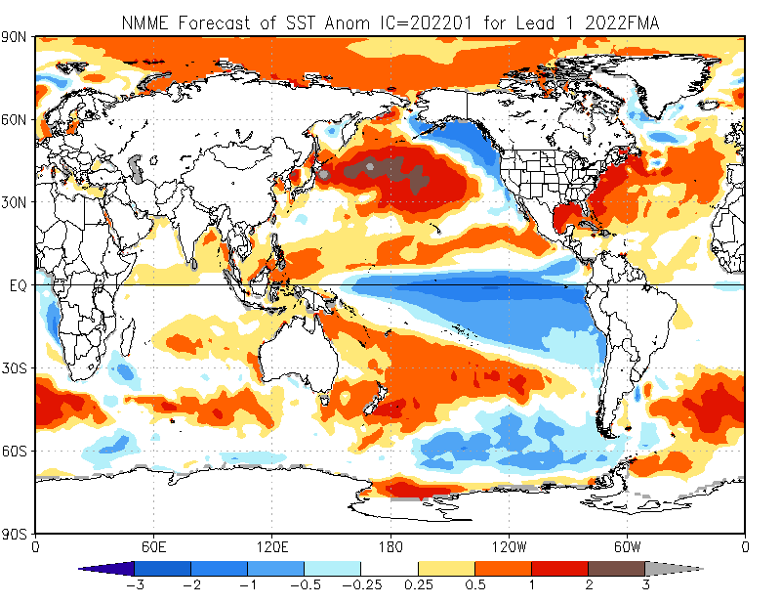

Slide 19
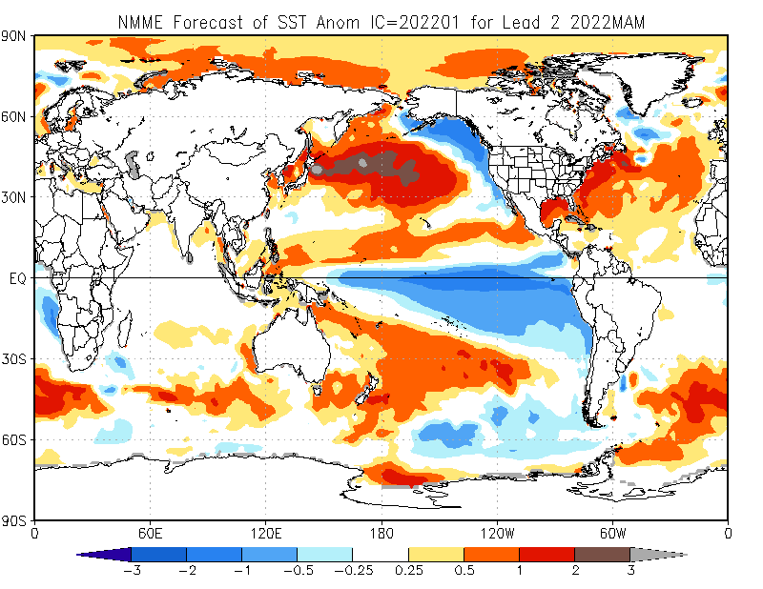

Slide 20
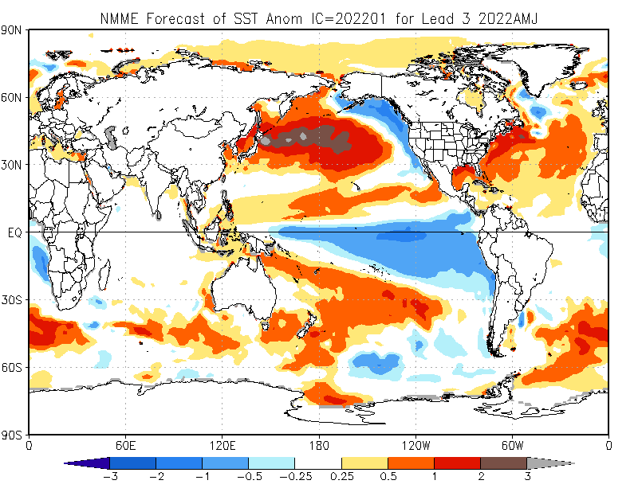

Slide 21
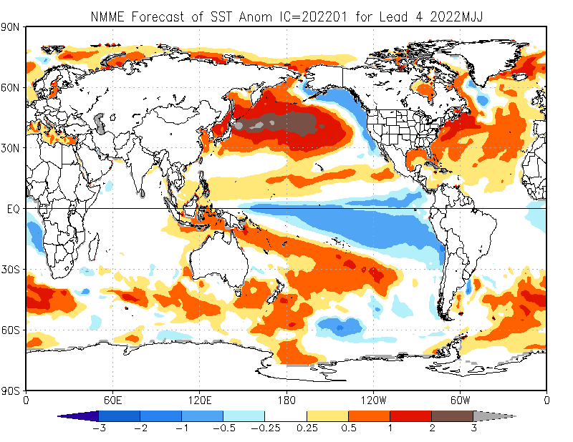

Slide 22
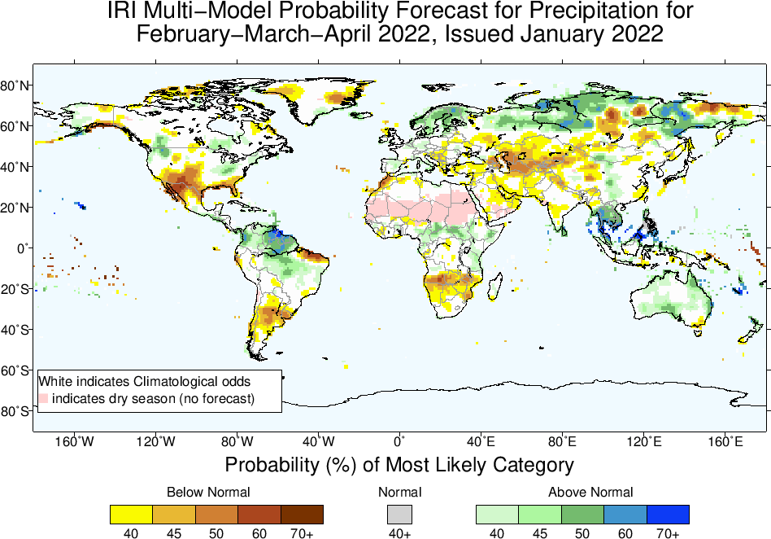

Slide 23
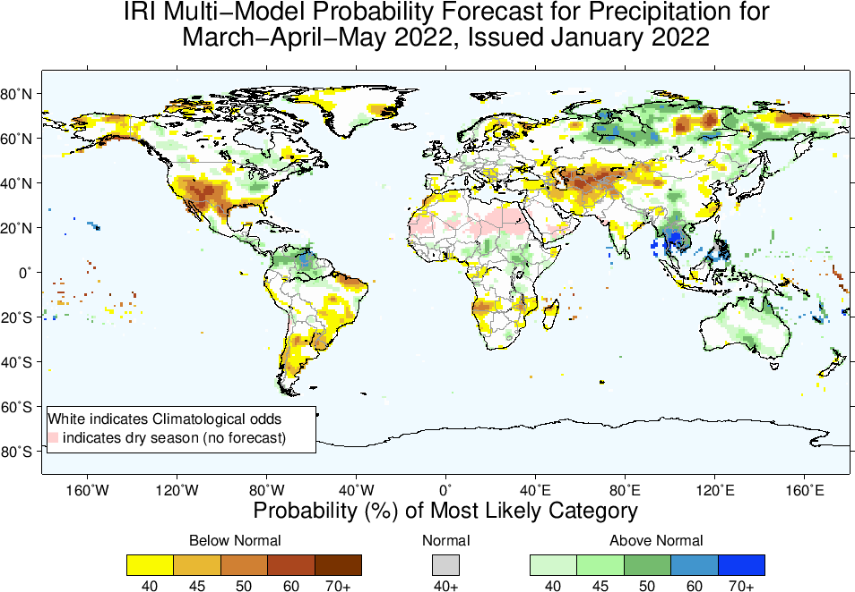

Slide 24
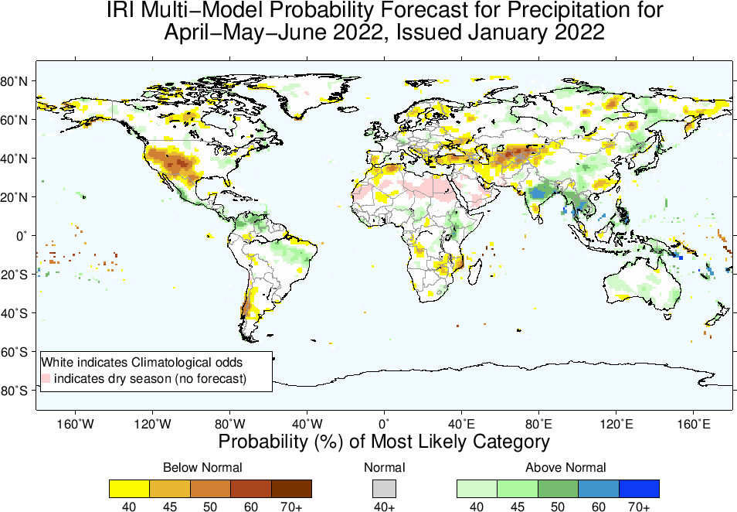

Slide 25
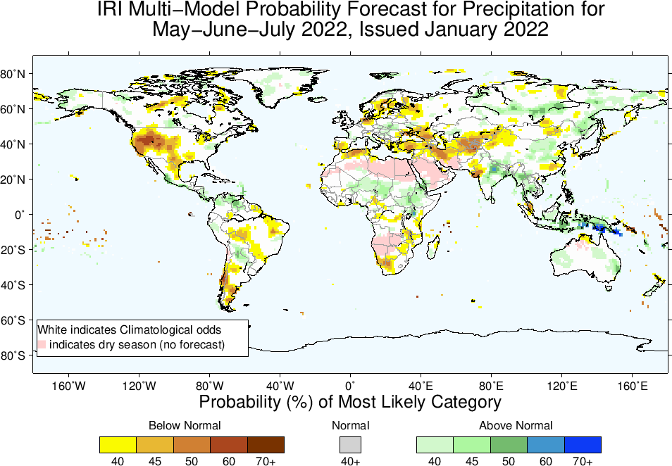

Slide 26
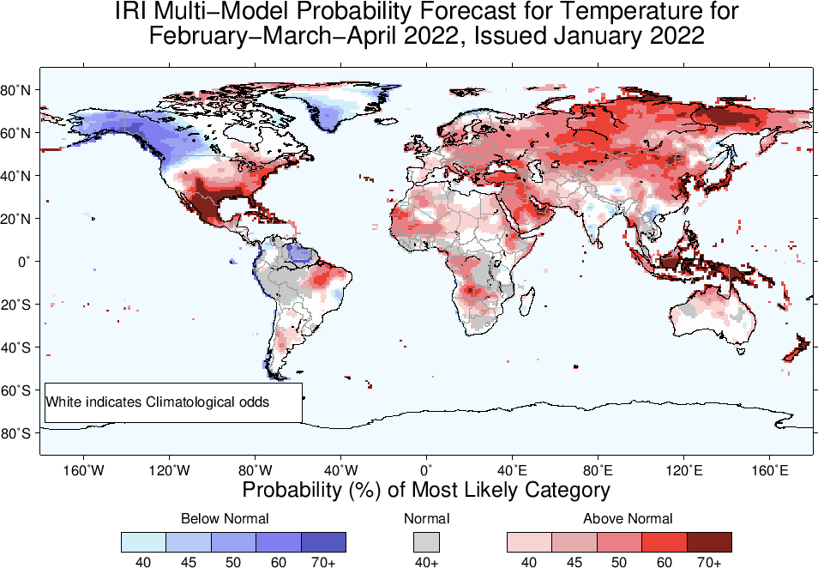

Slide 27
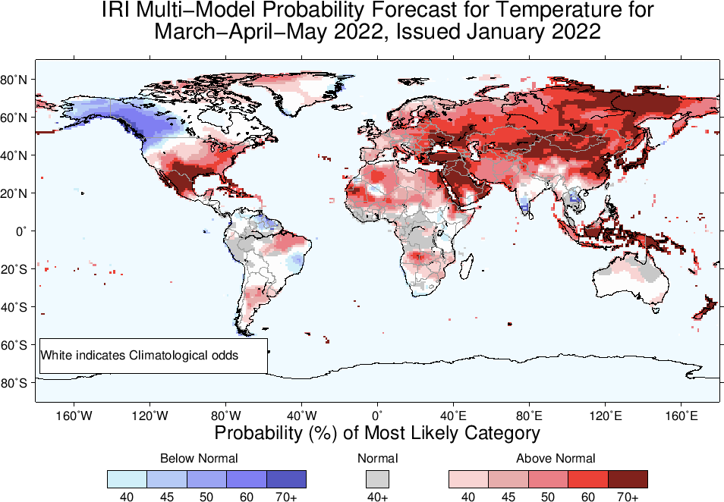

Slide 28
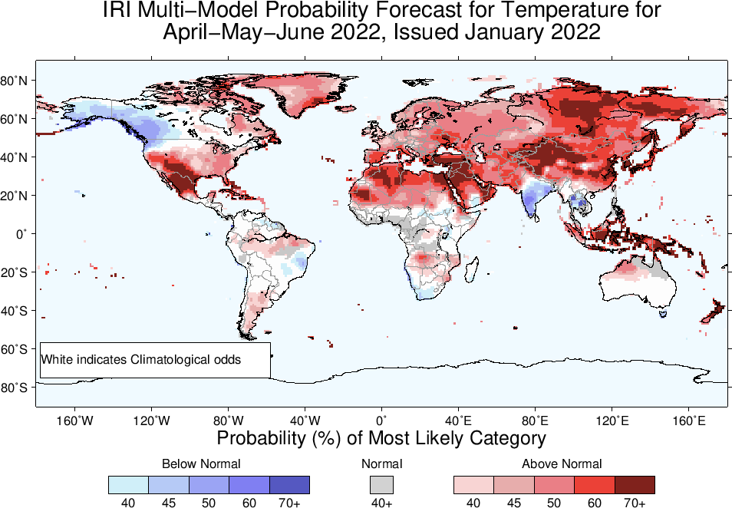

Slide 29
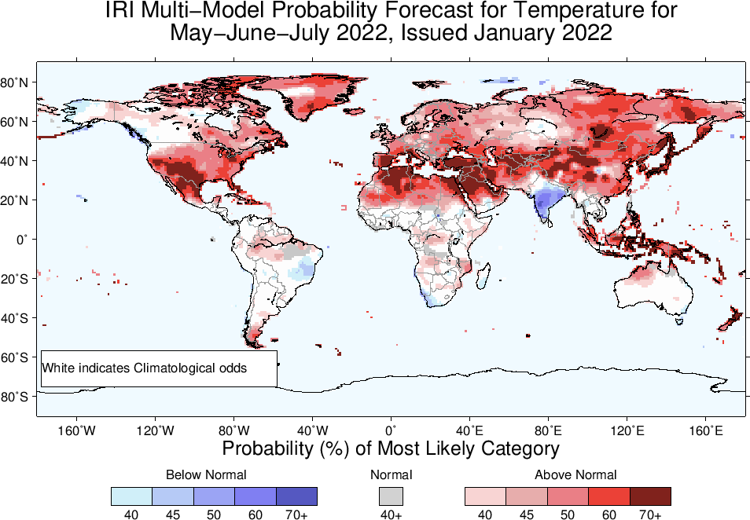

Slide 30
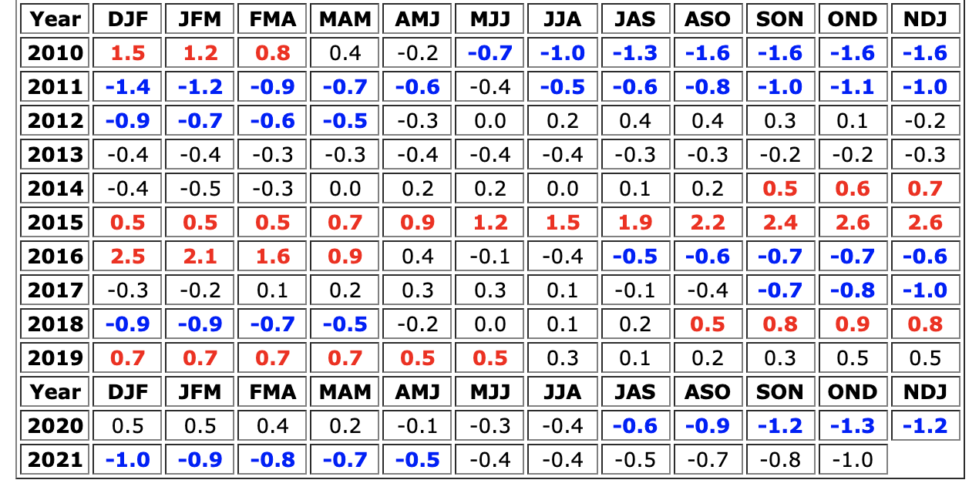
Summary
La Nina (Weak) is still there.
Equatorial sea surface temperatures (SSTs) are below-average across the central-eastern Pacific.
The tropical Pacific Atmospheric conditions are consistent with a weak La Nina.
Current conditions possibly meet the conditions of a COLD ESNO event before its transition to ENSO-neutral in MAM.

