Slide 1
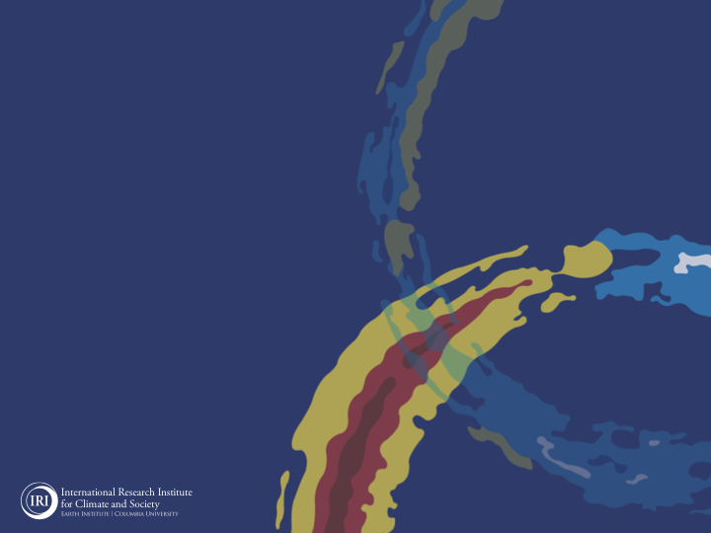
ENSO and Climate Outlook in February, 2024:
El NINO Advisory and LA NINA Watch! BOGO ☺
M. Azhar Ehsan
(azhar@iri.columbia.edu)
Associate Research Scientist
IRI ENSO and Climate Forecast Lead
Jeffrey Turmelle and Jing Yuan: forecast processing and web updates
Cuihua Li: Draft PowerPoint development
IRI’s Climate Group, led by Dr. Andrew Robertson: Forecast system development, ongoing innovation, and verification

Slide 2
Outline
Observed Oceanic and Atmospheric Conditions in
Tropical Pacific
Across the Globe
ENSO Forecast in
NMME
IRI ENSO Forecast Tool (Deterministic and Probabilistic)
Seasons Outlook of
SST
Precipitation and Temperature
Summary

Slide 3
Observations
Oceanic
Atmospheric

Slide 4
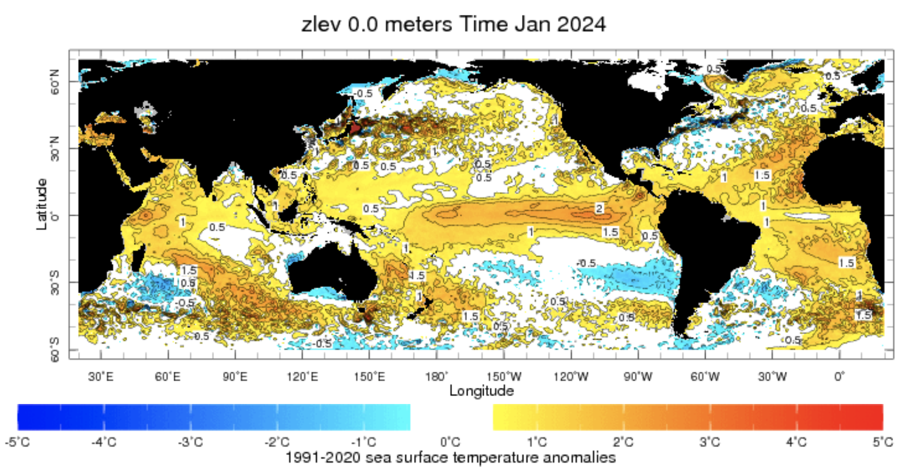
Evolution of SST Departures in Monthly (Jan, 2024) Data
For Jan, 2024
NINO 1+2: +0.83
NINO3: +1.87
NINO3.4: +1.78
NINO4: +1.45
In the Pacific Ocean: Above-Average SSTs persisted across the central (across the Date Line), surrounded by strong +ve SSTA in the high latitudes
Indian Ocean: Warm across Indian Ocean, Neutral IOD (Index value is -0.05 as of 18 Feb, 2024)
North-Pacific and North Atlantic Ocean: Negative PDO (-1.54), Warmer across Atlantic (TNAI, +1.10, TSAI, +1.2)
Source: https://iridl.ldeo.columbia.edu/maproom/Global/Ocean_Temp/ERSST_Anomaly.html

Slide 5
What's the underwater chatter?
December, 2023
February, 2024
Warm subsurface temperature anomalies dominate in the equatorial Pacific Ocean (Surface to 50 meter at depth).
Cold subsurface temperature anomalies have strengthened in the Pacific Ocean and expanded to 100ºW, while remaining at depth.
January, 2024

Slide 6
What's the underwater chatter?
Subsurface temperature anomalies became positive in February 2023 and have persisted as of January, 2024.
Variability in the anomalies was associated with several oceanic Kelvin waves.
Since late December 2023, positive anomalies have weakened and are near zero as of Feb, 2024 (slight negative).

Slide 7
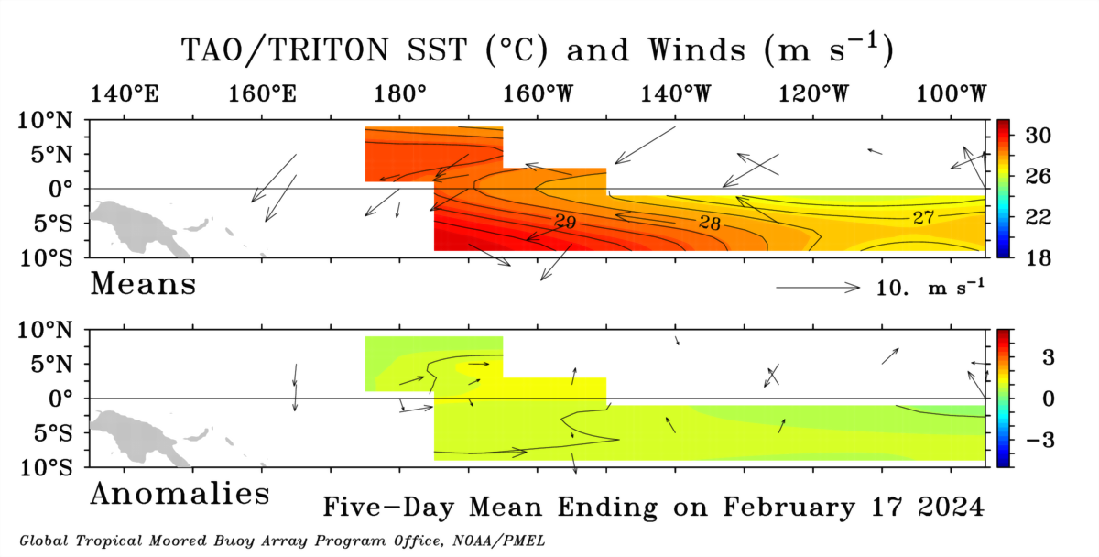
Most recent Sea Surface Temperature (SST) Lower-Level Winds

Slide 8
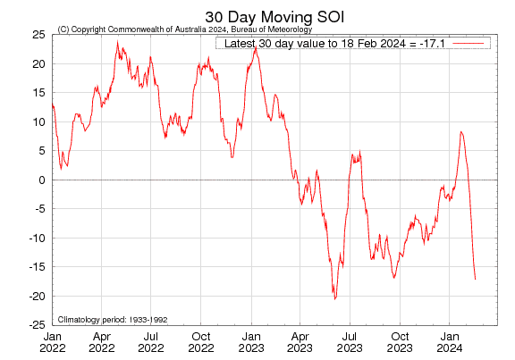
Most recent Southern Oscillation Index (SOI)
SOI was in ENSO-neutral state in Dec-23, and Jan-24.
There is a big dive.
Variability is higher and could be even stronger during upcoming months.
During El Niño, the pressure becomes below average in Tahiti and above average in Darwin, and the Southern Oscillation Index is negative.
A Sustained Negative values of the SOI above -7 typically indicate El Niño
Source:
http://www.bom.gov.au/climate/enso/#tabs=Pacific-Ocean&pacific=SOI

Slide 9
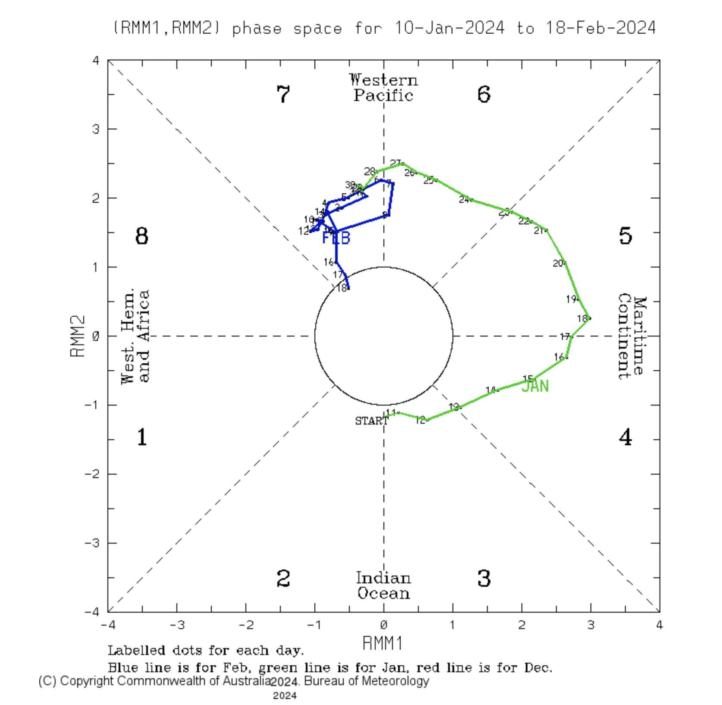
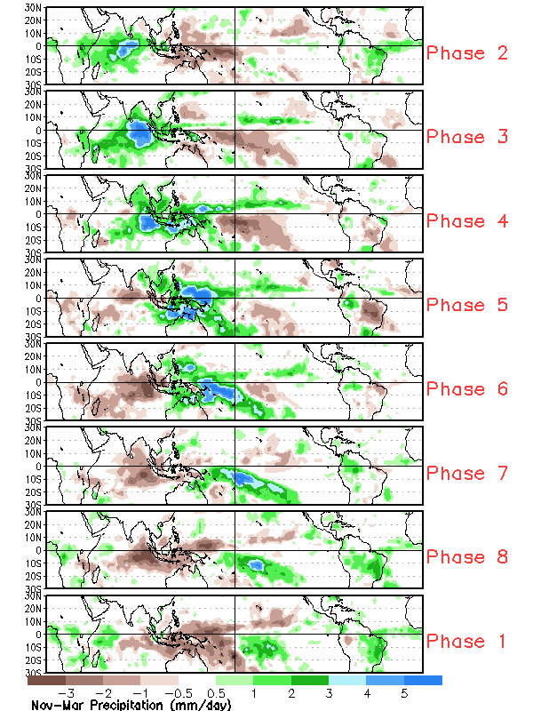
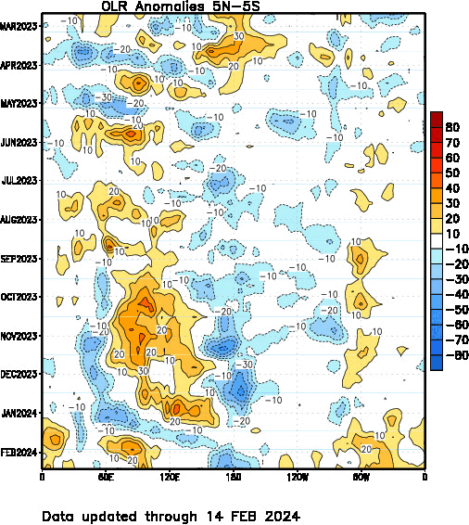
Most recent Outgoing Longwave Radiation (OLR)
During MJO Phases 6 and 7, there is often enhanced convection and rainfall activity over the central-western Pacific and,
Suppression of convection over the eastern Pacific.
This can lead to the weakening or suppression of trade winds in the central and eastern Pacific.
Constructive interference with ongoing
El Nino.

Slide 10
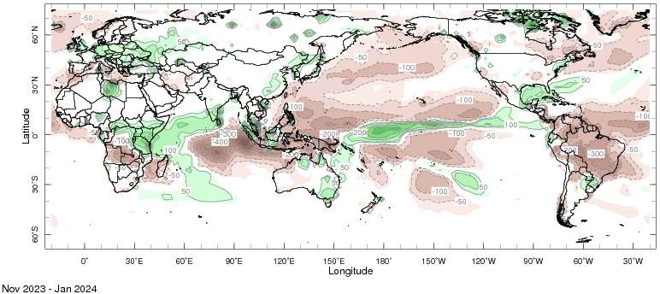
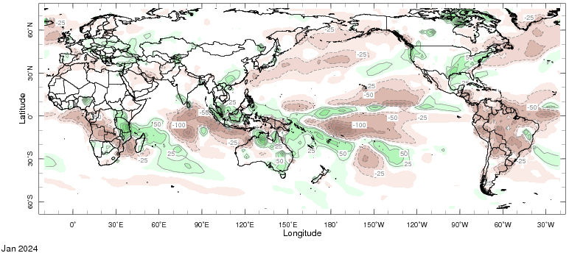
Most recent Precipitation Anomalies
(Nov-Jan, and Jan, 2024)
Dipole of Above/Below Average Rainfall W/E sides
Positive Indian Ocean Dipole (which is over now)

Slide 11
Forecasts
Nino-34 in NMME,
IRI ENSO Plume,
Probability of Nino-34,
Global SSTs from NMME,
Prcp. and Temp. outlook from IRI (February, 2024)

Slide 12
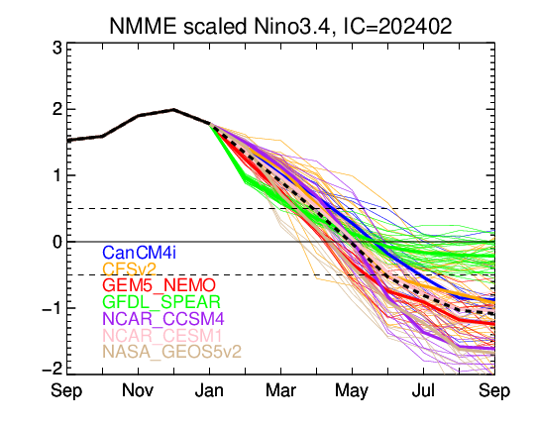
North American Multi Model Ensemble (NMME) ENSO Forecast (Feb, 2024 Initial)

Slide 13
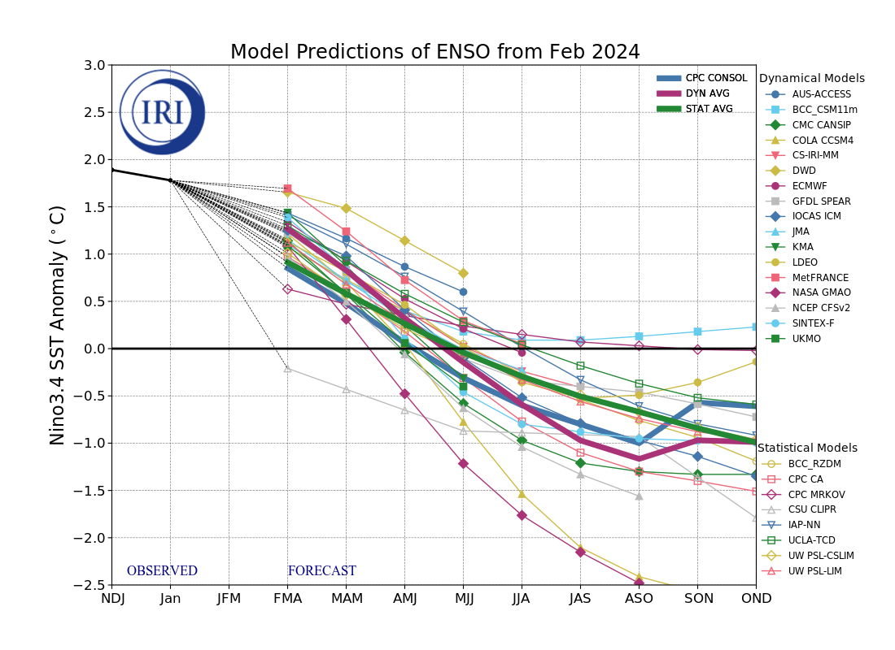
IRI’s ENSO Forecast Feb, 2024
Majority of models (DYN & STAT) indicate El Niño will persist through March-May 2024 and then transition to ENSO-neutral during April-June 2024.
After two seasons of ENSO-neutral conditions, most models indicate a transition to La Niña around Jul-Sep 2024.

Slide 14
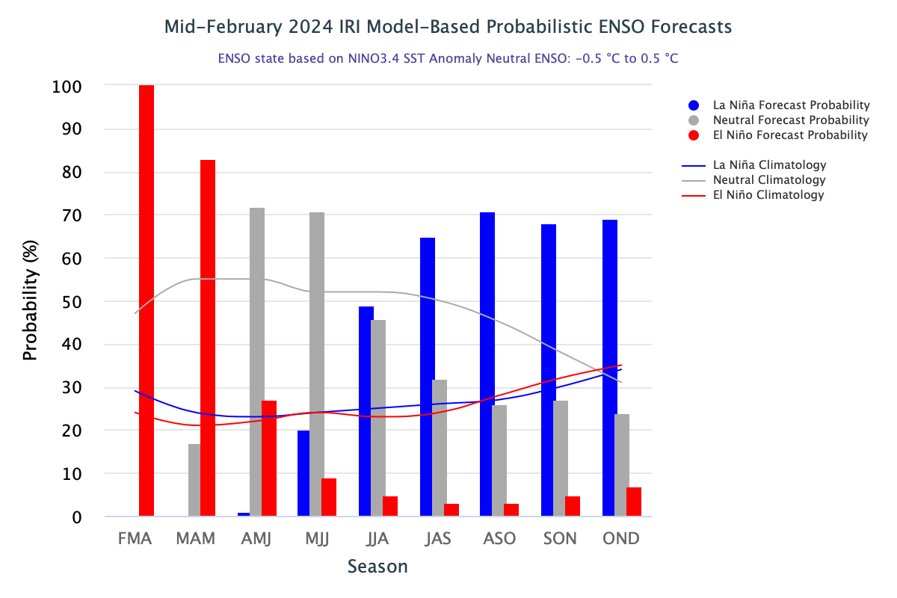
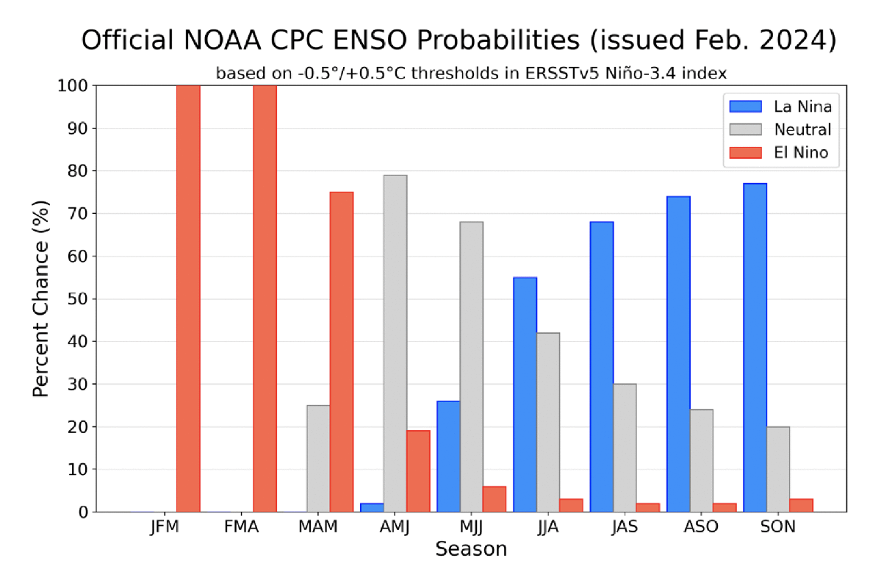
IRI’s Probabilistic ENSO Forecasts (on 19th Feb, 2024)

Slide 15
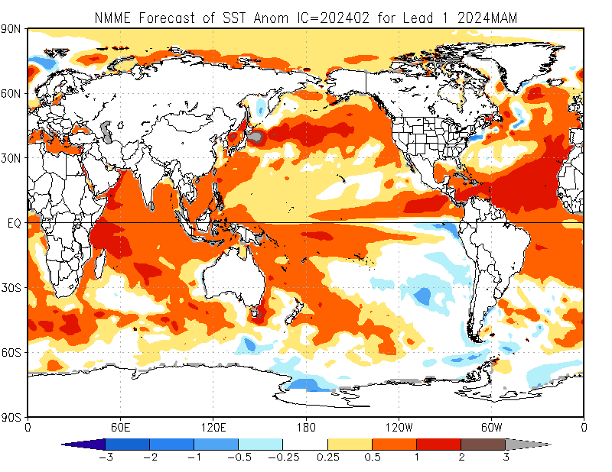
North American Multi Model Ensemble
(NMME) SST Forecast

Slide 16
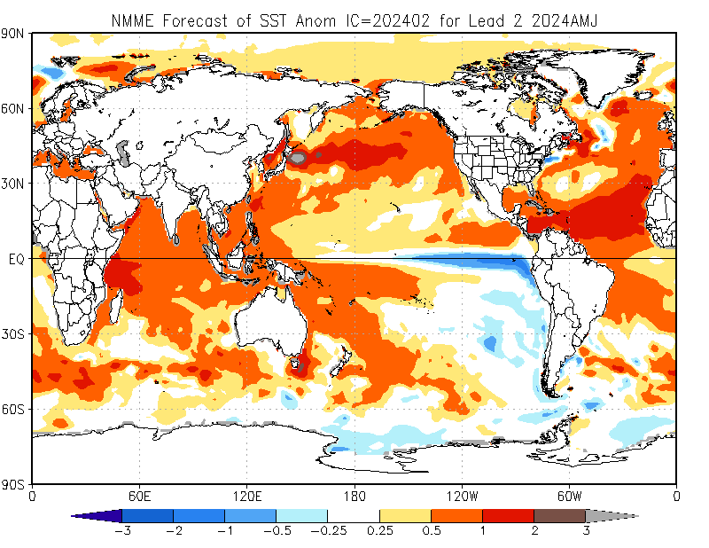

Slide 17
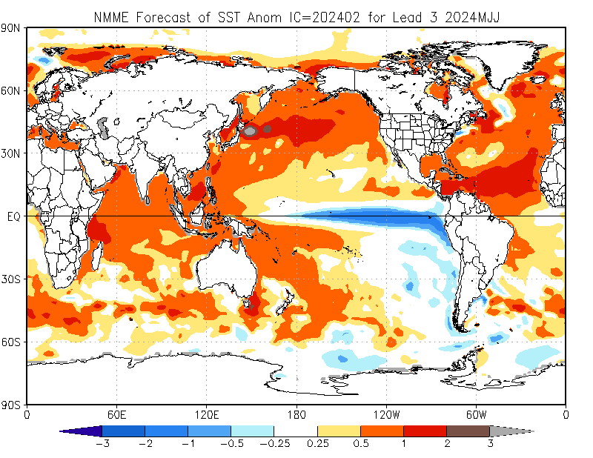

Slide 18
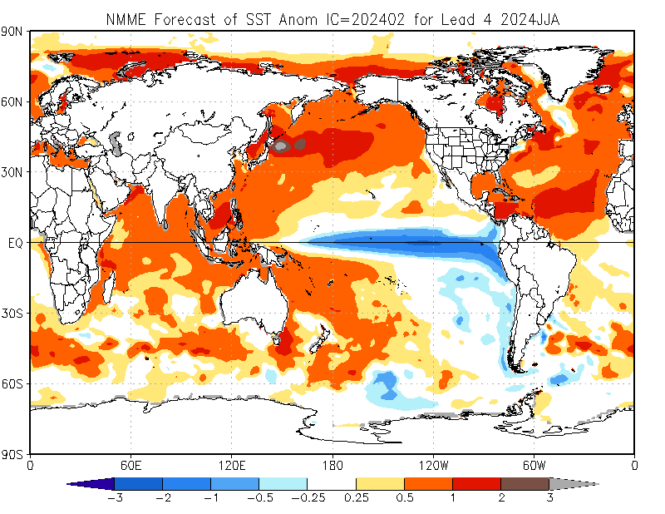

Slide 19
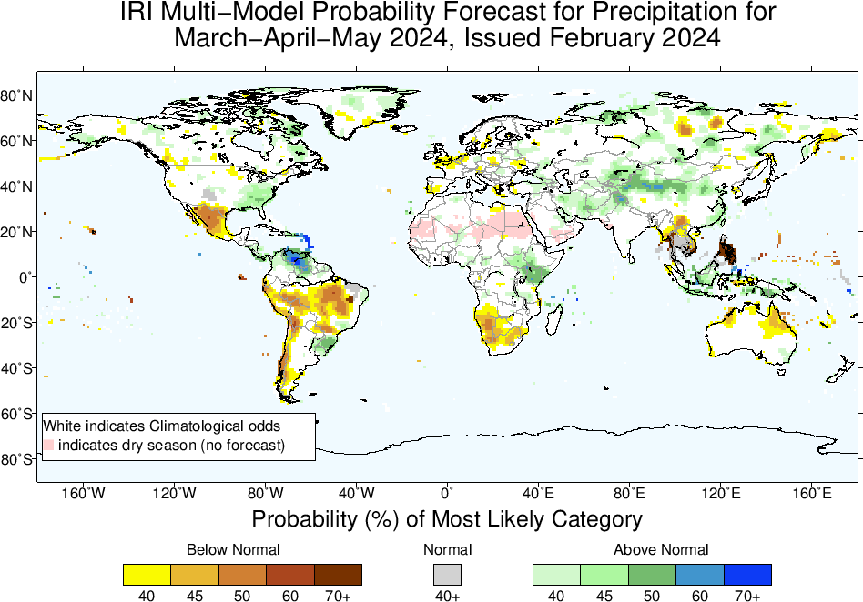
Precipitation Forecasts based on North American Multi Model Ensemble (NMME)

Slide 20
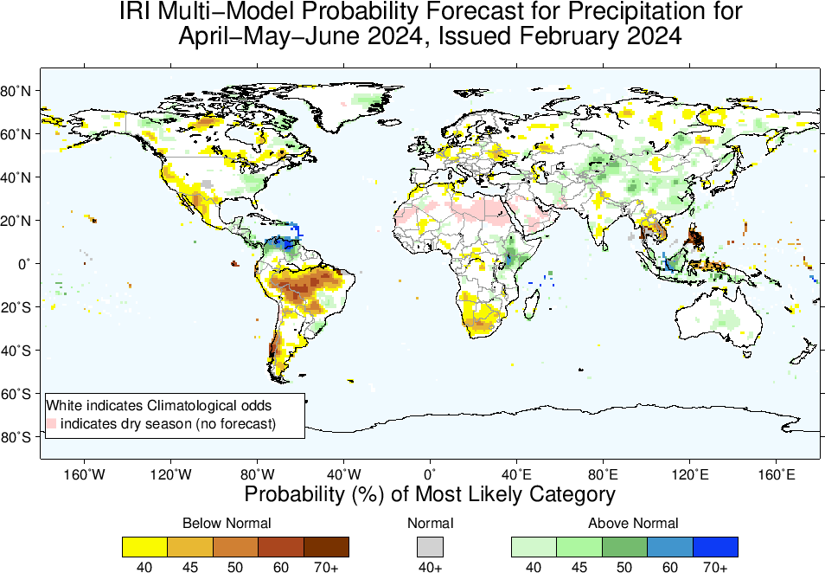

Slide 21
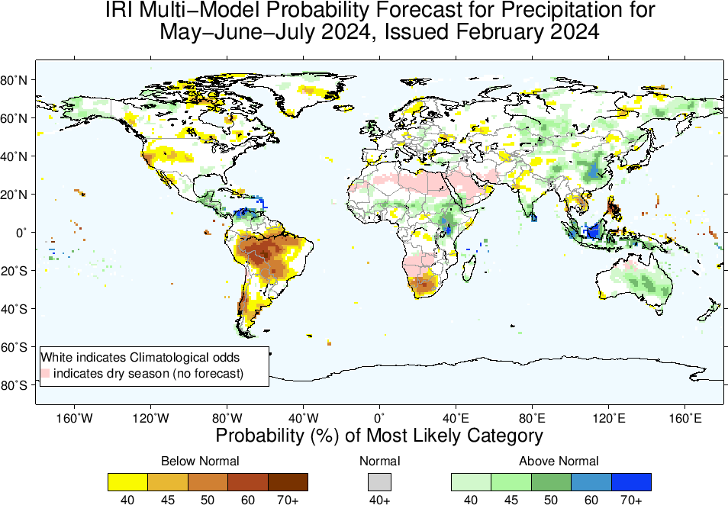

Slide 22
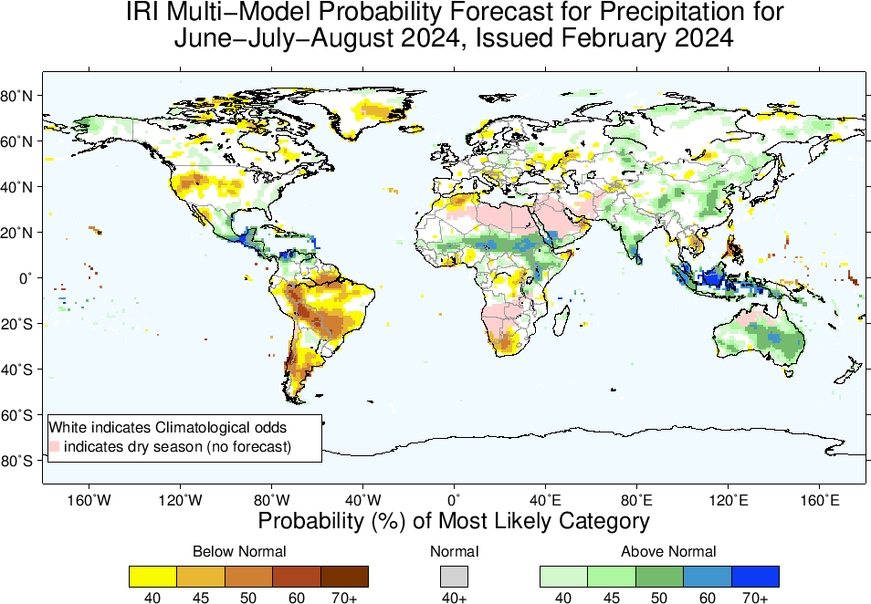

Slide 23
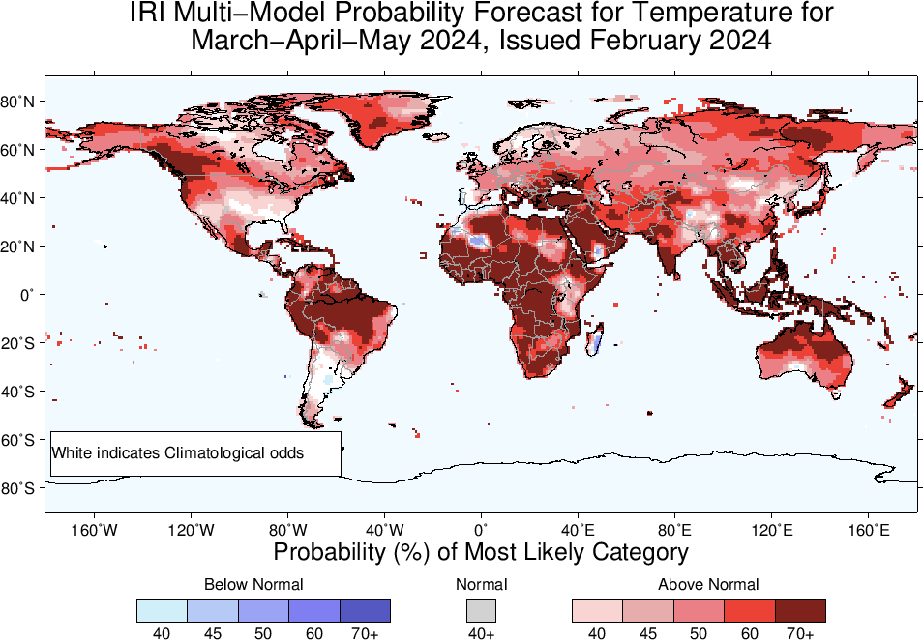
2m-Temperature Forecasts based on North American Multi Model Ensemble (NMME)

Slide 24
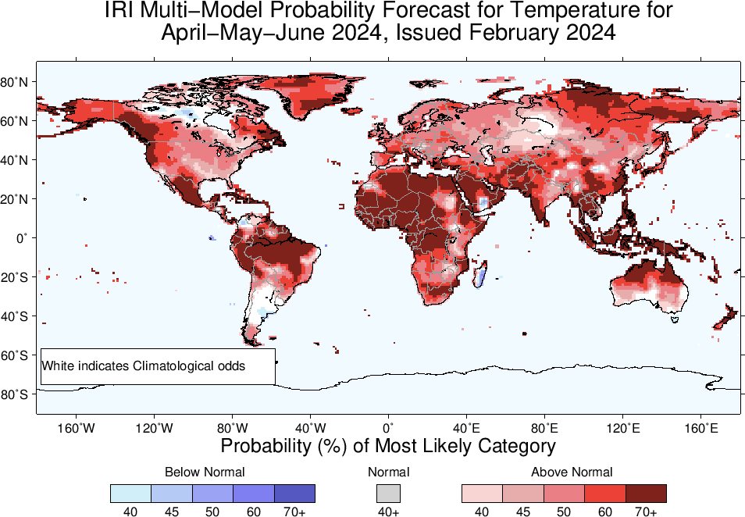

Slide 25
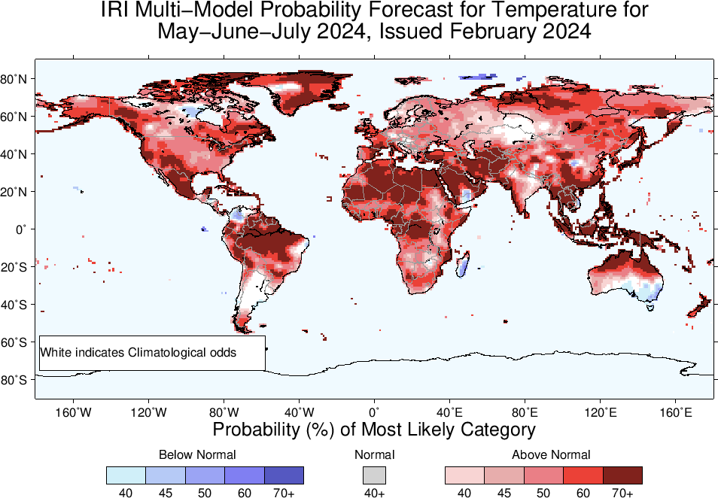

Slide 26
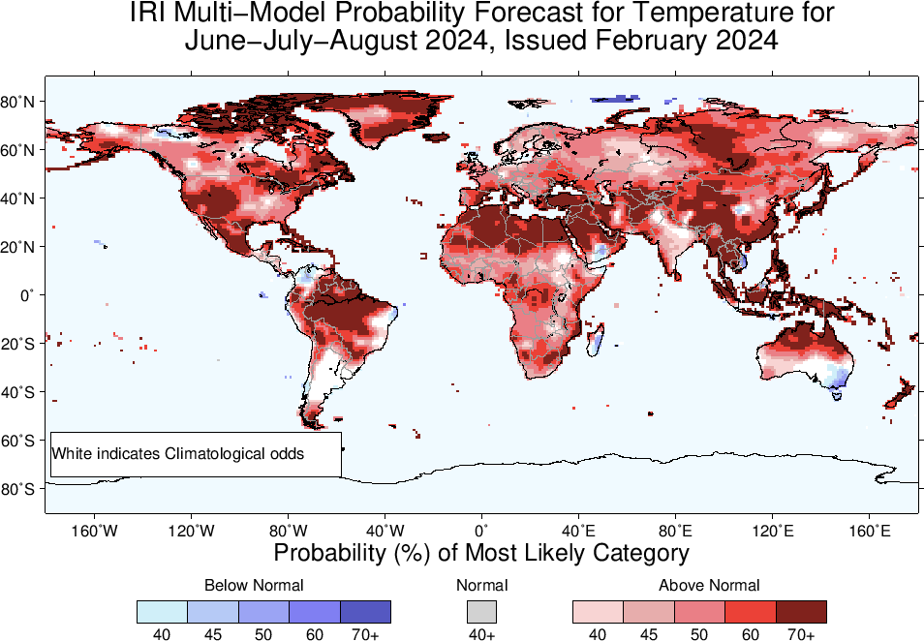

Slide 27
Summary
After its Peak in Nov-Jan, current El Nino has started declining (Dec, 2023 NINO3.4 Value was +1.99, while Jan, 2024 was +1.78), while for most recent week ending on 14 Feb, 2024, it was +1.5.
Positive Indian Ocean Dipole disappears.
The latest forecasts suggest that the current El Nino will persist through the boreal Spring (75% in MAM-2024), sharply weakening thereafter.
ENSO-Neutral is most probable in AMJ, MJJ, 2024.
LA NINA is most likely from JAS, and remain so onward.
The likelihood stands in the upper 60s and 70s, though forecasting at this time of the year is highly uncertain due to the forecasts passing through the boreal spring-time.

