Slide 1
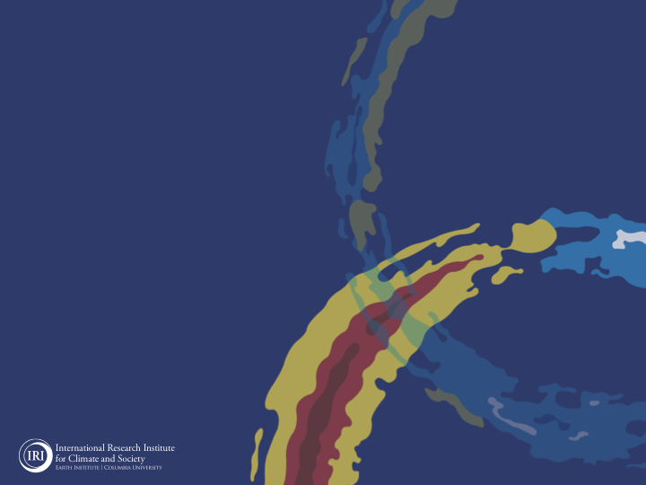
ENSO and Climate Outlook
in February 2023
Weak La Nina conditions still continue!
Will it survive?
M. Azhar Ehsan
(azhar@iri.columbia.edu)
Associate Research Scientist
IRI ENSO and Climate Forecast Lead
Jeffrey Turmelle and Jing Yuan: forecast processing and web updates
Cuihua Li: Draft PowerPoint development
IRI’s Climate Group, led by Dr. Andrew Robertson: Forecast system development, ongoing innovation, and verification

Slide 2
Outline
Observed Oceanic and Atmospheric Conditions in
Tropical Pacific
Across the Globe
ENSO Forecast in
NMME
IRI ENSO Forecast Tool (Deterministic and Probabilistic)
Seasons Outlook of
SST
Precipitation and Temperature
Summary

Slide 3
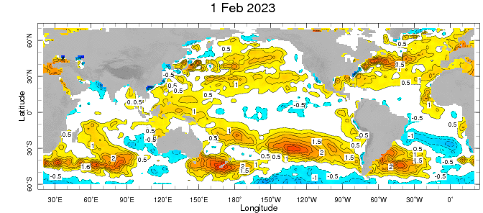
Evolution of EQ. Pacific SST Departures in Weekly OISST Data
In the Pacific Ocean: Normal SSTs anomalies persisted across the central (across the Date Line), surrounded by strong +ve SSTA in the high latitudes.
Indian Ocean: Weak warming on the West and near-normal/state in eastern side.
Atlantic Ocean: Weak warming.
January 23 PDO -0.96.
December PDO -2.24.
https://www.ncei.noaa.gov/access/monitoring/pdo/
http://www.bom.gov.au/climate/enso/#tabs=Indian-Ocean

Slide 4
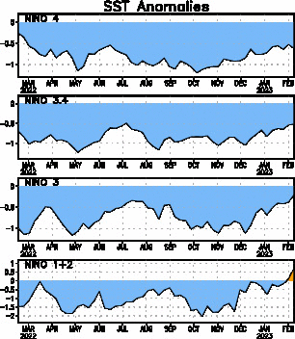
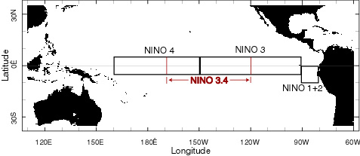
Most recent SST Anom.
Most Recent (08 Feb, 2023) SST Departures in different NINO regions
Niño 4
-0.6ºC
Niño 3.4
-0.5ºC
Niño 3
-0.2ºC
Niño 1+2
0.7ºC

Slide 5
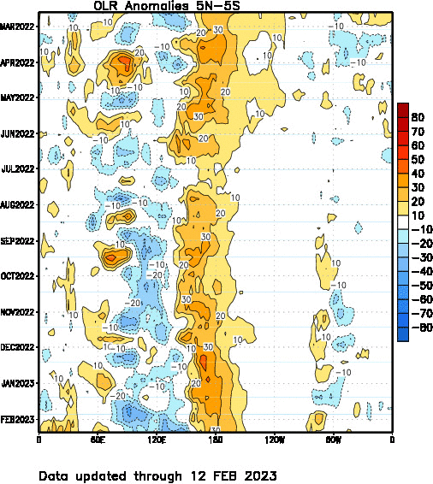
Most recent OLR

Slide 6
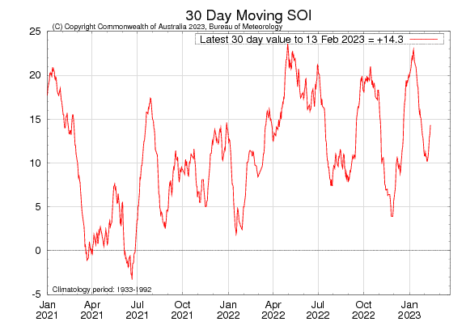
Most recent SOI
Sustained positive values of the SOI above +7 typically indicate La Niña

Slide 7
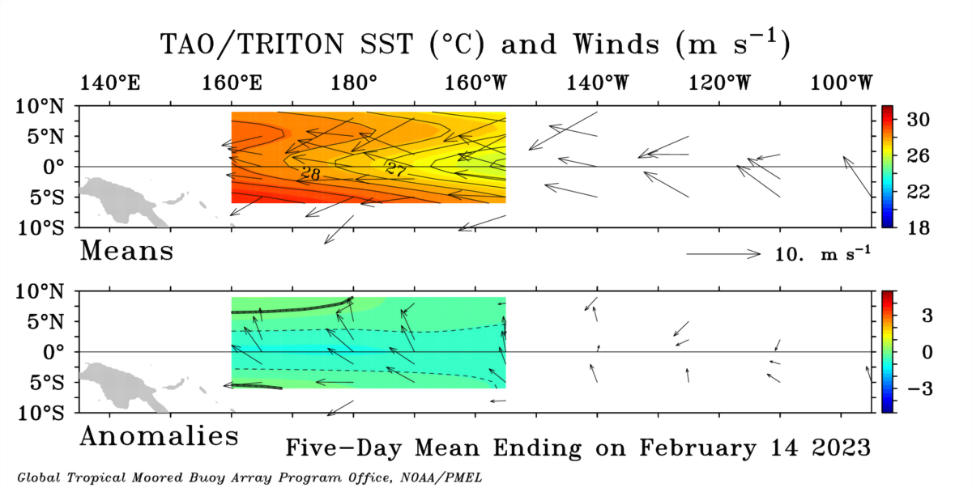
Most recent Lower-Level Winds

Slide 8
Subsurface Temperature Evolution
Last Month
Current Month
Feb, 2022

Slide 9
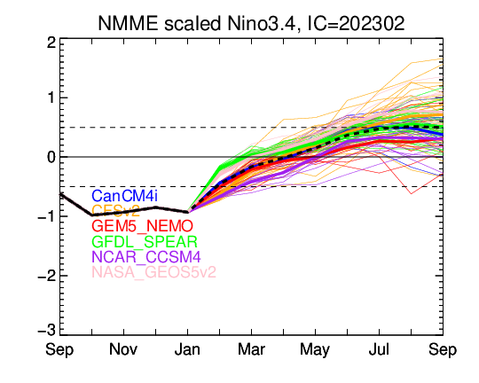
NMME’s ENSO Forecast

Slide 10
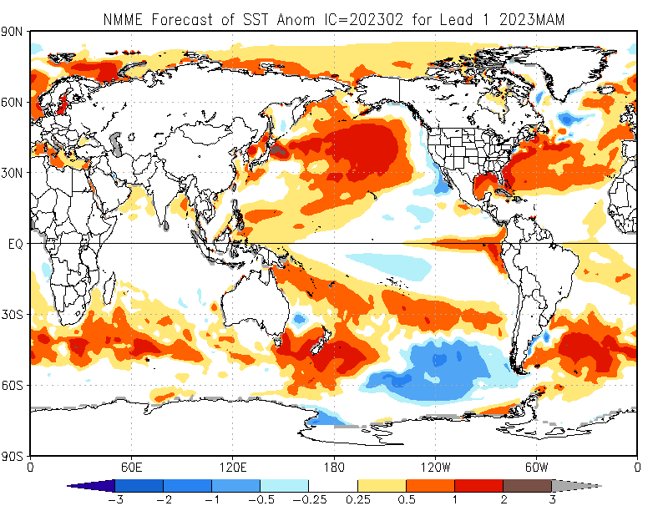

Slide 11
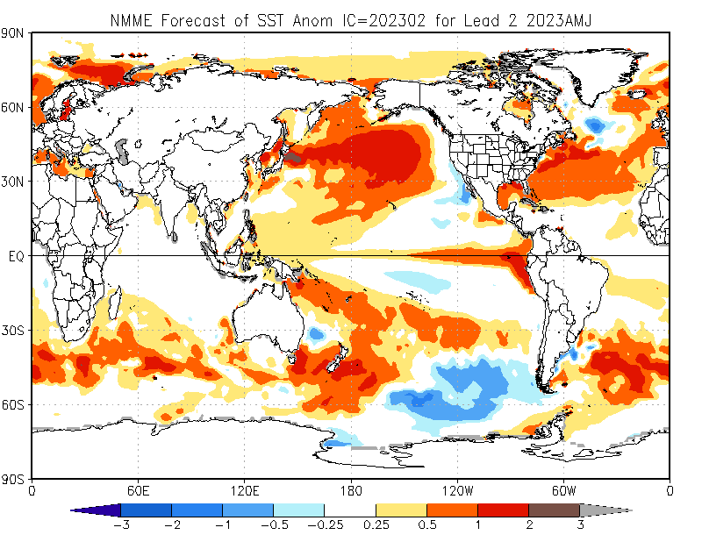

Slide 12
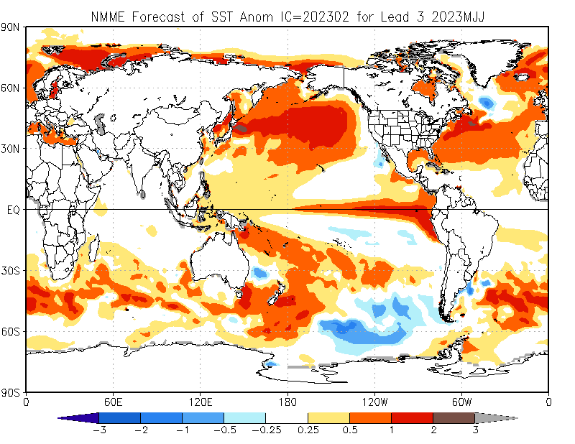

Slide 13
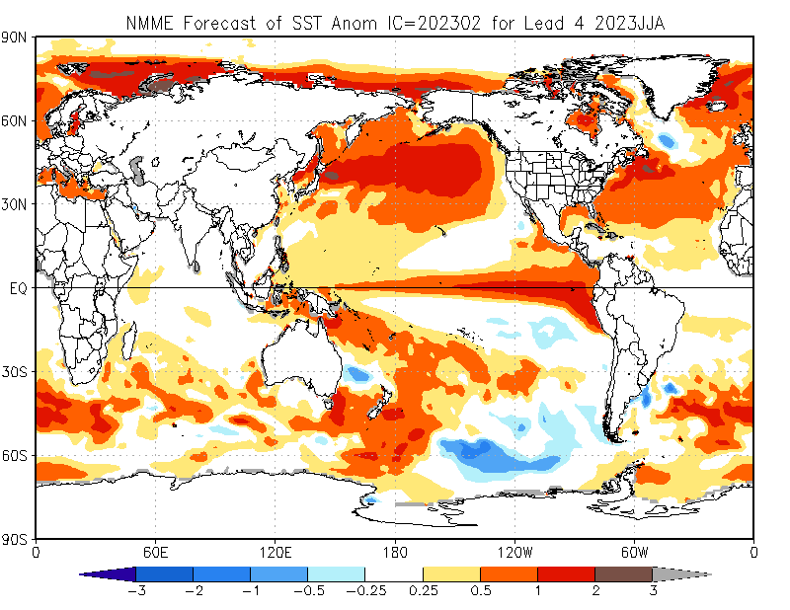

Slide 14
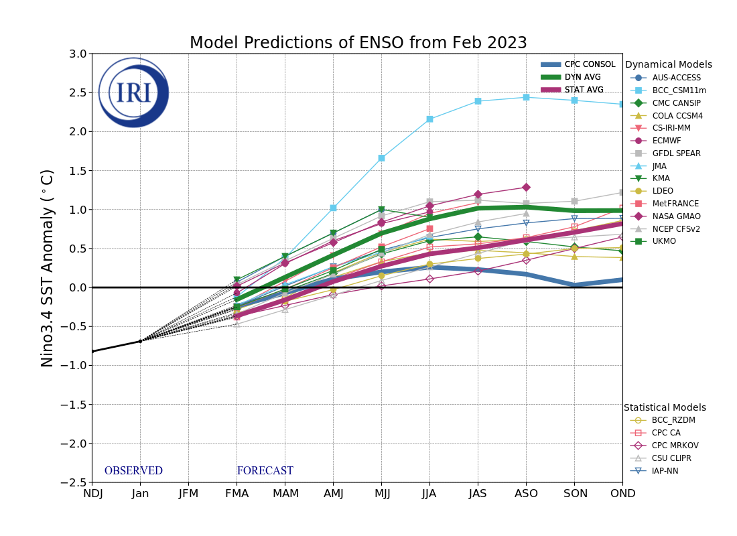
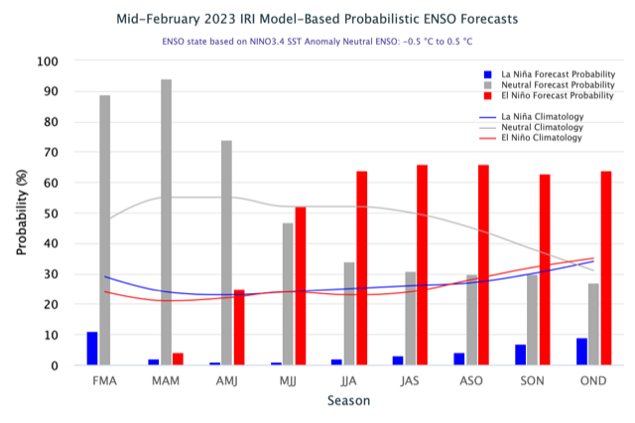
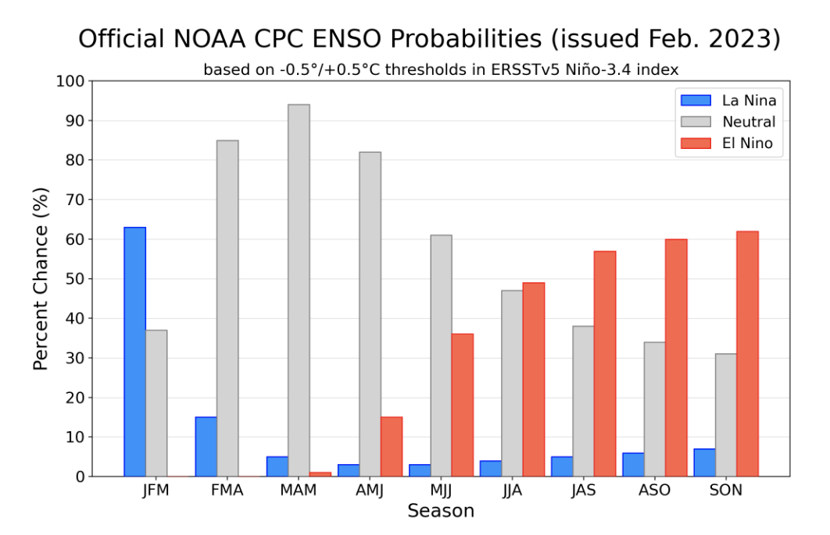
IRI’s ENSO Forecast (Feb, 2023)

Slide 15
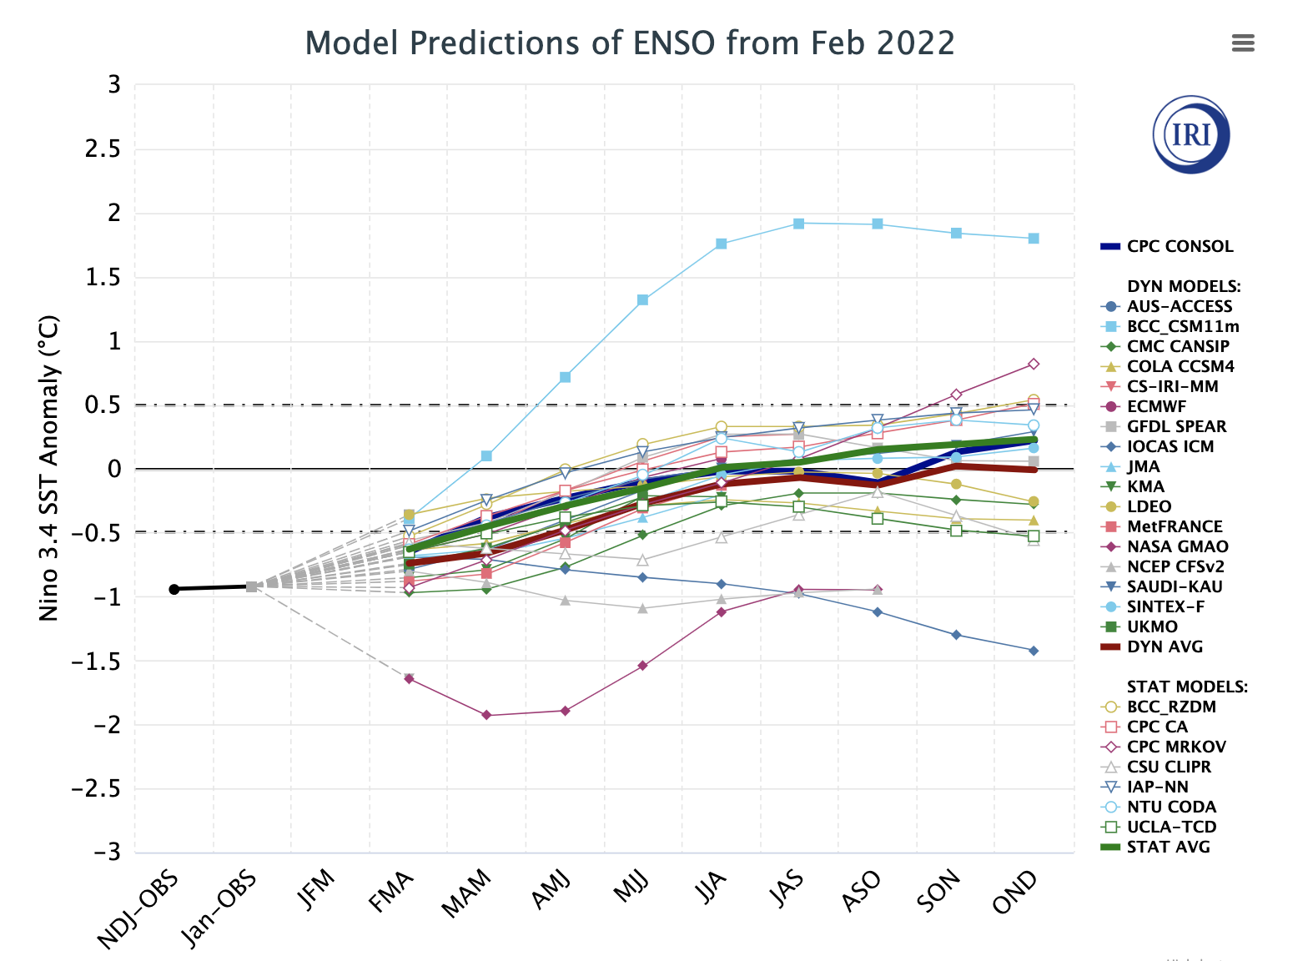
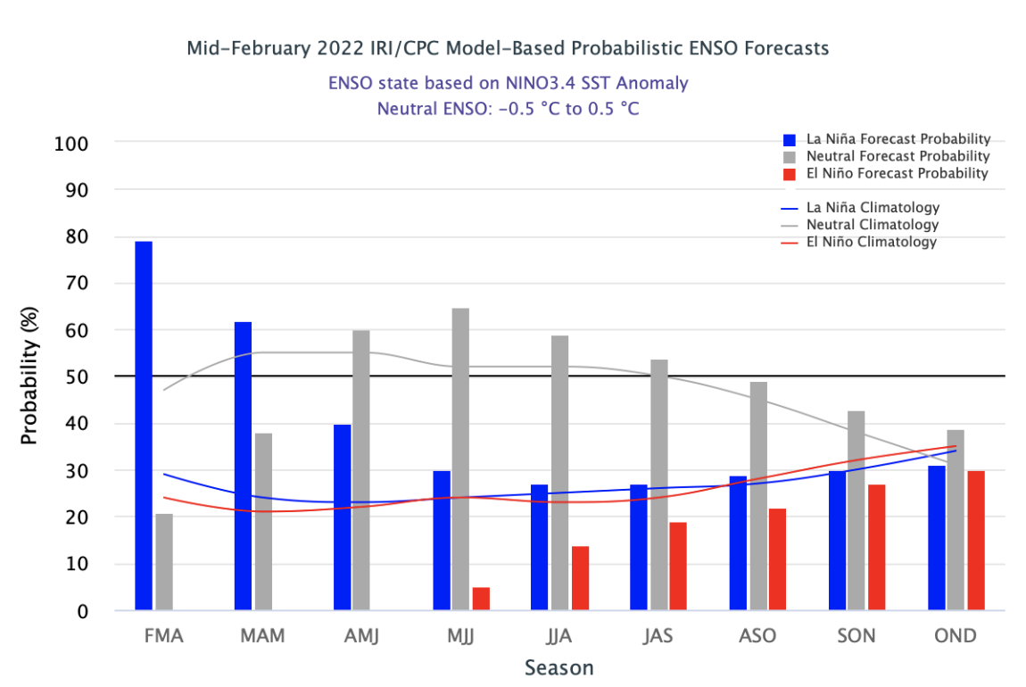
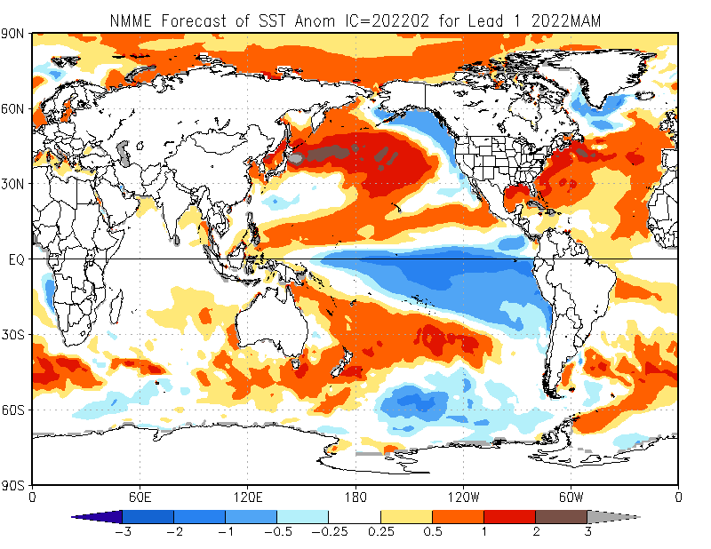
ENSO, Forecasts in Feb, 2022

Slide 16
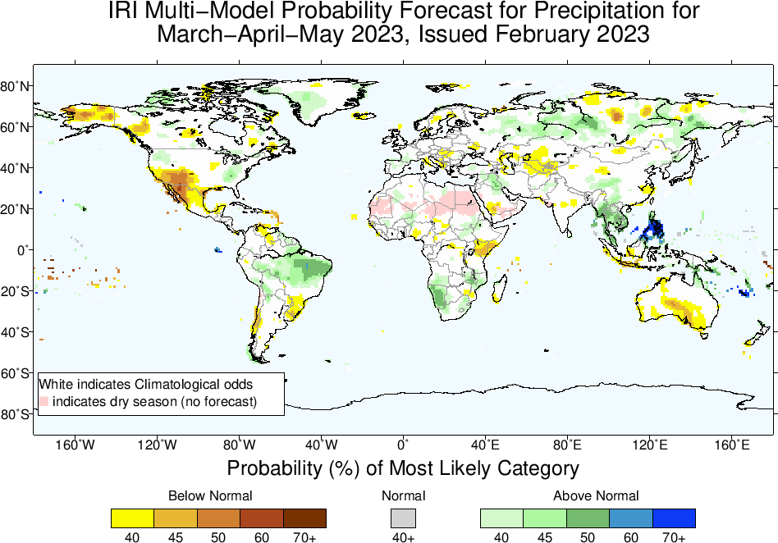

Slide 17
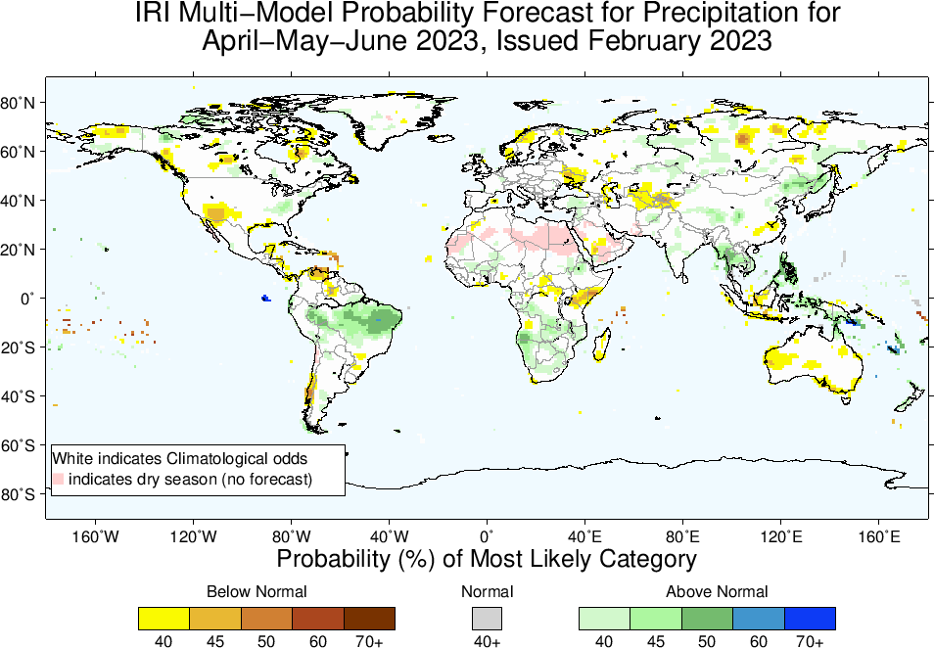

Slide 18
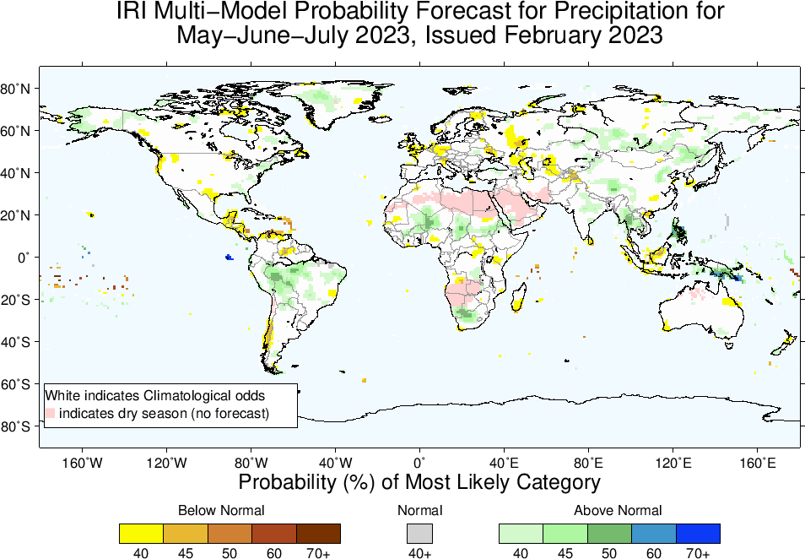

Slide 19
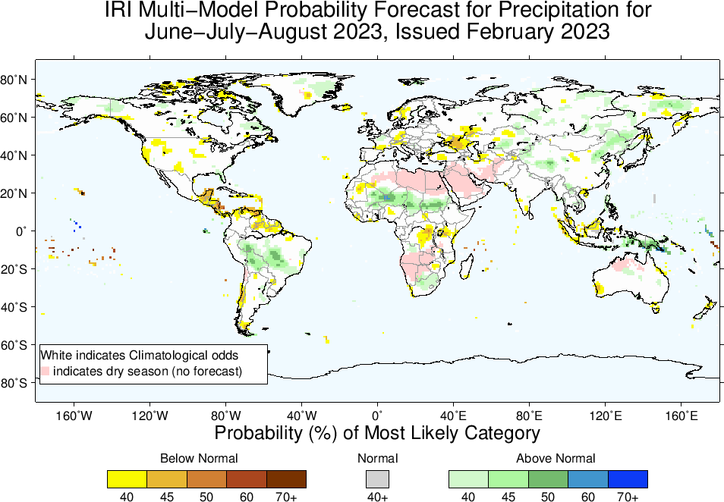

Slide 20
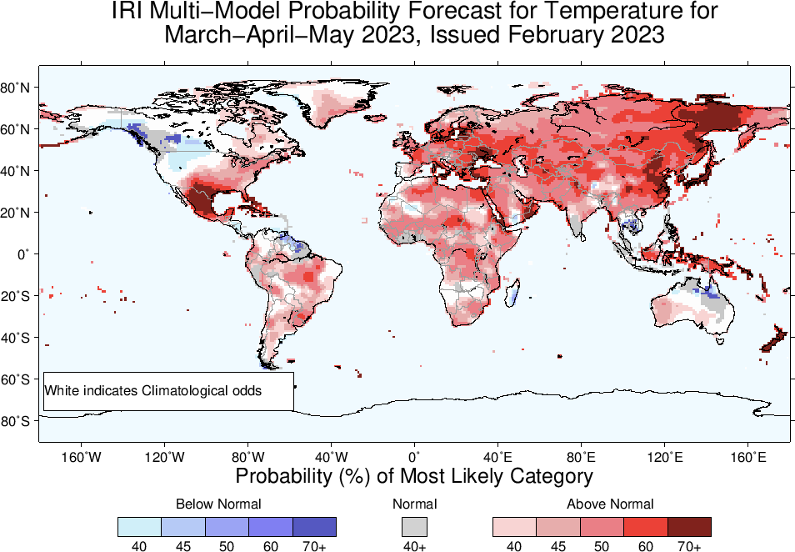

Slide 21
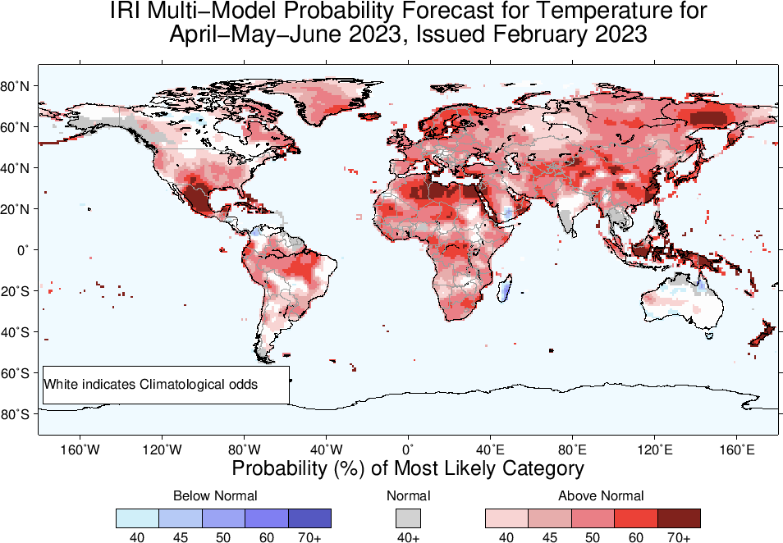

Slide 22
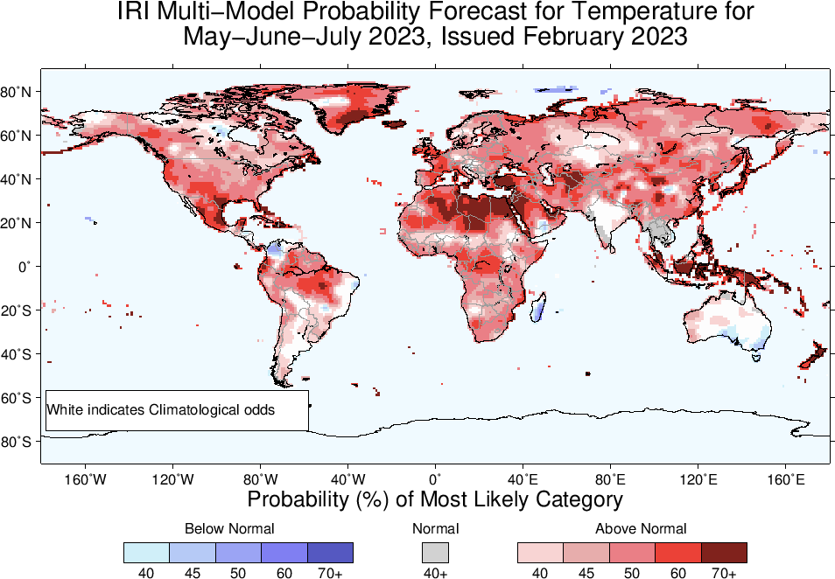

Slide 23
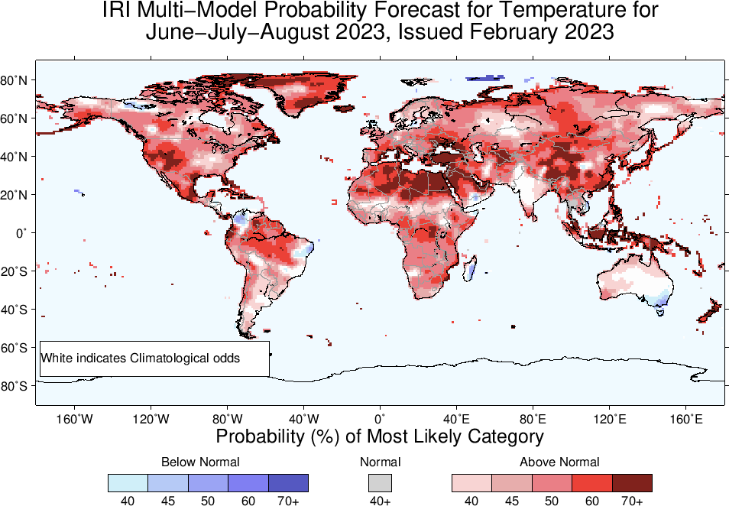

Slide 24
Summary
A weak La Niña is still there,
Both Oceanic and Atmospheric conditions show La Nina thresholds; e.g.,
Sea surface temperatures (SSTs) are below average across the central equatorial Pacific Ocean (-0.5 in NINO3.4)
SOI is still positive, stronger than average trade winds in central and western Pacific, Near-Normal in the eastern Pacific, reduced cloudiness over central Pacific (west of Date-line).
Warm Sub-Surface is moving eastward, and cold sub-surface is weak and confined near the easter Pacific. Therefore,
ENSO-neutral is highly favored for Mar-May 2023 and for next two seasons
El-Nino is most favorable starting from Jun-Aug 2023 onwards (Chances in 50s)
Caution: Forecast is highly uncertain beyond Mar-May 2023!

