Slide 1
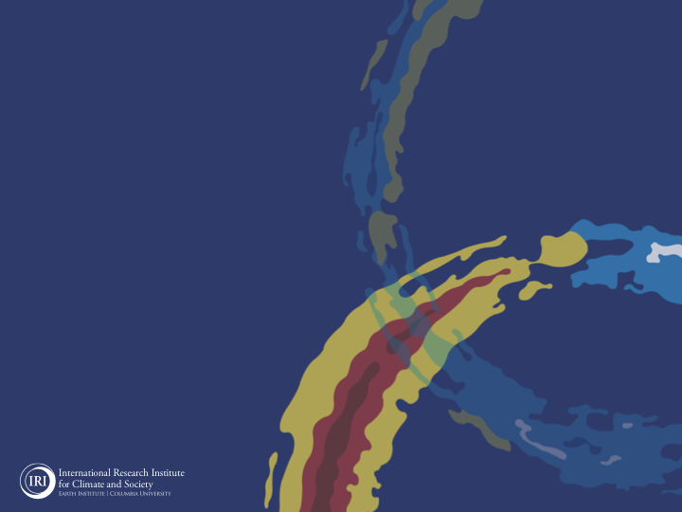
ENSO and Climate Outlook
in Feb 2022
Weak La Nina conditions still continue.
How Long this Kiddo can stay?
M. Azhar Ehsan
(azhar@iri.columbia.edu)
Associate Research Scientist
IRI ENSO and Climate Forecast Lead
Jeffery Turmelle and Jing Yuan: forecast processing and web updates
Cuihua Li: Draft PowerPoint development
IRI’s Climate Group, led by Dr. Andrew Robertson: Forecast system development, ongoing innovation, and verification

Slide 2
Outline
Observed Oceanic and Atmospheric Conditions in
Tropical Pacific
Indian and Atlantic Basins
ENSO Plume in
NMME and EU
IRI ENSO Plume
Seasons Outlook of
SST
Precipitation and Temperature
Summary

Slide 3
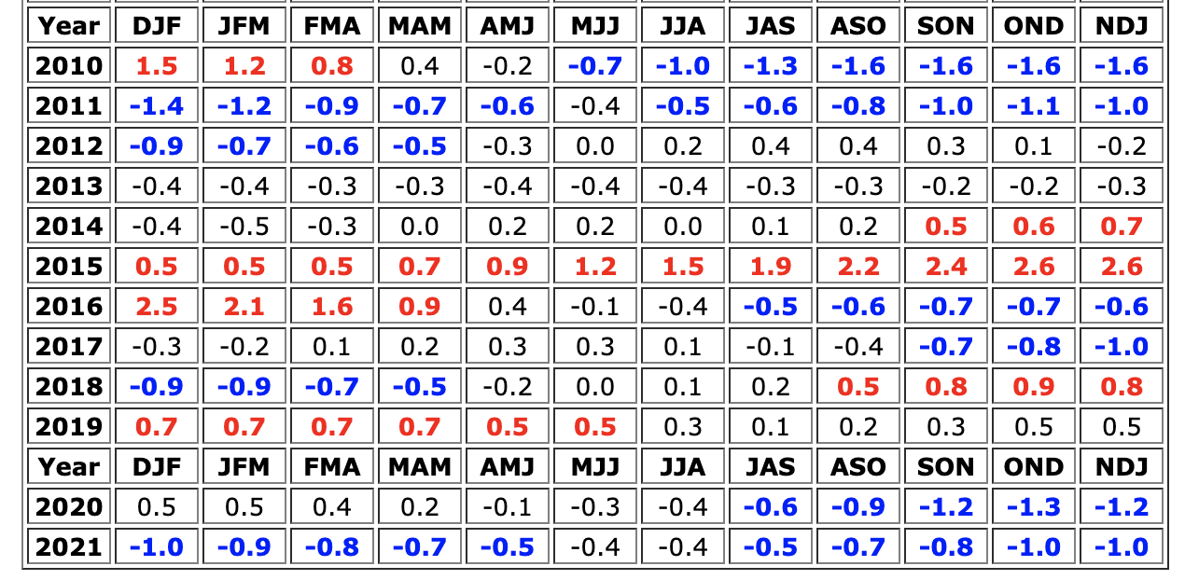
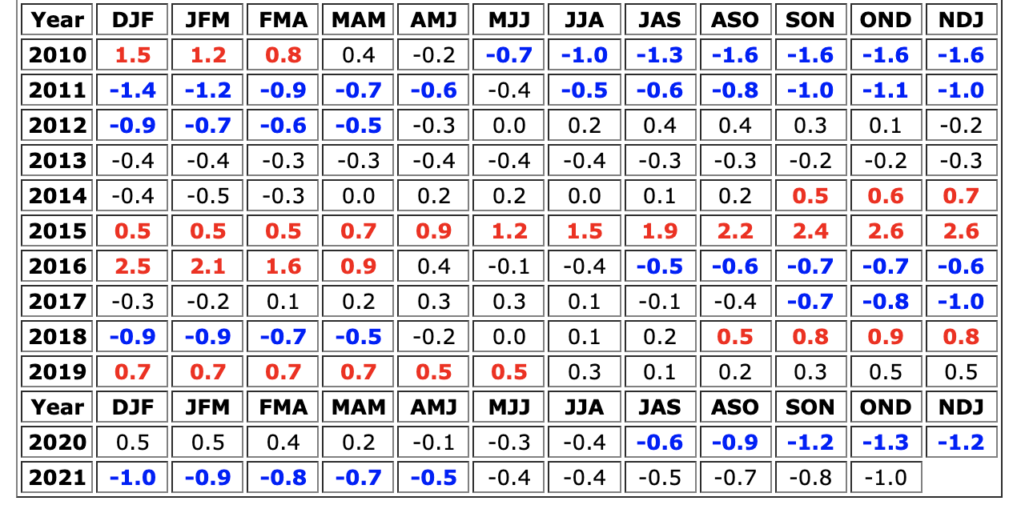
Summary-Jan2022
La Nina (Weak) is still there.
Equatorial sea surface temperatures (SSTs) are below-average across the central-eastern Pacific.
The tropical Pacific Atmospheric conditions are consistent with a weak La Nina.
Current conditions possibly meet the conditions of a COLD ESNO event before its transition to ENSO-neutral in MAM.
5 Seasons

Slide 4
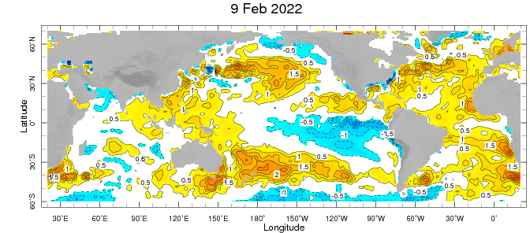
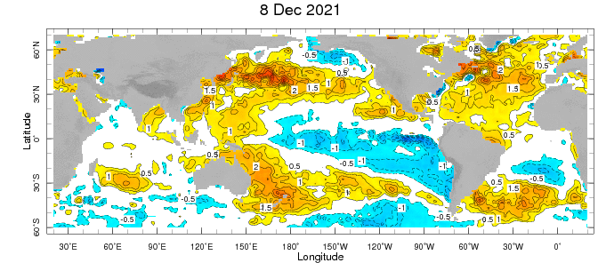
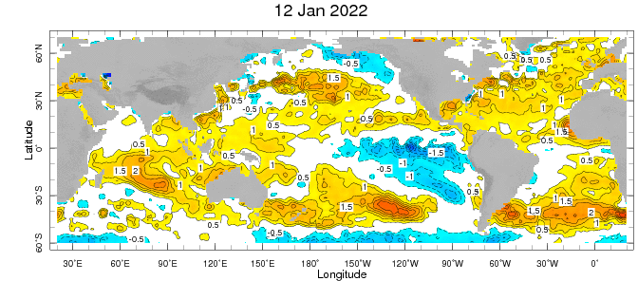
Weekly SST Anomalies ➔
Peak
Dec, 2021
Decline
Jan, 2022

Slide 5
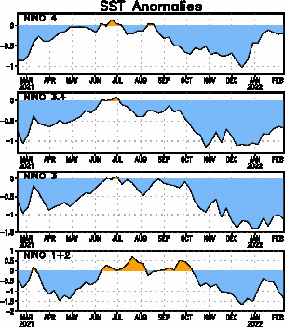
Persistent NINO3.4 values
cooler than −0.5 °C are
typical of La Niña, as per CPC Def.
Most recent Value is “-0.7”.

Slide 6
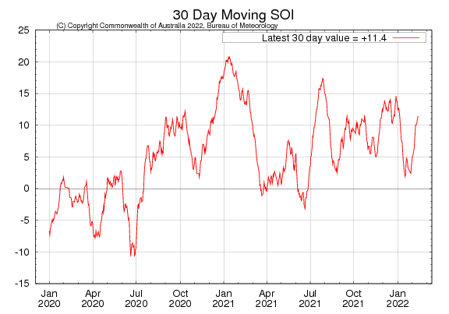
Tahiti_{SLP} – Darwin_{SLP}
ticked Up after a Plunge

Slide 7
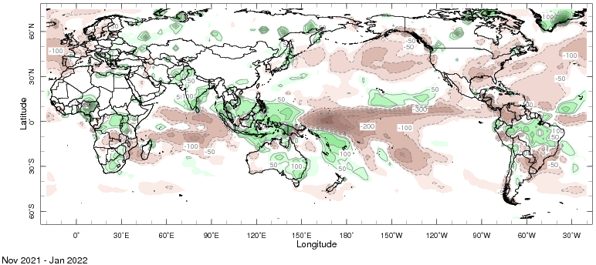
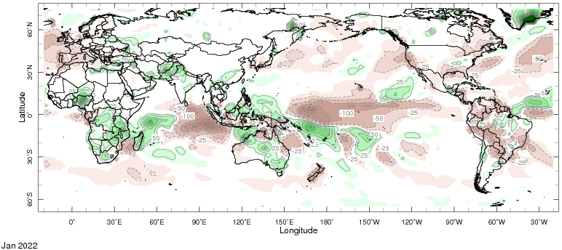

Slide 8
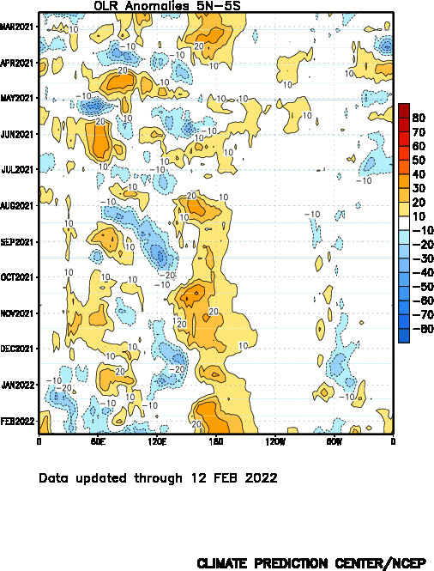
Strengthened!

Slide 10
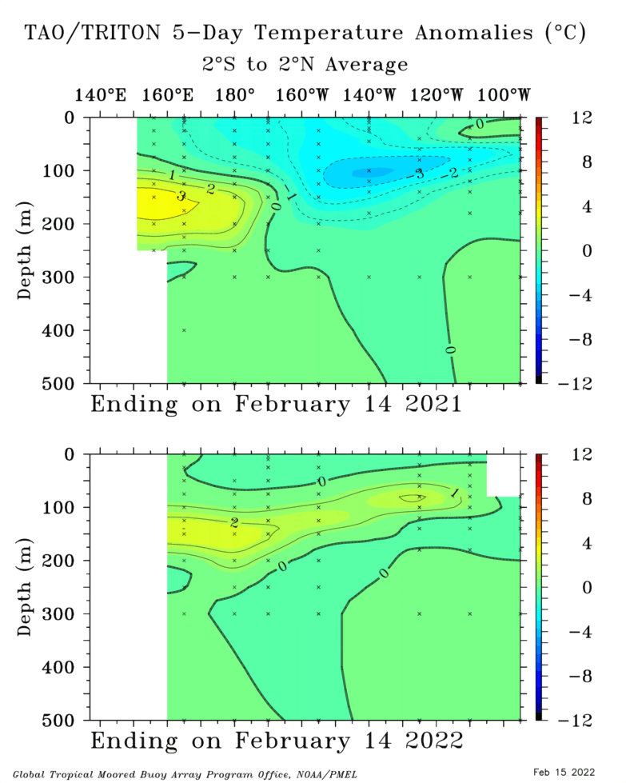
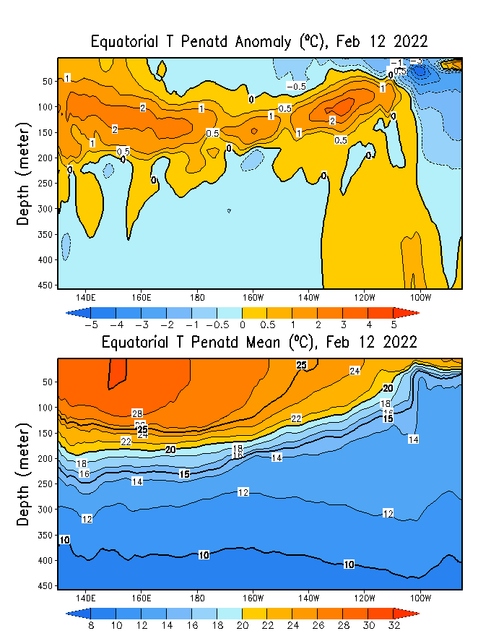
GODAS is used to initialize CCSM4 and CFSv2, among others.
GODAS
2021
2022
But,…

Slide 11
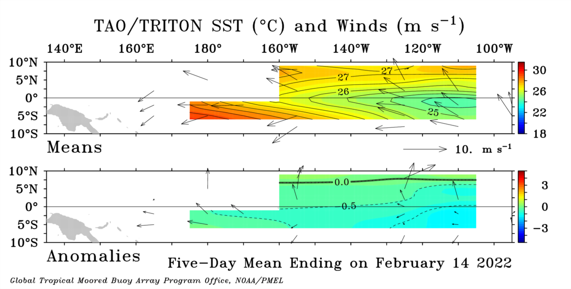
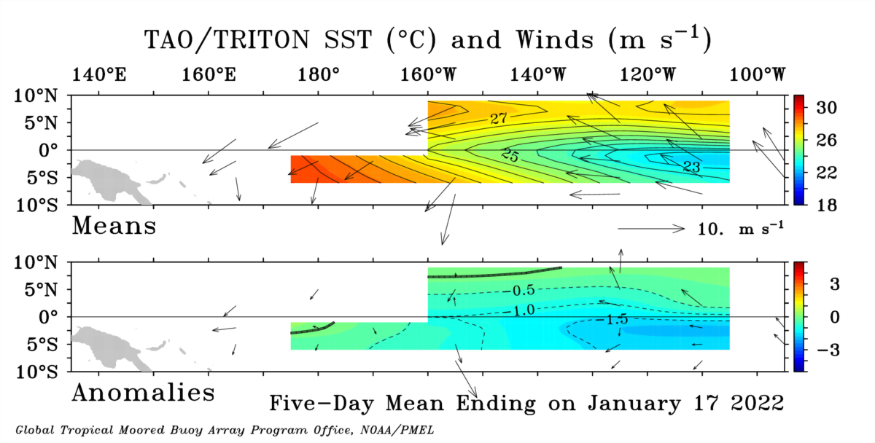
Mean
close to average in the east and stronger than average in the western
ANOM
Jan, 2022

Slide 12
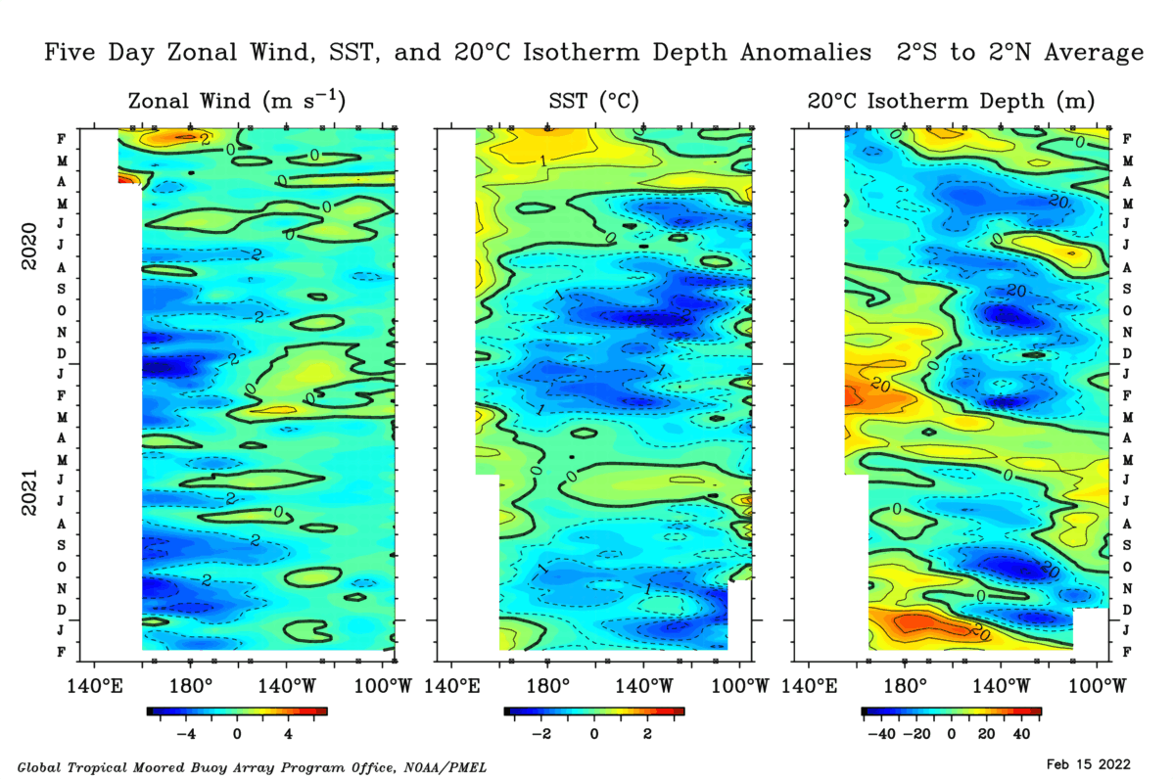

Slide 13
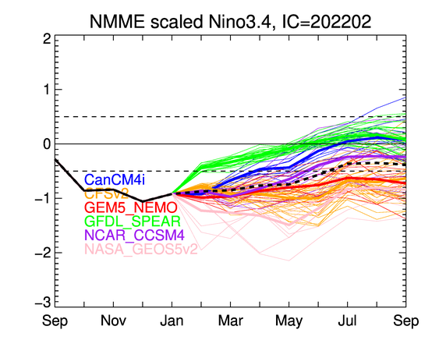
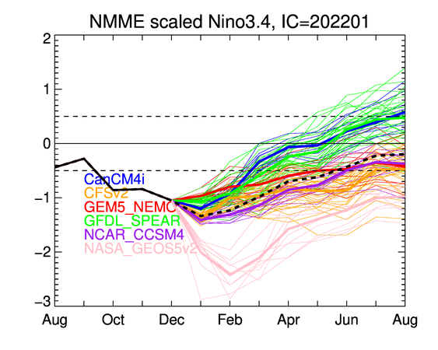
Forecast.
Large spread and Some Disagreements!
Jan, 2022

Slide 14
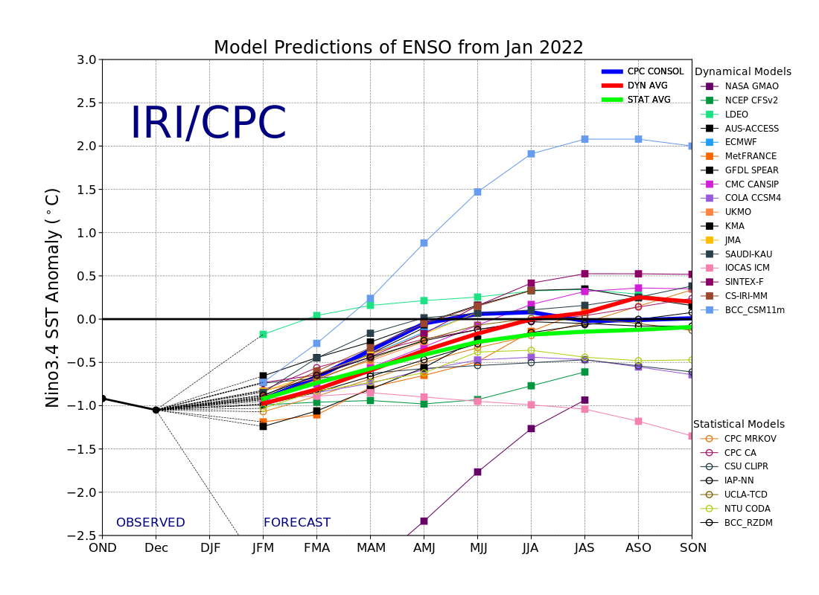

Slide 15
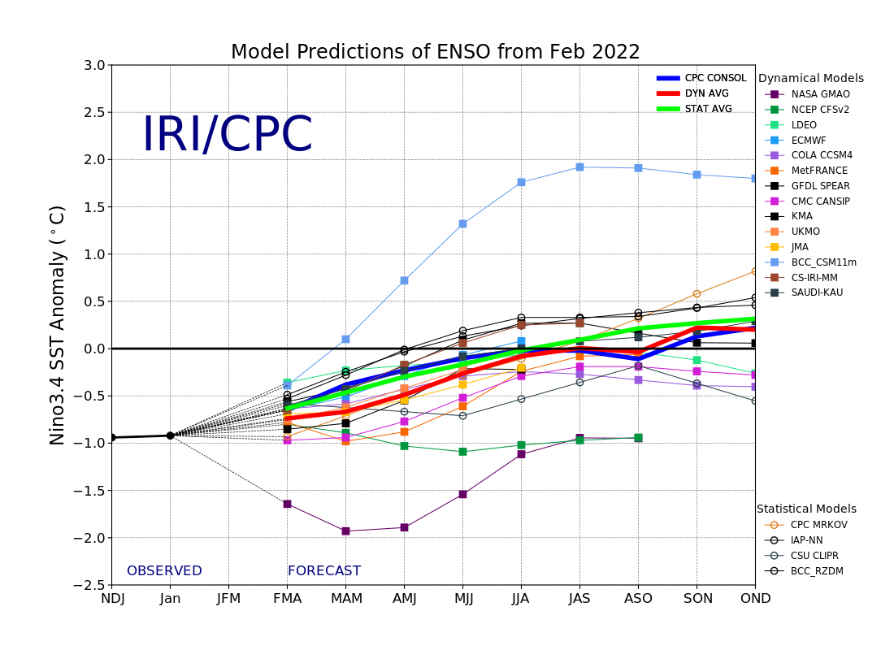
https://iri.columbia.edu/our-expertise/climate/forecasts/enso/current/?enso_tab=enso-sst_table

Slide 16
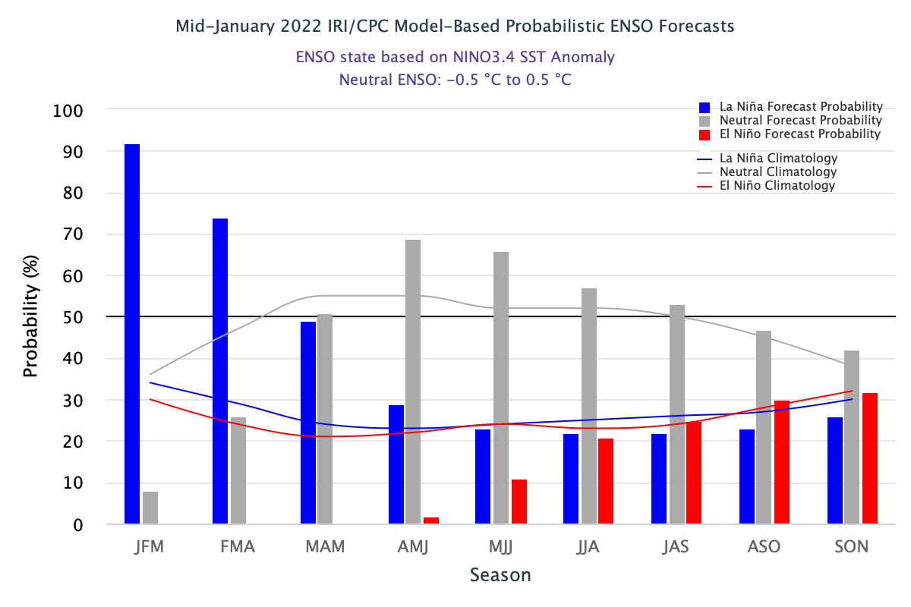
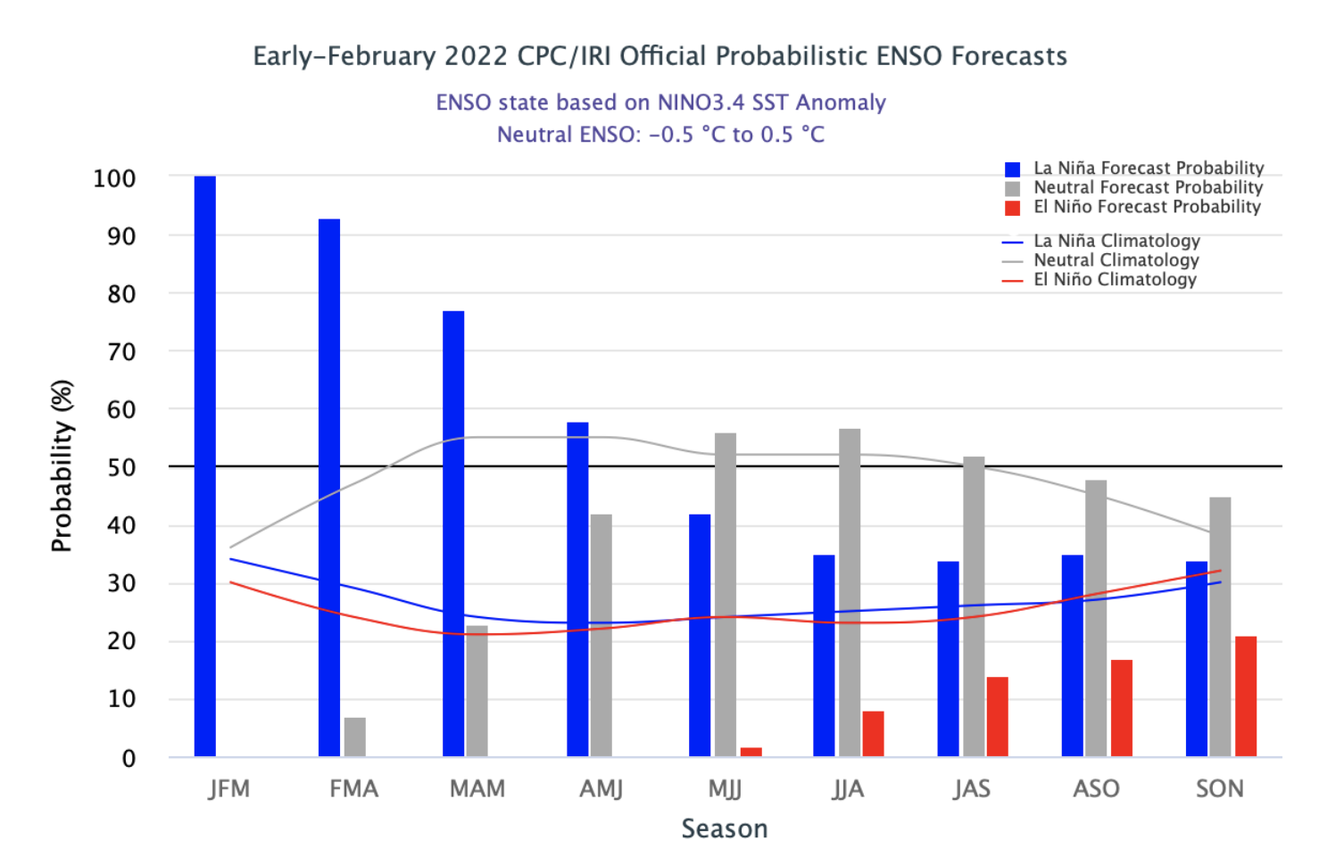

Slide 17
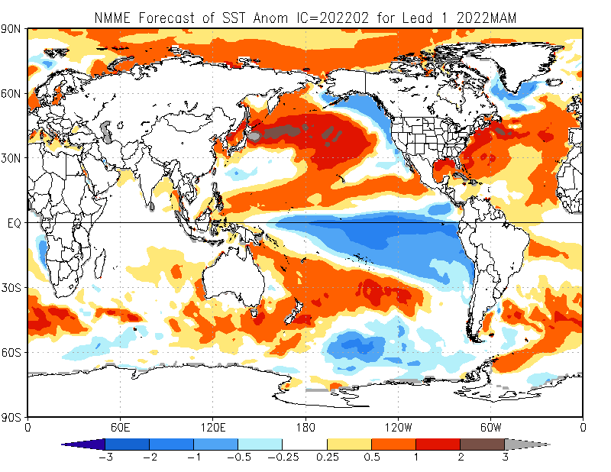

Slide 18
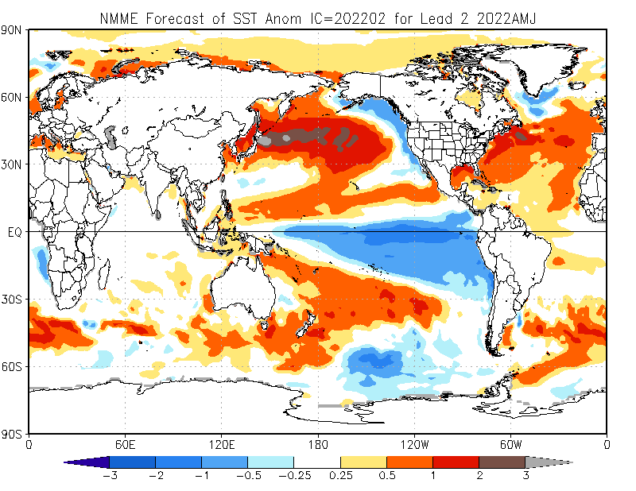

Slide 19
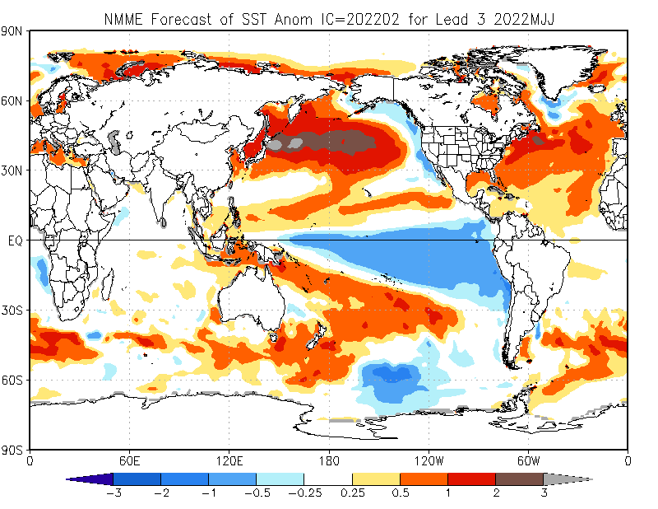

Slide 20
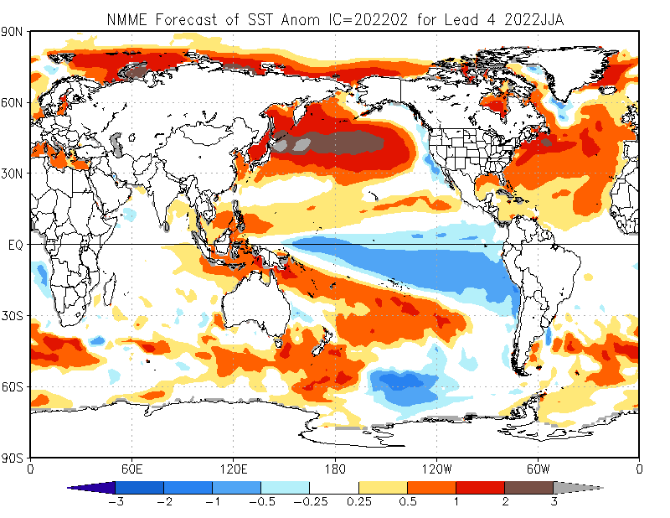

Slide 21
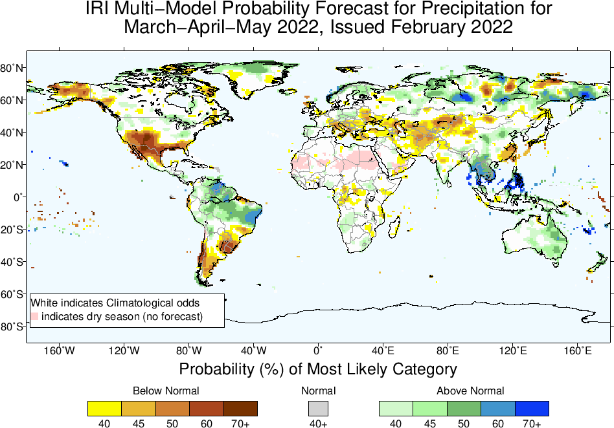

Slide 22
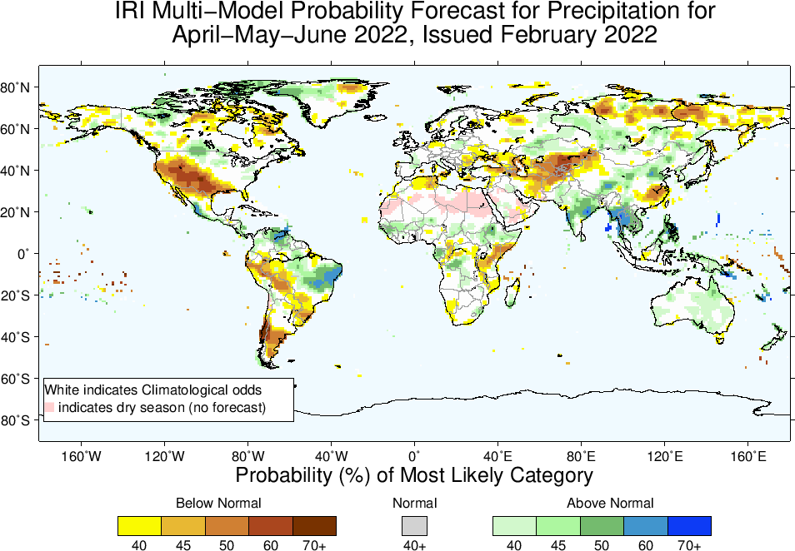

Slide 23
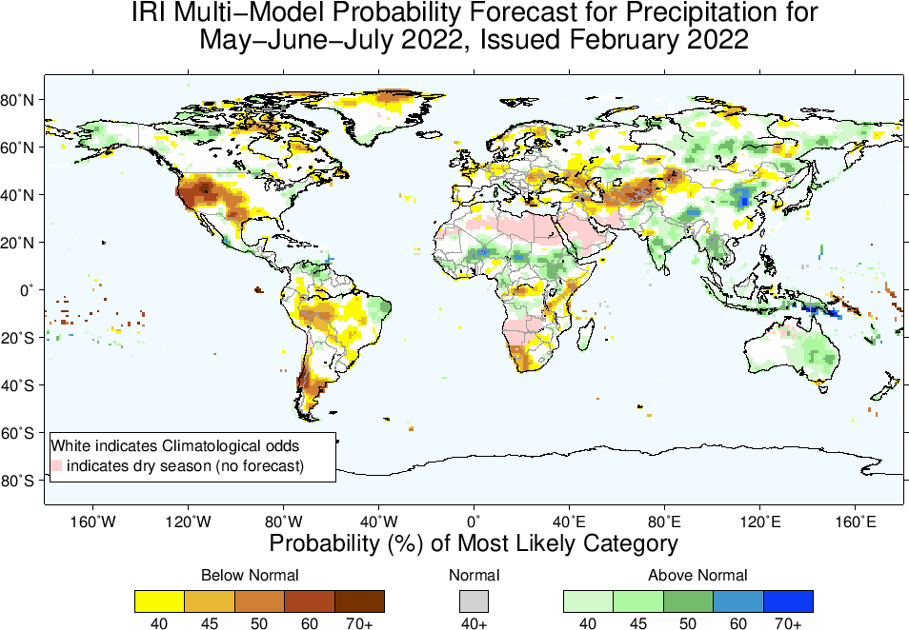

Slide 24
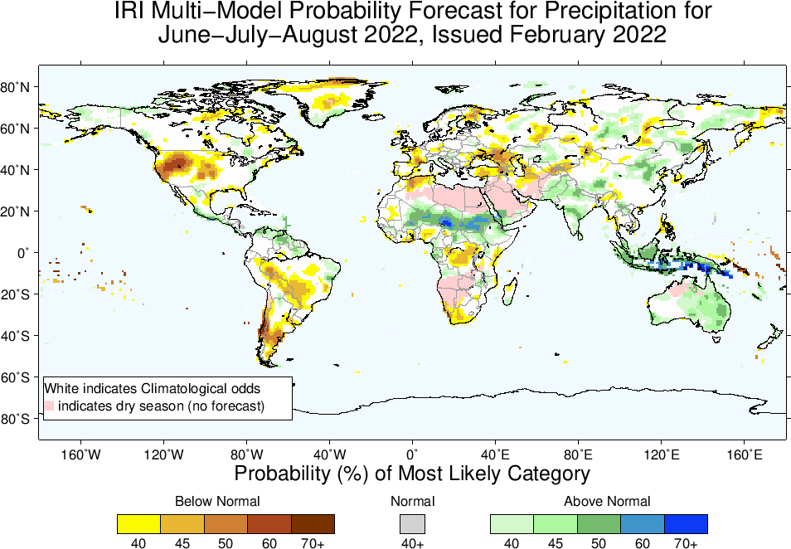

Slide 25
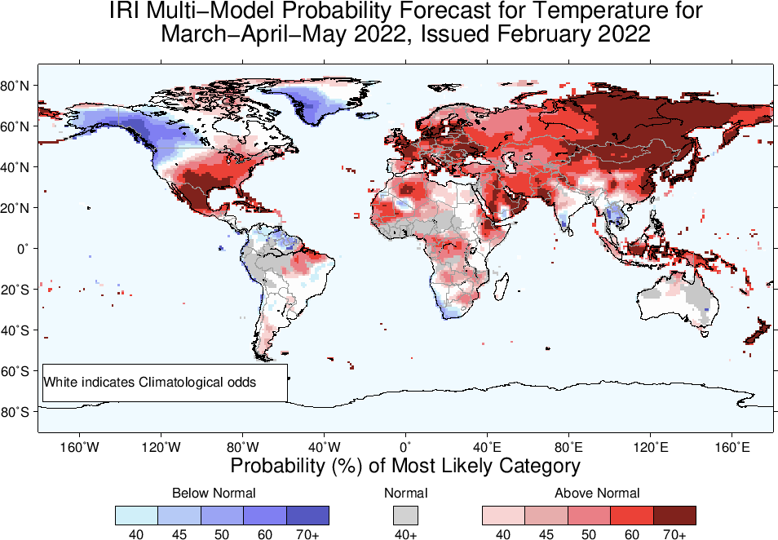

Slide 26
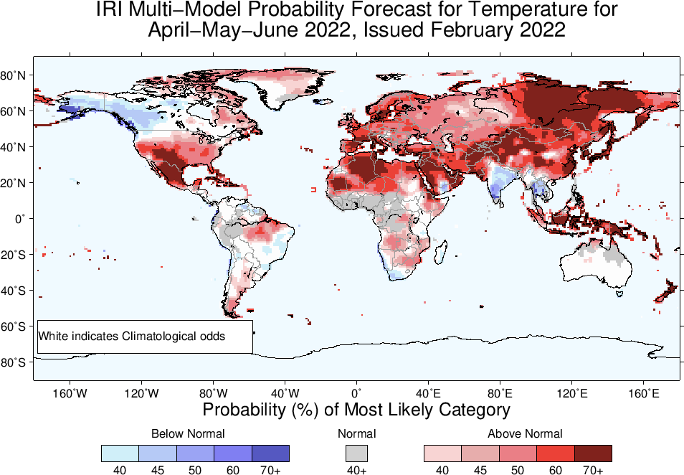

Slide 27
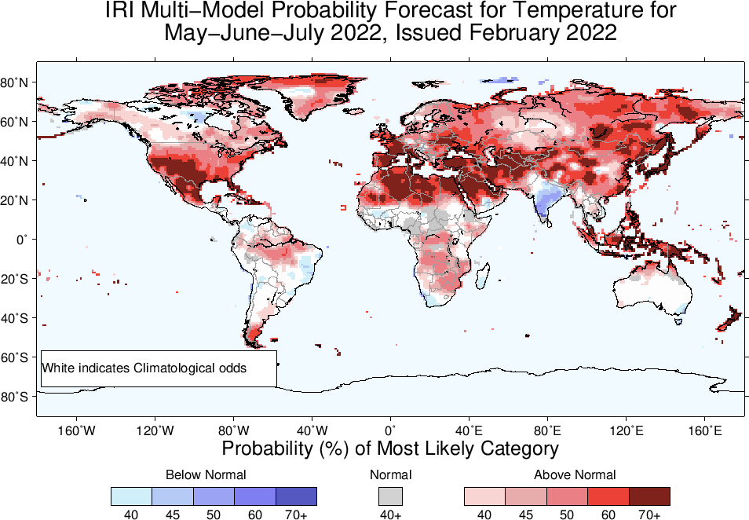

Slide 28
