Slide 1
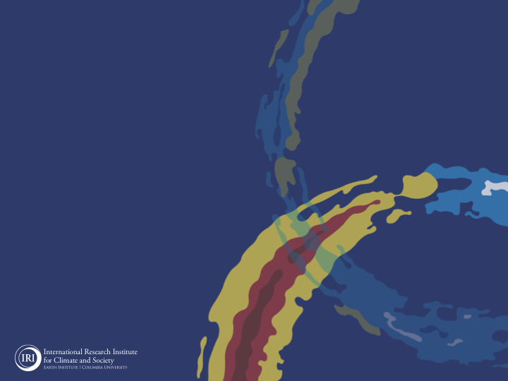
ENSO and Climate Outlook
February 2021:
La Niña conditions continue.
Transition anticipated
during late Spring (Apr-Jun).

Slide 2
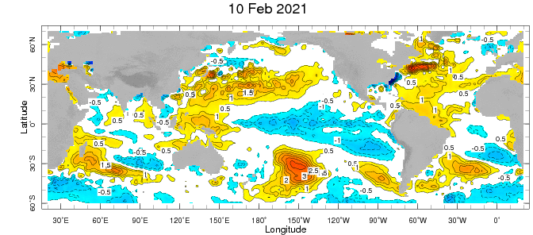
Weekly Sea Surface Temperature Anomalies (includes satellite data)

Slide 3
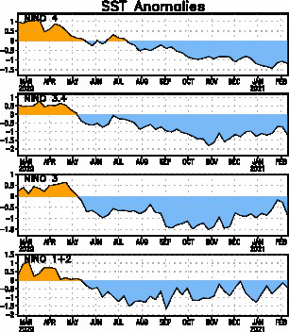
Near Dateline
This is the SST
Index
predicted
Eastern Eq. Pacific
Off Coast of S.America

Slide 4
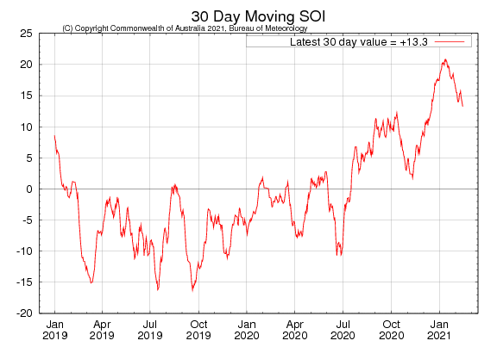
Tahiti_{SLP} – Darwin,AUS_{SLP}

Slide 5
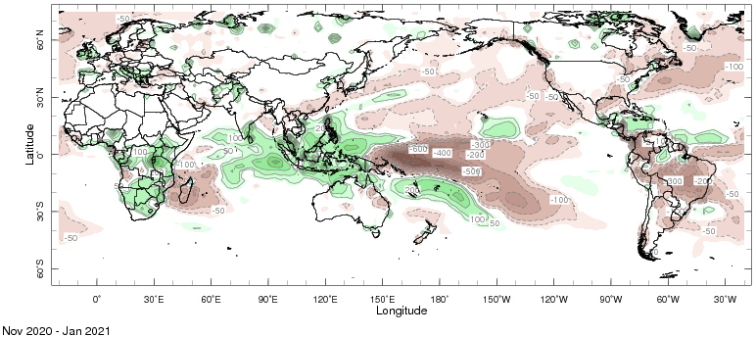
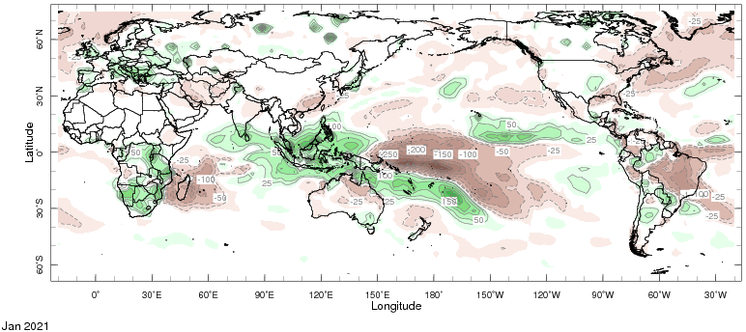
Precipitation Anomalies

Slide 6
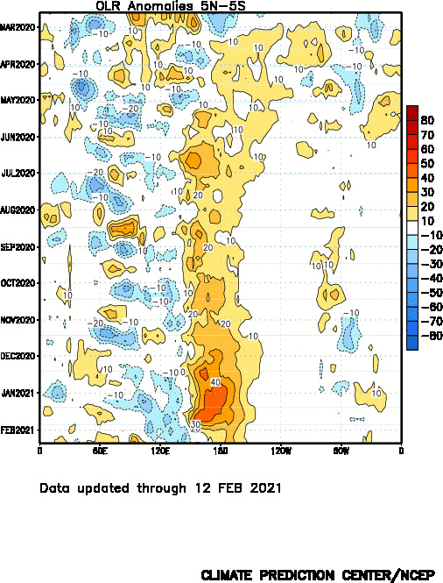
Wetter
Drier

Slide 7
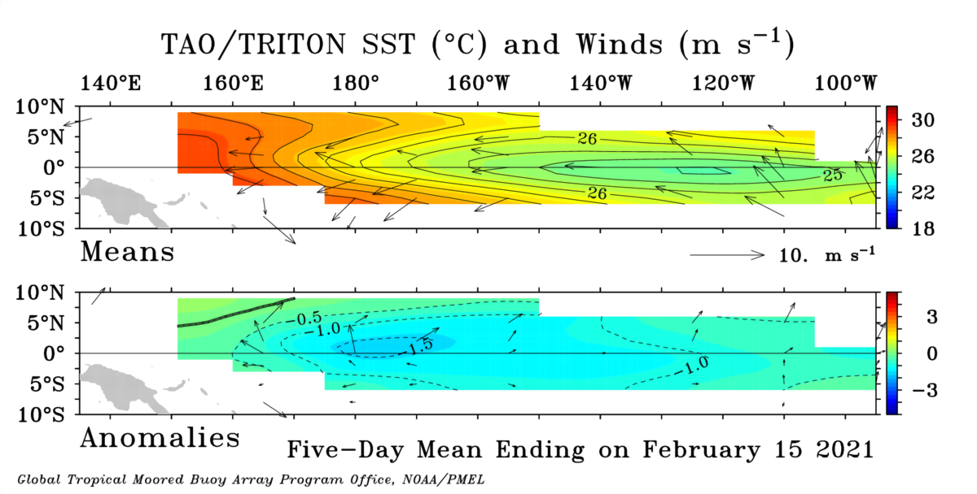

Slide 9
GODAS* Analysis
Used to initialize CFSv2 and CCSM4
TOTAL
ANOMALY
* Global Ocean Data Assimilation System

Slide 10
Analysis directly from TOGA-TAO buoy measurements.
TOTAL
ANOMALY

Slide 11
T
TAO/TRITON Temperature Anomalies
Analysis directly from TOGA-TAO buoy measurements.
Last Month (Jan ‘20)
Last 5 Days

Slide 12
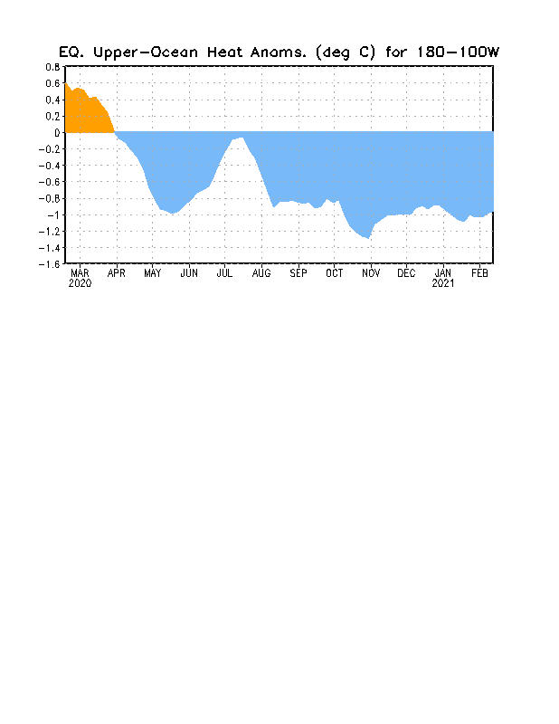

Slide 13
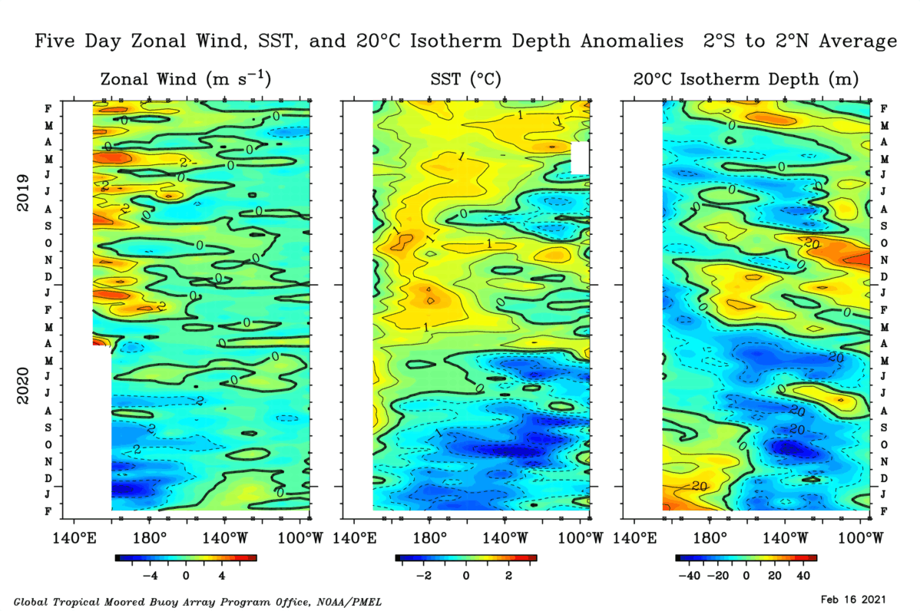

Slide 14
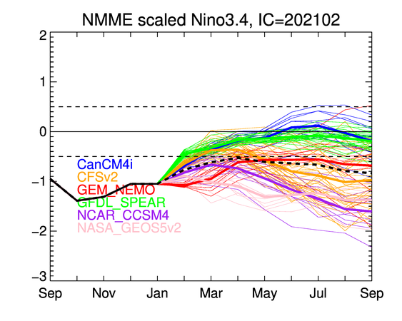

Slide 15
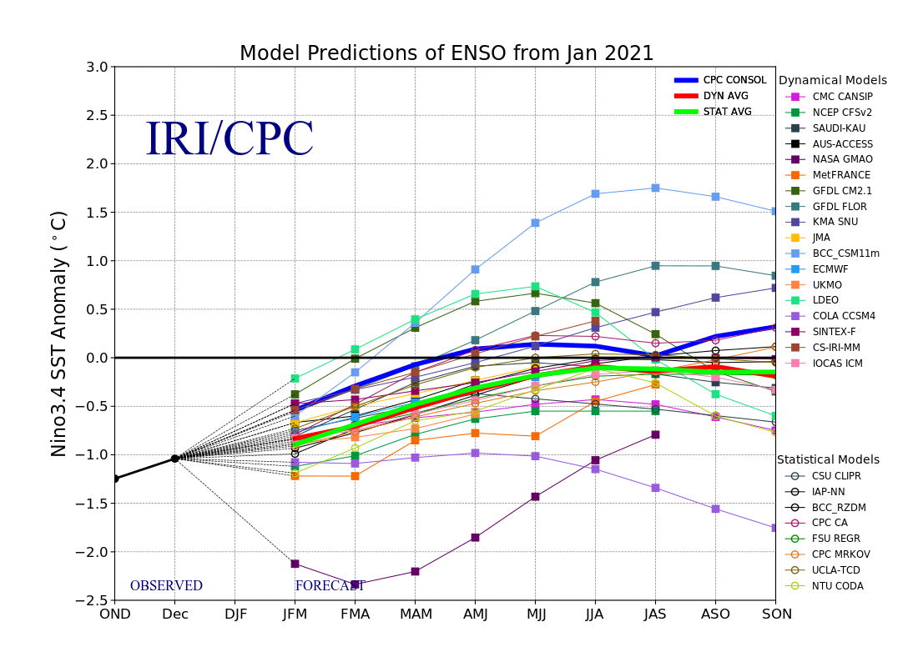

Slide 16
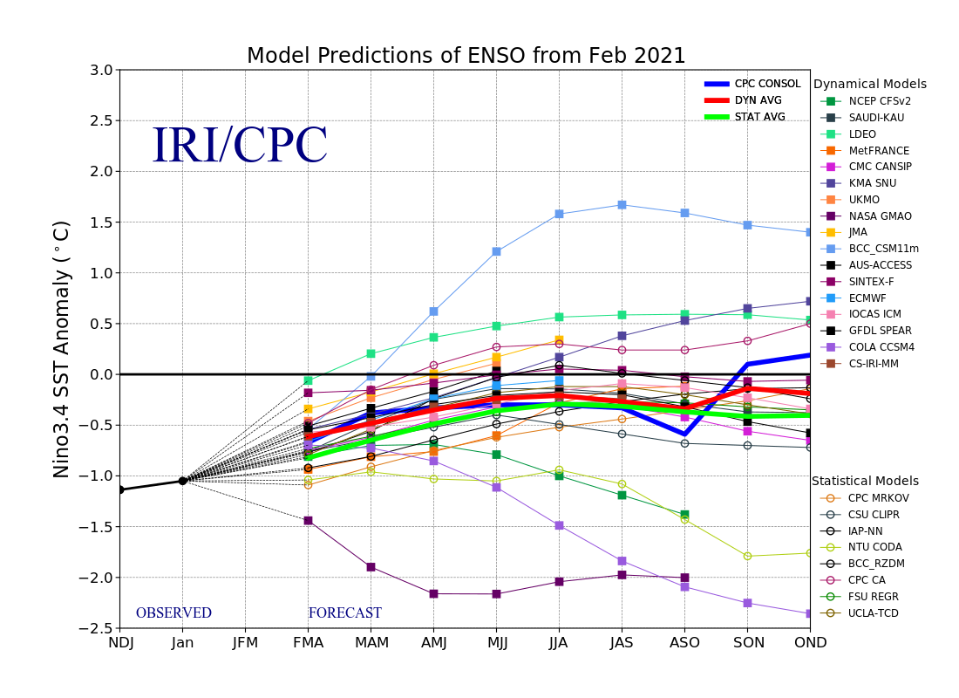

Slide 17
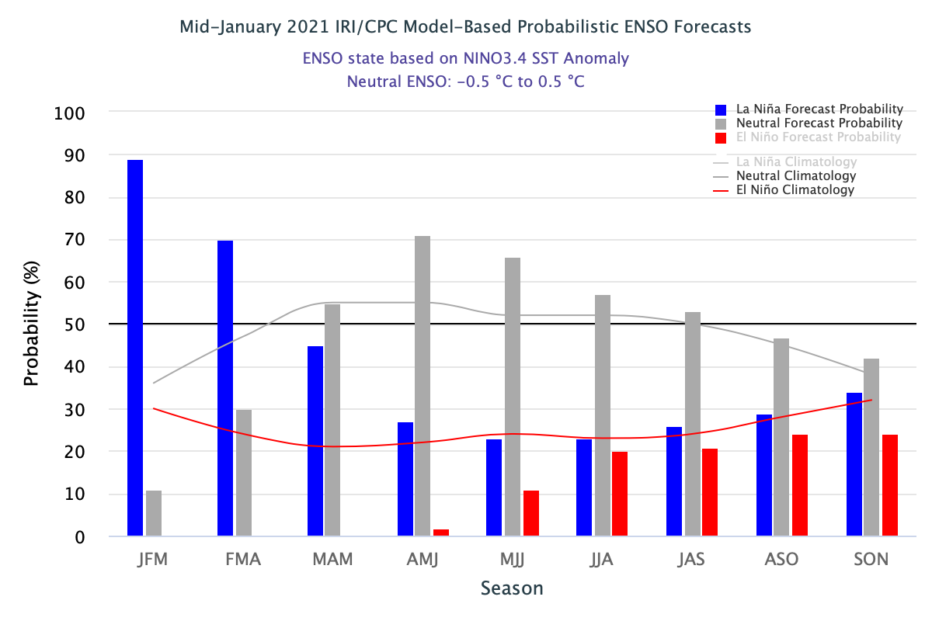

Slide 18
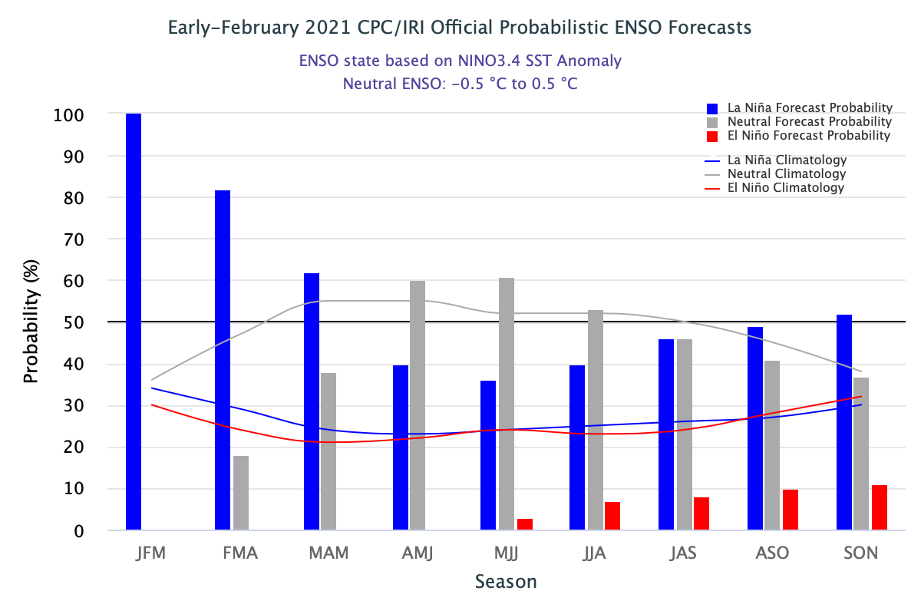

Slide 19
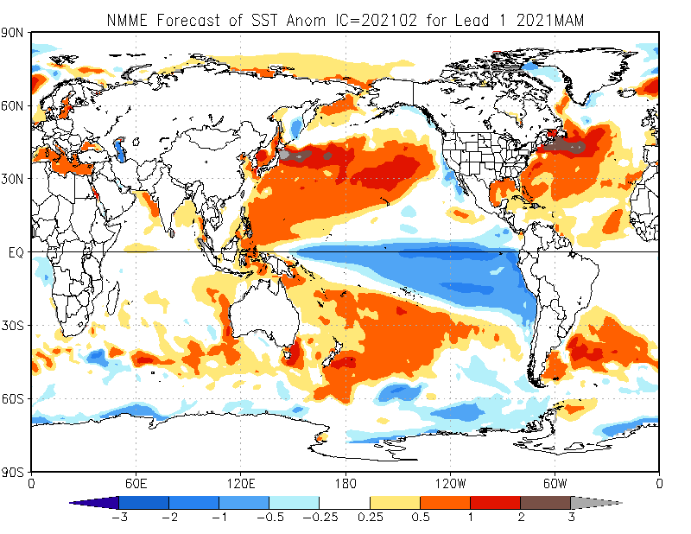

Slide 20
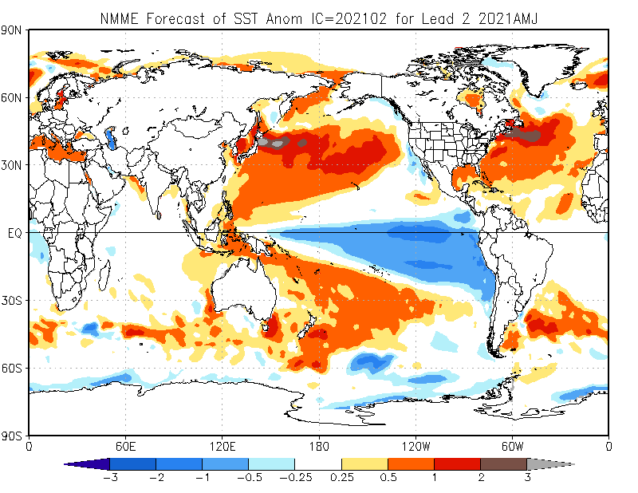

Slide 21
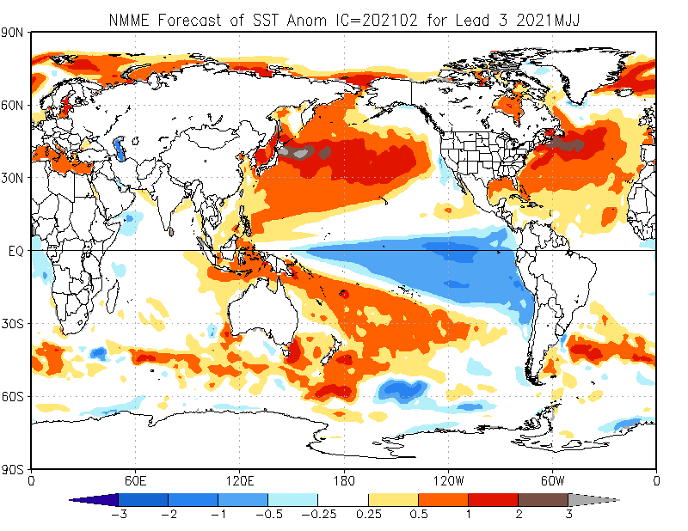

Slide 22
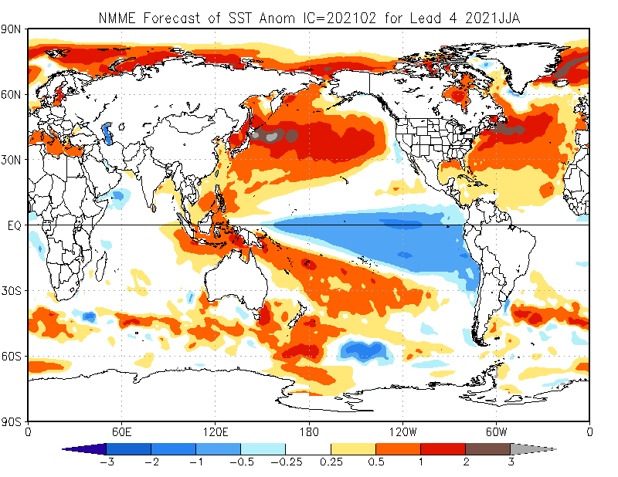

Slide 23
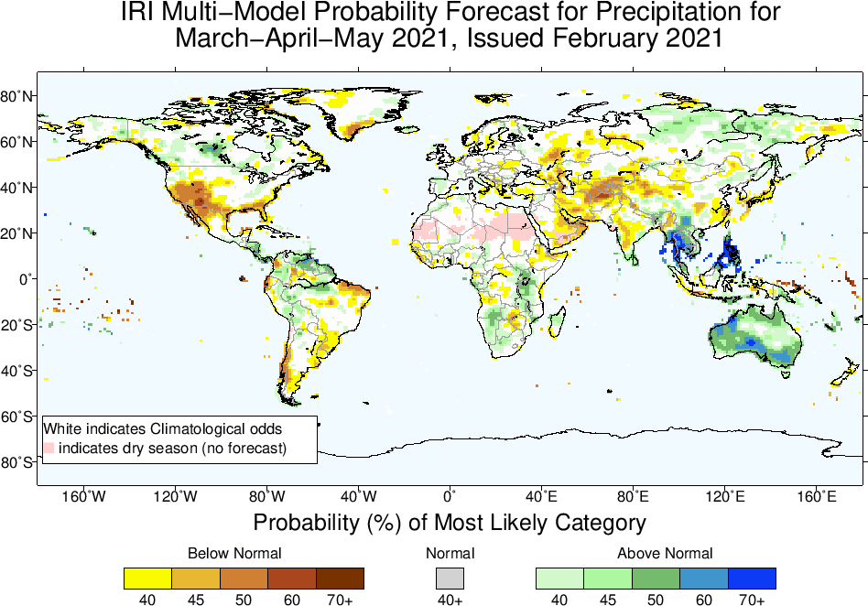

Slide 24
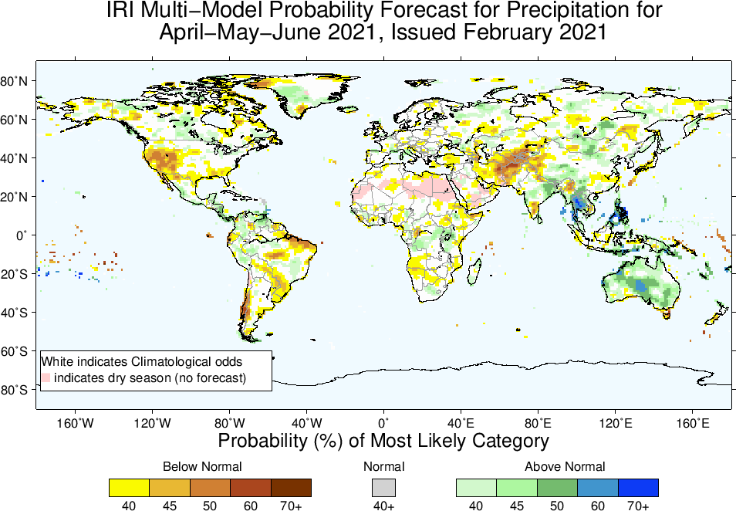

Slide 25
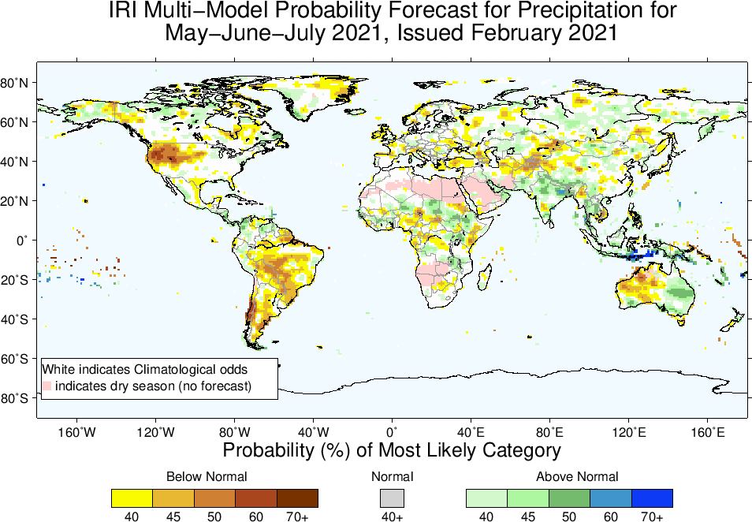

Slide 26
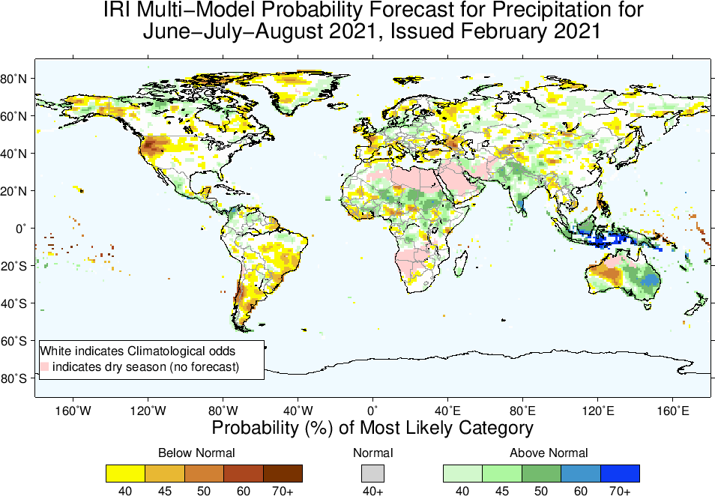

Slide 27
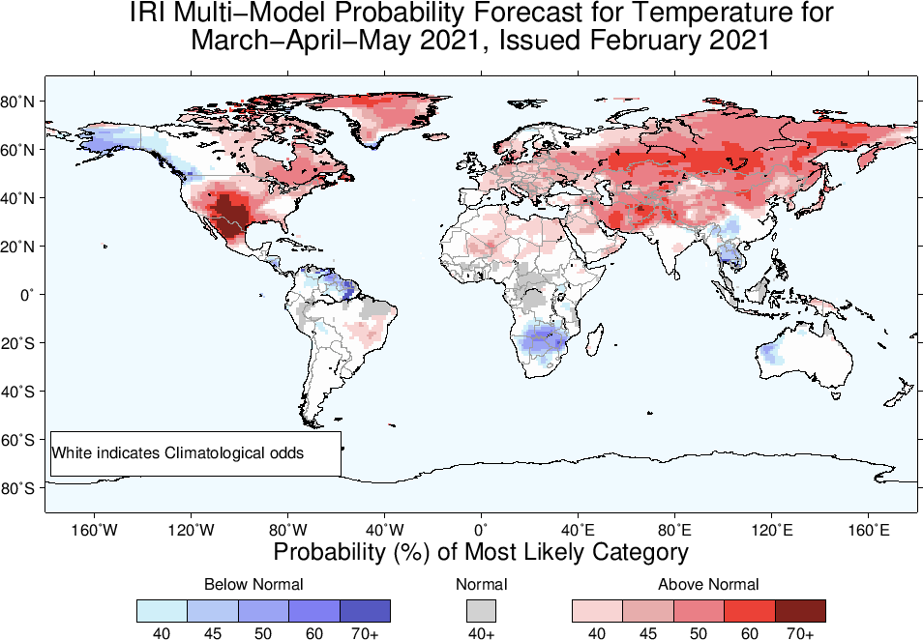

Slide 28
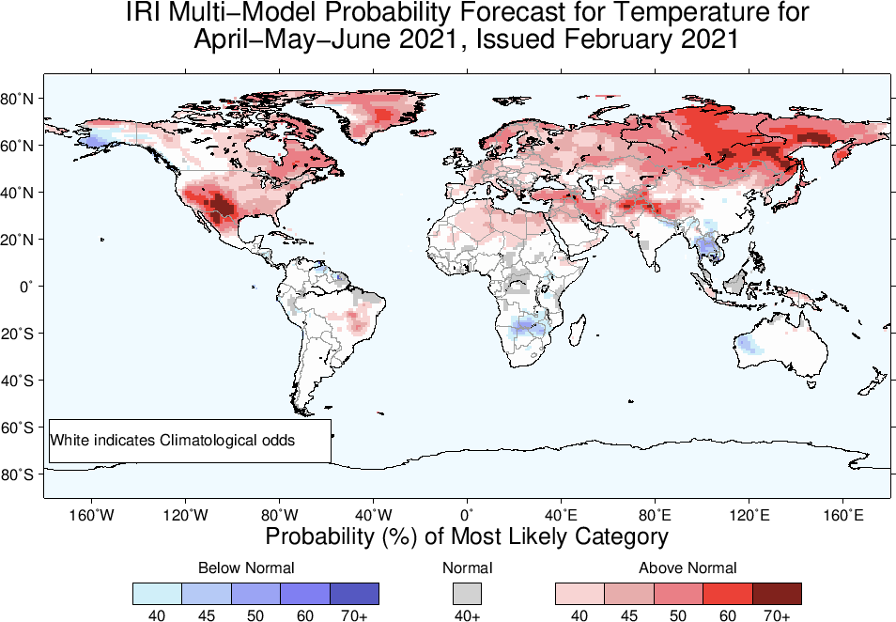

Slide 29
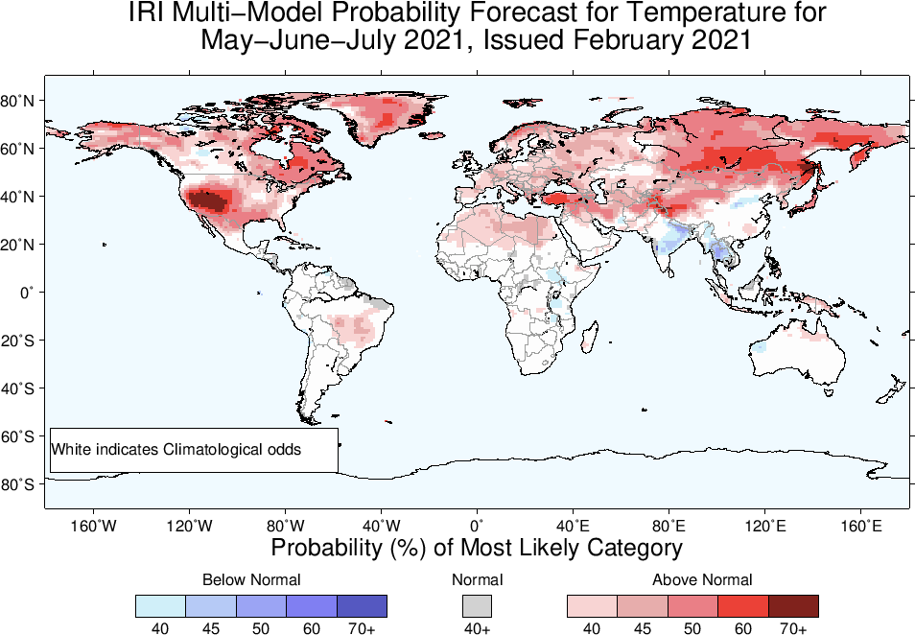

Slide 30
