Slide 1
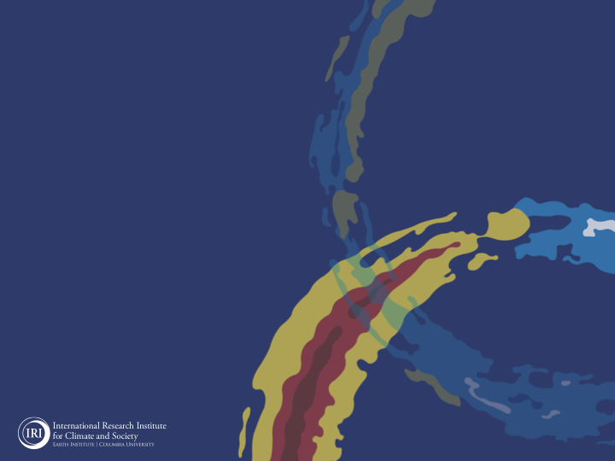
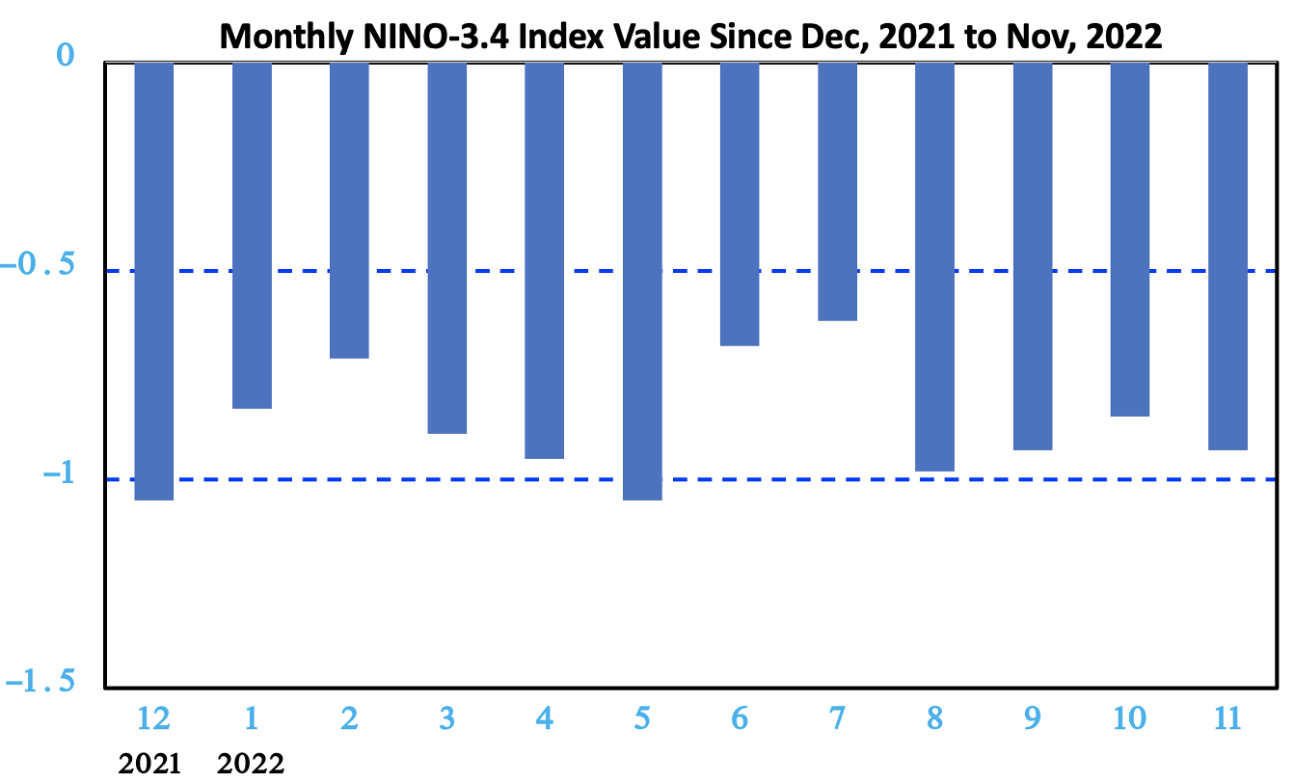
ENSO and Climate Outlook
in December 2022
Last briefing of 2022, and Demise of Multi-year La Nina!
M. Azhar Ehsan
(azhar@iri.columbia.edu)
Associate Research Scientist
IRI ENSO and Climate Forecast Lead
Jeffery Turmelle and Jing Yuan: forecast processing and web updates
Cuihua Li: Draft PowerPoint development
IRI’s Climate Group, led by Dr. Andrew Robertson: Forecast system development, ongoing innovation, and verification

Slide 2
Outline
Observed Oceanic and Atmospheric Conditions in
Tropical Pacific
Across the Globe
ENSO Forecast in
NMME
IRI ENSO Forecast Tool (Deterministic and Probabilistic)
Seasons Outlook of
SST
Precipitation and Temperature
Summary

Slide 3
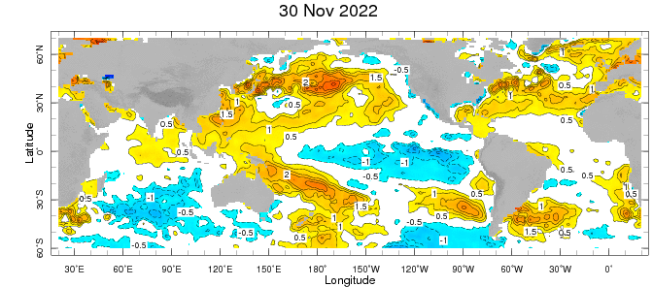
Evolution of EQ. Pacific SST Departures in Weekly OISST Data
In the Pacific Ocean: Below-average SSTs persisted across the central (across the Date Line), surrounded by strong +ve SSTA in the high latitudes.
Stronger Colder SSTAs exists in Eastern Pacific (120W to 80W).
Indian Ocean: Near-Normal
Atlantic Ocean: Near-Normal (slightly positive).
Strong Anomalies in the Northern Pacific and Atlantic. October PDO -2.44.
https://www.ncei.noaa.gov/access/monitoring/pdo/
http://www.bom.gov.au/climate/enso/#tabs=Indian-Ocean

Slide 4
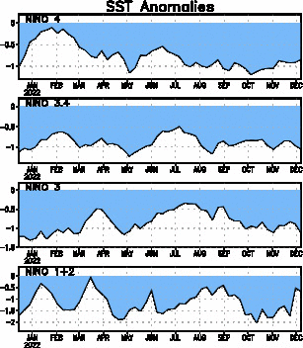
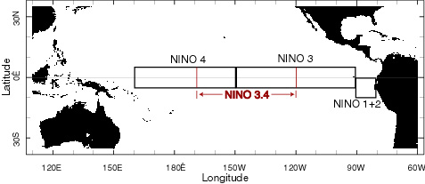
Most recent SST Anom.
Most Recent (07 Dec, 2022) SST Departures in different NINO regions
(All cooler than the long-term avg, (1991-2020))
Niño 4
-0.8ºC
Niño 3.4
-1.0ºC
Niño 3
-1.1ºC
Niño 1+2
-0.7ºC

Slide 5
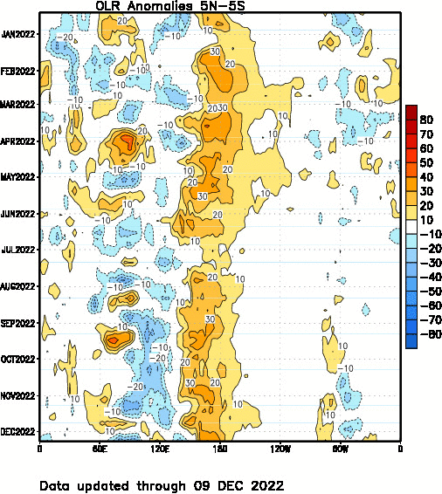
Most recent OLR

Slide 6
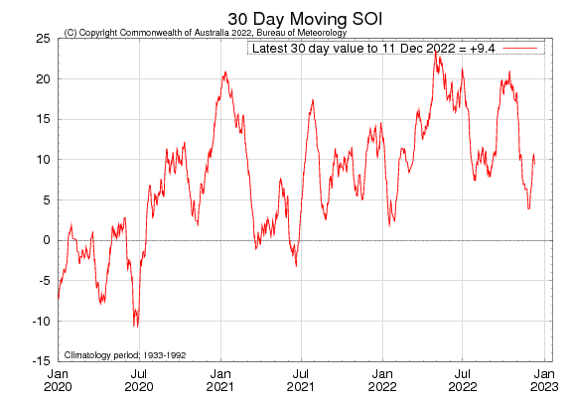
Most recent SOI
Sustained positive values of the SOI above +7 typically indicate La Niña

Slide 7
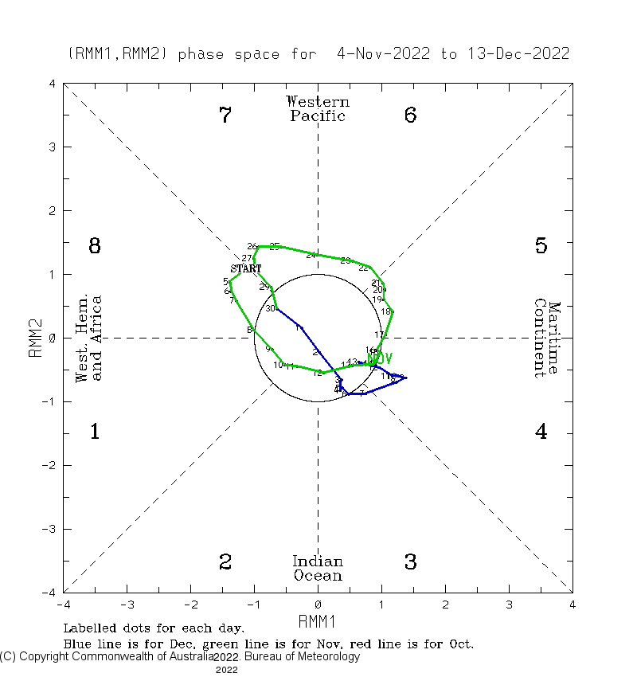
http://www.bom.gov.au/climate/mjo/

Slide 8
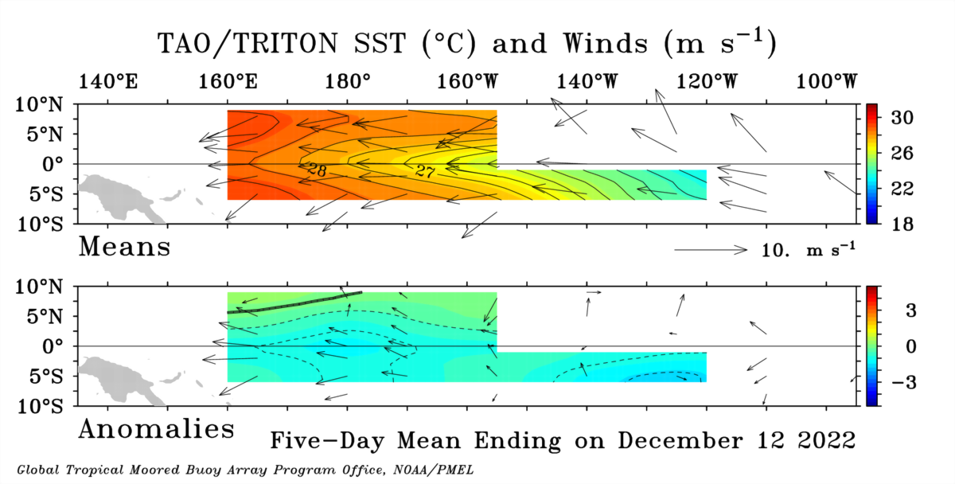
Most recent Lower-Level Winds

Slide 9
Subsurface Temperature Evolution (Last 4-Months)

Slide 10
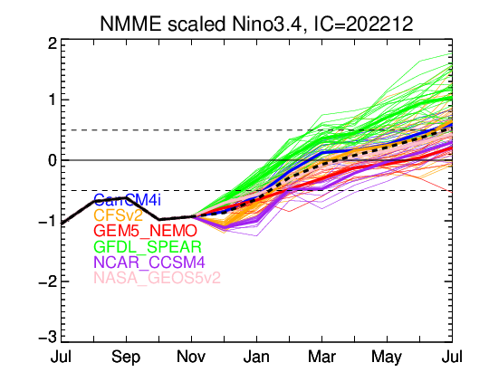
NMME’s ENSO Forecast
ENSO-neutral, In Feb, 2023

Slide 11
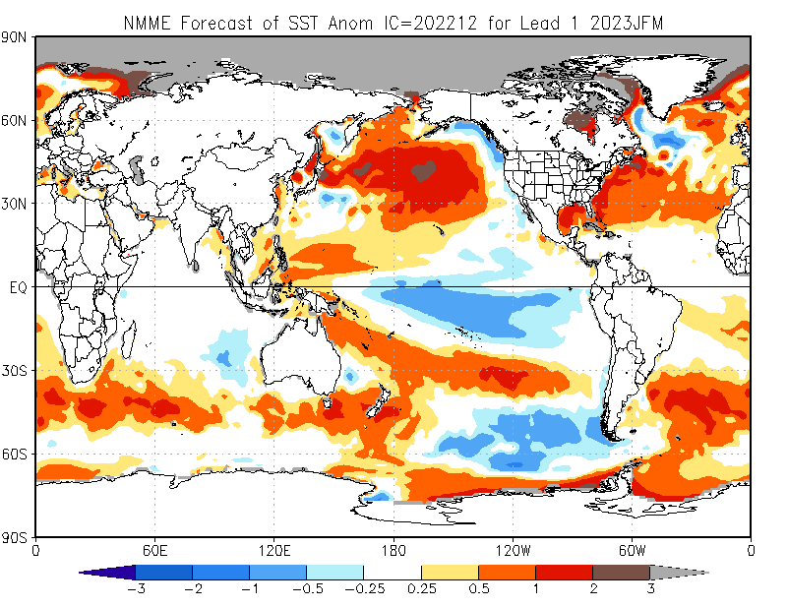

Slide 12
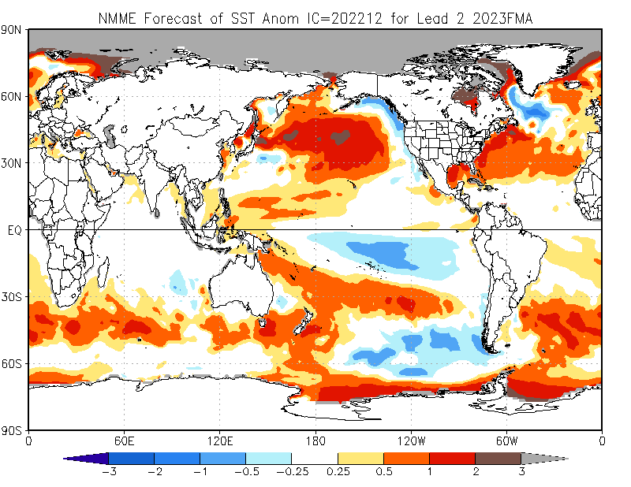

Slide 13
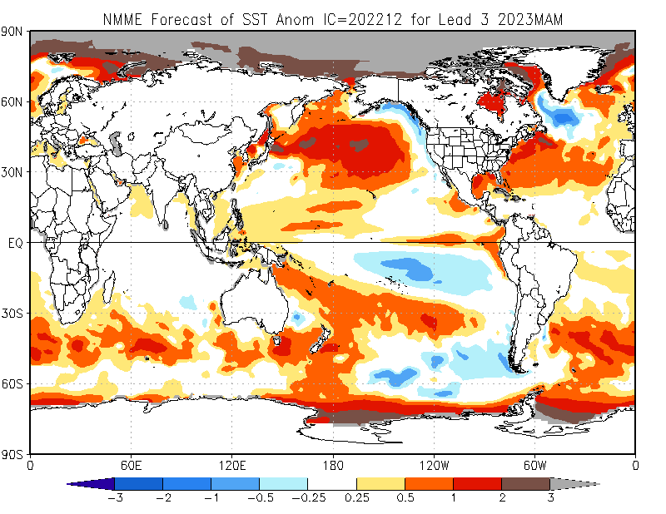

Slide 14
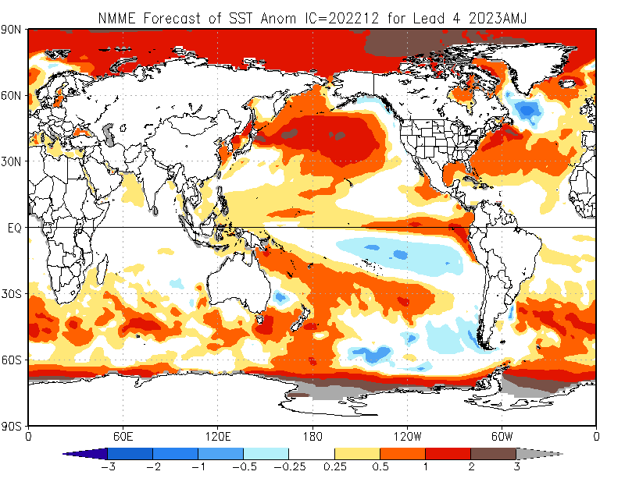

Slide 15
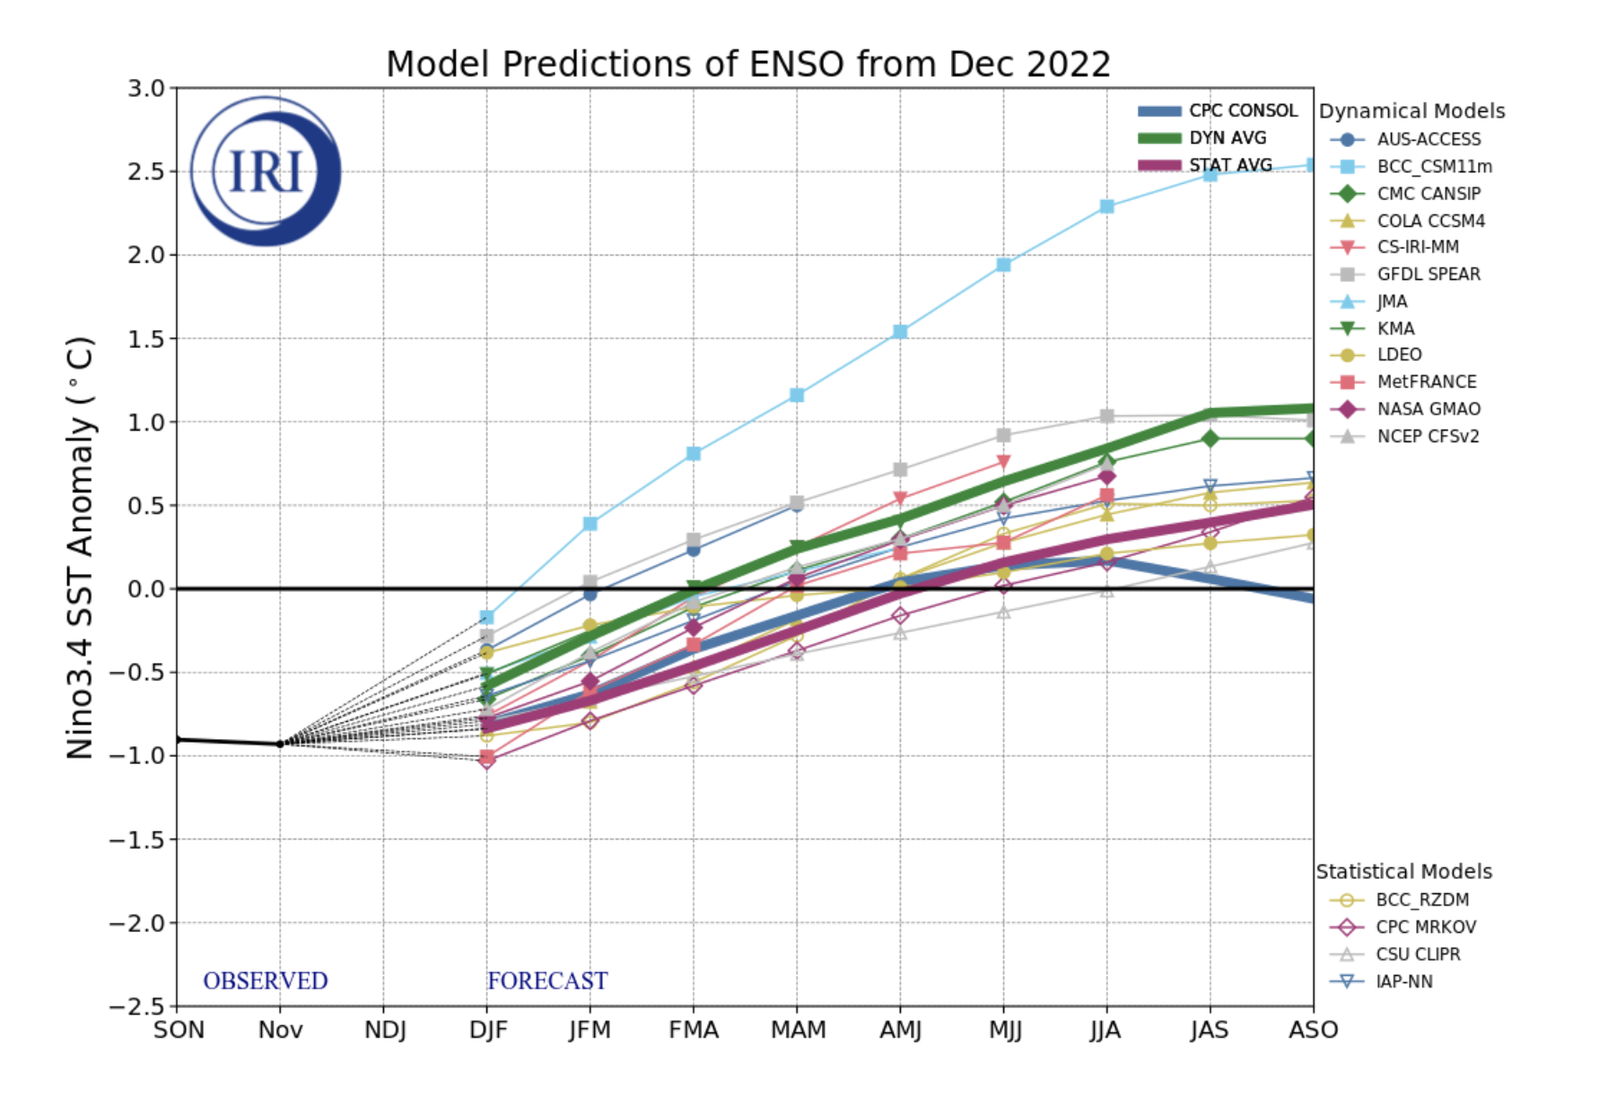
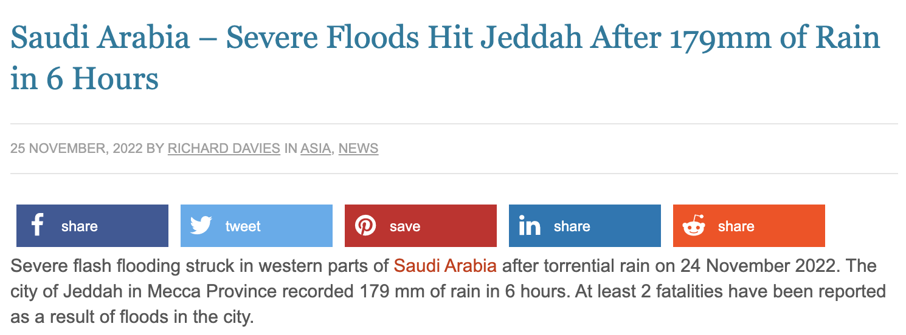
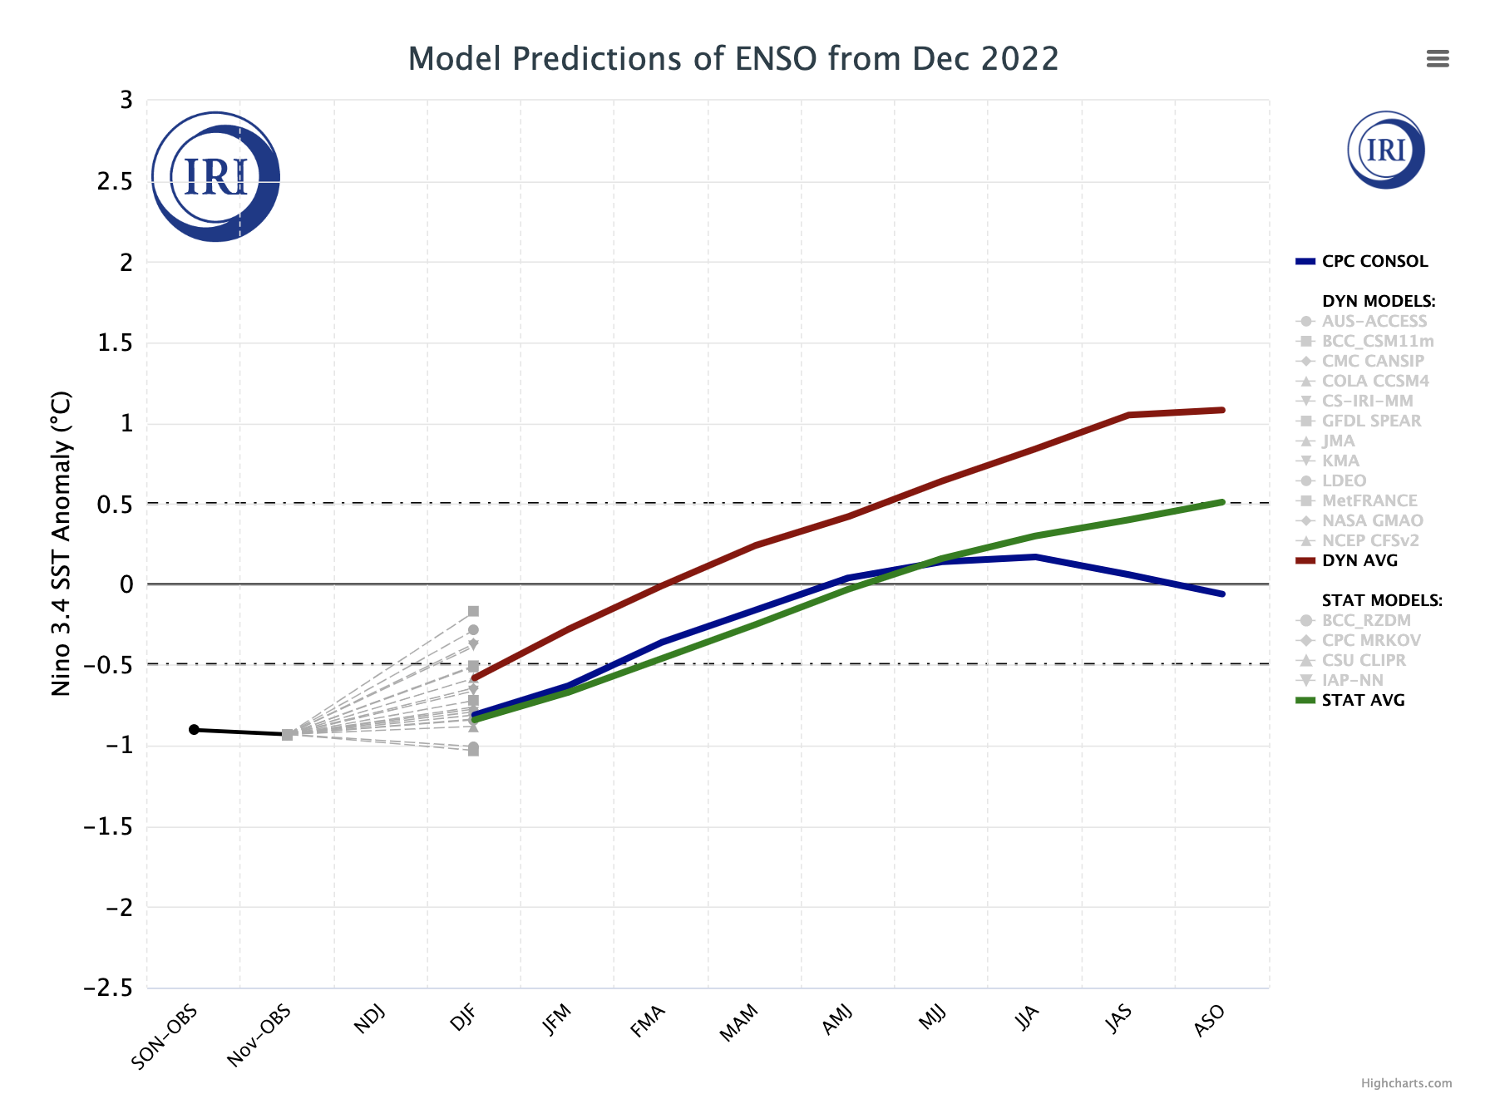
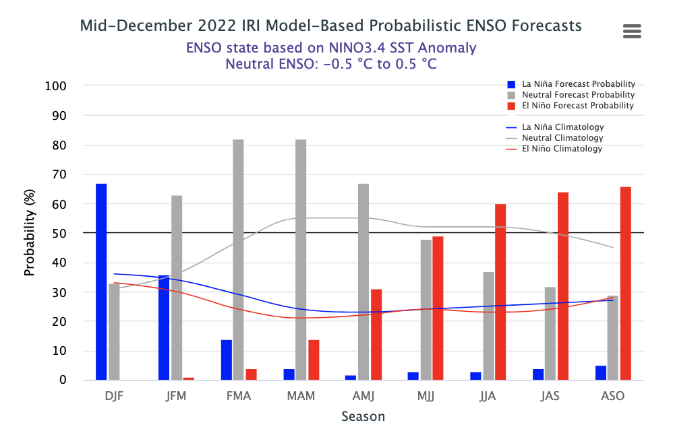
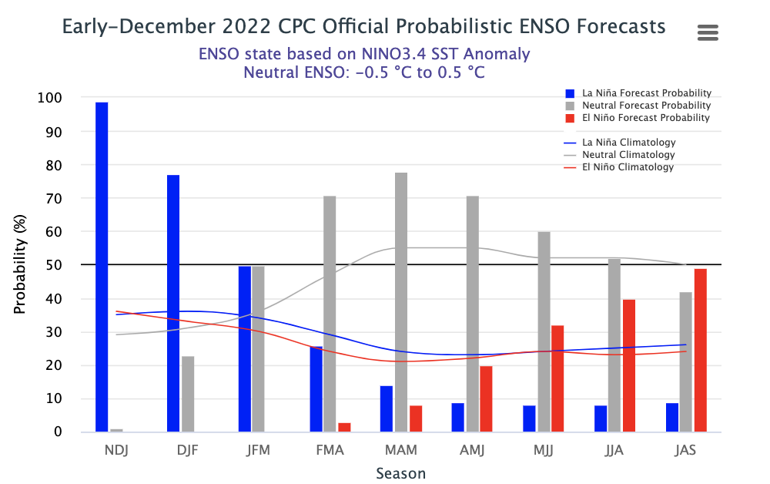
IRI’s ENSO Forecast (Dec, 2022)

Slide 16
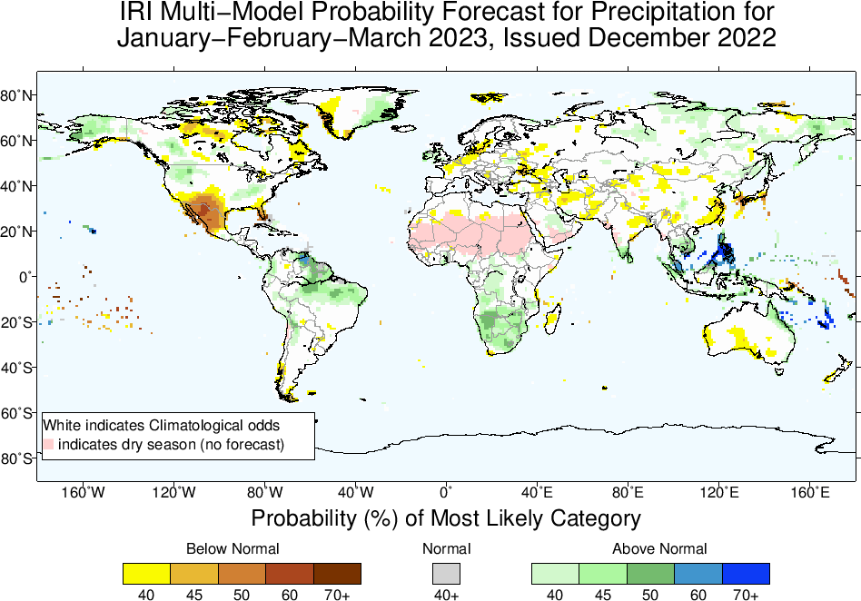

Slide 17
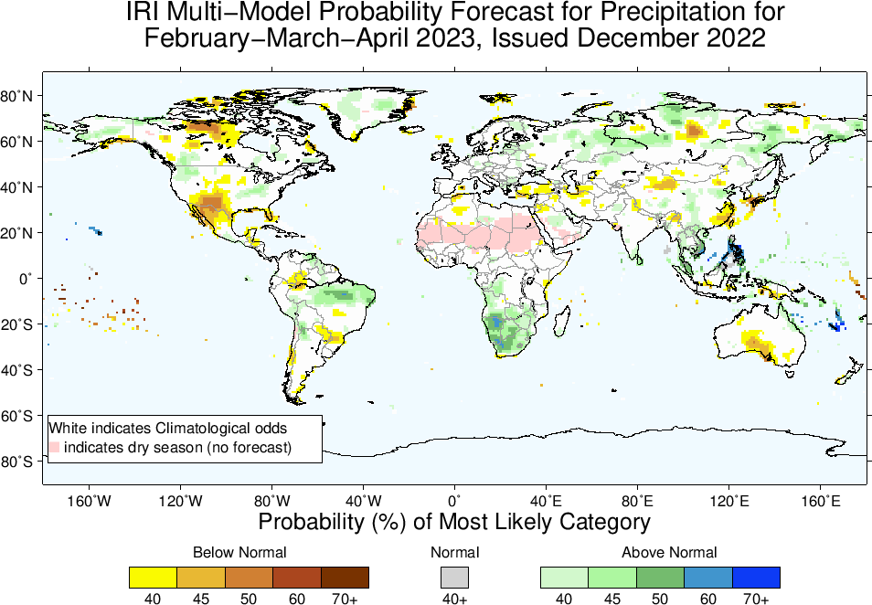

Slide 18
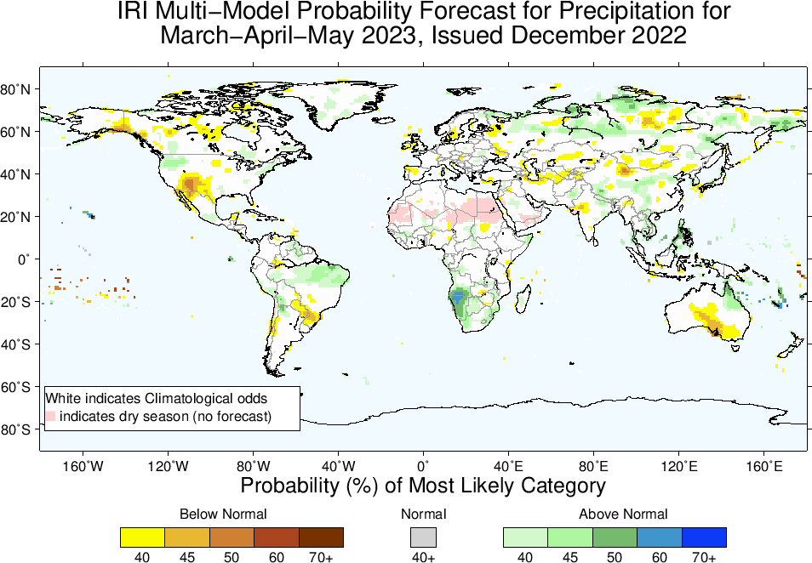

Slide 19
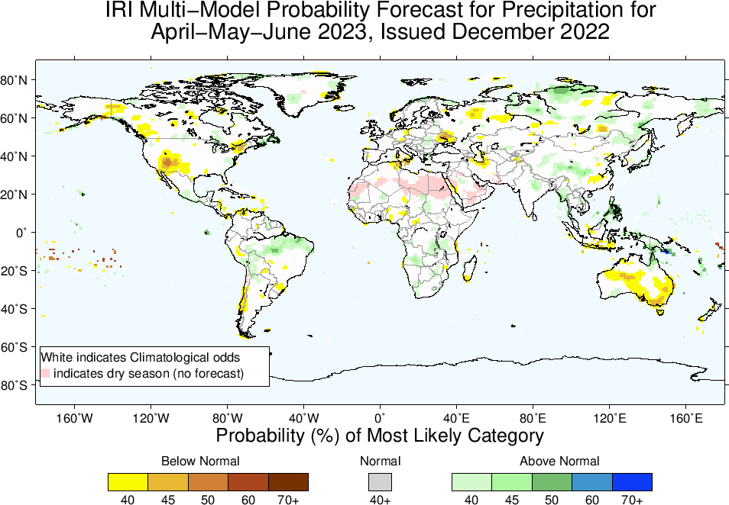

Slide 20
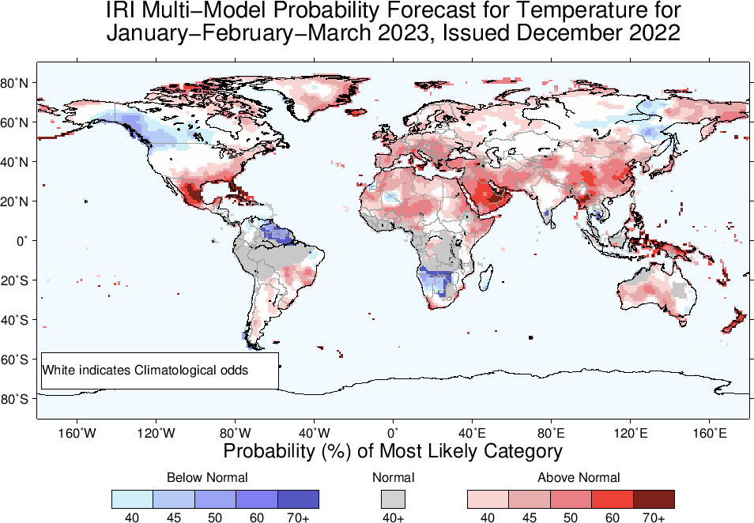

Slide 21
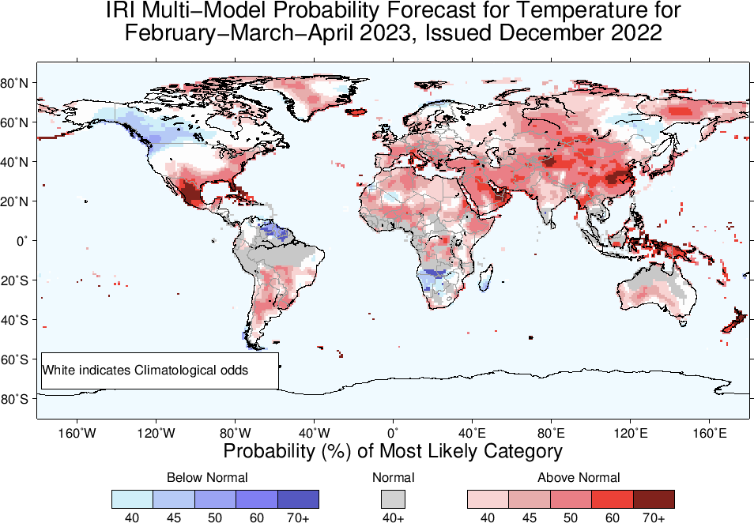

Slide 22
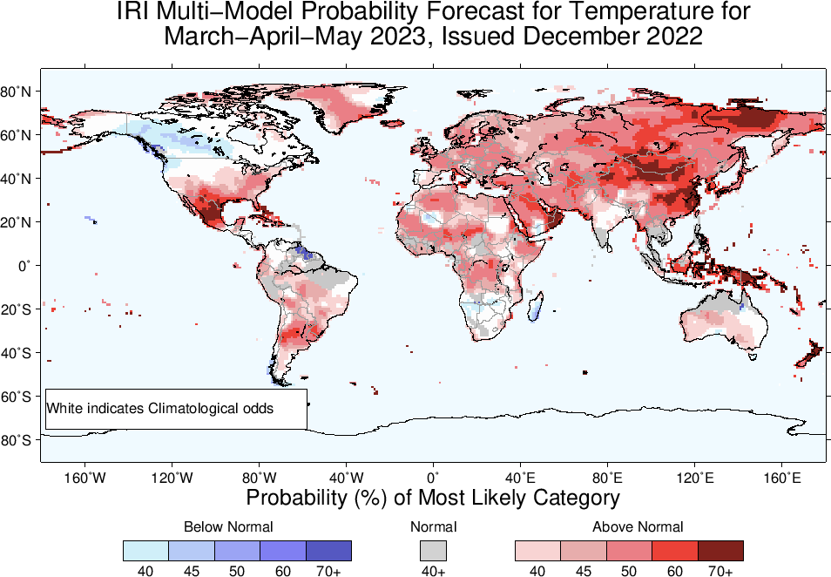

Slide 23
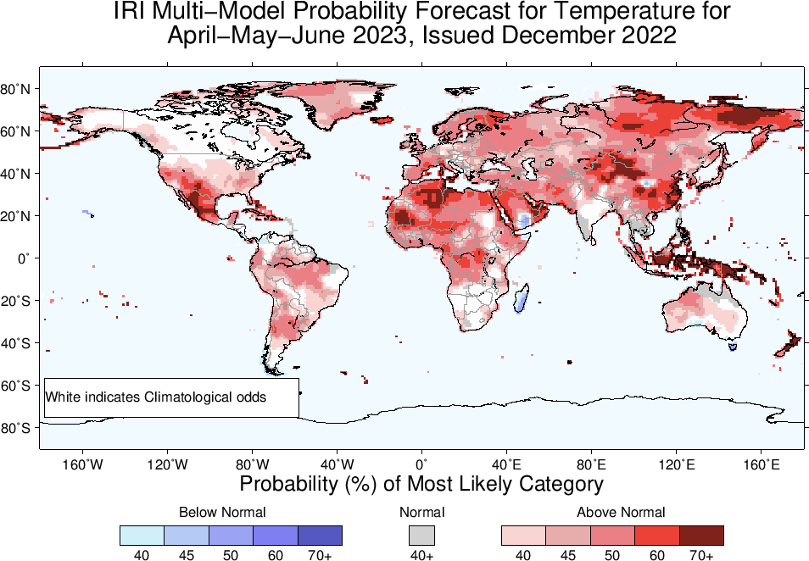

Slide 24
Summary
La Niña continues,
Both Oceanic and Atmospheric conditions show La Nina thresholds; e.g.,
Sea surface temperatures (SSTs) are below average across the central equatorial Pacific Ocean.
SOI is still positive (though ticked down but ticked up again, +9.4 as of Dec, 11, 2022), stronger than average trade winds, reduced cloudiness over central Pacific (west of Date-line).
ENSO-neutral is favored with 63% chances in Jan-Mar, 2023 and onward till Apr-Jun, 2023 (67% chance).
El-Nino is most favorable starting from May-Jul 2023 (49% chance) and most likely during boreal summer of 2023 with chances in high 60s.
Caution: Forecast is highly uncertain as we move from Spring to Summer time.

