Slide 1
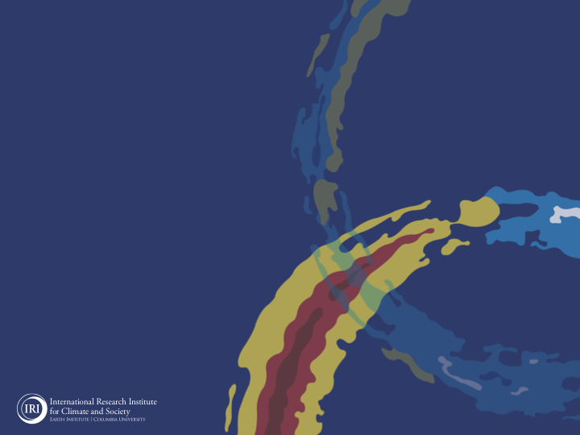
ENSO and Climate Outlook
December 2021:
La Nina Conditions Established. Dissipating in MAM2022!
M. Azhar Ehsan
(azhar@iri.columbia.edu)
Associate Research Scientist
IRI ENSO and Climate Forecast Lead
Jeffery Turmelle and Jing Yuan: forecast processing and web updates
Cuihua Li: Draft PowerPoint development
IRI’s Climate Group, led by Dr. Andrew Robertson: Forecast system development, ongoing innovation, and verification

Slide 2
Outline
Observed Oceanic and Atmospheric Conditions in
Tropical Pacific
Indian and Atlantic Basins
ENSO Plume in
NMME and EU
IRI ENSO Plume
Seasons Outlook of
SST
Precipitation and Temperature
Summary

Slide 3
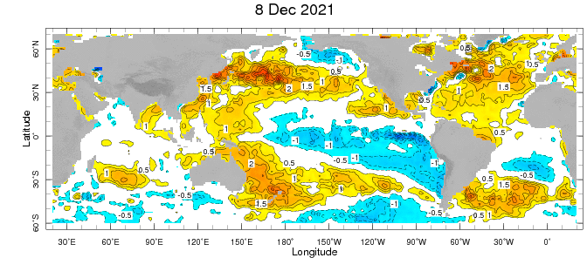
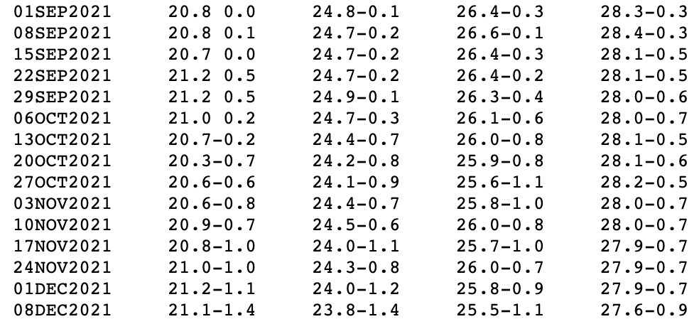
Weekly SST Anomalies ➔
1+2
3
3.4
4

Slide 4
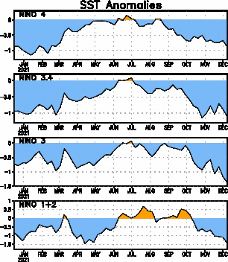
Neutral
La Nina 2021
La Nina 2020

Slide 5
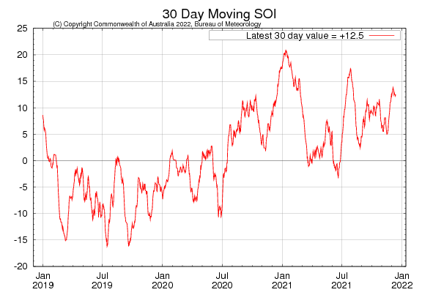

Slide 6
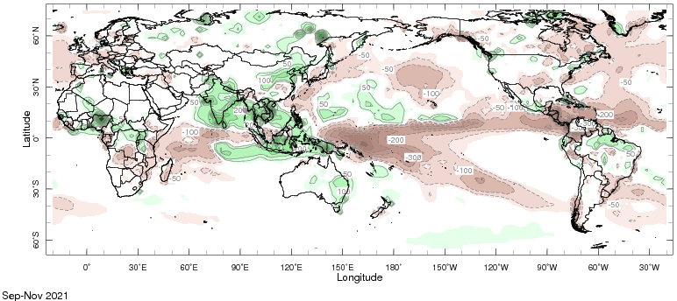
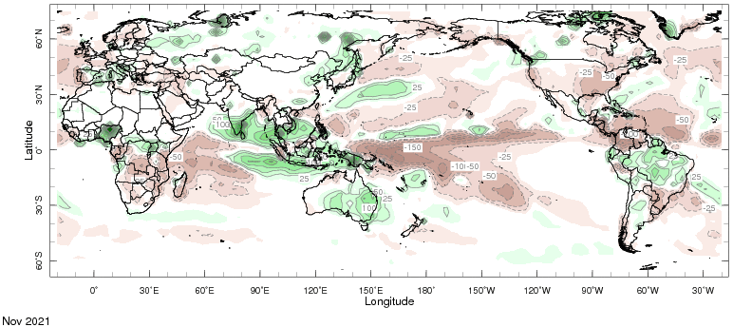
Precipitation Anomalies (SON & Nov, of 2021)
SON 2021
NOV, 2021

Slide 7
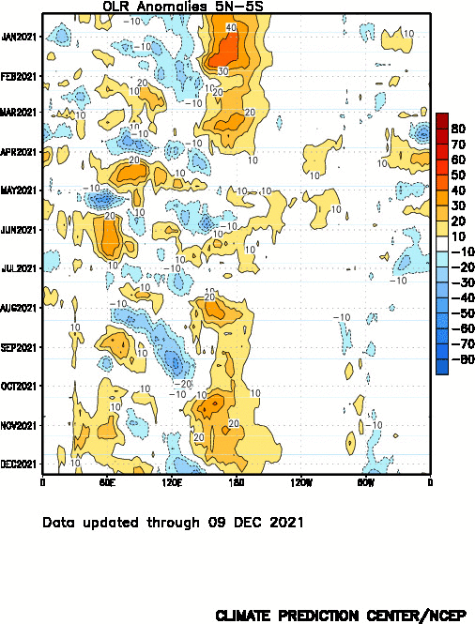

Slide 8
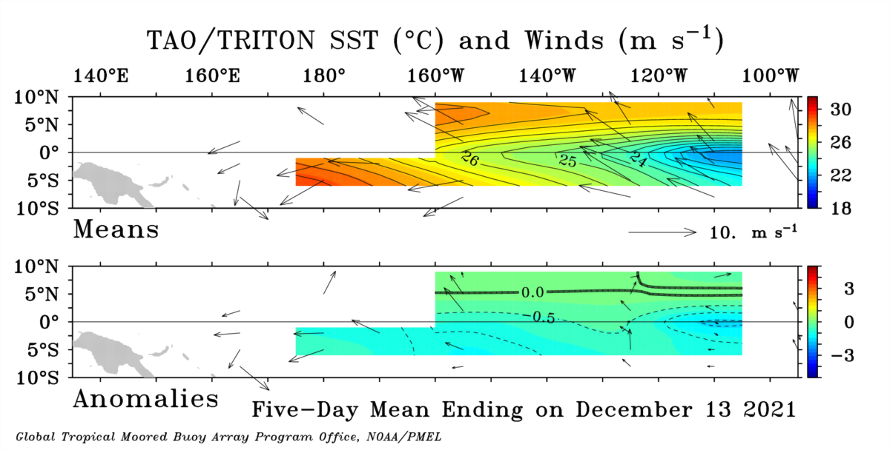
Pentad Sea Surface Temperatures and Winds
(From TOGA/TAO Buoys)

Slide 9
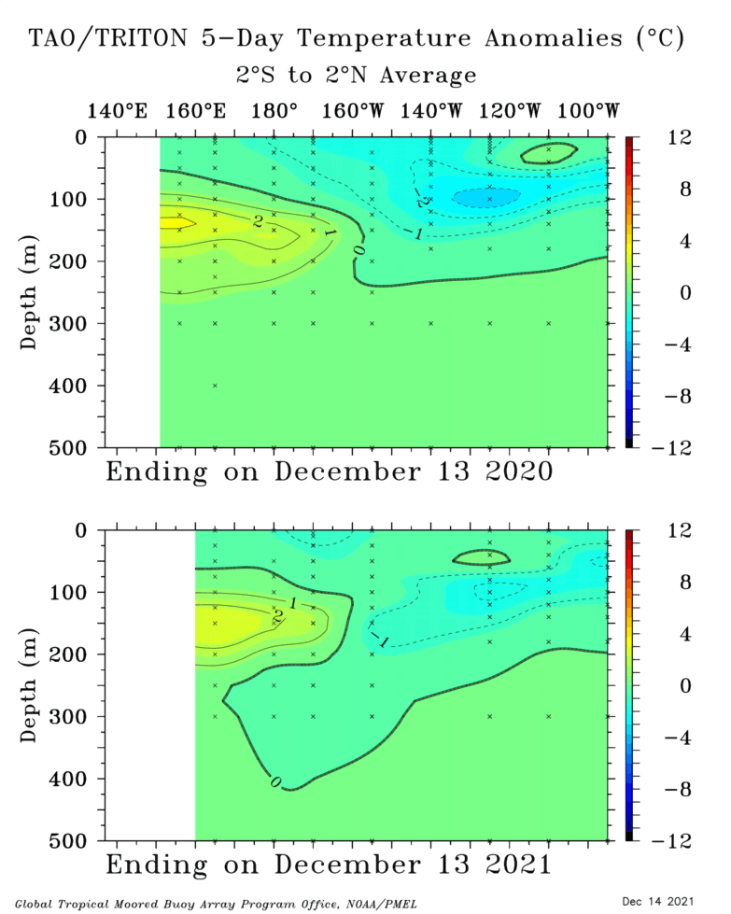
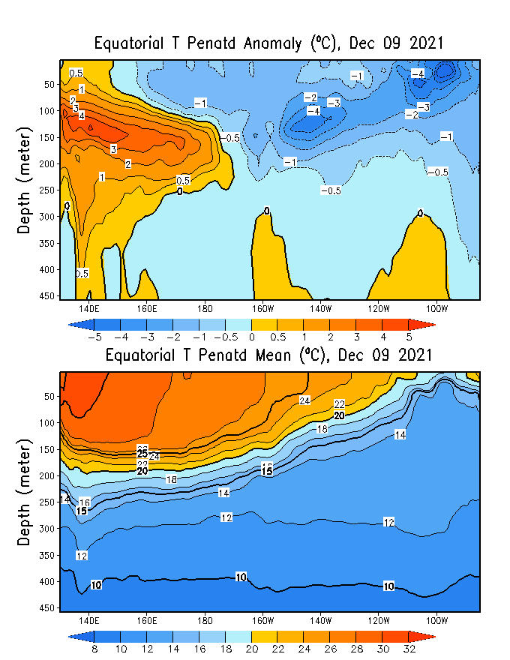

Slide 10
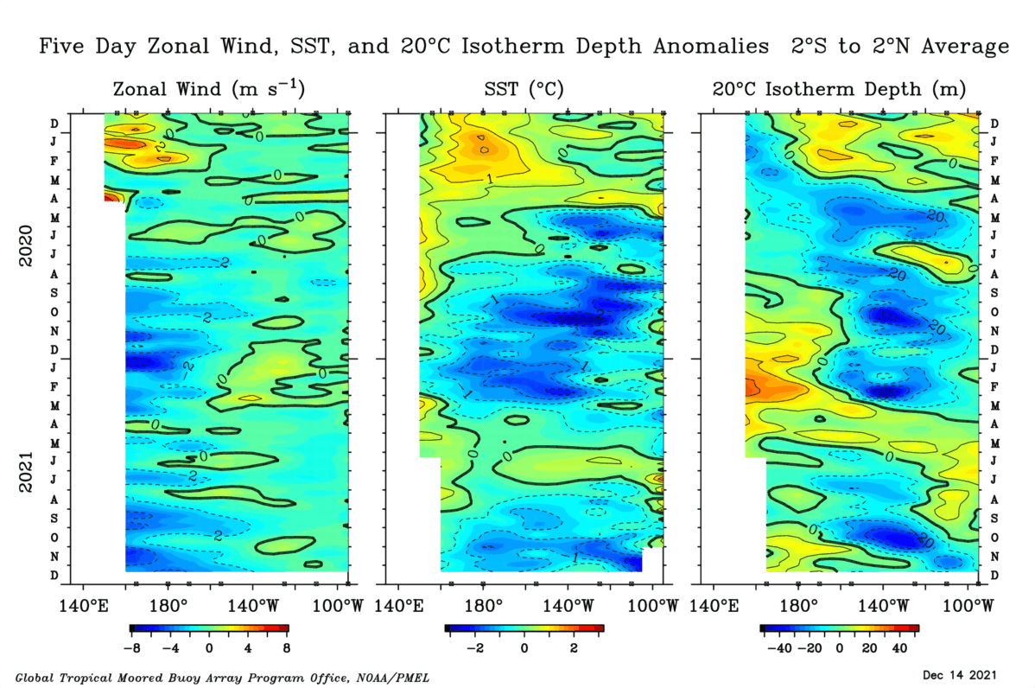
Enhanced Trade Winds.
Below-Normal SST Anomalies.
Shallower Subsurface,

Slide 11
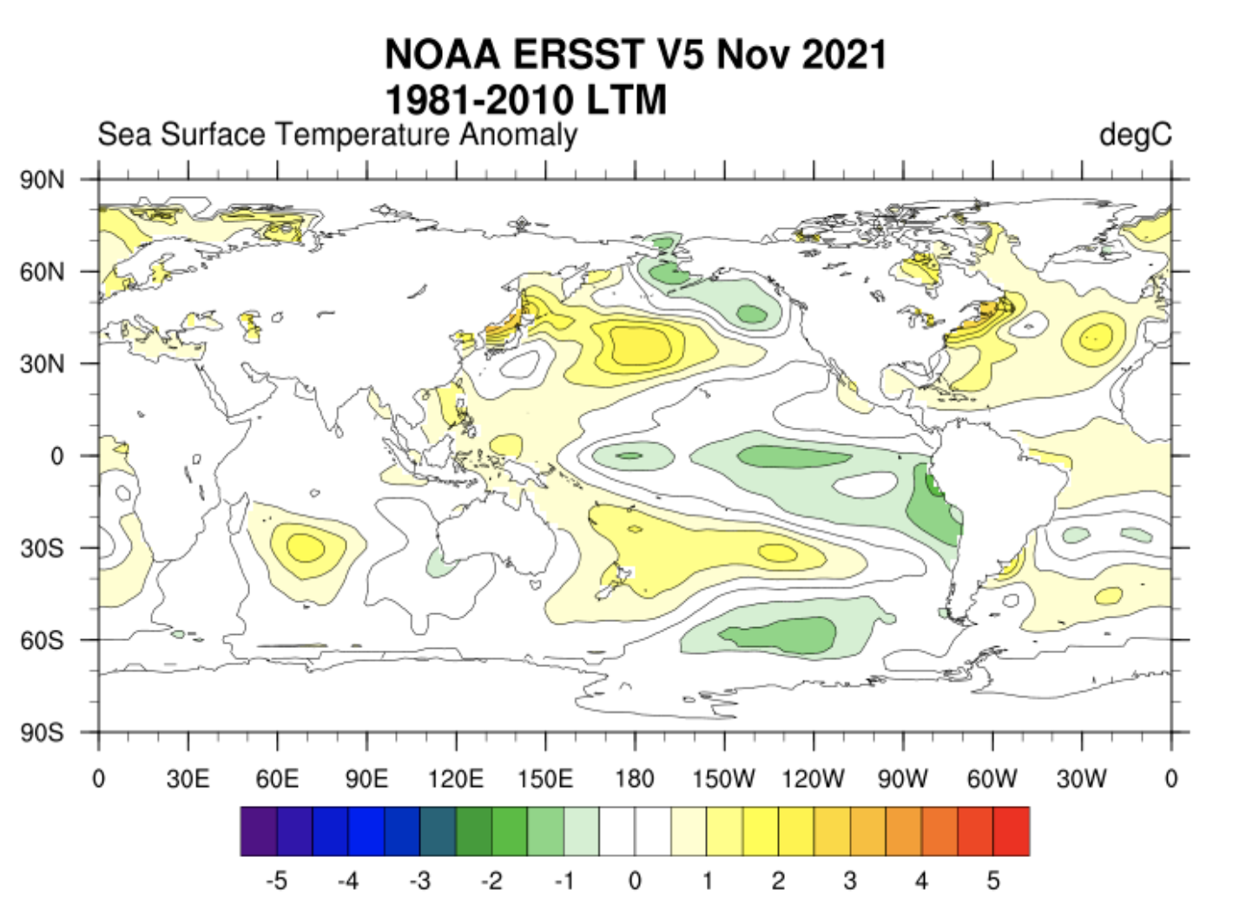
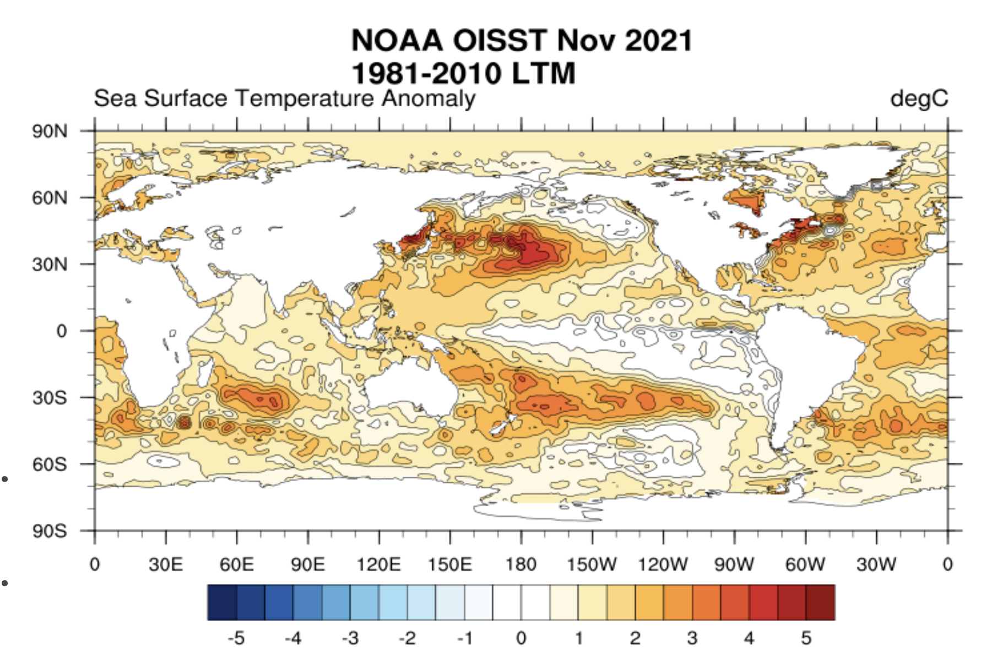
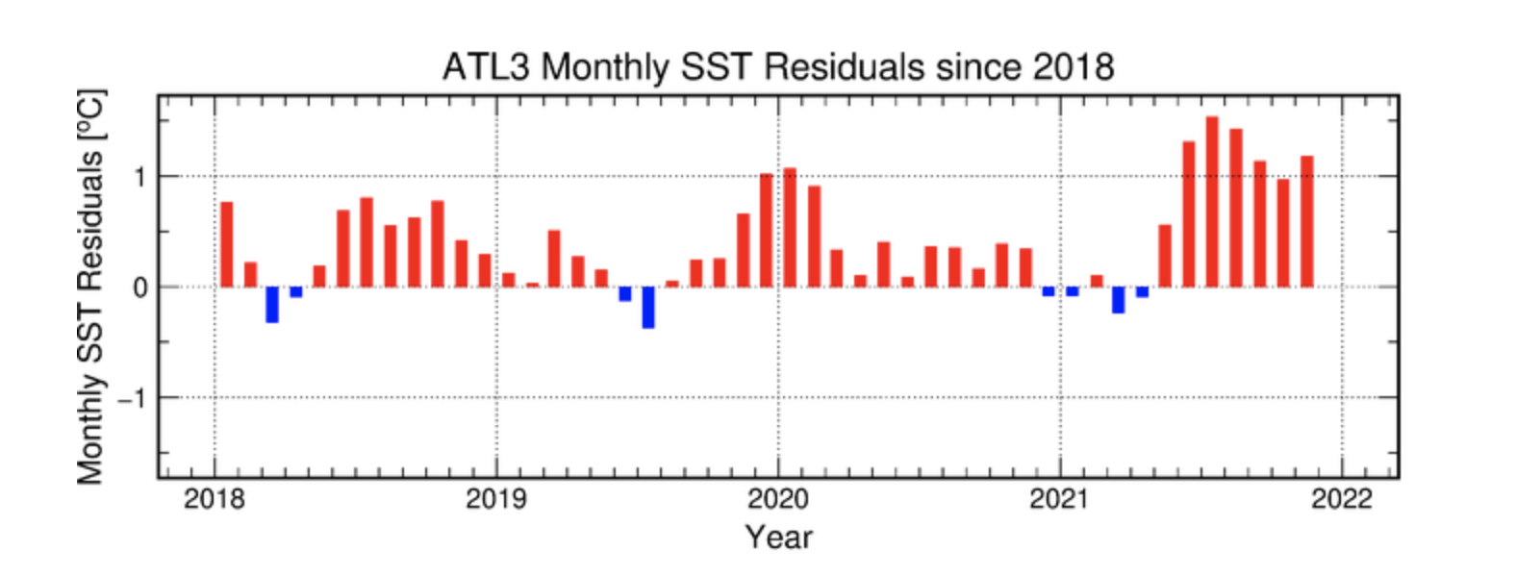

Slide 12
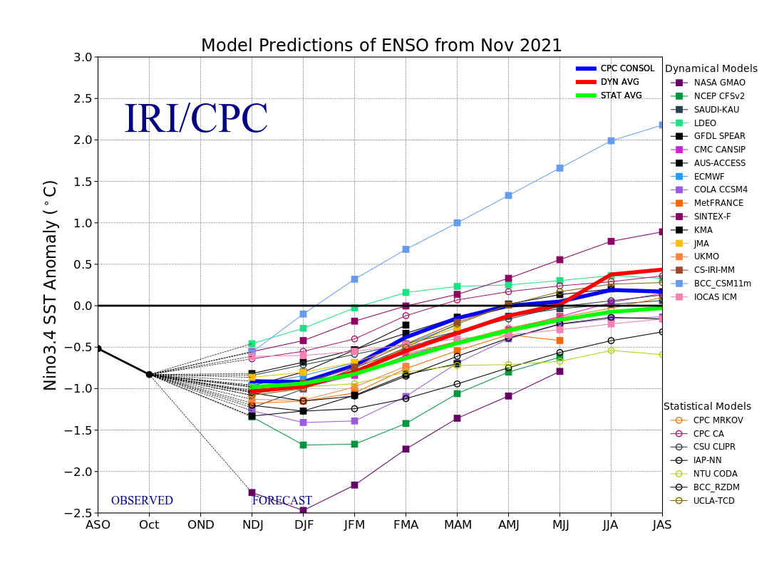

Slide 13
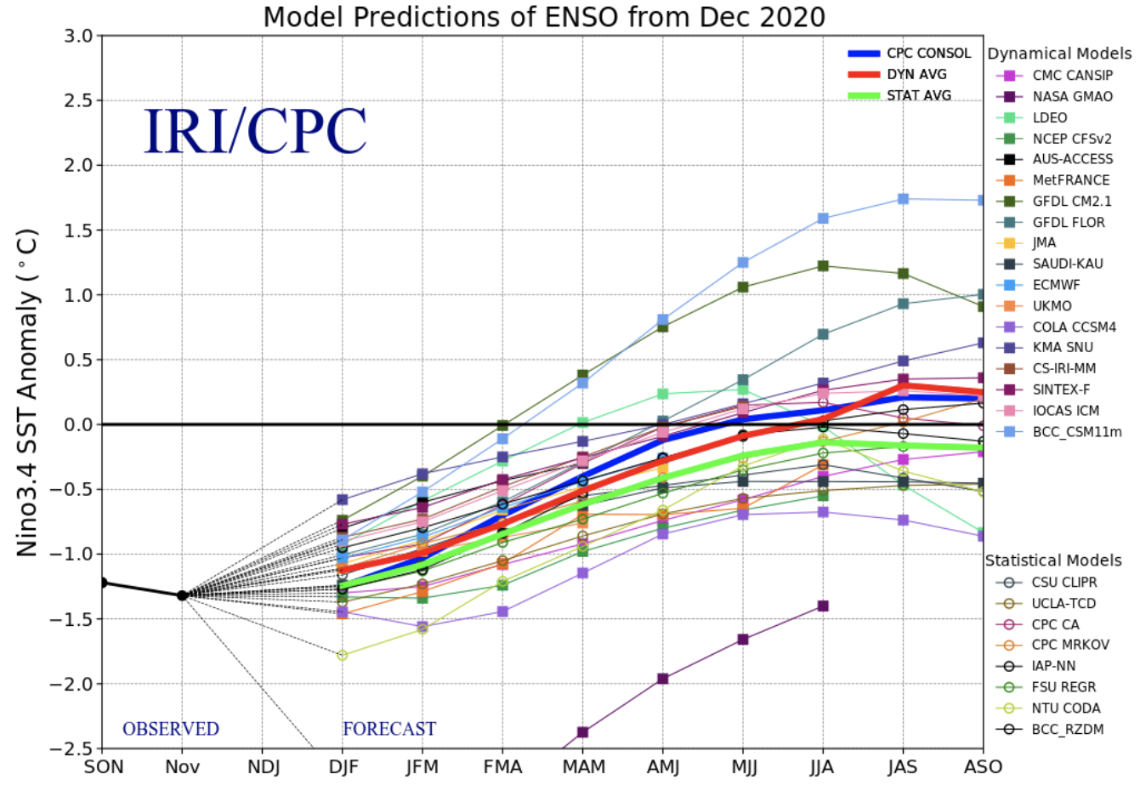
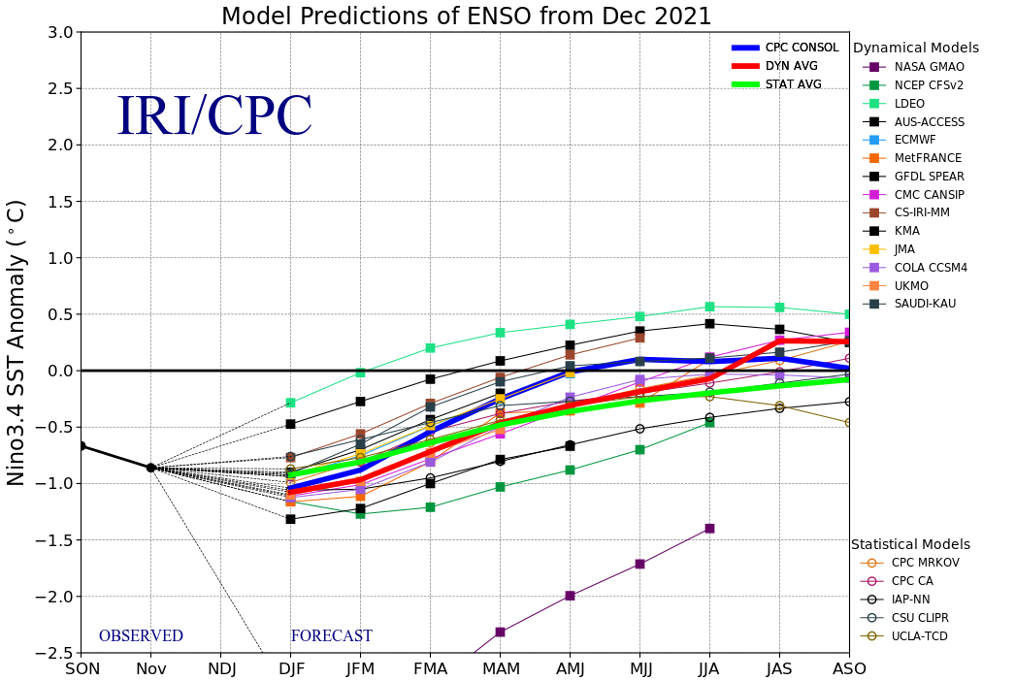

Slide 14
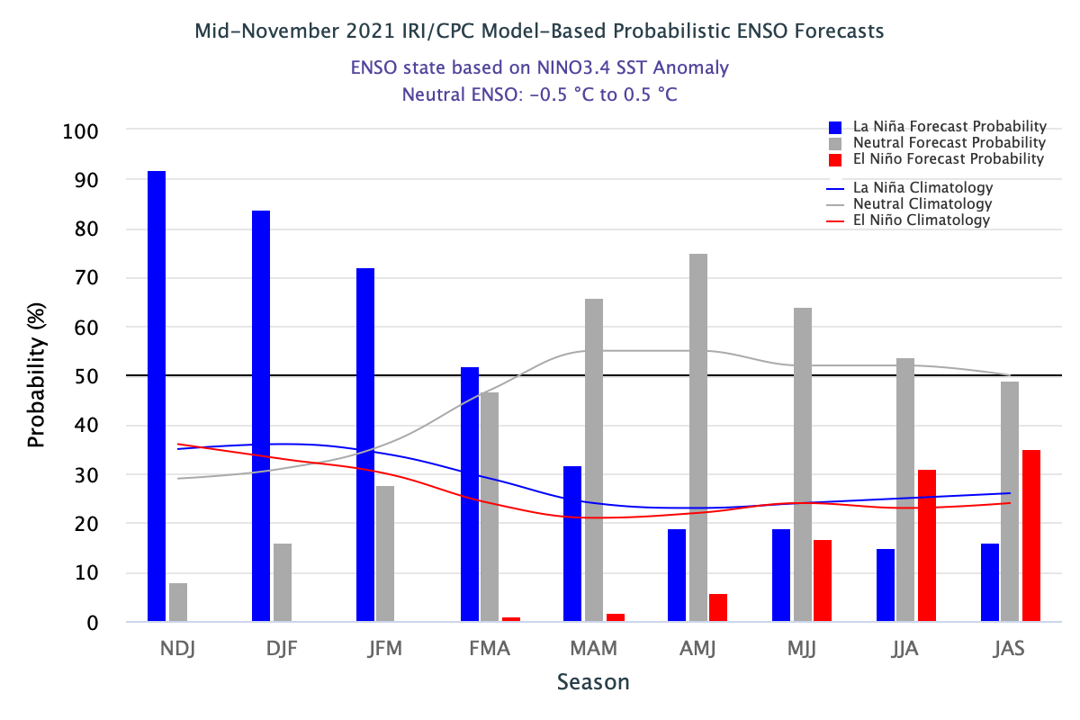
ENSO-Neutral

Slide 15
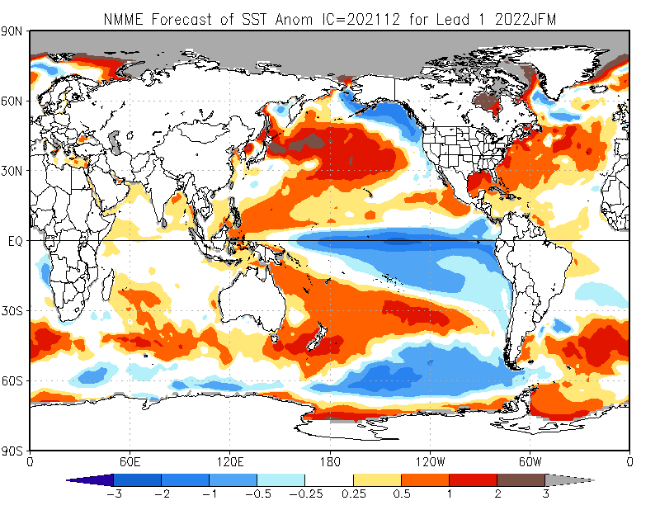

Slide 16
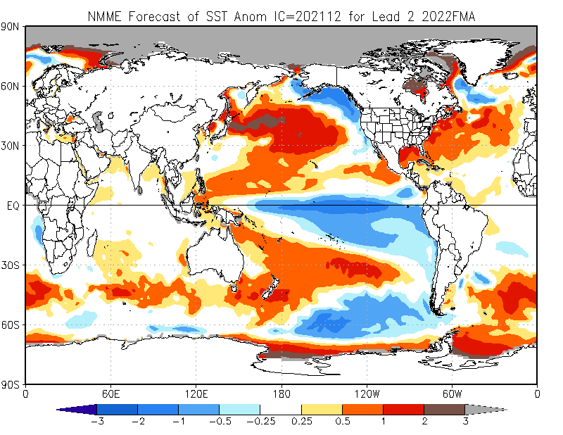

Slide 17
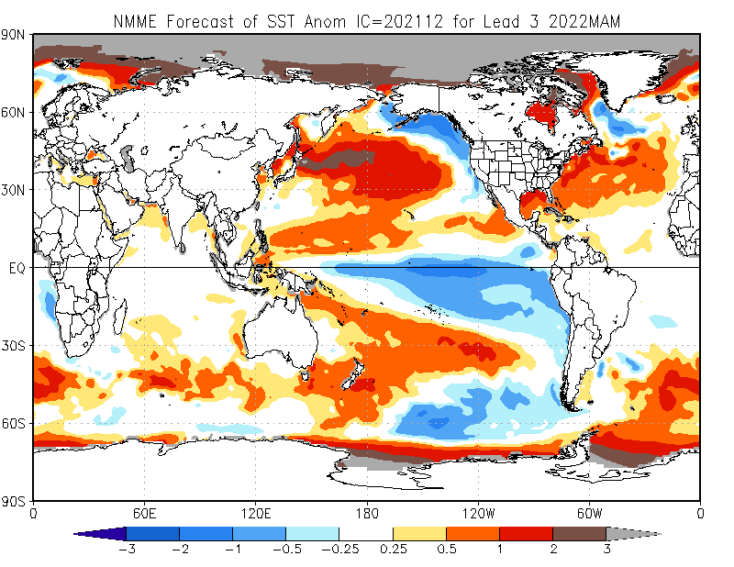

Slide 18
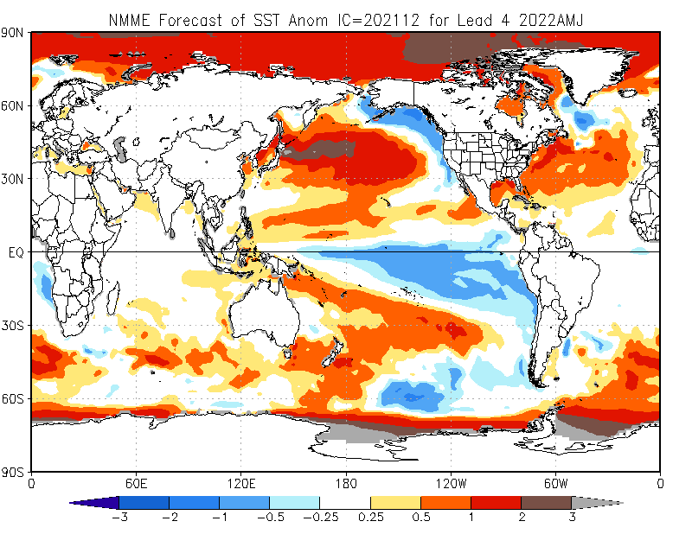

Slide 19
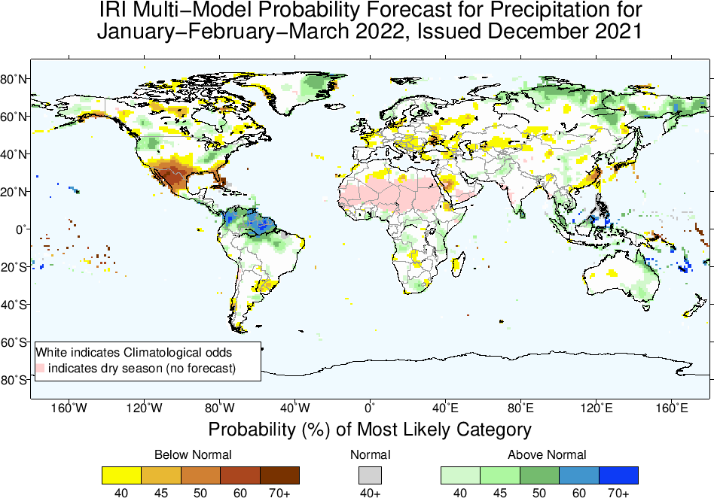

Slide 20
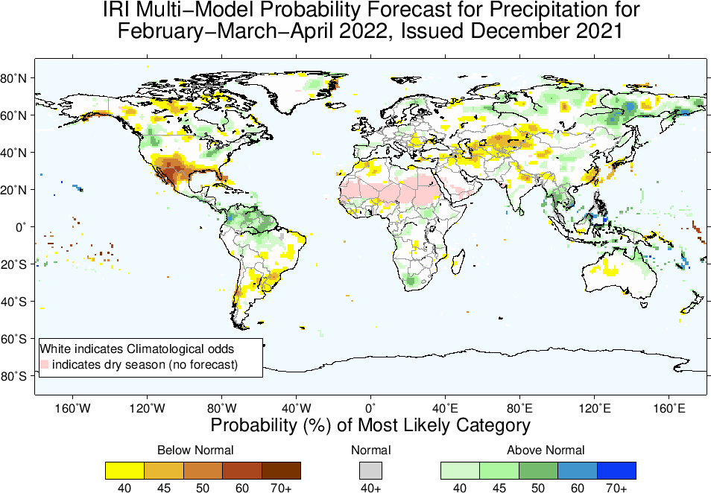

Slide 21
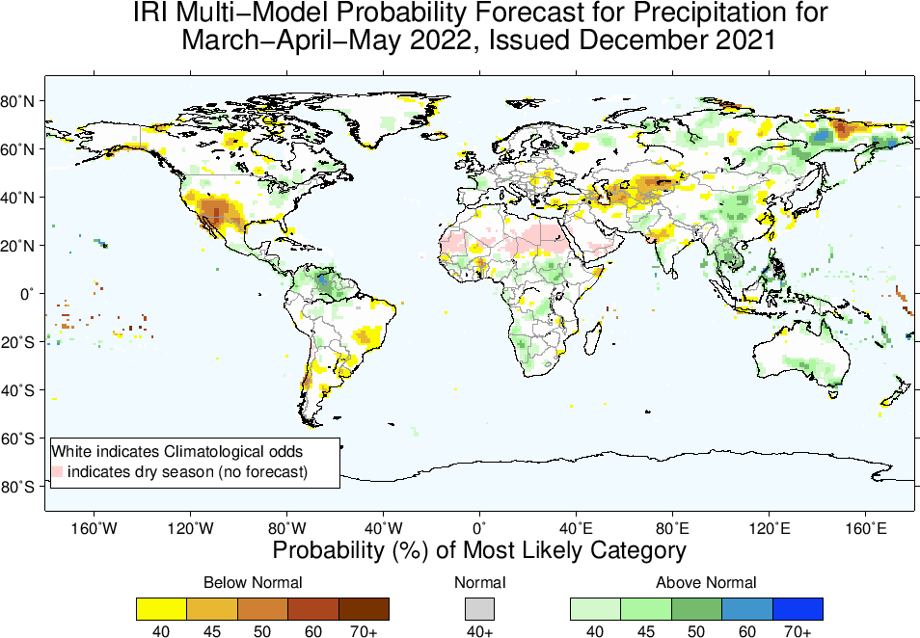

Slide 22
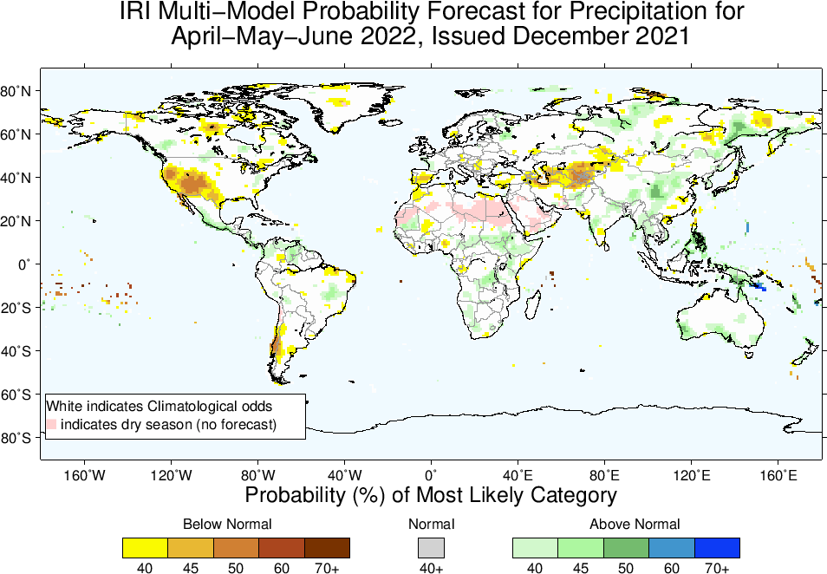

Slide 23
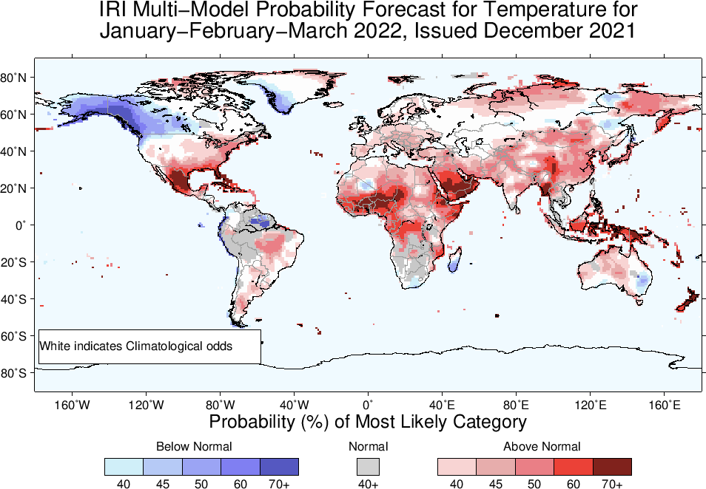

Slide 24
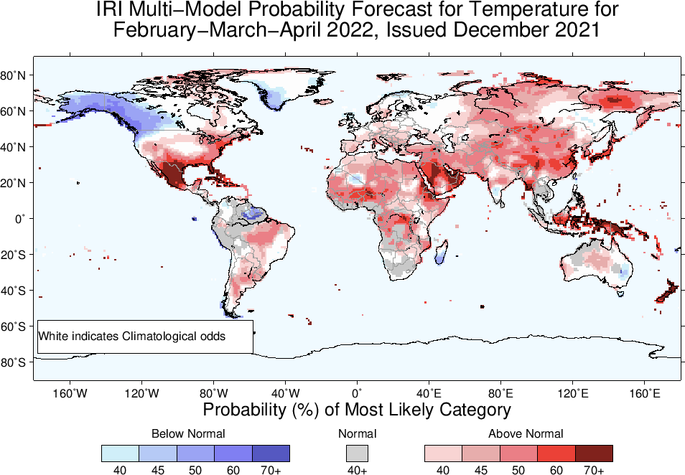

Slide 25
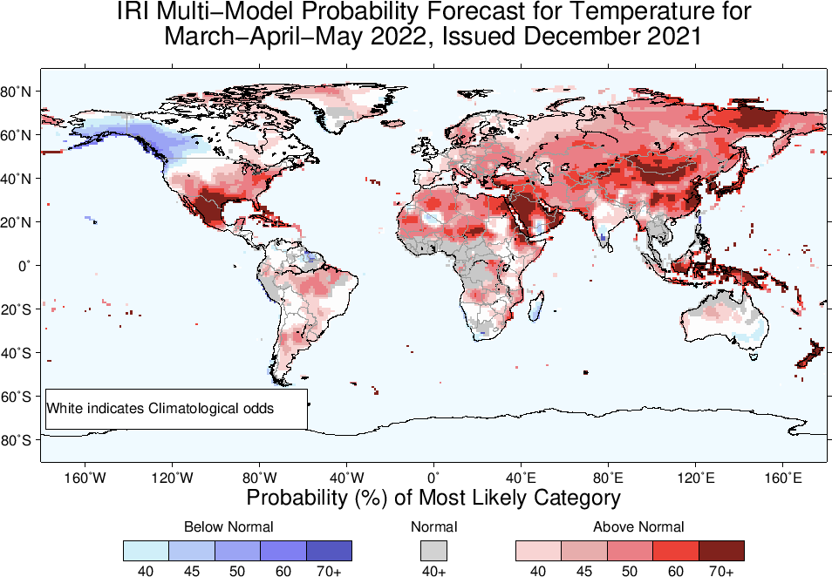

Slide 26
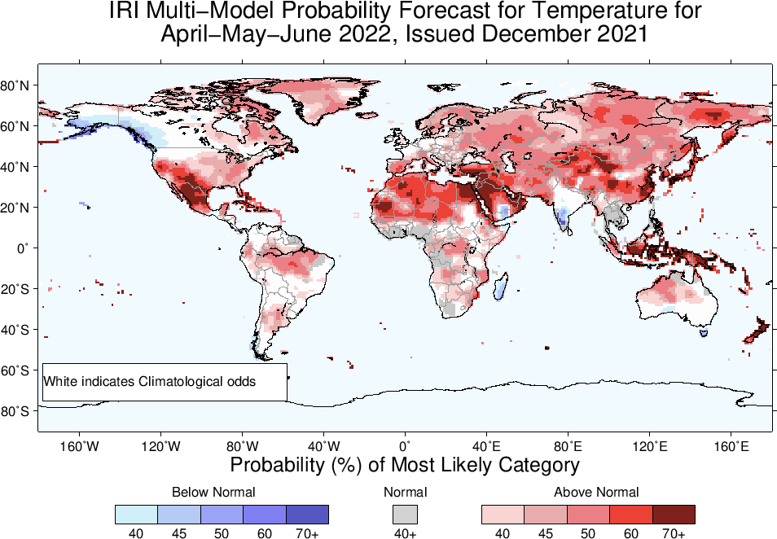

Slide 27
Summary
Patterns in the ocean and atmosphere indicate La Niña conditions continue in the equatorial Pacific.
These conditions are more likely to continue until the end of boreal winter.
La Niña is going to dissipate by MAM2022, and ENSO-Neutral conditions evolve.

