Slide 1
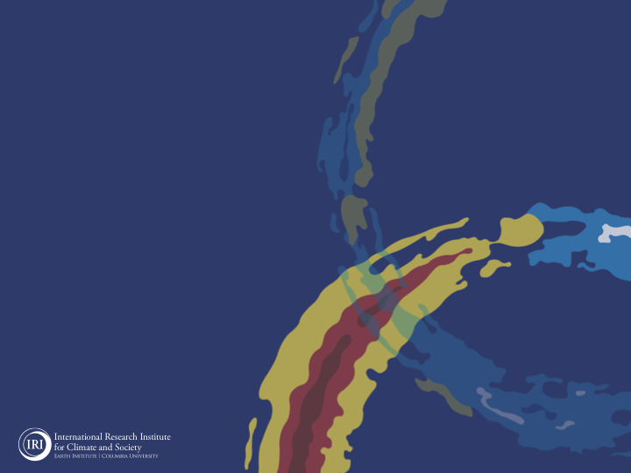
ENSO and Climate Outlook
August 2021:
ENSO-Neutral Conditions Trending Cooler. Are we in for a 2nd La Niña?
Acknowledgements:
Jeffery Turmelle and Jing Yuan: forecast processing and web updates
Cuihua Li: Draft powerpoint development
IRI’s Climate Group, led by Dr. Andrew Robertson: Forecast system development, ongoing innovation, and verification

Slide 2
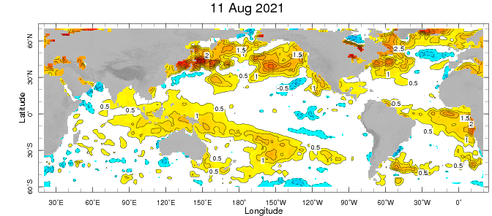
Weekly Sea Surface Temperature Anomalies (includes satellite data)
NINO3.4 = -0.4 C

Slide 3
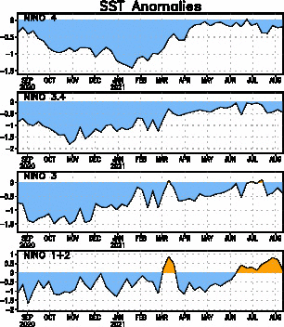
Near Dateline
This is the SST
Index
predicted
Eastern Eq. Pacific
Off Coast of S.America

Slide 4
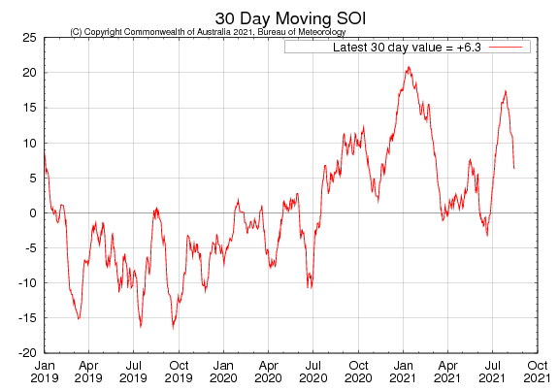
Tahiti_{SLP} – Darwin,AUS_{SLP}

Slide 5
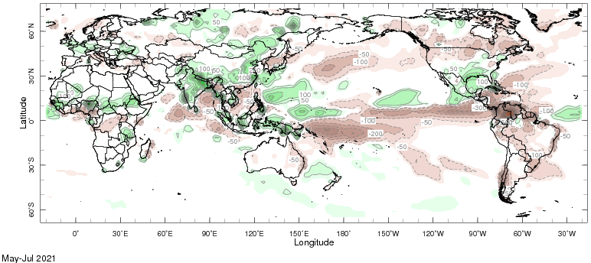
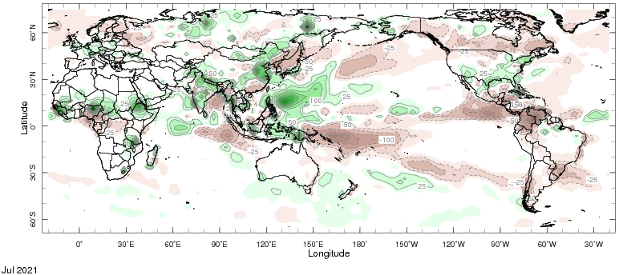
Precipitation Anomalies
MJJ 2021
July 2021

Slide 6
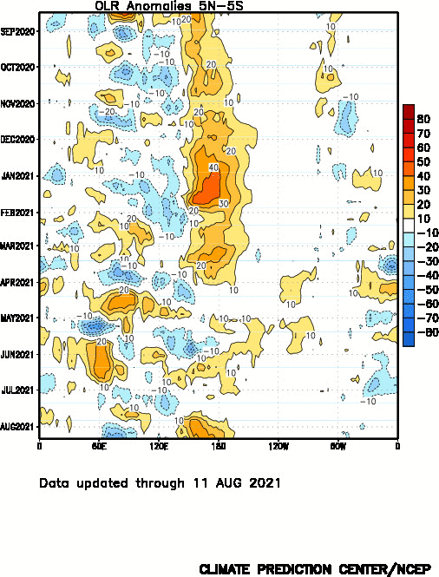
Drier
Wetter

Slide 7
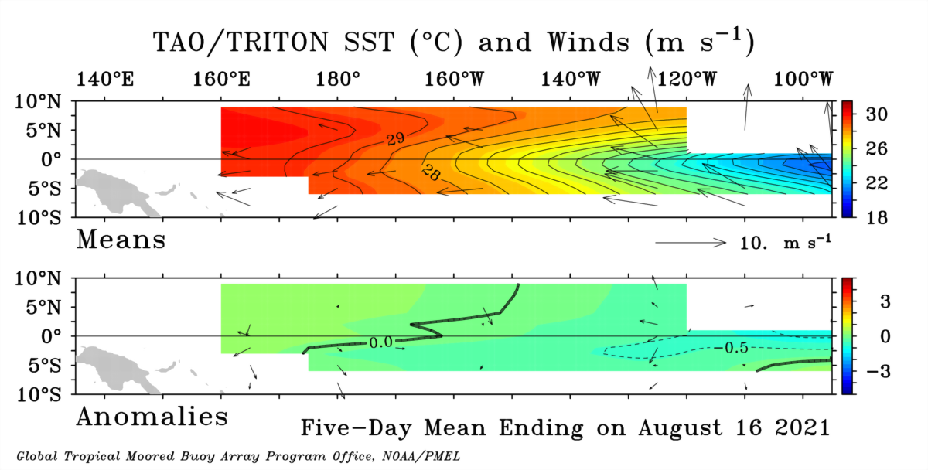

Slide 8
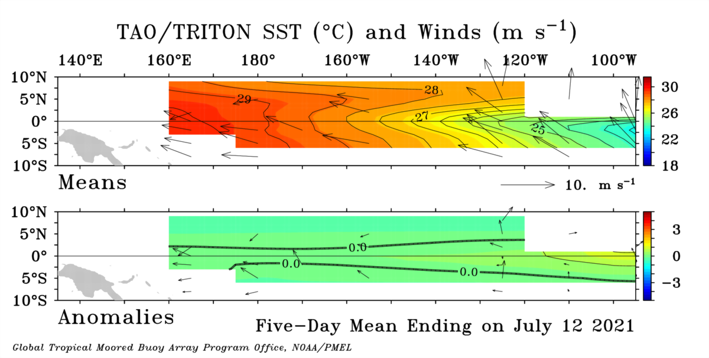
A Month Ago…

Slide 9
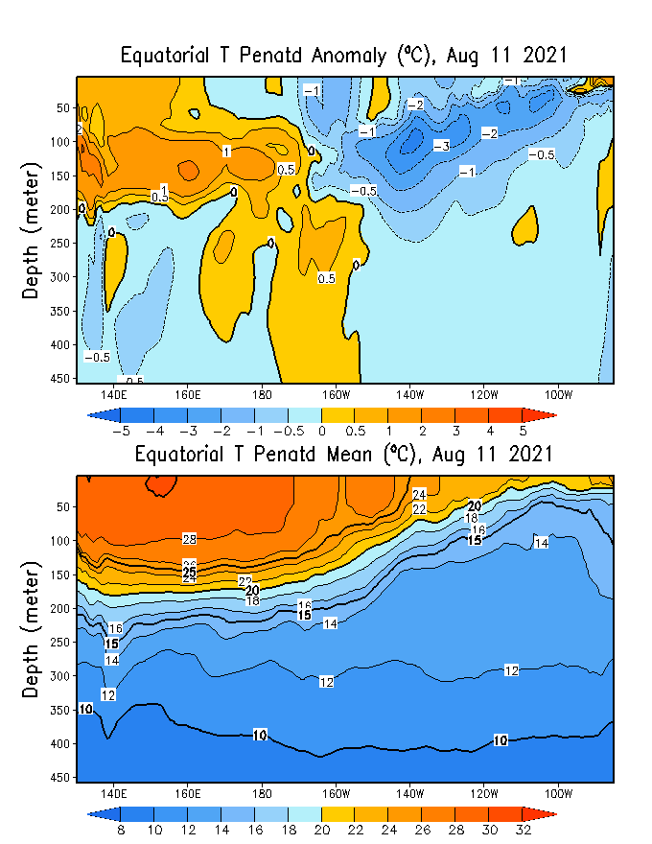
GODAS* Analysis
Used to initialize CFSv2 and CCSM4
* Global Ocean Data Assimilation System

Slide 10
Analysis directly from TOGA-TAO buoy measurements.
TOTAL
ANOMALY

Slide 11
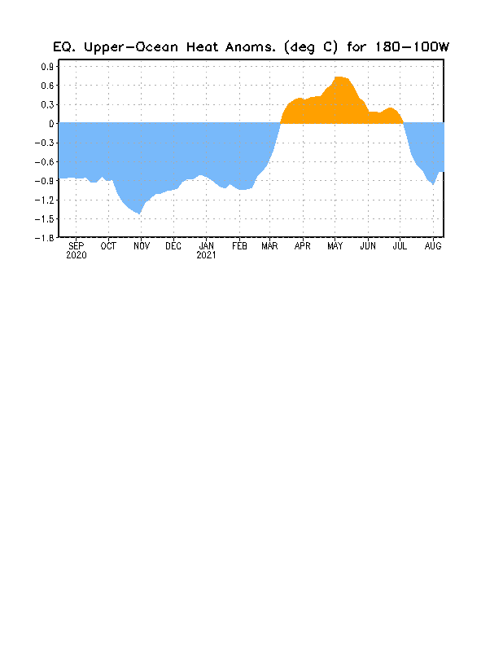

Slide 12
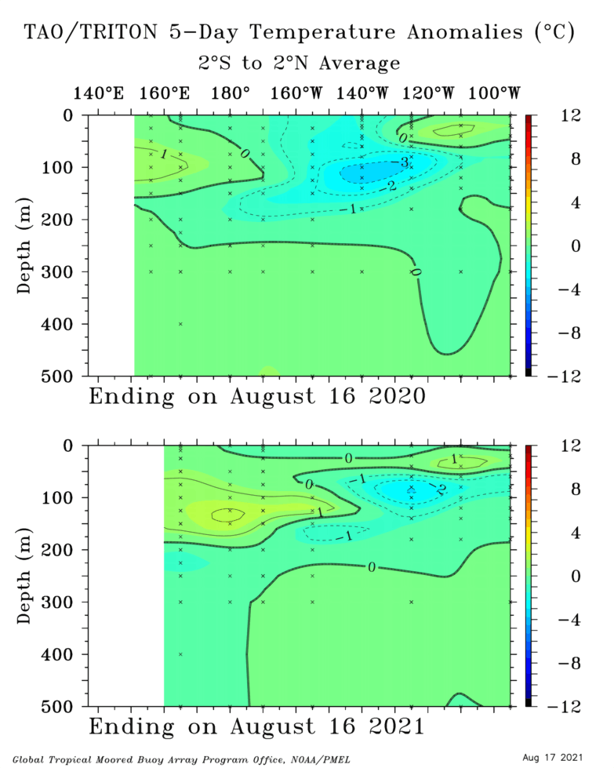
Last Year (Aug ‘20)
Last Month (Aug ‘21)

Slide 13
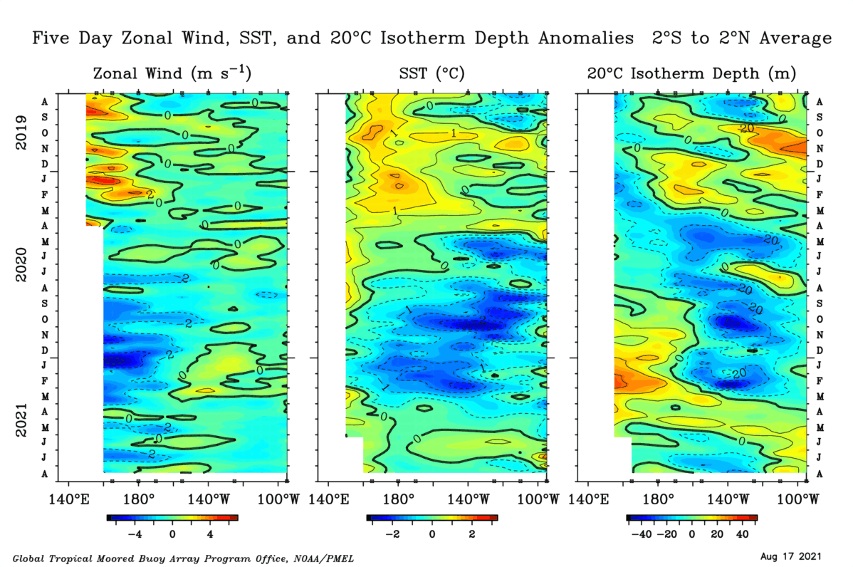

Slide 14
What’s going on??
➔ An updated exploration into some processes that may affect La Niña evolution.
Atlantic NINO
Growing W. Pacific warm pool
Sub-seasonal easterlies [MJO-related (?)]

Slide 15
Monthly Sea Surface Temperature Anomalies (includes satellite data)
Biggest Atlantic NINO on record. These events usually peak in July.

Slide 16
Weekly Sea Surface Temperature Anomalies (includes satellite data)
Western Pacific warm pool centering over Maritime Continent, and strengthening.

Slide 17
Sub-seasonal easterlies

Slide 18
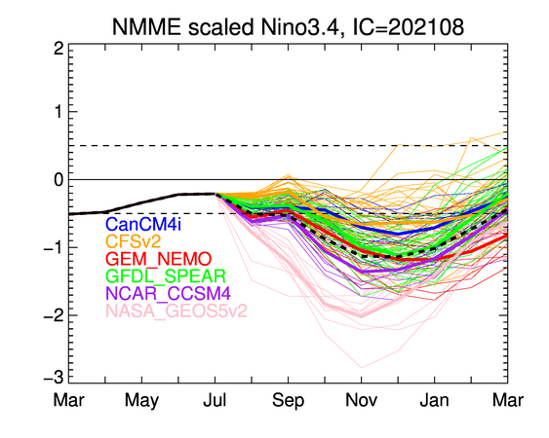

Slide 19
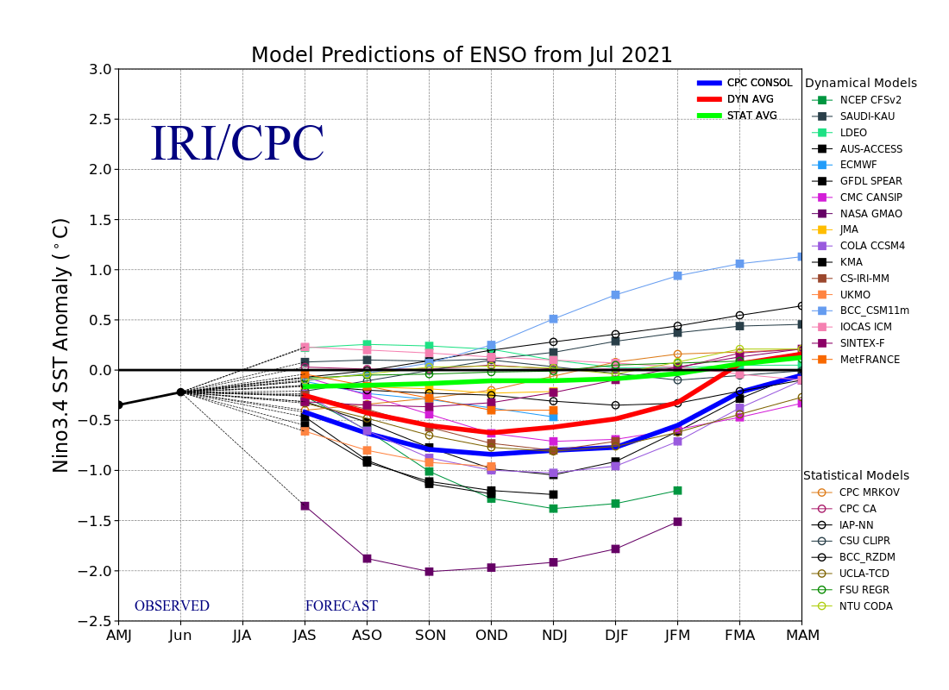

Slide 20
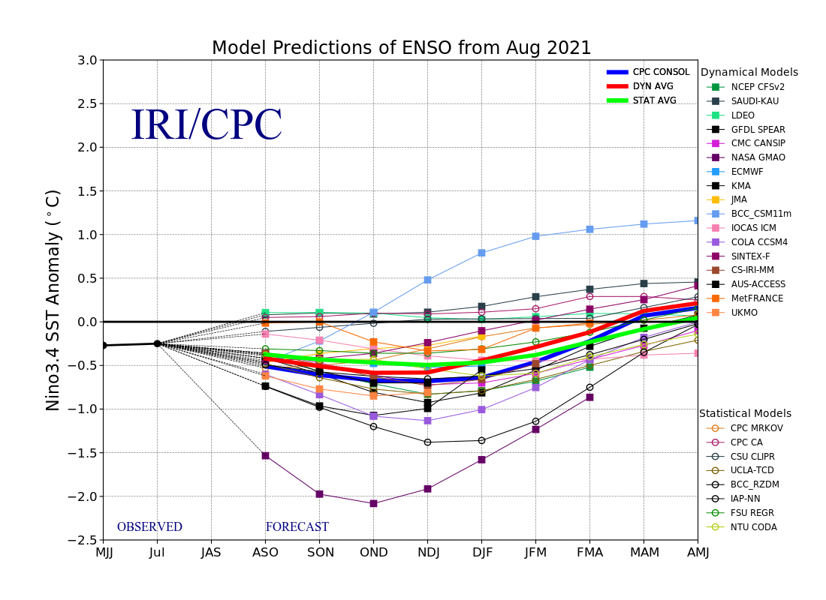

Slide 21
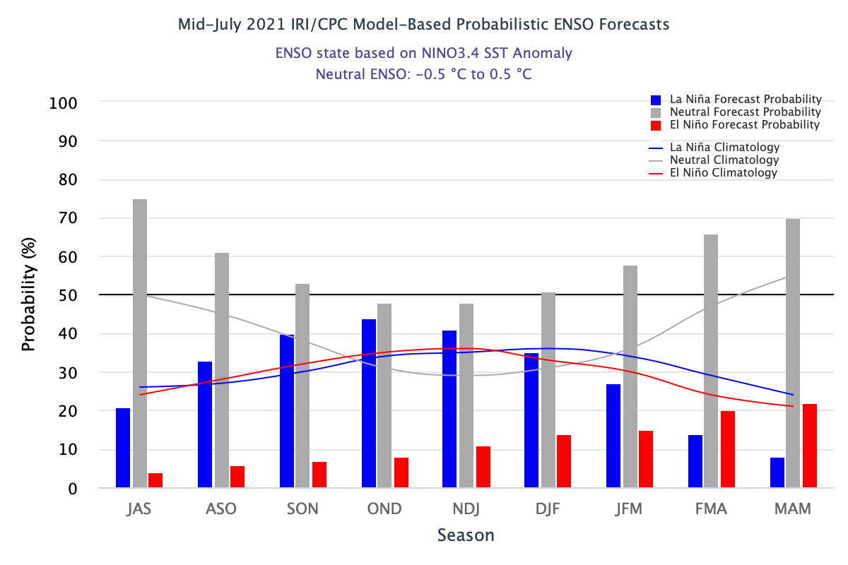

Slide 22
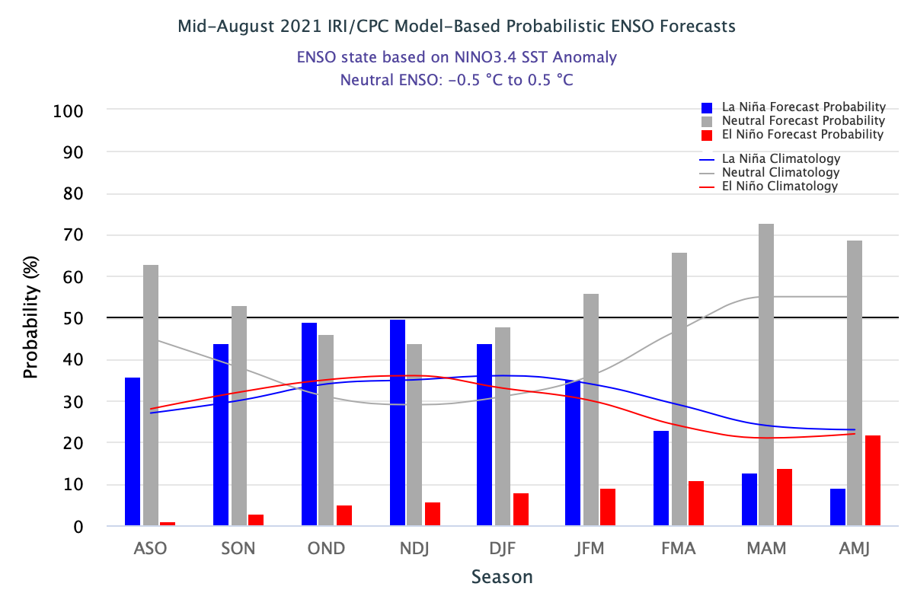

Slide 23
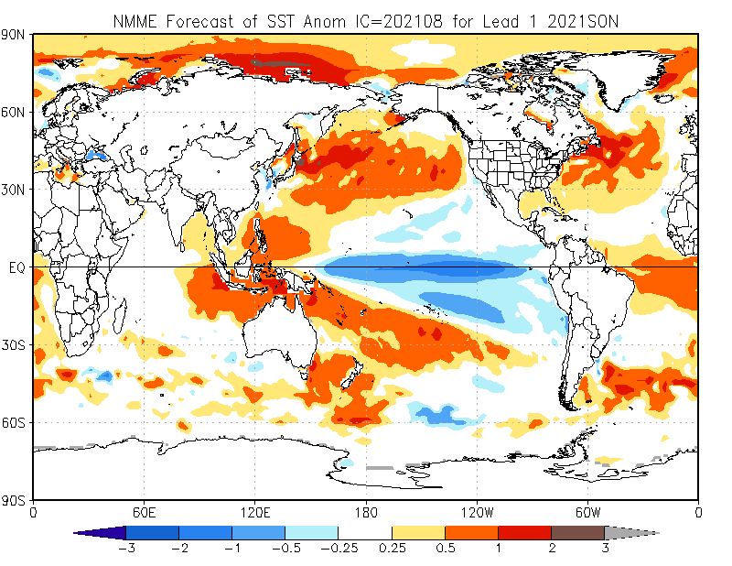

Slide 24
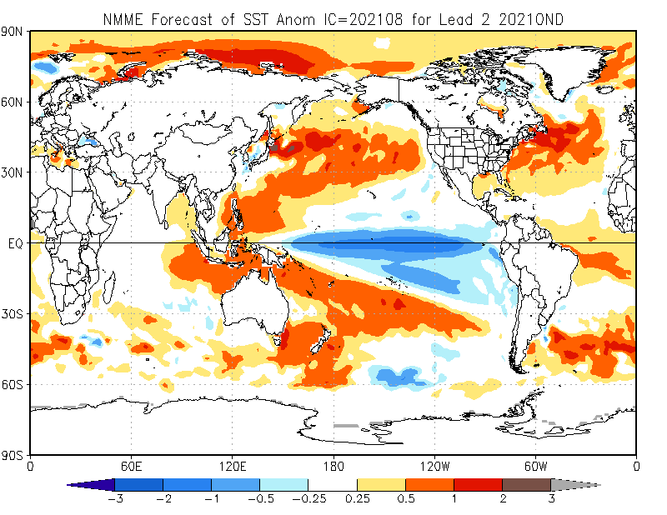

Slide 25
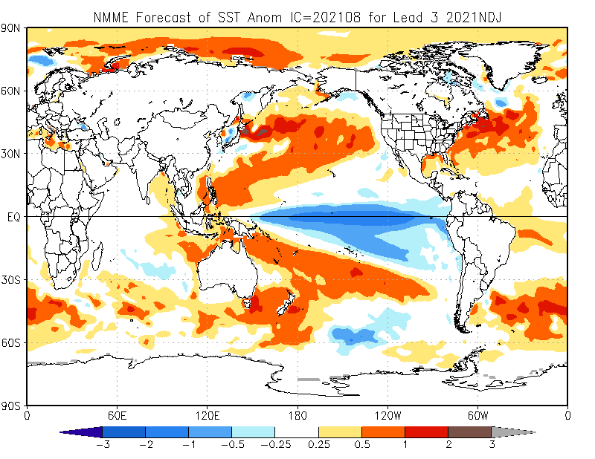

Slide 26
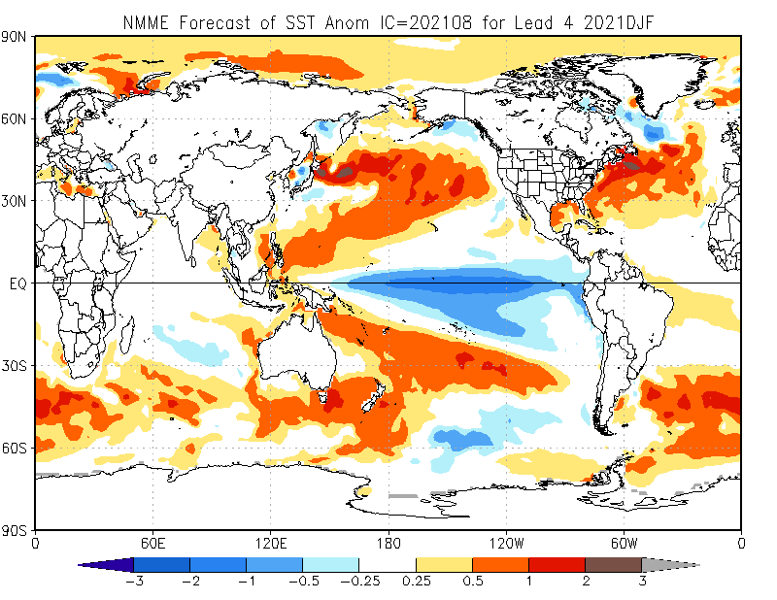

Slide 27
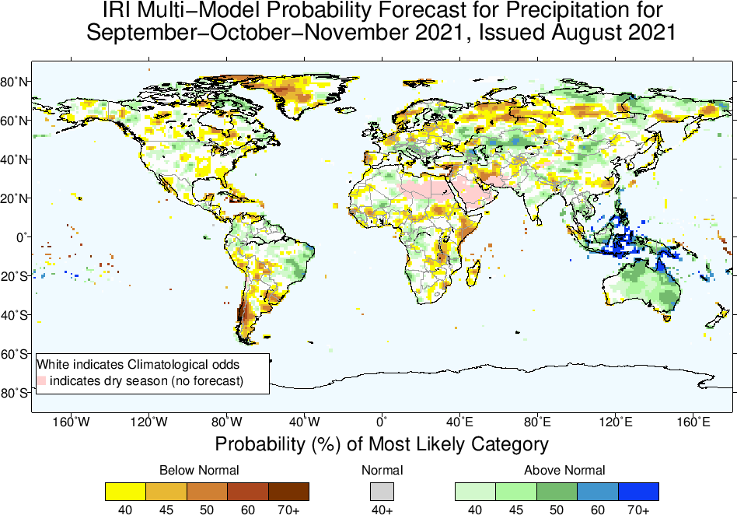

Slide 28
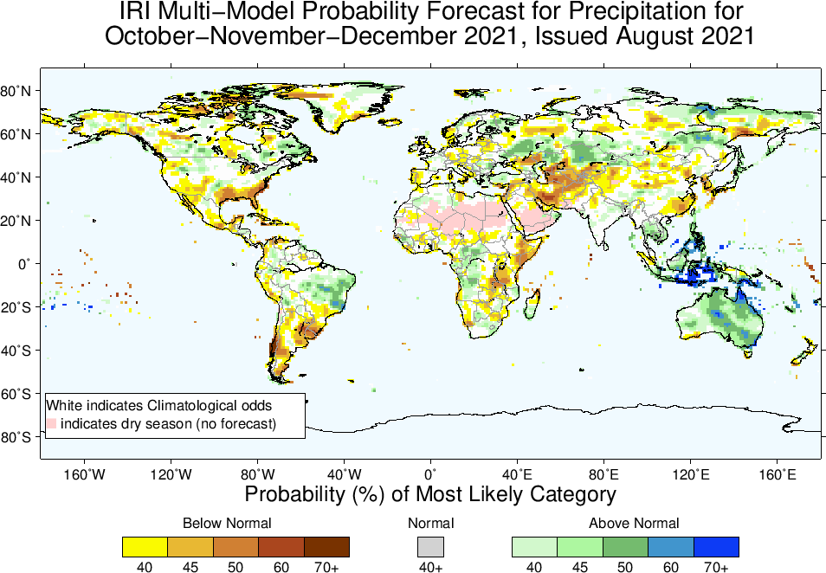

Slide 29
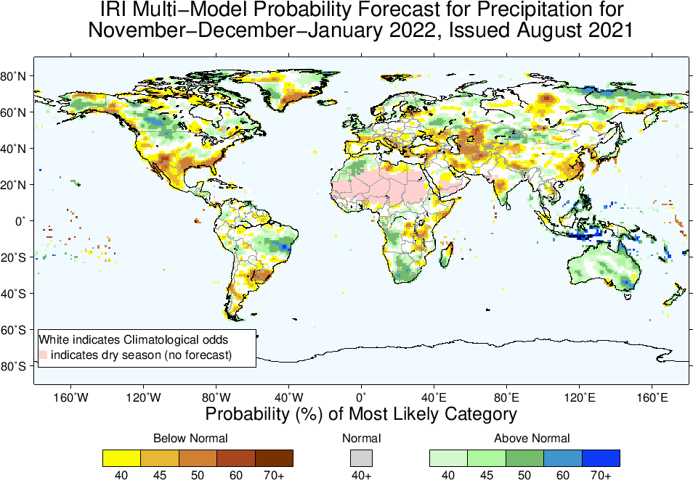

Slide 30
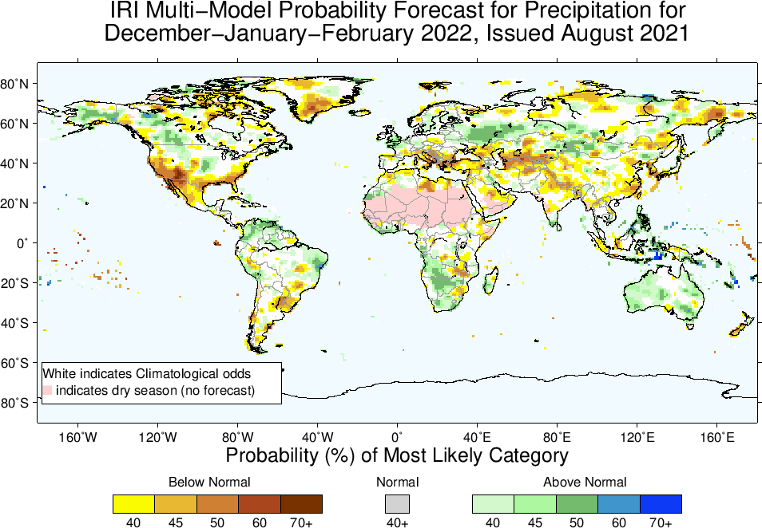

Slide 31
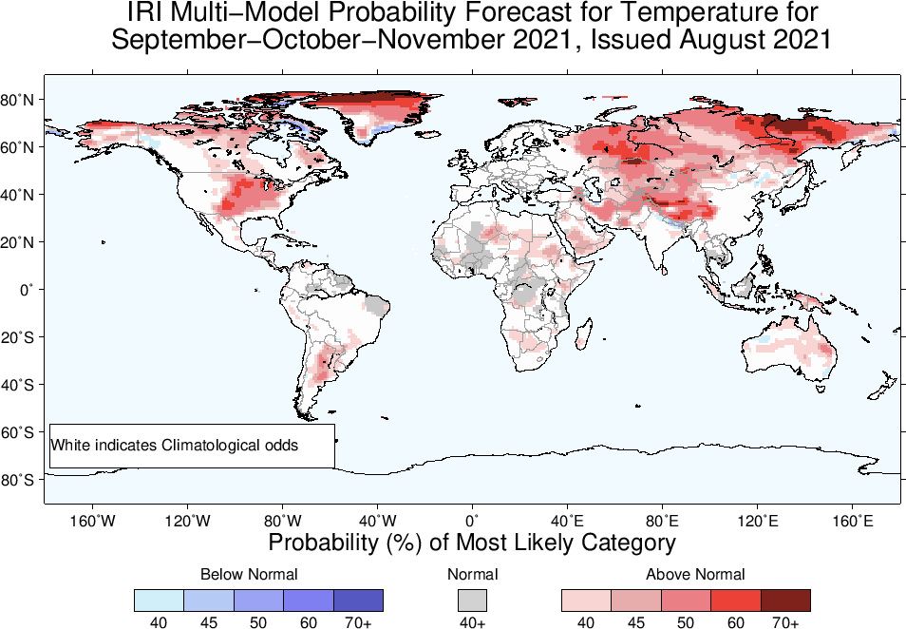

Slide 32
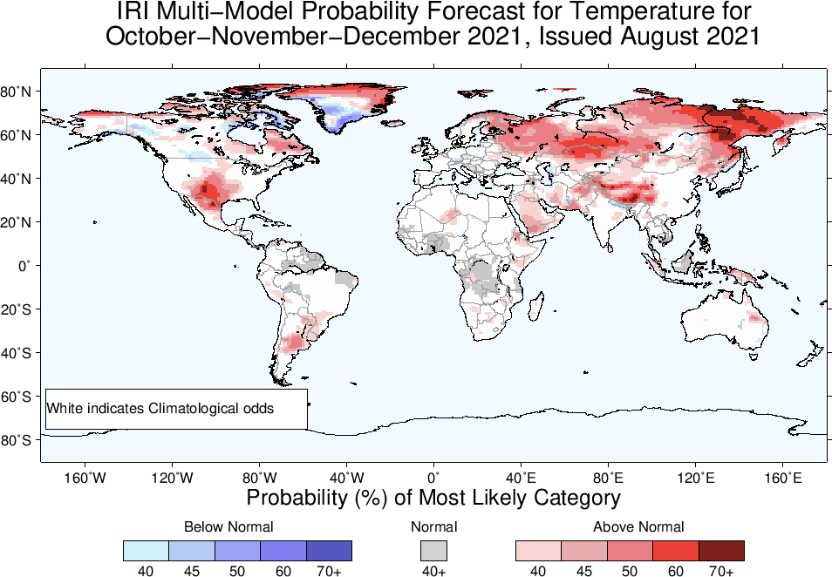

Slide 33
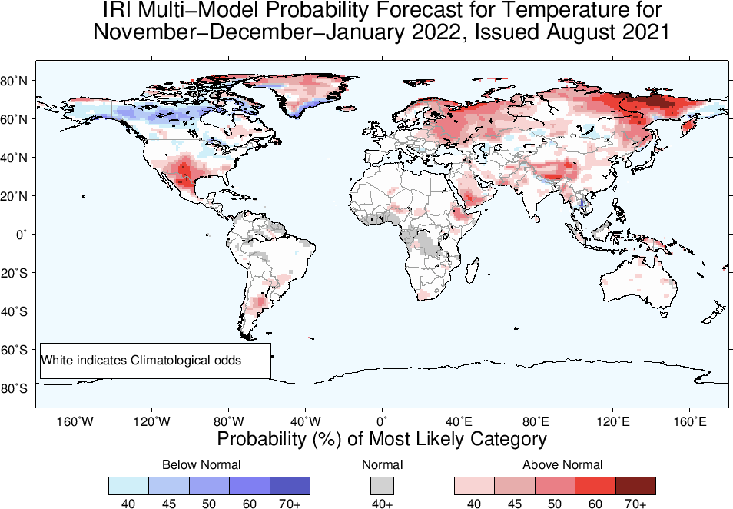

Slide 34
