Slide 1
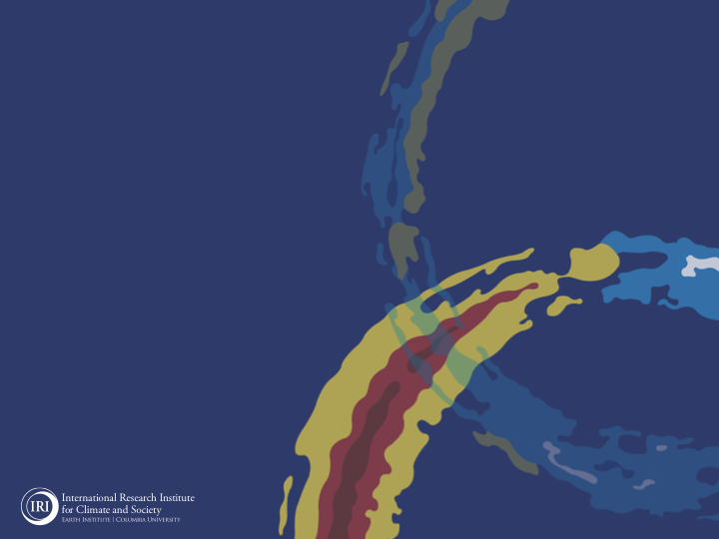
ENSO and Climate Outlook
in April 2023
"Who's there?"
the boy!
Yes, it's that time again! El Niño has arrived at our doorstep, bringing with it the potential for significant climate shifts!
M. Azhar Ehsan
(azhar@iri.columbia.edu)
Associate Research Scientist
IRI ENSO and Climate Forecast Lead
Jeffrey Turmelle and Jing Yuan: forecast processing and web updates
Cuihua Li: Draft PowerPoint development
IRI’s Climate Group, led by Dr. Andrew Robertson: Forecast system development, ongoing innovation, and verification

Slide 2
Outline
Observed Oceanic and Atmospheric Conditions in
Tropical Pacific
Across the Globe
ENSO Forecast in
NMME
IRI ENSO Forecast Tool (Deterministic and Probabilistic)
Seasons Outlook of
SST
Precipitation and Temperature
Summary

Slide 3
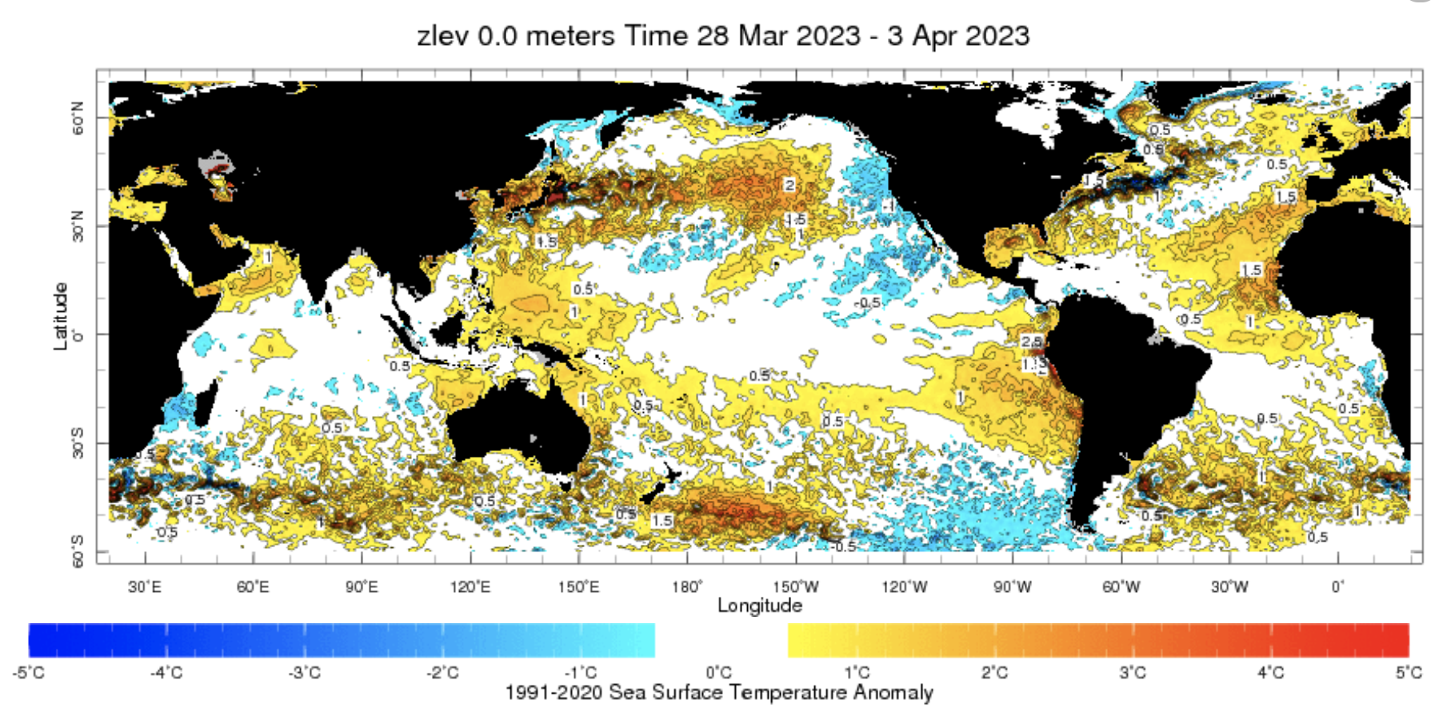
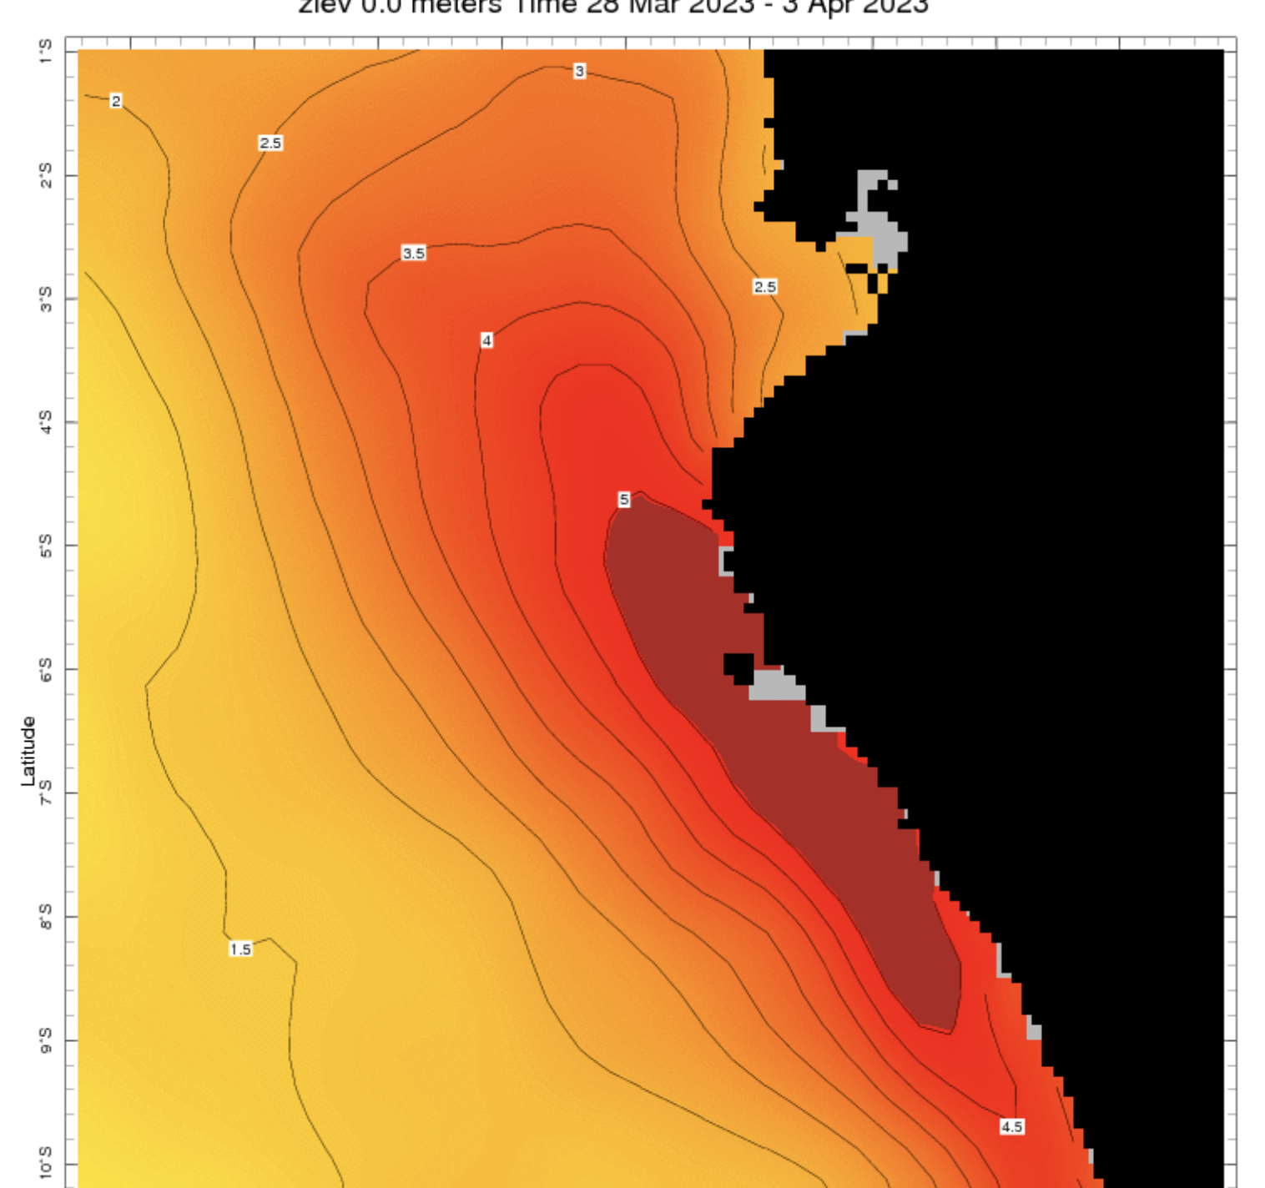
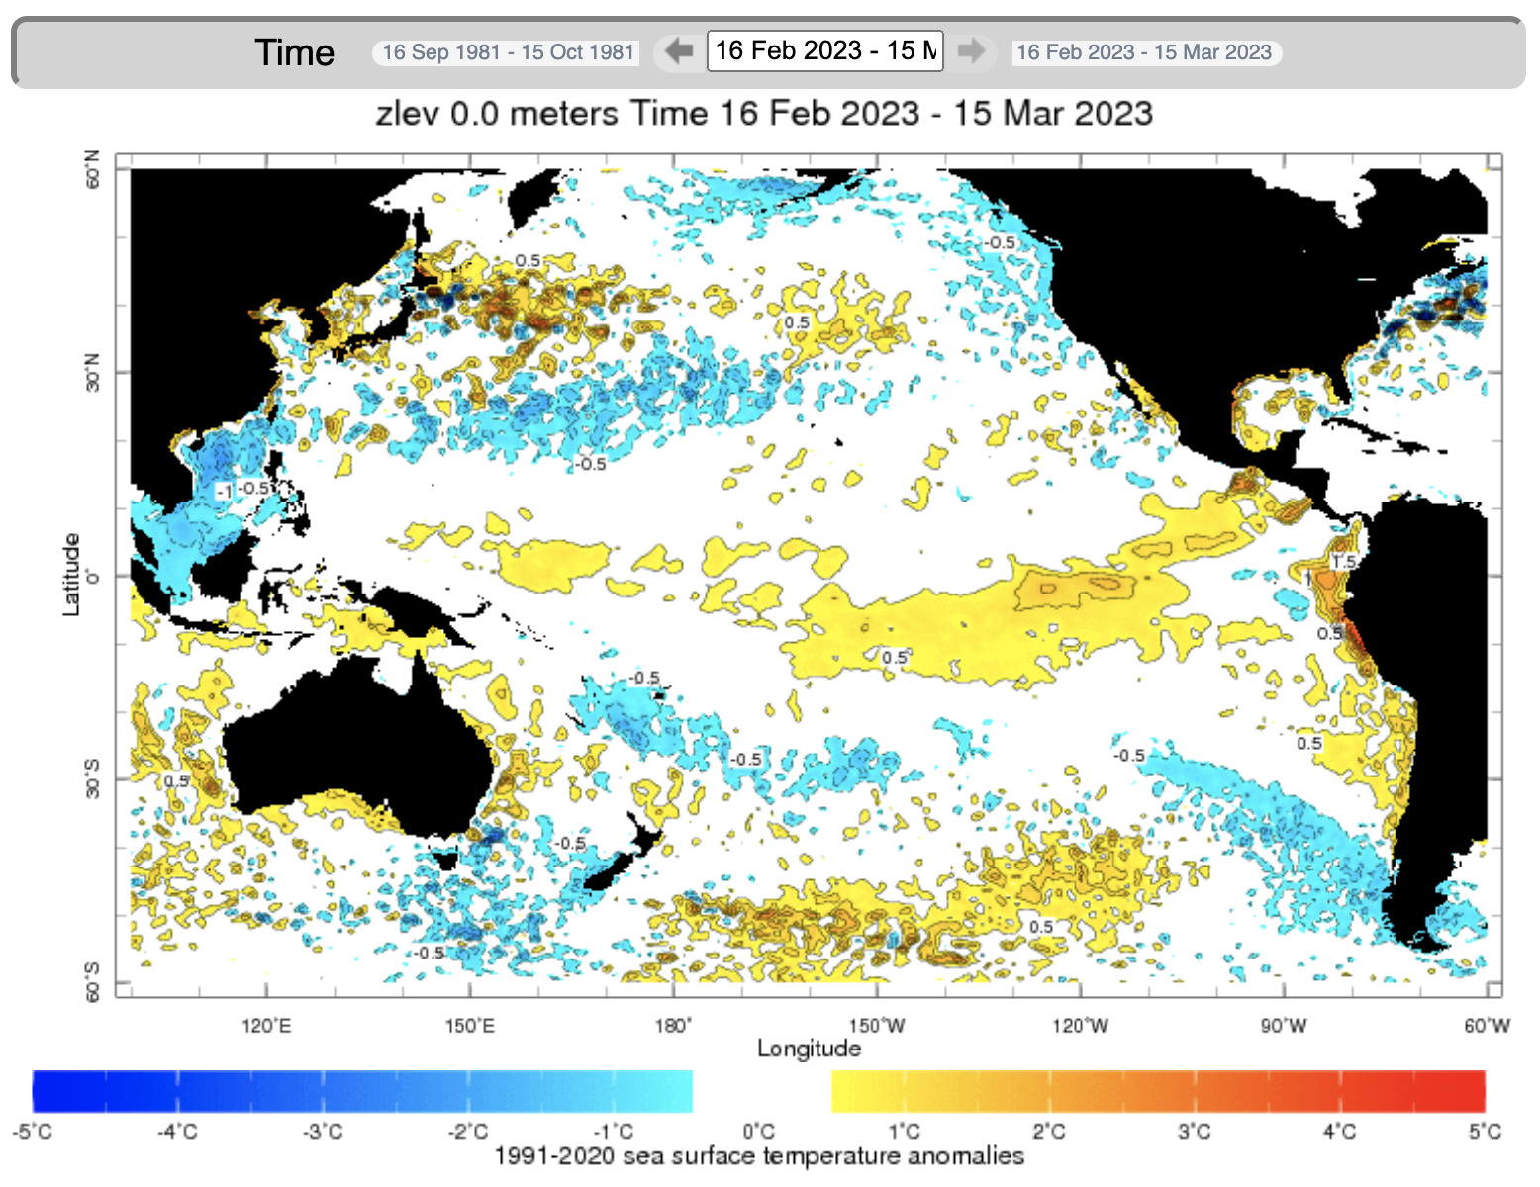
Evolution of EQ. Pacific SST Departures in Weekly OISST Data
Coastal El Niño already born, and mature!
https://iridl.ldeo.columbia.edu/maproom/Global/Ocean_Temp/Weekly_Anomaly.html?T=28%20Mar%202023%20-%203%20Apr%202023

Slide 4
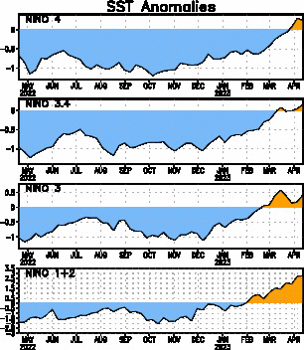
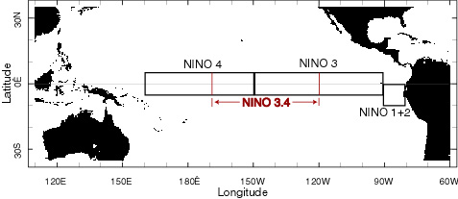
Most recent SST Anom.
Most Recent (12 Apr, 2023) SST Departures in different NINO regions
Niño 4
0.2ºC
Niño 3.4
0.1ºC
Niño 3
0.4ºC
Niño 1+2
2.7ºC

Slide 5
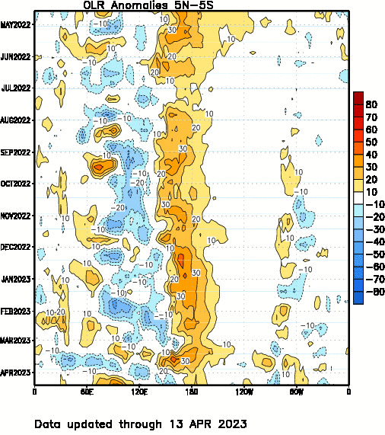
Most recent OLR

Slide 6
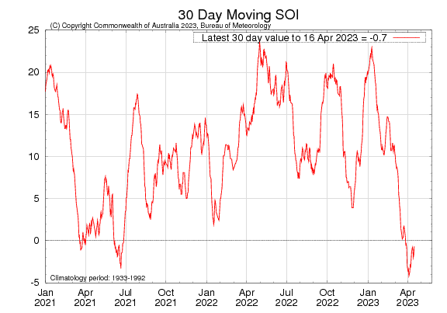
Most recent SOI
Sustained positive values of the SOI above +7 typically indicate La Niña

Slide 7
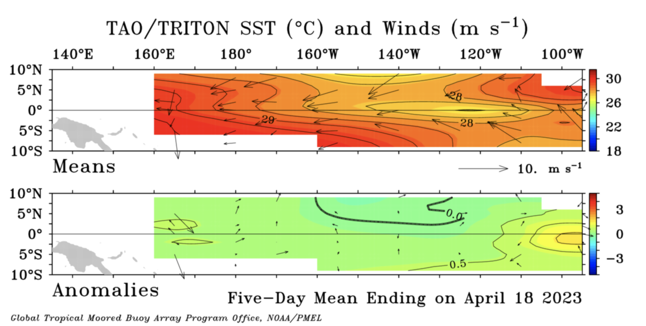
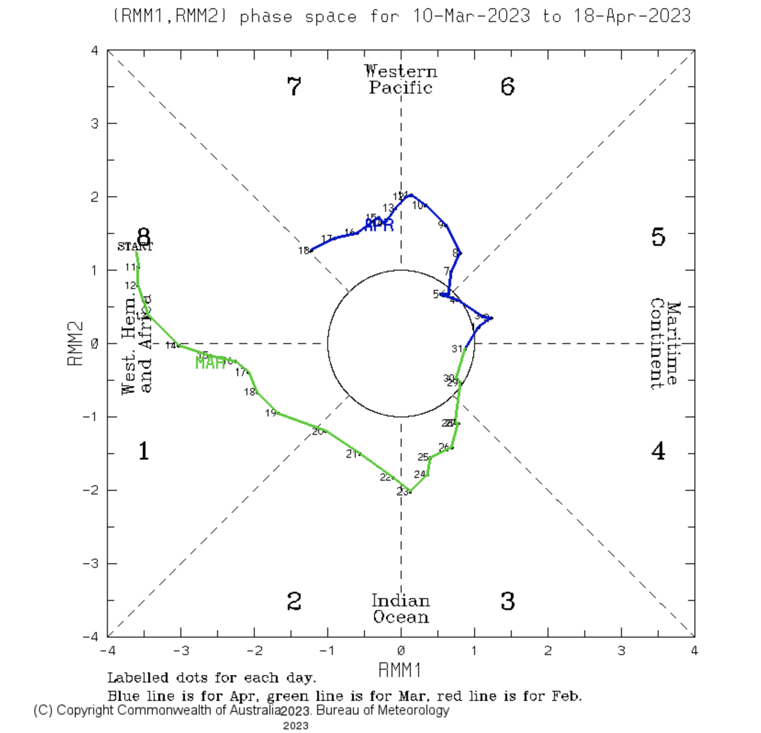
Most recent Lower-Level Winds
The trade winds observed in the 5-day period ending 18 April 2023 were below average in strength across the tropical.
In the tropical Pacific region, El Niño events typically lead to a sustained weakening or even a reversal of trade winds.
http://www.bom.gov.au/climate/mjo/

Slide 8
Subsurface Temperature Evolution
Last Month

Slide 9
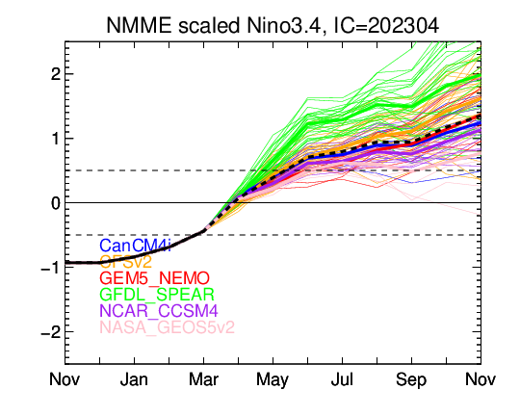
NMME’s ENSO Forecast

Slide 10
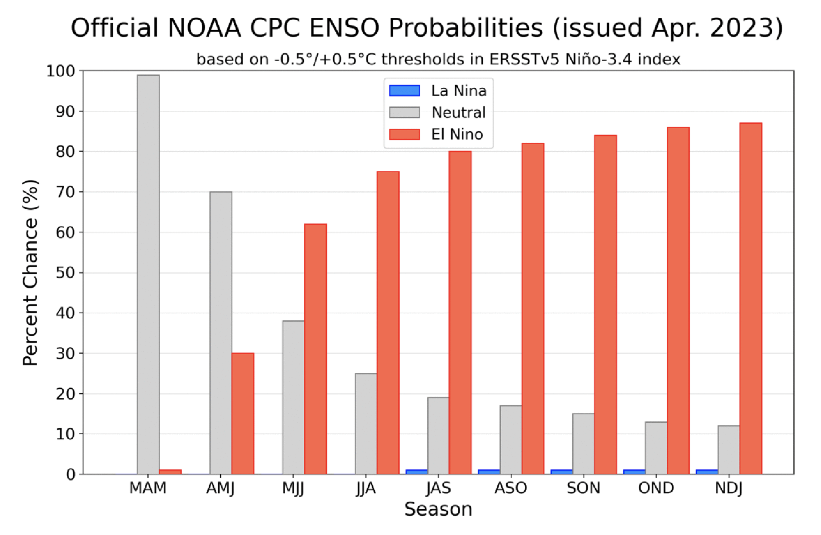

Slide 11
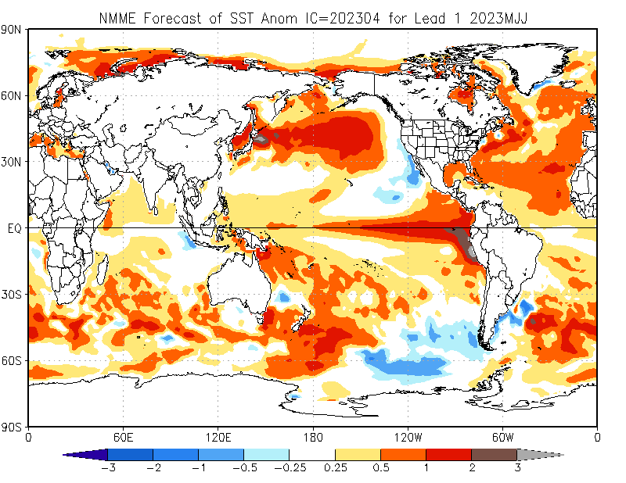

Slide 12
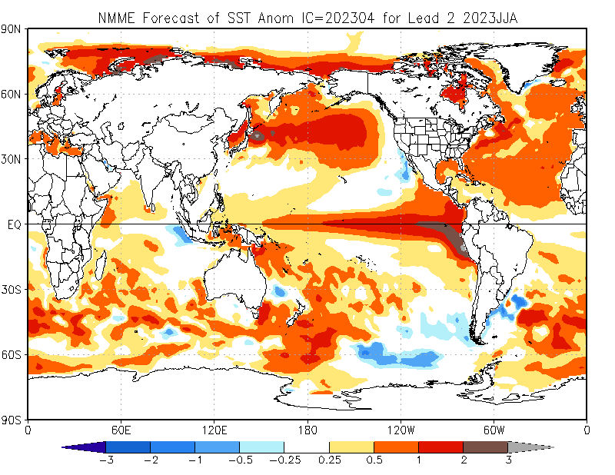

Slide 13
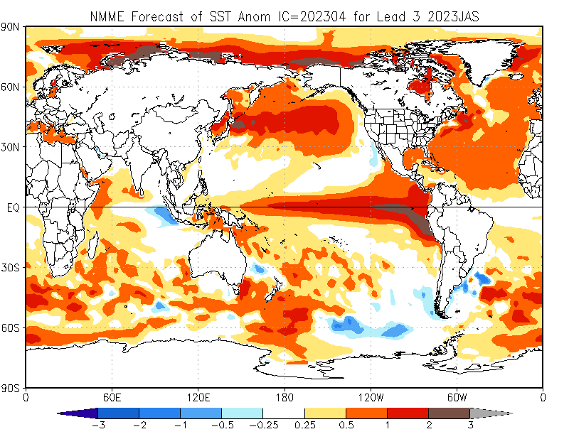

Slide 14
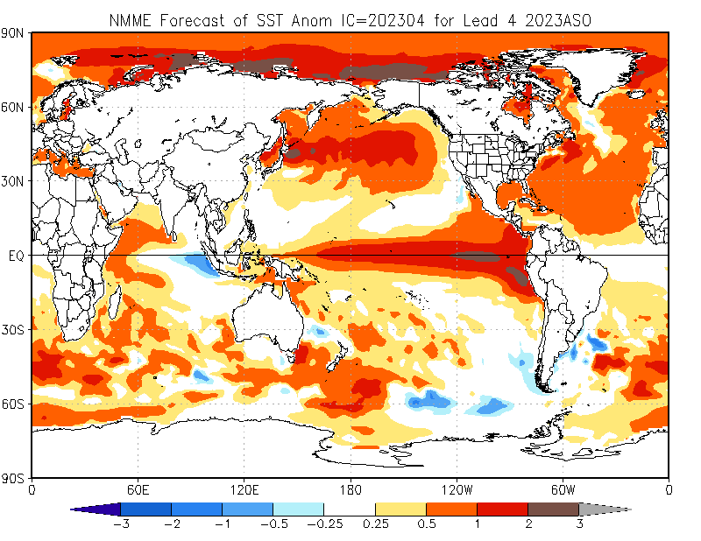

Slide 15
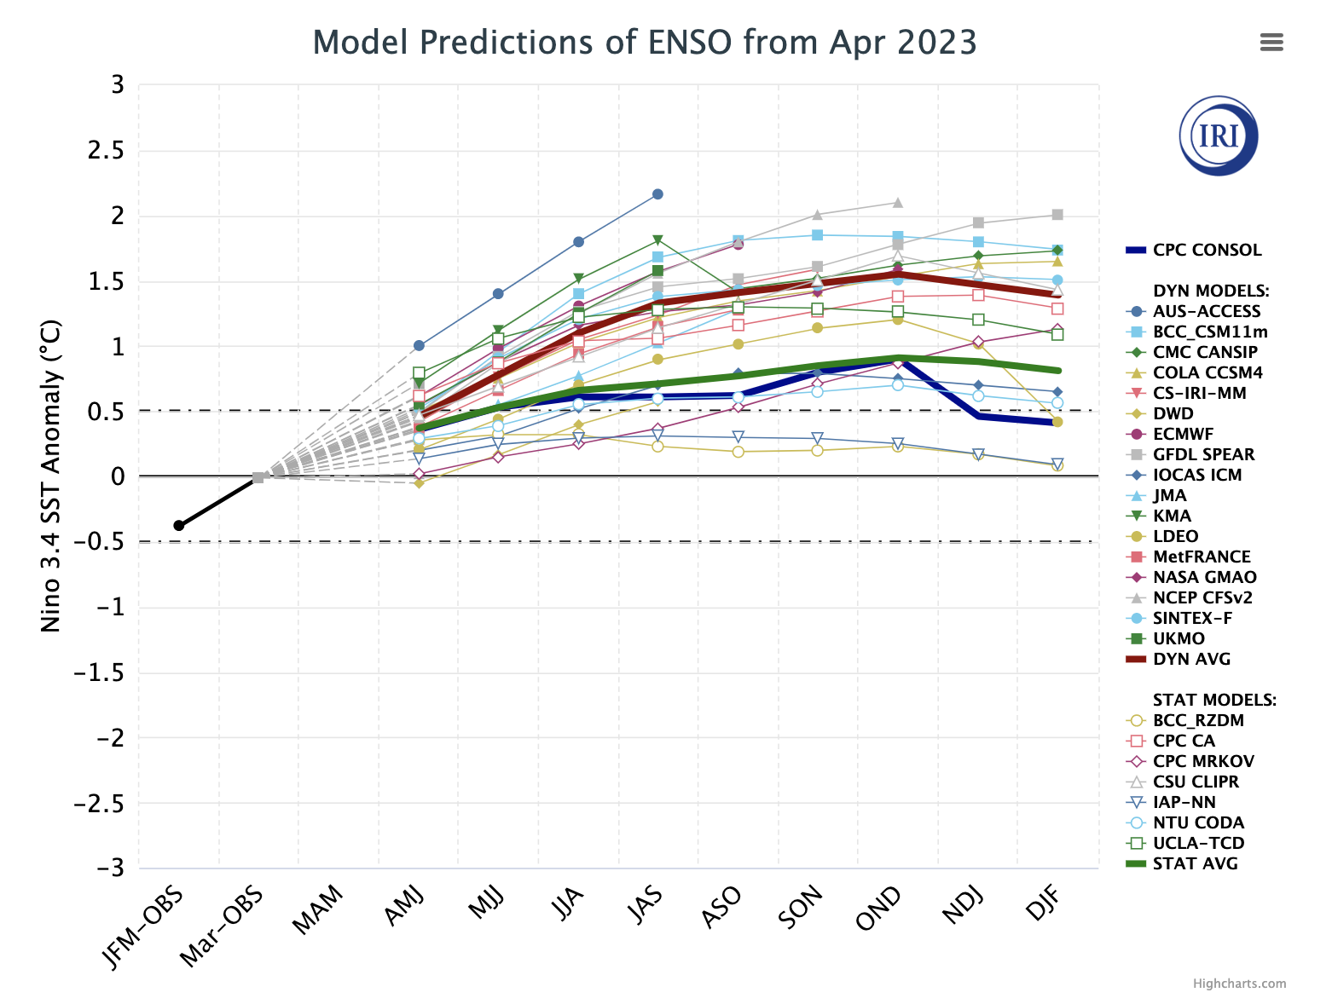
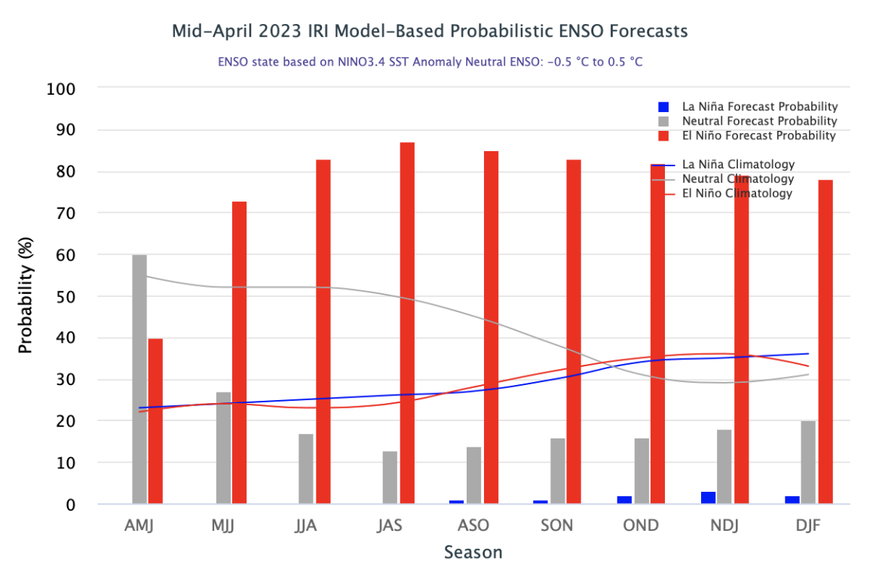
IRI’s ENSO Forecast (April, 2023)

Slide 16
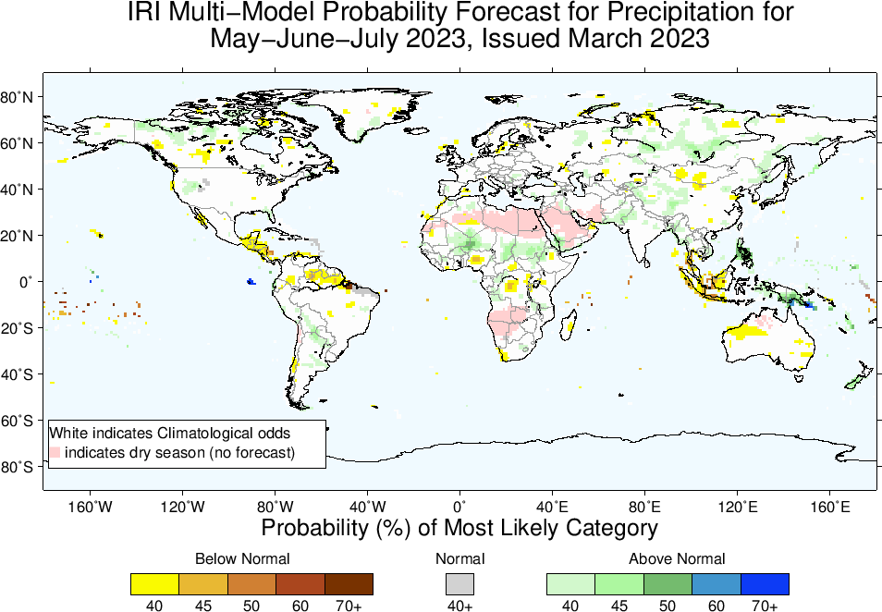
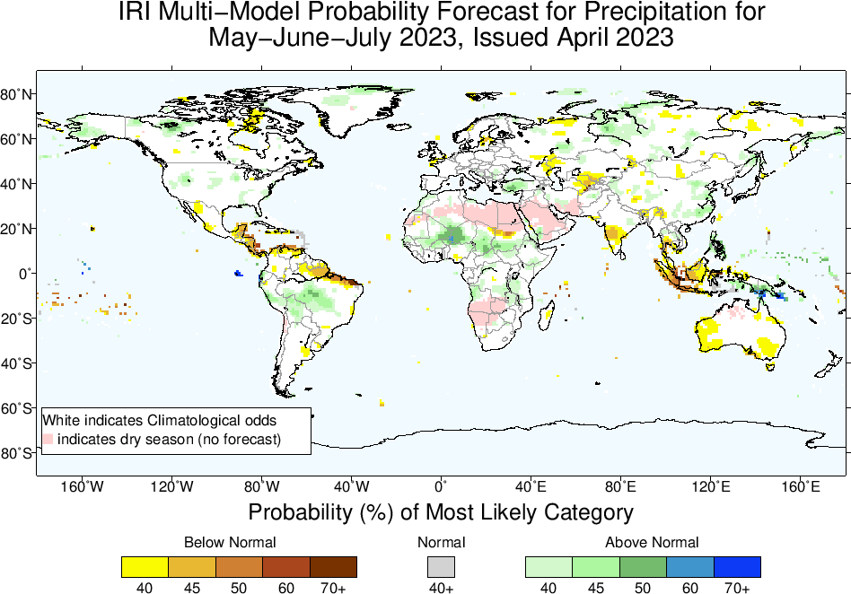
Precipitation Forecasts: Season # 1, May to Jul
Highlights:
Shift towards Above-Normal
Central-West South America,
Sahel region
Shift towards Below-Normal
Northeast South America,
Central America,
South Asia (central-Southern India)
Maritime Continent,
Parts of Australia

Slide 17
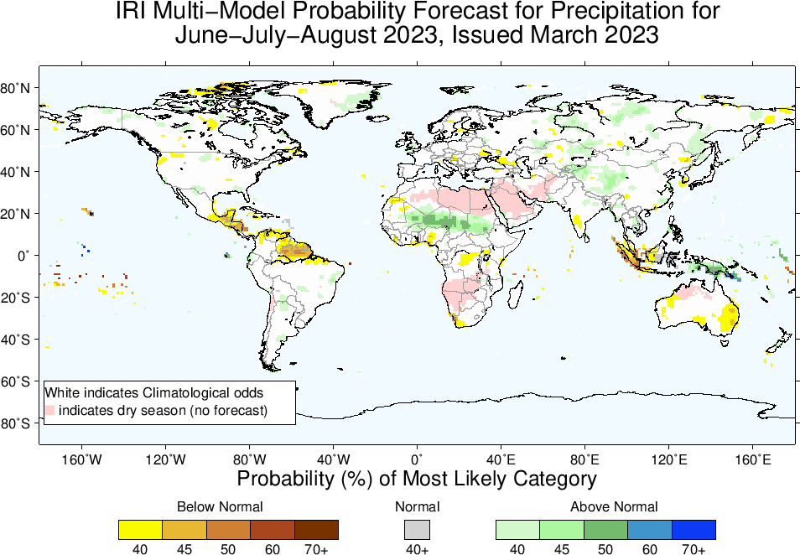
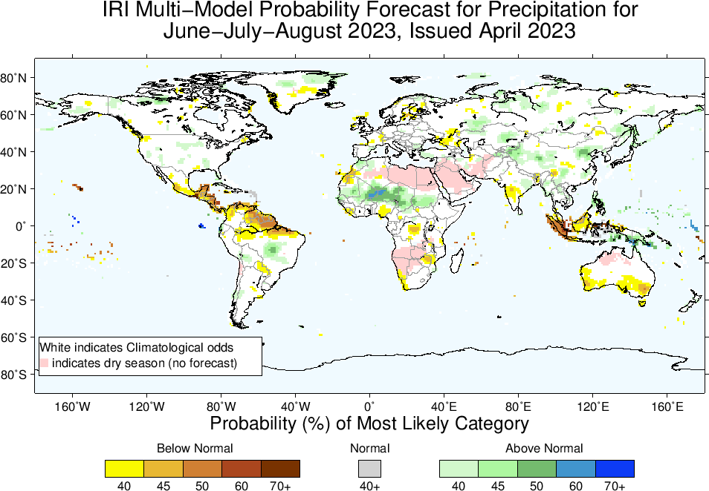
Precipitation Forecasts: Season # 2, Jun to Aug
Highlights:
Shift towards Above-Normal
Central-East South America,
Sahel region
Western-Central and north-eastern China
Shift towards Below-Normal
Northeast South America,
Central America,
South Asia,
Maritime Continent,
Parts of Australia

Slide 18
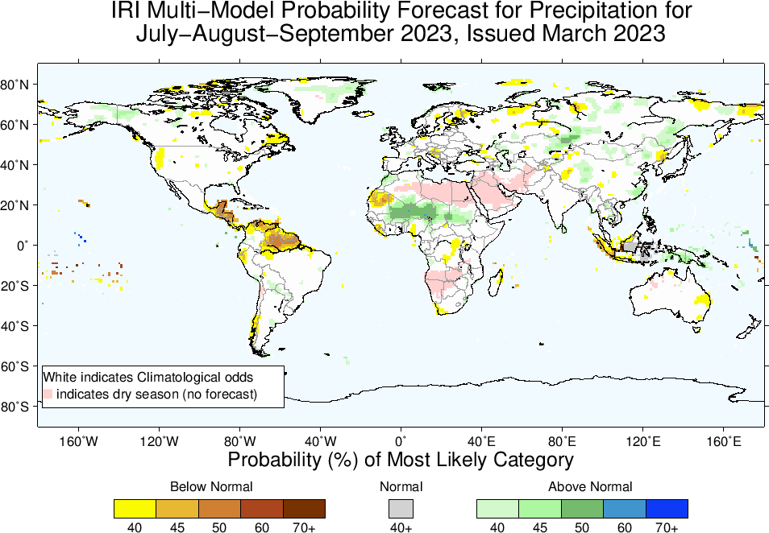
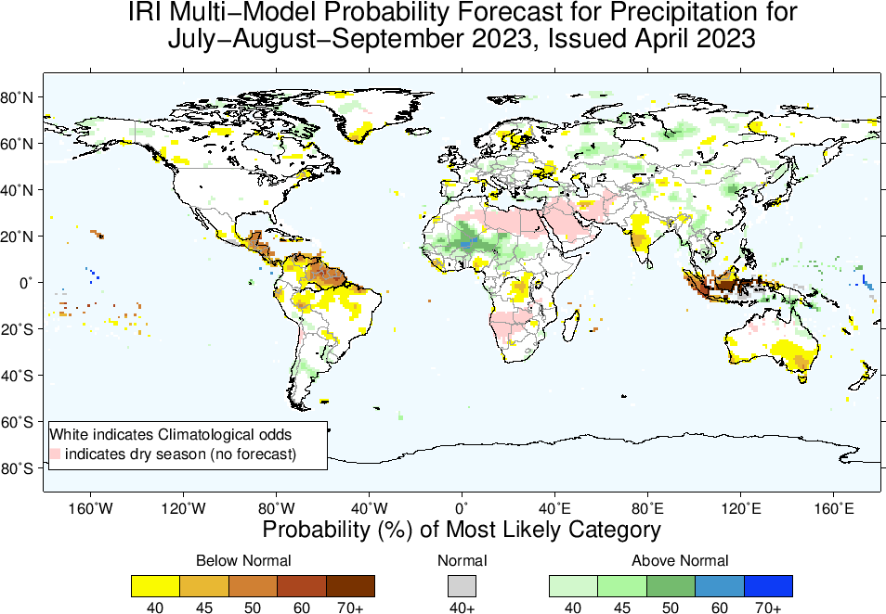
Precipitation Forecasts: Season # 3, Jul to Sep
Highlights:
Shift towards Above-Normal
Sahel region (Western)
Western-Central and north-eastern China
Shift towards Below-Normal
Northeast South America,
Central America,
South Asia,
Maritime Continent,
Parts of Australia (Southeast)

Slide 19
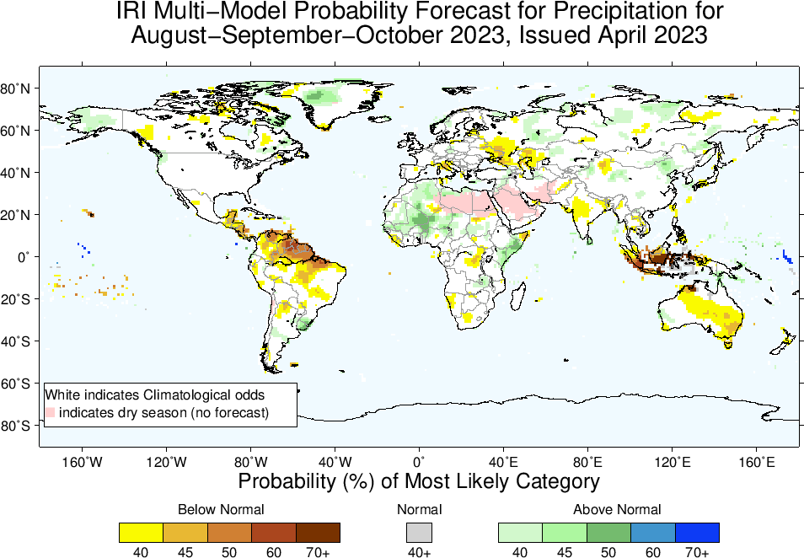
Highlights:
Shift towards Above-Normal
Sahel region (Western)
North-east Africa (southeast Ethiopia, Somalia, eastern Kenya)
Shift towards Below-Normal
North-Northeast South America,
Central America,
South Asia,
Maritime Continent,
Parts of Australia
Precipitation Forecasts: Season # 4, Aug to Oct

Slide 20
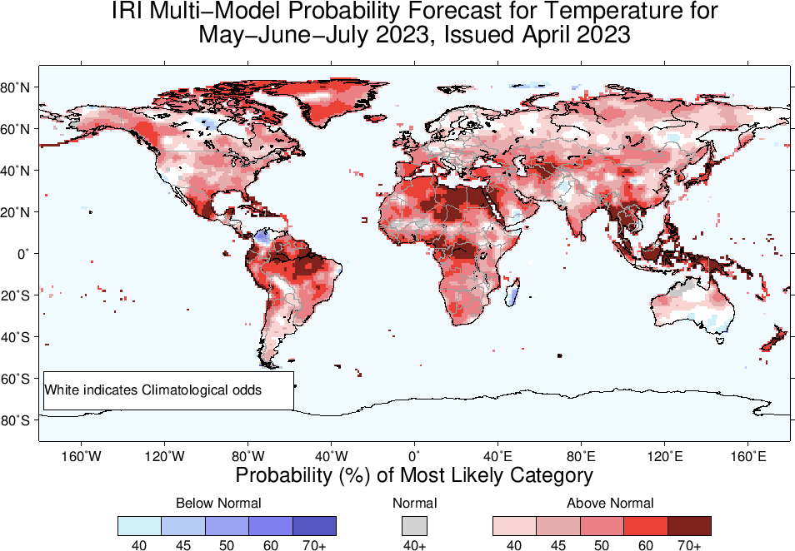
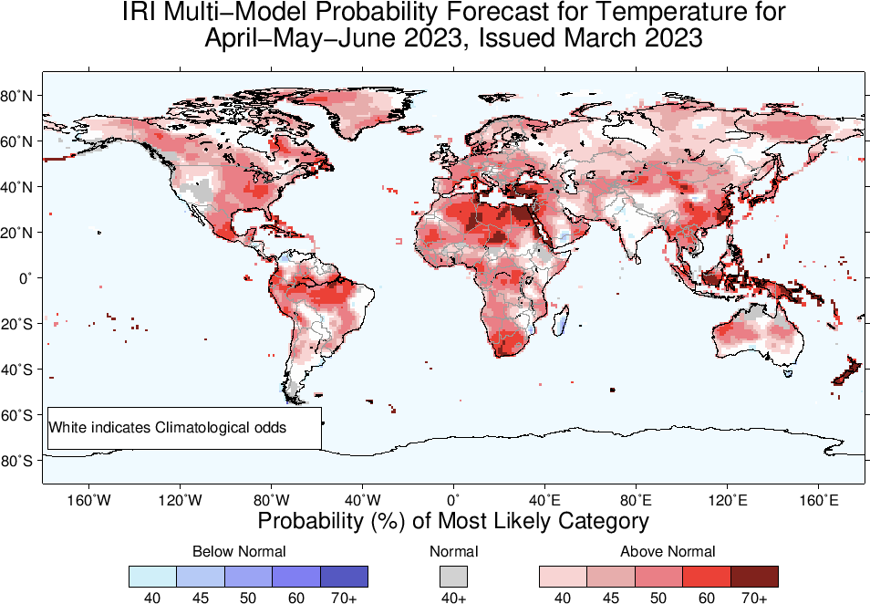
Highlights:
Shift towards Warmer/Above-Normal
Most land areas,
Southeast Asia, the Maritime Continent regions, Northeast South America.
Shift towards Colder/Below-Normal
Northern tip of South America,
Central Pakistan
Most of Madagascar,
Southeast Australia
Temperature Forecasts: Season # 1, May to Jul

Slide 21
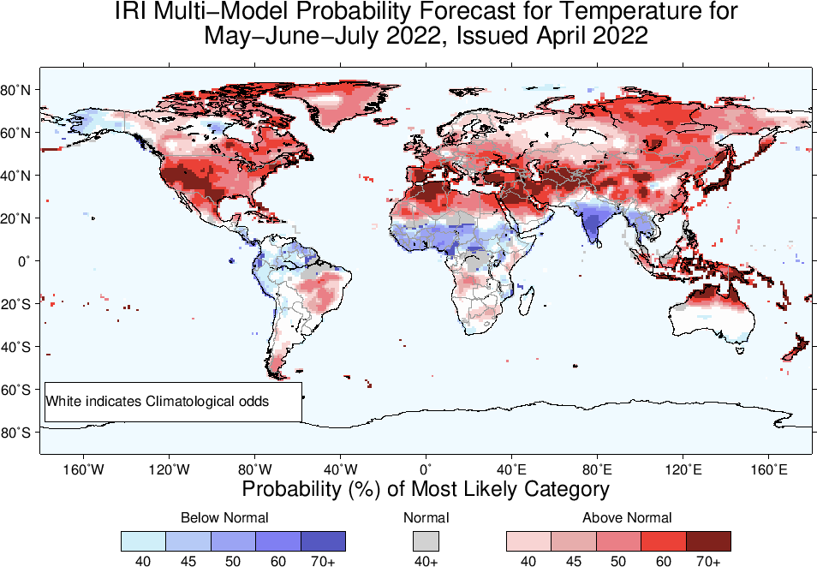
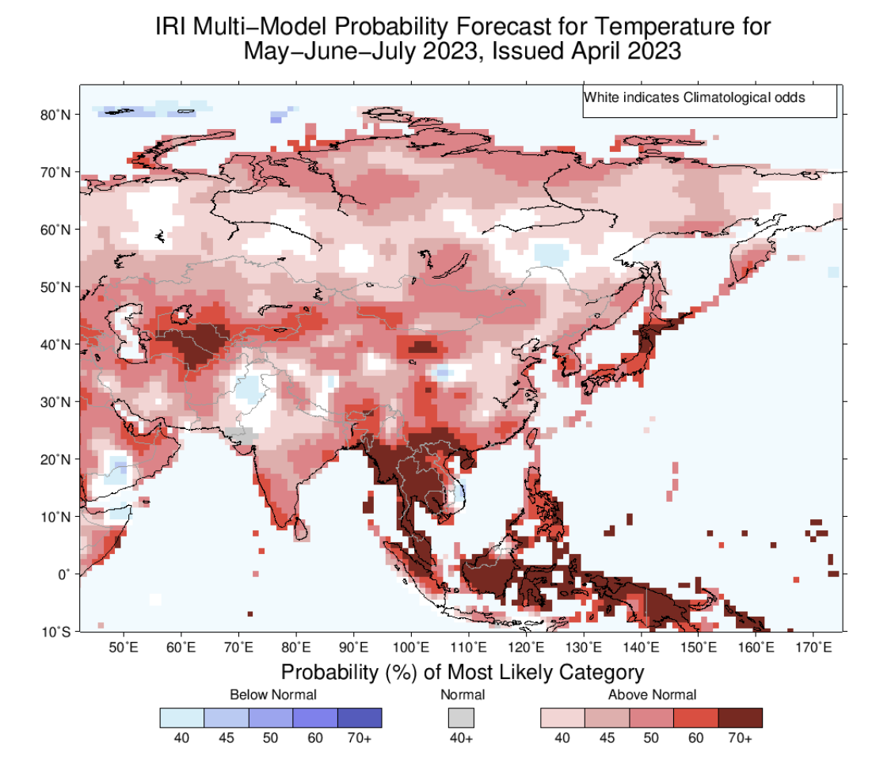
April, 2022, Initialized, target May-Jul, 2022

Slide 22
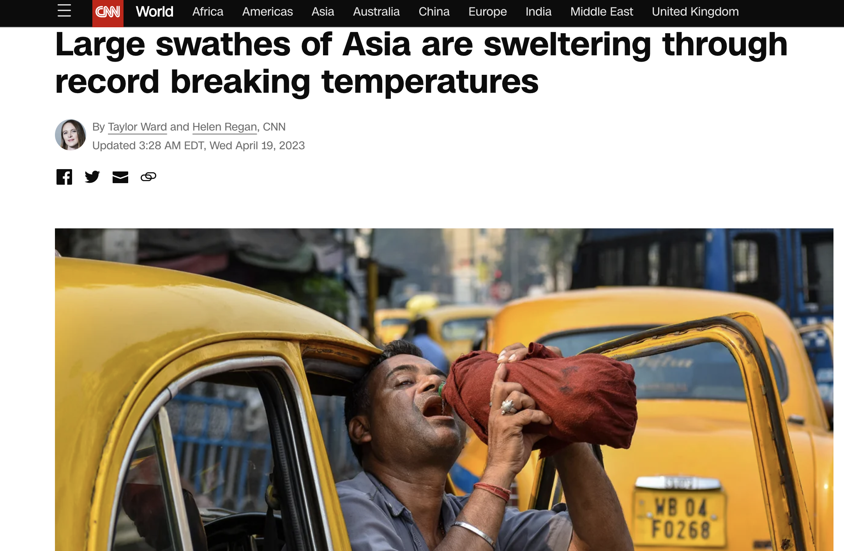

Slide 23
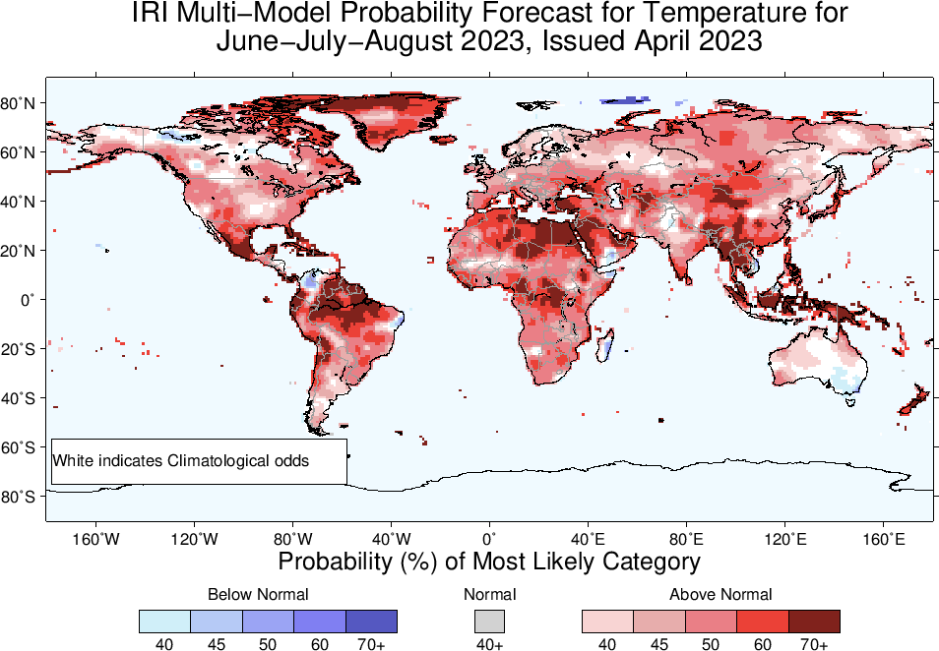

Slide 24
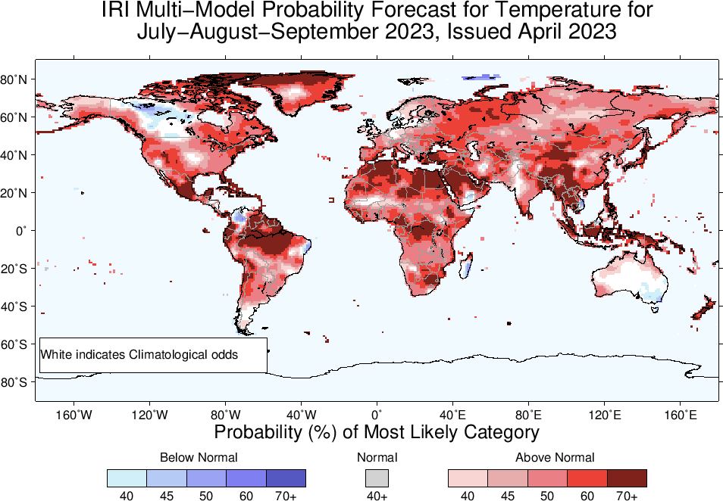

Slide 25
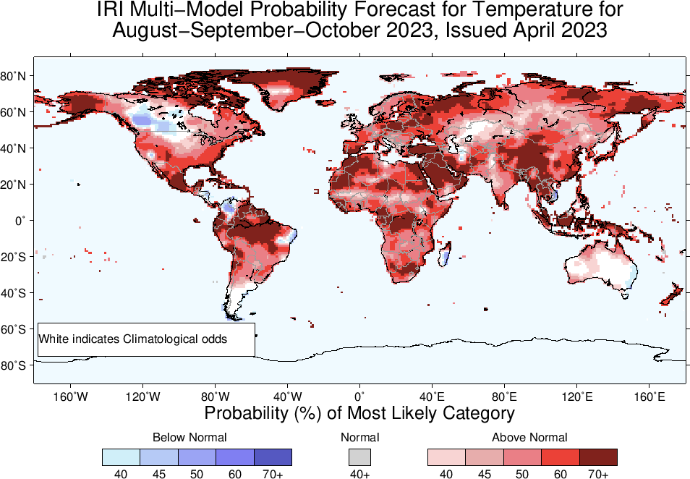

Slide 26
Summary
El Niño is knocking at the Door!
Sea surface temperatures (SSTs) are in ENSO-neutral range across the central equatorial Pacific Ocean, but warming up gradually. Substantially Warm SSTs in far eastern Pacific for example, NINO1+2 index is +2.7.
Coastal El Niño warning issued.
SOI is in ENSO-neutral range, weak trade winds, even some westerlies in central and western Pacific.
Warm Sub-Surface across the Pacific. Therefore,
El Niño Watch!
El-Nino onset is likely starting from May-Jul 2023 (73% chances), and continue till rest of 2023.

