Slide 1
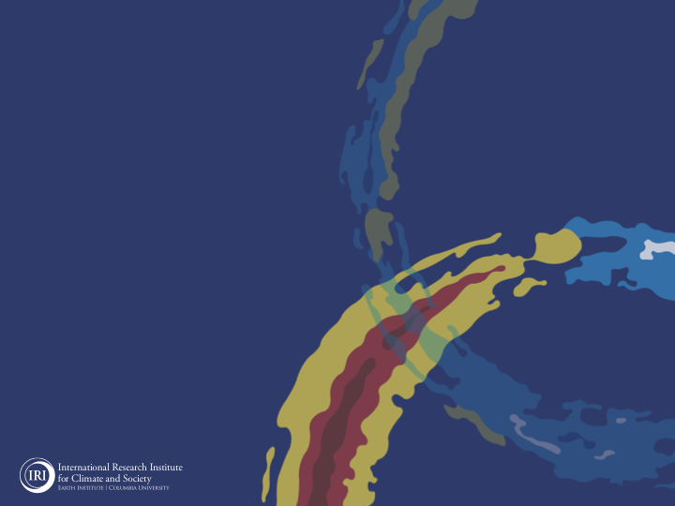
ENSO and Climate Outlook
in Apr 2022
La Nina Continues,…
M. Azhar Ehsan
(azhar@iri.columbia.edu)
Associate Research Scientist
IRI ENSO and Climate Forecast Lead
Jeffery Turmelle and Jing Yuan: forecast processing and web updates
Cuihua Li: Draft PowerPoint development
IRI’s Climate Group, led by Dr. Andrew Robertson: Forecast system development, ongoing innovation, and verification

Slide 2
Outline
Observed Oceanic and Atmospheric Conditions in
Tropical Pacific
Across the Globe
ENSO Plume in
NMME
IRI ENSO Plume and Probabilistic Forecast
Seasons Outlook of
SST
Precipitation and Temperature
Summary

Slide 3
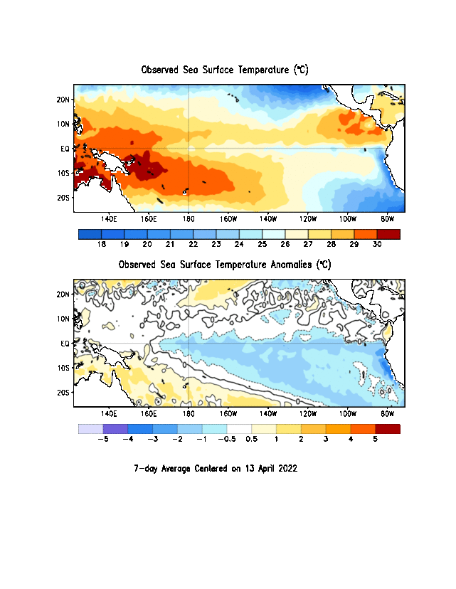
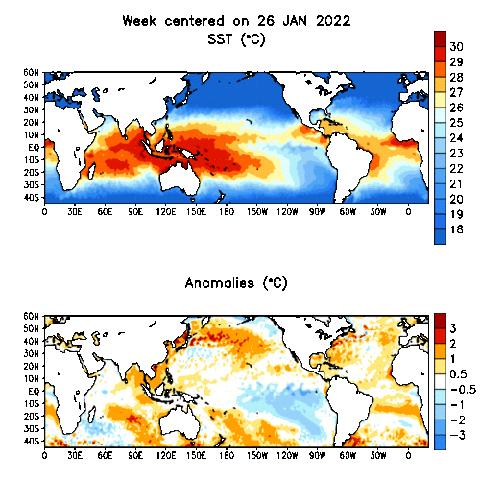
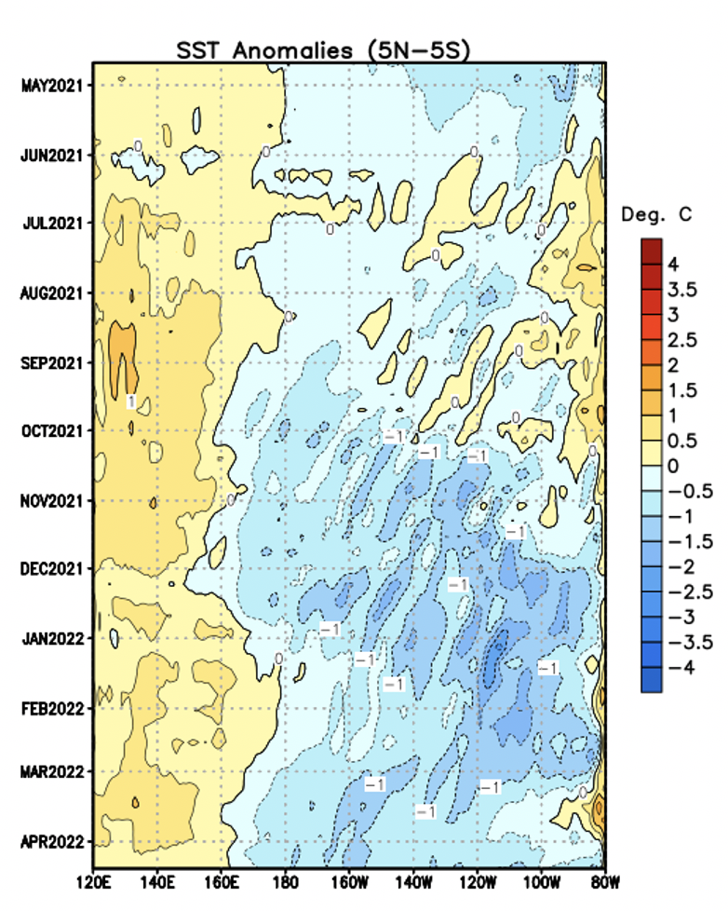
Evolution of EQ. Pacific SST Departures in Weekly OISST Data
(13 April, 2022)
Below-average SSTs persisted across the central to eastern equatorial Pacific Ocean.

Slide 4
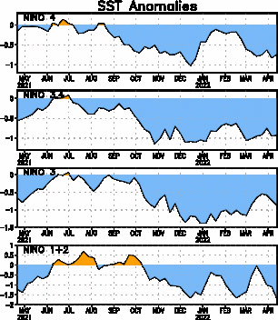
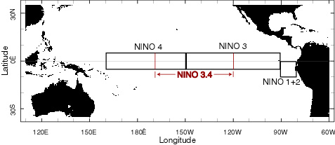
Most Recent SST Departures in different NINO regions (All cooler than the long-term avg, (1991-2020))
Niño 4
-0.7ºC
Niño 3.4
-0.9ºC
Niño 3
-0.9ºC
Niño 1+2
-1.7ºC

Slide 5
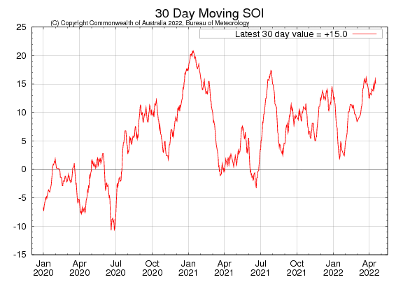
Tahiti_{SLP} – Darwin_{SLP}
ticked Up and sustained.

Slide 6
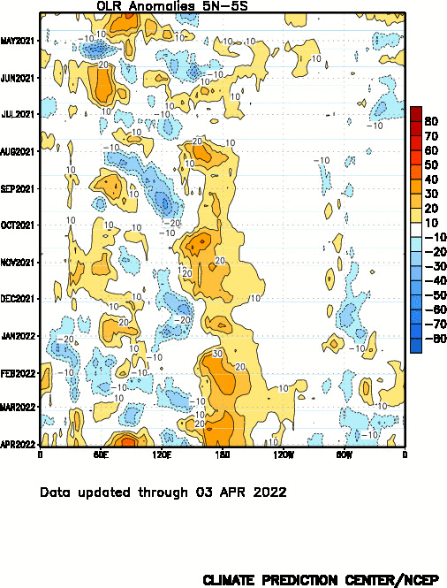
Suppressed convection

Slide 7
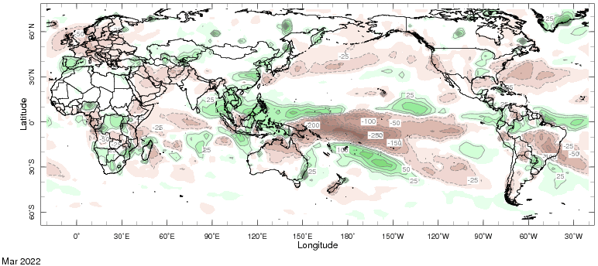
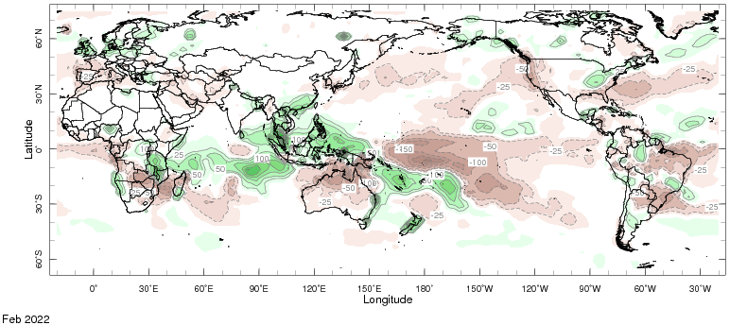
Monthly Prcp. Anomalies
March, 2022
Feb, 2022

Slide 8
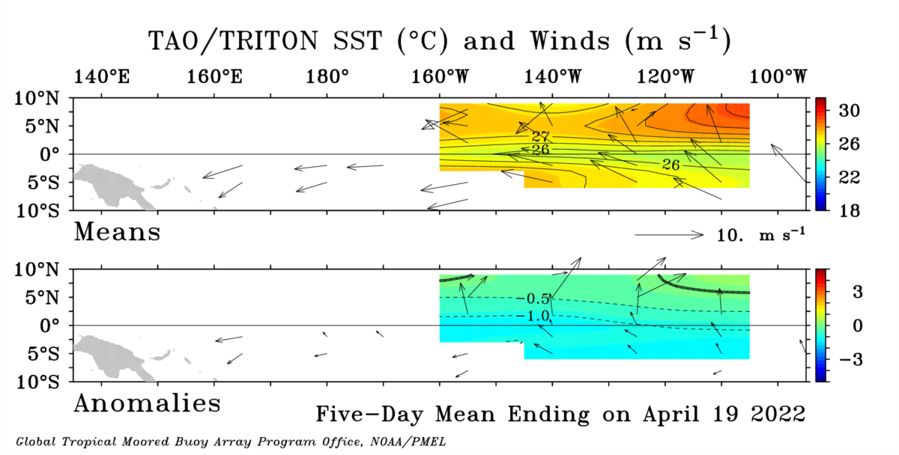

Slide 9
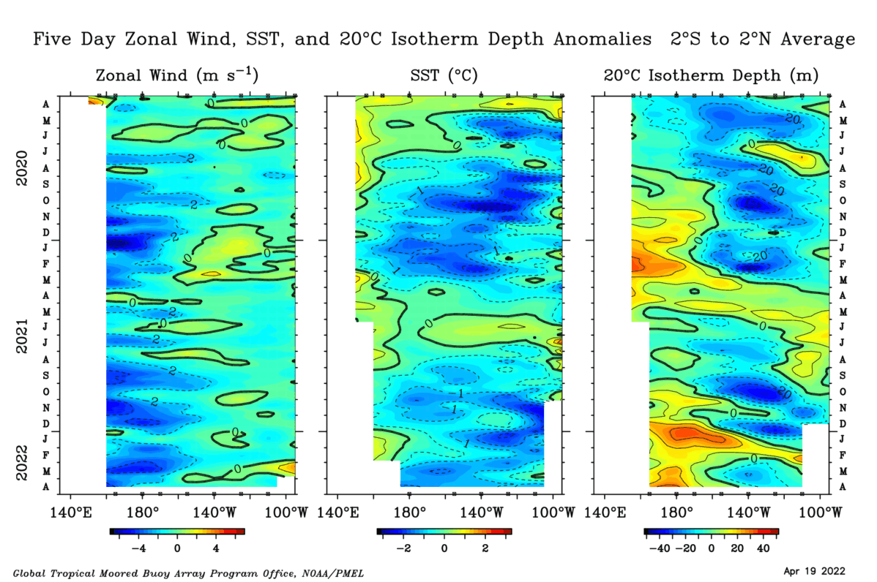
Easterly wind anomalies dominated in the central and east-central Pacific, except one major disruption during late December-to-early January 2022.
During mid Dec-21 to Feb-22, a downwelling Kelvin wave shifted eastward. From Feb-22, an upwelling Kelvin wave shifted eastward into the eastern Pacific, and shallower than average depth and below-normal SST persisted and strengthened recently.

Slide 10
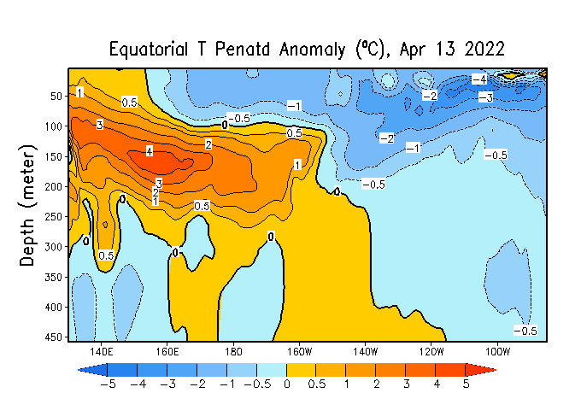
TOGA/TAO
GODAS
There is a large pool of cooler-than-average water under the surface, adding confidence that La Niña’s demise is not imminent.
Notes:
Negative subsurface temperature anomalies prevail across the Pacific Ocean (160E to 110 W), and we see -ve temperature anomalies near the surface as well. Positive anomalies are now restricted to the western Pacific and mostly at the depth, slight positive anomalies are also evident in far eastern Pacific.
Central and Eastern Pacific upper-ocean heat content (0-300 meters) is negative, after a slight positive during the month of February.

Slide 11
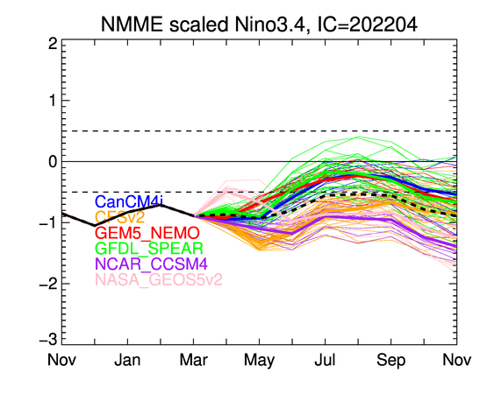

Slide 12
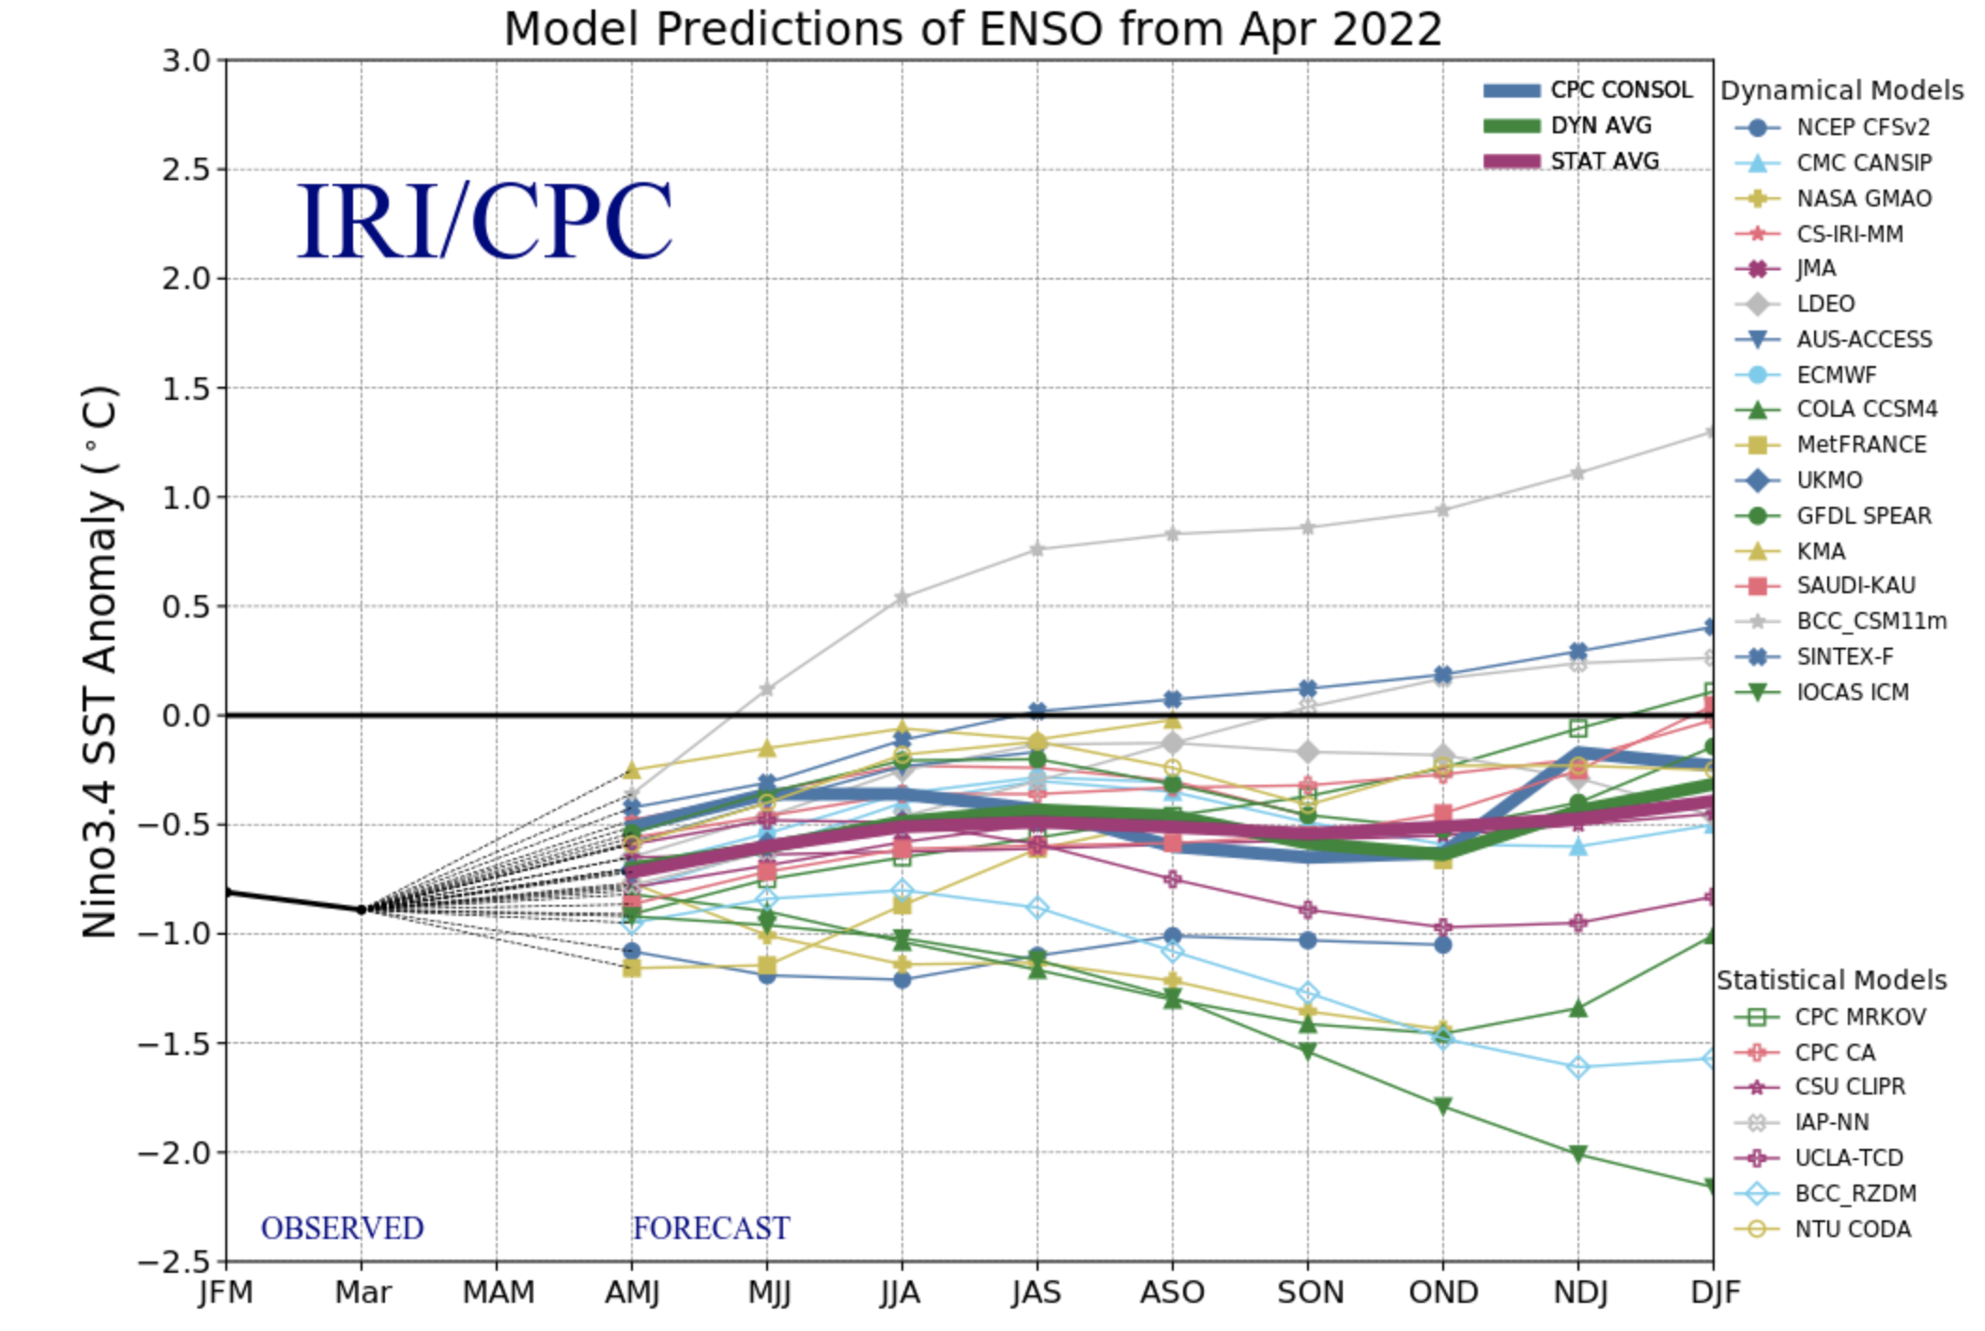
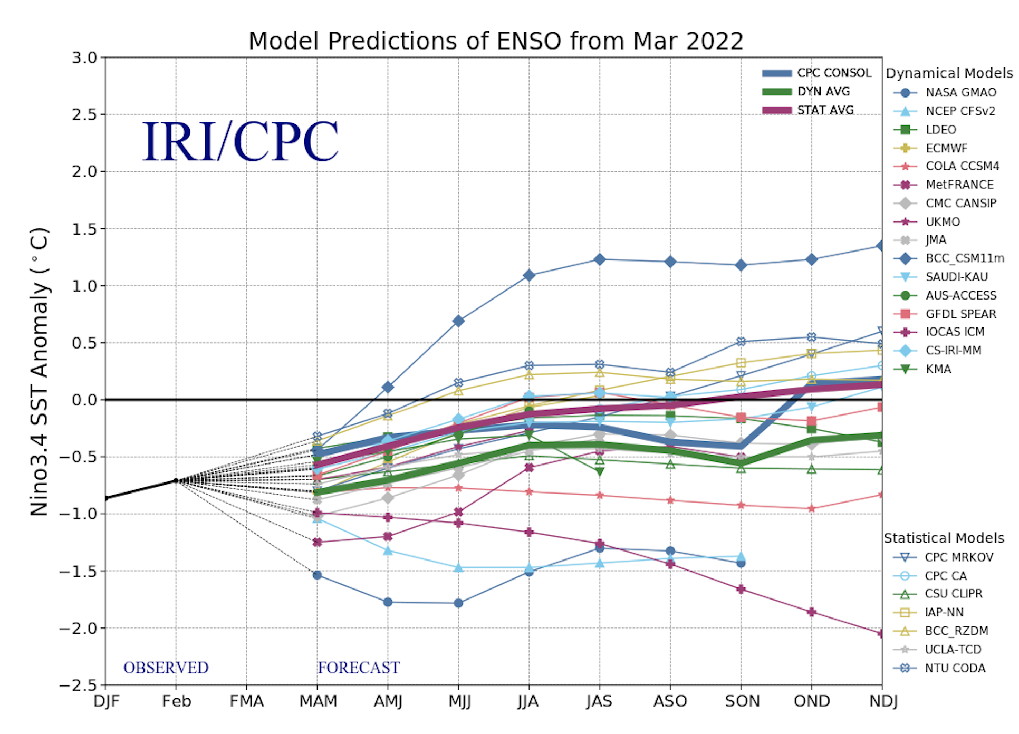
Last Month

Slide 13
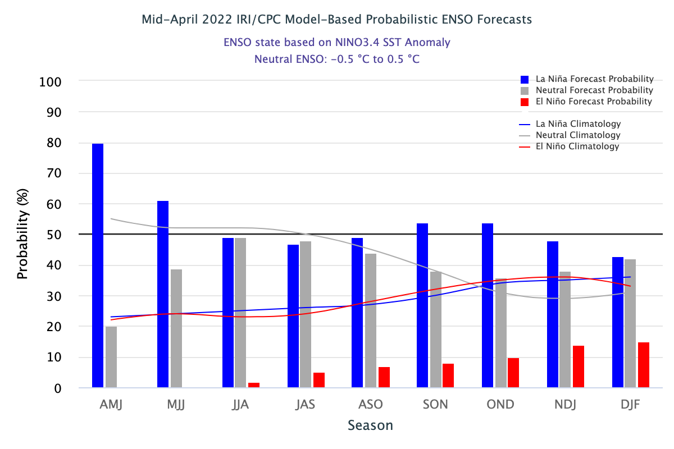
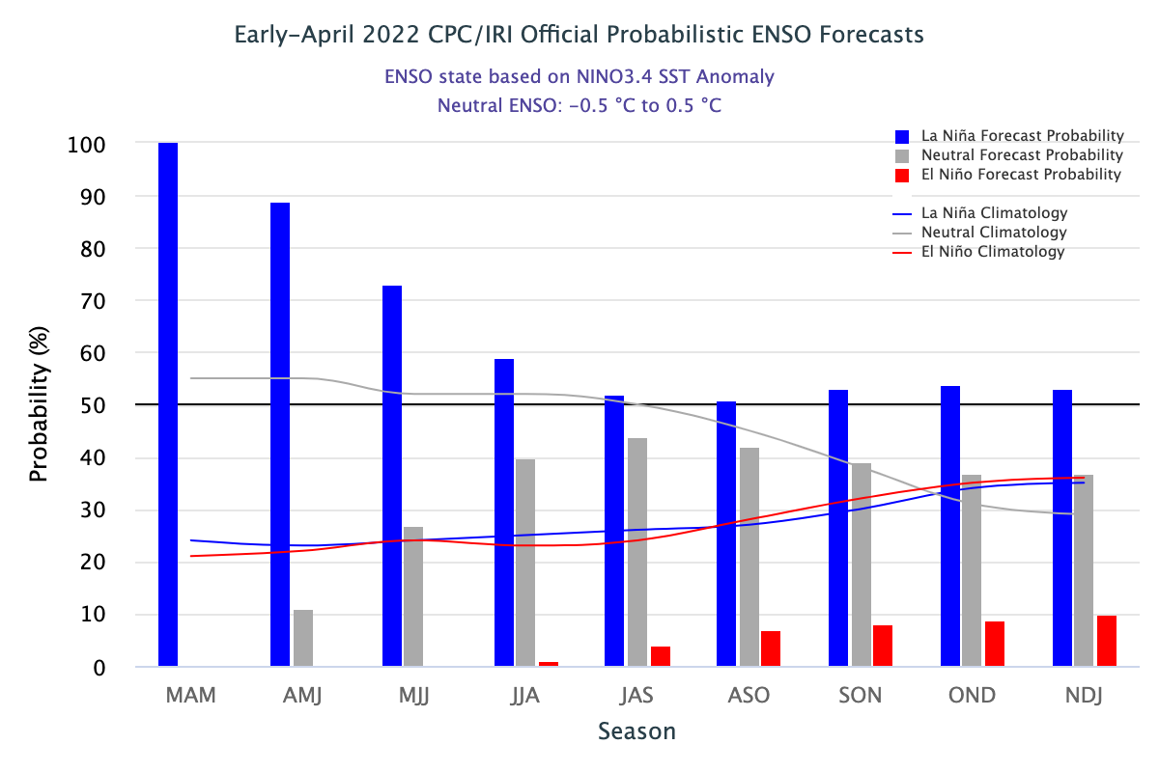
Subjective ENSO Update

Slide 14
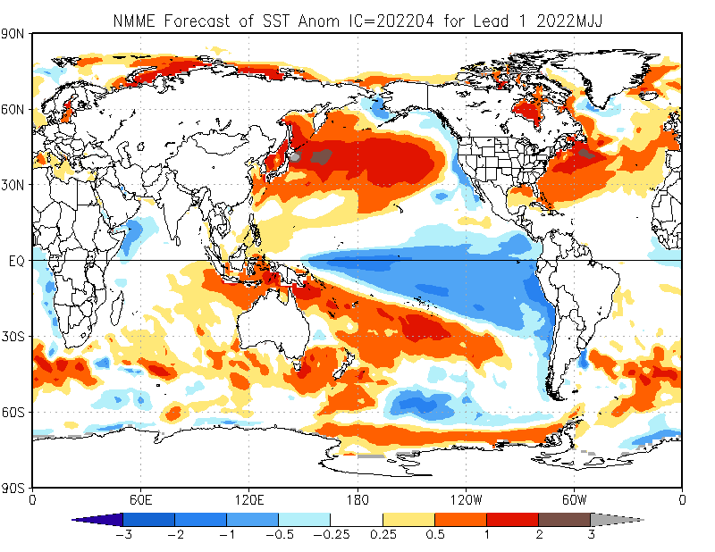
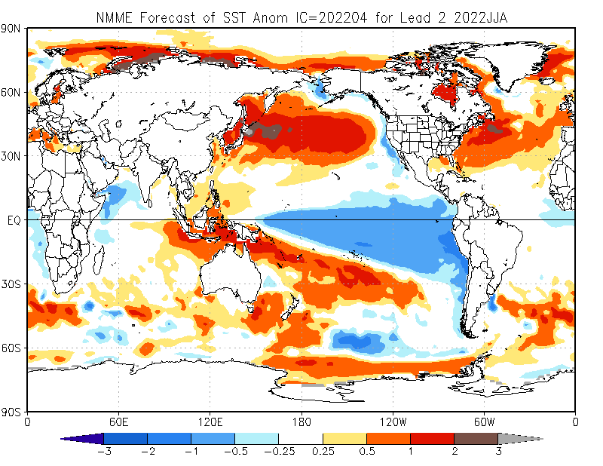
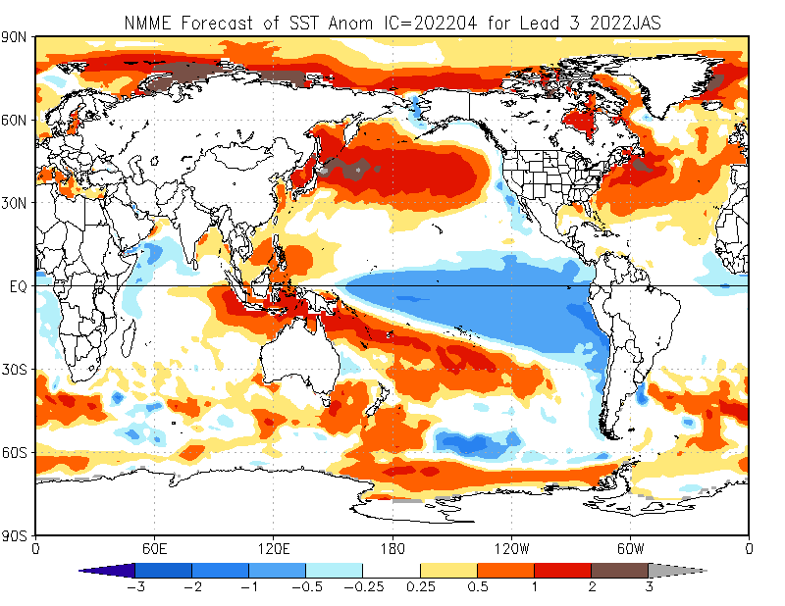
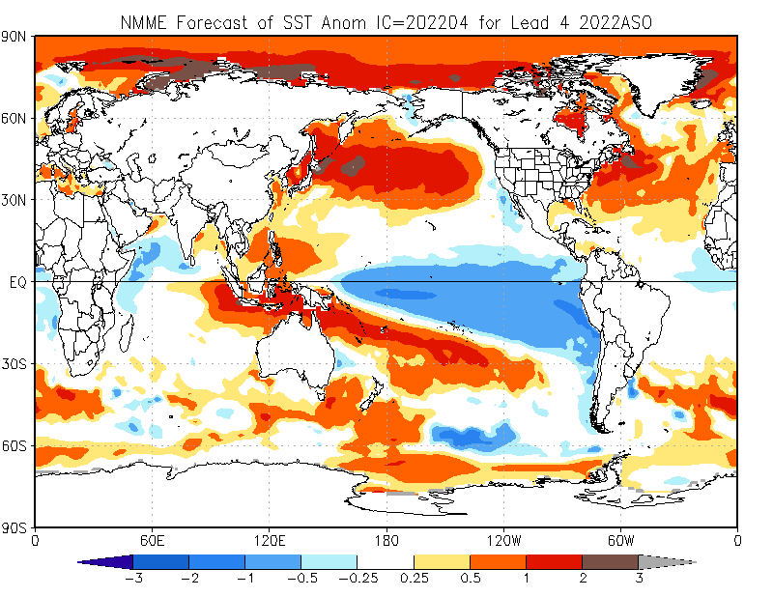
NMME: Sea Surface Temperature Forecast
May-Jul 2022
Jun-Aug 2022
Jul-Sep 2022
Aug-Oct 2022

Slide 15
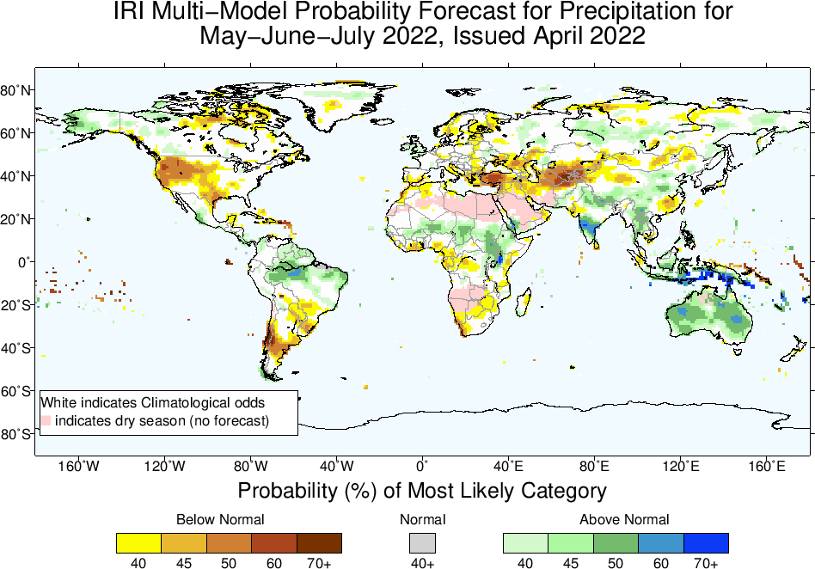
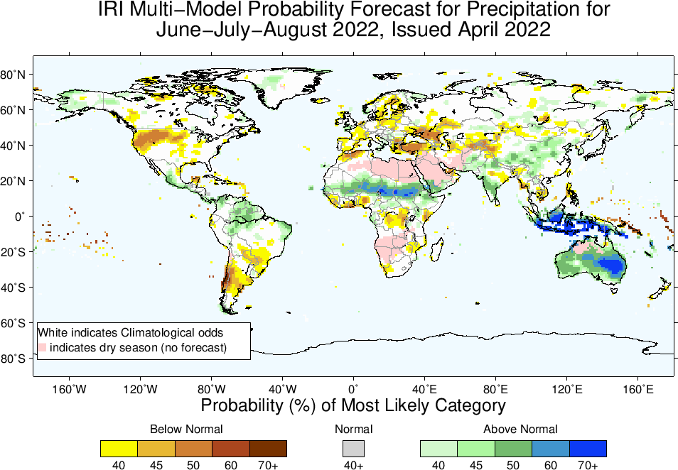
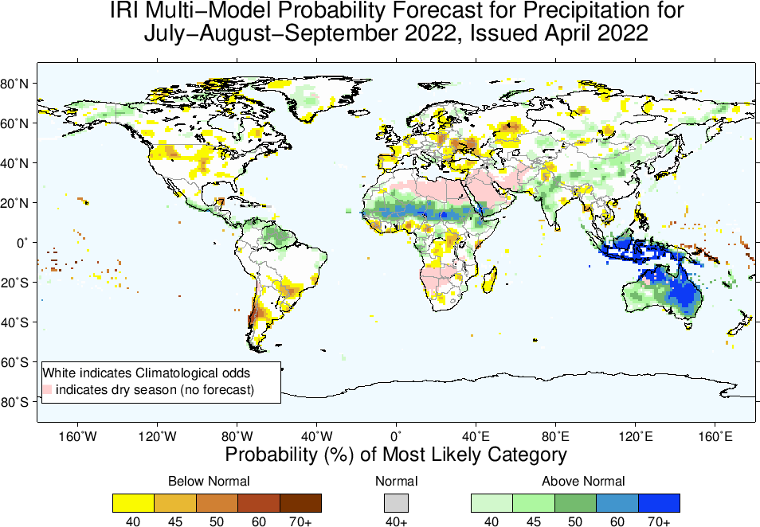
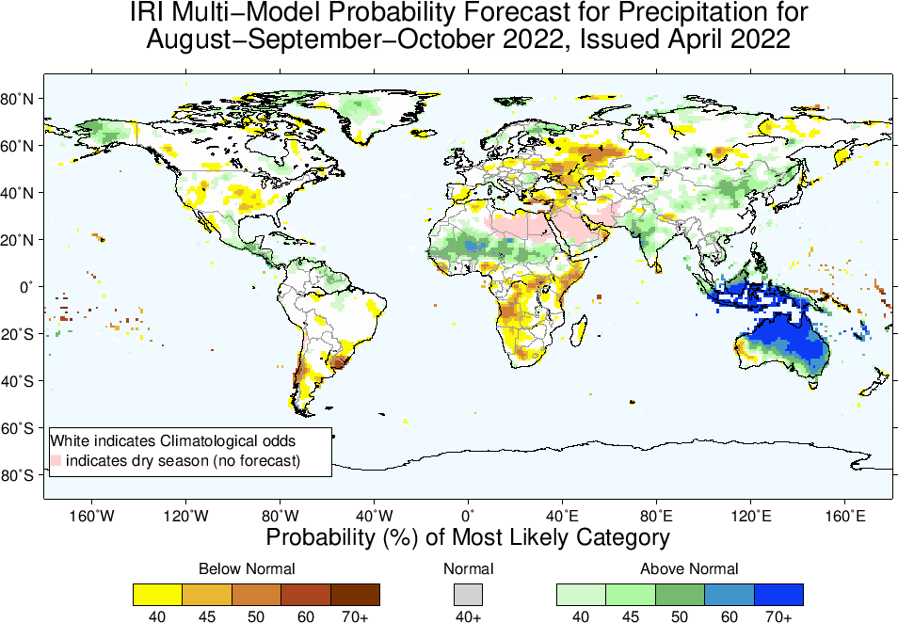
May-to-Jul
Jun-to-Aug
Jul-to-Sep
Aug-to-Oct

Slide 16
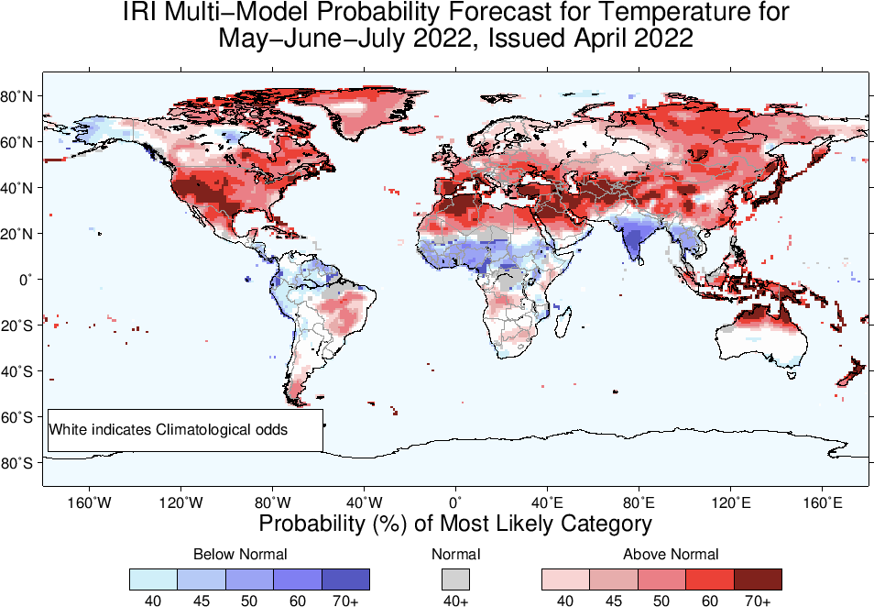

Slide 17
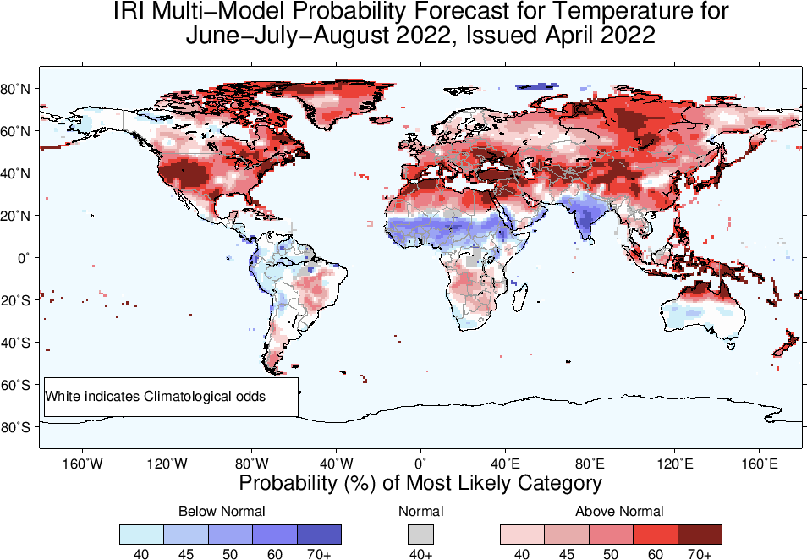

Slide 18
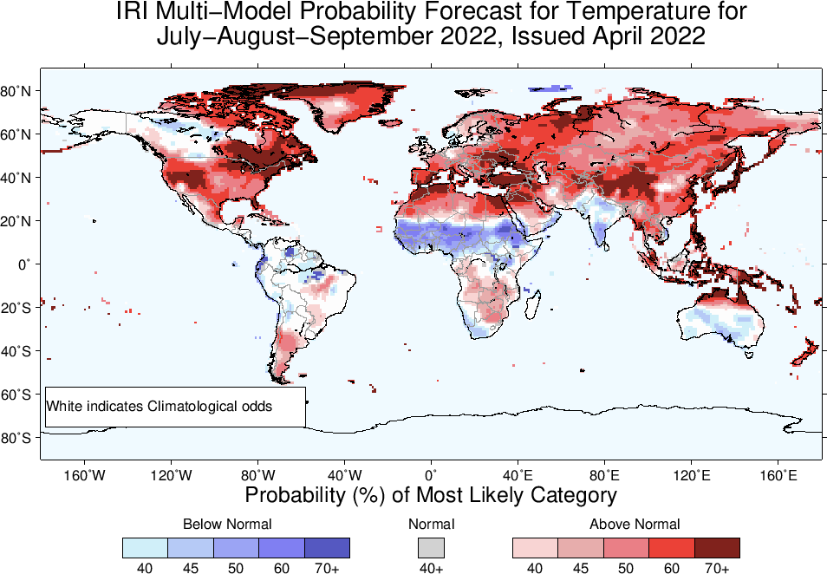

Slide 19
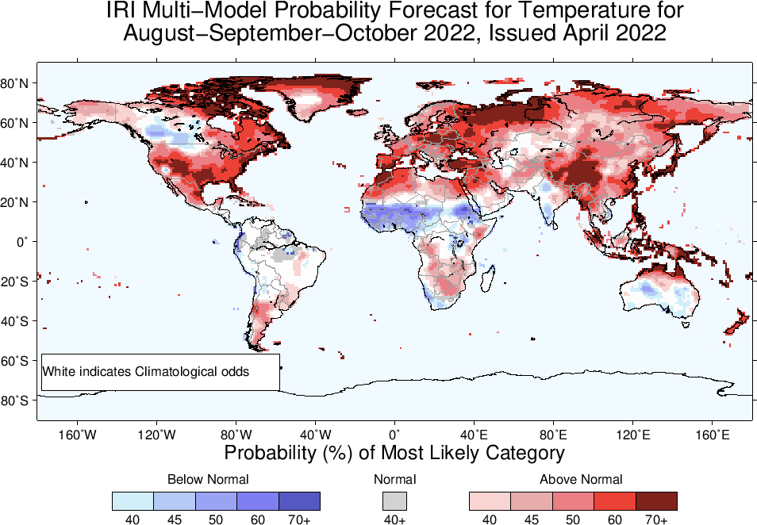

Slide 20
Summary
La Niña is still there, because; current atmosphere-ocean conditions are consistent for La Nina, i.e.,
Sea surface temperatures (SSTs) are below average across the equatorial Pacific Ocean.
SOI is positive, above-average trade winds, reduced cloudiness over central Pacific.
Long-range Forecast is tough (indicative of large uncertainty) in April, due to SPB, and we see forecast is staying between La Nina and Neutral states just after one season, So;
La Niña is favored to continue with high chances during May-Jun-Jul, (61%), while probabilities for La Niña decrease to 47-49% in boreal summer, increasing to 54% during Sep-Nov, and Oct-Dec, while ENSO-neutral probabilities follow their seasonally-varying climatological probabilities.

