Slide 1
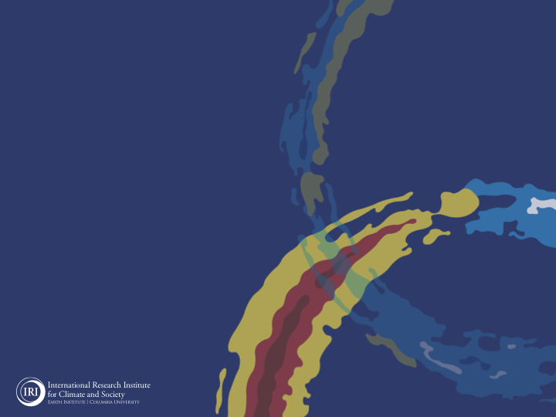
ENSO and Climate Outlook
April 2021:
La Niña: Her bags are packed, and the Uber has been called.

Slide 2
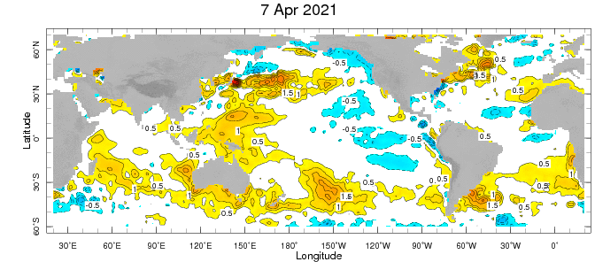
Weekly Sea Surface Temperature Anomalies (includes satellite data)

Slide 3
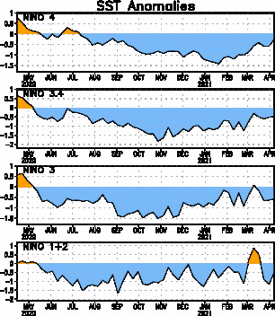
Near Dateline
This is the SST
Index
predicted
Eastern Eq. Pacific
Off Coast of S.America

Slide 4
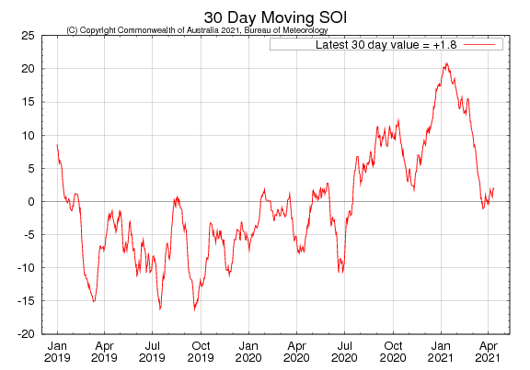
Tahiti_{SLP} – Darwin,AUS_{SLP}

Slide 5
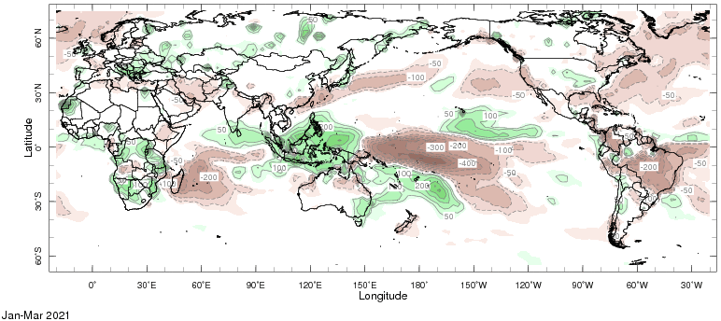
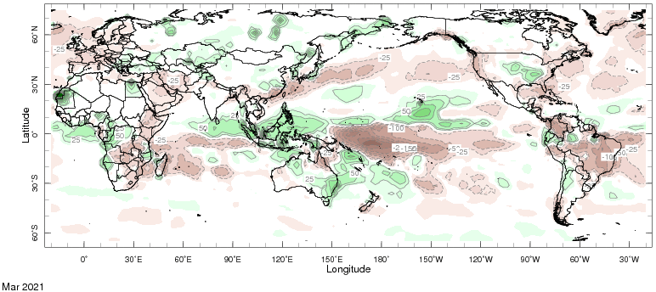
Precipitation Anomalies

Slide 6
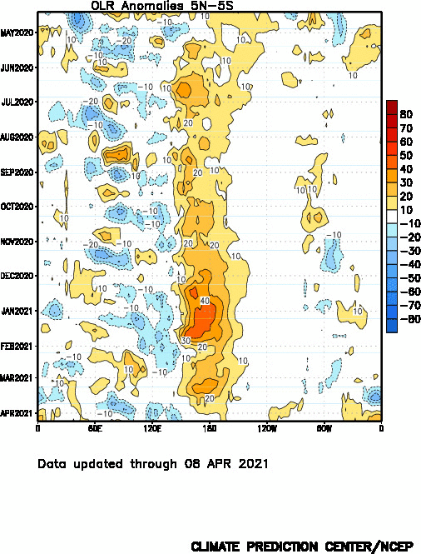
Drier
Wetter

Slide 7
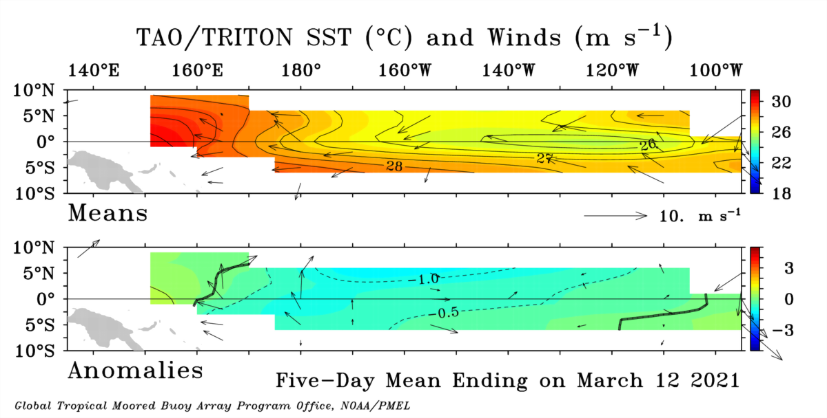

Slide 8
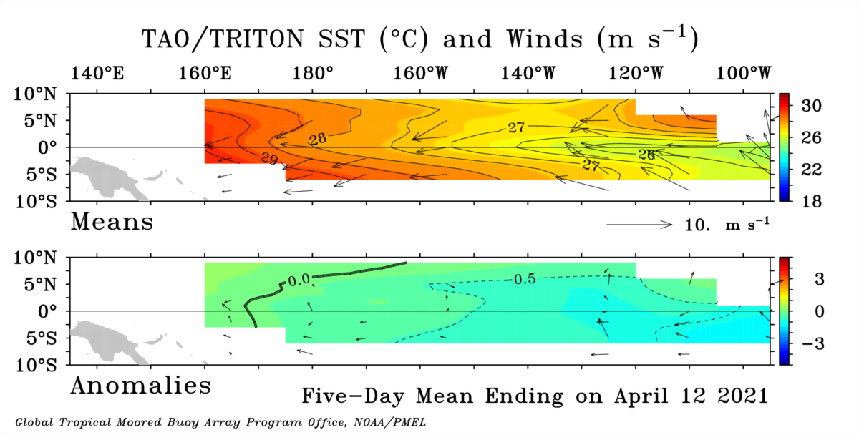

Slide 9
GODAS* Analysis
Used to initialize CFSv2 and CCSM4
TOTAL
ANOMALY
* Global Ocean Data Assimilation System

Slide 10
Analysis directly from TOGA-TAO buoy measurements.
TOTAL
ANOMALY

Slide 11
Analysis directly from TOGA-TAO buoy measurements.
Last Month (Mar ‘21)
Last 5 Days

Slide 12
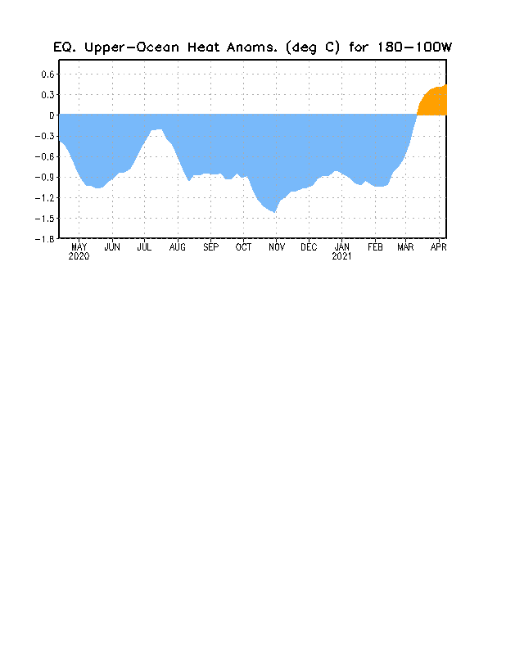

Slide 13
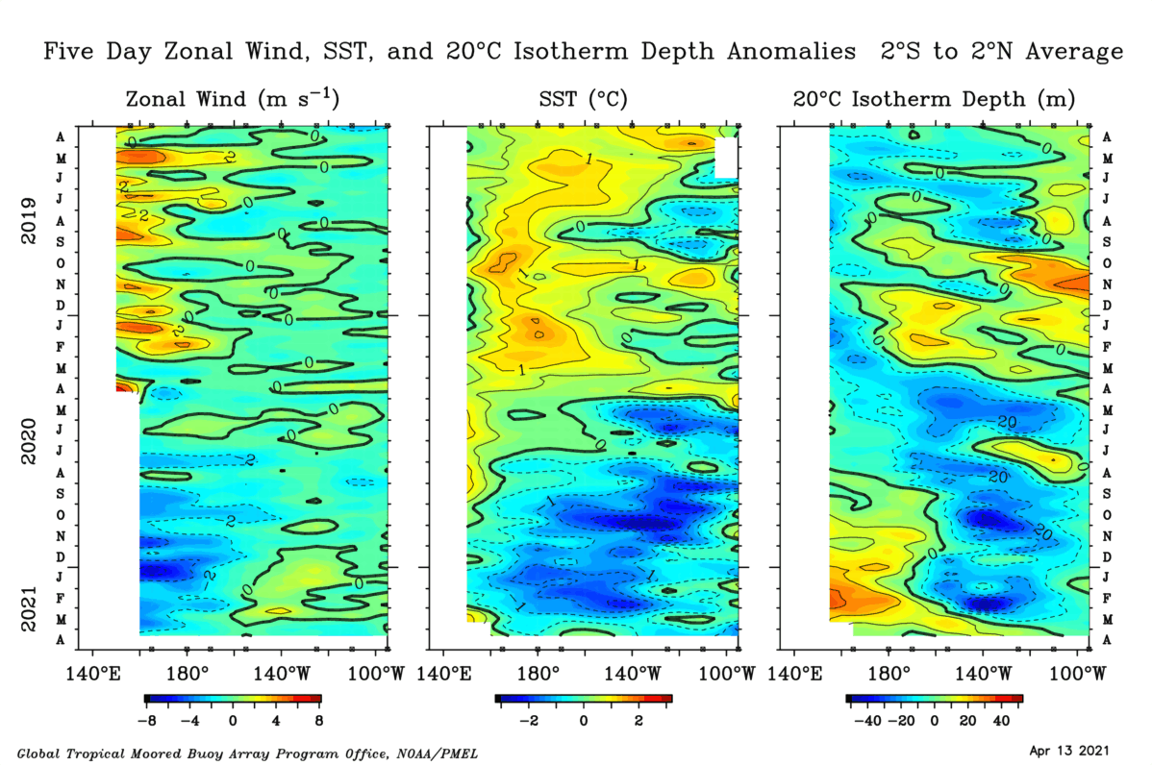

Slide 14
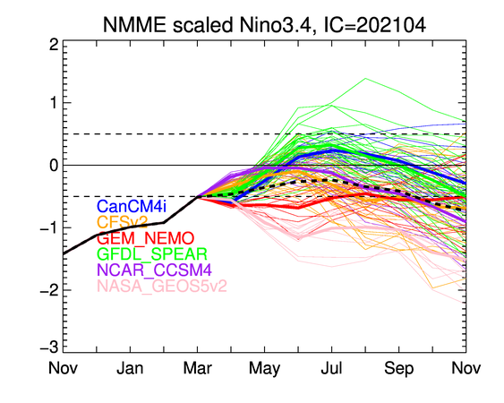

Slide 15
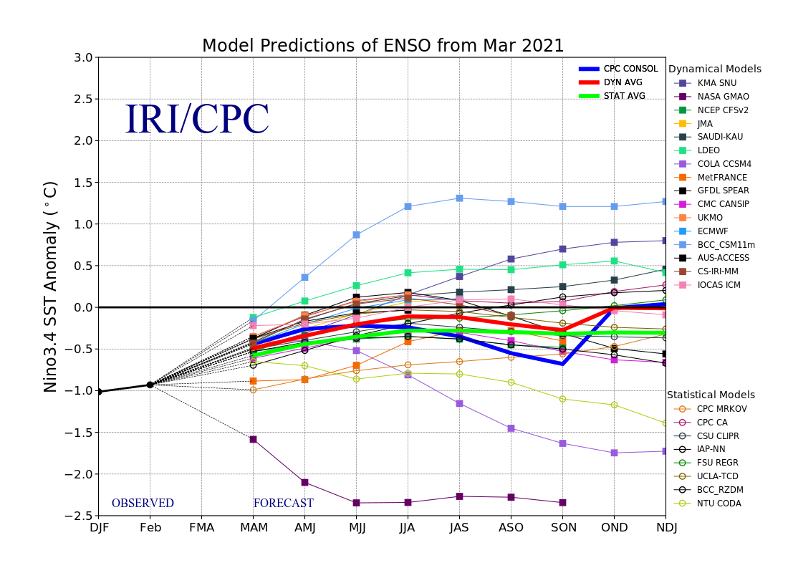

Slide 16
X
X
X
X
X
X
X

Slide 17
X
X
X
X
X
X
X

Slide 18
X
X
X
X
X
X
X

Slide 19
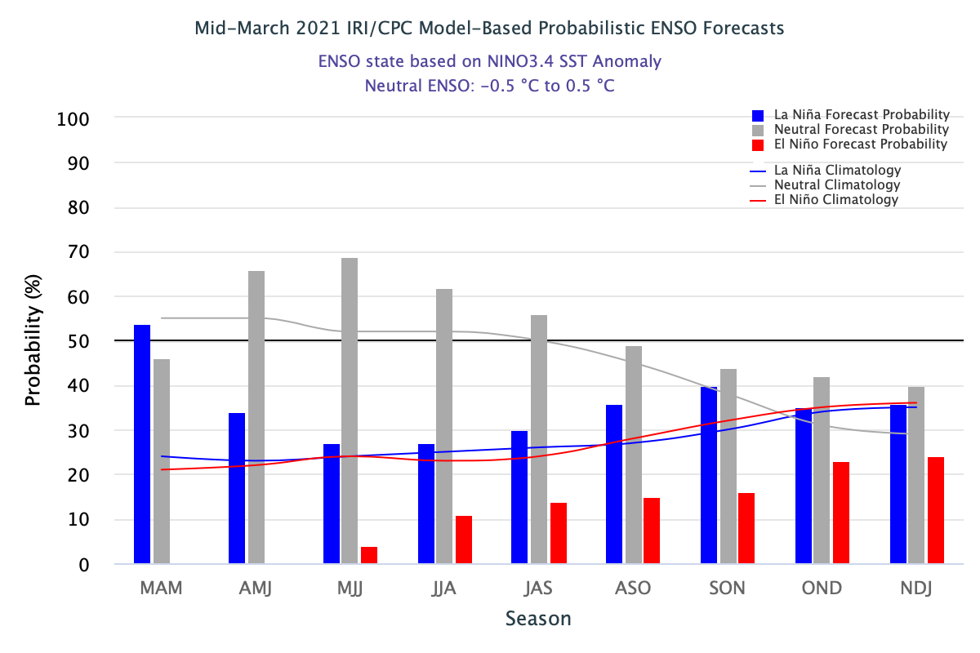

Slide 21
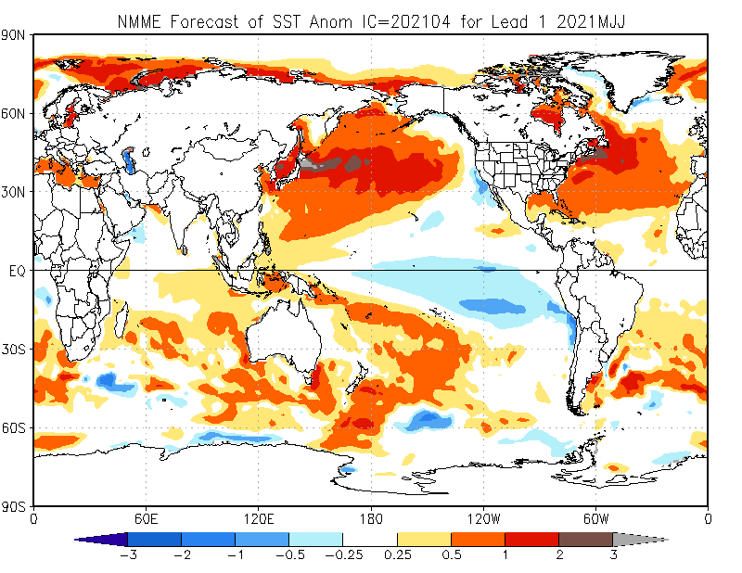

Slide 22
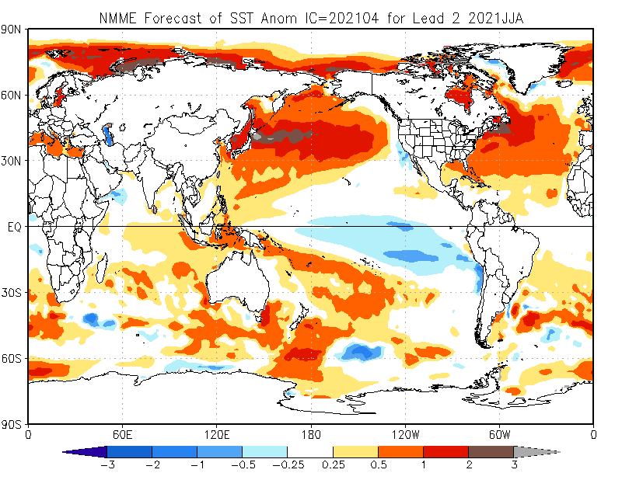

Slide 23
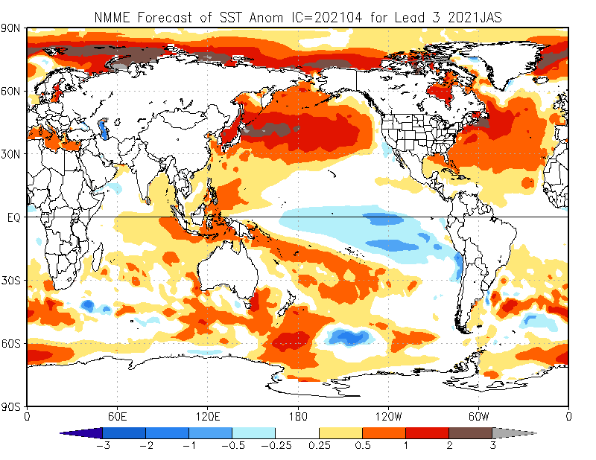

Slide 24
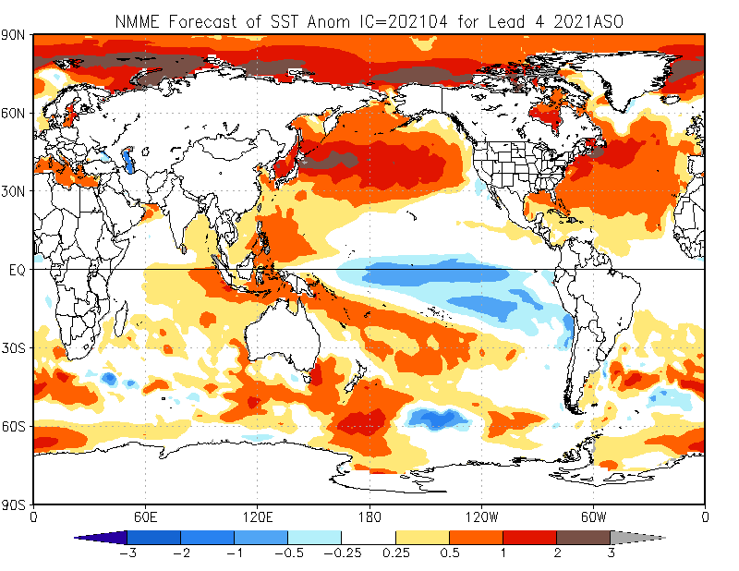

Slide 25
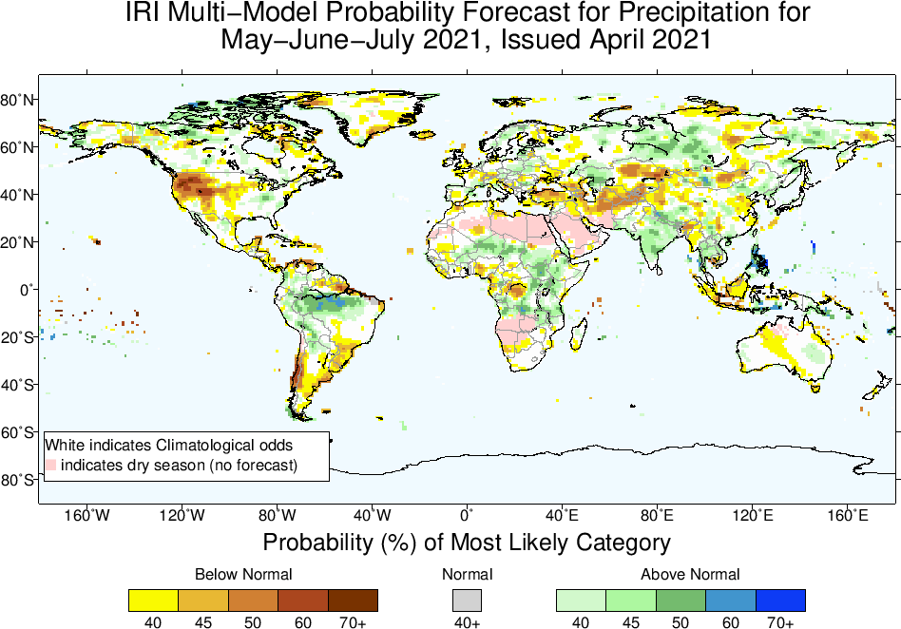

Slide 26
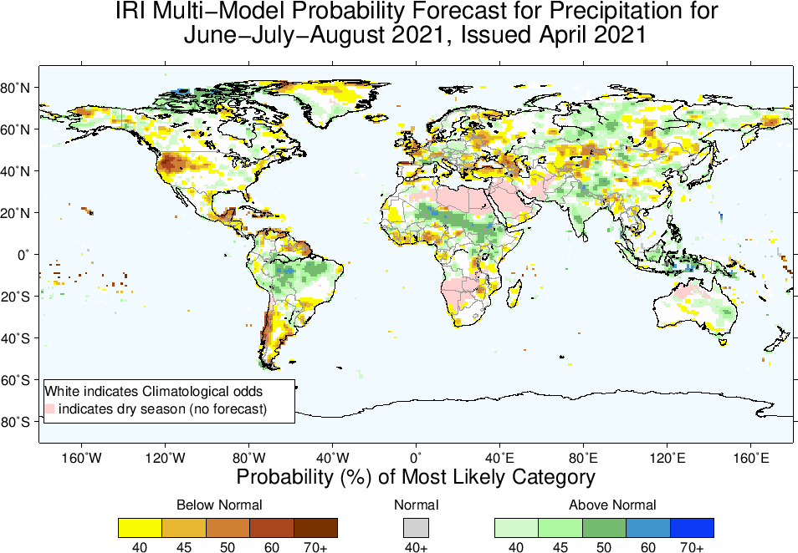

Slide 27
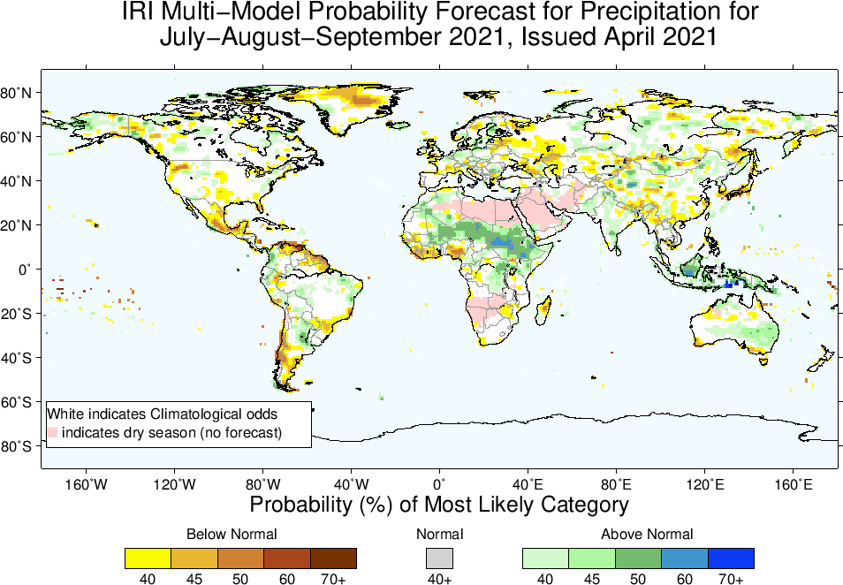

Slide 28
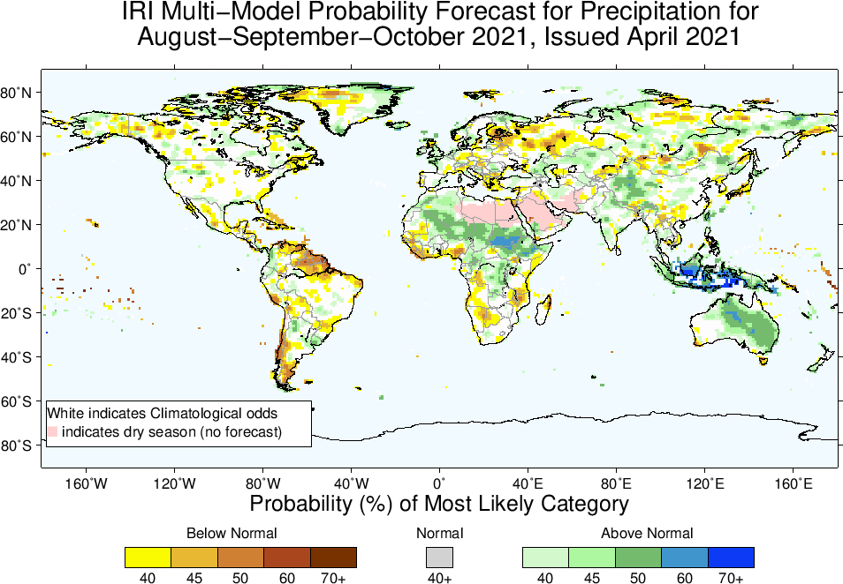

Slide 29
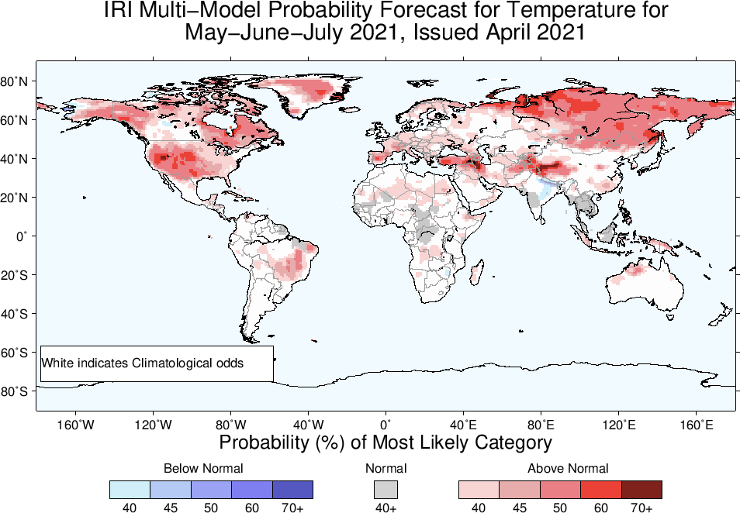

Slide 30
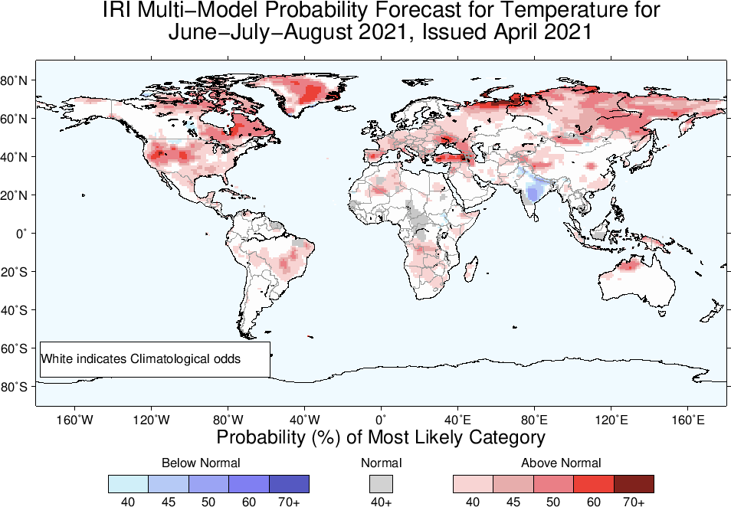

Slide 31
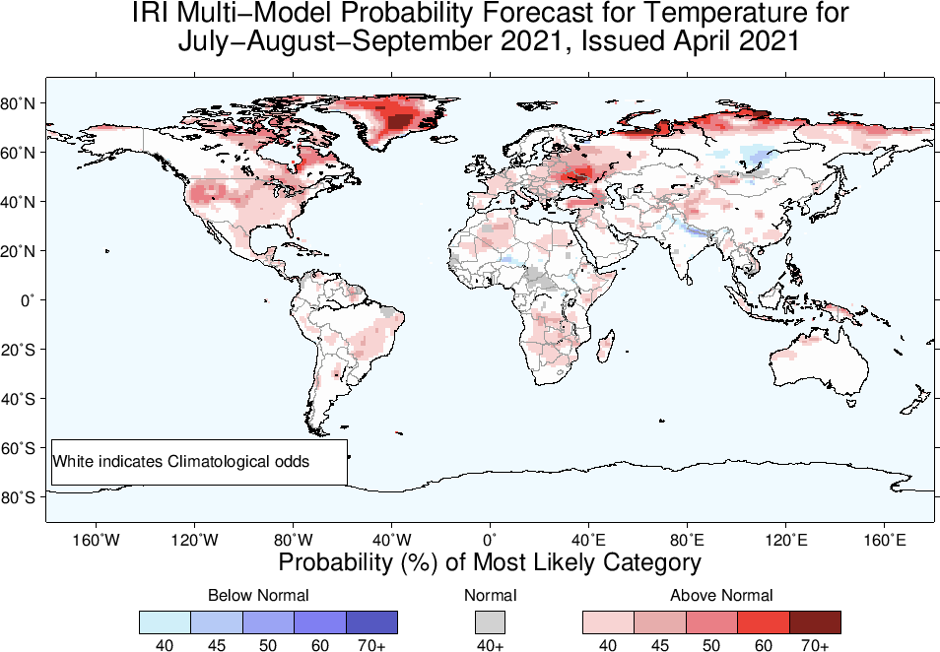

Slide 32
